Slide 1
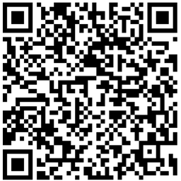
Office image and notes acceptance
The embedded image must retain a slide locator and an on-demand vision state.
Notes:
Speaker note: inspect the QR acceptance marker separately.
[Sources]
- Local repository fixture: qr-code.png

Slide 2
The regional table remains queryable
Region | Branch | Score
North | Beijing | 83
East | Shanghai | 81
Notes:
Speaker note: cite slide 2 when discussing Beijing score 83.
[Sources]
- Deterministic acceptance data

