Slide 1
CWA Advanced Class Notes
Joe Attili – AA2IL
September 19, 2022

Slide 2
Topics
Contesting
  Terminology
  Mini-tests
  Etiquette
  Logging
Chasing DX
TBD

Slide 3
Why Radio Sport?
Major activity in our hobby
Fun Competition
  Some say its the most fun you can have with your cloths on
Become a better operator
  Difficult conditions
  Emergency Comms
Quickly rack up entities for “paper chasing”
Dormant bands suddenly light up
Test effectiveness of your station
…

Slide 4
Some Terminology
Runner
  Station Calling CQ (soliciting contacts)
  Usually achieve a higher QSO rate, especially if you are a “big gun”
  Need to be able to recognize calls and exchanges without too many repeats
Search and Pounce (S&P)
  Tune across band answering runners
  Often lower rate because you are competing with other S&Pers
  Much easier – can listen to runner until you get call and info
    Be careful with serial numbers, not always consecutive
  Often a better strategy for “little pistols” in larger contests
Some mix of these is needed to work everybody

Slide 5
Some More Terminology
SO1R/SO1V – Single Operator, One Radio/One VFO
  Most of us mere mortals
SO2R – Single Operator, Two (or more) Radios
  Generally running on one radio and searching for multipliers on the other
2BSIQ – Two-band Simultaneous Interleaved QSOs
  Running on two bands, alternating CQ calls
SO2V – Single Operator, Two VFO’s
  One transmitter and two receivers (one in each ear)
Multi-Operator
  Larger contest stations with two or more ops

Slide 6
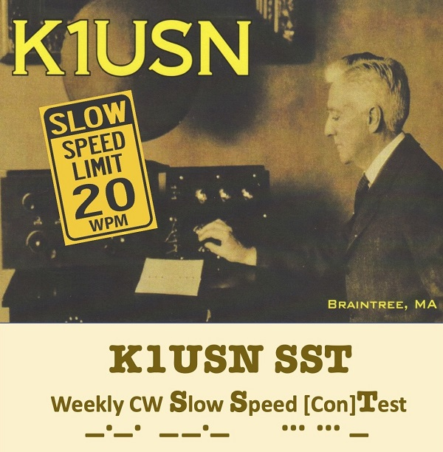
SST Weekly Practice Contest
“Slow” Speed Test
Friday 2000z and Monday 0000z
Very Relaxed Pace - Speed limit is 20 wpm
Exchange: NAME and STATE
    CQ SST N7KOM
                KM6GOX
    KM6GOX TU TIM OR
                GE TIM DEREK CA
    GE DEREK 73 N7KOM
Great place to get used to contesting and to try running

Slide 7

MST Weekly Practice Contest
Medium Speed Test
Monday 1300z and 1900z, Tuesday 0300z
Relaxed Pace - Speed limit is 25 wpm
Exchange: NAME and SERIAL No.
    CQ SST NJ7V
                SV2HUD
    SV2HUD TU CHARLIE 28
                TU VAS 37
    TU VAS 73 NJ7V
Great place to build up confidence and skill

Slide 8
CWT Weekly Practice Contest
Monday 1300z and 1900z, Tuesday 0300z and 0700z
Very popular and very fast – average speed ~39 wpm
Exchange: NAME and MEMBER No. or STATE or “CWA”
    CQ CWT AA2IL
                N7AUE
    N7AUE TU JOE 3177
                TU JIM NV
    73 AA2IL
If you are aspiring to become a member of CWops, this is the place to get you call recognized and build up sponsorship

Slide 9
UPCOMING CONTESTS
CQ WW RTTY
  Very popular and good way to get ready for CQ WW CW in November
  This coming weekend starting at 0000z Saturday for 48-hours
  Everybody works everybody
  Condx have been good this week
California QSO Party
  More competitive than most state QPs
  Oct 1 1600z through Oct 2 2200z
  Exchange:
    CA stations send SERIAL No. and COUNTY
    Non-CA send SERIAL No. and STATE
  CW QSOs count 1.5x Phone QSOs (no digi contacts)

Slide 10
Some DOs and DON’Ts
Do
  Start off S&Ping until you build up skill and confidence
  If you are running, ask for a repeat if you have any doubt about what you copied
  Be courteous but concise
Don’t send unnecessary information
  Runner’s Call – he knows what it is
  Signal report if not part of the contest exchange
  Anything other than 5NN if a signal report is required
  Long greetings – exception is SSTs and MSTs where friendly greetings are encouraged

Slide 11
More DOs and DON’Ts
Do:
  Upload your summary to 3830scores.com
    Track your progress
  Upload your log to LoTW and Clublog
    The final courtesy of a QSO is a confirmation (QSL)
  Call your CWA advisor and classmates for extra brownie points!!!
Don’t:
  Send “B4” to a Dupe
    Its almost always faster to work him again
    He may not have you correctly in his log

Slide 12
Cut Numbers
In the CWTs and many of the larger contests, you will here ops use abbreviations for numbers in the exchange
  599 → 5NN or even ENN
  11 → AA
  100 → ATT
  2198 → UAND
Other than 5NN, I don’t like this practice and advise against it
One other place where a cut number is useful is if you enter a contest late, you can send a leading “T” to alert the other station to this:
  4 → T4
I advise against sending leading zeros for numbers above 9

Slide 13
Computers and Logging
Computers are a fixture in most ham stations now and are invaluable for contesting
N1MM logger is the most popular logging program used for contesting
  Many useful features
  Windoz Only
  No comparable option for Linux
At this point, you should be using a contest logger
  Good idea to let computer do sending for you
  Also use the “band map” to help with S&P (verify call sign!)
Do not use the “call history files” and “auto-fill” until you can consistently copy exchanges
  When you begin to use these features, you still need to verify that the information is correct

Slide 14
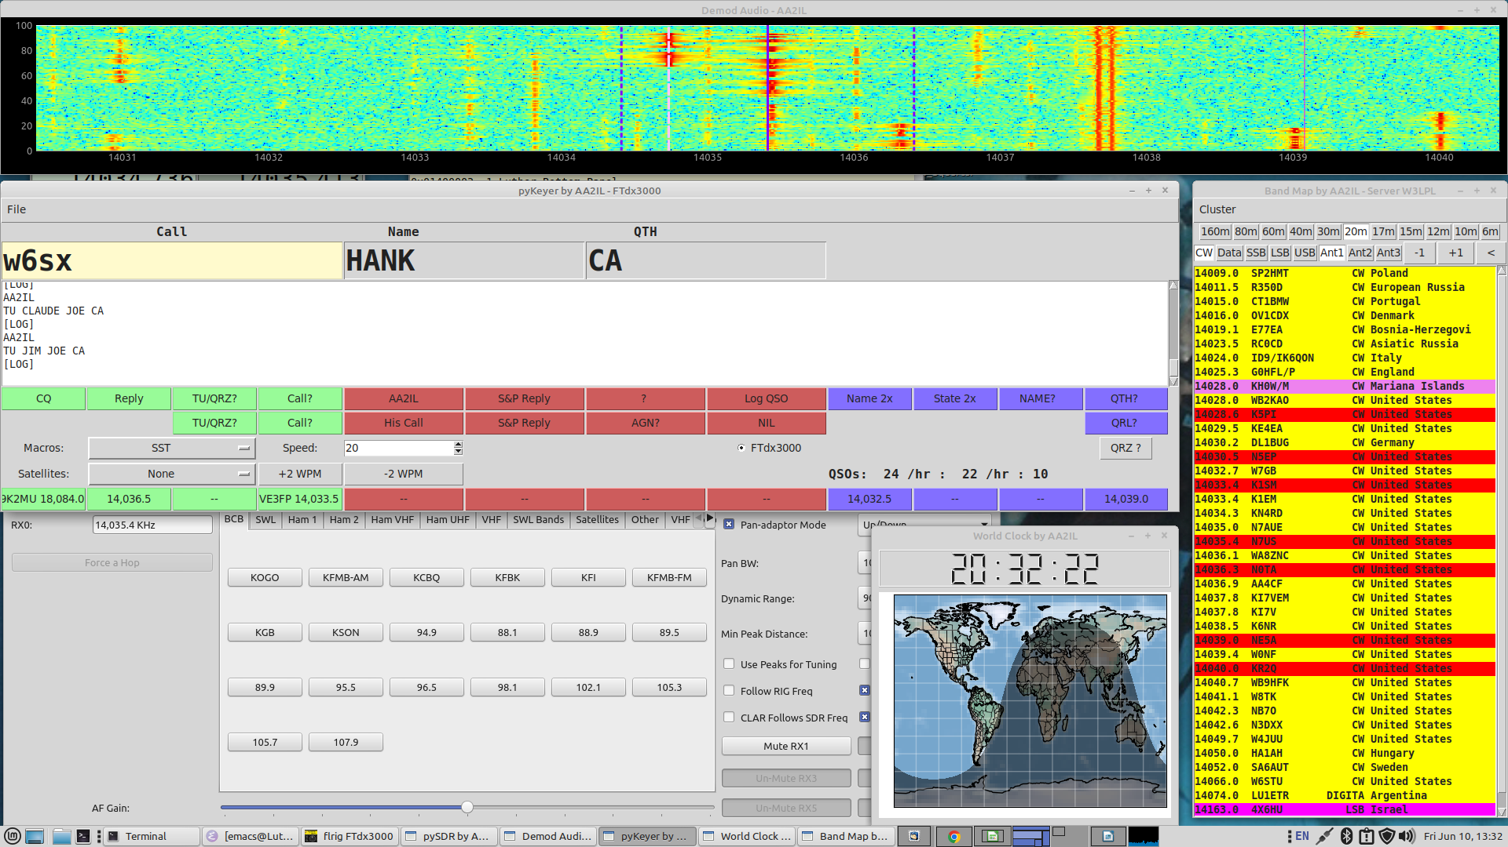
My Screen During a Contest

Slide 15
Basic N1MM Setup

Slide 16
Reverse Beacon Network (RBN)

Slide 17
Chasing (Rare) DX
For many, this is the most exciting aspect of ham radio
CW is the best mode for working weak stations rapidly
  Unfortunately, much of the activity has migrated to FT8
Your contesting skills will serve you well!
Do:
  Listen Listen and Listen some more!
  Figure out where he is listening and transmit near there
Don’t:
  Tune up and/or transmit on top of DX
  Call when he is clearly calling someone else
  Continue to use simplex when he is running split
  Try to engage him in a conversation if he is running a pile-up

