Slide 1
CWA Advanced Class Notes
Joe Attili – AA2IL
Jim Mueller - N7AUE
September-October, 2023

Slide 2
Session 0
Meet and Greet
Introduce ourselves
Test Jitsi and Sidetone audio
  No time limit on Jitsi “free” account
  No special audio settings
  Jitsi seems to prioritize audio over video when allocating bandwidth
Do the first three h/w assignments before 1st class
  Some students do not like the “new” audio practice files
  The “old” files are available on my Github repository:
  https://github.com/aa2il/CWA
Current DX: E51D (North Cook Isl.) and 9Q2WX (DRC) should be active for a few more days

Slide 3
Overview
8-weeks (M & Th 7-8PM on the West Coast)
  MST follows immediately after on Mondays
  Please use headphones!!!
Daily Practice
  Two or three 15-minute sessions per day is much more effective than one 4-hour block once per week
  Homework: Short stories, QSOs and CWT exchanges
  RufzXP and MorseRunner
    There is a “community edition” of Morse Runner that includes several different contest formats
  GET ON THE AIR!!!
    SST, MST and CWT are great contest practice
    Ragchews
In-class exercises will reinforce skills but are no substitute for practice and OTA time
We will supplement each class with related topics to help improve your operating skills and overall enjoyment of our great hobby

Slide 4
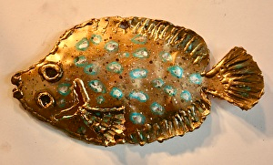
About AA2IL
Grew up in Upstate New York
  Job Transfer brought me to San Diego in 1993
  Current QTH is in a rural area in the foothill North East of SD
First licensed in the late 1970s as a teenager
  Went silent for over 20-years
Retired in Oct. 2021 after 35-years as an Electrical Engineer (signal processing)
Radio activities include
  Chasing DX and contesting
  VHF/UHF and satellites
  Antennas, Linux software development and micro-controllers
Modest HF station
  Main rig is an FTdx3000, no amplifier
  100W and wire antennas
I took this class in spring 2002
  Biggest take-away was how crucial daily practice is to improving speed

Slide 5
Week 1 - Session 1
Go over h/w and OTA activities
There are a bunch of State QSO Parties this weekend:
  IA, NH, NJ, TX and WA (see contestcalendar.com for particulars)
  Exchange is RST + STATE (out of staters) and RST + County (in-state)
  RST is ALWAYS 5NN in a contest!
  Speeds tend to be reasonable (tend to attract a lot of casual ops)
  Its great fun to be on the other end of the pile-up
Get on the air!
  There’s always rags to chew, POTA/SOTA/SES stations …
    Route 66 SESs
  SST, MST, CWT ...
  E-mail each other and/or Jim & I to arrange a sked …
A few comments regarding this course
Word game drill – keep it simple!
  Animals
  Colors

Slide 6
Philosophy
Its a hobby, not a competition!
  Keep it fun!!!
Just like on the air (OTA), there are different skill levels coming into this class
  Compare yourself only to yourself, not your classmates
  Don’t get frustrated or worry about slowing down your classmates
    All of us, even the CW “speed demons,” have been where you are now
  More skilled ops, PSE QRS! GET THE MESSAGE THROUGH!!!
Challenge yourself
  Listen to homework a little faster than you are comfortable with
  Strive to make a few more QSOs in the CWTs
  Try “running” in the SSTs and MSTs
  Practice sending a little faster …
Practice, get OTA and HAVE FUN!!!
In-class activities will focus on contesting at first and gradually build up to longer QSOs

Slide 7
GitHub Repository
I have set up a repository on GitHub for items related to CW and this class:
  https://github.com/aa2il/CWA
There have been complaints about the “new” CWA practice files. The “old” versions of these files are available there. Use these instead if you prefer:
  “OLD Advanced QSOs”
  “OLD Advanced Short Stories”
The sub-folder “N1MM” contains a collection of “quick-start” guides for N1MM logger
  N1MM is the most popular contest logging program but certainly not the only one available
The file “Panagrams.pdf” contains a long list of panagrams you can use for sending practice.
  Panagrams are helpful in that they hit each letter of the alphabet at least once
Poke around and feel free to suggest other material to include there
Get an audio player that allows you to change the replay speed (e.g. audacity)

Slide 8
Week 1 - Session 2
Questions on h/w & on the air activities?
There are five (5) state QPs this weekend including TX and WA
Morse Runner CE has several different contests
  https://github.com/w7sst/MorseRunner
Iambic Master is a program for Winkeyer to help you with your sending
  https://sites.google.com/site/korkowp1/iambic-master
Contesting Intro
Drill: Simulated SST
  Each student gets to run and others call
  Muley and I might just jump in on this one

Slide 9
Why Radio Sport?
Major activity in our hobby
Fun Competition
  Some say its the most fun you can have with your clothes on
Become a better operator
  Difficult conditions
  Emergency Comms
Quickly rack up entities for “paper chasing” (WAS, DXCC, DX Challenge …)
  Regular Participation in CWTs is easiest path to CWops membership
Dormant bands suddenly light up
Test effectiveness of your station
…

Slide 10
Some Terminology
Runner
  Station Calling CQ to solicit contacts
  Usually achieve a higher QSO rate, especially if you are a “big gun”
  Need to be able to recognize calls and exchanges without too many repeats
Search and Pounce (S&P)
  Tune across band answering runners
  Often lower rate because you are tuning and competing with other S&Pers
  Much easier than running since you can listen to runner until you get call and info
    Be careful with serial numbers, not always consecutive
  Often a better strategy for “little pistols” in larger contests
Some mix of these is needed to work everybody
  I do a lot of this

Slide 11
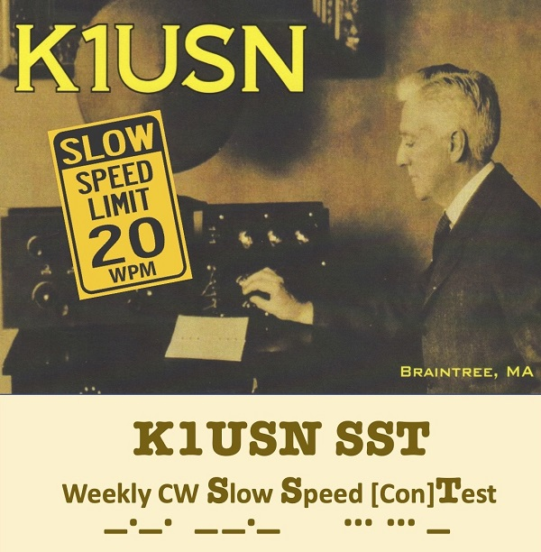
SST Weekly Practice Contest
“Slow” Speed Test
Friday 2000z and Monday 0000z
Very Relaxed Pace - Speed limit is 20 wpm
Exchange: NAME and STATE
    CQ SST AC7FX
                W0ABE
    W0ABE TU JOHN WA
                GE JOHN FIN CO
    GL FIN 73 AC7FX
If you miss something: ?, AGN, CALL?, NAME?, QTH?, ...
Great place to get used to contesting and to try running

Slide 12
Week 2 - Session 3
Go over h/w and on air activities
The first “major” contest of the winter season:
  CQ WW RTTY
  Everyone works everyone
  SSB and CW versions are in October and November
More Contesting
MST

Slide 13
Some More Terminology
SO1R/SO1V – Single Operator, One Radio/One VFO
  Most of us mere mortals
SO2V – Single Operator, Two VFO’s
  One transmitter and two receivers (one in each ear)
SO2R – Single Operator, Two (or more) Radios
  Generally running on one radio and searching for multipliers on the other
2BSIQ – Two-band Simultaneous Interleaved QSOs
  Running on two bands, alternating CQ calls
Multi-Operator
  Larger contest stations with two or more ops

Slide 14
Some Contest DOs ...
Do
  Start off S&Ping until you build up skills and confidence
    This is all many ops ever do
  If you are running, ask for a repeat if you have any doubt about what you copied
    You only get one chance at the caller
  If you are S&Ping, you can either ask for a repeat or just listen to his next QSO
    Be careful about serial numbers!
    When you are starting out, listen before and after so not to slow down runner
  When you ask for a repeat, try to be specific which element that you missed
    NAME?, NR?, QTH?, AGN?, ?
  If the runner misses your call, send it again then give your exchange
    Courtesy demands that we look out for each other
  Be courteous but concise
  QRS if caller is slower or conditions are difficult
  After the contest, record your claimed score at 3830scores.com and you submit log to contest sponsor

Slide 15
… and DON’Ts
Don’t send unnecessary information
  Runner’s Call
    He knows what it is and its your problem if you are S&P and get it wrong!
  DE before your call or NR before your Serial Number
    Wastes time, throws off timing and can be confusing
  Signal report if it is not part of the contest exchange
  Anything other than 5NN (or ENN) if a signal report is required
  “Flow control” prosigns, e.g. K, BK, ...
  Long greetings/chatter
    SST and MST are exceptions as friendly greetings are encouraged
    I do like to send a quick comment to people I know
    Some contests are very slow, e.g. VHF+, so chatter is acceptable
Bottom line is we want to keep things moving!!!

Slide 16
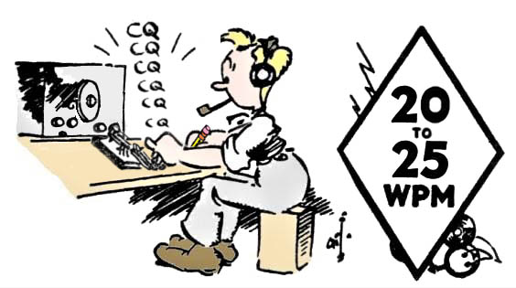
MST Weekly Practice Contest
ICWC Medium Speed Test
Monday 1300z and 1900z, Tuesday 0300z
Relaxed Pace - Speed limit is 25 wpm
Exchange: NAME and SERIAL No.
    CQ MST W0ABE
                NN7O
    NN7O TU FIN 28
                TU TOM 17
    TU TOM 73 W0ABE
                N7AUE You don’t need to wait for another CQ
    N7AUE TU FIN 29
                TU FIN MULEY 24
    TU MULEY 73 W0ABE
Great place to build up confidence and skill

Slide 17
Week 2 - Session 4
Go over h/w and on air activities
On the Air
  CQ WW RTTY
  ME State QP
  See WA7BNM’s https://www.contestcalendar.com
  South Pacific DXpeditions: Chatham, Lord Howe and Tuvalu
Additional Practice Files – Panagrams at 10-25 WPM:
  https://cwa.cwops.org/intermediate-pangrams-files
Comments about RTTY
CWT
Muley Map
CWT Simulation (Time Permitting)

Slide 18
RTTY Contesting
Many CW contesters also enjoy RTTY contesting
  Fast paced, rates can approach those of CW
  Most modern rigs have soundcard built-in so easily plug-and-pray
  Signaling is not as efficient as CW but higher than voice
  Ops tend to naturally spread out so its not the QRM-fest typical of FTx contests
Good place to experiment with SO2R/SO2V and/or Sprinits
  Decoding is off-loaded to your computer so you can concentrate on juggling two radios
Do NOT use cut numbers
  All symbols are 5-bits
  Cap. letters, digits, punctuation and control characters are obtained by switching between two tables with 32-symbols each
  Result is that it actually takes longer to send 5NN than 599
Send <CR> and spaces before and after your messages to help separate from noise/garbage
See rttycontesting.com for more info

Slide 19
CWT Weekly Practice Contest
Wednesday 1300z and 1900z, Thursday 0300z and 0700z
Very popular and very fast – “average” speed ~39 wpm
Exchange: NAME and MEMBER No. or STATE or “CWA”
    CQ CWT AE5JT
                NN7O
    NN7O TU JEFF 3389
                TU TOM CA or TOM CWA
    73 AE5JT or R or EE
If you are aspiring to become a member of CWops, this is the easiest place to get your call recognized and build up sponsorship

Slide 20
CWT is a Unique Beast
Goals for participants vary
  Sharpen or maintain skills
  Make as many contacts as possible in an hour
  Enjoy QRQ CW
  Try new equipment, s/w, techniques ...
  ...
Each session is only an hour and not scored
Most ops are using Call History
  Once you get call sign, you’ve have everything
  Don’t ask for repeats of exchange
Recommendations
  CWA Students should NOT use call history
  Check your copy against the Club Roster or Call History

Slide 21
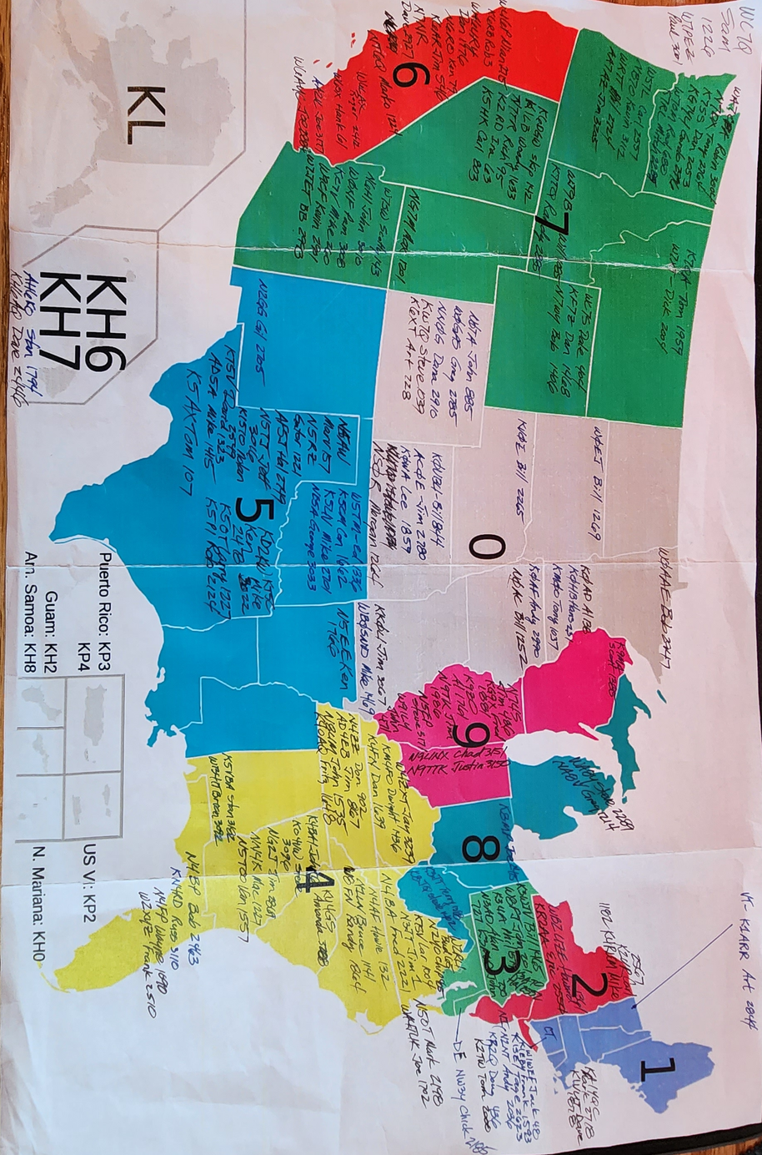
The Muley Map

Slide 22
Week 3 - Session 5
Go over h/w and on air activities
Upcoming contests
  ?
Anatomy of a QSO – Part 1
  Hit and Run
  Short and Sweet QSOs
Short and Sweet QSO (DX/POTA/SOTA, etc.)
  Each student gets to run and others call
Sending Practice

Slide 23

“Hit and Run” QSOs
By convention, a valid QSO must exchange some type of information in addition to call signs
The minimal amount of “information” is a signal report (however meaningless it might be)
Example – A “rare” DX station running a pile-up
  His goal is to work as many stations as possible
  Your goal is to bag an ATNO
  CQ 3B7M UP
                AC7FX
    AC7FX 5NN
                TU 5NN
    R 3B7M UP
Contest exchanges (and FT4/8) obviously fall into this category

Slide 24
Short QSOs
Special Event, POTA, SOTA, etc. ops also are generally trying to work as many stations as possible so they might only send a 5NN signal report (or RST + STATE)
Some ops will exchange more meaningful information quickly (e.g. Actual RST and/or Op NAME)
Example – A not-so-rare DX station who’s not in a hurry
  CQ CQ CQ SV2HUD SV2HUD
                W0ABE W0ABE
  W0ABE GM 559 OP VAS VAS BK
                GM VAS UR 569 IN CO CO OP JUSTIN JUSTIN BK
  QSL JUSTIN TNX ES 73
                TU VAS 73 GL
He may or may not want to engage further depending on conditions (QSB, QRN, etc.)

Slide 25
Some Thoughts on Sending
Sending clean and crisp code is as important as copying
  Your “fist” is your signature on the air
General rule of thumb is to never send faster than you can comfortably copy
  Will depend on conditions
But, as you head copy skills improve, you will likely outpace your “clean” sending speed
In a contest, most ops are using a computer for sending
  This is perfectly acceptable and I encourage you to do this, especially in the CWTs
However, a well-rounded CW operator must have a decent “fist” so you need to devote time to practicing sending

Slide 26
Sending Practice Ideas
Lists of panagrams (see CWops website and my github site)
Look around the room and/or send whatever comes to mind
Get on the air and rag chew
Use your paddles in SST or POTA activations
Try sending above your comfort zone (off the air)
Programs exist that turn sending with an external keyer into a game
  Iambic Master + Winkeyer
  Morseino
  Role your own (nanoIO, K3NG, ...)
Other options
  Use a code reader (e.g. FLDIGI – ONLY FOR THIS PURPOSE!!!!!)
  Record your sending and play it back to hear what you sound like

Slide 27
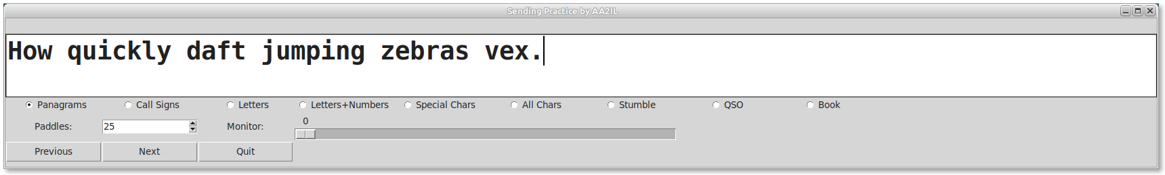
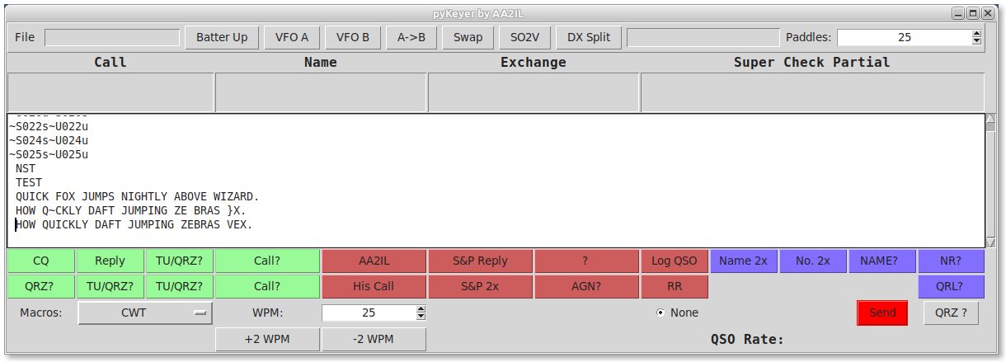
Feedback from My Keyer

Slide 28
Week 3 - Session 5
Go over h/w and on air activities
Upcoming contests
  Arkansas QP is this weekend (5NN + STATE)
  CQ WPX CW next weekend (5NN + SERIAL)
    Look for increased DX activity surrounding contest
Sending
Anatomy of a QSO – Part 2
  Rag Chewing
Practice “cookie cutter” Rag Chews
  CQ/Greeting
  “Big Three:” RST, Name, QTH

Slide 29
Rag Chew QSOs
There’s no precise definition for a “rag chew” QSO but they generally begin with “the big three”
  Signal Report (RST)
  Location (QTH)
  Name (OP)
  CQ CQ CQ AA2IL AA2IL AA2IL K
  AA2IL DE KB1FGC KB1FGC KN
    KB1FGC DE AA2IL = GE OM ES TNX FER CALL = UR 57N 57N IN RAMONA, CA RAMONA, CA, ABT 30 MILES NE OF SAN DIEGO = NAME HR IS JOE JOE = HOW CPY? <AR> KB1FGC DE AA2IL <KN>
  AA2IL DE KB1FGC RR FB JOE TNX FER RPRT, SOLID COPY = UR RST 55N
  55N = OP RICH RICH ES QTH PROSPECT, CT PROSPECT, CT = HW? BK

Slide 30
Week 3 - Session 6
Go over h/w and on air activities
AR State QSO Parties is this weekend
CQ WPX is next weekend
Computers and Logging
QSO Practice (if we have time)
  Team up and send something you might send in a rag chew (rig/antenna, weather, ham radio adventures, ...)

Slide 31
Computers and Logging
Computers are a fixture in most ham shacks now and are invaluable for contesting
  Logging & Scoring
  Keeping track of duplicates
  Sending
N1MM logger is the most popular logging program used for contesting
  Many useful features
  Windoz Only
  No comparable option A clone is available for Linux (?)
At this point, you should be using a contest logger
  Its a good idea to let the computer do the sending for you, especially in the “fast” contests
    The other ops will appreciate the “machine” code!
  For S&P, you can also use the memory keyer in your rig for sending (e.g. Yaesu FH-2)
  Use the “band map” to help with S&P (verify the call sign!)
Try not to use the “call history files” and “auto-fill” until you can consistently copy exchanges
  When you begin to use these features, you still need to verify that the information is correct!

Slide 32
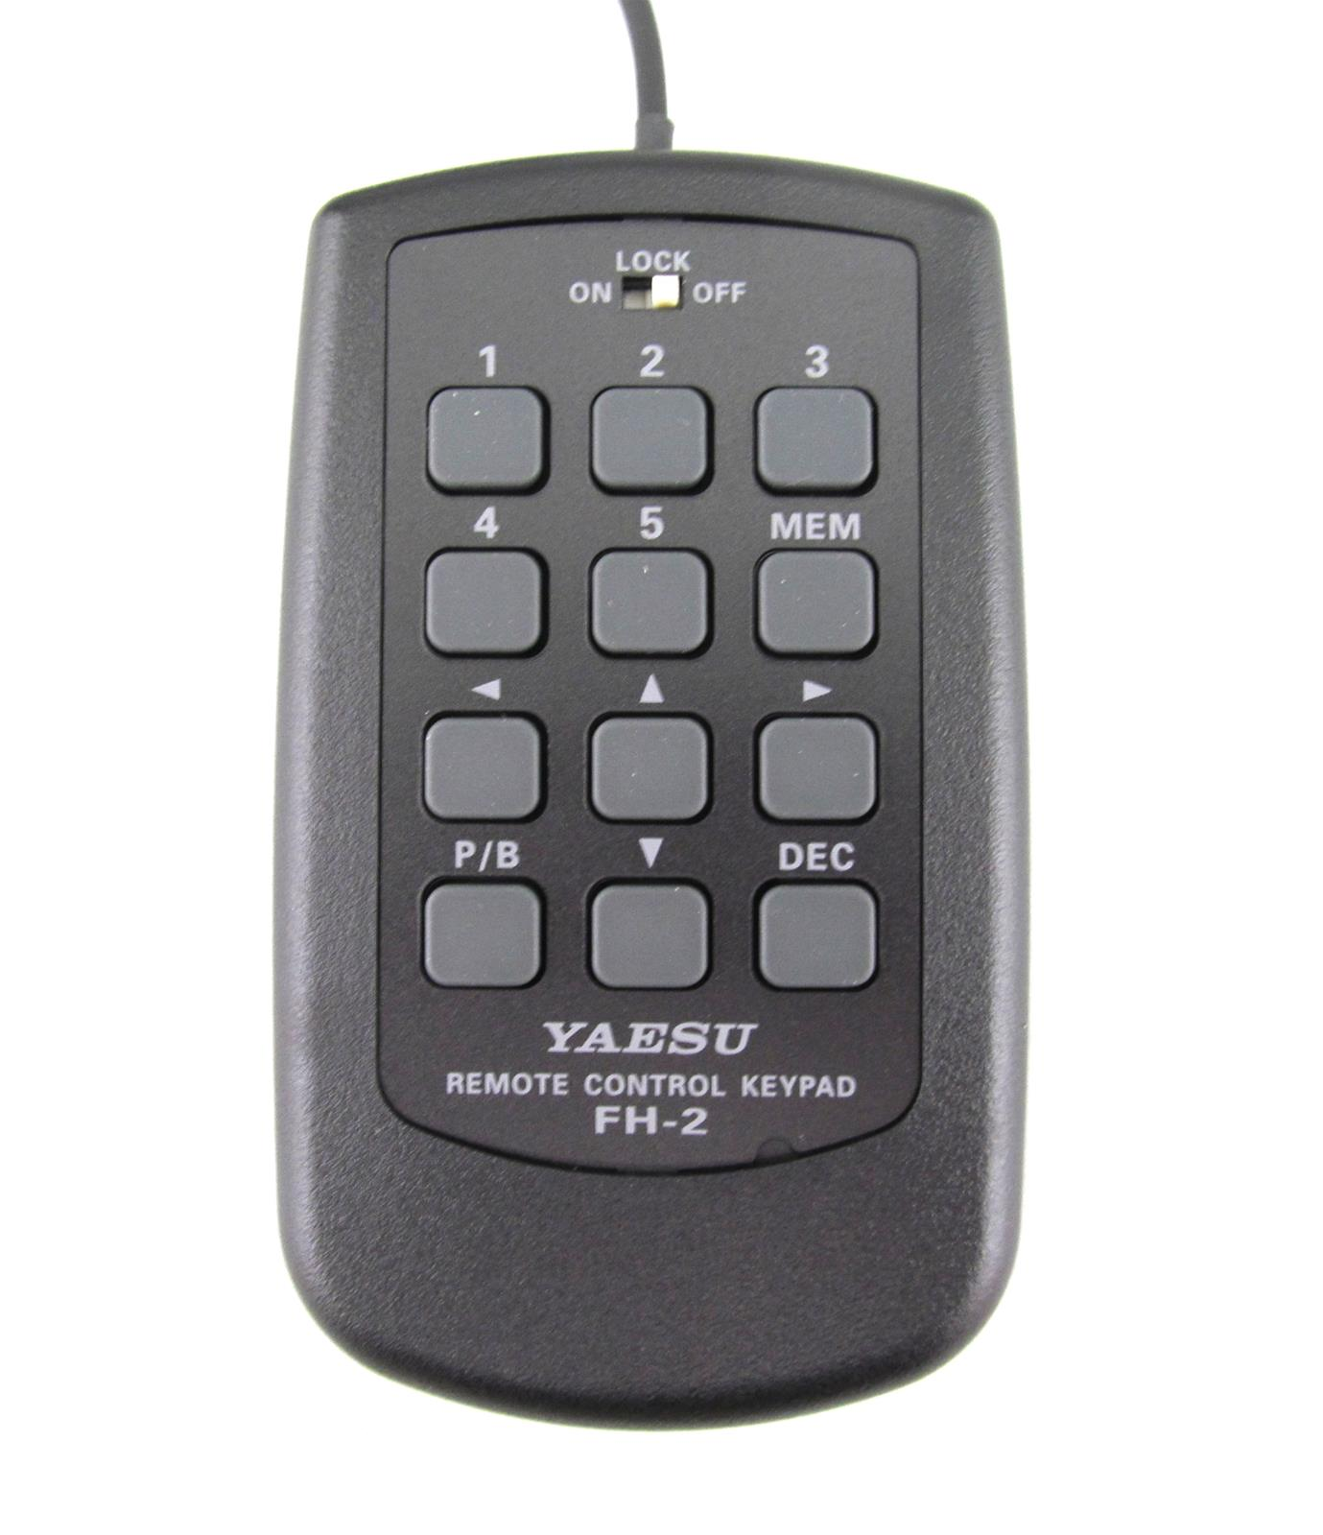
Rig Memory Keyer
Most (all?) modern rigs have a built-in memory keyer to which you can program several short messages
My “default” messages are (mainly for quick DX contacts):
  Msg 1 = AA2IL
  Msg 2 = TU 5NN CA
  Msg 3 = OP JOE
  Msg 4 = 73
  Msg 5 = BK
For S&P in a CWT (or SST), you might use something like this:
  Msg 1 = AA2IL
  Msg 2 = TU JOE 3177 or TU JOE CWA or TU JOE CA
  Msg 3 = JOE
  Msg 4 = 3177 or CWA or CA
  Msg 5 = AGN? or ?
Yaesu rigs also have a serial counter so feasibly, you use this facility to S&P in almost any contest
This is NOT cheating – contesting is fatiguing and you want to employ any fair means that will maximize your BIC time and therefore your enjoyment and score!!!

Slide 33
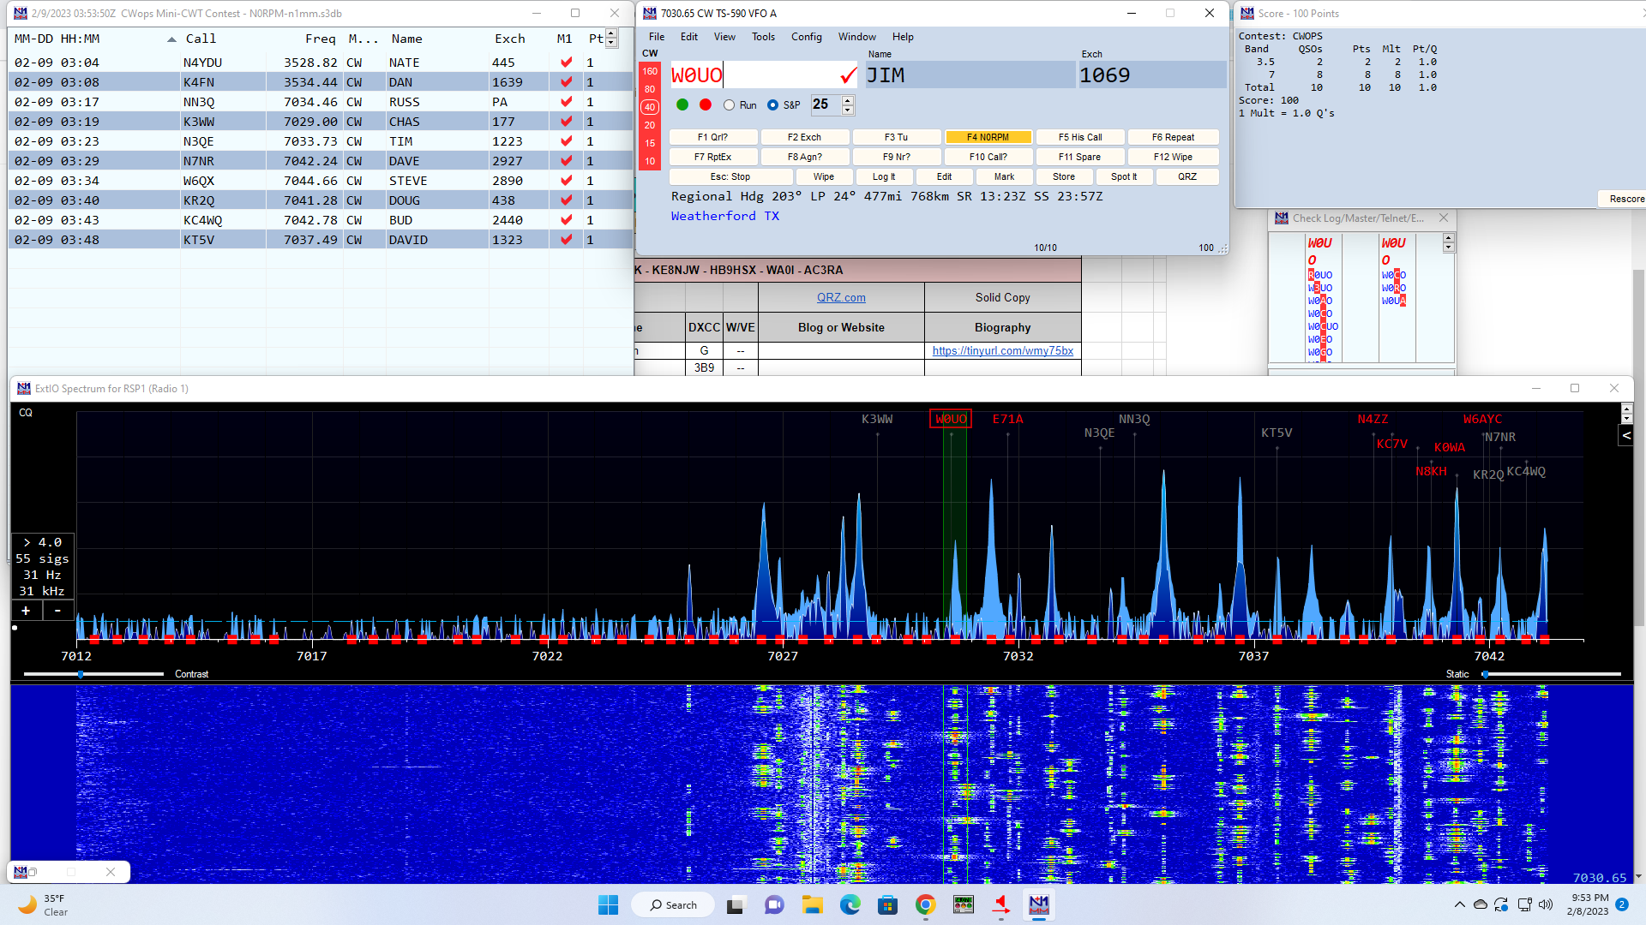
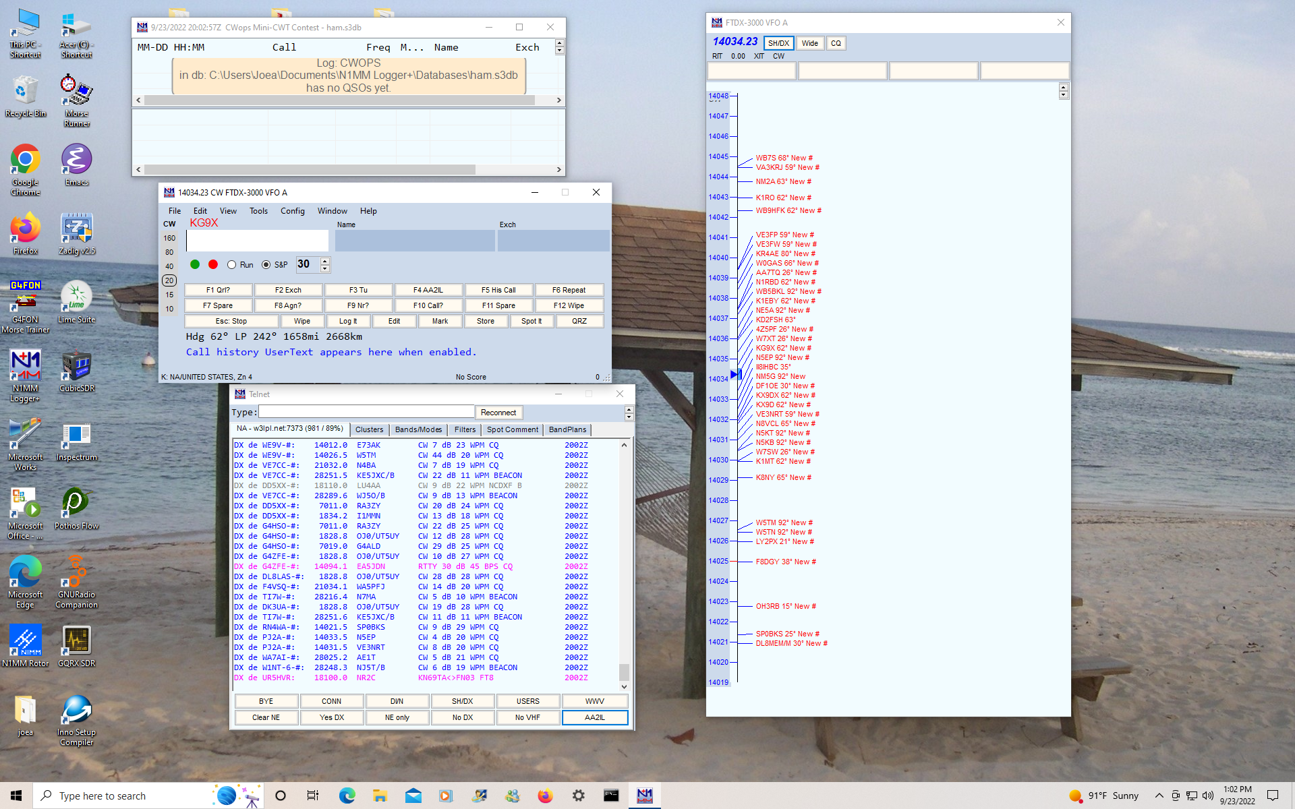
N1MM Logger
(Screenshot courtesy of N0RPM)

Slide 34
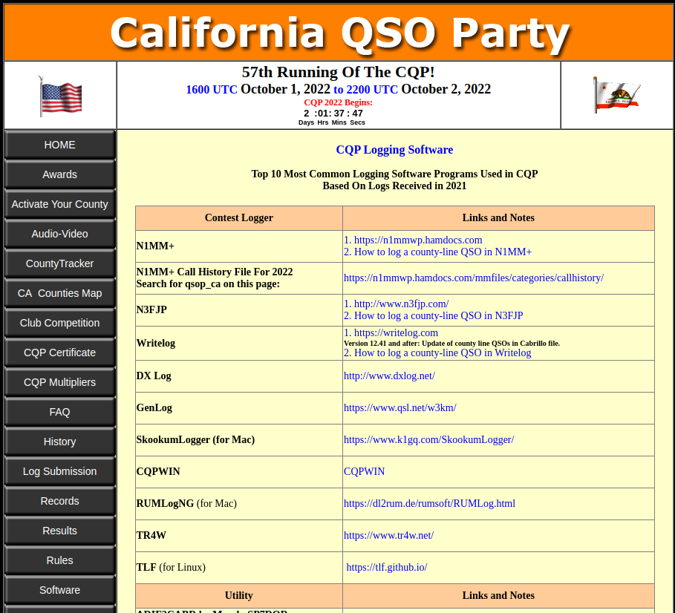
Other Loggers

Slide 35
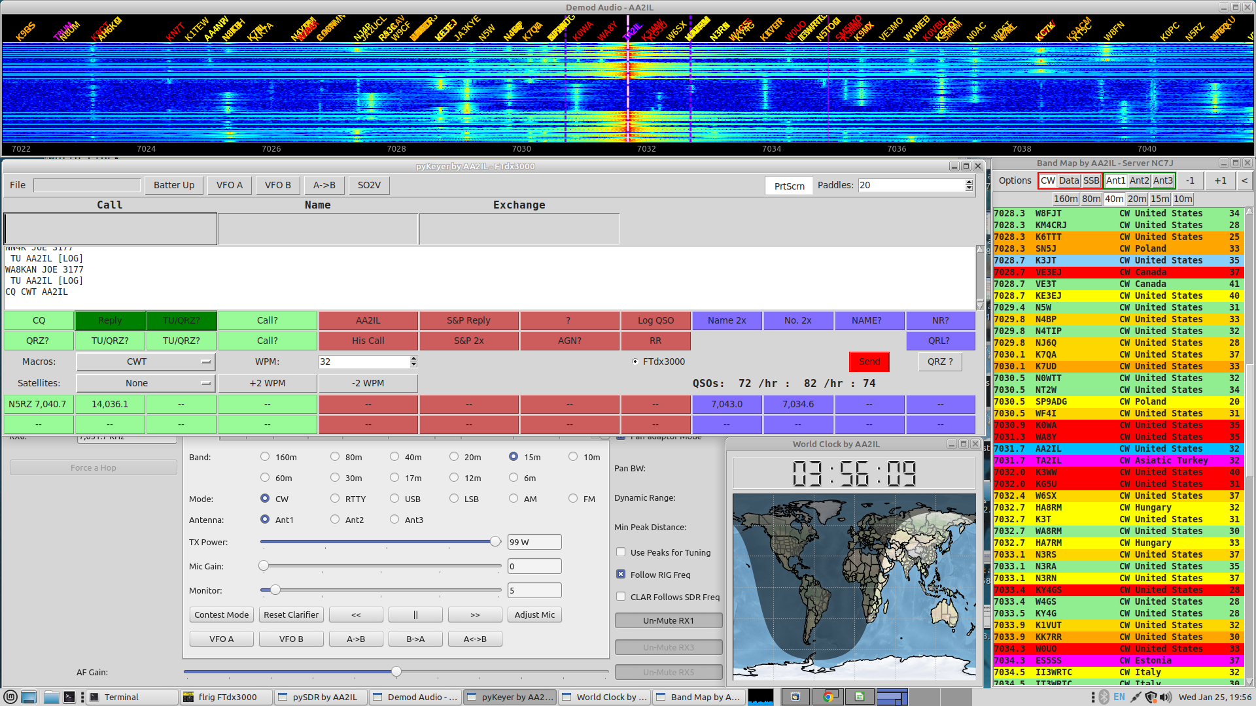
My Screen During a Contest

Slide 36
Week 4 - Session 7
Next Monday is Memorial Day – class?
Go over h/w and on air activities
CQ WPX CW
    Worldwide → Work anyone anywhere
    Value of contacts depends on country and continent
    Multipliers are PrefiXes (AA7, N7, WB0 ...)
    Exchange is 5NN + SERIAL (Same as Morse Runner)
    Look for plenty of DX activity before and after the contest
    Can you get DXCC in one weekend?
A Comment on Speed
Cut Numbers
Math Drill

Slide 37
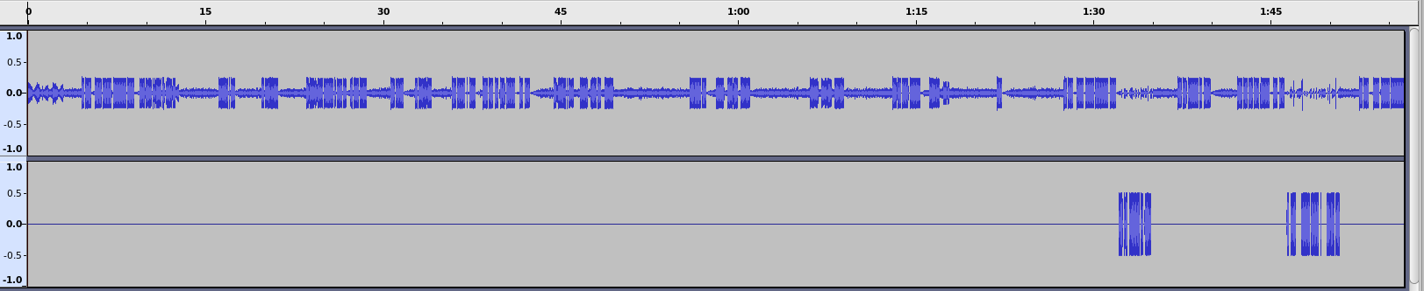
Fast is NOT Always Faster
TU WJ0W
N4EEB
KB1EFS
N4EEB
N4EEB
N4EEB 599 LN FL
599 LN FL
NAME
R
TU WJ0W
AA2IL
RANDY ND
TU WJ0W
KB1EFS
N4EEB
N4EEB
N4
N4EB RANDY ND
AGN
599 LN FL
LN
AA2IL
TU JOE CA
Audio Clip is from Jan. 2023 NAQP – PSE_QRS.mp3
Running OP is clearly struggling (major kudos for putting ND on the air!)
Persistent Pouncer with a somewhat difficult call and name only finally slows down after several repeats
  Other pouncer gave up and moved on
  “LN” is probably a shortened version of “ELLEN” but just doesn’t work in this context (IMHO)
Runner never gets call correct so won’t get credit for QSO
I was able to complete a contact quickly with no repeats simply by tapping on the brakes

Slide 38
Cut Numbers
In the CWTs and many of the larger contests (e.g. CQ WPX), you will hear ops use abbreviations for numbers in the exchange
  599 → 5NN or even ENN
  11 → AA
  100 → 1TT or ATT
  1090 → ATNT
  2198 → UAND
Other than 5NN, I don’t like this practice and advise against it
  However, others use it so you need to understand it!
I find the easiest way to deal with a cut number is to log it and unwind actual meaning later
One place where a cut number can be somewhat useful is if you enter a contest late, you can send a leading “T” in your serial number to alert the other station to this:
  4 → T4 or TT4
I advise against sending leading zeros for numbers above 9
  Don’t send TT7 or T25 in MST, just 7 or 25 – very few ops get over 100 Q’s in the MST

Slide 39
Cut Numbers (cont.)
Acceptable:
  0 → T
  1 → A
  9 → N
Creative (Avoid Using These!):
  0 → the letter O
  5 → E
  2 → U 3 → V NO!!!!! Sound too much like 4
  8 → D 7 → B NO!!!!!! Sounds too much like 6
CQ WPX:
  599 → ENN
  1921 → AN2A
  Some ops are very creative!

Slide 40
CW Math Drill
1 plus 2
Is 3 R 3 times 5
Is 15 R 15 div 3
? 15 div 3 Is 5 R 5 minus 1
Is 6 NO 5 minus 1 Is 4 R …
Etc.
Use ? Or AGN? for repeats and R to confirm answer
  Try not using “voice” since you can’t do that on the air
No Cut Numbers this time - We’ll do that on Thursday

Slide 41
Week 4 - Session 8
Jim N7AUE led
  Went over h/w & on the air activities
  Discussion of various aids and techniques that he found helpful for building speed

Slide 42
Week 5 - Session 9
Go over h/w and on air activities
Up-coming Contests
  ARRL QRM-fest (aka International Digital)
  ARRL June VHF
  ARRL Field Day
  Handful of State QPs
Topics for Second Half of CWA
  Rag-chewing
  Chasing DX
  RBN and Other Operating Aids
  CW for Field Day
After the contest – Log Check Reports
Sentences Drill

Slide 43
More Contest DOs and DON’Ts
Before the contest:
  Become familiar with the rules (who to work, exchange, scoring, multipliers, log submission deadline)
  Update and test computer OS and logging software (Also test your rig and antennas)
  Take a look at the NCJ for hints from top-tier contesters
After the contest:
  Upload your summary to 3830scores.com
    Track your progress
    Get more visibility for your call sign
    Credits toward club awards
  Upload your log to LoTW and Clublog
    The final courtesy of a QSO is a confirmation (QSL)
  Submit your log to the contest sponsor
    Helps with log checking
    Many sponsors will provide you a log-check report so you can see how accurate you are
During the contest:
  Don’t send “B4” to a Dupe
    Just work him again - Its almost always faster
    He may not have you correctly in his log
    He may be using an old-school paper log
  Call your CWA advisors/classmates/friends for extra brownie points!!!

Slide 44
What If You Miss Something?
Occasionally, you will miss a call sign or part of an exchange:
  QSB, QRM, QRN, Poor Fist, Fatigue …
If you are running, you must ask for a repeat if you have any doubts:
  Call sign: N0? or PM? or 0? or CALL? or ? or “the pregnant pause”
  Serial: NR?
  Name: Name?
  QTH: QTH?
  Entire Call or Exchange: ? or AGN?
If you are S&Ping, use your discretion whether to ask for a repeat or just listen to the next QSO
  How competitive are you?
  How busy is the runner?
  Try not to slow the runner or next caller down
  Don’t ask for his call sign unless he hasn’t ID’sed in sevesral QSOs
  Be careful with serial numbers – they are not always consectutive!
In either case, try to be specific what you need
Perfection is not necessary in an un-scored practice contest but don’t get lazy!

Slide 45
Scoring & Classifications
YOUR SCORE = QSO POINTS x MULTIPLIERS
Unassisted – No spotting assistance or multi-signal decoder
Assisted – Use of Spotting Assistance
  DX Cluster, Reverse Beacon Network, CW Skimmer, WSJT-X ...
QRP – 5-Watts or less
Low Power – 100-Watts or less
High Power – Over 100-Watts
Single Op, Multi-op, ...

Slide 46
Accuracy is Important!
Your score is generally the product of the number of QSOs and the number of “multipliers” (one or both may be weighted)
  To get credit for a QSO, you must copy the call sign and exchange correctly
  Your score tends to increase quadratically the longer you operate but ...
  Errors tend to reduce your score quadratically as well
Scoring for contests sponsored by the ARRL is particularly brutal as there is usually an additional penalty for each busted QSO
The winners of many large contests are often determined by which ops make fewer mistakes
This is not as much of a concern in the practice contests (SST/MST/CWT) since they are not adjudicated but how you practice will likely be reflected in your performance in an actual contest

Slide 47
Log Check Report (LCR)
Contest: 2022 CQ WORLD WIDE CW DX CONTEST
Call: AA2IL
Category: Single Op All Band Low Power Assisted
Location: SDG
Processed: 2023-03-02 04:59:20
Thank you for submitting a log in the 2022 CQ WW DX CW Contest.
Your log checking report is below. We believe it is helpful for participants
to receive information on how their log was scored.
Log checking details for CQ WW CW 2022:
7,770 Logs total
4,586,154 QSOs total
4,307,679 (93.9%) QSO checked against another log
4,184,853 (97.1%) QSO checked good when checked against another log
70,417 ( 1.8%) Busted calls
14,157 ( 0.5%) Busted exchange
37,279 ( 0.9%) Not in log
Median score reduction for all logs: 8.8%
Median error rate for all logs: 2.67%

Slide 48
Log Check Report (cont.)
************************** Summary ***************************
309 Raw QSO before checking (does not include duplicates or missing exchanges)
305 Final QSO after checking reductions
835 Raw QSO points
799 Final QSO points
75 Raw zones
74 Final zones
131 Raw countries
130 Final countries
206 Raw mults
204 Final mults
172010 Raw score
162996 Final score
1.3% error rate based on raw and final qso counts
5.2% score reduction
1 (0.3%) not in log
3 (1.0%) incorrect calls
0 (0.0%) incorrect exchanges
0 (0.0%) missing exchanges
0 (0.0%) duplicates removed
2 (0.6%) calls unique to this log only (not removed)

Slide 49
Log Check Report (cont.)
************************* Not In Log *************************
14060 CW 2022-11-27 2358 AA2IL 03 TY5AF 35
*********************** Incorrect Call ***********************
21031 CW 2022-11-26 0128 AA2IL 03 JJ1JML 25 correct JJ0JML
7007 CW 2022-11-26 0612 AA2IL 03 EA8M 33 correct EA8RM
21055 CW 2022-11-26 2239 AA2IL 03 JJ0JMD 25 correct JJ0JML
********* Unique Calls Receiving Credit (not removed)*********
********************** Lost Multipliers **********************
14060 CW 2022-11-27 2358 AA2IL 03 TY5AF 35 Not in log C,Z
************* Stations Copying AA2IL Incorrectly *************
14026 CW 2022-11-26 0148 KP3DX 08 AA2I 05
********** Stations Receiving Not In Log From AA2IL **********
7041 CW 2022-11-26 1517 JH4UYB 25 AA2IL 03
21000 CW 2022-11-27 2247 JQ1NGT 25 AA2IL 03
******** Stations Copying AA2IL Exchange Incorrectly *********
21000 CW 2022-11-26 0111 KH7Q 31 AA2IL 5 correct 3
14063 CW 2022-11-27 2123 NP4AW 08 AA2IL 05 correct 3

Slide 50
Week 5 - Session 10
Go over h/w and on air activities
Up-coming Contests
  ARRL QRM-fest (Intl Digi)
  Kentucky State QP
  POTA Contest
Rag-chews – after the “big three”
Practice inner part of a Rag-Chew QSO
    Rig, Ant, Power ...
    Weather …
    Job, family, …
    Ham exploits, activities, other hobbies…
    Etc. etc.

Slide 51
Rag Chew QSOs
There’s no precise definition for a “rag chew” QSO but they generally begin with “the big three”
  Signal Report (RST)
  Location (QTH)
  Name (OP)
  CQ CQ CQ AA2IL AA2IL AA2IL K
  AA2IL DE KB1FGC KB1FGC KN
    KB1FGC DE AA2IL = GE OM ES TNX FER CALL = UR 57N 57N IN RAMONA, CA RAMONA, CA, ABT 30 MILES NE OF SAN DIEGO = NAME HR IS JOE JOE = HOW CPY? <AR> KB1FGC DE AA2IL <KN>
  AA2IL DE KB1FGC RR FB JOE TNX FER RPRT, SOLID COPY = UR RST 55N
  55N = OP RICH RICH ES QTH PROSPECT, CT PROSPECT, CT = HW? BK

Slide 52
Rag Chew QSOs (cont.)
At this point, we can continue the QSO or politely end it
  KB1FGC DE AA2IL = RR SOLID CPY RICH ES GUD TO MEET U = XYL IS RINGING DINNER BELL SO MUST SAY 73 FOR NW = HPE CU AGN SN = 73 <SK> KB1FGC DE AA2IL <KN>
  AA2IL DE KB1FGC = FB JOE TNX FER QUICK CHAT ES WILL LOOK FER U AGN 73 73 <SK> AA2IL DE KB1FGC K EE
  EE
There is a lot more detail than in a “Hit an Run” QSO
A lot of jargon and abbreviations are used to shorten the messages
I like to use the “break” or “double dash” (=,<BT>) to separate various thoughts and also to bide a little time while I’m thinking of the next thing to say
I also like to use accepted pro-signs to help with flow of transmissions

Slide 53
Common Abbreviations
ABT | About |  | FT | Feet |  | PWR | Power |  | WX | Weather
AGN | Again |  | GA | Good afternoon |  | R | Roger, Decimal point |  | XCVR | Transceiver
ANT | Antenna |  | GB | God bless |  | RIG | Radio equipment |  | YL | Young lady
B4 | Before |  | GBA | God bless America |  | RPT | Report |  | YR | Year
BK | Back to you |  | GD | Good day |  | RPRT | Report |  | YRS | Years
BTU | Back to you |  | GE | Good evening |  | RCVR | Receiver |  | XYL | Wife (Ex-young-lady)
BURO | QSL Bureau |  | GL | Good luck |  | RX | Receiver |  | 73 | Best regards
C | Yes (“Si”) |  | GM | Good morning |  | SIGS | Signals |  | 88 | Hugs and Kisses
CONDX | Conditions |  | GN | Good night |  | SRI | Sorry
CPY | Copy |  | GUD | Good |  | TKS | Thanks |  | <AR> | End of Message
CU | See you |  | HI | Laugh |  | TNX | Thanks |  | <AS> | Stand by
CUL | See you later |  | HPE | I hope/I hope to |  | TU | Thank you |  | <BT> | Break
CQ | Calling anyone (“Seek You”) |  | HR | Here |  | TX | Transmitter |  | K | Go (anyone)
DE | From (“de”) |  | HW | How |  | U | You |  | <KN> | Go only
DR | Dear |  | LID | Bad operator |  | UR | Your/You’re/You are |  | <SK> | End of contact
DX | Long-distance |  | NIL | Nothing |  | URS | Yours
EL | Element |  | NR | Near |  | VERT | Vertical |  | BN | BEEN
ES | And |  | OM | Old Man |  | VY | Very |  | MT | MEET
FB | Fine business |  | OP | Operator |  | W | Watt(s) |  | And so on | And so on and so on …..
FER | For |  | PSE | Please |  | WID | With

Slide 54
Rag Chew QSOs (cont.)
If we both choose to continue the conversation, there are a lot of things to talk about:
  KB1FGC DE AA2IL = RR SOLID AGN = RIG HR IS A YAESU FTDX300 ABT 100W TO A MOXON BEAM UP 30 FT = WX HR TODAY SUNNY AND HOT, TEMP NR 100 DEG F = SO BTU RICH <KN>
  R FB JOE DIDNT MISS A DIT = UR RIG AND ANT DOING NICE JOB HR IN CT = RIG HR IS KNWD TS2000 WID AMP RUNNING 500W TO A DIPOLE UP 45 FT = WX HR IS COOL AND RAIN, TEMP IN LOW 50S = FALL IS HR IN THE GREAT NE = BTU JOE KN
  VY GUD RICH = I GREW UP IN UPSTATE NY AND MISS THIS TIME OF YR = WENT TO THE BEACH WID MY XYL YESTERDAY TO REMIND US WHY WE LIVE HR HI HI = I RETIRED LAST YR AFTER 35 YRS AS AN ELEC ENGR = NW I HV LOTS OF TIME TO PLAY RADIO = WHAT DO YOU DO FOR WRK RICH? <KN>
  AA2IL DE KB1FGC R SOLID AGN JOE = MY FAMILY RUNS AN ANTIQUE TRUCK MUSEUM AND I USED TO DRIVE BIG RIGS = BEEN A HAM FER 25 YRS, I ENJOY CW RAG CHEWING AND CHASING DX. I ALSO LIKE TO REPAIR VINTAGE RIGS AND IM WORKING ON A SATELLITE SETUP
  ...
… and so on and so on
Be sure to identify every 10-minutes
Keep subject matter friendly and upbeat and non-controversial
Keep exchanges short – don’t dominate the conversation

Slide 55
Rag Chew Drill
For practice tonight, operate as if you’ve met the other op before::
  CQ CQ CQ N5GG N5GG K
  N5GG DE AA7TO AA7TO KN
  AA7TO DE N5GG = GE JR ES GUD TO CU AGN = UR 57N 57N IN DALLAS = HOW? BK
  RR HI COLIN GUD TO HEAR U ALSO = UR 5NN IN LAS VEGAS, FB SIG = RIG HR IS ICOM 7300 100W TO A VERTICAL ON MY TRUCK = WX HR IS HOT AND DRY, TEMP IN LOW 90S = BTU COLIN KN
  VY GUD JR SOLID CPY = RIG HR IS TS450 100 W AT A DIPOLE AT 40 FT = WX TODAY WAS HOT AND HUMID, SUMMER HAS ARRIVED BK
  RR FB COLIN = YOUR TS4500 DOING A GREAT JOB = IT WAS GUD CHATTING WITH YOU AGN, I NEED TO QRT NW = HPE CU SOON 73 73 <SK> N5GG DE AA7TO K
  OK JR WILL LOOK FOR U AGN 73 <SK> AA7TO DE N5GG E E
  E E

Slide 56
Week 6 - Session 11
Go over h/w and on air activities
Upcoming contests
  ARRL June VHF Contest
    50-MHz and up – 6m has been fantastic this spring
    FT8 dominates on 6m but look for CW around 50.090 MHz +/- and SSB 50.125 MHz and up
    Look for 2m and 70cm FM on the calling frequencies and up
Chasing DX
  The bands have come back to life!
  DXpeditioners are traveling again
  Look for increased activity in the days surrounding the major International contests
20-questions Drill

Slide 57
Chasing (Rare) DX
This is quintessential ham radio and, for many, its most exciting aspect
CW is the best mode for working weak stations rapidly
  For better or worse, much DX activity has migrated to FT8
  However, most large DXpeditions will operate CW as part of their effort
Your QRQ and contesting skills will serve you well!
The Internet and SDR have changed the landscape
  Instant pile-ups once a rare station is spotted
  A Panadapter gives you “situational awareness”
    Can do this to some extent with dual VFOs or XIT/RIT
    Radios with dual receivers are an advantage
    Consider using a WebSDR, be creative!
  Embrace it and use it to your advantage!

Slide 58
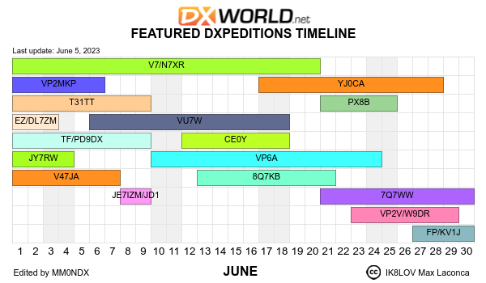
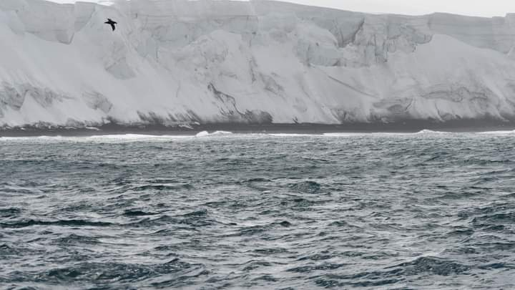
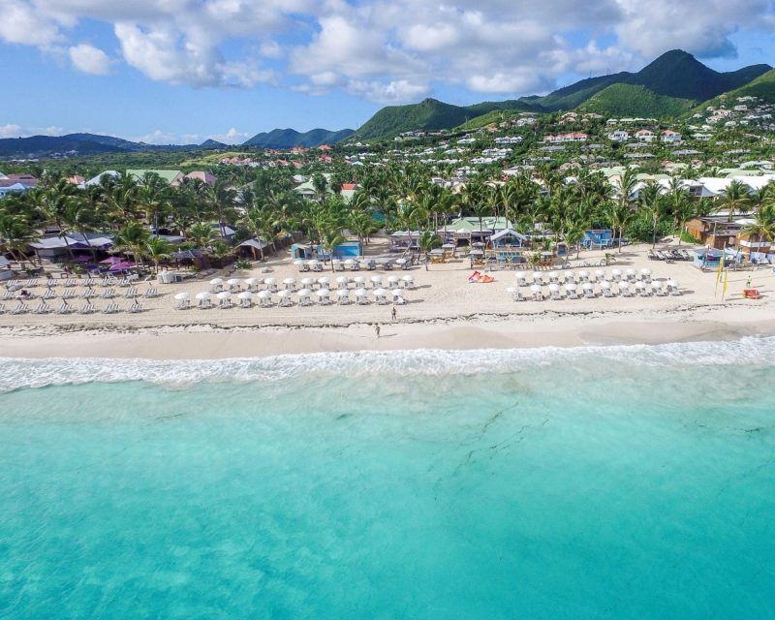
Up-coming DXpeditions

Slide 59
Chasing DX (cont.)
Do:
  Listen Listen Listen and Listen some more!
    Make sure you can hear him and verify his call!
  Figure out his timing and where he is listening – and then transmit accordingly
    Often listening UP 1-KHz or more, depending on demand
  Use full QSX (break-in) and “Split”
    Learn how to rapidly use dual VFOs and/or XIT/RIT functions on your rig
  Be courteous and concise
  Understand Propagation and Be Patient
  Take a look at QRZ.com and/or the DXpedition website for operating plans and QSL info
Don’t be the lid who:
  Tunes up and/or transmits on top of the DX!!!
  Continues to operate simplex when the DX is running split (3Y0J UP)
  Continues to call when the DX is clearly calling someone else
  Thinks he’s the “DX Police” (These guys usually cause more QRM than the errant simplex op!)

Slide 60
My Contact Last Fall with D60AE (Comoros)
Turned on radio to participate in an SST
Saw D60AE Spotted on 20m – clicked on it
He was ~539 and a large pile-up extending up ~10 KHz
Watched SDR waterfall to see who he was working and his patterns
  About 7.5 KHz up, slowly moving down
Set my rig to “split” while listening to a few more contacts
Moved my XIT down a little more, threw out my call
  After 4 or 5 tries, he came back with WW2IL
  I sent AA2IL one more time, he responded correctly
  Exchanged 5NNs and 73s
  Confirmed “In the Log” the next day on Clublog
Remember, my station is a “little pistol” - 100 W and wire antennas
  Approximately 10,500 miles distance

Slide 61
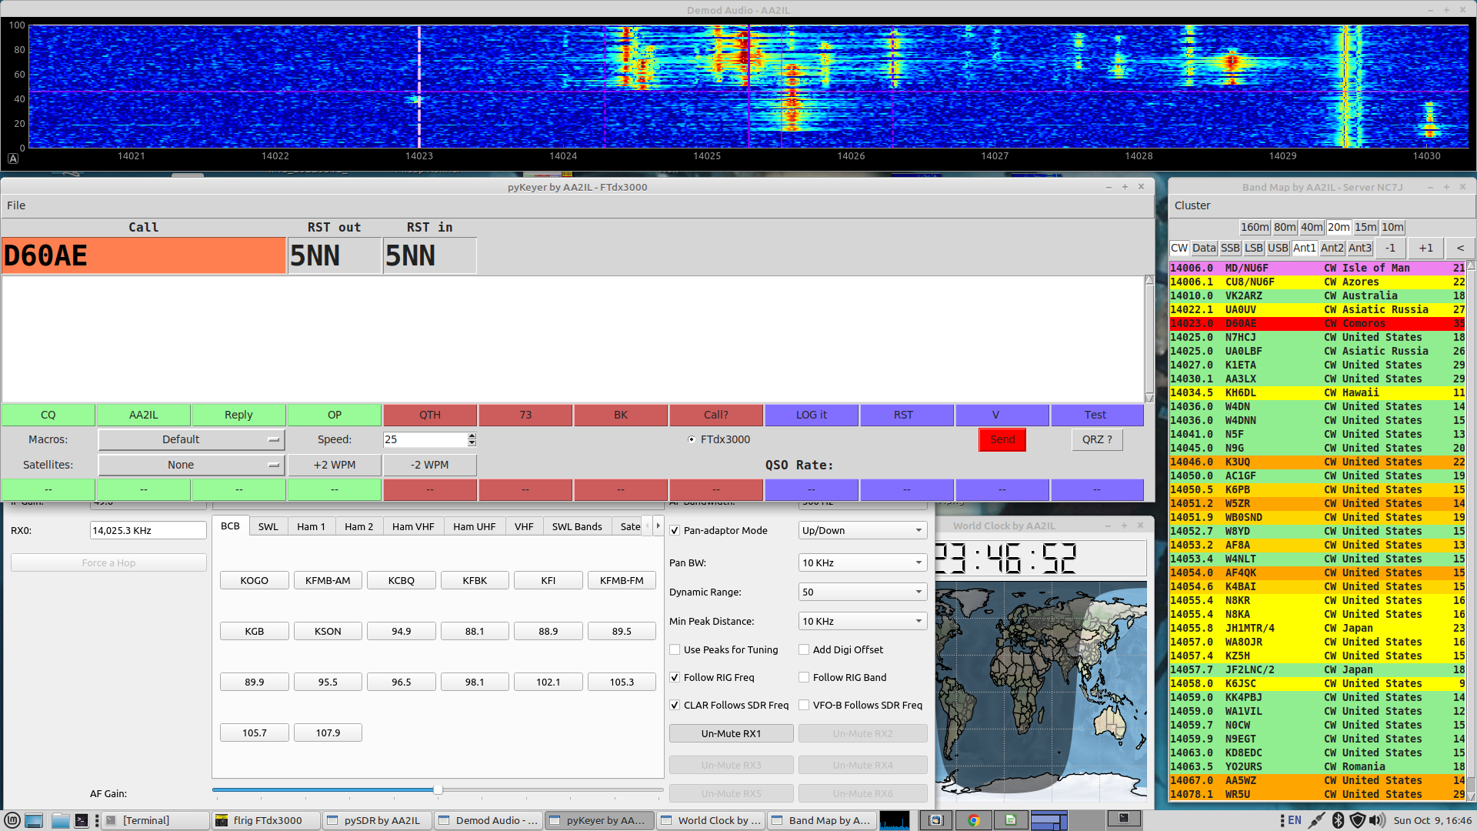
SDR Panadapter (Post-QSO)

Slide 62
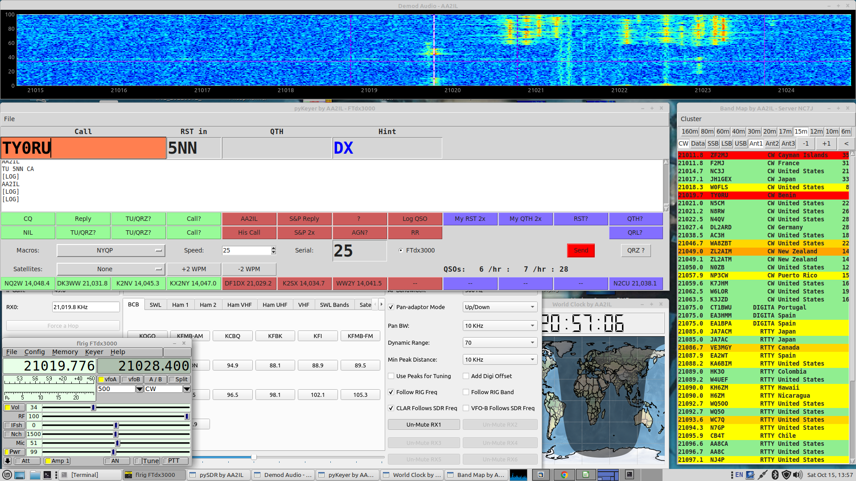
SDR Panadapter (Benin TY0RU)

Slide 63
Week 6 - Session 12
Go over h/w and on air activities
Upcoming contests
  June VHF
  SKCC WES
DX Cluster and Reverse Beacon Network
20 Questions (again)

Slide 64
Spotting Networks
The DX Cluster refers to websites that list DX stations that other ops have “spotted”
  Rare and not so rare DX
  Running stations in a domestic contest
  dxwatch.com and dxheat.com are my “go to” sites but there are many others
Reverse Beacon Network (RBN)
  A world-wide system of SDRs monitoring one or more bands and using automatic decoders
    CW and RTTY Skimmers
  You can view data “live” or download and analyze historical data off-line
  This is an excellent tool for assessing your station’s performance
    Send CQ <YOUR_CALL> or TEST <YOUR_CALL> a few times to get spotted
  reversebeacon.net – can also get raw RBN spots in real-time
  PSK Reporter does something similar for FT4/8 signals → Almost everyone is a spotter/monitor!
The use of these tools, even once, puts you in the “assisted” category in a contest
These tools have altered the landscape for chasing DX
  No longer have to endlessly “spin the big knob” to find DX
  Generates instant pile-ups

Slide 65
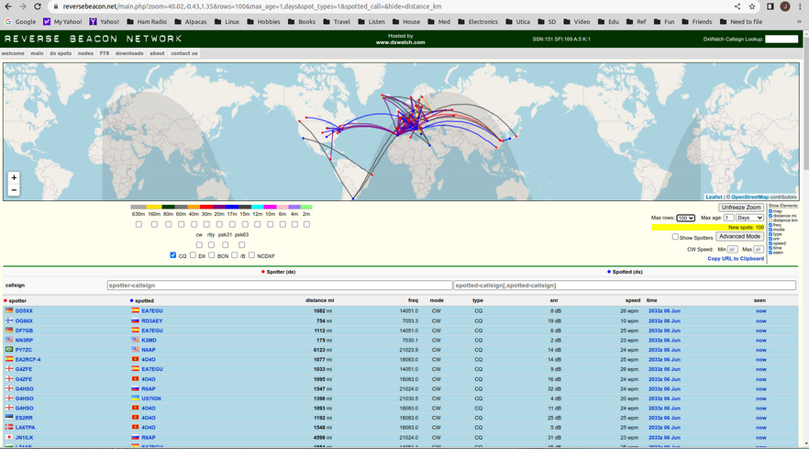
Reverse Beacon Network (RBN)

Slide 66
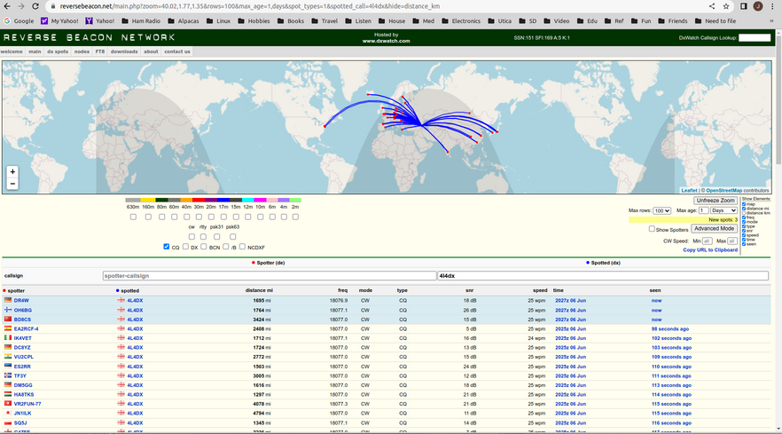
RBN Real-Time Filters

Slide 67
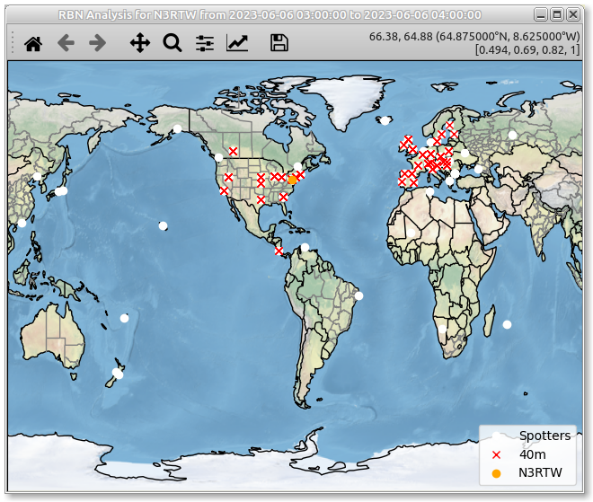
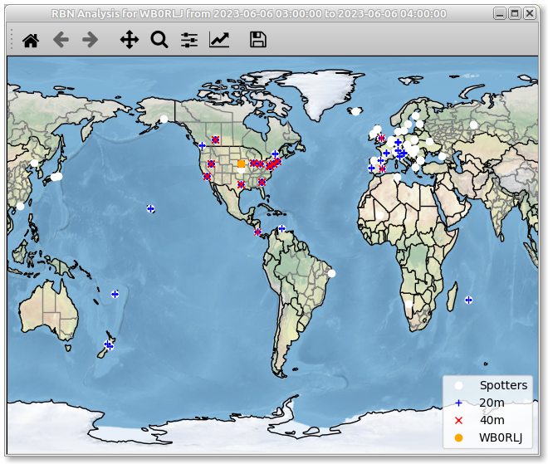
Can You Hear Me Now?
Archived data from Monday’s 0300 MST (June 6, 2023)
N3RTW
WB0RLJ

Slide 68
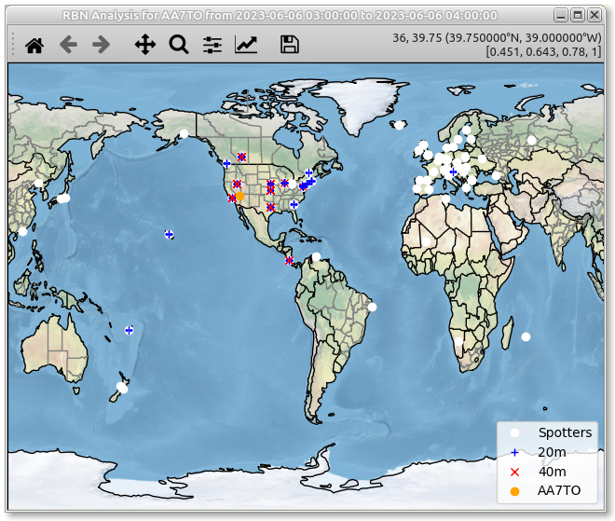
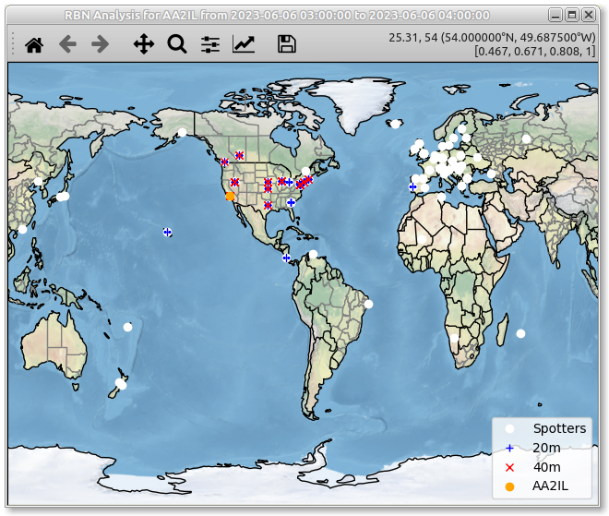
Can You Hear Me Now?
Archived data from Monday’s 0300 MST (June 6, 2023)
AA7TO
AA2IL

Slide 69
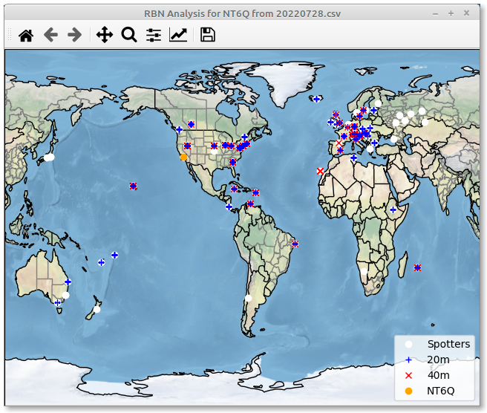
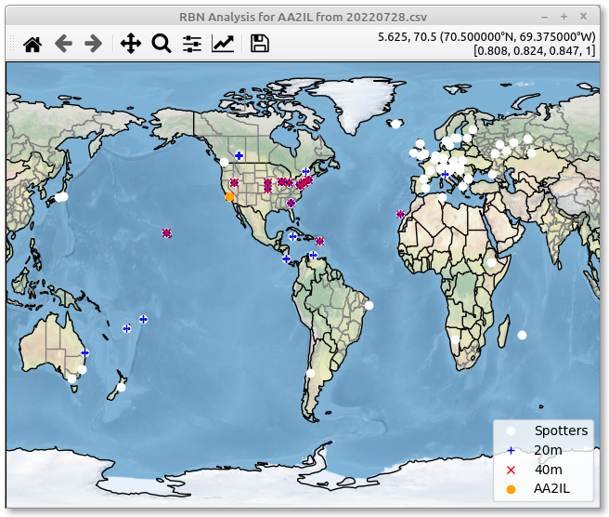
Big Gun vs Little Pistol
CWT 0300-0400 July 28, 2022
NT6Q
AA2IL

Slide 70
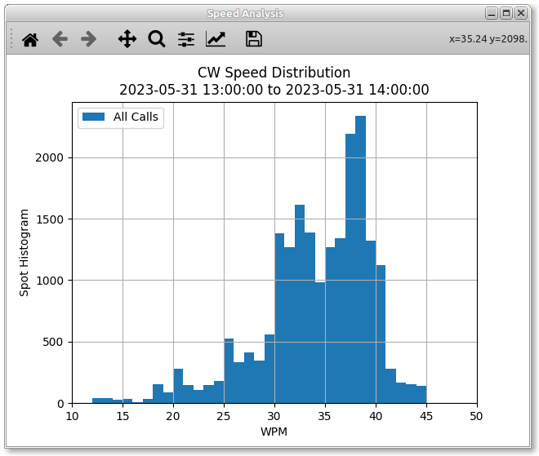
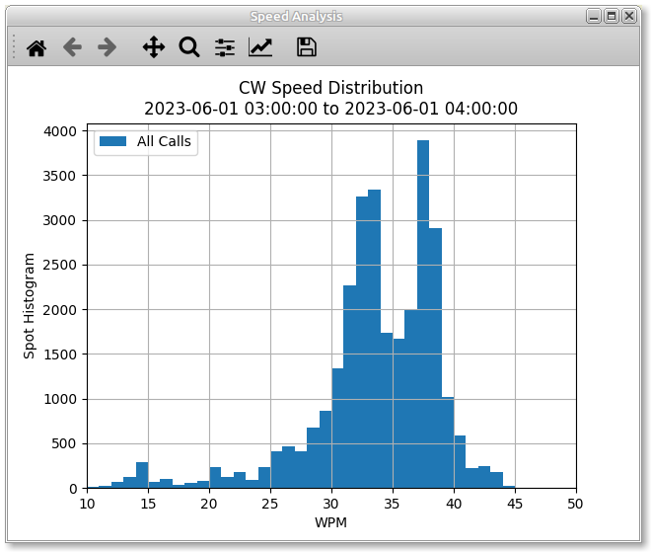
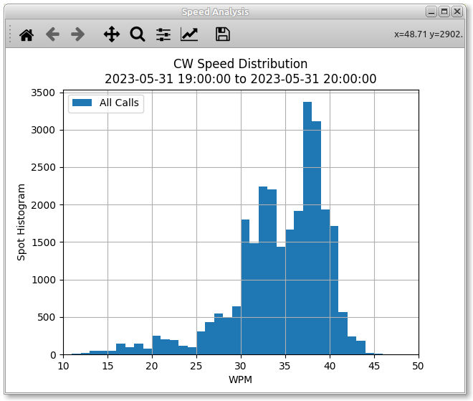
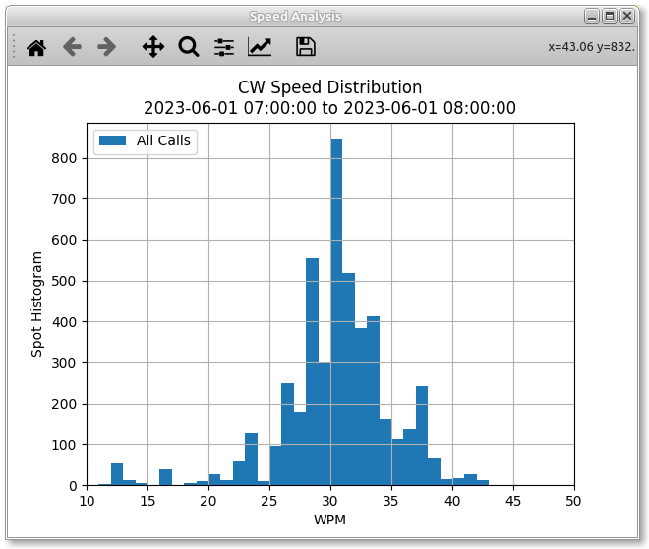
Speed Analysis – Last Week’s CWTs
1300Z
0300Z
Mean=33.6
Mode=38
Mean=33.6
Mode=38
Mean=33.2
Mode=37
Mean=33.2
Mode=37
1900Z
0700Z
Mean=30.0
Mode=30
Mean=33.9
Mode=37

Slide 71
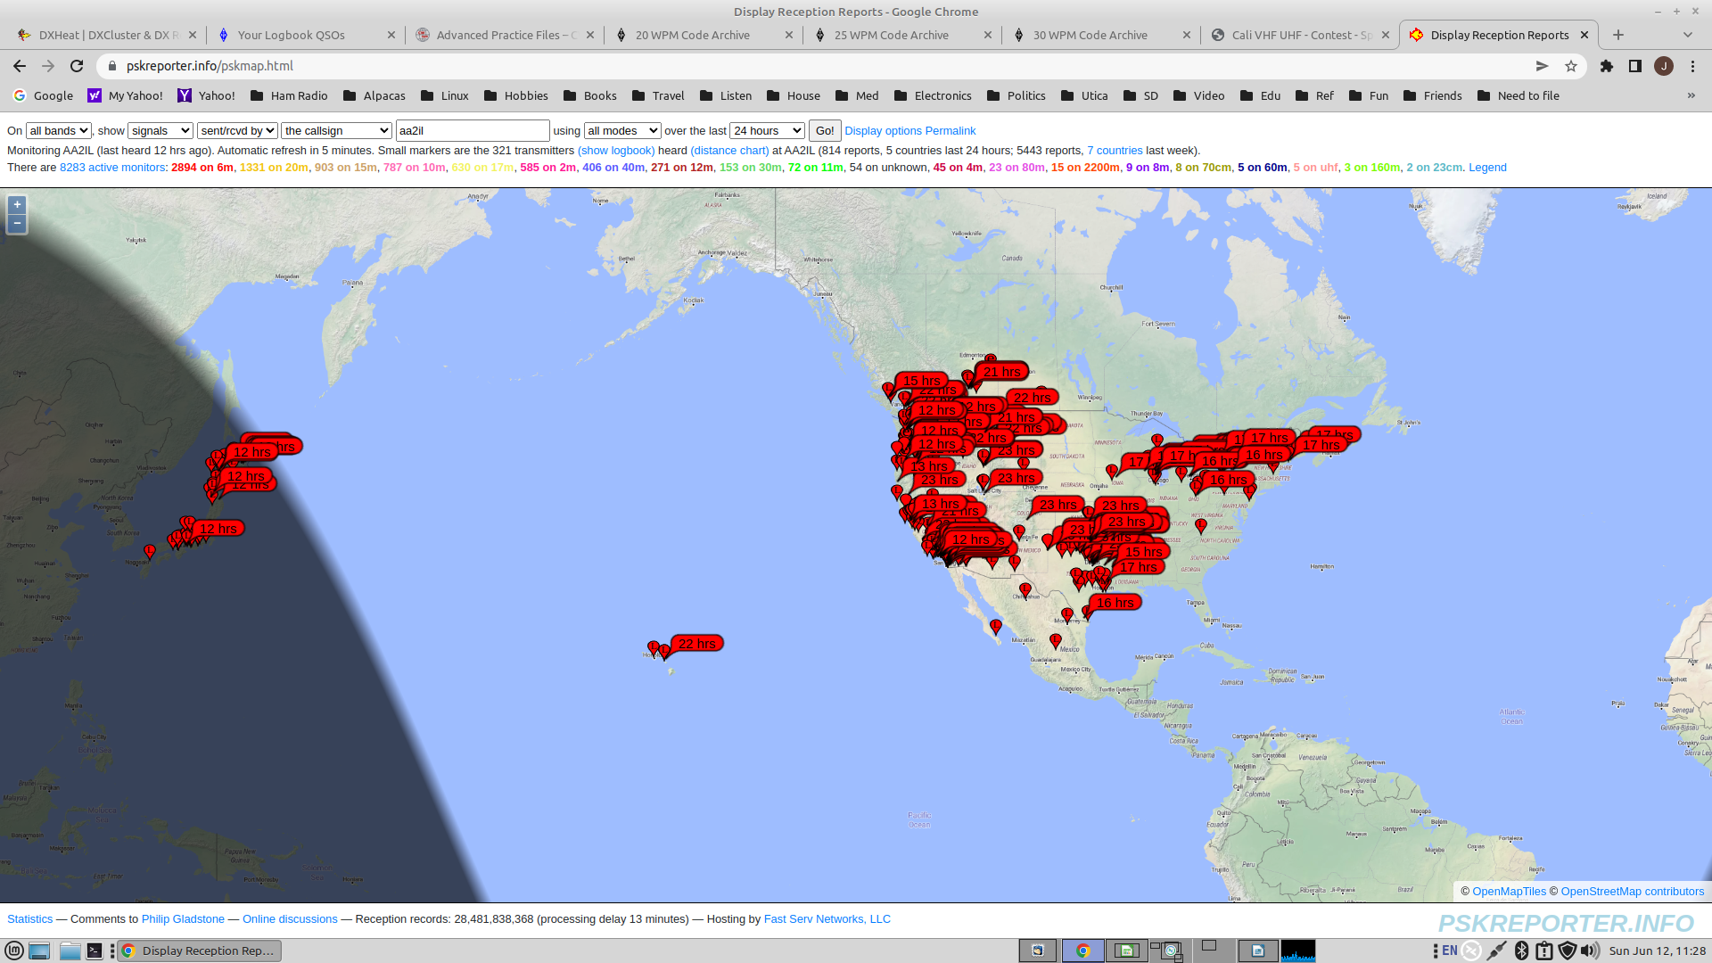
PSK Reporter – Stations Who Heard Me on 6m During the June 2022 VHF Contest

Slide 72
Week 7 - Sessions 13+14
Go over h/w and on air activities
Upcoming contests
  All Asian DX CW
  West Virginia QP
  Stew Perry Top Band (160m)
Field Day
  And other contesting left-overs
Field Day Drill

Slide 74
ARRL Field Day
Fourth Weekend in June
One of the most popular operating event all years
  “Its not a contest” – Logs are not adjudicated
  RAC Section list as been updated (and a few other rule changes)
Exchange:
  No. TRANSMITTERS, CLASS and SECTION
    CQ FD AA2IL
                N7AUE
    N7AUE TU 2E SDG
                TU 1B NV
    73 AA2IL

Slide 75
ARRL Sweepstakes (CW)
First full weekend in November
Very popular “treasure hunt”
Non-trivial Exchange:
  SERIAL, PRECEDENCE, YOUR CALL, CHECK, SECTION
    CQ SS AA2IL
                N7AUE
    N7AUE TU 123 A AA2IL 78 SDG
                TU 456 U N7AUE 74 NV
    73 AA2IL

Slide 76
Sprint Contests
The QSY requirements make these events quite different compared to a typical contest:
  If you call CQ, you must QSY at least 5-KHz before you can call CQ again
  If you pounce, you can answer one caller and then you must QSY
The order of the elements in the exchange indicates who is the CQer and who is the pouncer:
  CQ NA AA2IL
  N7AUE
  N7AUE AA2IL 123 JOE CA
  AA2IL 456 JIM NV N7AUE
  TU
  W0WL
  W0WL N7AUE 457 JIM NV
  N7AUE 789 JOE WA W0WL
  TU
See https://www.kkn.net/n6tr/sprint.html for an in depth look

Slide 77
QTCs
Some European contests include “QTCs” which add another level of difficulty to the exchange
  A QTC is info from a previous contact you had in the contest
  True test of skill since nearly impossible to predict
Example (Time Call Number)
    CQ TEST SV2HUD
                NJ7V
    NJ7V TU 5NN 123
    TU 5NN 456
    R QTC?
                R 1608 KM6GOX 455
    R ...
YL3JD’s QTC Trainer: https://yl3jd.fizioikskile.lv/qtc/
YL3JD’s Contest Trainer: https://yl3jd.fizioikskile.lv/fsm/

Slide 78
CQP Log Check Report
AA2IL QTH:SDIE
CQP LOG CHECKING RESULTS
:
QSO: 21031 CW 2022-10-01 1641 AA2IL/6 37 SDIE N5KB 22 IA
Duplicate QSO....removed without penalty…
:
QSO: 7030 CW 2022-10-02 0207 AA2IL/6 547 SDIE N2JF 105 FL
This QSO was removed without penalty because it is not in the received stations log (NIL)
:
QSO: 7030 CW 2022-10-02 0216 AA2IL/6 562 SDIE VA3FN 66 ON
Half-credit awarded for this QSO: serial # 76
:
QSO: 3542 CW 2022-10-02 0612 AA2IL/6 783 SDIE W6NL 1106 MONO
No credit award for this QSO: serial # 772, location mismatch SCLA
:
After Log Checking:
Total Raw QSO's: 933 CW: 933 PH: 0
Duplicate QSO's: 22
Number of QSO's earning full or partial credit: 909
CW QSO's: Full Credit: 903 Half-Credit: 6 No-credit (NIL or Multiple Errors): 2
PH QSO's: Full Credit: 0 Half-Credit: 0 No-credit (NIL or Multiple Errors): 0
Checked Mults: 56
QSO Points granted: 2718
FINAL SCORE: 152208

Slide 79
IARU HF Log Check Report
2022 IARU HF CHAMPIONSHIP AA2IL
There were 404 calls found.
Your full callsign is = AA2IL
Your ITU zone was 6
CALLSIGN CHECK RESULTS
----------------------
40CW JI1RFN is a busted call. The correct call is JI1RFB.
You had 1 calls in your log which were not found in the database of good
callsigns. All of these were judged to be busted calls and will be removed
from your score - along with an additional penalty of one QSO per busted
Callsign.
EXCHANGE CHECK RESULTS
----------------------
40CW K2ZW : 8 should be 6
100.0% of your non dupe QSOs had their exchanges checked.
There was only one exchange error found. This QSO will be removed from your
your score with no penalty.

Slide 80
IARU HF Log Check Report
CROSS CHECK RESULTS
-------------------
15CW K4ZW QSO not found in log.
87.8% of your remaining good QSOs were cross checked.
There was one bad cross check QSO removed.
You had one not-in-log which will be deducted from your score.
There is an additional penalty of one QSO for every not-in-log.
DUPE CHECK RESULTS
------------------
KA0PQW is a dupe on 40CW at line # 403
There were 404 QSOs checked for dupes.
There was one dupe found. It was removed with no penalty.
Error rate = 0.7% (100 X (Busted QSOs / Duped QSO total))

Slide 81
Week 8 - Session 15
Go over h/w and on air activities
Field Day is this weekend – Have Fun!!!
Before a contest:
  Propagation?
  Other prep?
QSLing
Where to you go from here?
  GOTA!!!
  LICW
  Become a CWA Advisor
Other Topics?
QSO Drill

Slide 82
“Squeeze” Sending
CWops encourages use of paddles and electronic keyers
  Cleaner fist at faster speeds
  Most ops “hit a wall” at 15-20 wpm using a straight key
  Eventually, you will hit a wall with a keyer also → keyboard sending
There are two types of paddles
  Single lever
  Dual lever
With a dual lever paddle, you can “squeeze” the levers together to form letters with alternating dit/dah patterns:
  Reduces number of “motions” required to form a symbol
  A, C, K, N, R, period, …
  Can even combine squeeze technique with “non-squeeze” to form most other symbols
    L, F, Q, Y, ...

Slide 83
“Squeeze” Sending (cont.)
If you don’t “squeeze,” there is no real difference between single and dual-lever paddles
The advantage of squeezing dual-paddles over a single-lever paddle is not nearly as much as using an electronic keyer over a straight key
  HST guys use single-lever paddles because less prone to making mistakes
There are two Iambic “squeeze” modes:
  Mode A: Sending stops after current element is sent
  Mode B: Alternate element is sent before sending stops
Excellent video demonstration by AA4OO:
  https://www.youtube.com/watch?v=6R4t3Wq1Gic

Slide 84

Session 16 – Graduation!!
Certificates
Major CW contests throughout the year:
  NAQP – January and August
  ARRL International DX CW – February
  CQ WPX CW - May
  IARU HF Championships – July (WRTC)
  CWops CW Open – September
  California QSO Party - October
  ARRL Sweepstakes - November
  CQ WW CW – November
  State QPs - February - November
CWops
One last rag chew drill?

Slide 85
CWops Membership
Requirements
Demonstrate Proficiency at 25-WPM or higher
  Easiest way is to make several contacts in the CWTs
  You can also schedule contacts with current members to gain sponsorship (or call/answer CQ or have a give-back QSO or ...)
Nomination + 3-sponsors
You don’t need to be perfect!
  Implicit is the understanding that you will continue to improve as you get more involved with the club activities
Dues: $15/yr or $60 for 5-years or $125 for life

Slide 86
CWops Activities
CWTs, CW Open, OTA Give Back, QTX
CWA - Please consider becoming a Advisor
  You can also be a co-advisor
Solid Copy - Monthly Newsletter
E-mail Reflector
Awards: CWT Participation, ACA, CMA, WAS, DXCC, WAE, WAZ ...
  Upload your logs to https://cwops.telegraphy.de/
  Post CWT summaries to https://3830scores.com/

Slide 87
My Favorite Ham Websites
Contesting related:
  WA7BNM’s Contest Calendar: contestcalendar.com
  WA7BNM’s Contest Score Rumors: 3830scores.com
DX Cluster:
  DX Heat: www.dx-world.net
  DX Watch: dxwatch.com
Activity:
  Reverse Beacon Network: reversebeacon.net
  PSK Reporter: pskreporter.info
Chasing DX:
  DX World: dx-world.net
  DX News https://dxnews.com/
Propagation:
  VOCAP
  DX View (TNX JR)
Just Plain Cool:
  ADIF to MAP: http://analyzer.adventureradio.de/index.php
There are many other very good sites

Slide 88
Final Comments
It has been a genuine pleasure working with each of you
  You each have made significant progress
  There is an optional self-evaluation on the CWops website
Please keep in touch
Keep on practicing
Get on the air!
Please provide feedback to us on this class:
  Overall format (too much talk, not enough practice?)
  Topics you would have like to see
  Topics that we should have skipped ...
If any of you are linux hackers and are interested, I’d like some collaborators on the operating tools I showed you

Slide 89
Additional Material
Morse Code Timing
A simple iambic keyer/code practice oscillator
FT8
My station and software

Slide 90
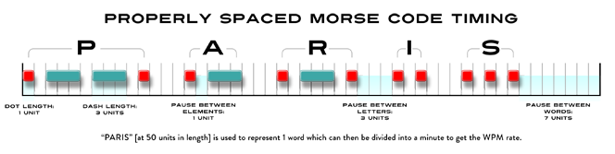
T = Duration of a dit (seconds)
“Paris” is the “standard” word length = 50 dits
WPM = No. Times we can send this standard word in a minute = 60 sec. / (50 T)
T = 1.2/WPM seconds
e.g. For 25 WPM, each dit is 1.2/25 = 0.048 s = 48 ms

Slide 91
Homebrew Arduino Nano
Keyer/Code Practice Oscillator
A number of keyers are commercially available and are quite popular, e.g.
  Winkeyer
  Morseruino
You can easily “roll your own” using a micro-controller (Arduino, ESP-32, ...)
  This is a much cheaper option, especially if you have a well-stocked junk box
  K3NG – Has every feature imaginable!
  Fldigi Nano IO (W1FKJ) – easily fits in an arduino nano
The keyer I use is an adaptation of W1FKJ’s Nano IO
  Full schematics and firmware source are available at https://github.com/aa2il/nanoIO
  Doubles as a code practice oscillator and gives you feedback on your timing
  Minimal parts count
  Current firmware is not compatible with Winkeyer protocol so will not work with N1MM logger

Slide 92
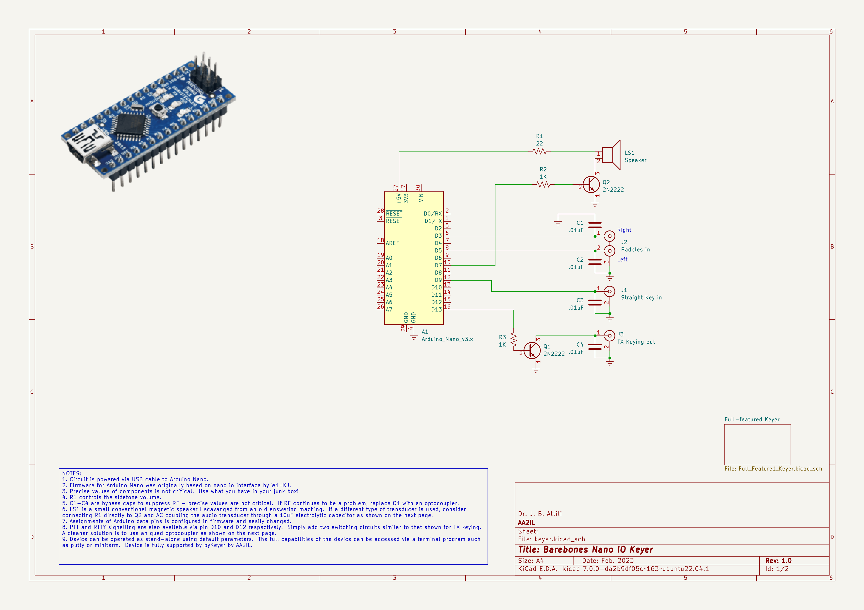
Schematic

Slide 93
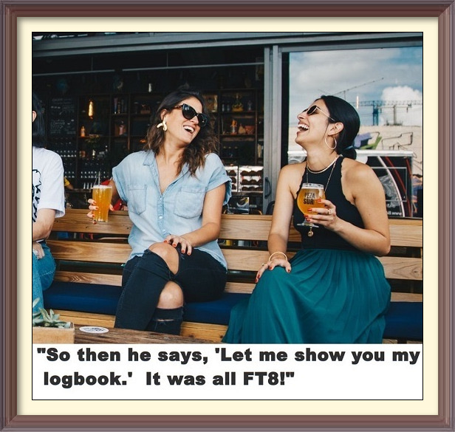

The Elephant in the Room

Slide 94
What about FT8?
There is no question that FT8 is by far the most popular mode in use these days
  Nearly all DXpeditions include a significant FT8 component in their operating plan
There is also no denying that this mode stirs up some very heated comments amongst CW devotees.
On the plus side:
  The use of error control coding introduces redundancy that improves performance compared to RTTY
  In an age of ever increasing restrictions (e.g. HOAs) and RF noise, it offers many ops an opportunity for many to still enjoy our great hobby
  It can provide a gateway to newcomers (who we hope will eventually become bored with FT8 and endeavor to learn CW!)
  It is possible to enjoy being on the air while doing something else
  There’s always a party to be found on somewhere!

Slide 95
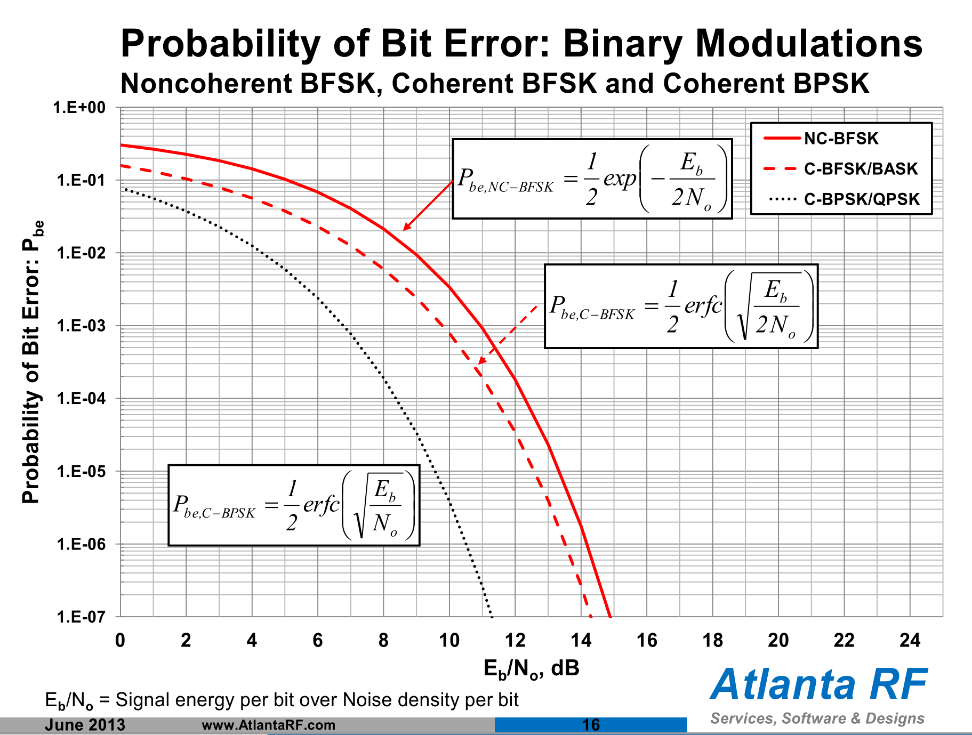
FT8 – The Rest of the Story
Major Objections include:
  The existence of “robot” variants of WSJT-X that don’t require any human intervention – not as prevalent as it is made out to be
  Lack of a conversational capability - JS8CALL is not very popular
  Dependency on an accurate clock – easy to overcome using a cell-phone or GPS dongle
IMHO, the WSJT software and operating technique have not kept up with the explosive popularity of this mode
  Confining a large number of ops into a single voice channel with no standard method to “spread out” results in a “QRM-fest”
Its sensitivity/capabilities are greatly exaggerated:
  Referencing the SNR of a signal that only occupies a few Hz of bandwidth to 2.5KHz is questionable:
    SNRft8 = S / N = [Eb R] / [No Bref] = Eb/No R/Bref
    Eb = Average Energy per Information bit
    No = Noise Power Spectral Density (assumed white)
    R = Information data rate = ~77-bits/15-sec.
    R/Bref = (77/15)/2500 ~ -27 dB
    Eb/No = SNRft8 + 27dB is the standard measure of SNR when evaluating the performance of a digital comm schemes
  The myth that FT8 somehow magically digs signals out from well beneath the noise floor and is therefore much more sensitive compared to other modes, including CW, is simply NOT TRUE!
The F/H mode is confusing and of dubious value since it reduces the fox’s signal by 6-dB each time he doubles the number of streams
  Burying this option in an obscure menu doesn’t help – turns out “hounds” don’t need it if they stay above 1-KHz!
  Signals from the MSHV variant look similar but are not F/H

Slide 96
Why do I Still Use FT8 Occasionally?
Its radio – it still requires some skill to navigate through propagation and QRM
  CW is much more satisfying!!!
Chasing DX
  You need to be where the action is
  The behavior in some recent CW DX pile-ups has been a blemish on our great hobby (DQRM, lids, cops). The FT8 pile-ups were much more orderly (not at all perfect!).
VHF Contesting and EME
  FT8 is dominant on 6m and JT65 is dominant on EME
Although exaggerated, the signal reports are real and objective measures (unlike the usual 5NN)
PSK Reporter immediately shows what bands are open and who’s on
I can still play radio while doing something else

Slide 97
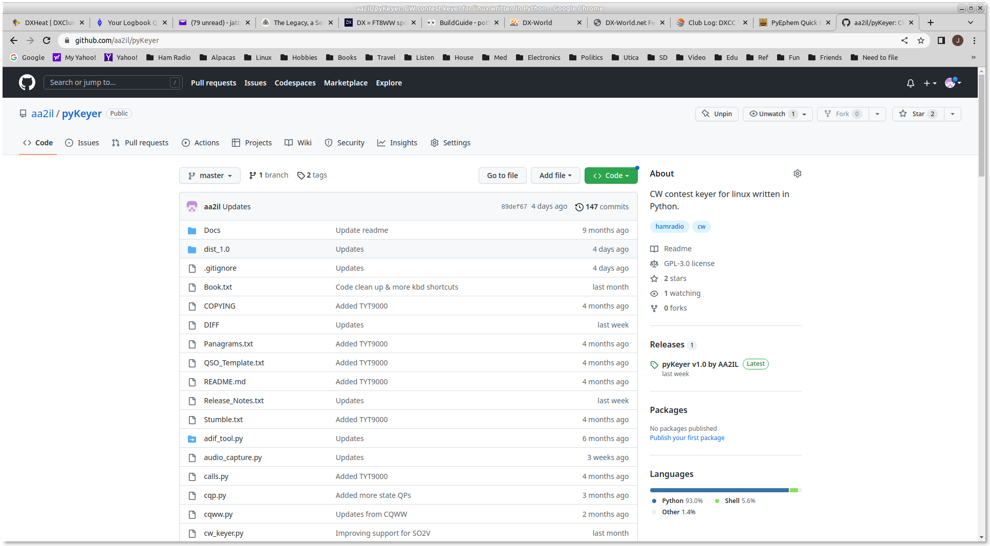
AA2IL Homebrew Software
Source and some binaries are available at github.com/aa2il
  Integrated suite of apps
  Developed under linux but most recently ported to Windoz
  Windoz binaries also available – see “Releases” on RHSs
  Very little documentation
  Would welcome collaboration!
pyKeyer
  Contest rig control (via flrig) and logging
  Practice mode for contests and sending
bandmap
  DX Cluster spots
  Worked/”Need” tracking
wclock – World clock with gray-line map
pySDR
  Software Defined Receiver
  Panadapter
  Does not work yet on Windoz

Slide 98
AA2IL HF Station
SDR
Yaesu
FTdx3000
RX RF
Linux
Computer
CAT Control
Internet
Internet
ISP
Or
Phone
Straight Key Port
Nano IO
Keyer
Paddles
Straight Key

Slide 99
Other Topics – Next Time?
SOTA/POTA
VHF+ and Satellite Contacts
Other games:
  Dear Diary – sending practice, what did you do today?
  Never ending story – each person adds to the story
    It was sunny today
    My dog went outside
    He chased a cat …
Log for Old Men – A couple of students were using this one
Muley had an interesting variation of SST drill where he and I jumped in under other call signs

