Slide 1
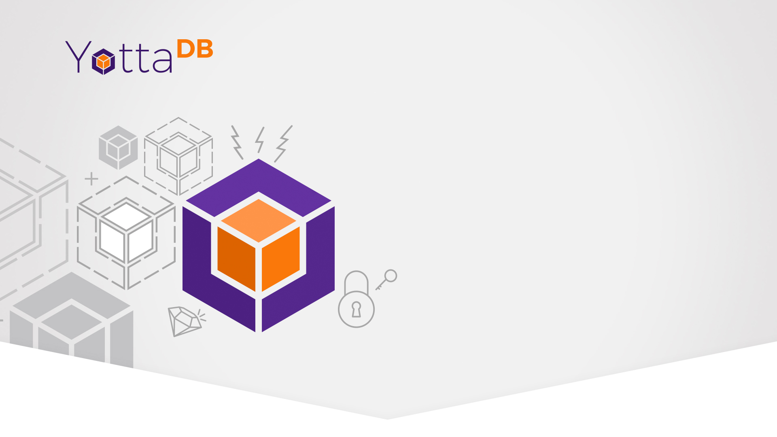
Adding Microservices to VistA using Octo and Go
July 10, 2019

Slide 2

Outline
What is a micro-service
What is VistA
How do we make a VistA micro-service?
Demo
Conclusion

Slide 3
What is a micro-service
A self-contained piece of functionality which can be easily written, tested, and deployed without major changes to the underlying system
  Communicates with other components through some mechanism; usually a TCP connection
  Small, small, small!

Slide 4
Why a micro-service
Easy to create
Easy to test
Easy to deploy
Easy to destroy
What does ‘easy’ mean?

Slide 5
What is VistA
I’m the wrong one to ask
Open source EHR system
  Monolithic
  Stores data in M data model using FileMan
  Allows some RPC calls

Slide 6
How?
How do we offer a micro-service for a monolithic application?

Slide 7
How?
How do we offer a micro-service for a monolithic application?
  We provide an interface that allows us to write self-contained bits of business logic

Slide 8
How?
How do we offer a micro-service for a monolithic application?
  We provide an interface that allows us to write self-contained bits of business logic
  We use infrastructure which allows us to easily deploy micro-services and hide them behind routers

Slide 9
How - Specifically
Run VistA as you normally would
Have a replication stream going to a VistA instance deployed in Kubernetes, running Octo and the VistA mapper
Write code in your language of choice to implement a specific new feature
  Any logic to commit new data still needs to call into the VistA RPC’s

Slide 10
How - Specifically
Kubernetes?
  Tool to manage docker containers and coordinate scaling up/down, restarting containers, etc.
Octo?
  Postgres-compatible SQL engine which speaks directly to YottaDB

Slide 11
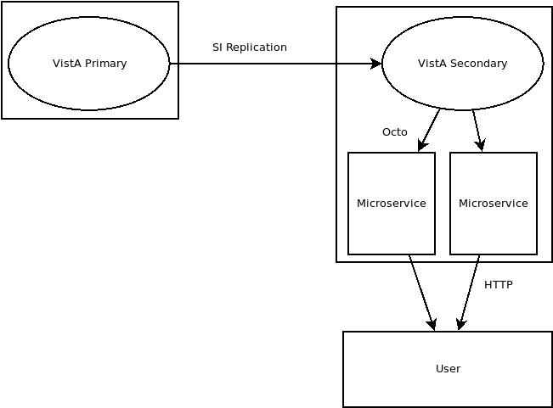
How - Specifically

Slide 12
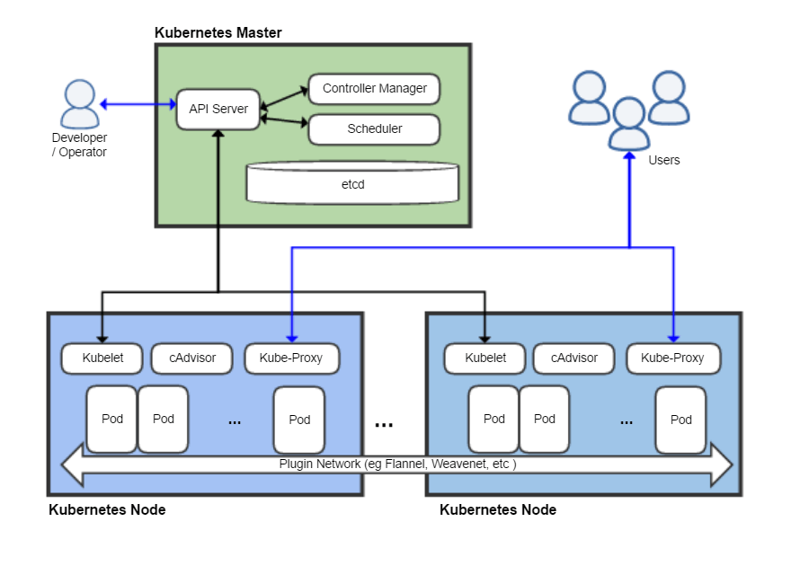
How - Specifically

Slide 13
Demo
🤞🤞🤞🤞

Slide 14
Demo
Super simple; let’s get a list of patients currently checked into a particular unit of the hospital
A simple SQL query, back by almost-live data, retrieved by a Go application and converted to JSON
Simple web-front end displays the list of patients

Slide 15
Query
SELECT h1.NAME, p1.NAME, p1.SEX, p1.AGE, v1.CHECK_OUT_DATE_TIME, v1.VISIT_ADMIT_DATE_TIME
FROM HOSPITAL_LOCATION h1
INNER JOIN VISIT v1
ON (v1.HOSPITAL_LOCATION = h1.HOSPITAL_LOCATION_ID)
INNER JOIN PATIENT p1
ON (v1.PATIENT_NAME = p1.PATIENT_ID)
WHERE h1.NAME = 'ICU/CCU'

Slide 16
Conclusions
We talked about micro-services
We talked about VistA
We talked about Octo
We saw how it can be done

