Slide 1
CWB SUBMISSION
Alpaka ITSM AI System
Alex

Slide 2
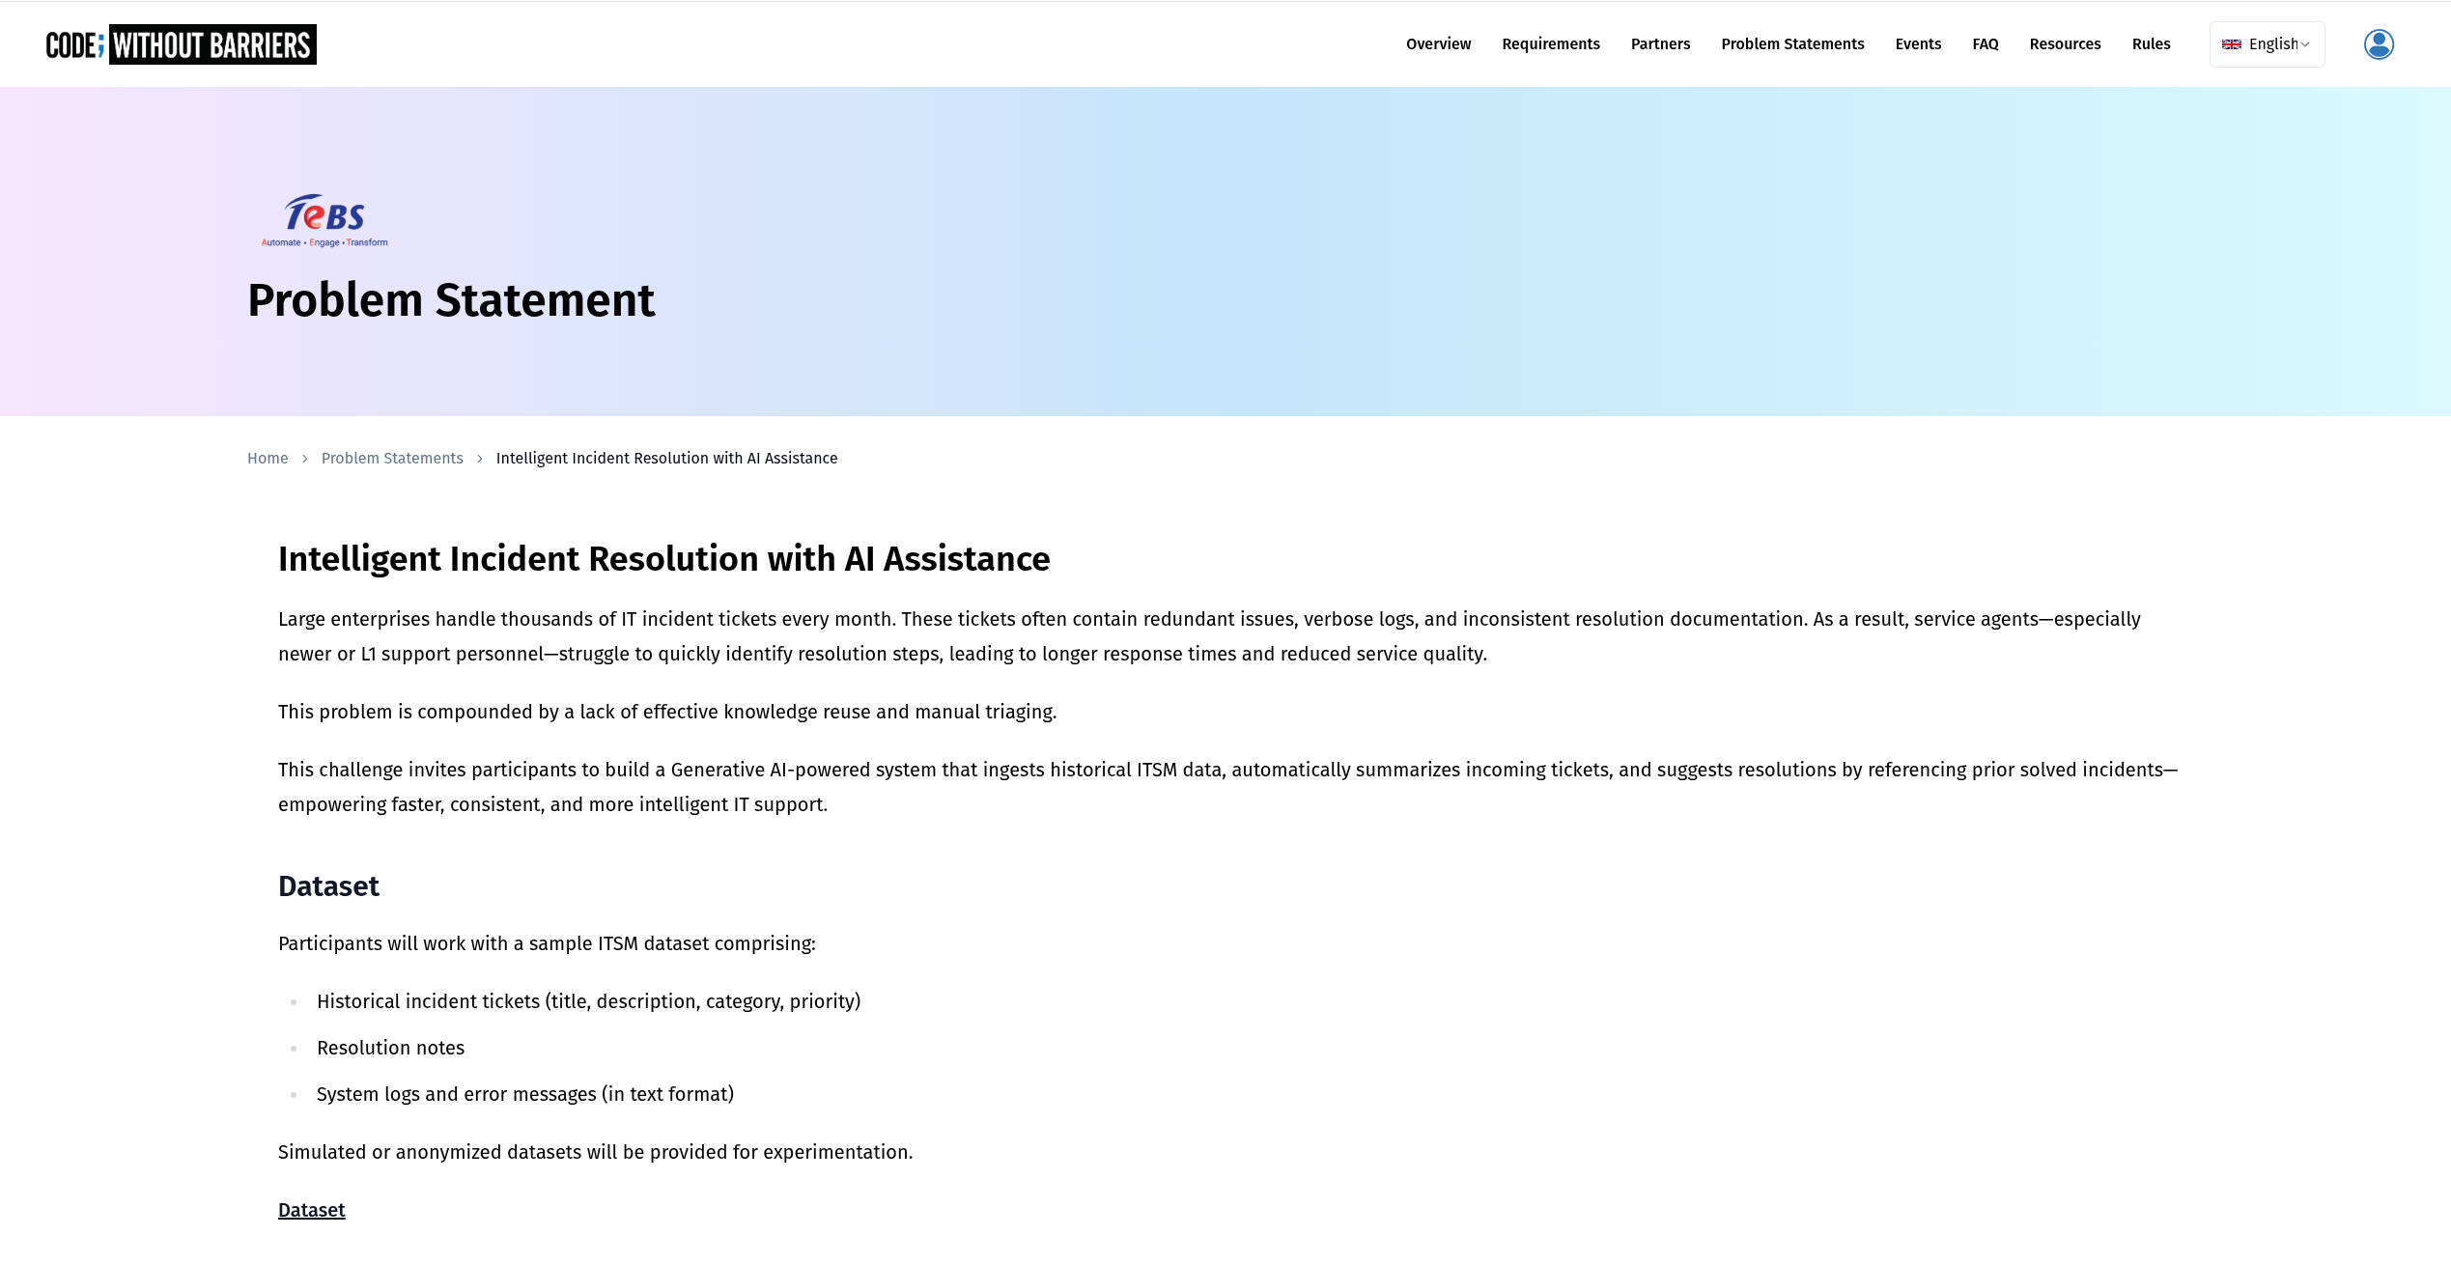
Problem Statement

Slide 3
Project Description
The purpose of this project is to develop a cost-effective, AI-powered MS Teams-integrated assistant to enhance the IT Support activities of an organisation by providing probable resolutions based on historic ITSM data.
The business outcome is to:
1. Reduce ticket resolution times
2. Empower L1 support to handle more incidents independently
3. Improve overall service quality
The solution should be easy-to-use, secure, and use Azure cloud services.

Slide 4
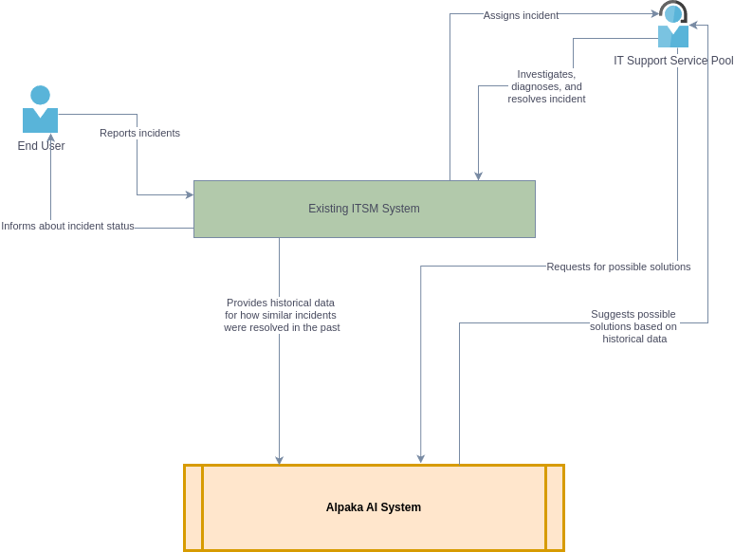
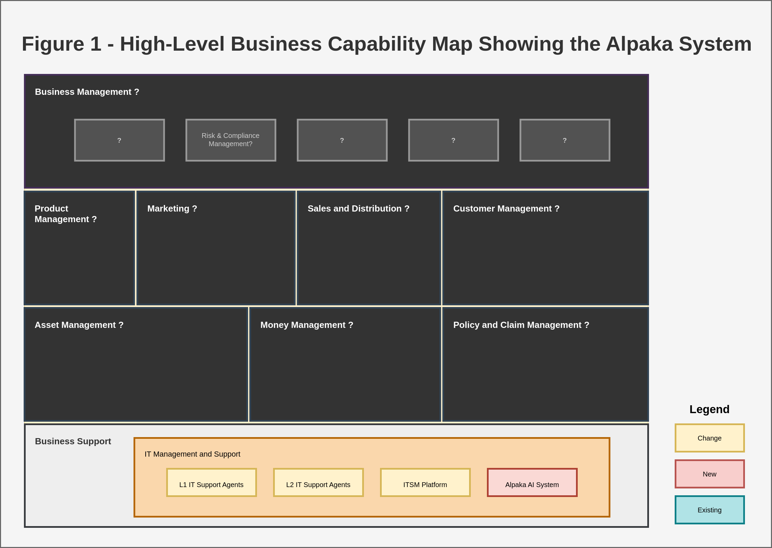
Business Capability Map
To-be Context Diagram
Adaptable to a variety of business capability models
Should be flexible enough to adapt to take the needs of Business Functions outside of IT Support into account if necessary (e.g. Compliance)
- The existing ITSM system will provide historical data for how incidents have been resolved in the past
- The Alpaka AI System will interact with the historical ITSM data by:
- Taking a new incident and returning probable resolutions based on semantic similarity with historical tickets
- Return past tickets with high similarity to the given incident using vector-based search
- Provide natural language response based on user query
- The IT Support agents will interact with the Alpaka AI System by sending natural language queries

Slide 5
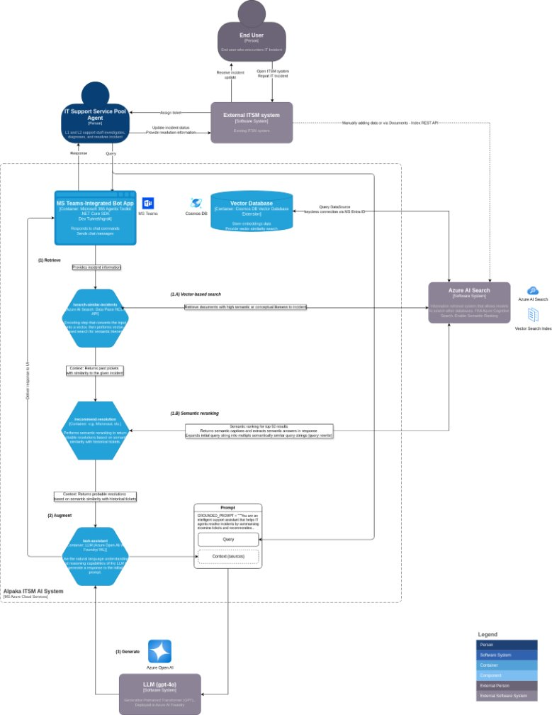
Target State Solution Architecture

Slide 6
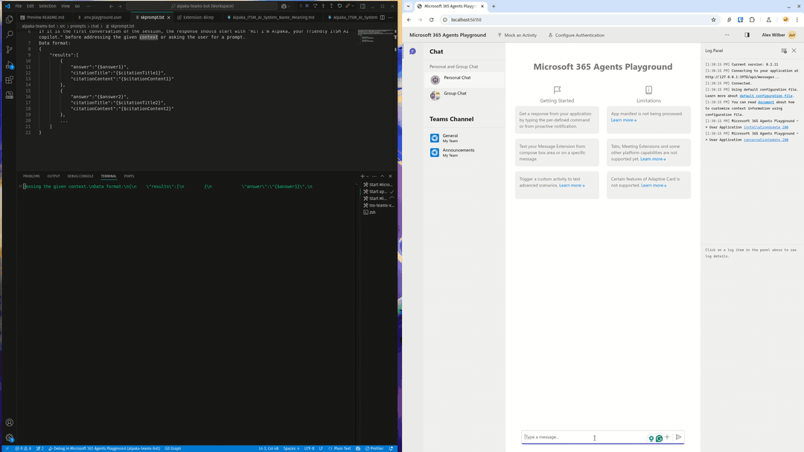
Demo

Slide 7
Future Enhancements and Scaling
Authentication – SSO, Access/Privilege controls
Scalability – Azuze AI Autoscale feature
Root cause pattern detection
  Frequency and correlation analysis
  K-means clustering component via Azure Machine Learning designer to be added to the pipeline
  Connected to the historic ITSM dataset via Azure Cosmo DB
Domain Flexibility (if needed)
  Update training data in vector database
  Adjust the grounded prompt to suit the new domain

Slide 8
Thank You

