Slide 1
W15-on site assignment
Follow the assignment of week 13 again
Let the queue size to be robust

Slide 2
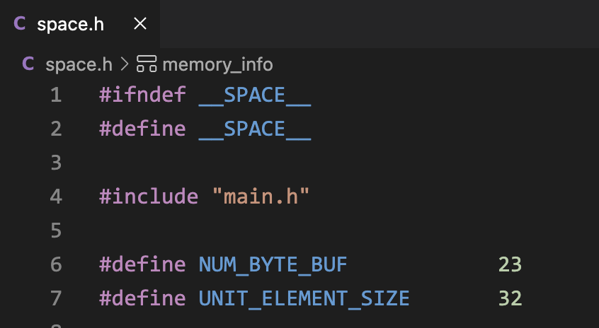
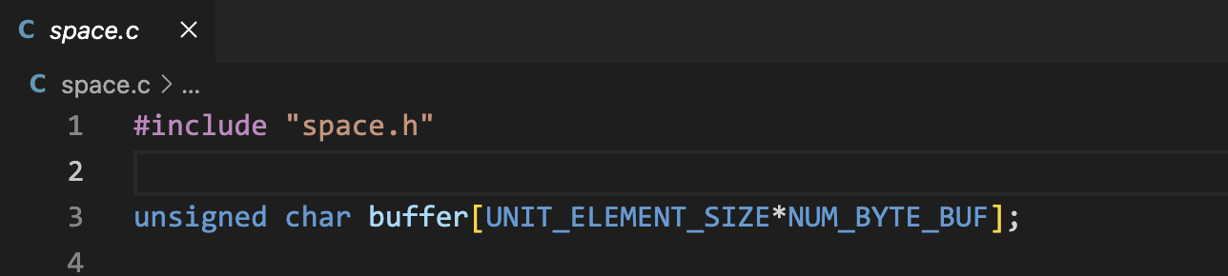

Slide 3
Design your program flow by yourselves
You should also deliver a PDF to briefly describe the designed program flow

