Slide 1



Real-Time
AI-Powered Health Coach for Diabetes

Slide 2


Ashna Ali Sai Kiran Basetty Sreevardhan Reddy Soma Venkata Sai Veeramalla
Who We Are…..?
DATA DIVERS

Slide 3
Problem Statement
Why this…?
Challenge:
Diabetes is a complex, chronic disease with multiple forms (Type 2, prediabetes, gestational) and requires early detection for effective management.
Existing Gaps:
Current models overlook real-time glucose data and face issues with imbalanced datasets, which weakens predictive accuracy.
Our Approach:
We integrate structured health data (age, BMI, blood pressure) with continuous glucose monitoring (CGM) time-series data, leveraging advanced ML techniques like SMOTE, RFE, and LIME for a more accurate and interpretable model.

Slide 4

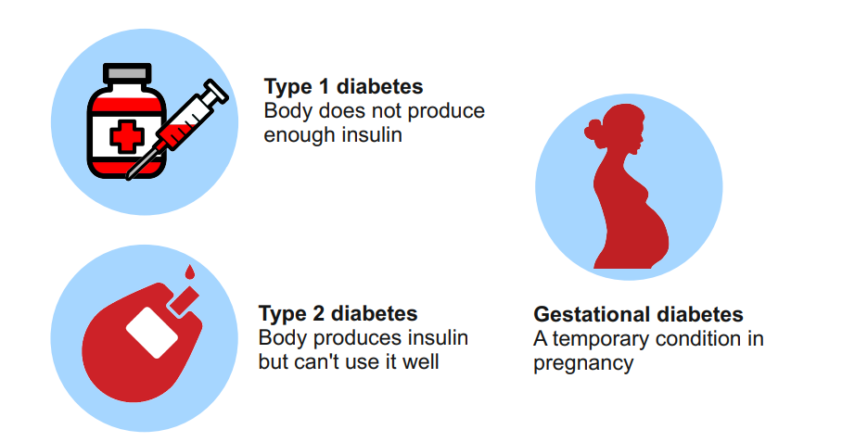
Understanding Diabetes Types
There are primarily two types of diabetes:
Type 1 :
Type 1 is often diagnosed in children and requires lifelong insulin therapy.
Type 2:
Type 2 is more common and linked to lifestyle factors.
And also, there are other kinds of diabetes.
Prediabetes:
It was initial stage of diabetes,
Gestational diabetes:
Usually seen during in pregnancy and resolves after childbirth.
Understanding these types is crucial for taking preventive measures before becoming Diabetic.

Slide 5
Project Overview
This project aims to address the challenges of accurate diabetes prediction by developing a machine learning model that integrates Multimodal health data, including Demographic information, Biometric measurements, and Continuous Glucose Monitoring (CGM) Time-Series Data. By combining the strengths of techniques such as SMOTE for handling data imbalance, Recursive Feature Elimination (RFE) for feature selection, and LIME for interpretability, this model seeks to provide a more accurate and interpretable prediction of prediabetes, Type 2 diabetes, and gestational diabetes. The integration of these diverse data sources presents a unique opportunity to improve the prediction accuracy, offering a more comprehensive view of factors contributing to diabetes risk than single-source models can achieve.

Slide 6

Data Collection
Collected different types of data from resources like Kaggle, Github
Structured Data:
Kaggle:
https://www.kaggle.com/datasets/alexteboul/diabetes-health-indicators-dataset
2. https://www.kaggle.com/datasets/iammustafatz/diabetes-prediction-dataset.
3. https://www.kaggle.com/datasets/ishandutta/early-stage-diabetes-risk-prediction- dataset.
4. https://www.kaggle.com/datasets/uciml/pima-indians-diabetes-database.
Github:
1. https://github.com/steve-zeyu-zhang/DiabetesDiagnosis.
Time Series:
Kaggle:
1.https://www.kaggle.com/datasets/merinda33/mage-interpolation/data
Github:
1.https://github.com/irinagain/Awesome-CGM?tab=readme-ov-file.
.

Slide 7
Preliminary Analysis
Data Preprocessing and Visualization:
Handle missing values, outliers and encoding of categorical features to prepare for data.
Graphically represent how demographic, biometric and cgm data influence diabetes predictions.
Model Integration and Deployment:
Confirm Streamlit’s user interface seamlessly interacts with backend model ensuring smooth data submission.Test the integration of mongo DB with the model to guarantee efficient data retrieval and prediction storage processes.
Model Performance and Evaluation:
Conduct cross-validation and hyper parameter tuning to optimize model performance and enhance predictive accuracy.
Data Retrieval and Integration:
Retrieve subsets of data from MongoDB for preliminary analysis.
Implement efficient methods for aligning structured and time-series data, ensuring they are correctly linked for model training and prediction.

Slide 8
Preliminary Analysis
Data Overview and Quality Check:
Examine the Mongo DB repository that stores user demographic , lifestyle and biometric data.Check the dataset for missing values, inconsistencies and duplicates across the data.
Documentation and Logging:
Maintain comprehensive documentation of all the system components including data preprocessing steps, model training and user interactions with stream lit interface.
Security and Privacy Check:
Ensure compliance with data security standards by encrypting data transfers and implementing access controls within the MongoDB database.

Slide 9
Methodologies
Data Collection and Preprocessing:
Collected data from sources like GitHub repo’s ,Kaggle.
Preprocessing Steps:
Cleaning and handling missing values, Normalize numeric data using standard scaling techniques, One hot encode categorical variables, Handle data imbalances using SMOTE to balance representation of pre-diabetes, type-2 and gestational diabetes classes.
Feature Extraction and Selection:
Considering the features for model is most important thing and for that feature selection we used “Feature Engineering” for extracting relevant features from data, And Recursive Feature Elimination (RFE) used for reducing complexity and enchance the model performance.
Model Training and Validation:
Model is developed using the Deep learning tool like (TensorFlow, Keras) to train on combined structures and time-series data. Use cross-validation techniques and metrics such as ROC-AUC, F1-score, and confusion matrices to evaluate model performance.

Slide 10
Methodologies
Model Fine-Tuning and Optimization:
Hyperparameter Tuning: Optimize model parameters (learning rate, number of layers) to improve accuracy, sensitivity, and specificity.
Interpretability Enhancement: Use Local Interpretable Model-agnostic Explanations (LIME) to make the model predictions transparent and understandable, aiding in trust and adoption by healthcare providers.
Integration and Deployment:
Streamlit Web Application: Integrate the trained model into a user-friendly web application, allowing real-time interaction for healthcare providers and individuals.
Database Integration: Securely store user inputs, predictions, and CGM data in MongoDB, enabling seamless data retrieval and real-time updates.

Slide 11
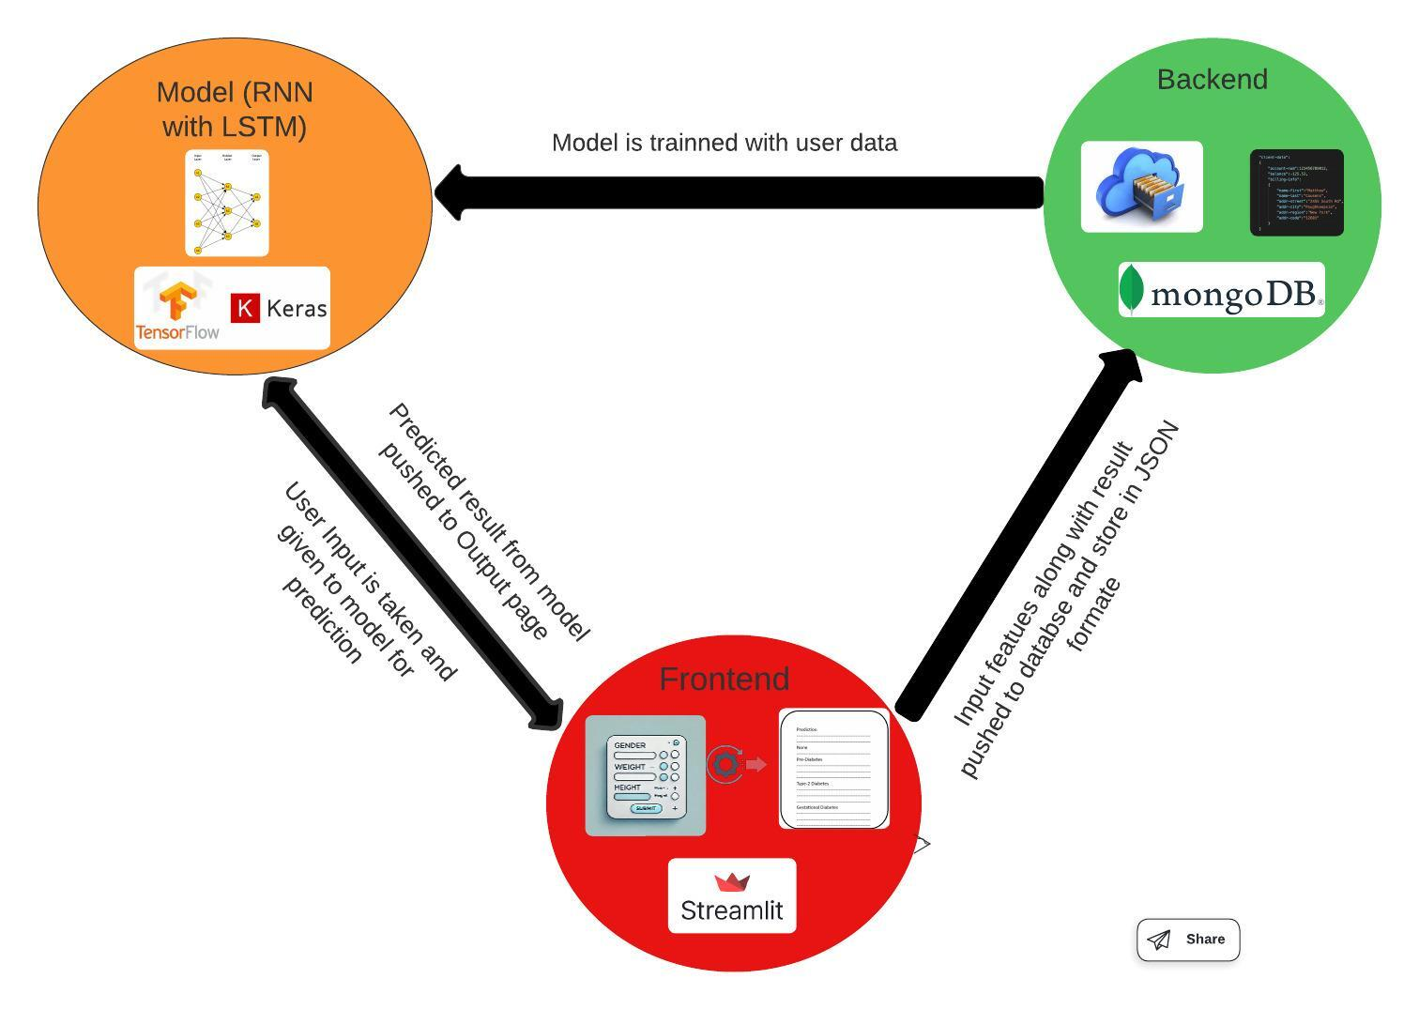
ARCHITECTURE DIAGRAM

Slide 12
INTEGRATION OF DATA WITH MODELS
Integrating demographic (age, gender) and biometric data (BMI, blood pressure) using a seamless data pipeline. This data forms the foundation for assessing individual risk factors for diabetes.
Incorporate real-time glucose readings from CGM devices, which provide critical insights into glucose fluctuations and patterns.
Create a robust framework to synchronize structured demographic and biometric data with CGM time-series data.

Slide 13
INTEGRATION OF DATA WITH MODELS
This integration allows the model to process comprehensive data inputs holistically, improving predictive accuracy.
Combine structured data models and time-series models using an ensemble approach, ensuring that each data type contributes effectively to the final prediction.
Use Local Interpretable Model-agnostic Explanations (LIME) to integrate interpretability into the predictive process, ensuring healthcare providers understand how specific data points influence predictions.

Slide 14
CONCLUSION
This project successfully integrates advanced machine learning techniques with real-time data inputs to enhance the prediction of pre-diabetes, Type 2 diabetes, and gestational diabetes. By combining demographic, biometric, and CGM data in a user-friendly application, the model provides personalized and accurate predictions that empower healthcare providers and individuals to make informed decisions.
Our approach addresses key limitations in current diabetes prediction methods, paving the way for more effective and early interventions, ultimately contributing to better diabetes management and improved patient outcomes.

Slide 15
Thank You...!
Team Data Divers
Collaborate, Innovate, Deliver

