Slide 1
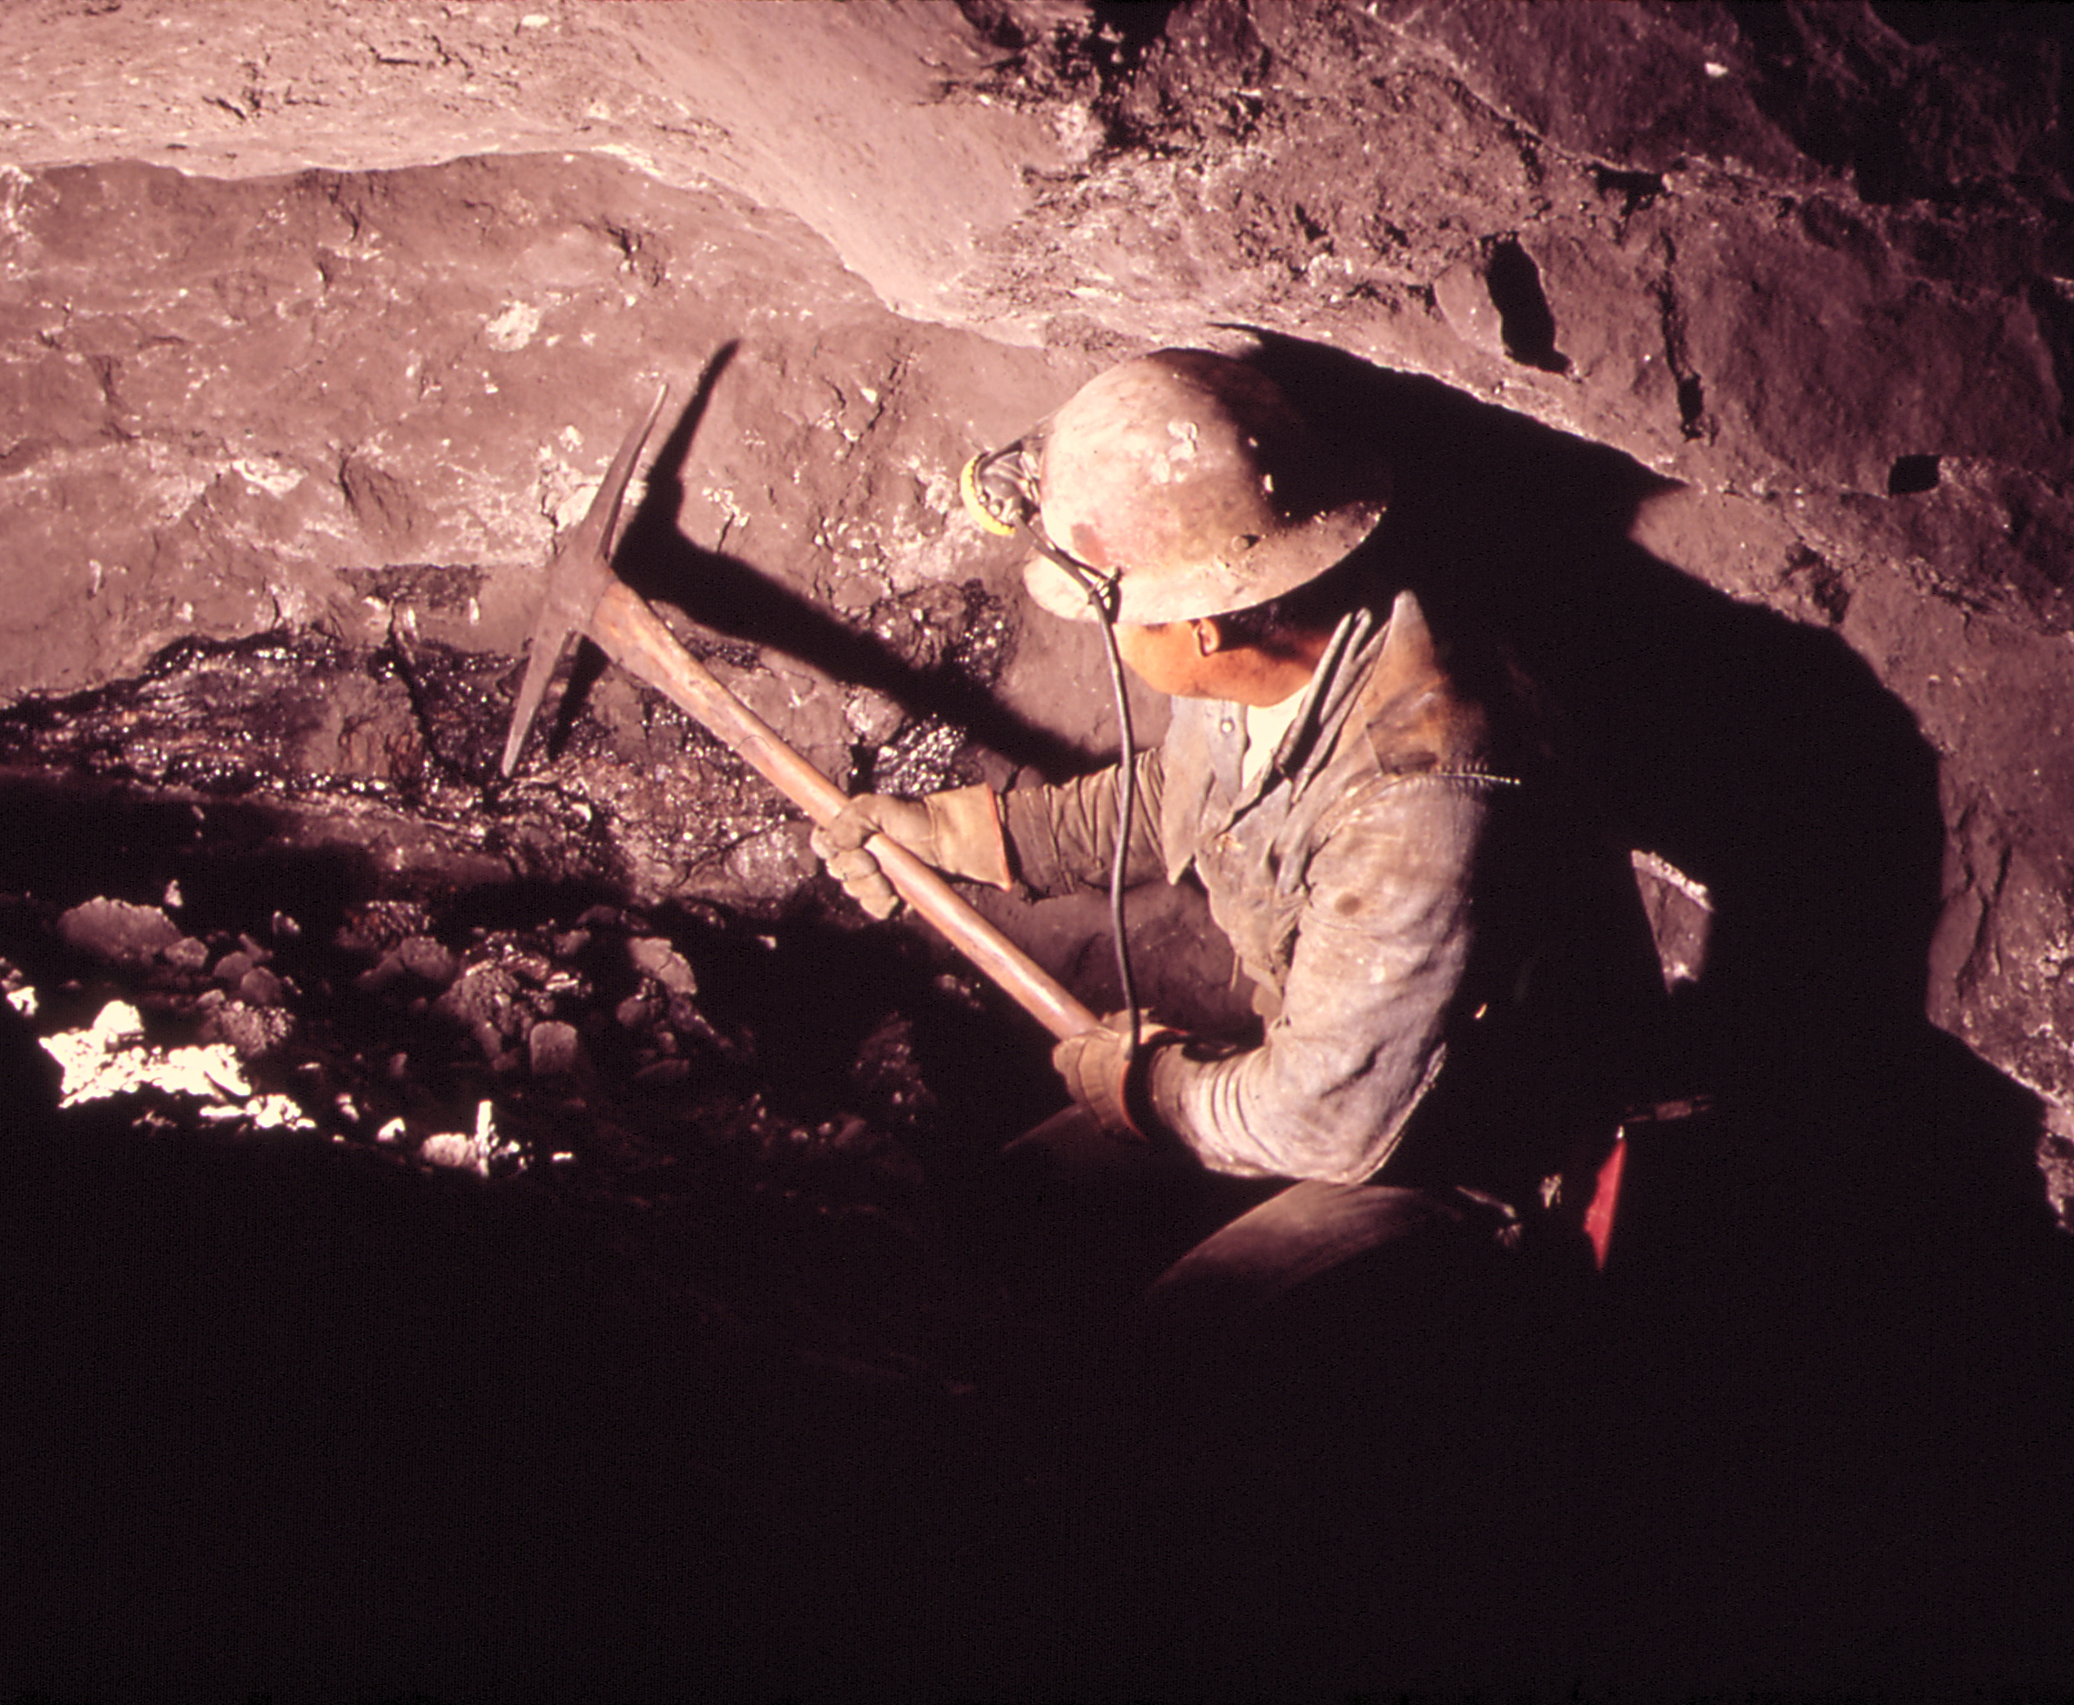
Mining Worker Safety Helmet: IoT-Based Solution for Enhanced Safety
Using ESP32 and Arduino Uno for Improved Monitoring and Alerts
Ashna Ali
Praveen Kumar Reddy Kadapala
Aishwarya Musuku
Charitha Darapaneni
Ankitha Srirama Reddy
Nikhilesh Chintala

Slide 2
Agenda
IoT System Architecture and Wiring
Backend API and Frontend Dashboard
Demo of Alerts

Slide 3
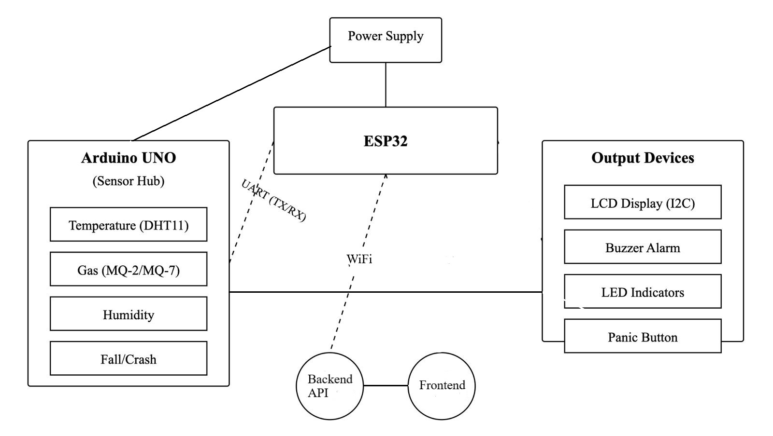
System Architecture

Slide 4
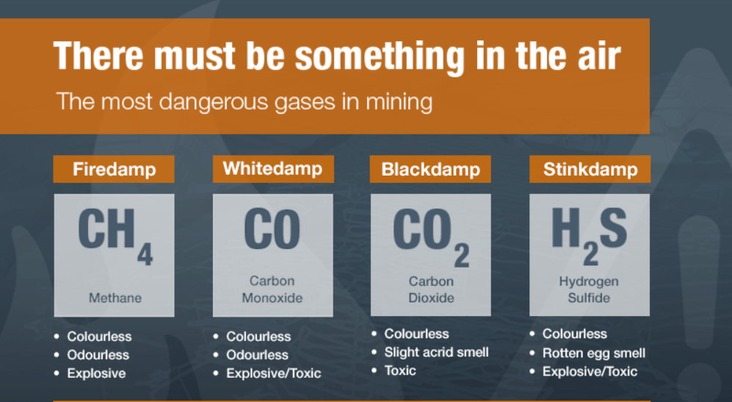
Introduction
Mining environments pose significant risks including exposure to toxic gases, extreme temperatures, and structural collapses
This project aims to develop an IoT-based helmet that ensures real-time monitoring and emergency alerts to protect miners

Slide 5
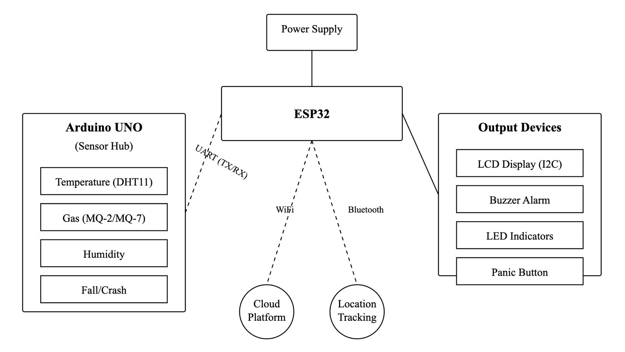
System Overview
The system uses ESP32 as the main microcontroller for data processing and communication. An optional Arduino Uno board can be used as a sensor hub
Real-time data from environmental sensors is processed and transmitted wirelessly to a monitoring system

Slide 6
Hardware Components
ESP32 microcontroller for processing and Wi-Fi/Bluetooth communication
Sensors such as gas and temperature sensors, along with an LCD display, panic button, buzzer and LEDs for alerts
The Arduino Uno may be used to read and preprocess sensor data before sending it to the ESP32

Slide 7






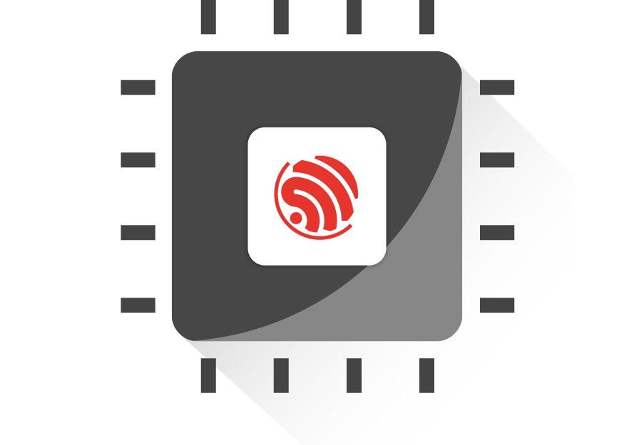
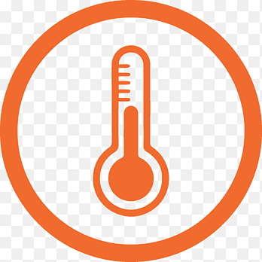
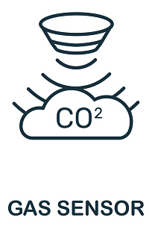
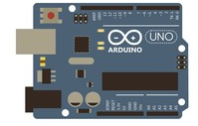
Detailed Connections
Connection
The gas and temperature sensors are connected directly to the ESP32's analog and digital pins
The LCD display interfaces via I2C, and the panic button, buzzer, and LEDs connect to GPIO pins for feedback
Optional: The Arduino Uno reads sensor data and send it to the ESP32 through UART
Data Transfer
Optional Data Transfer
Optional Connection

Slide 8
Communciation Strategy
The ESP32 transmits data to the central system (web application) using WiFi and supports Bluetooth for potential location tracking
Emergency alerts are activated by the panic button, triggering the ESP32 to send immediate alerts

Slide 9
Benefits and Advantages
ESP32 provides integrated WiFi and Bluetooth, simplifying communication
High processing power enables real-time monitoring, enhancing miner safety
The modular design (with using the Arduino Uno) offers scalability for larger operations

Slide 10
Challenges and Solutions
Challenges include maintaining reliable signal transmission and managing power consumption
Solutions: ESP32's dual mode communication and deep-sleep mode for power savings

Slide 11
Expected Outcomes
Continuous monitoring of gas levels and temperature provides real-time safety
1
Immediate alerts via buzzer and LEDs notify workers of hazards
2
Location tracking can be enabled using Bluetooth
3

Slide 12
Conclusion and Future Prospects
The system ensures safety through reliable monitoring and communication. ESP32 simplifies the design with built in Wi-Fi/Bluetooth
Future enhancements could include additional sensors and GPS for surface tracking

Slide 13
Thank you

