Slide 1
面內磁場下1T相二碲化鉑約瑟夫森接面之電流－相位關係研究
Study of the Current–Phase Relation of a 1T-PtTe$​_{2}$ Josephson Junction Under an In-Plane Magnetic Field Student: Tao-Yi Hsu (徐道宜) Advisor: Dr. Kuei-Lin Chiu (邱奎霖 博士)

Slide 2
Introduction
Outline

Slide 3
Introduction
Research motivation
1T-PtTe$​_{2}$ (Type-II Dirac)
Theory
Josephson effect & CPR
Josephson diode effect

Slide 4
Research Motivation

Slide 5
Topological SC
Type-II Dirac semimetal PtTe$​_{2}$ proximitized by a superconductor
Platform for novel quantum transport (surface/edge states)
CPR
Direct probe of junction physics beyond simple $sinϕ$
Harmonics encode transparency / Andreev bound states

Slide 6
1T-PtTe$​_{2}$: A Type-II Dirac Semimetal

Slide 7
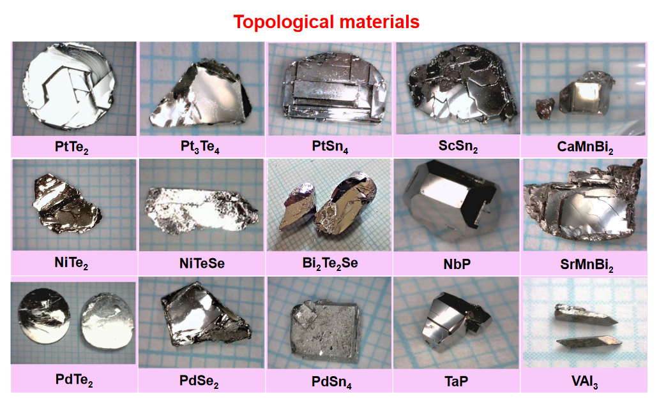
Crystal Structure:
Layered Transition Metal Dichalcogenide (TMD).
CdI$​_{2}$-type trigonal structure ($P\overset{‾}{3}m1$).
Te-Pt-Te tri-layers bound by van der Waals forces.
Electronic Properties:
Type-II Dirac Fermions: Lorentz-invariance violating tilted Dirac cones.
High conductivity and potential topological surface states (TSS).
Crystal structure of PtTe$​_{2}$.

Slide 8
Theoretical Background
Josephson Effect & Current–Phase Relation

Slide 9
Josephson relations
DC: $I_{s}=I_{c}sinϕ$ (ideal tunnel junction)
AC: $\dot{ϕ}=\frac{2e}{ℏ}V$
Beyond sinusoidal CPR
High transparency → skewed CPR
Harmonics: Iϕ=n​Insinnϕ+δn
Access via asymmetric SQUID readout

Slide 10
Josephson Diode Effect (Concept)

Slide 11
Definition
Non‑reciprocal critical current $I_{c}^{+}≠\left|I_{c}^{−}\right|$
Superconducting rectification without Joule heating
Typical ingredients
Broken inversion symmetry + broken time‑reversal symmetry
Often tuned by $B_{∥}$ with strong spin–orbit coupling

Slide 12
Theoretical Model: Rashba + Zeeman
Rashba + Zeeman: Why We Care
Platform: 2D electron system at an interface (e.g. PtTe$​_{2}$ surface / S–PtTe$​_{2}$ junction)
Key ingredients:
Strong spin–orbit coupling (SOC) → Rashba effect
External magnetic field → Zeeman effect
Combined effect:
Generates helical spin–momentum locking + spin splitting
Breaks inversion and time-reversal symmetries → allows finite-momentum pairing and Josephson diode effect (JDE)
Minimal 2D Model (Rashba + Zeeman)
Momentum in plane: $k=\left(k_{x},k_{y}\right)$
Spin Pauli matrices: $σ=\left(σ_{x},σ_{y},σ_{z}\right)$
Total Hamiltonian:
$$H\left(k\right)=\underset{H_{0}}{\underset{⏟}{\frac{ℏ^{2}k^{2}}{2m}−μ}}+\underset{H_{R}}{\underset{⏟}{α_{R}\left(k_{y}σ_{x}−k_{x}σ_{y}\right)}}+\underset{H_{Z}}{\underset{⏟}{1/2gμ_{B}B⋅σ}}.$$
We will discuss:
$H_{0}$: Free 2D electron gas
$H_{R}$: Rashba spin–orbit coupling
$H_{Z}$: Zeeman coupling to external magnetic field
Free 2D Electron Gas ($H_{0}$)
Hamiltonian:
$$H_{0}=\frac{ℏ^{2}k^{2}}{2m}−μ, k^{2}=k_{x}^{2}+k_{y}^{2}.$$
Symmetries:
Time-reversal symmetry (TRS): preserved
Inversion / mirror symmetry (including $z→−z$): preserved if structure is centrosymmetric
Spin SU(2) symmetry: full spin-rotation invariance
In-plane rotational symmetry (if effective mass isotropic): approx. preserved
Physical picture:
Spin-degenerate parabolic bands
No spin–momentum locking; spin and momentum are independent
Rashba Term ($H_{R}$): Origin and Form
Requires structural inversion asymmetry (SIA) + strong SOC
Rashba Hamiltonian:
$$H_{R}=α_{R}\left(σ×k\right)⋅\hat{z}=α_{R}\left(k_{y}σ_{x}−k_{x}σ_{y}\right).$$
Parameters:
$α_{R}$: Rashba coupling strength $∝$ interfacial electric field $E_{z}$
Physical effect:
Spin–momentum locking in the plane:
Spin lies in-plane and perpendicular to momentum
Splits the spin-degenerate Fermi surface into two helically polarized Fermi circles
Rashba: Symmetry Breaking
Breaks structural inversion symmetry (SIA):
Under $z→−z$: interfacial electric field $E_{z}$ changes sign
Rashba coupling $α_{R}$ changes sign → $H_{R}$ is not inversion-invariant
Breaks full spin SU(2) symmetry:
Spin no longer freely rotates; spin orientation is tied to momentum direction
Only combined spin–orbital rotations may remain as approximate symmetries
Preserves time-reversal symmetry (TRS):
Under $T$: $k→−k$, $σ→−σ$
$H_{R}\left(k\right)→H_{R}\left(−k\right)$ → TRS holds
Kramers degeneracy: states at $k$ and $−k$ remain degenerate
Zeeman Term ($H_{Z}$): Origin and Form
External magnetic field $B$ couples to spin:
$$H_{Z}=\frac{1}{2}gμ_{B}B⋅σ=\frac{1}{2}gμ_{B}\left(B_{x}σ_{x}+B_{y}σ_{y}+B_{z}σ_{z}\right).$$
Examples:
In-plane field along $y$: $H_{Z}^{\left(y\right)}=1/2gμ_{B}B_{y}σ_{y}$.
Physical effects:
Spin-splitting of bands
Polarization of spins along $B$
Modifies Fermi surfaces for spin-up and spin-down differently
Zeeman: Symmetry Breaking
Breaks time-reversal symmetry (TRS):
Magnetic field $B$ is odd under time reversal
With $B≠0$, the system is no longer invariant under $T$
Lifts Kramers degeneracy
Reduces spin SU(2) to U(1):
Only spin rotations about the $B$ axis remain symmetric
Spin is preferentially aligned parallel or antiparallel to $B$
Spatial symmetries:
Depending on the crystal, $B$ selects a preferred axis
May break certain rotational or mirror symmetries (e.g. in-plane mirrors) depending on direction of $B$
Rashba + Zeeman Together
Combined Hamiltonian:
$$H\left(k\right)=\frac{ℏ^{2}k^{2}}{2m}−μ+α_{R}\left(k_{y}σ_{x}−k_{x}σ_{y}\right)+\frac{1}{2}gμ_{B}B⋅σ.$$
Symmetry summary:
Inversion symmetry (along $z$): broken by Rashba
Time-reversal symmetry: broken by Zeeman (finite $B$)
Spin SU(2): strongly broken; only residual rotations around special axes
Physical consequences:
Spin texture becomes helical + spin-split
Fermi surfaces for opposite spins are shifted and distorted
This structure is the microscopic origin of:
finite-momentum Cooper pairing ($q≠0$)
$ϕ_{0}$-shifted and second-harmonic CPR
Josephson diode effect (JDE)
Connection to Finite-Momentum Pairing
In presence of Rashba + Zeeman:
Spin–momentum locking: spin orientation tied to $k$
Zeeman shifts spin-split Fermi surfaces in momentum space
Result:
Cooper pairs formed between time-reversed partners no longer centered at $q=0$
Effective pair momentum:
$$q\left(B\right)∝B_{∥},$$
e.g. $q_{x}∝B_{y}$ for certain helical textures
In the Josephson junction:
Additional phase:
$$δ\left(B\right)≃2q\left(B\right)⋅L,$$
Appears in CPR as:
$$I\left(ϕ\right)=I_{1}sinϕ+I_{2}sin\left(2ϕ+δ\right).$$
This is the GL-level description used to model JDE in PtTe$​_{2}$ / NiTe$​_{2}$ junctions.
Symmetry & JDE (Summary)
Two key symmetry breakings for JDE / $ϕ_{0}$-junction:
Inversion symmetry broken → Rashba SOC
Time-reversal symmetry broken → Zeeman field
Rashba + Zeeman together:
Generate helical spin–momentum locking + finite-$q$ pairing
Lead to a CPR containing higher harmonics and phase shifts:
$$I\left(ϕ\right)=I_{1}sinϕ+I_{2}sin\left(2ϕ+δ\right),$$
Allow nonreciprocal critical current:
$$I_{c}^{+}≠\left|I_{c}^{−}\right| ⇒ \text{Josephson diode effect}.$$
Take-home message:
Rashba = inversion breaking + SOC
Zeeman = time-reversal breaking
Combination is the microscopic mechanism for JDE

Slide 13
Experimental Methods
Device Fabrication Flow
Crystal Growth: Self-flux method (provided by Prof. C.S. Lue, NCKU).
Exfoliation: Mechanical exfoliation of PtTe$​_{2}$ flakes onto SiO$​_{2}$/Si substrates.
E-beam Lithography (EBL):
PMMA resist coating.
Pattern definition for contacts and SQUID loops.
Metallization:
Superconducting electrodes: Al (Aluminum) or Nb (Niobium).
In-situ Ar ion milling to ensure transparent interfaces.
E-beam evaporation & Liftoff.
Design: Asymmetric dc-SQUID geometry for CPR retrieval.
Measurement Setup

Slide 14
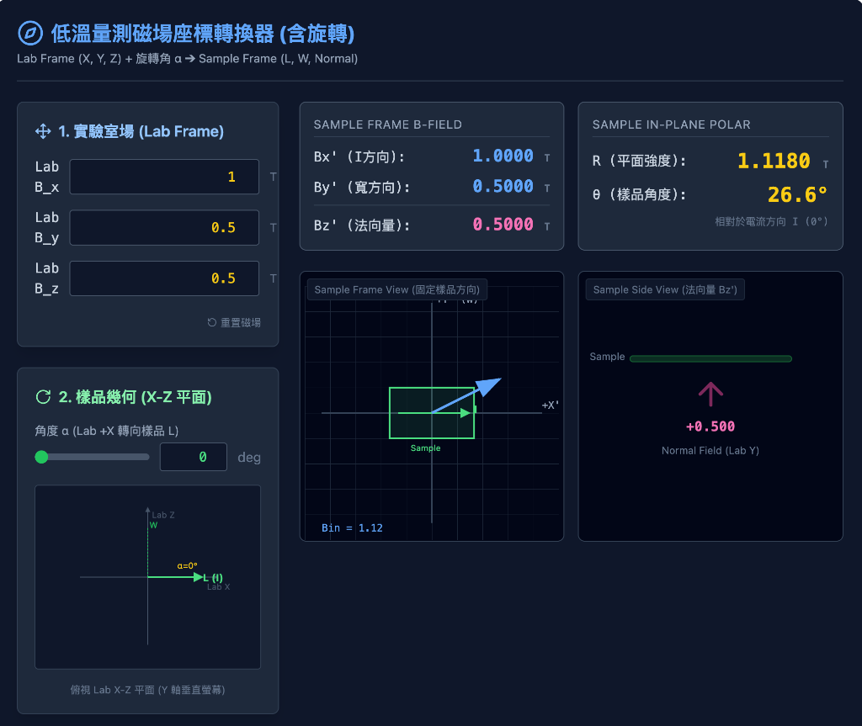
Cryogenic system: Dilution refrigerator (base ~40 mK)
Electronics: low-noise filtering, 4-terminal measurement
Magnetic control: 3-axis vector magnet (precise $B_{∥}$ and $B_{⟂}$ alignment)
Measurement Schematic

Slide 15
Results: Basic Characterization
I-V Characteristics (DC Transport)
Typical IV Curve:
Clear Superconducting branch ($V=0$).
Switching Current ($I_{c}$) and Retrapping Current ($I_{r}$).
Hysteretic behavior (underdamped junction).

Slide 16
Observation:
Sharp transition indicates high-quality junction.
Finite resistance in normal state ($R_{N}$).
Excess Current observed at high bias $→$ High transparency interface.
I-V Curve at Base Temp.

Slide 17
Fraunhofer Pattern (AC Josephson Effect)

Slide 18
Field modulation: $I_{c}$ vs. out-of-plane $B_{⟂}$
Pattern cues
Regular lobes → initially uniform current distribution
Deviations → non-uniformity / phase winding changes
Fraunhofer Pattern

Slide 19
Results: Current-Phase Relation
CPR Retrieval Method
Asymmetric SQUID Technique:
Large junction ($I_{ref}$) // Small junction ($I_{test}$).
$I_{c}\left(Φ_{ext}\right)≈I_{ref}+I_{test}\left(ϕ\right)$.
Assumes $I_{ref}≫I_{test}$ and sinusoidal $I_{ref}\left(ϕ\right)$.
Math Model:
$$I_{s}\left(ϕ\right)=I_{1}sin\left(ϕ\right)+I_{2}sin\left(2ϕ+δ\right)$$
$I_{1}$: Fundamental component (conventional).
$I_{2}$: Second harmonic (4$π$-periodic / ABS).
Measured CPR & Fitting

Slide 20
Key Findings:
Skewed CPR: Deviation from pure sine wave.
High $I_{2}/I_{1}$ ratio: Significant second harmonic component detected.
Indicates presence of highly transparent Andreev Bound States (ABS).
Extracted CPR Waveforms

Slide 21
Results: In-Plane Magnetic Field Effect
Tunable CPR with In-Plane Field

Slide 22
Applying $B_{∥}$ modifies CPR shape
Suggests a phase shift ($ϕ_{0}$) in higher harmonics
Correlates with emergence of the Josephson diode effect
CPR Evolution under In-Plane Field

Slide 23
Josephson Diode Effect (JDE)
Definition: Non-reciprocal critical current ($I_{c}^{+}≠\left|I_{c}^{−}\right|$).
Mechanism:
Inversion symmetry breaking (structural or field-induced).
Time-reversal symmetry breaking ($B$-field).
Finite momentum Cooper pairs?
Result:
Efficiency $η=\frac{I_{c}^{+}−\left|I_{c}^{−}\right|}{I_{c}^{+}+\left|I_{c}^{−}\right|}$.
Tunable by magnetic field angle and magnitude.

Slide 24
Conclusion
Summary
Successful Fabrication:
High-quality 1T-PtTe$​_{2}$ Josephson junctions and SQUIDs realized.
Anomalous CPR:
Observed significant second harmonic ($I_{2}$) contribution.
Direct evidence of high-transparency transport modes.
Magnetic Tuning:
In-plane magnetic field effectively modulates the CPR and induces Josephson Diode Effect.
Demonstrates potential for tunable superconducting logic and phase batteries.
Future Outlook
Optimization: Improving fabrication yield and interface control.
Material Exploration: Extending to other Weyl/Dirac semimetals.
Quantum Information: Integration into superconducting qubit circuits (e.g., as non-linear inductive elements).

Slide 25
References

