Slide 1
Investigation of Current-Phase Relationship in 1T-Phase Platinum Ditelluride Josephson Junctions under In-Plane Magnetic Field
面內磁場下 1T 相二碲化鉑約瑟夫森接面之電流-相位關係研究 Tao-Yi Hsu (徐道宜)

Slide 2
Introduction
Outline
Introduction
Research Motivation
Type-II Dirac Semimetal (1T-PtTe$​_{2}$)
Theoretical Background
Josephson Effect & CPR
Josephson Diode Effect (JDE)
Experimental Methods
Device Fabrication
Measurement Setup
Results & Discussion
Basic Characterization
Current-Phase Relation (CPR) Analysis
Magnetic Field Dependence
Conclusion
Research Motivation
Emerging Topological Materials:
Integration of Type-II Dirac Semimetals (e.g., PtTe$​_{2}$) with superconductors.
Exploring novel quantum transport phenomena (e.g., topological protection, helical edge states).
Current-Phase Relation (CPR) Physics:
Direct measurement of CPR harmonics ($I\left(ϕ\right)$) beyond standard sinusoidal form.
Understanding the role of superconducting proximity effect in topological materials.
Superconducting Diode Effect:
Investigating non-reciprocal transport ($I_{c}^{+}≠I_{c}^{−}$) in symmetric/asymmetric structures.
Potential for dissipationless superconducting electronics.
1T-PtTe$​_{2}$: A Type-II Dirac Semimetal

Slide 3
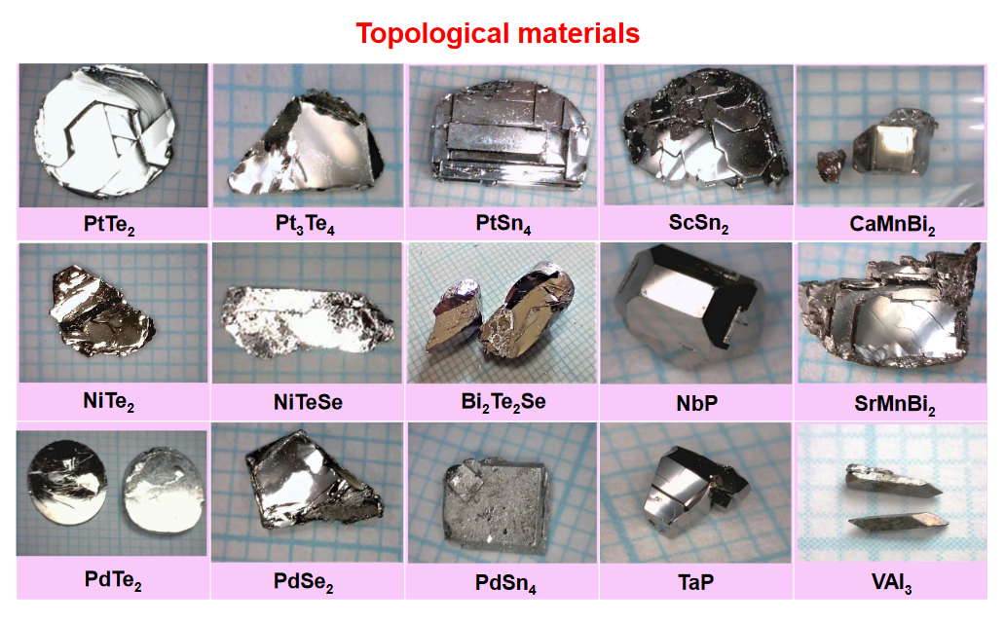
Crystal Structure:
Layered Transition Metal Dichalcogenide (TMD).
CdI$​_{2}$-type trigonal structure ($P\overset{‾}{3}m1$).
Te-Pt-Te tri-layers bound by van der Waals forces.
Electronic Properties:
Type-II Dirac Fermions: Lorentz-invariance violating tilted Dirac cones.
High conductivity and potential topological surface states (TSS).
Crystal structure of PtTe$​_{2}$.

Slide 4
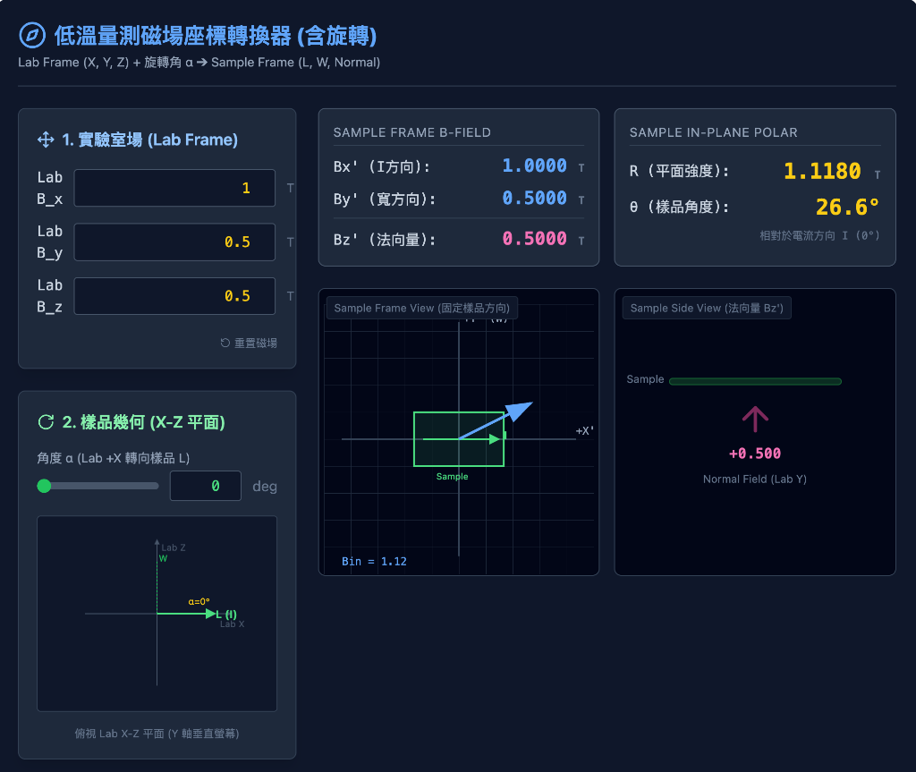
Experimental Methods
Device Fabrication Flow
Crystal Growth: Self-flux method (provided by Prof. C.S. Lue, NCKU).
Exfoliation: Mechanical exfoliation of PtTe$​_{2}$ flakes onto SiO$​_{2}$/Si substrates.
E-beam Lithography (EBL):
PMMA resist coating.
Pattern definition for contacts and SQUID loops.
Metallization:
Superconducting electrodes: Al (Aluminum) or Nb (Niobium).
In-situ Ar ion milling to ensure transparent interfaces.
E-beam evaporation & Liftoff.
Design: Asymmetric dc-SQUID geometry for CPR retrieval.
Measurement Setup
Cryogenic System: Dilution Refrigerator (DR)
Base temperature: ~40 mK.
Electronics:
Low-noise filtering.
4-terminal measurement (Current bias, Voltage readout).
Magnetic Field Control:
3-axis vector magnet.
Precision alignment of In-plane field ($B_{∥}$) and Perpendicular field ($B_{⟂}$).
Measurement Schematic

Slide 5
Results: Basic Characterization
I-V Characteristics (DC Transport)
Typical IV Curve:
Clear Superconducting branch ($V=0$).
Switching Current ($I_{c}$) and Retrapping Current ($I_{r}$).
Hysteretic behavior (underdamped junction).

Slide 6
Observation:
Sharp transition indicates high-quality junction.
Finite resistance in normal state ($R_{N}$).
Excess Current observed at high bias $→$ High transparency interface.
I-V Curve at Base Temp.

Slide 7
Fraunhofer Pattern (AC Josephson Effect)
Magnetic Field Modulation:
$I_{c}$ vs. $B_{⟂}$ (Out-of-plane field).
Pattern Analysis:
Regular oscillation indicates uniform current distribution initially.
Deviations suggest non-uniformity or phase winding changes.
Fraunhofer Pattern

Slide 8
Results: Current-Phase Relation
CPR Retrieval Method
Asymmetric SQUID Technique:
Large junction ($I_{ref}$) // Small junction ($I_{test}$).
$I_{c}\left(Φ_{ext}\right)≈I_{ref}+I_{test}\left(ϕ\right)$.
Assumes $I_{ref}≫I_{test}$ and sinusoidal $I_{ref}\left(ϕ\right)$.
Math Model:
$$I_{s}\left(ϕ\right)=I_{1}sin\left(ϕ\right)+I_{2}sin\left(2ϕ+δ\right)$$
$I_{1}$: Fundamental component (conventional).
$I_{2}$: Second harmonic (4$π$-periodic / ABS).
Measured CPR & Fitting

Slide 9
Key Findings:
Skewed CPR: Deviation from pure sine wave.
High $I_{2}/I_{1}$ ratio: Significant second harmonic component detected.
Indicates presence of highly transparent Andreev Bound States (ABS).
Extracted CPR Waveforms

Slide 10
Results: In-Plane Magnetic Field Effect
Josephson Diode Effect (JDE)
Definition: Non-reciprocal critical current ($I_{c}^{+}≠\left|I_{c}^{−}\right|$).
Mechanism:
Inversion symmetry breaking (structural or field-induced).
Time-reversal symmetry breaking ($B$-field).
Finite momentum Cooper pairs?
Result:
Efficiency $η=\frac{I_{c}^{+}−\left|I_{c}^{−}\right|}{I_{c}^{+}+\left|I_{c}^{−}\right|}$.
Tunable by magnetic field angle and magnitude.
Tunable CPR with In-Plane Field
Observation:
Applying $B_{∥}$ modifies the CPR shape.
Induces a phase shift ($ϕ_{0}$) in the second harmonic?
Evidence of Josephson Diode Effect (JDE).
CPR Evolution under In-Plane Field

Slide 11
Conclusion
Summary
Successful Fabrication:
High-quality 1T-PtTe$​_{2}$ Josephson junctions and SQUIDs realized.
Anomalous CPR:
Observed significant second harmonic ($I_{2}$) contribution.
Direct evidence of high-transparency transport modes.
Magnetic Tuning:
In-plane magnetic field effectively modulates the CPR and induces Josephson Diode Effect.
Demonstrates potential for tunable superconducting logic and phase batteries.
Future Outlook
Optimization: Improving fabrication yield and interface control.
Material Exploration: Extending to other Weyl/Dirac semimetals.
Quantum Information: Integration into superconducting qubit circuits (e.g., as non-linear inductive elements).

Slide 12
References

