Slide 1

Investment Proposal for Shruti Suman
Strategic plan to maximize growth opportunities
Notes:
AI-generated content may be incorrect. ---

Slide 2
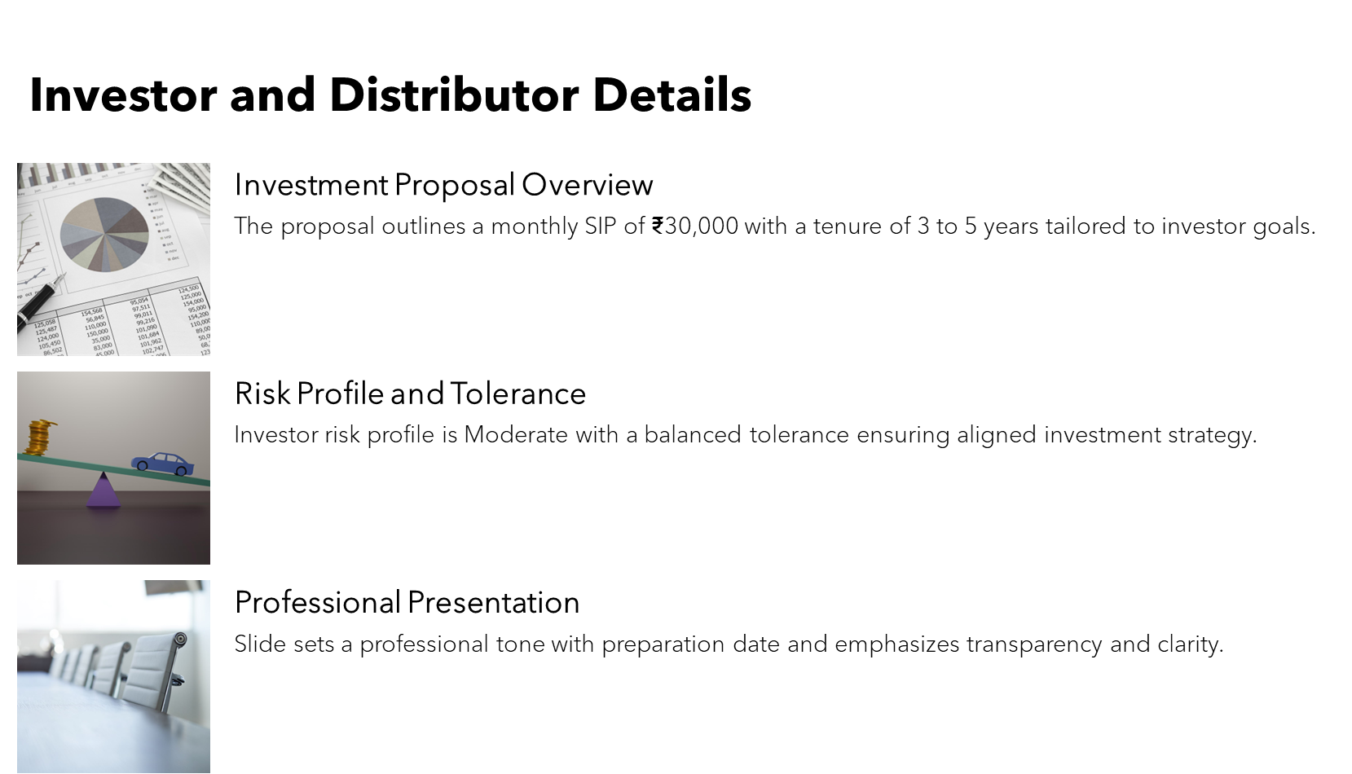
Notes:
This slide introduces the investment proposal prepared for Shruti Suman by Adarsh Shukla. It includes the investor’s key details such as SIP amount of ₹30,000 per month, tenure of 3–5 years, and risk profile marked as Moderate with Balanced tolerance. The cover slide sets the professional tone of the presentation and provides the date of preparation (29 December 2025). It emphasizes that the proposal is tailored to the investor’s financial goals, liquidity preferences, and tax considerations, ensuring clarity and transparency from the outset.

Slide 3
Asset Mix & Suggested Allocation
Notes:
Portfolio Structure and Allocation

Slide 4
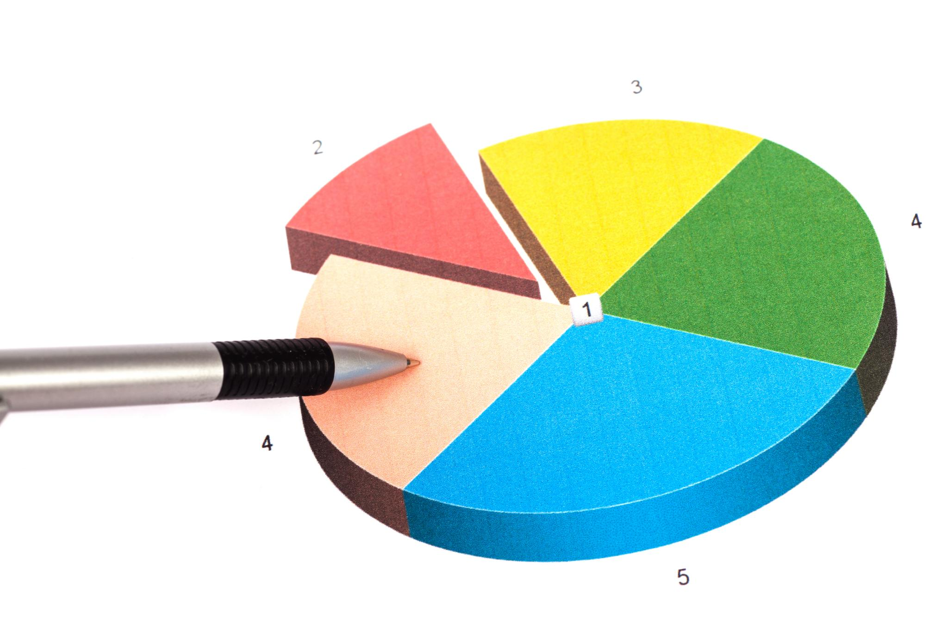
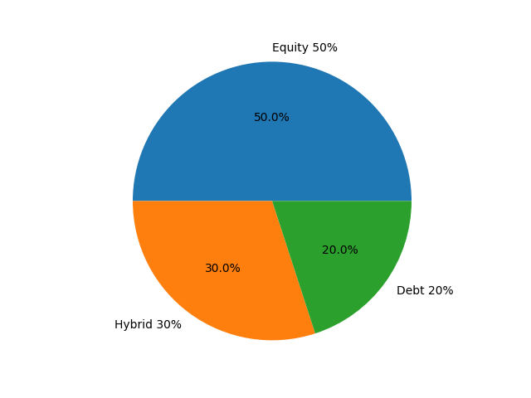
Portfolio Structure and Allocation
Asset Mix Overview
Recommended portfolio allocation is 50% equity, 30% hybrid, and 20% debt based on tenure and risk appetite.
Fund Details and Weighting
Suggested funds include Axis Liquid Fund (20%), ICICI Balanced Advantage Fund (30%), Parag Parikh Flexi Cap Fund (25%), and HDFC Mid-Cap Fund (25%).
Investment Roles Explained
Funds provide liquidity and stability, dynamic allocation, diversified equity exposure, and mid-cap growth potential.
Notes:
This slide presents the recommended asset mix based on the investor’s tenure and risk appetite: Equity 50%, Hybrid 30%, and Debt 20%. It lists all suggested funds with their respective weights and categories: Axis Liquid Fund – Direct Growth (Debt/Liquid) at 20%, ICICI Prudential Balanced Advantage Fund — Regular Growth (Hybrid/Dynamic AA) at 30%, Parag Parikh Flexi Cap Fund – Direct Growth (Equity/Flexi Cap) at 25%, and HDFC Mid‑Cap Fund – Direct Growth (Equity/Mid Cap) at 25%. This allocation strategy optimizes growth potential while mitigating volatility over the 3–5 year horizon. Each fund serves a distinct role: liquidity and stability, dynamic allocation, diversified equity exposure, and mid‑cap growth.

Slide 5
Fund Analysis Slides
Notes:
Axis Liquid Fund – Direct Growth, ICICI Prudential Balanced Advantage Fund — Regular Growth, Parag Parikh Flexi Cap Fund – Direct Growth, HDFC Mid‑Cap Fund – Direct Growth

Slide 6

Axis Liquid Fund – Direct Growth
Fund Performance Metrics
The fund's 3-year CAGR is 7.08%, slightly outperforming the category at 7.02%, indicating consistent returns.
Risk and Volatility Indicators
Beta of 0.38 and standard deviation around 0.80% reflect low volatility and moderate risk for investors.
Liquidity and Expense Profile
High liquidity with exit-load reducing to zero after day 7 and low expense ratio of 0.24% enhance investor appeal.
Investment Rationale
Designed as a high-liquidity sleeve to protect near-term obligations and mitigate equity-cycle risk effectively.
Notes:
This slide provides a detailed analysis of Axis Liquid Fund – Direct Growth. Key metrics include: 3Y CAGR (fund vs category): 7.08% vs 7.02%, Sharpe: 3.65, Beta: 0.38, Std. Dev.: ~0.80%, Exit‑load grid: day‑1 0.0070% → day‑7+ 0%, AUM: ₹37,357.87 Cr, Expense: 0.24% (Direct), Alpha: ~1.30, Riskometer: Low to Moderate. Rationale: High‑liquidity sleeve to ring‑fence near‑term obligations and reduce equity‑cycle risk. The table of metrics is formatted professionally with Calibri font, 12pt, and numeric values right-aligned for clarity.

Slide 7
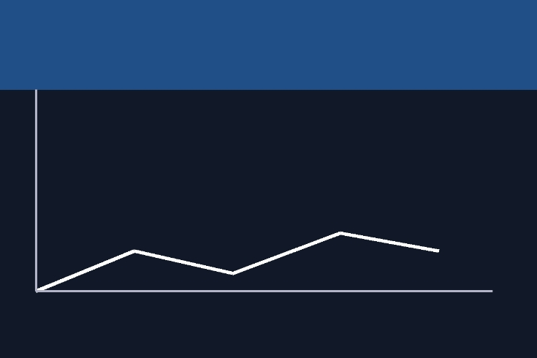
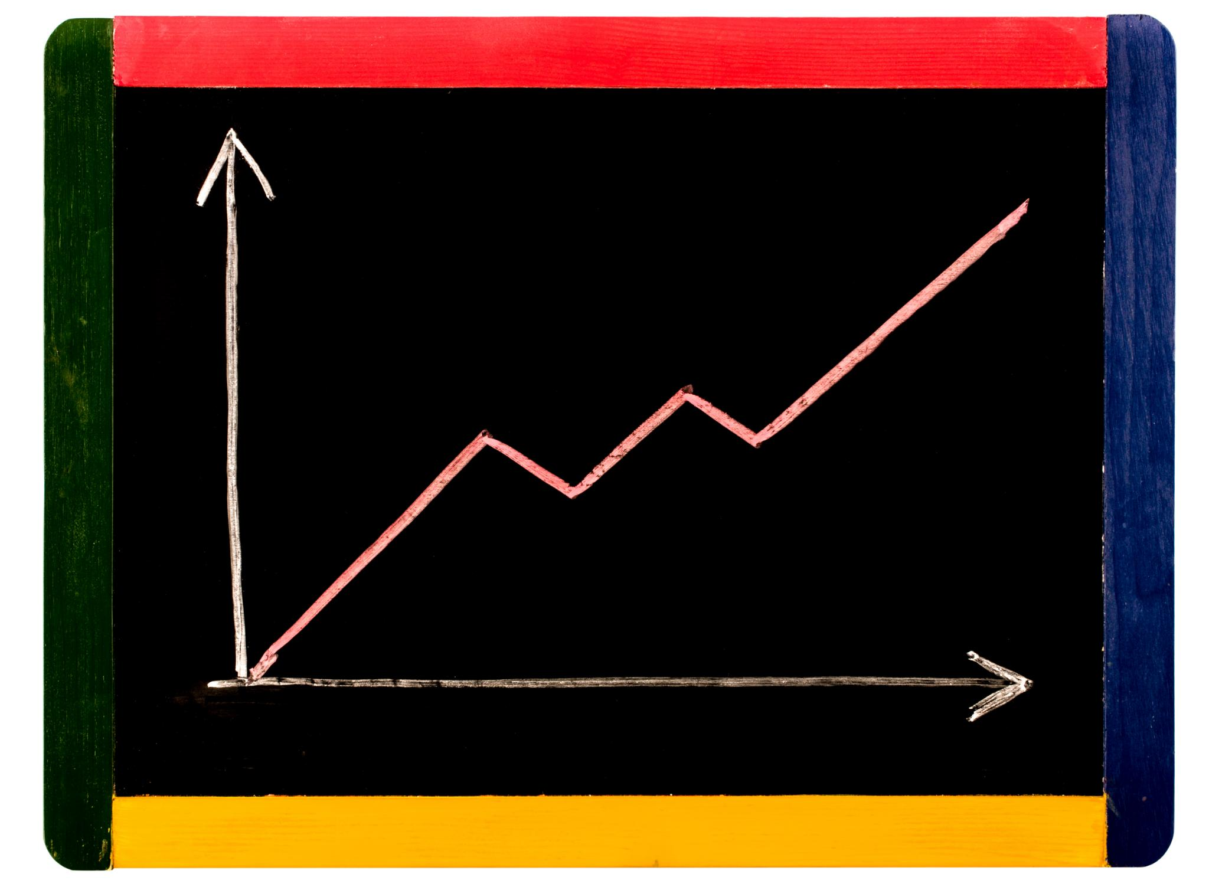
ICICI Prudential Balanced Advantage Fund — Regular Growth
Fund Performance Metrics
The fund shows a strong 3-year CAGR of 13.61% and a Sharpe ratio of 1.19 indicating good risk-adjusted returns.
Risk and Volatility
With a beta of 0.55 and standard deviation of 5.46%, the fund has moderate volatility and a 'Very High' riskometer rating.
Investment Strategy Rationale
Dynamic allocation moderates drawdowns and serves as a stabilizer for investors over 3 to 5 years with balanced risk tolerance.
Notes:
This slide details ICICI Prudential Balanced Advantage Fund — Regular Growth. Metrics include: 3Y CAGR: 13.61% vs 11.96%, Sharpe: 1.19, Beta: 0.55, Std. Dev.: 5.46%, Exit‑load: >30% units: 1% within 1 year, AUM: ₹69,868 Cr, Expense: 1.43% (Regular), Alpha: 3.06%, Riskometer: Very High. Rationale: Dynamic allocation moderates drawdowns; stabiliser for 3–5 yrs and balanced tolerance. The slide uses a fixed-height table for metrics and a bold italic rationale beneath the title.

Slide 8

Parag Parikh Flexi Cap Fund – Direct Growth
Strong Growth Performance
The fund's 3-year CAGR is 23.06%, outperforming the category average of 17.76%, indicating robust returns.
Risk and Volatility Measures
With a Beta of 0.57 and Std. Dev. of 8.41%, the fund exhibits lower volatility and balanced risk compared to peers.
Fund Expense and AUM
Expense ratio stands at 0.63% with assets under management totaling ₹1,29,783 Cr, reflecting significant market presence.
Investment Rationale
The fund is a core flexi-cap option with a strong risk-adjusted profile and very high riskometer rating.
Notes:
This slide covers Parag Parikh Flexi Cap Fund – Direct Growth. Metrics: 3Y CAGR: 23.06% vs 17.76%, Sharpe: 1.55, Beta: 0.57, Std. Dev.: 8.41%, Portfolio P/E: 20.62, Exit‑load: For units >10%: 2% ≤365d; 1% 366–730d, AUM: ₹1,29,783 Cr, Expense: 0.63%, Alpha: 7.42%, Riskometer: Very High. Rationale: Core flexi‑cap with lower beta and strong risk‑adjusted profile vs category. The metrics table is styled with Calibri font and clear alignment for readability.

Slide 9

HDFC Mid‑Cap Fund – Direct Growth
Fund Performance Metrics
HDFC Mid-Cap Fund delivers a strong 3-year CAGR of 26.95%, outperforming benchmark returns.
Risk and Volatility Measures
The fund shows favorable risk metrics including Sharpe ratio of 1.316 and Beta of 0.858, indicating balanced risk.
Fund Size and Expenses
With an AUM of ₹92,168.85 Cr and expense ratio of 1.36%, the fund offers scale with reasonable costs.
Investment Rationale
Quality-biased mid-cap strategy with prudent sizing, suitable for a 3 to 5 year investment horizon.
Notes:
This slide presents HDFC Mid‑Cap Fund – Direct Growth. Metrics: 3Y CAGR: 26.95% vs 24.74%, Sharpe: 1.316, Beta: 0.858, Std. Dev.: 13.847%, Exit‑load: 1% ≤365 days; Nil thereafter, AUM: ₹92,168.85 Cr, Expense: 1.36%, Alpha: 4.77%, Riskometer: Very High. Rationale: Quality‑biased mid‑cap engine; strong risk metrics; prudent sizing for 3–5 yr horizon. The slide maintains professional formatting with a fixed-height table and rationale in bold italic beneath the title.

Slide 10
Key Metrics & Compliance Notes
Notes:
Understanding Metrics and Regulatory Guidelines

Slide 11
Key metrics of all funds
Metrics related to funds | Axis Liquid Fund – Direct | ICICI Prudential BAF – Regular | Parag Parikh Flexi Cap – Direct | HDFC Mid‑Cap – Direct
CAGR (3Y) | 7.08% | 13.61% | 23.06% | 26.95%
Sharpe | 3.65 | 1.19 | 1.55 | 1.316
Beta | 0.38 | 0.55 | 0.57 | 0.858
Expense | 0.24% | 1.43% | 0.63% | 1.36%
AUM (₹ Cr) | 37,357.87 | 69,868 | 1,29,783 | 92,168.85
Exit‑load | Day‑1 0.007% → Day‑7+ 0% | >30% units: 1% within 1 year | 2% ≤365d; 1% 366–730d (for units >10%) | 1% ≤365 days; Nil thereafter

Slide 12

Understanding Metrics and Regulatory Guidelines
Performance and Risk Metrics
Explains Sharpe ratio, Beta, Standard deviation, Sortino ratio, and rolling returns for fund evaluation.
Risk Categorization
Riskometer categorizes funds from Low to Very High risk, aligning with investor risk profiles.
Regulatory Compliance
SEBI caps exit loads at 3%, with scheme-specific guidelines ensuring investor protection.
Investor Disclaimer
Mutual fund investments carry market risks; past performance may not predict future results.
Notes:
This slide educates the investor on critical performance and risk metrics used in fund evaluation. It explains Sharpe ratio (risk-adjusted returns), Beta (market sensitivity), and Standard deviation (volatility). Sortino ratio focuses on downside risk, while rolling returns assess consistency across time frames. The Riskometer categorizes funds from Low to Very High risk, ensuring alignment with investor profiles. Compliance notes highlight SEBI’s cap on exit loads at 3%, though scheme-specific grids apply. The slide concludes with a disclaimer: “Mutual fund investments are subject to market risks. Past performance may or may not be sustained.” All text is formatted in Calibri 12pt for clarity and professionalism.

