Slide 1
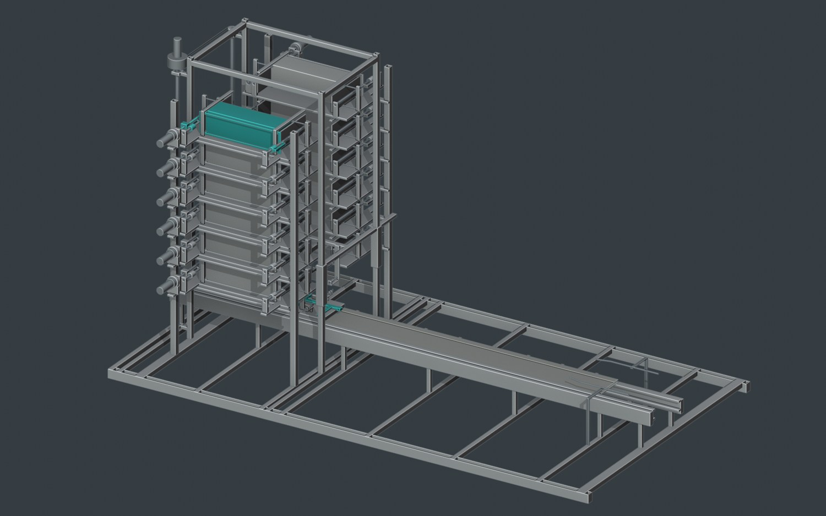
DEPARTMENT OF MECHANICAL ENGINEERING
VOLLEY
A Commanded Electromagnetic CubeSat
Deployment Mechanism
Adityavardhan Mishra · 23070125054
Pratham Chawla · 23070125029
Symbiosis Institute of Technology, Pune
B.Tech · Mechanical Engineering
Guide: Vikas Gulia
Design and Computational Evaluation · October 2026
01 / 31
Notes:
Speaker: Adityavardhan Mishra
Planned duration: 15 seconds
VOLLEY is a commanded electromagnetic CubeSat deployment mechanism. We developed and computationally evaluated a complete storage, transfer, launch and carrier-recovery reference. This presentation explains the engineering, the results and the programme it supports.

Slide 2
OUTLINE
From the delivery problem to the engineering result
Problem and
Mechanism and
Research programme
objectives
evaluation
Development history,
Problem, prior work and
Mechanism, models,
research ecosystem and
design objectives
numerical checks and
next hardware stage
mission results
One connected argument: mission, machine, evidence and development.
Department presentation format; blackbook chapters 1–11
02 / 31
Notes:
Speaker: Adityavardhan Mishra
Planned duration: 15 seconds
We begin with the mission and the design choices, then follow one payload through the machine. We explain the coupled motor and source, geometric and structural checks, and matched mission comparison. We close with the completed study and the next development steps.

Slide 3
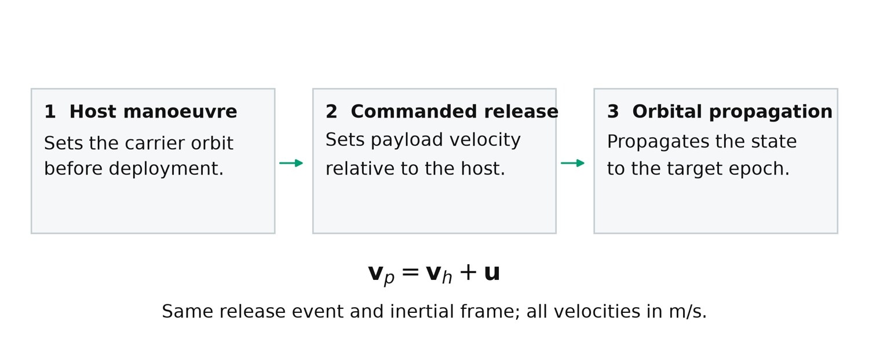
INTRODUCTION
The host moves the orbit. VOLLEY commands departure.
Initial integration audience:
orbital-transfer and rideshare
host operators
POEM inspires reuse of an
orbital platform; Electron Kick
Stage inspires host manoeuvres
Individual departure velocity is an
additional mission variable
Explanatory schematic. Release velocity and host velocity refer to the same event and frame.
Add a controllable relative release state to a manoeuvring host.
Blackbook §§1.1,2.2,8.1; ISRO POEM; Rocket Lab Kick Stage
03 / 31
Notes:
Speaker: Adityavardhan Mishra
Planned duration: 40 seconds
A satellite inherits the host state and a relative release vector at separation. POEM demonstrated a powered, attitude-controlled platform using a spent PS4 stage. Electron’s Kick Stage demonstrated manoeuvres before satellite release. These are architectural precedents. Our evaluated host remains a generic manoeuvring reference, with no approved vehicle accommodation. The service question is whether additional local release control is worth its installed and operating burden.

Slide 4
LITERATURE REVIEW AND RESEARCH GAP
The contribution is the integrated retained-carrier cycle
Prior work / study
Engineering focus
Zhao et al. (2022)
Stacked electromagnetic deployment
Zhao et al. (2025)
Storage and transport interfaces
Feng et al. (2025)
Reachable-domain study
VOLLEY
Integrated custody, finite motor/source, arrest and mission burden
Connect custody, finite motor force, source response, arrest and mission burden.
Blackbook chapter 3; doi:10.3390/rs14174205; doi:10.3390/aerospace12060466; doi:10.1155/ijae/3000765
04 / 31
Notes:
Speaker: Adityavardhan Mishra
Planned duration: 40 seconds
Adjustable electromagnetic separation is established prior art. We credit the published deployers and their experimental evidence. Our contribution is the design-specific integration and evaluation of a reusable retained-carrier architecture. The same represented geometry and mass connect the feeder, finite motor, source-limited shot, structural budget and mission comparison. Results from another apparatus support methods and comparisons; they are not measurements of VOLLEY.

Slide 5
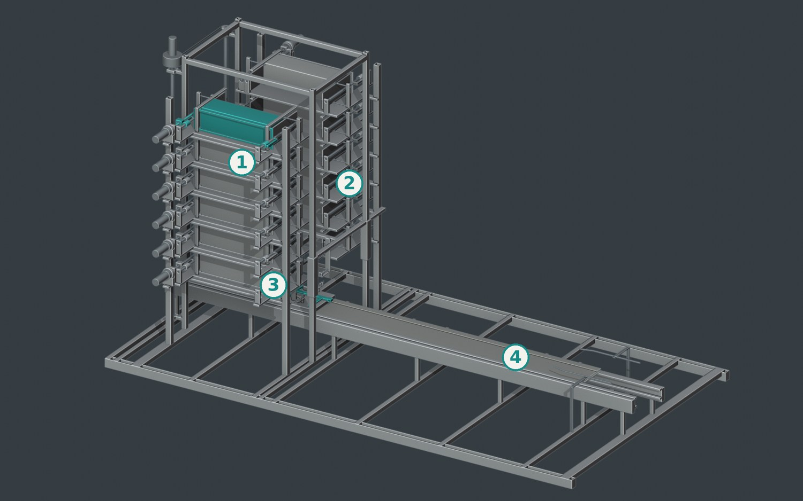
OBJECTIVES AND CONFIGURATION
A complete reference for twelve retained payloads
Two fixed six-cell banks; one
indexed captive pallet
Guided lead-screw feed; positive
carrier capture
Reusable moving-magnet carrier;
fixed three-phase stator
CAD-derived assembly view. The represented payload is a 3U envelope surrogate.
12 × 4 kg
1–3 m/s
2250 mm
3U envelope surrogates
Analysed command cases
Guide-rail allocation
Define a repeatable path from storage to free departure.
Blackbook §§2.1–2.3,5.1
05 / 31
Notes:
Speaker: Adityavardhan Mishra
Planned duration: 45 seconds
The academic reference holds twelve identical four-kilogram 3U surrogates. Their contact envelope is 340.5 by 100 by 100 millimetres. Two fixed six-cell banks feed one captive pallet on an indexed lift. The pallet docks to a retained magnetic carrier. The objectives are continuous custody, finite electromagnetic force, source-coupled release and arrest, and a mission assessment including retained resources. Mixed 1U/3U belongs to the subsequent prototype programme.

Slide 6
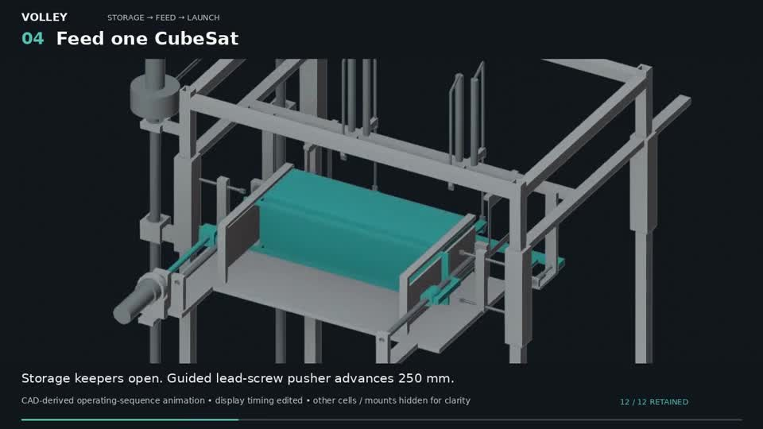
FEEDER MECHANISM
Feed one cell into a supported receiver
Index the receiver to the selected
cell
Open the permitted restraint;
advance the guided pusher
Establish receiving containment;
retract the pusher and close the
cell
CAD-derived operating sequence; display timing edited. Static fallback shown.
The selected guided lead screw transfers the payload into the lift-held pallet.
Blackbook §§5.1–5.4,7.4; Labs feeder selection
06 / 31
Notes:
Speaker: Adityavardhan Mishra
Planned duration: 65 seconds
Follow the payload, not just the actuator. It begins retained in a fixed cell. The lift-held pallet is indexed to the source. A guided positive pusher advances the payload along the restrained path. The receiving end frames and keepers contain it before the pusher retracts and the source closes. The receiver then moves to the carrier. The lead screw offers controlled travel and a defined load path. Seven feeder alternatives were compared in Labs; their scores are engineering judgments, not measured reliability. We retained the runner-up and rejected concepts for traceability.

Slide 7
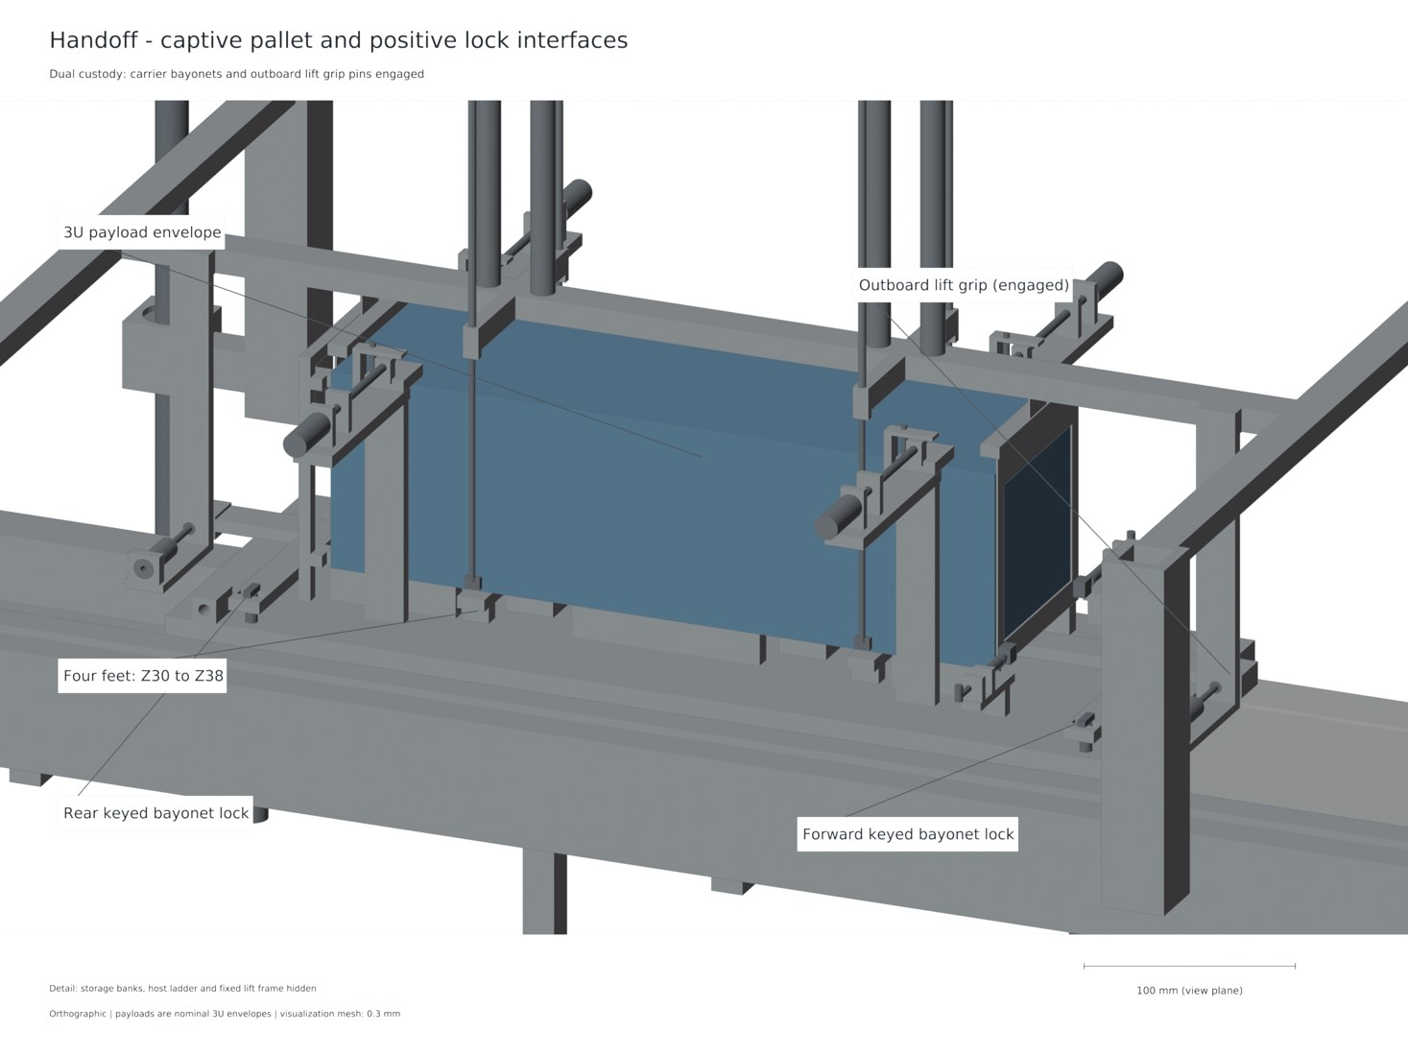
PALLET DOCKING AND RELEASE
Transfer custody before withdrawing support
Carrier capture caps and
independent pins engage
Keyed pallet shafts insert 12 mm
and rotate 90°
Only then do lift grips retract and
the lift clear the launch path
CAD-derived docking state. Modelled capture sequence; not a photographed hardware test.
One captive pallet stays with the reusable carrier through launch and recovery.
Blackbook §§5.2–5.4,9.2
07 / 31
Notes:
Speaker: Adityavardhan Mishra
Planned duration: 55 seconds
Four pallet feet land on the carrier while the lift remains engaged. Capture caps, lock pins and the keyed pallet shafts establish carrier capture. Lift grips retract by 26 millimetres only after the permitted state is established. Before departure, fixed cams open the forekeepers. Electrical braking reduces the unilateral rear-contact reaction to zero; the payload then leaves. The pallet and magnetic carrier remain on the host, arrest under the motor map and return. This separates payload release from carrier recovery.

Slide 8
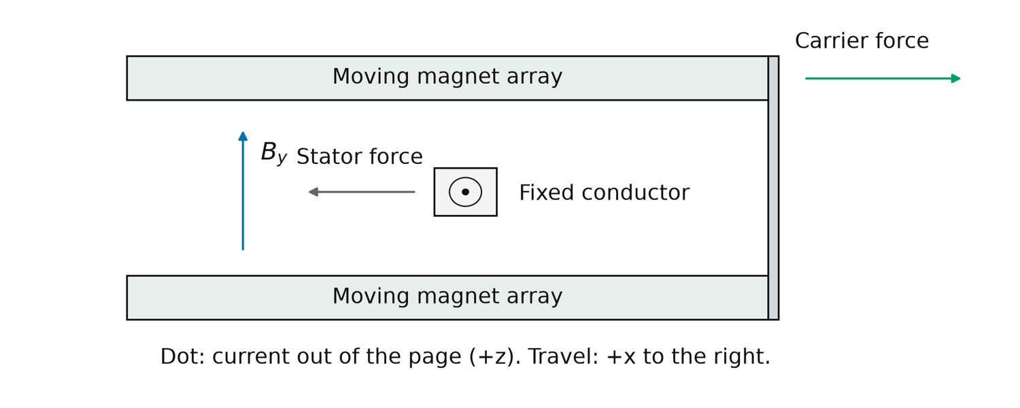
ELECTROMAGNETIC OPERATING PRINCIPLE
Finite geometry sets the motor force
Integrate current density over the
Fₓ = ∫Cu (J × B)ₓ dV
represented copper
Finite magnet blocks, active
conductors and returns enter the
calculation
Launch and arrest use their
corresponding
position-dependent maps
Local force/reaction schematic. The numerical model integrates the represented finite geometry.
≈1.328 N/A
≈1.399 N/A
Active-conductor coefficient
Including represented returns
Opposed permanent-magnet arrays exchange force with a fixed three-phase winding.
Blackbook §§4.2,6.1–6.2
08 / 31
Notes:
Speaker: Adityavardhan Mishra
Planned duration: 55 seconds
The phased fixed winding and moving magnet arrays form a linear synchronous motor. Current density and magnetic field give longitudinal Lorentz force. The equal and opposite reaction acts on the moving array carrier. A periodic wave is useful for initial sizing, but finite end geometry and returns matter to launch and arrest. We report approximately 1.328 newtons per peak phase ampere for active conductors and 1.399 including represented returns. Pratham will now explain how those forces were coupled to a finite source and checked against the mechanical cycle.

Slide 9
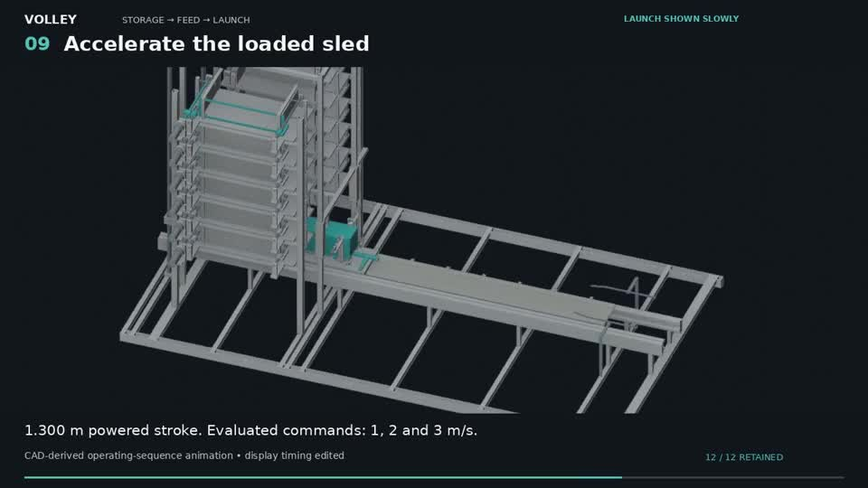
RESEARCH METHODOLOGY
Solve source, current and motion together
Phase voltage, current and
Vq = R Iq + L dIq/dt + Ke(x) v
back-emf
Finite capacitance and ESR
constrain available terminal
power
Rear contact reaches zero; the
retained carrier then arrests
CAD-derived operating sequence; display timing edited. Static fallback shown.
The release event changes the mechanical connectivity of the model.
Blackbook §§4.3–4.4,6.3–6.4
09 / 31
Notes:
Speaker: Pratham Chawla
Planned duration: 60 seconds
The shot calculation couples current dynamics, finite force, source voltage and motion. The phase relation contains winding resistance, inductance and back-emf. The capacitor is not ideal: its internal voltage, ESR and physical power root are evaluated. Requested braking is also constrained by regenerative terminal voltage. Payload and carrier initially interact through compressive rear contact. That contact cannot pull the payload. After detachment, the reduced mechanical system changes and the same finite motor arrests the retained carrier. The audit checks the algebra and limiting logic of an instrumented production solver; it is not an unrelated full physics implementation.

Slide 10
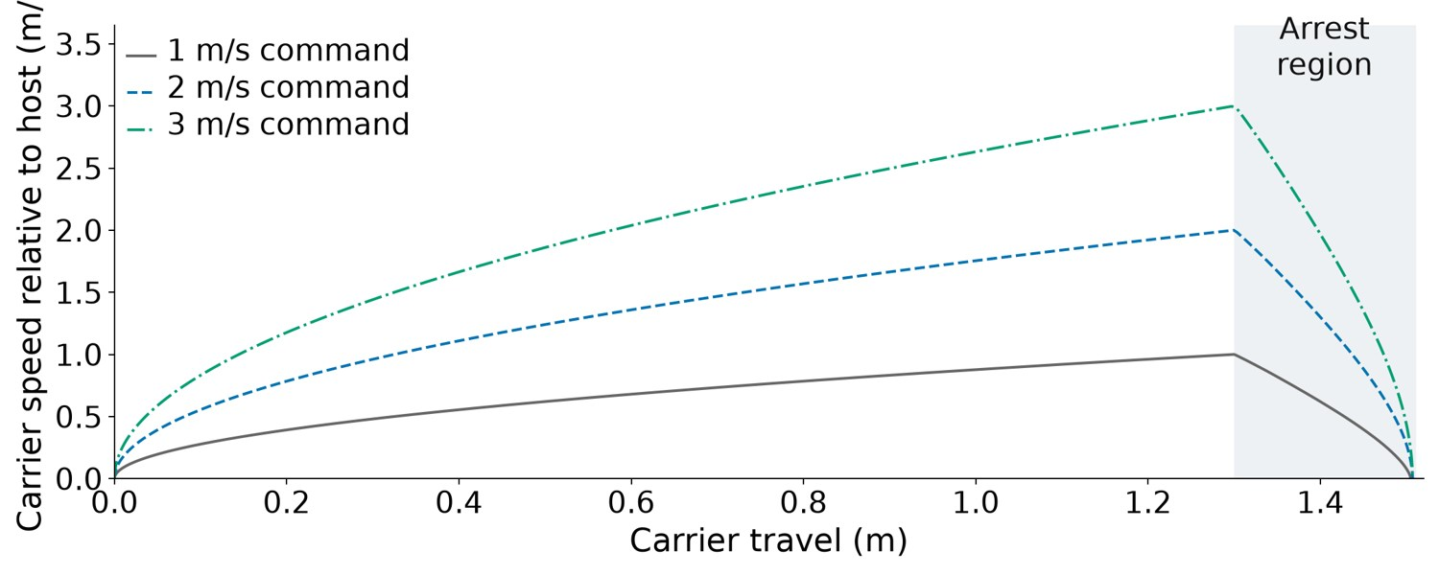
COUPLED OPERATING RESULTS
The principal 3 m/s case completes release and arrest
Computed histories. Principal case: 3 m/s command, nominal source, 20 µH; source and case-specific checks apply.
3 m/s command → 2.999864 m/s release · carrier stop position 1.507289 m
Blackbook §§6.3–6.4; coupled shot and timestep audit
10 / 31
Notes:
Speaker: Pratham Chawla
Planned duration: 75 seconds
The source reference uses 64 Eaton-family cells in a 32-series two-parallel arrangement. Nominal capacitance is 6.25 farads and ESR 0.176 ohms; adverse source assumptions are separate. One three-half-bridge inverter uses ten MOSFETs per switch position, sixty in total. We show the nominal twenty-microhenry principal replay. Relative release is 2.999864 metres per second; stopping occurs at 1.507289 metres from the model origin. All six principal combinations of nominal/adverse conditions and three inductances pass declared checks in the refined audit. The 1 and 2 metre-per-second cases support the analysed range, while the full timestep audit applies specifically to 3 metres per second.
Displayed result context: 64 cells, 32S2P; 86.4 V initial source command; Principal nominal replay: 2.999864 m/s relative departure; Carrier stops at 1.507289 m, inside the post-release allocation

Slide 11
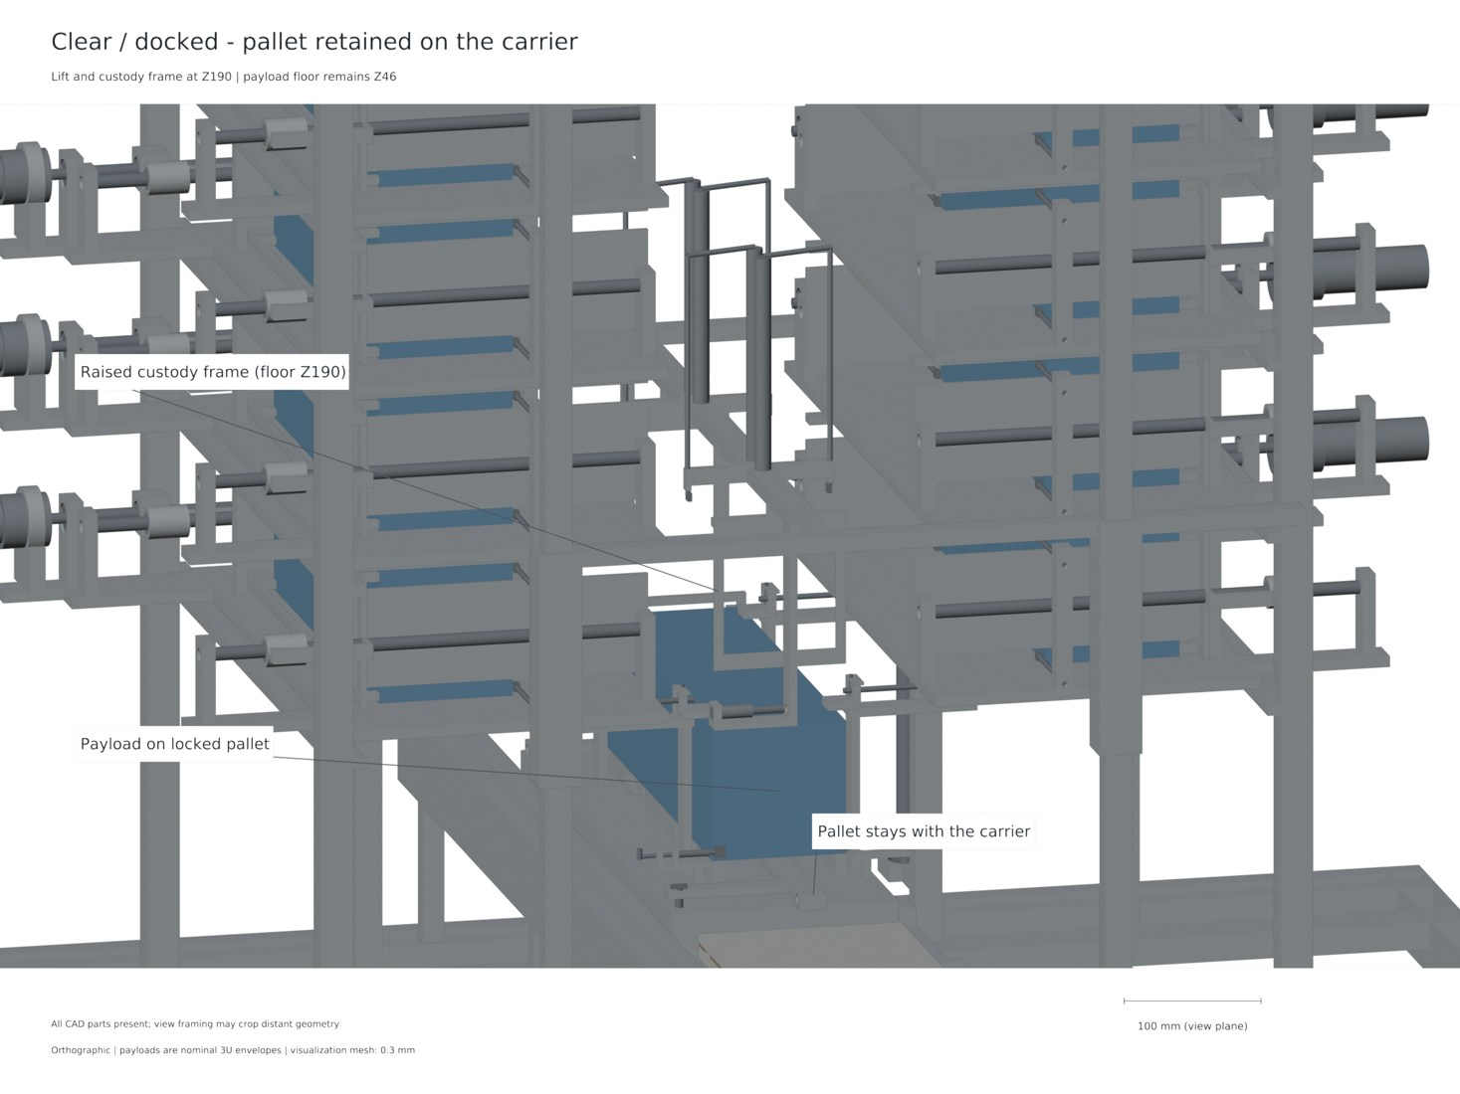
CAD AND INTEGRATION VERIFICATION
Check solids, states and the represented motion path
Eight native and STEP states
retain part identities and pallet
counts
154 accepted sampled-motion
and refinement checks
Named solid-volume mass ledger
separates CAD material and
allowances
CAD-derived launch-ready state. Native solid and exchange-geometry records support the displayed
arrangement.
8
154
149.557 kg
Native / STEP states
Motion / refinement checks
Represented dry CAD mass
Geometry is checked beyond a single assembly rendering.
Blackbook §§7.1,7.3–7.5; native/STEP readback
11 / 31
Notes:
Speaker: Pratham Chawla
Planned duration: 45 seconds
An isometric rendering explains the assembly, but geometric checks use individual shapes, connected-solid status and intersections. Eight states preserve the part identities and physical pallet count. The accepted motion record combines 135 retained poses and 19 final direct checks. Certain changes also have strict material-subset or conservative travel-envelope arguments. These are nominal geometric checks with stated allocations, not a measured manufacturing tolerance distribution. Represented dry CAD mass is 149.557 kilograms; a separate seven-kilogram power/control allowance is carried into mission accounting.

Slide 12
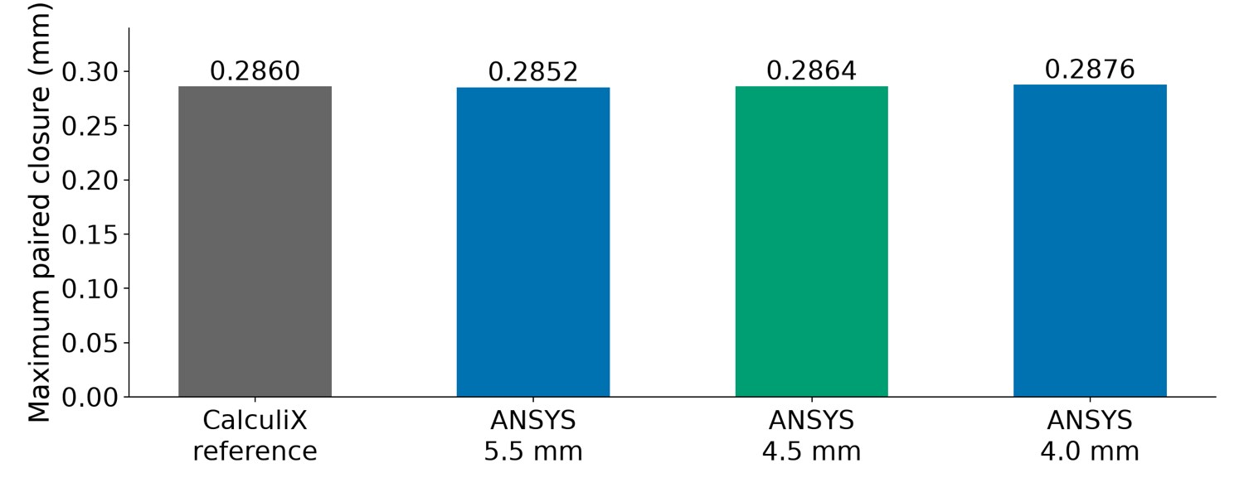
STRUCTURAL ANALYSIS
Independent static calculations reproduce paired closure
Computed bare-chassis comparison. ANSYS mesh refinement sensitivity is distinct from experimental accuracy.
Paired closure: 0.285983 mm (CalculiX) · 0.286392 mm (primary ANSYS sample)
Blackbook §7.2; corrected matched ANSYS static cross-check
12 / 31
Notes:
Speaker: Pratham Chawla
Planned duration: 60 seconds
Magnetic attraction loads the carrier across the gap. The actual connected bare-chassis geometry is subjected to opposed inward patches with matched numerical restraints. Each resultant is approximately 3010.481 newtons. CalculiX gives 0.285983 millimetres paired closure; the primary ANSYS sample gives 0.286392, approximately 0.143 percent higher. Three ANSYS meshes examine refinement sensitivity. A sum of two remaining gaps does not establish each individual assembled gap. The individual-face budget additionally uses centring, flatness, assembly and thermal allocations. Solver agreement supports this matched numerical boundary; it does not measure complete assembled hardware.
Displayed result context: Each array patch receives approximately 3.010 kN inward; CalculiX reference paired closure: 0.285983 mm; Primary ANSYS sampled closure: 0.286392 mm

Slide 13
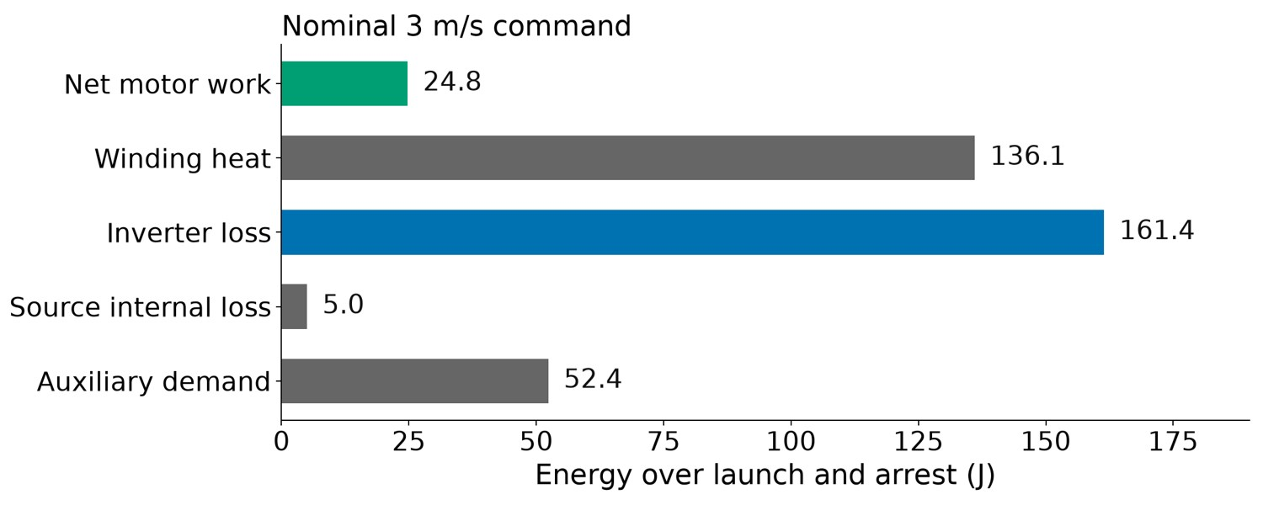
THERMAL ANALYSIS AND CONTROLS
Thermal budgets and interlocks complete the operating
boundary
Copper heating uses the current
history and represented
conductor field
Repeated-shot estimates
distinguish bulk rise, local rise
and cooling assumptions
24 nominal commands; 166
passing interlock-model tests
Computed principal-case energy account. Numerical residuals check conservation; they are not efficiency or
reliability measurements.
Electrical losses, contact assumptions and sequencing stay explicit.
Blackbook §§5.4,7.6–7.7; source energy and interlock records
13 / 31
Notes:
Speaker: Pratham Chawla
Planned duration: 50 seconds
Energy accounting includes mechanical change, copper, inverter, bank and auxiliary terms. Thermal estimates distinguish bulk temperature rise from local adiabatic observations. The 3.295053-kelvin quantity in the repeated-operation discussion is a temperature rise, not a percentage. Four hundred and fifty seconds is assumed shot spacing, not the diffusion time. The interlock model checks twenty-four nominal commands and one hundred and sixty-six tests, including declared power-loss, jam, disagreement, timeout and host-burn cases. These test the represented logic. They do not provide a measured probability of successful release.

Slide 14
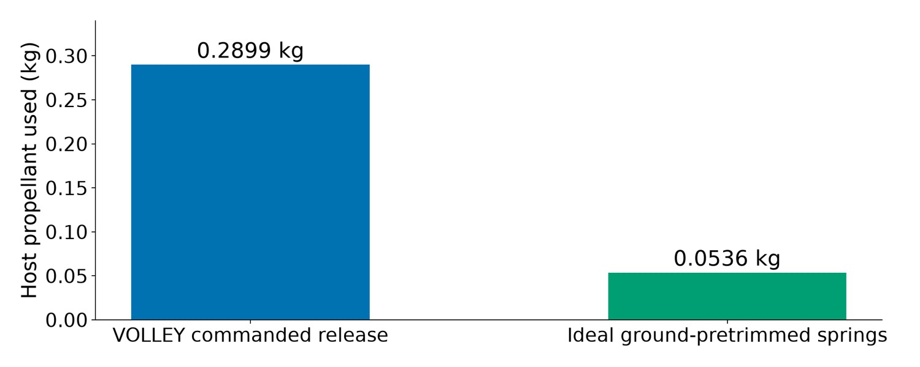
MISSION COMPARISON
Compare equal delivery targets and count retained resources
Selected feasible tested policies in the alternating target family with a 5 N host ceiling; device masses and burn guards retain their declared differences.
Host propellant: 0.2899 kg (VOLLEY) · 0.0536 kg (ideal ground-pretrim spring)
Blackbook §§8.2–8.5; mission comparison and native Orekit replay
14 / 31
Notes:
Speaker: Pratham Chawla
Planned duration: 90 seconds
A fair comparison includes device mass, changing host mass, recoil, fuel and allowed operations. We use the same target position and velocity states at a common terminal epoch. In the selected alternating-family five-newton cases, VOLLEY uses about 0.28987 kilograms of host propellant and ideal ground-pretrimmed springs about 0.05365. Retained device assumptions are 156.557 and 72 kilograms respectively. The result establishes no mass or fuel advantage for VOLLEY in this tested preplanned service. This identifies where a customer case must be stronger, such as a genuine need for on-orbit command flexibility. That flexibility has not itself been priced as demonstrated economic benefit. Native Orekit replay checks the declared mission arcs and J2 boundary; it is not a full flight safety analysis.
Displayed result context: Common payload manifest, target states and terminal epoch; Compare host-assisted VOLLEY with host-assisted spring alternatives; In the tested preplanned case, ideal ground pretrim uses less propellant

Slide 15
CONCLUSIONS
A complete computational reference connects the machine to
the mission
Operating cycle
Coupled model
Engineering checks
Storage, feed, capture,
Finite force, source
Geometry, structure,
departure, arrest and return
response and retained mass
thermal budgets and
are defined
are evaluated together
mission resources share an
evidence chain
The study delivers a defined operating cycle and configuration-specific engineering results.
Blackbook chapters 9–11
15 / 31
Notes:
Speaker: Pratham Chawla
Planned duration: 40 seconds
The achieved result is a complete computational design reference. It provides an explicit payload path, a finite motor and source-coupled operating study, geometric and structural checks, thermal and control budgets, and a matched mission comparison. The 1–3 metre-per-second study supplies the evaluated academic envelope. The conclusions include both the supported operation and the system trade revealed by the mission case. This is the engineering basis for selecting and instrumenting a physical article.

Slide 16
TIMELINE AND WORK PROGRESS
Development follows linked engineering questions
01
02
03
Concept and architecture
Integrated evaluation
Prototype requirements
Concept and host architecture
Integrated computational
Reusable tools and Labs
→ feeder, carrier and finite
reference → independent
investigations →
motor models
numerical comparisons
physical-development
requirements
Five-plus years of VOLLEY development produced a connected engineering record.
Blackbook development appendix; documented project history
16 / 31
Notes:
Speaker: Pratham Chawla
Planned duration: 30 seconds
VOLLEY developed over more than five years. We describe the stages using the documented lineage rather than assigning every related repository the same age. Concept selection led to payload handling, finite motor geometry, coupled source and motion, structural and mission evaluations. The completed reference now supports prototype requirements. Related tools emerged from specific engineering needs. Adityavardhan will close by showing that ecosystem and its staged development direction.

Slide 17
RESEARCH ECOSYSTEM
An engineering ecosystem grew around the deployment
problem
VOLLEY Labs
Reusable tools
Future interfaces
VOLLEY Labs: feeder
Reusable tools: motor
GatewayCX: proposed
alternatives, force
design, separation/orbits,
cislunar network
benchmarking and new
CAD automation and source
relationship; technical paper
speed configurations
traceability
draft for future peer review
Each related project addresses a specific part of the development chain.
VOLLEY Labs research catalogue; engineering tool repositories; GatewayCX architecture
17 / 31
Notes:
Speaker: Adityavardhan Mishra
Planned duration: 35 seconds
The ecosystem is organised by the questions it answers. Labs preserves mechanism alternatives, experimental comparisons, new speed configurations and lunar architecture studies. The related repositories extract reusable tools for motor design, separation dynamics, orbital comparison, CAD evidence and numerical traceability. GatewayCX is a separate cislunar communications architecture. Future VOLLEY delivery studies could consider deployment of suitable infrastructure for that network; no integrated flight system is claimed. The technical paper is planned as a publication of the checked study, with a venue still unselected.

Slide 18
FUTURE WORK
Gen6 turns the reference into an instrumented hardware
programme
01
02
03
Gen6 prototype
Higher-speed study
Long-term architecture
Gen6: instrumented feed/lock
Higher-speed programme:
Future host: a POEM-inspired
and motor/source articles, then
separate ~10 m/s
free-flying carrier, replenishable
a mixed 1U/3U prototype
computational design; 1 km/s
constellations and Artemis-era
stretch research objective
lunar science/communications
Long-term cislunar delivery: 3.5 km/s departure research, with targeting and capture designed separately.
Blackbook §11.2; Labs high-speed and lunar architecture studies; NASA lunar infrastructure programme
18 / 31
Notes:
Speaker: Adityavardhan Mishra
Planned duration: 65 seconds
Gen6 begins with instrumented mechanism and motor articles and an integrated mixed one-unit/three-unit prototype. A separately specified Labs configuration has computed ten-metre-per-second release cases. Kilometre-per-second performance is a stretch research objective requiring a different source, stroke, loading and host architecture. The 3.5-kilometre-per-second case is a longer-term departure scenario, not an achieved launcher rating or automatic lunar-orbit delivery; lunar targeting and capture remain separate. The wider service hypothesis is standardised batches of short-life spacecraft, clustered or phased deployment, replenishment and planned disposal where mission needs permit. Artemis-era lunar infrastructure motivates later communications and science applications, including a possible GatewayCX relationship.

Slide 19
DEPARTMENT OF MECHANICAL ENGINEERING
Commanded deployment, evaluated as a
complete system
A defined machine. Coupled engineering. A measured route to hardware.
Questions
CubeSat interface sources; Zhao 2022/2025; Feng 2025; Halbach and finite-motor literature
Native CAD, finite-element, circuit and orbital source records accompany the study
VOLLEY technical record: github.com/aaaaaaaaaaaavm/VOLLEY
Full bibliography in blackbook; technical appendix and source-linked study records
19 / 31
Notes:
Speaker: Adityavardhan Mishra
Planned duration: 20 seconds
The full references and source routes are provided in the technical appendix and supporting records. The study connects a defined machine, coupled calculations and a clear hardware measurement programme. We welcome questions; both of us can address the mechanism, methods and results.

Slide 20
APPENDIX A1 · REFERENCE CONFIGURATION
Reference quantities and mass boundaries
Payloads: 12 × 4 kg; each 340.5
× 100 × 100 mm
Dry CAD 149.557 kg;
power/control allowance 7 kg;
loaded device 204.557 kg
Retained moving carrier plus
pallet: 13.127806 kg
CAD-derived assembly; mass values are modelled/allocated, not scale measurements.
Keep represented CAD material, system allowances and payloads separate.
Blackbook: Reference configuration
20 / 31
Notes:
Speaker: Shared questions

Slide 21
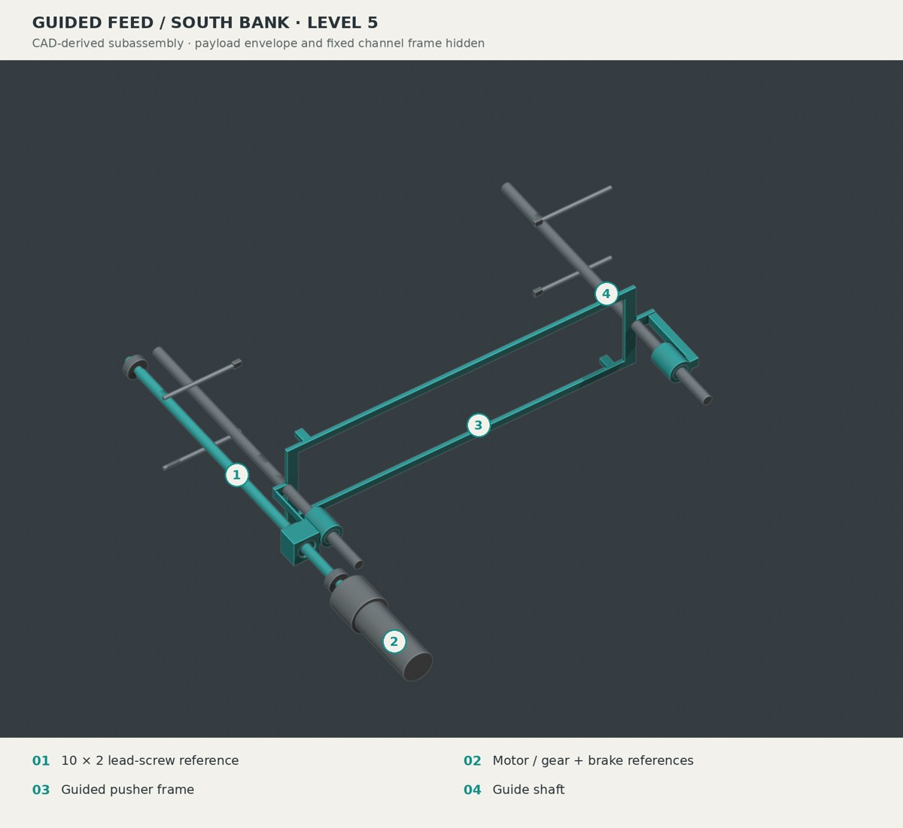
APPENDIX A2 · FEEDER SELECTION
Why a guided lead screw?
Lead screw selected;
rack-and-pawl retained as
runner-up
Seven candidates preserve
pantograph, telescope, belt,
drum and spring/gate concepts
Weighted scores are declared
judgments; measured reliability
remains a hardware question
CAD-derived feeder detail. Detailed comparison remains in Labs.
Selection balances restraint, controlled travel, packaging and failure behaviour.
Blackbook: Feeder selection
21 / 31
Notes:
Speaker: Shared questions

Slide 22
APPENDIX A3 · PALLET CUSTODY
Capture before lift release
12 mm lock insertion; keyed
heads rotate 90°
Lift grips retract 26 mm only after
permitted carrier capture
Same pallet remains through
launch, arrest and return
CAD-derived state; interlock logic and geometric checks have separate scopes.
Carrier capture and independent locking precede lift withdrawal.
Blackbook: Pallet custody
22 / 31
Notes:
Speaker: Shared questions

Slide 23
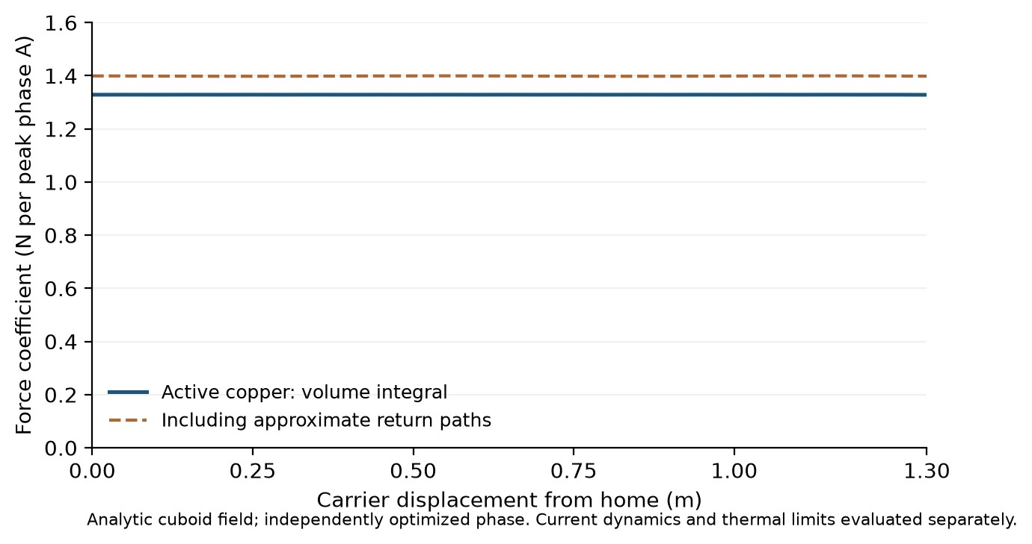
APPENDIX A4 · ELECTROMAGNETIC METHODS
Finite-field and current-path comparisons
Finite source-face comparison
checks the active field/force
formulation
Conduction FEM at 0.65 m:
1.396651 N per peak phase
ampere
Uniform bars plus approximate
returns: 1.399055 N/A; local
difference −0.1718%
Fₓ = ∫ (J × B)ₓ dV
Numerical comparison at stated stations; not a physical accuracy specification.
Alternative calculations test different aspects of the represented model.
Blackbook: Electromagnetic methods
23 / 31
Notes:
Speaker: Shared questions

Slide 24
APPENDIX A5 · ELECTRICAL REFERENCE
Source and switching allocations
Nominal source
Adverse source
Power stage
32S2P, 64 cells; nominal
Adverse 3.9375 F and 0.352
Three half bridges, 10
6.25 F and 0.176 Ω
Ω; 2.9 V/cell regeneration
devices per switch position,
terminal cap
60 MOSFETs; 40 kHz
reference PWM
Ratings enter the model with finite impedance and declared switching assumptions.
Blackbook: Electrical reference
24 / 31
Notes:
Speaker: Shared questions

Slide 25
APPENDIX A6 · ENERGY VERIFICATION
Principal nominal energy account
Capacitor draw: 379.682 J in the
20 µs principal nominal replay
Copper 136.066 J; inverter
161.429 J; bank 5.039 J;
auxiliaries 52.389 J
Full-cycle mechanical term
24.768 J; do not equate it with
peak moving-body kinetic energy
Numerical ledger for one specified case; regenerative braking and event boundaries matter.
Signed energy terms include source and auxiliary losses.
Blackbook: Energy verification
25 / 31
Notes:
Speaker: Shared questions

Slide 26
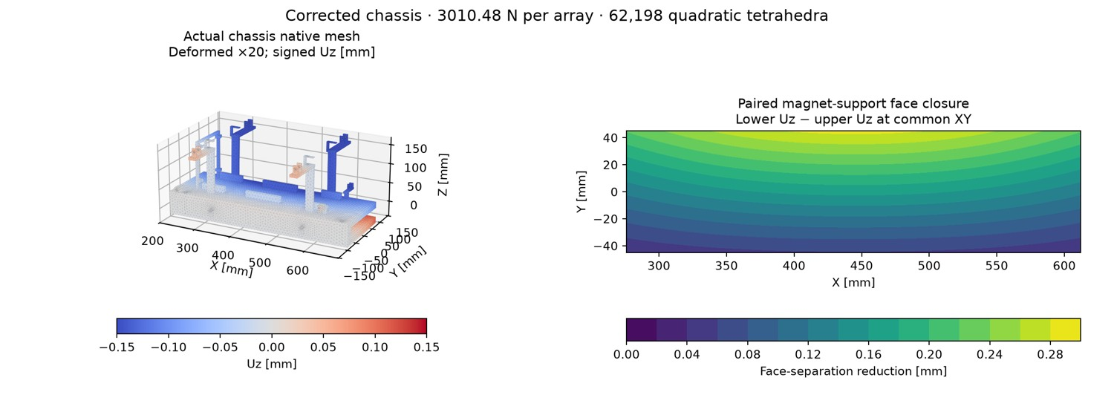
APPENDIX A7 · STRUCTURAL INTERPRETATION
Gap closure and individual-face budgets
CalculiX nominal paired closure
0.285983 mm; 1.3-load closure
0.371778 mm
Conditional centring split, plus
alignment/flatness/assembly/thermal
allowances
Individual-face reference design
budget 0.264111 mm
Native bare-chassis mesh and paired closure. Deformation ×20; assembled allowances are separate.
A paired closure is not an individual assembled clearance.
Blackbook: Structural interpretation
26 / 31
Notes:
Speaker: Shared questions

Slide 27
APPENDIX A8 · THERMAL AND CONTROL SCOPE
Thermal and fault interpretation
Temperature and time
Thermal measures
Encoded logic
3.295053 K is a temperature
Bulk, volume-99 and
166 interlock tests verify
rise; 450 s is the inter-shot
sharp-corner mesh
encoded logic, not a
interval
observations have different
measured reliability
meanings
probability
Keep quantities and test meanings distinct.
Blackbook: Thermal and control scope
27 / 31
Notes:
Speaker: Shared questions

Slide 28
APPENDIX A9 · MISSION MECHANICS
Host reaction and the common terminal epoch
Principal 3 m/s nominal relative
release gives about 2.927 m/s
payload inertial increment
Count carrier acceleration,
subsequent carrier arrest and
changing retained mass
Compare all payload
position/velocity targets at a
common epoch
Explanatory mission schematic; complete comparison includes host manoeuvres and device mass.
A commanded relative release differs from the payload inertial increment.
Blackbook: Mission mechanics
28 / 31
Notes:
Speaker: Shared questions

Slide 29
APPENDIX A10 · RESEARCH CONFIGURATIONS
Higher-speed work already in Labs
New configuration
Model checks
Alternative design
Longer powered travel,
Retained-carrier
Attached-shoe alternative
revised finite winding and
nominal/adverse cases pass
and its adverse speed miss
source accounting
their declared circuit/motion
remain separately recorded
checks
The approximately 10 m/s study is a separately specified computational design.
Blackbook: Research configurations
29 / 31
Notes:
Speaker: Shared questions

Slide 30
APPENDIX A11 · CISLUNAR ARCHITECTURE
Lunar departure and capture are separate operations
Parking-orbit screen
Departure energy
Capture design
Ideal 500 km parking-orbit
A prograde 3.5 km/s
Lunar targeting, host recoil
screen: approximately 3.058
increment from that
and lunar capture require
km/s departure increment
reference is Earth-escape
their own complete mission
energy
design
Departure speed alone does not establish lunar-orbit delivery.
Blackbook: Cislunar architecture
30 / 31
Notes:
Speaker: Shared questions

Slide 31
APPENDIX A12 · REFERENCES AND RESEARCH ECOSYSTEM
Selected bibliography and research record
Y. Zhao et al. (2022). “Design and analysis of a new deployer for the in-orbit release of multiple stacked CubeSats.” Remote Sensing
14(17), 4205.
doi:10.3390/rs14174205
Y. Zhao et al. (2025). “Simulation analysis and experimental verification of the transport characteristics of a high-volume CubeSat
storage device.” Aerospace 12(6), 466.
doi:10.3390/aerospace12060466
H. Feng, Y. Yang and Y. Wu (2025). “Design and reachable domain analysis of on-orbit electromagnetic launcher for CubeSats.”
International Journal of Aerospace Engineering, 3000765.
doi:10.1155/ijae/3000765
Architectural and mission context
ISRO · POEM-3 mission account
Rocket Lab · Electron guide v7.0
NASA · Lunar surface technology
Planned IEEE-formatted paper · venue unselected · manuscript unsubmitted
The paper documents the checked study; tools retain their own contribution boundaries.
Blackbook: References and research ecosystem
31 / 31
Notes:
Speaker: Shared questions

