Slide 1

Department of Mechanical Engineering
B.Tech Project Presentation on
VOLLEY: Design and Computational
Feasibility Assessment of a Commanded
Electromagnetic CubeSat Deployment Mechanism
Presented By
Adityavardhan Mishra · Pratham Chawla
PRN 23070125054 · PRN 23070125029
Guide: Vikas Gulia
Final review: 31 October 2026
SYMBIOSIS INSTITUTE OF TECHNOLOGY PUNE
1

Slide 2
Presentation route
OUTLINE
01 Introduction
07 Work progress
02 Literature review
08 Results
03 Research gap
09 Conclusion
04 Objectives
10 Future work
05 Research methodology
11 References
06 Timeline
PRESENTATION GUIDE
User-specified final-review outline
2

Slide 3
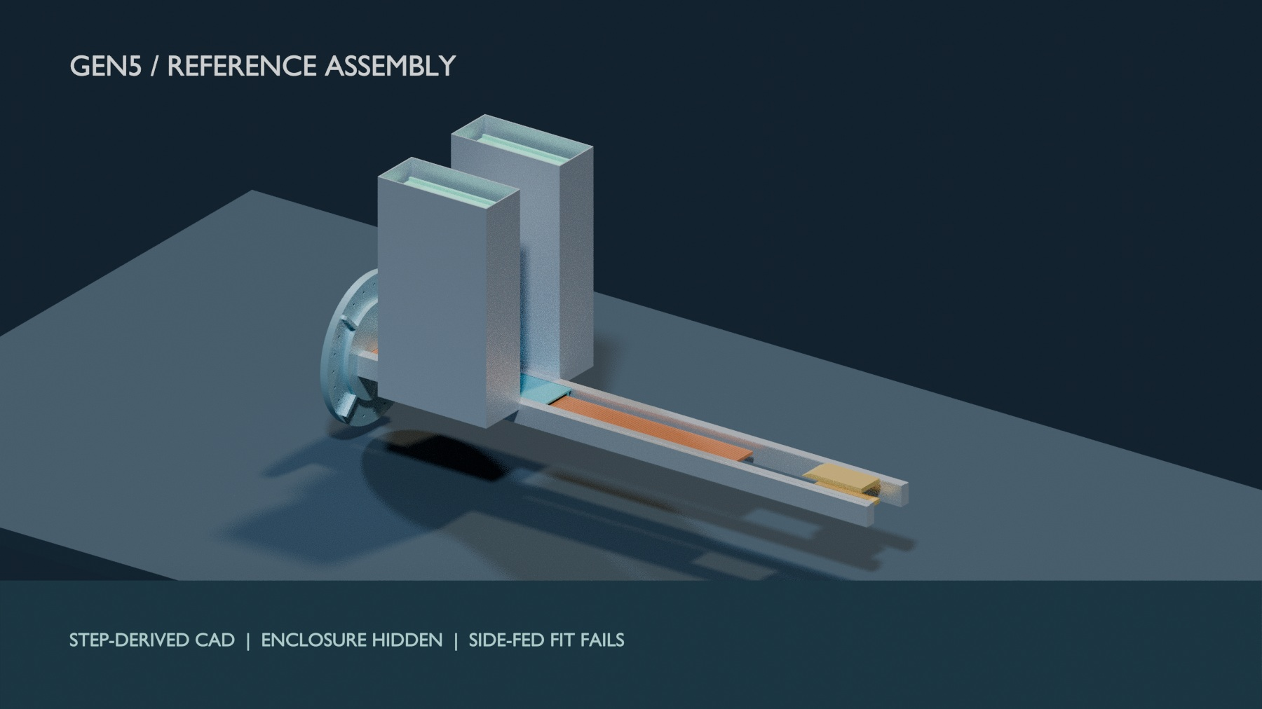
Which missions might value orbital choice?
INTRODUCTION
Repeat fleets
Configurable satellite fleets exist; demand for VOLLEY is unconfirmed.
Delivery buyer
A carrier or fleet operator might seek several release states from one host.
STEP-derived Gen5 reference; side-fed placement fails its fit check.
Test on one matched mission against springs, host manoeuvres, transport and onboard propulsion.
GEN5 MODEL STUDY
NASA 2026 Small Spacecraft SoA; local market audit; STEP-derived Gen5 CAD
3

Slide 4
Existing methods solve different parts of the problem
LITERATURE REVIEW
Approach
Strength
Limit for this thesis
Spring deployer
Flight heritage; compact; simple
Limited tailored release speed
Spring release / drag
Relative state or drag can create phasing
Timing alone, with no relative state change, cannot
Orbital transfer vehicle
Larger orbit changes
Greater bus, mass and integration burden
Electromagnetic research
Commandable acceleration studied
Armature, high-g or maturity constraints vary
GEN5 MODEL STUDY
JAXA; Foster et al. 2018; Feng et al. 2025; Zhao et al. 2022/2025
4

Slide 5
A narrower, testable contribution
RESEARCH GAP
Commanded release for an unmodified CubeSat at moderate acceleration, with the full system counted.
Contribution examined
Boundary
Gen5 reusable-sled linear motor, 3U payload, magazine, pulse power, arrest and orbital utility.
Electromagnetic CubeSat deployment exists in prior work. Payload qualification and physical performance remain unproved.
GEN5 MODEL STUDY
Thesis manuscript, Related Work and Introduction
5

Slide 6
The analytical research objectives have outcomes
OBJECTIVES
Research objective
Final thesis outcome
Design a commandable 3U system
Evaluated Gen5 reference; separate FM08-R3 feeder selected
Calculate shot and control performance
Historical model completed; finite force screen challenges its rating
Evaluate orbital utility
Conditional orbit results; real lifetime unvalidated
Count full installed burden
Mass rollup completed; 3U parity criterion failed
Test credibility of key claims
Numerical cross-checks and limits recorded
GEN5 MODEL STUDY
Thesis manuscript, BASELINE.md and PROVENANCE.md; presentation synthesis
6

Slide 7
The analysis chain from mission to decision
RESEARCH METHODOLOGY
Mission &
payload needs
Architecture
trade
CAD & mass
model
Shot, power &
orbit models
Numerical
cross-checks
Sensitivity &
acceptance bands
→
→
→
→
→
Models were challenged and revised; hardware performance remains outside this thesis's evidence.
GEN5 MODEL STUDY
Thesis manuscript, Models and Verification; validation register
7

Slide 8
Numerical checks changed the review baseline
RESEARCH METHODOLOGY
Question
Method / cross-check
Evidence limit
Field and thrust
Analytic; 2-D FEM; independent 3-D numerical force
Shared ideal inputs; no motor measurement
Shot and power
Dynamics; Monte Carlo; ngspice
Assumed components and interfaces
Structure and flow
CAD; CalculiX; OpenFOAM
No payload qualification
Orbital change
Orbit model; Cowell / GMAT cases
Lifetime depends on atmosphere
GEN5 MODEL STUDY
VOLLEY-thesis/appendix/PROVENANCE.md; validation run sheets
8

Slide 9
Project evolution: documented decisions and analysis
TIMELINE
2023
Hosted concept
Free-flyer concept reframed around a host platform
Mid-2025*
LSM direction
Coilgun study gives way to a linear synchronous motor
2025–26*
CAD generations
Geometry and mass models mature through Gen5
Jul–Sep 2026
Gen5 evidence
Cross-checks, defect corrections and thesis record
Oct 2026
Final review
Gen5 study and FM08-R3 feeder design selection
* Approximate historical milestone; not a documented semester deadline.
GEN5 MODEL STUDY
VOLLEY-thesis/appendix/HISTORY.md; thesis README; PLAN-R2
9

Slide 10
2026 findings changed the review baseline
TIMELINE
Jul
CAD-derived sled mass replaced an optimistic parametric estimate
Aug
Depth-resolved thrust calculation lowered the historical model speed
Aug
Enclosure buildup exposed the full 3U mass penalty
2026
Independent orbit checks rejected a solar-invariance claim
Final
Results and failures retained in the submitted thesis record
GEN5 MODEL STUDY
HISTORY.md; PROVENANCE.md; thesis manuscript, Limitations
10

Slide 11
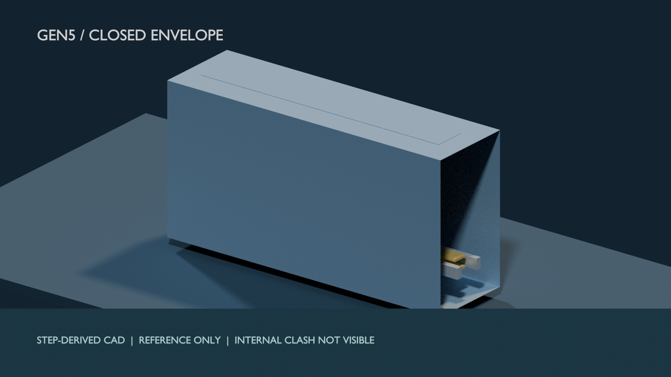
The current review package is assembled and traceable
WORK PROGRESS
Analysis delivered
Shot, circuit, structural, thermal, orbit and alternative-case models.
Evidence delivered
Manuscript, STEP, scripts, numerical checks and defect register.
FreeCAD-linked STEP envelope; internal interference is concealed.
Fixed computational study with failed design gates; no physical qualification claim.
GEN5 MODEL STUDY
Thesis README; validation register; STEP view provenance
11

Slide 12
Gen5: fixed reference geometry, feeder fit still open
RESULTS
• 1.3 m powered stroke; 1.5 m release station
• Reusable 9.45 kg magnet sled
• Two cassettes; twelve 3U satellites
• FreeCAD STEP assembly: side-fed placement clashes
Enclosure hidden for visibility; no fabricated article.
GEN5 MODEL STUDY
FreeCAD Gen5 STEP reference; view provenance and P116
12

Slide 13
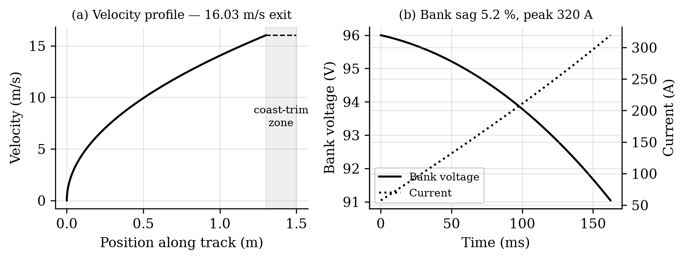
Historical periodic-model shot: challenged by finite geometry
RESULTS
16.0 m/s
10.07 g
2.782 kJ
18.8%
exit speed
acceleration
gross draw
net efficiency
P118 challenges 16.0 m/s; P117 reconciles 124.5 J to assumed model terms.
GEN5 MODEL PREDICTION
Thesis BASELINE.md; F01_shot.png; P117 energy audit
13

Slide 14
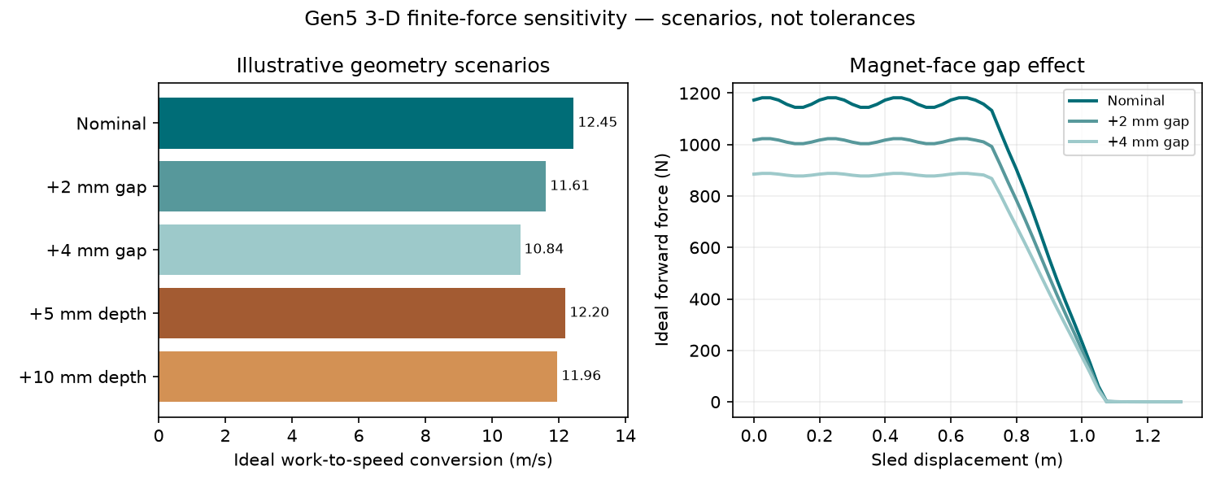
Independent 3-D check confirms ideal finite-force work
RESULTS
1.042 kJ
Ideal 3-D work: independent surface-charge formulation agrees with P118 under shared inputs.
−13% work
Illustrative 12-to-14 mm magnet gap change; not a measured tolerance or motor rating.
No measured force, selected inverter or demonstrated release speed exists.
COMPUTATIONAL CROSS-CHECK
P118 analytic; P119 2-D FEM; P121 3-D numerical; P122 gap sensitivity
14

Slide 15
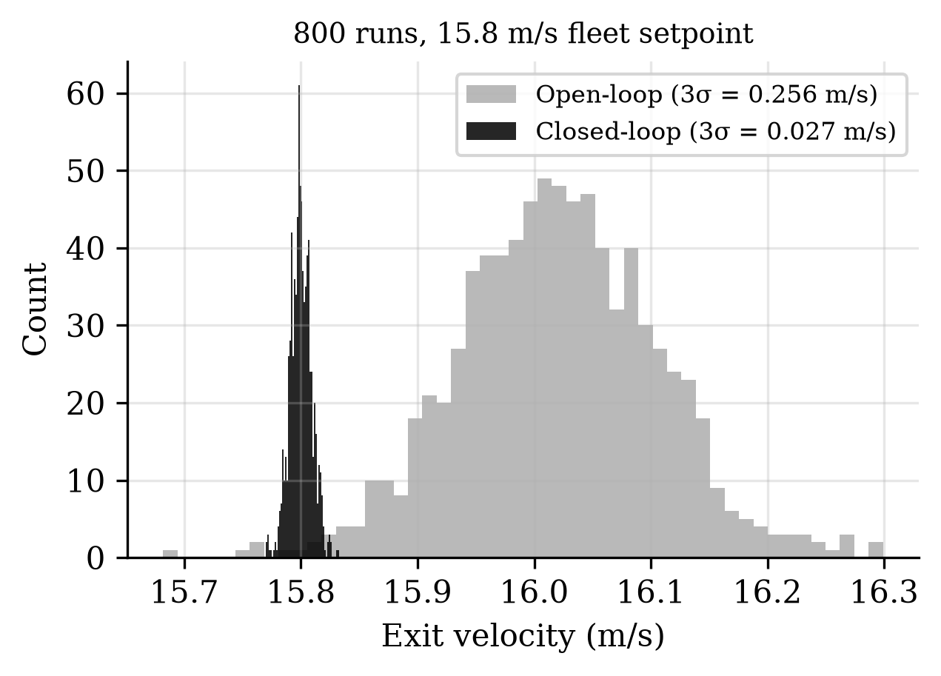
Modelled command precision is narrow; it is unmeasured
RESULTS
0.0274 m/s
3σ exit-velocity dispersion at a 15.8 m/s fleet setpoint.
Evidence limit
Monte Carlo under modelled sensing and plant tolerances; no measured dispersion.
GEN5 MODEL PREDICTION
Thesis BASELINE.md; PROVENANCE.md; F03_mc.png
15

Slide 16
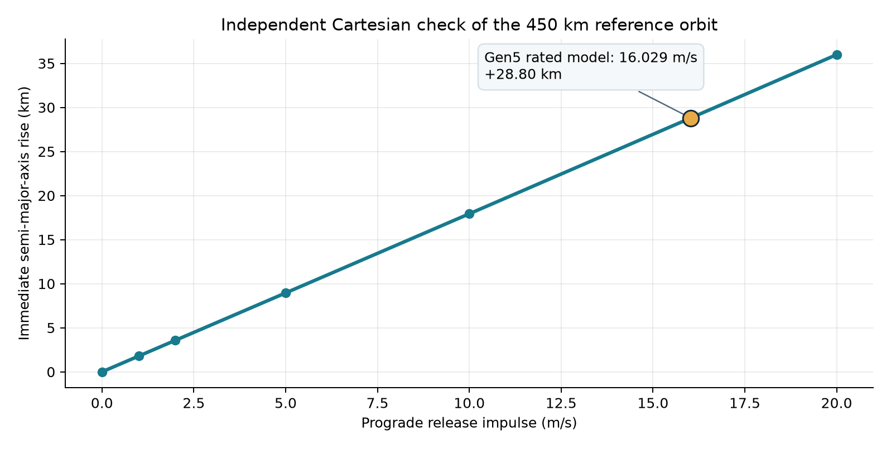
Historical orbit input has a separate geometry check
RESULTS
+28.8008 km
Immediate two-body axis rise for an assumed historical 16.029 m/s input.
1.602 model
P134 checks the shared static atmosphere; actual lifetime and achieved release remain unvalidated.
Persistent phasing requires a relative state change; this result concerns orbital energy.
GEN5 TWO-BODY CHECK
P115 Cartesian orbit check; manuscript Astrodynamic Utility
16

Slide 17
Gen5 fails its 3U mass comparison
RESULTS
Modeled dry mass, 12 slots
126.6 kg
Gen5 per 3U
10.55 kg
Spring comparator
~6 kg
1.76× heavier per 3U payload; the preset 15% parity band fails.
GEN5 MODEL STUDY
Thesis manuscript, Payload Class and Mass-per-Satellite; A46 enclosure result
17

Slide 18
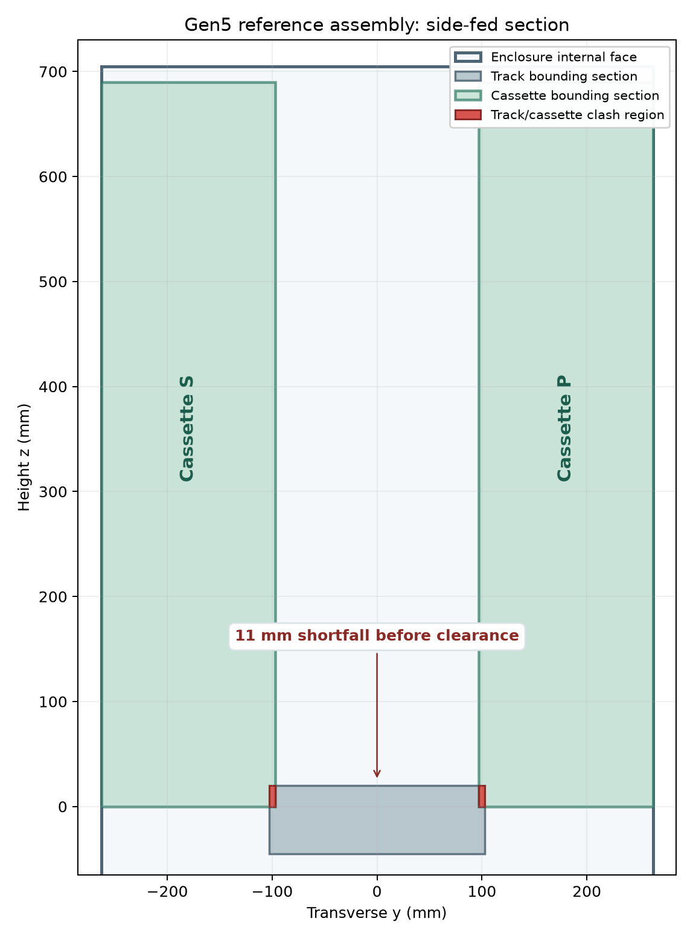
The current side-fed assembly fails a geometric fit check
RESULTS
11 mm short
537 mm of track and cassette width inside 526 mm of usable enclosure width.
32,915 mm³
Cassette/track clash per side. Full audit: 17 intersecting pairs, including sled/track and sled/stator.
Reference placement only: a new feeder or enclosure would need a new configuration and rerun.
CAD INTERFERENCE • OPEN
FreeCAD Gen5 Review.FCStd; P116 assembly packaging report
18

Slide 19
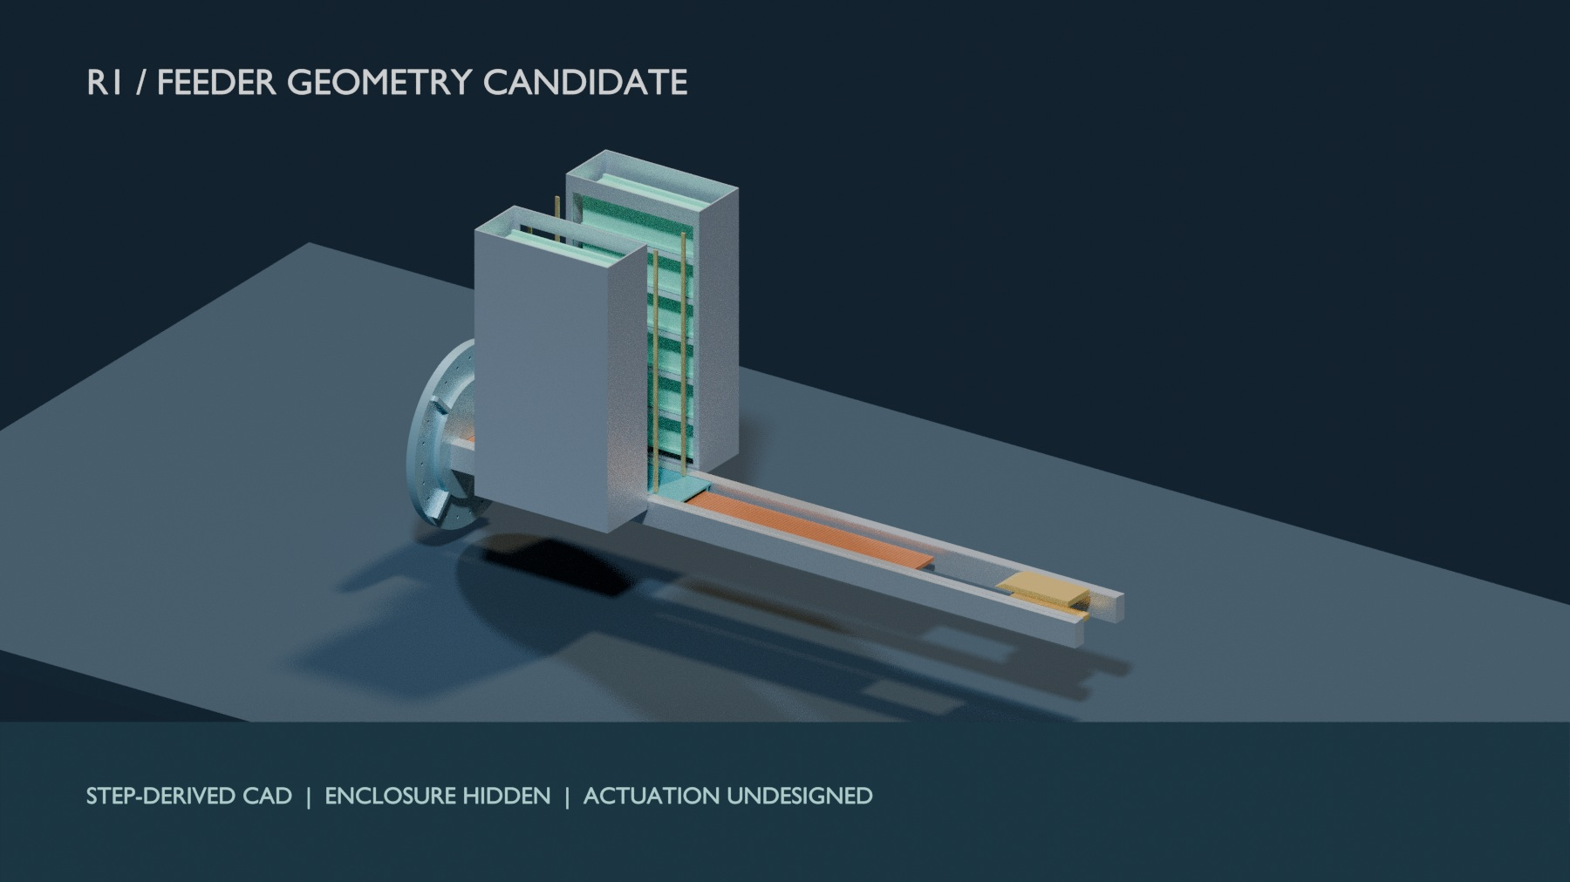
R1 clears cassette width, but still has assembly clashes
RESULTS
12 / 12
Selected scripted 3U paths clear; a whole-assembly audit still finds five intersecting solid pairs.
570 mm
Wider enclosure; 0.5° assumed alignment stack fails its 5 mm gap; lift and retention still open.
Separate R1 candidate; no change to evaluated Gen5 shot, mass or host-fit claims.
UNSELECTED GEOMETRY
FreeCAD R1 STEP candidate; exact-solid route ledger
19

Slide 20
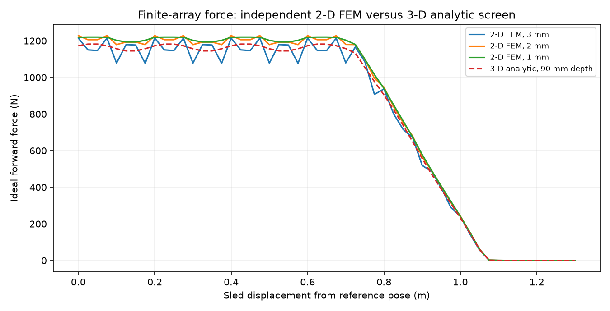
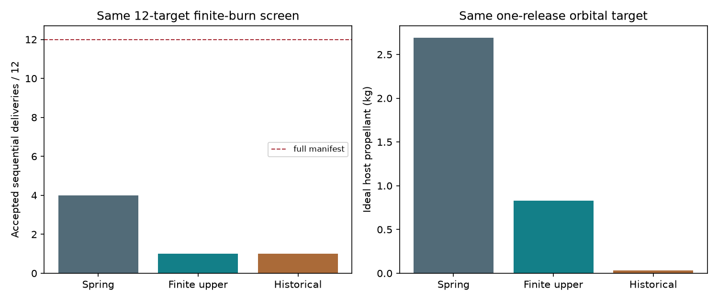
Computed results: from force to mission decision
RESULTS
1. Finite-force geometry screen
2. Matched mission screen
→
P125: single-string source power fails at the older commercial ESR bound; no twelve-shot case closes.
CAPTURED COMPUTATIONAL RESULTS
P118–P127 finite force, source, tolerance and arrest; matched reference
20

Slide 21
Matched reference mission finds no twelve-shot closure
RESULTS
+52.7 kg
One-event device plus resized fuel: Gen5 exceeds spring despite an ideal 1.87 kg fuel saving (P123).
4 / 1 / 1
Accepted twelve-shot prefixes: spring, finite Gen5, historical Gen5.
Assumed host and devices; optimizer result is not an infeasibility proof or product advantage.
BOUNDED MISSION SCREEN
Common-input spring/Gen5 study; 100 N host, 450 km, 12 × 4 kg payloads
21

Slide 22
This Gen5 configuration does not pass selection
CONCLUSION
• Historical 16.0 m/s is challenged; ideal 12.448 m/s lacks a sourceable single-string bank.
• The modeled system is 76% heavier per 3U customer and the evaluated side-fed CAD clashes.
• R1 retains sled/track and sled/stator clashes; its assumed 0.5° gap stack fails.
• No matched twelve-shot reference closes; Gen5 is a documented negative design study.
STEP reference, enclosure hidden; fit fails. No physical test.
GEN5 MODEL STUDY
Thesis conclusion; P116; matched mission; STEP view provenance
22

Slide 23
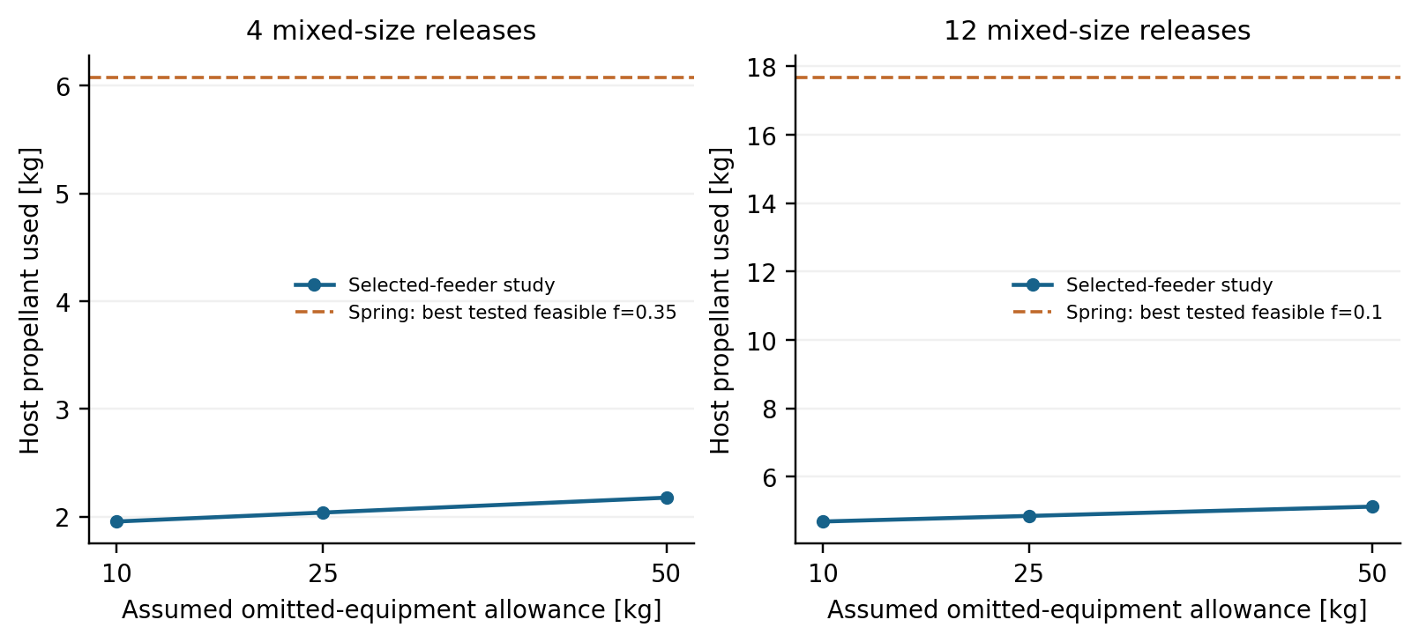
Commanded release trades host propellant against device burden
GEN6 MISSION STUDY
4.04 / 12.82 kg
Less propellant for four / twelve releases at the central allowance, compared with lowest-consumption tested springs.
Dry burden is larger
38.84 / 60.33 kg added device mass exceeds the propellant-use reduction. No installed-mass advantage established.
Imposed 3–6 m/s release; no achieved motor rating. Spring alternatives may use longer maneuver windows.
CONDITIONAL RESOURCE STUDY
FBR-02 · selected-feeder mass retarget and 26 native Orekit replays
23

Slide 24
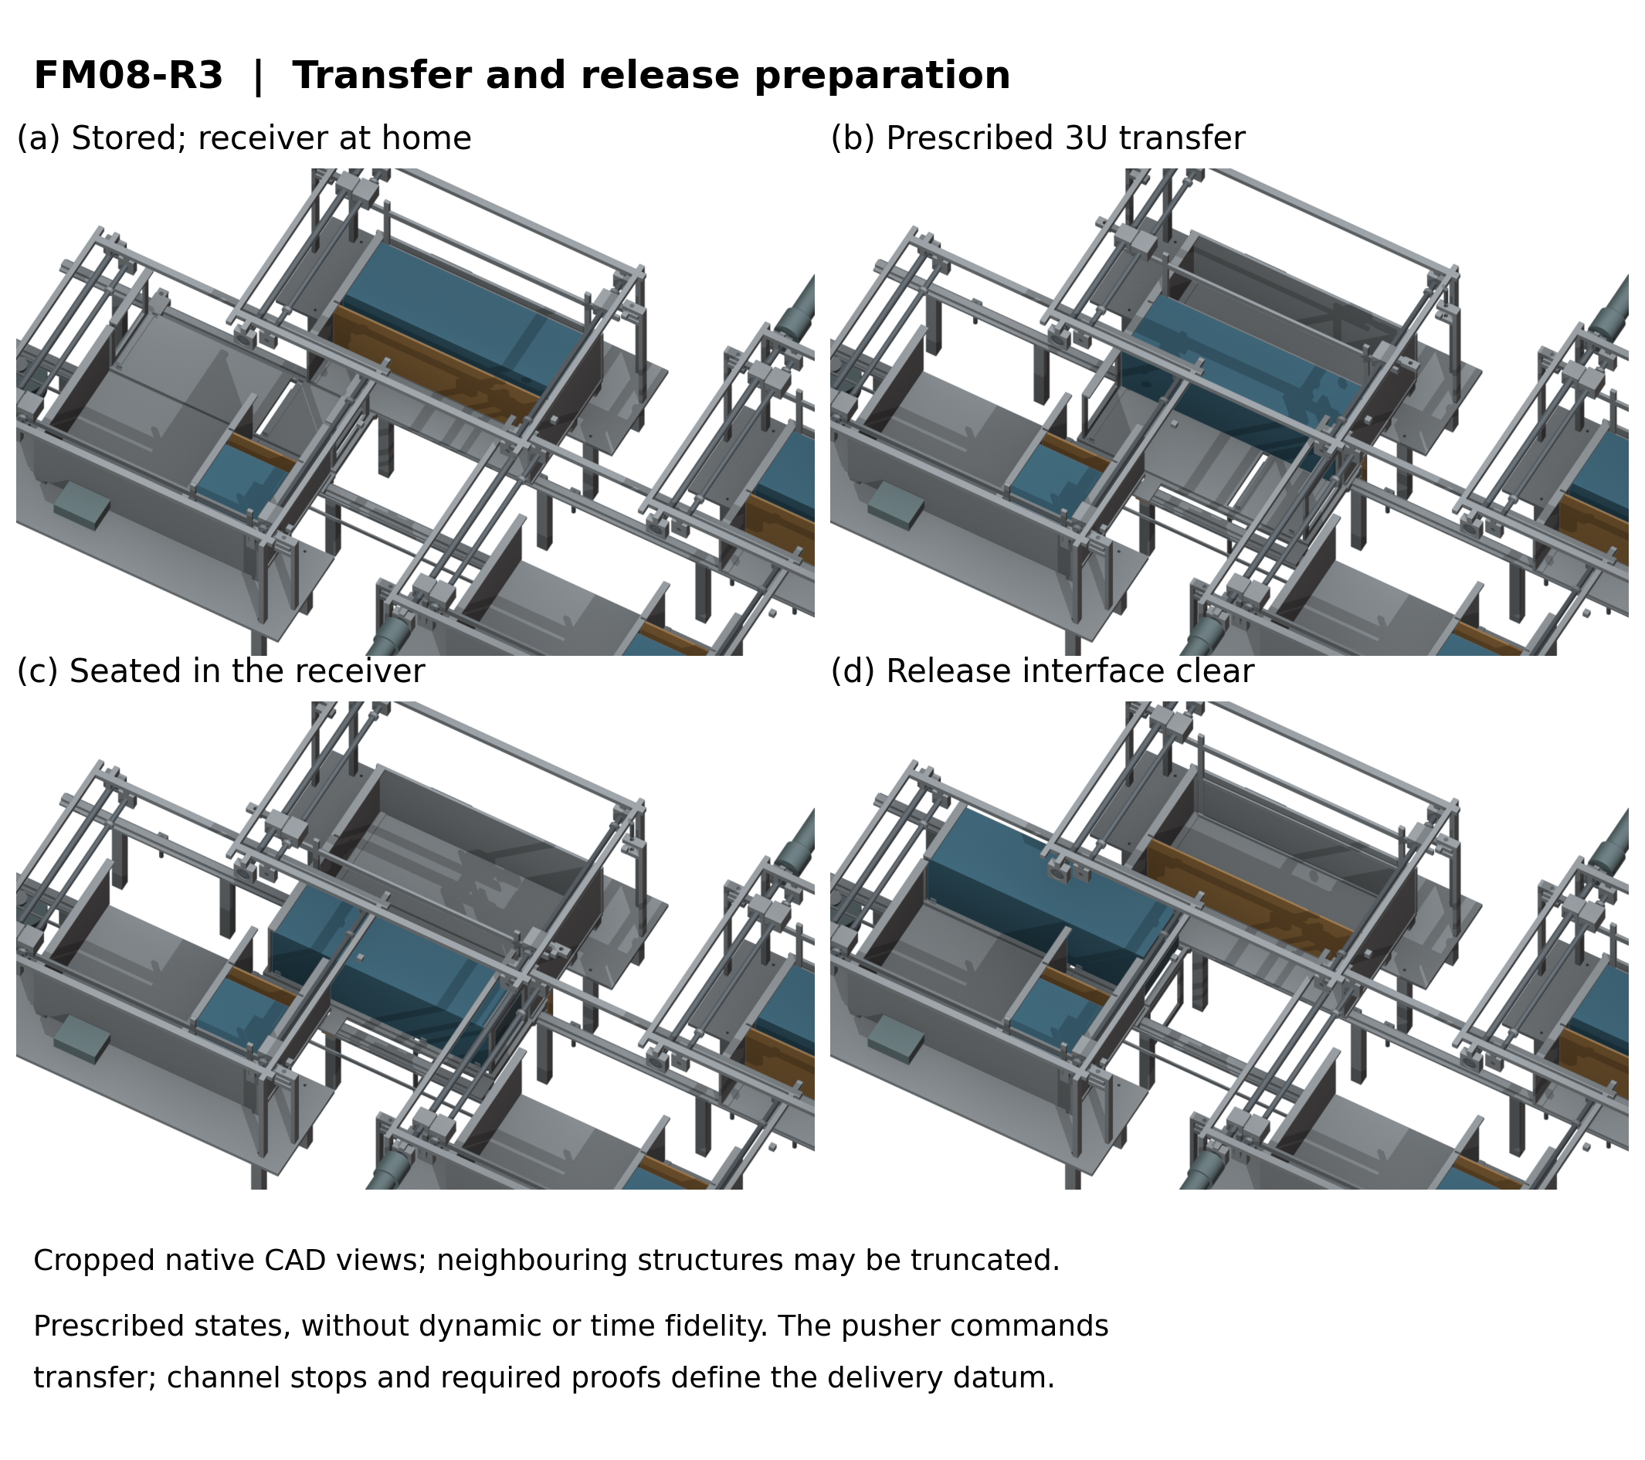
A guided lead screw controls each cassette transfer
GEN6 SELECTED DESIGN
• Two 1U + two 3U; one indexed receiver
• Fixed 1U spacers stay in their cassettes
• Far stop proved → feed → seating proof → capture
• Index clutch disengaged before launch arming
• Release inhibited on jam, power loss or contradictory state
Source-derived prescribed CAD states. Academic design selection; measured reliability and qualification require hardware.
SELECTED ACADEMIC DESIGN
FM08-R3 · native CAD / STEP and FDR10 design verification · 23 October
24

Slide 25
Next phase: instrument and test the selected design
FUTURE WORK
Integrate
Confirm payload, host, material and supplier interfaces
Build
Manufacture and inspect the selected mechanism
Measure
Transfer, custody, release, arrest and repeated-cycle behavior
Qualify
Environmental tests and independent integration review
PHYSICAL DEVELOPMENT
Selected FM08-R3 design; physical development and provider integration
25

Slide 26
Core literature and standards (1/2)
REFERENCES
• [1] JAXA, JEM Payload Accommodation Handbook, Vol. 8: Small Satellite Deployment ICD.
• [2] Cal Poly, CubeSat Design Specification, Rev. 14.1, 2022.
• [3] C. Foster et al., ‘Constellation phasing with differential drag on Planet Labs satellites,’ J. Spacecraft Rockets 55(2), 2018.
• [4] H. Feng et al., ‘Design and reachable domain analysis of on-orbit electromagnetic launcher for CubeSats,’ Int. J. Aerospace Eng., 2025.
• [5] Y. Zhao et al., ‘Design and analysis of a new deployer for the in-orbit release of multiple stacked CubeSats,’ Remote Sensing 14(17), 4205, 2022.
SOURCE LIST
Bibliography from VOLLEY-thesis/source/paper.tex
26

Slide 27
Methods and project records (2/2)
REFERENCES
• [6] Y. Zhao et al., ‘Simulation analysis and experimental verification of the transport characteristics of a high-volume CubeSat storage device,’ Aerospace 12(6), 466, 2025.
• [7] K. Halbach, ‘Design of permanent multipole magnets with oriented rare earth cobalt material,’ Nucl. Instrum. Methods 169, 1980.
• [8] NASA, General Environmental Verification Standard (GEVS), GSFC-STD-7000A, 2013.
• [9] D. A. Vallado, Fundamentals of Astrodynamics and Applications, 4th ed., 2013.
• [10] A. Mishra, VOLLEY-thesis: manuscript, baseline, provenance and validation records, evidence snapshot 5b92edc, 20 Oct 2026.
• [11] VOLLEY, Gen6 G0 mission and article requirements, 12 Oct 2026 (study requirements).
SOURCE LIST
Bibliography from VOLLEY-thesis/source/paper.tex; project records
27

Slide 28
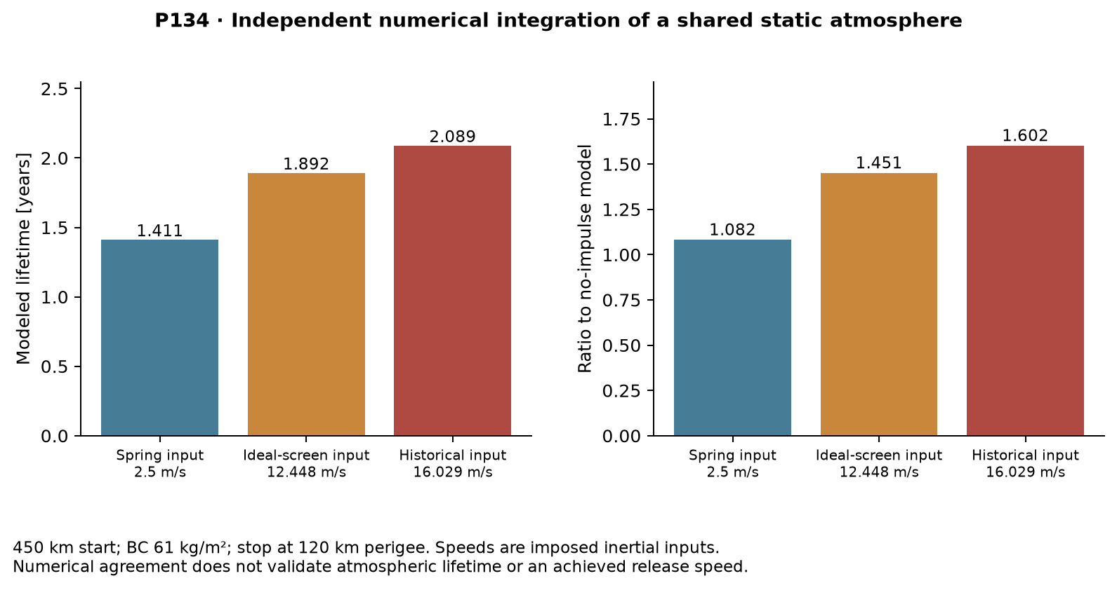
What the reconciled numerical record establishes
EVIDENCE APPENDIX
1.602 model ratio
Separate integration, same static atmosphere. Actual lifetime is unvalidated.
Failures retained
22 Gen5/R1 intersections; 126.562 kg model; archived mission screens fail. New Gen6 targeting is separately bounded.
MODEL EVIDENCE ONLY
P133/P134 · technical evidence revision, 16 October 2026
28

Slide 29
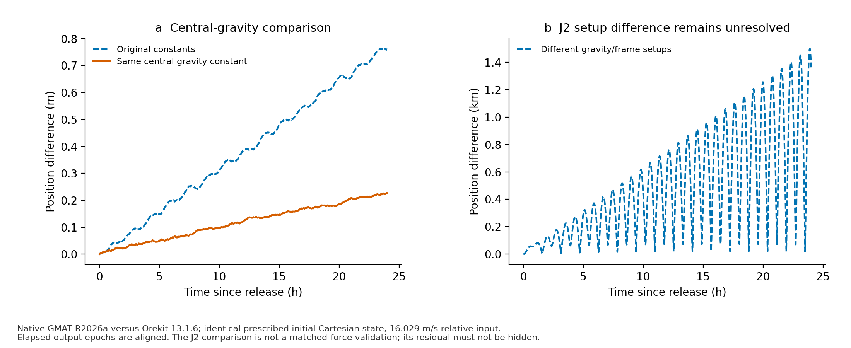
Native solvers: agreement and unresolved differences
EVIDENCE APPENDIX
Prescribed states; no release-accuracy or hardware validation. J2 frames are not harmonized.
ORBITAL ANALYSIS
Orekit 13.1.6 / GMAT R2026a; 18 October evidence supplement
29

Slide 30
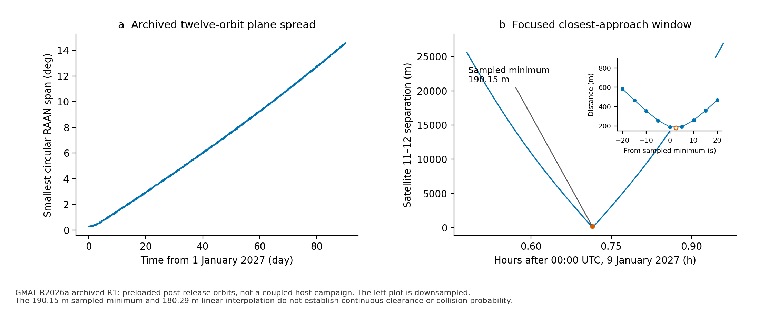
Archived campaign: sampled proximity has a limit
EVIDENCE APPENDIX
190.15 m sampled; 180.29 m interpolated. Continuous clearance remains unproven.
GMAT R1 ARCHIVE
Twelve preloaded post-release orbits; simulation dates in 2027
30

Slide 31
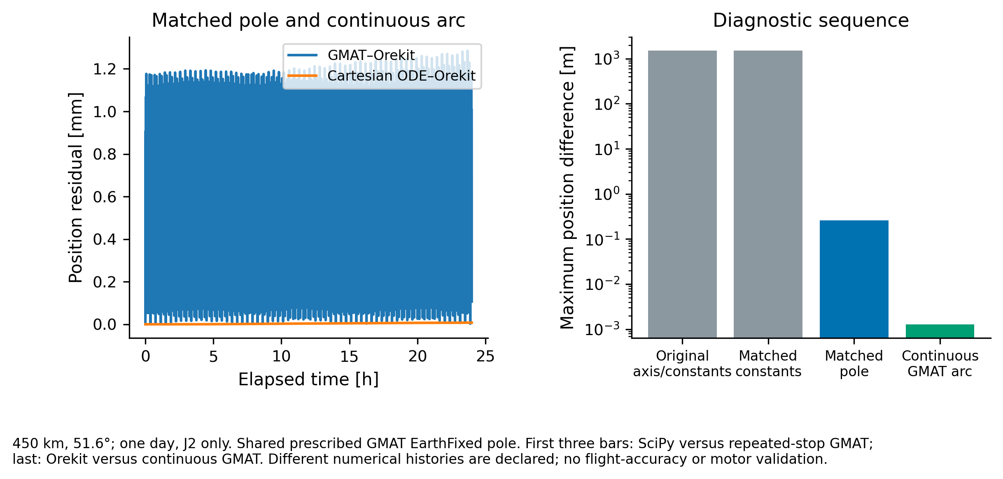
The J2 setup discrepancy now has a bounded resolution
EVIDENCE APPENDIX
1.285 mm maximum over one day. Shared orientation; no physical orbit or release-accuracy claim.
NUMERICAL CONSISTENCY
GMAT R2026a / Orekit 13.1.6 · matched prescribed pole, 19 October
31

Slide 32
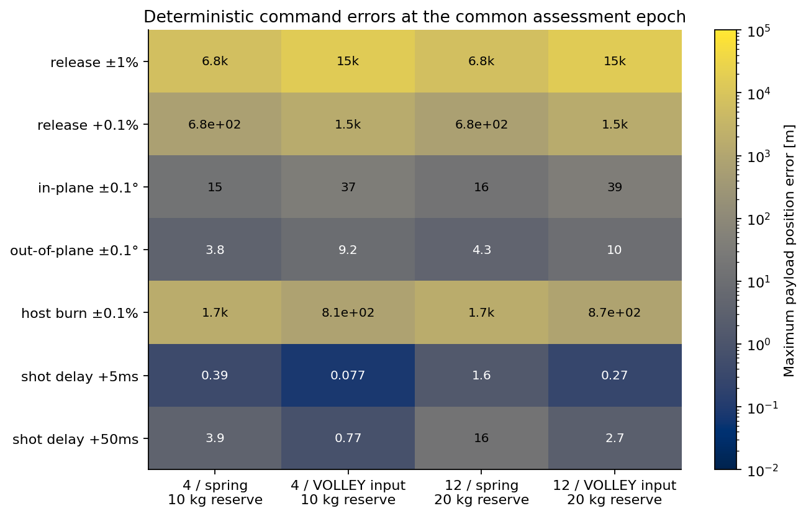
Precise delivery needs a measured control budget
FUTURE-WORK APPENDIX
+0.1% imposed release-speed bias gives ~1.53 km error. Numerical agreement is not flight precision.
GEN6 SURROGATE
CNR-01 · complete native event replay and deterministic sensitivity
32

Slide 33
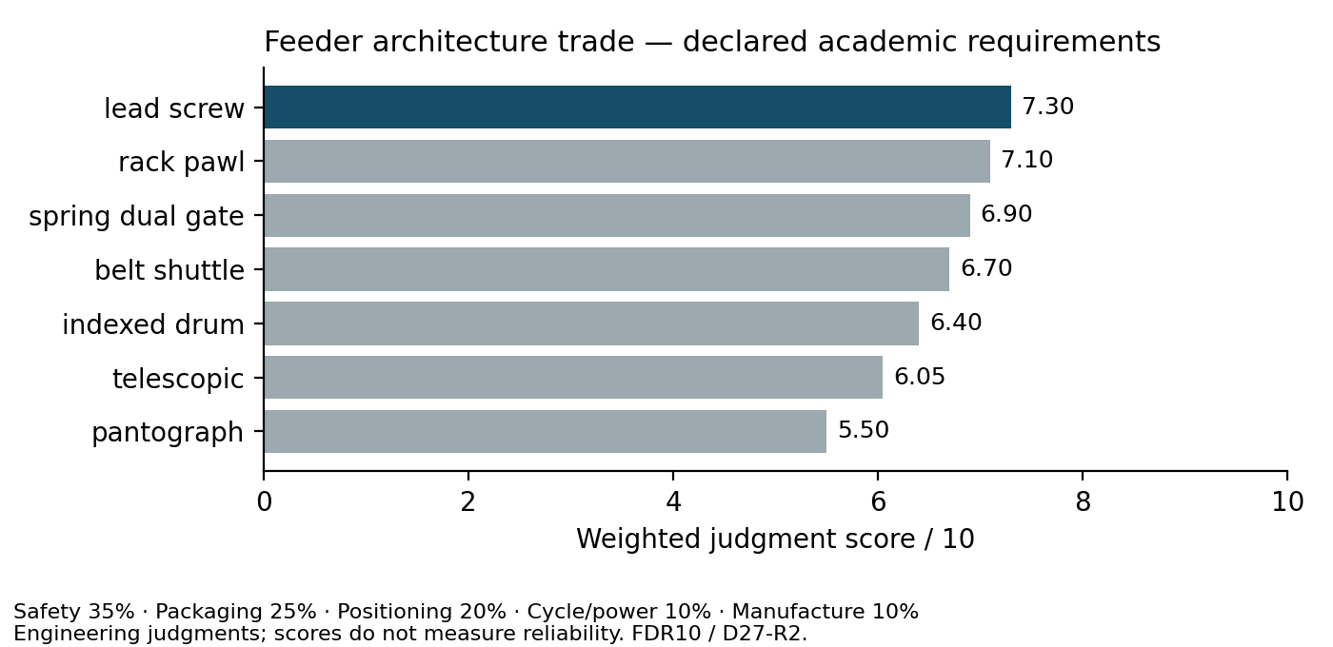
The safety-led trade selects a reversible guided drive
SELECTED FEEDER APPENDIX
• Lead screw 7.30; rack/pawl runner-up 7.10
• Equal weights tie the top three
• Conditional motor sizing at 50 N / 100 N
• Four- and twelve-cell fault-sequence checks
• Scores and logical tests do not measure reliability
Channel containment and controllability drive the choice. Original unconverged contact results supply no precision/load rating.
SELECTED LEAD SCREW
FDR10 / FM08-R3 · quantified judgment sensitivity and executable checks
33

Slide 34
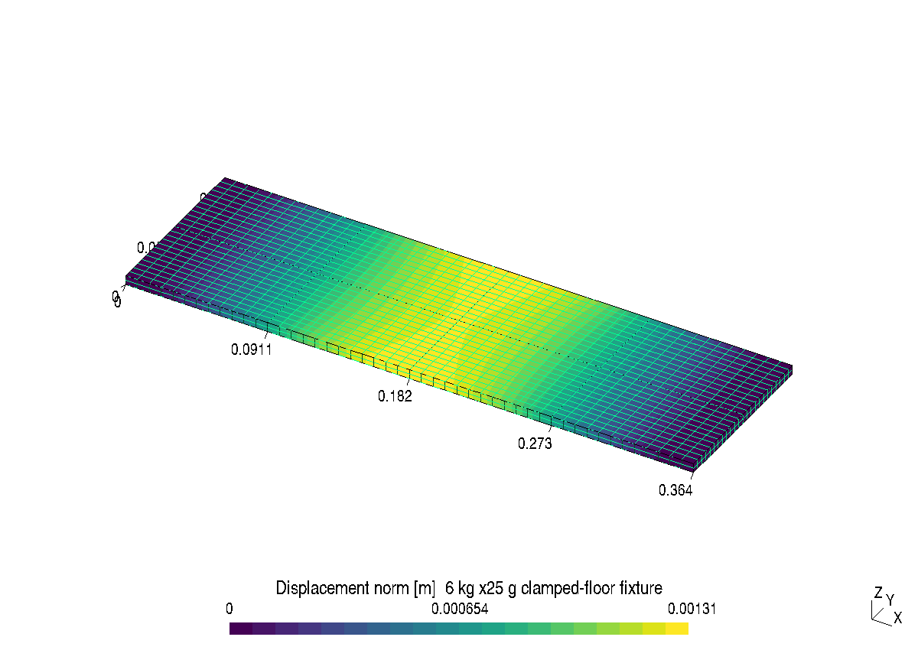
Native mesh and result view: keep the fixture explicit
EVIDENCE APPENDIX
Displacement norm in metres. Actual joints absent; peak support stress is not converged or a strength pass.
ASSUMED CLAMPED FLOOR
CalculiX2.23 DAT / INP displayed in Gmsh4.14.1 · undeformed geometry
34

Slide 35
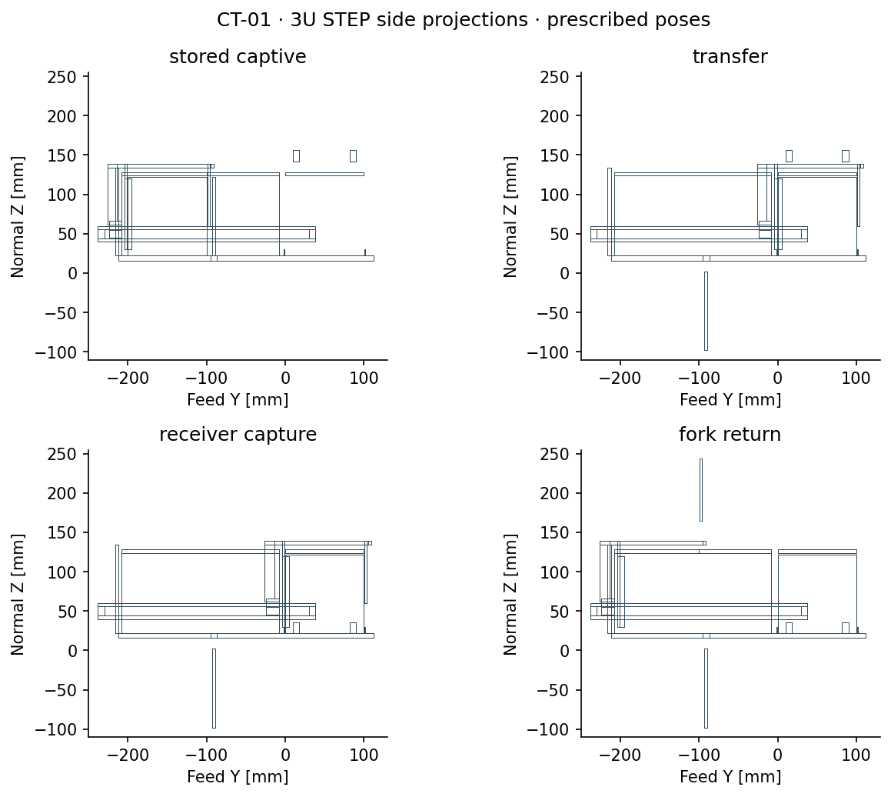
Continuous feed geometry exposes the remaining safety work
FUTURE-WORK APPENDIX
• 20 continuous 1U/3U phase checks
• Downward gate needs under-deck volume
• Stop travel and adverse fit cases fail
• Real latch/custody and drive remain open
Native CAD and nominal translation proof do not establish full mechanism safety or a selected feeder.
PRESCRIBED MOTION ONLY
CT-01 · separate captive-transfer coupon; 19 October 2026
35

Slide 36
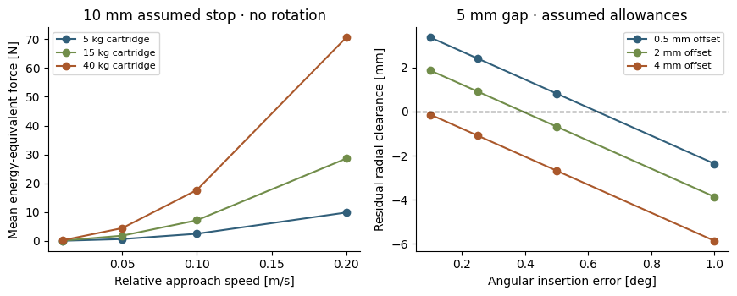
Orbital reload: define the interface before promising a service
FUTURE-WORK APPENDIX
108 capture / 36 fit sensitivities. No integrated reload mechanism; ground loading remains the assumption.
BASELINE OPERATIONAL NO-GO
RPL-01 · limited cooperative-cartridge feasibility
36

Slide 37
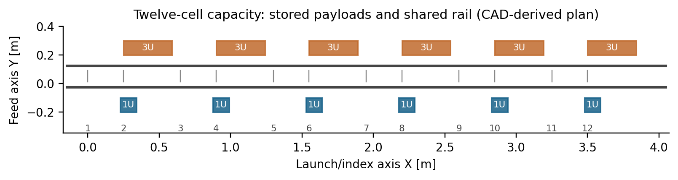
Twelve dedicated cells require a larger host allocation
GEN6 SCALING APPENDIX
398 parts; 4.21 m envelope
18.26 s allocation residual
Six 1U + six 3U; 83.331 kg partial feeder accounting. Full installed mass and host approval are separate.
241.818 s coast minus 223.556 s feeder-only allocation. Launch, charging, braking and reset must also fit.
Two nominal native/STEP states and twelve modeled payload swept corridors clear represented geometry; no hardware qualification.
DETAILED SCALING STUDY
Native FreeCAD / STEP · FBR-02 nominal scheduling and mass boundary
37

Slide 38
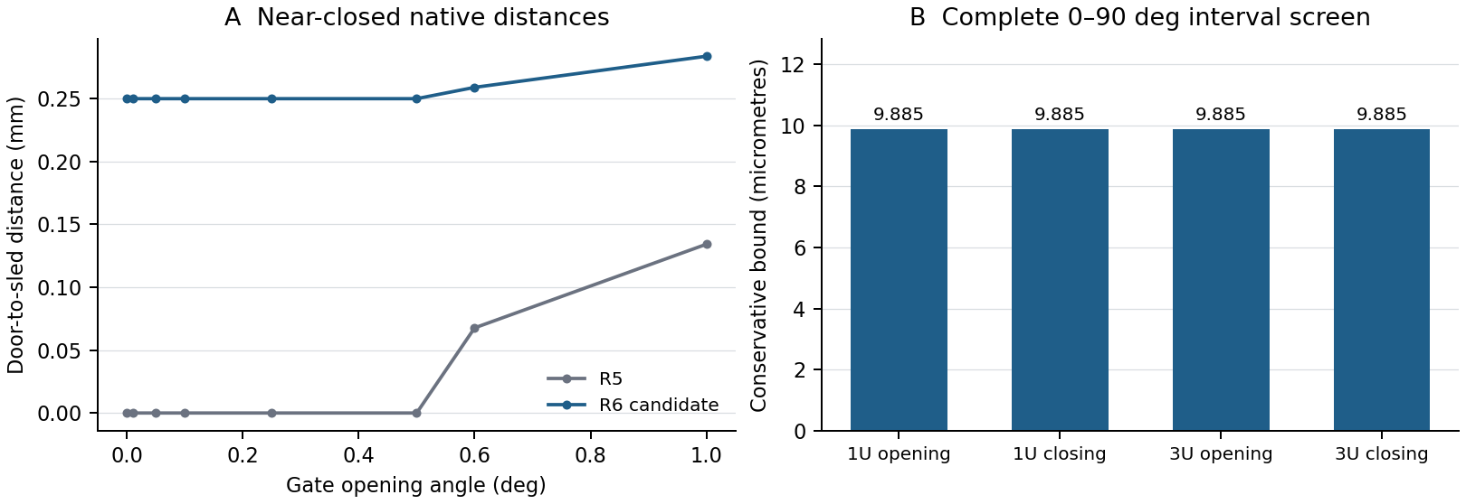
Gate relief passes the complete-angle nominal screen
FUTURE-WORK APPENDIX
• Panel lower edge relieved by 0.25 mm
• Four full opening/closing intervals checked
• Eight assembly and two gate STEP readbacks
• Nominal numerical bound; loaded fit and actuation remain separate
Smallest guarded bound: 0.0098846 mm. No manufactured-clearance, contact-convergence or qualification claim.
NATIVE GEOMETRY RESULTS
RVC01 · FM07-R6 candidate; separate from evaluated Gen5
38

Slide 39
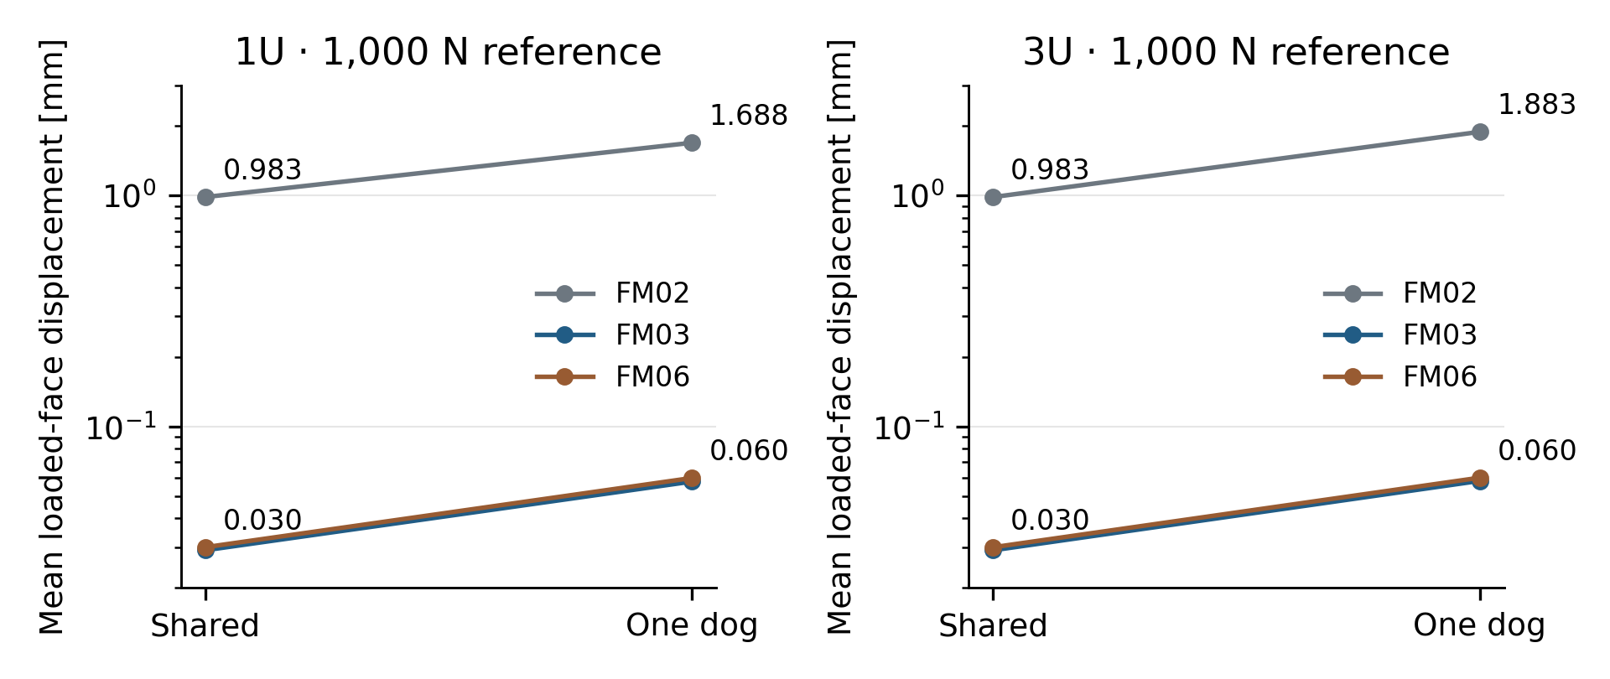
Component stiffness improves within an idealized fixture
FUTURE-WORK APPENDIX
• 12 actual-FM06 plus 40 historical receiver analyses
• 3U one-dog mean: 1.883 to 0.0600 mm
• Clamped bores do not bound assembled stiffness
• 1,117/1,215 adverse guide-fit residuals nonpositive
Assumed elastic properties; no selected material allowable, real joint-contact acceptance or hardware testing.
COMPONENT FIXTURE RESULTS
FLR01 / FLR02 / FLR03 · Gmsh 4.14.1 / CalculiX 2.23
39

Slide 40
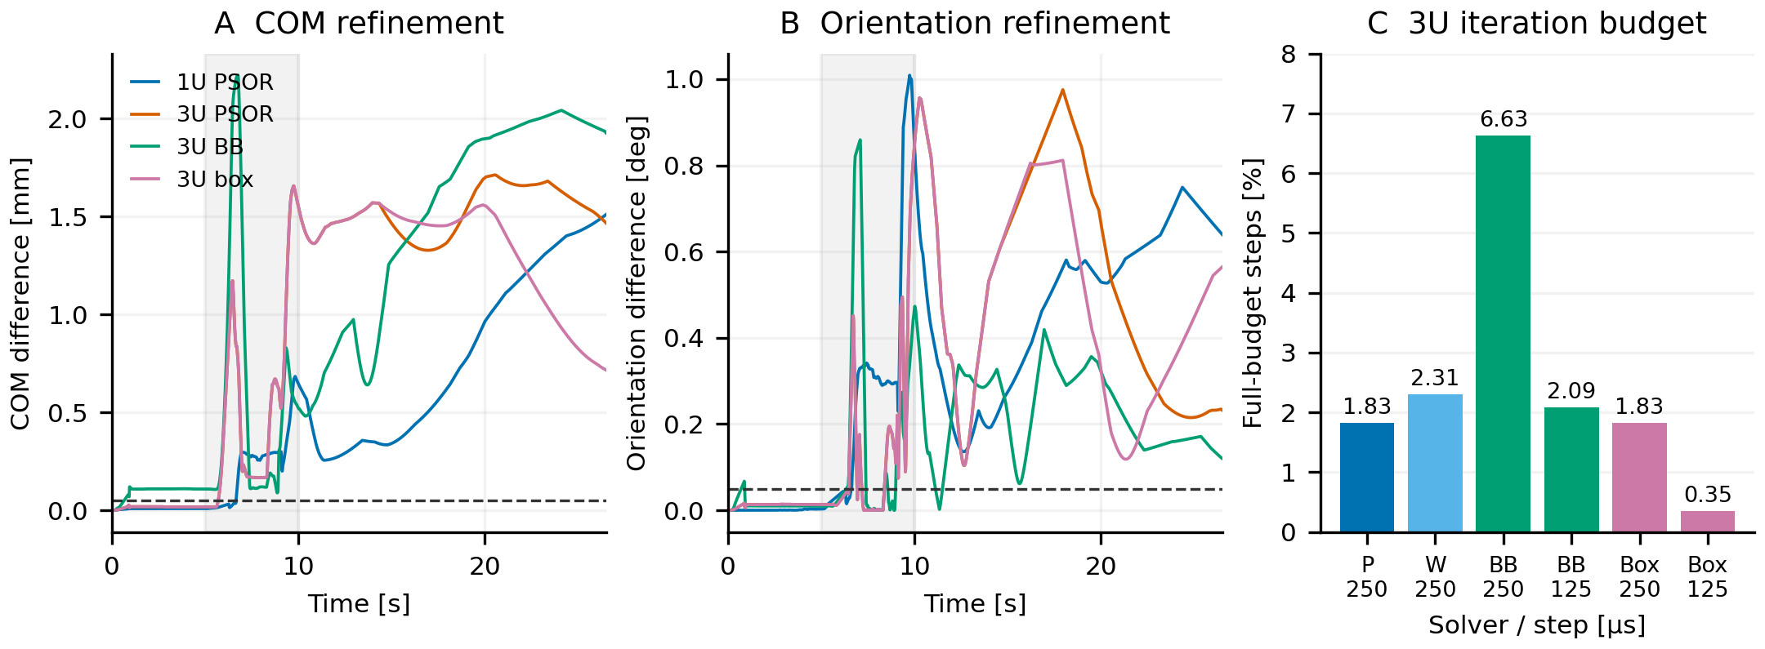
Contact diagnosis retains the numerical acceptance criteria
FUTURE-WORK APPENDIX
• Instrumented baseline reproduced byte for byte
• PSOR, BB and exact-box refinements exceed pose limits
• Sensitivity develops during feed deceleration
• No qualified correction or contact-force rating
Nominal FM07-R6 rotary screens pass separately; FM06 contact results do not validate that revised assembly.
NUMERICAL METHOD RESULTS
FCE13 · FM06-R1; six additional completed native Chrono cases
40

