Slide 1

Department of Mechanical Engineering
B.Tech Project Presentation on
VOLLEY: Controlled CubeSat Deployment
from a Hosted Orbital Platform
Completed Gen5 system-level computational evaluation
Presented By
Adityavardhan Mishra · Pratham Chawla
PRN 23070125054 · PRN 23070125029
Guide: Vikas Gulia
Final review: 10 October 2026
SYMBIOSIS INSTITUTE OF TECHNOLOGY PUNE
1

Slide 2
Presentation route
OUTLINE
01 Introduction
07 Work progress
02 Literature review
08 Results
03 Research gap
09 Conclusion
04 Objectives
10 Future work
05 Research methodology
11 References
06 Timeline
PRESENTATION GUIDE
User-specified final-review outline
2

Slide 3
The thesis answers an orbital-delivery trade question
INTRODUCTION
Shared destination
Conventional release
VOLLEY question
Secondary CubeSats inherit the orbit chosen for the primary customer.
Spring deployers provide a small relative impulse. Subsequent orbit or drag differences can produce phasing.
Can commanded release provide useful orbital choice at an acceptable installed cost?
Study outcome: useful modelled orbital change, but an unfavourable 3U mass trade
GEN5 MODEL STUDY
Thesis manuscript, Introduction; JAXA J-SSOD; EXOpod documentation
3

Slide 4
Existing methods solve different parts of the problem
LITERATURE REVIEW
Approach
Strength
Limit for this thesis
Spring deployer
Flight heritage; compact; simple
Limited tailored release speed
Spring release / drag
Relative state or drag can create phasing
Timing alone, with no relative state change, cannot
Orbital transfer vehicle
Larger orbit changes
Greater bus, mass and integration burden
Electromagnetic research
Commandable acceleration studied
Armature, high-g or maturity constraints vary
GEN5 MODEL STUDY
JAXA; Foster et al. 2018; Feng et al. 2025; Zhao et al. 2022/2025
4

Slide 5
A narrower, testable contribution
RESEARCH GAP
Commanded release for an unmodified CubeSat at moderate acceleration, with the full system counted.
Contribution examined
Boundary
Gen5 reusable-sled linear motor, 3U payload, magazine, pulse power, arrest and orbital utility.
Electromagnetic CubeSat deployment exists in prior work. Payload qualification and physical performance remain unproved.
GEN5 MODEL STUDY
Thesis manuscript, Related Work and Introduction
5

Slide 6
The analytical research objectives have outcomes
OBJECTIVES
Research objective
Final thesis outcome
Design a commandable 3U system
Gen5 CAD and complete subsystem architecture documented
Calculate shot and control performance
Rated shot, power and dispersion models completed
Evaluate orbital utility
Predicted energy and lifetime benefit for stated cases
Count full installed burden
Mass rollup completed; 3U parity criterion failed
Test credibility of key claims
Numerical cross-checks and limits recorded
GEN5 MODEL STUDY
Thesis manuscript, BASELINE.md and PROVENANCE.md; presentation synthesis
6

Slide 7
A completed analysis chain from mission to decision
RESEARCH METHODOLOGY
Mission &
payload needs
Architecture
trade
CAD & mass
model
Shot, power &
orbit models
Numerical
cross-checks
Sensitivity &
acceptance bands
→
→
→
→
→
Models were challenged and revised; hardware performance remains outside this thesis's evidence.
GEN5 MODEL STUDY
Thesis manuscript, Models and Verification; validation register
7

Slide 8
Numerical checks strengthened the final baseline
RESEARCH METHODOLOGY
Question
Method / cross-check
Evidence limit
Field and thrust
Analytic winding; magpylib; FEM
No measured thrust constant
Shot and power
Dynamics; Monte Carlo; ngspice
Assumed components and interfaces
Structure and flow
CAD; CalculiX; OpenFOAM
No payload qualification
Orbital change
Orbit model; Cowell / GMAT cases
Lifetime depends on atmosphere
GEN5 MODEL STUDY
VOLLEY-thesis/appendix/PROVENANCE.md; validation run sheets
8

Slide 9
Project evolution: documented decisions and analysis
TIMELINE
2023
Hosted concept
Free-flyer concept reframed around a host platform
Mid-2025*
LSM direction
Coilgun study gives way to a linear synchronous motor
2025–26*
CAD generations
Geometry and mass models mature through Gen5
Jul–Sep 2026
Gen5 evidence
Cross-checks, defect corrections and thesis record
Oct 2026
Final review
Gen5 results, failed criterion and thesis record presented
* Approximate historical milestone; not a documented semester deadline.
GEN5 MODEL STUDY
VOLLEY-thesis/appendix/HISTORY.md; thesis README; PLAN-R2
9

Slide 10
2026 findings were incorporated in the final baseline
TIMELINE
Jul
CAD-derived sled mass replaced an optimistic parametric estimate
Aug
Depth-resolved thrust calculation lowered the rated speed
Aug
Enclosure buildup exposed the full 3U mass penalty
2026
Independent orbit checks rejected a solar-invariance claim
Final
Results and failures retained in the submitted thesis record
GEN5 MODEL STUDY
HISTORY.md; PROVENANCE.md; thesis manuscript, Limitations
10

Slide 11
The thesis deliverables are complete and traceable
WORK PROGRESS
Design delivered
Analysis delivered
Evidence delivered
Gen5 CAD, magazine and release architecture, subsystem models and system mass rollup.
Shot, control, circuit, structure, thermal, orbit and alternative-case results.
Manuscript, figures, scripts, numerical checks, provenance and defect register.
Scope: completed computational thesis; physical qualification belongs to a later development phase.
GEN5 MODEL STUDY
Thesis README; BASELINE.md; PROVENANCE.md; validation register
11

Slide 12
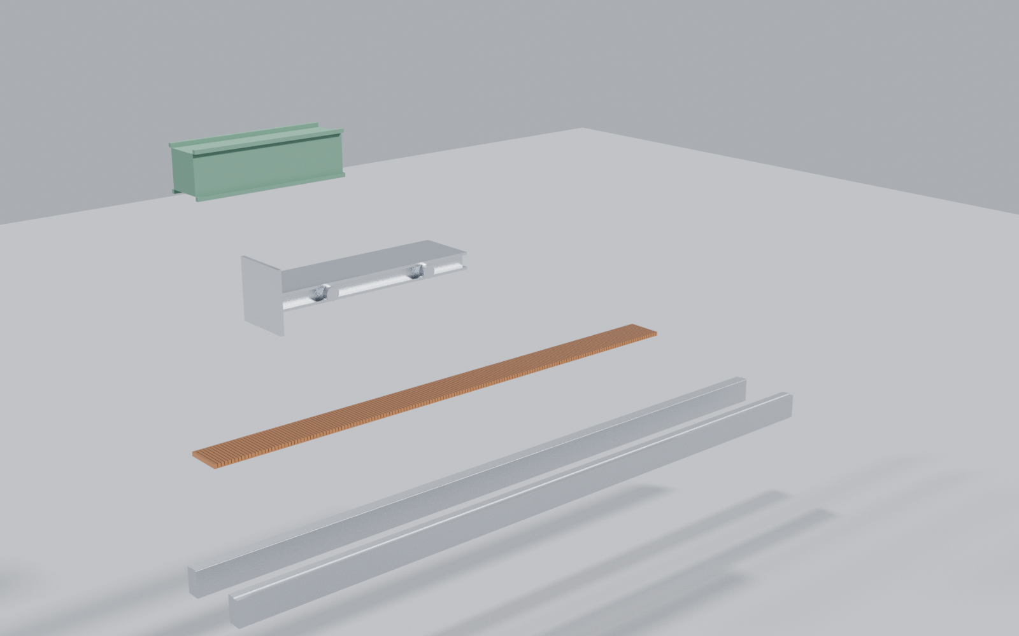
Gen5: complete computational system configuration
RESULTS
• 1.5 m linear-motor track and double-sided Halbach arrays
• Reusable 9.45 kg magnet sled
• Two cassettes; twelve 3U satellites
• Pulse bank, restraint and eddy-current arrest
GEN5 MODEL STUDY
Thesis manuscript, System Architecture; CAD render
12

Slide 13
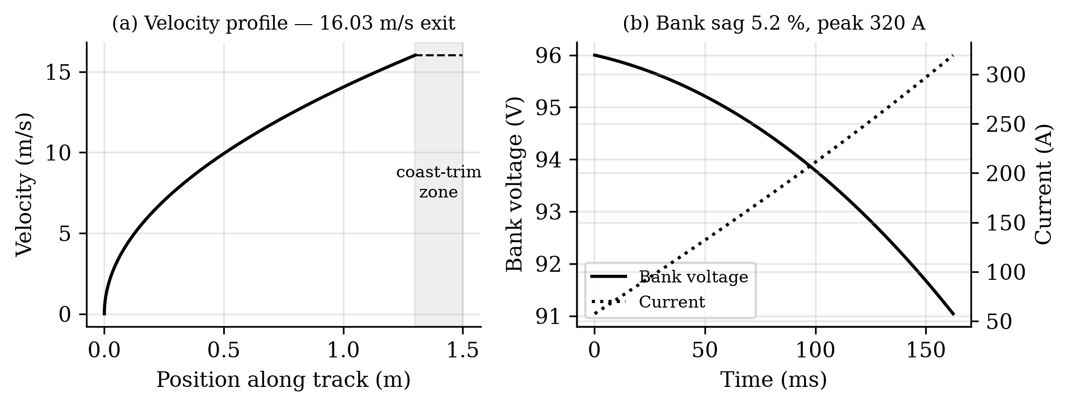
Rated 3U shot: performance predicted by the model
RESULTS
16.0 m/s
10.07 g
2.782 kJ
18.8%
exit speed
acceleration
gross draw
net efficiency
GEN5 MODEL PREDICTION
Thesis BASELINE.md; F01_shot.png
13

Slide 14
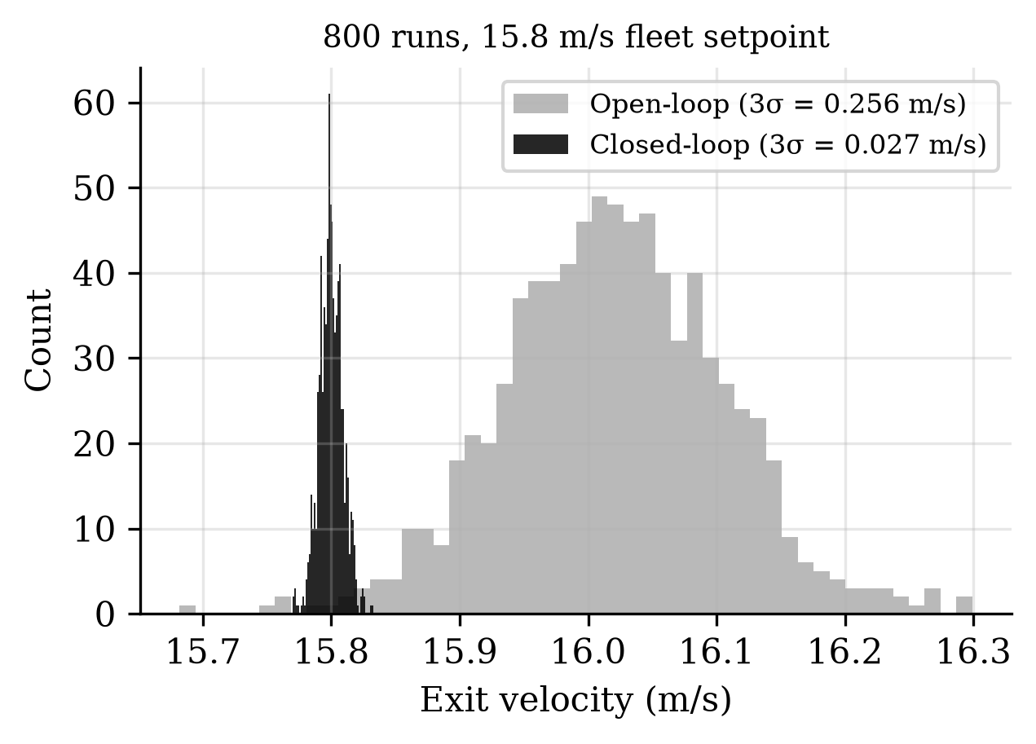
Modelled command precision is narrow; it is unmeasured
RESULTS
0.0274 m/s
3σ exit-velocity dispersion at a 15.8 m/s fleet setpoint.
Evidence limit
Monte Carlo under modelled sensing and plant tolerances; no measured dispersion.
GEN5 MODEL PREDICTION
Thesis BASELINE.md; PROVENANCE.md; F03_mc.png
14

Slide 15
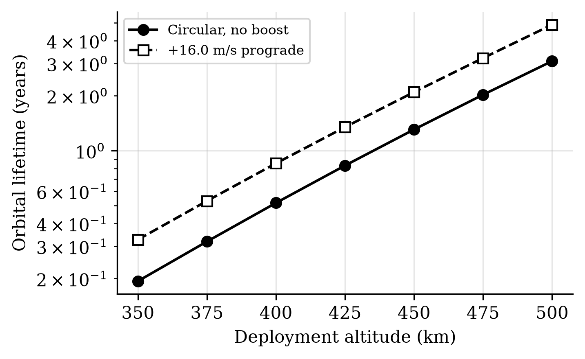
Commanded velocity can change orbital energy
RESULTS
+28.8 km
Predicted semi-major-axis rise for one maximum-velocity release.
1.60×
Predicted lifetime at stated mean solar activity; atmosphere-dependent.
Persistent phasing requires a relative state change; this result concerns orbital energy.
GEN5 MODEL PREDICTION
Thesis manuscript, Astrodynamic Utility and Limitations; F04_life.png
15

Slide 16
Gen5 fails its 3U mass comparison
RESULTS
Dry system
126.6 kg
Gen5 per 3U
10.55 kg
Spring comparator
~6 kg
1.76× heavier per 3U payload; the preset 15% parity band fails.
GEN5 MODEL STUDY
Thesis manuscript, Payload Class and Mass-per-Satellite; A46 enclosure result
16

Slide 17
The study ends with a clear engineering decision
RESULTS
Supported
Rejected for 3U
Unverified
Modelled commandable release and a conditional orbital-energy benefit.
The complete Gen5 configuration misses the preset spring-mass parity target.
Payload loads, magnetic cleanliness, cycle life and host interfaces require tests.
Decision: retain the numerically checked model; do not select Gen5 as a 3U flight configuration.
EVIDENCE BOUNDARY
Thesis OPEN_PROBLEMS.md; PROVENANCE.md; manuscript Limitations
17

Slide 18
Computational demonstration: from shot to orbit
RESULTS
1. Simulate a 3U shot → 16.0 m/s
2. Model the orbital response
→
Compare predicted orbital change and full installed mass with the spring baseline. Simulation, not physical demonstration.
SIMULATION DEMONSTRATION
Thesis analysis/results; BASELINE.md; manuscript Astrodynamic Utility
18

Slide 19
The research question has a completed answer
CONCLUSION
• The Gen5 system-level model predicts 16.0 m/s 3U release and a conditional orbital benefit.
• The complete modelled system is 76% heavier per 3U customer than the spring comparator.
• Independent numerical checks corrected the baseline and defined the limits of its claims.
• Conclusion: the analytical objective is complete; Gen5 does not pass the 3U selection criterion.
GEN5 MODEL STUDY
Thesis manuscript, Conclusion; BASELINE.md; PROVENANCE.md
19

Slide 20
Gen6 reopens the mechanism and installed-system trade
FUTURE WORK
One shared path • sequential feed • commanded release for each CubeSat
• Investigate approximately 1–2 m/s through 1 km/s across mission cases.
• Compare electromagnetic, stored-energy, gas/fluid, hybrid, BOLLEY and conventional options.
• Count feeder, retention, arrest, control, energy, thermal, host loads and shared faults.
1 km/s is a research target, not demonstrated speed or payload/provider compatibility.
GEN6 PLAN • NOT ACHIEVED
CURRENT PLAN AND STATUS — PLAN-R2, 29 Sep 2026
20

Slide 21
Next milestone: one reviewable first-test configuration
FUTURE WORK
Freeze
Named mission, payload and host surrogate
Decide
Fair mechanism and installed-burden trade
Measure
Field, contact, release, arrest, loads and cycle behavior
Review
Drawings, BOM, procedures, uncertainty and review decision
GEN6 PLAN • NOT ACHIEVED
PLAN-R2 N0–N5 and agreed near-term end goal
21

Slide 22
Core literature and standards (1/2)
REFERENCES
• [1] JAXA, JEM Payload Accommodation Handbook, Vol. 8: Small Satellite Deployment ICD.
• [2] Cal Poly, CubeSat Design Specification, Rev. 14, 2020.
• [3] C. Foster et al., ‘Constellation phasing with differential drag on Planet Labs satellites,’ J. Spacecraft Rockets 55(2), 2018.
• [4] H. Feng et al., ‘Design and reachable domain analysis of on-orbit electromagnetic launcher for CubeSats,’ Int. J. Aerospace Eng., 2025.
• [5] Y. Zhao et al., ‘Design and analysis of a new deployer for the in-orbit release of multiple stacked CubeSats,’ Remote Sensing 14(17), 4205, 2022.
SOURCE LIST
Bibliography from VOLLEY-thesis/source/paper.tex
22

Slide 23
Methods and project records (2/2)
REFERENCES
• [6] Y. Zhao et al., ‘Simulation analysis and experimental verification of the transport characteristics of a high-volume CubeSat storage device,’ Aerospace 12(6), 466, 2025.
• [7] K. Halbach, ‘Design of permanent multipole magnets with oriented rare earth cobalt material,’ Nucl. Instrum. Methods 169, 1980.
• [8] NASA, General Environmental Verification Standard (GEVS), GSFC-STD-7000A, 2013.
• [9] D. A. Vallado, Fundamentals of Astrodynamics and Applications, 4th ed., 2013.
• [10] A. Mishra, VOLLEY-thesis: manuscript, baseline, provenance and validation records, repo head b30ffdc, 28 Sep 2026.
• [11] VOLLEY/BOLLEY, Current Plan and Status — PLAN-R2, controlled working baseline, 29 Sep 2026 (project plan).
SOURCE LIST
Bibliography from VOLLEY-thesis/source/paper.tex; project records
23

