Slide 1
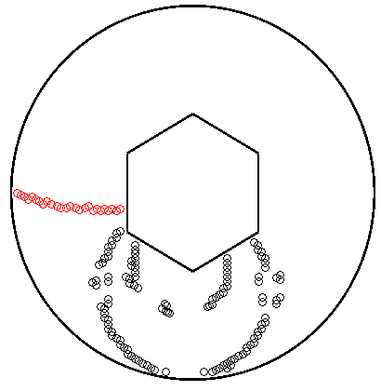
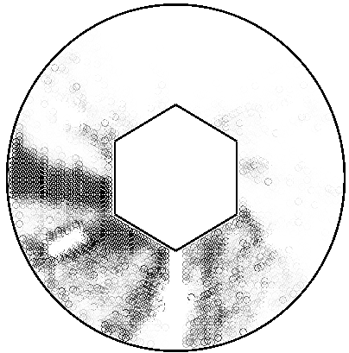
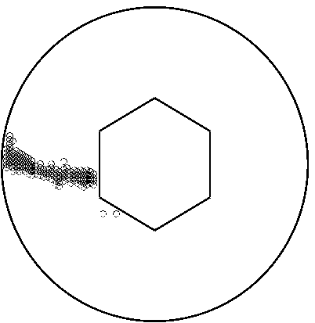
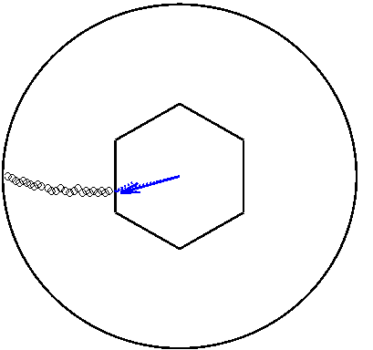
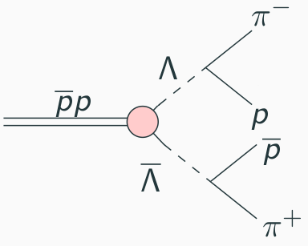
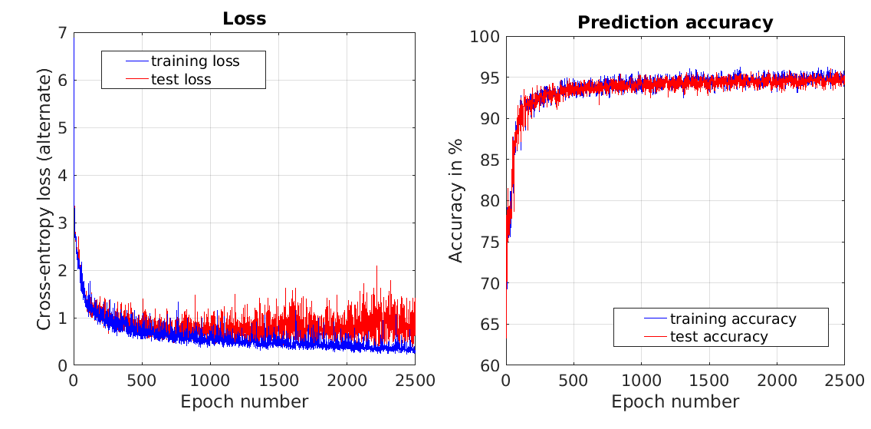
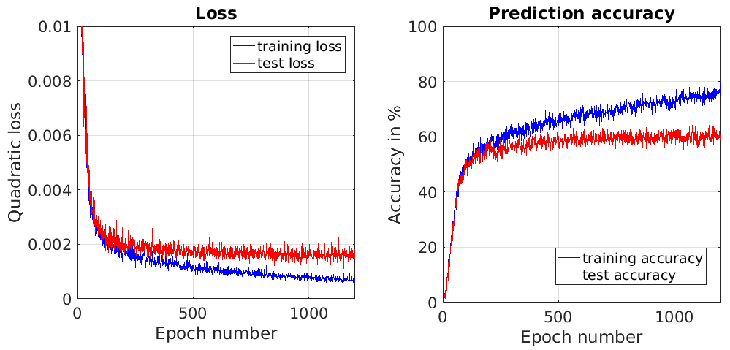
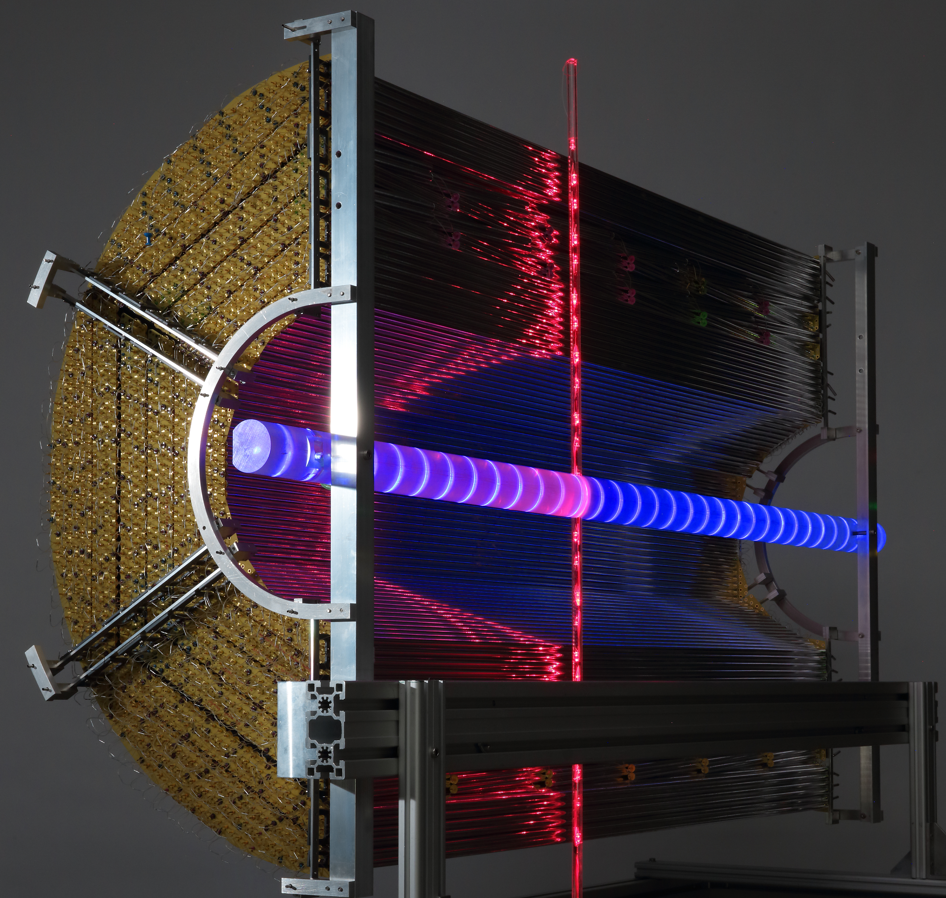
Pattern Recognition Using Neural Networks in the PANDA Experiment
Introduction
In the PANDA experiment (anti-Proton ANnihilation at DArmstadt) anti-protons are accelerated onto a stationary proton target. They annihilate into new particles and we have studied the specific decay reaction to the right. Four charged final state particles are created from the decay.
Input
Output
Results
The accuracy of the pattern recognizer is based on correctly predicted hits and misses. A correct prediction for the regression network is when the momentum vector is within 5° and 10% of the magnitude.
Project in Computational
Science 2017
Neural Network
Thresholding
Filtering
A visual representation of the reconstruction process for a specific event. The blue arrows represent the predicted (solid arrow) and true (dashed arrow) momentum vector.
Problem description
Identify specific particle tracks
Extract observables
Are neural networks viable?
Decay reaction
Method
Two neural networks were created. The first network was trained to recognize and reconstruct the track of a final state particle based on which tubes in the STT registered a hit. This takes as input the raw signals from the STT and outputs which tubes were hit by the particle.
The second network was trained to determine the momentum of the particle based on its track. Since the pattern recognition network outputs a single track, it is possible to connect the two networks together. This way one can extract the momentum directly from the raw STT signals.
The straw tube tracker (STT) has 4542 tubes spread in a cylindrical fashion. If a charged particle enters a tube, the tube registers a hit.
Results for the pattern recognition network.
Project members:
Adam Hedkvist
Arvi Jonnarth
Supervisors:
Michael Papenbrock
Karin Schönning
Course coordinator:
Maya Neytcheva
Results for the momentum regression network.
Conclusions
To implement this method, more realistic decay reactions need to be studied. New network structures can be explored as well as different loss functions.
The Straw Tube Tracker

