Slide 1
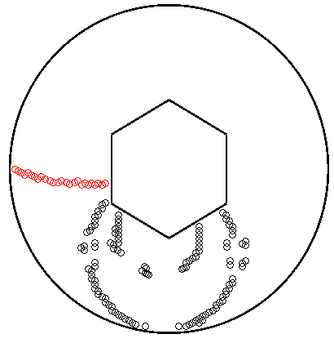
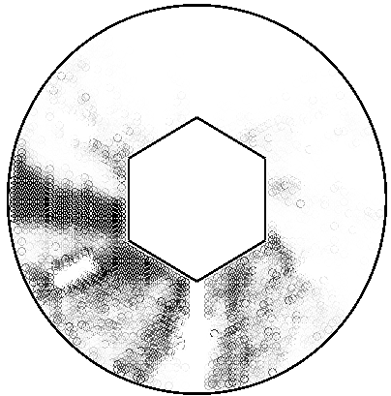
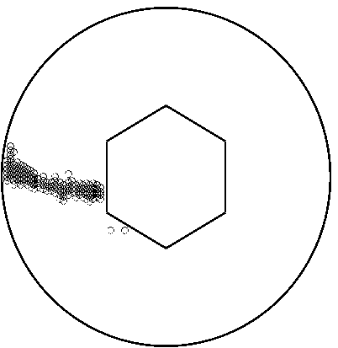
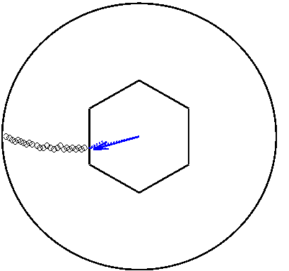
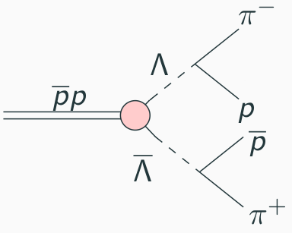
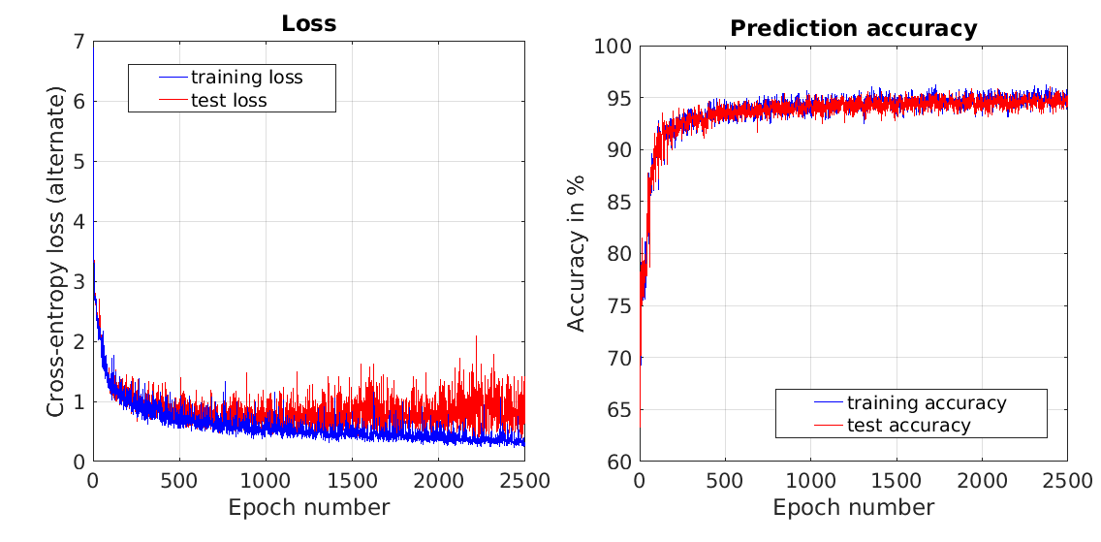
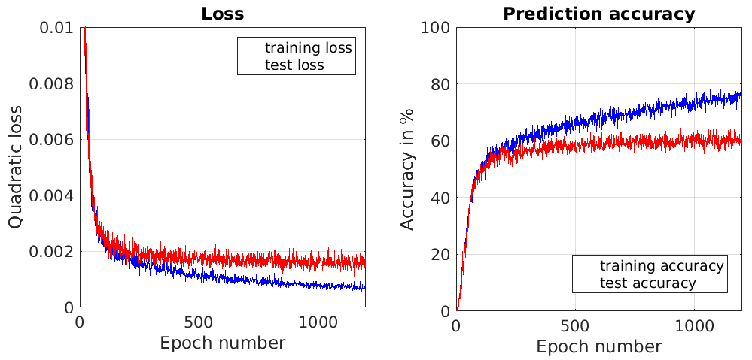
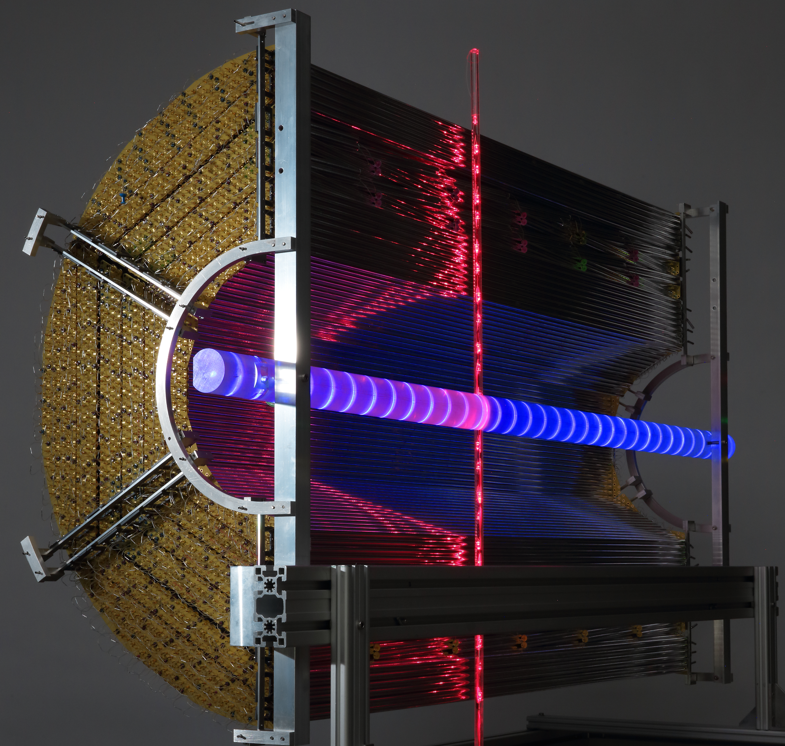
Pattern Recognition Using Neural Networks in the PANDA Experiment
Introduction
In the PANDA experi-ment, anti-protons are accelerated onto a stationary proton target and they annihilate. We have studied the specific decay reaction to the right where four charged particles are created. These are detected by the straw tube tracker (STT) where 4542 tubes are arranged cylindrically.
Input
Output
Discussion
With a 95 % prediction accuracy for the pattern recognizer it can be a great tool for particle identifi-cation. When the networks have been trained they can easily be implemented into a realistic setting.
Project in Computational
Science 2017
Neural Network
Thresholding
Filtering
A visual representation of the reconstruction process for a specific event. The blue arrows represent the predicted (solid arrow) and true (dashed arrow) momentum vector.
Method
Two neural networks were implemented to solve different sub-problems and trained on simulated data. The networks can be connected together to directly extract physical observables of the particles from the raw detector signals.
First network (pattern recognizer):
Input: Raw STT signals (tube hits)
Output: Specific particle track
Second network (momentum regressor):
Input: Specific particle track
Output: 2D momentum vector
Results
The accuracy of the pattern recognizer is based on correctly predicted hits and misses. A correct prediction for the regression network is when the momentum vector is within 5° and 10% of the magnitude.
Decay reaction
Problem description
Identify specific particle tracks
Extract physical observables
Are neural networks viable?
Results for the pattern recognition network.
Project members:
Adam Hedkvist
Arvi Jonnarth
Supervisors:
Michael Papenbrock
Karin Schönning
Course coordinator:
Maya Neytcheva
Results for the momentum regression network.
Outlook
Study more realistic decay reactions
Explore different network structures
Explore other loss functions
Possible to extract other observables
The Straw Tube Tracker

