Slide 1
Pattern recognition in the PANDA experiment with neural networks
Arvi Jonnarth & Adam Hedkvist

Slide 2
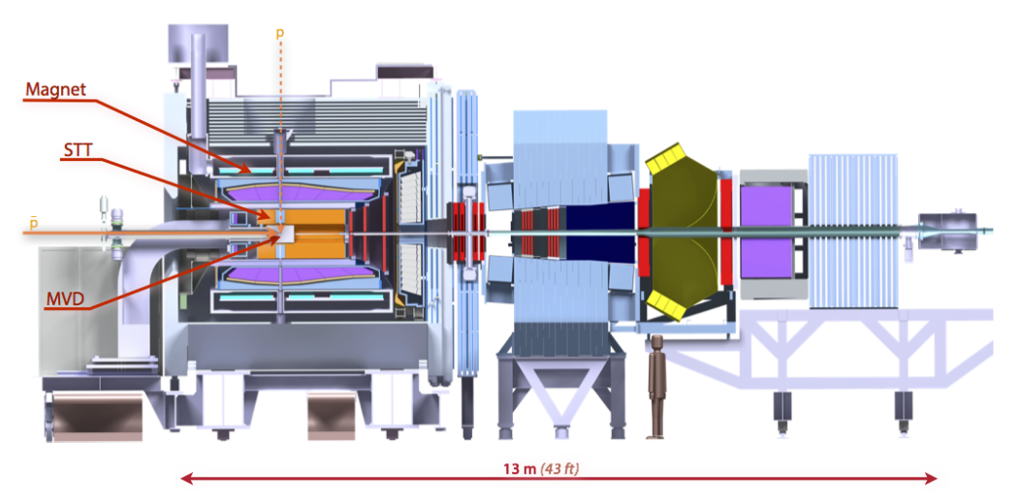
Introduction
PANDA (anti-Proton ANnihilation at DArmstadt)
Several detectors, we study the STT (Straw tube tracker)
Extract particle tracks
Method of choice: Neural networks

Slide 3
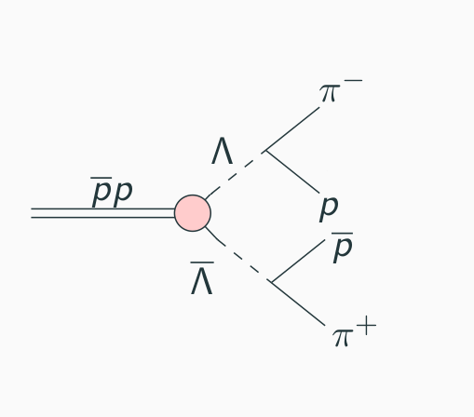
Physical background
An anti-proton beam hits a proton target.
Decay reactions
Simple reaction
Easy to study
Other reactions exist

Slide 4
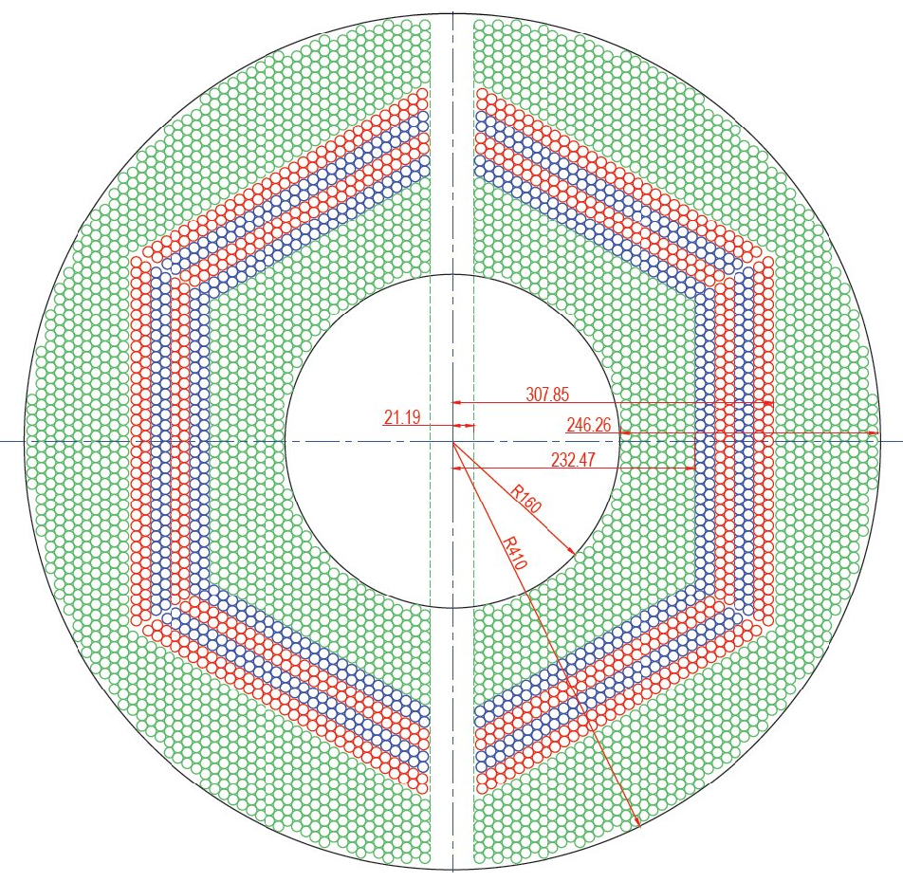
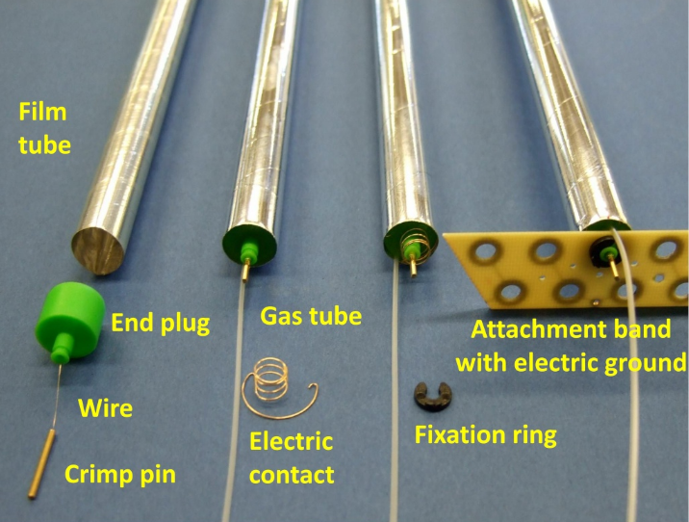
The straw tube tracker
4542 tubes
Detects charged particles
Ionizes gas and registers as a hit

Slide 5
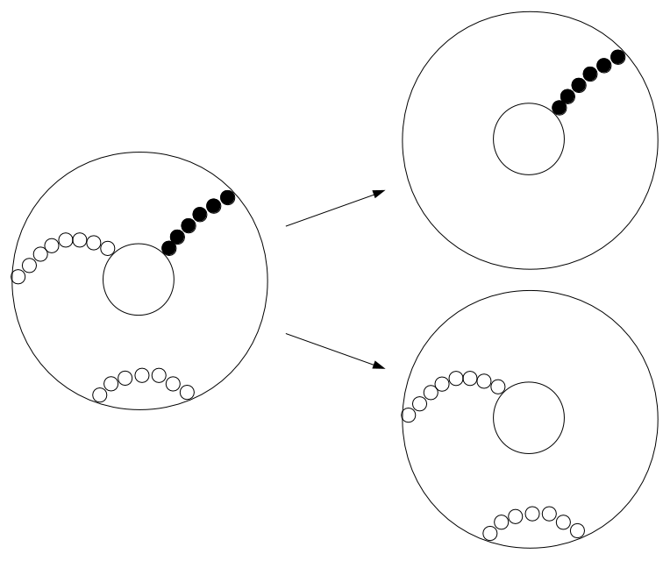
Problem description
Separate final state particle tracks
Is machine learning a viable option?

Slide 6
Method
Simulate particle tracks
Preprocess data in Matlab
Training and testing data sets
Insert into neural network
Classify one track of interest

Slide 7
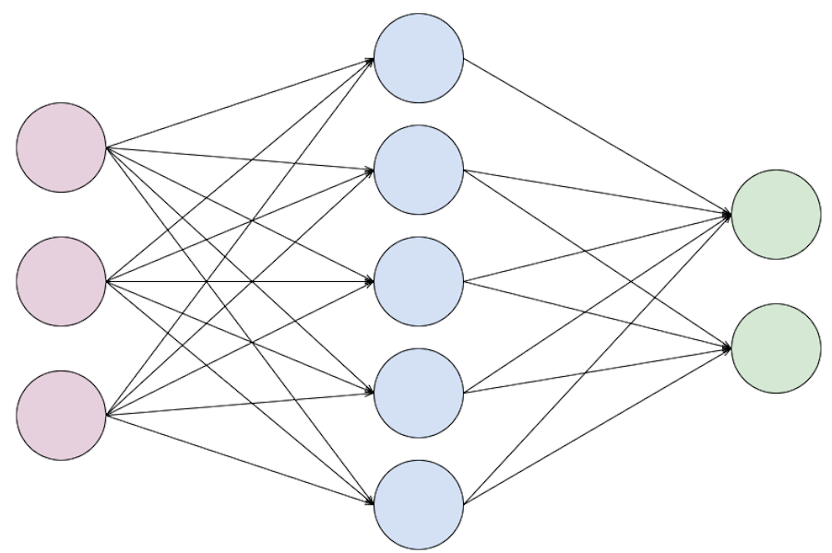
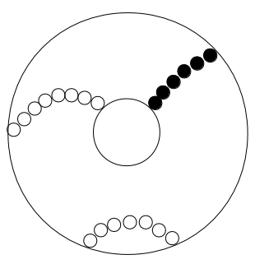
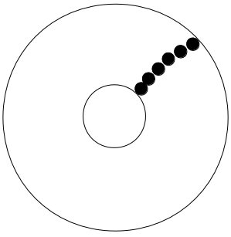
Neural networks
Input
Hidden
layer
Output
Activation
function
Weights

Slide 8
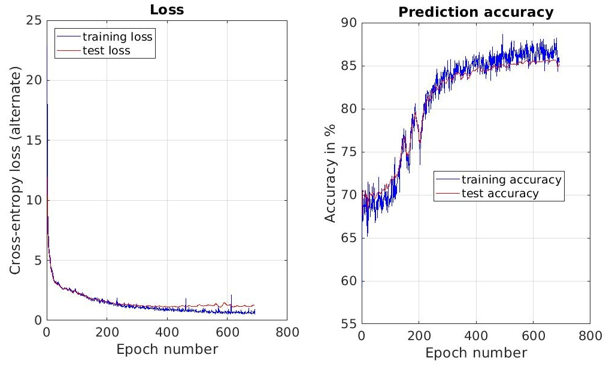
Results
Min loss: 0.524
Highest accuracy: 85.68%

Slide 9
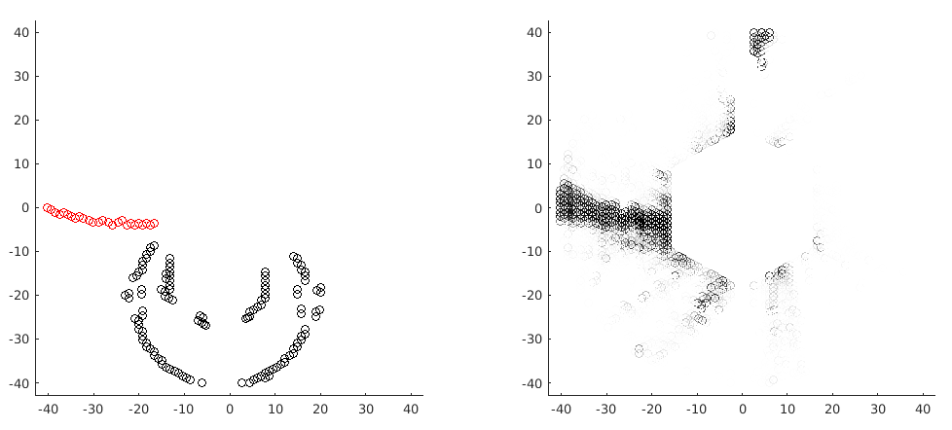
Results
Input:
Output:

Slide 10
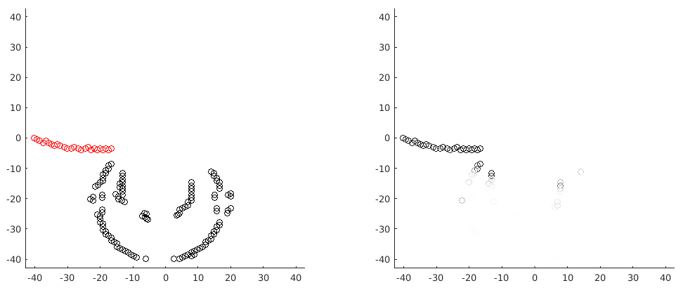
Results
Input:
Output:

Slide 11
Discussion and conclusions
Finding good parameters can be difficult
Large networks require large data sets
One network for each particle
Requires sufficient hardware
Is machine learning a viable option?

Slide 12
Future improvements
Include other detectors
Include different decay reactions
Study different network structures
Optimize hyperparameters with different optimization methods

Slide 13
Thank you for listening!

