Slide 1
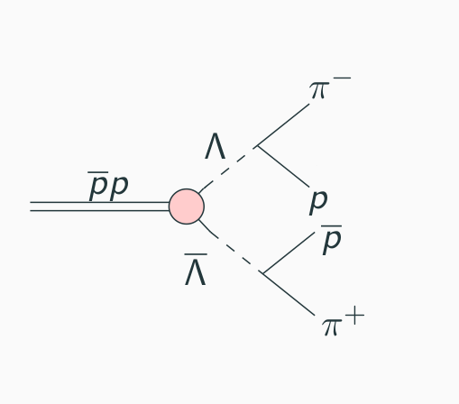
Decay reaction
Lambda Lambda-bar reaction
7 GeV?

Slide 2
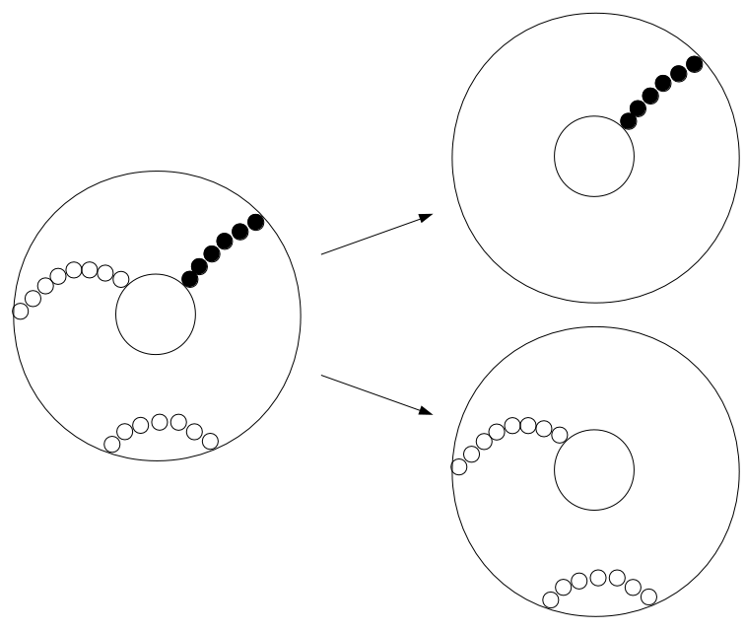
Problem description
Separate final state particle tracks
Is machine learning a viable option?

Slide 3
Method
Creating data from sim digi reco
Using STTHit branch to get all STTHits
Using MCTrack with GetPDGCode to find specific particles
Using SttMvdGemIdealTrackCand to compare our results
Write into CSV file
Implement neural network in matlab

Slide 4
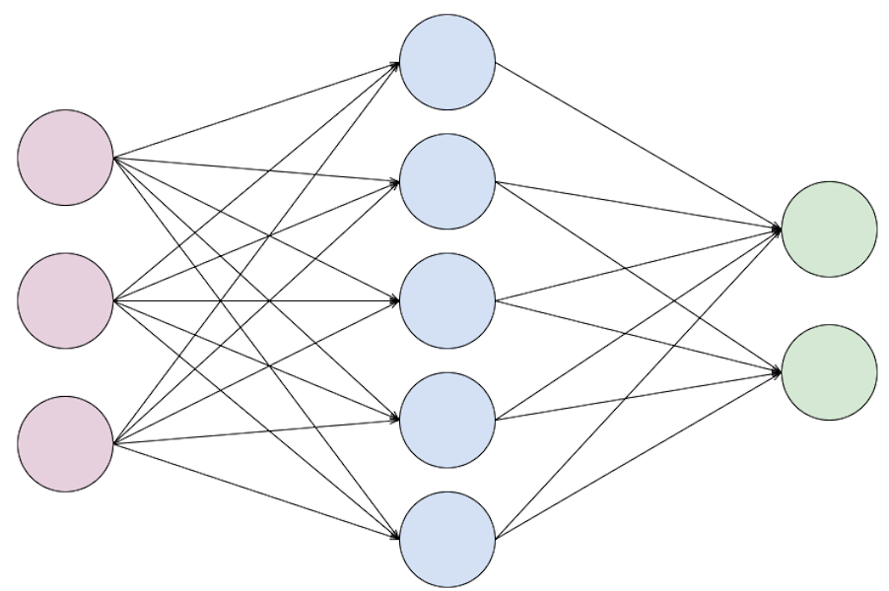
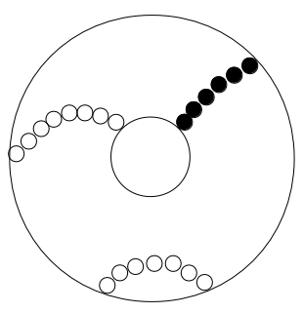
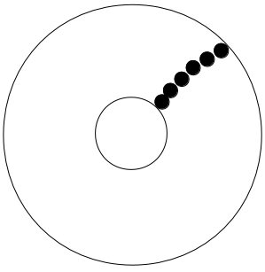
Neural networks
Input
Hidden
layer
Output
Activation
function
Weights

Slide 5
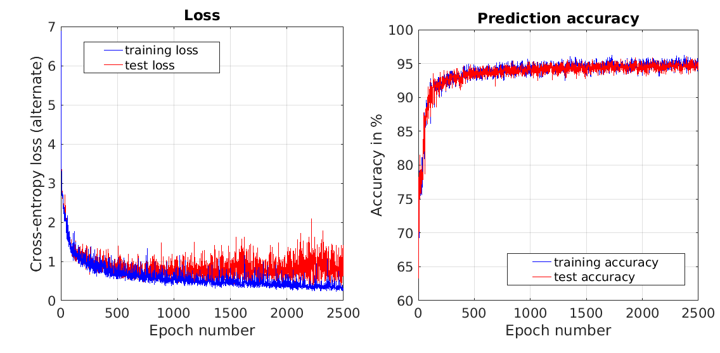
Results

Slide 6
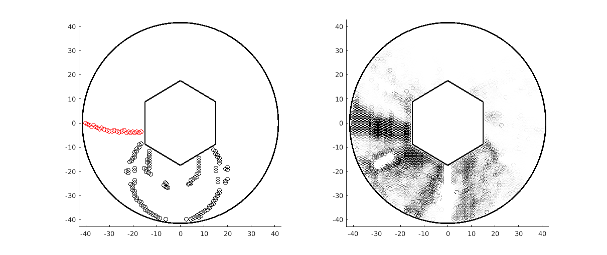
Results
Input:
Output:

Slide 7
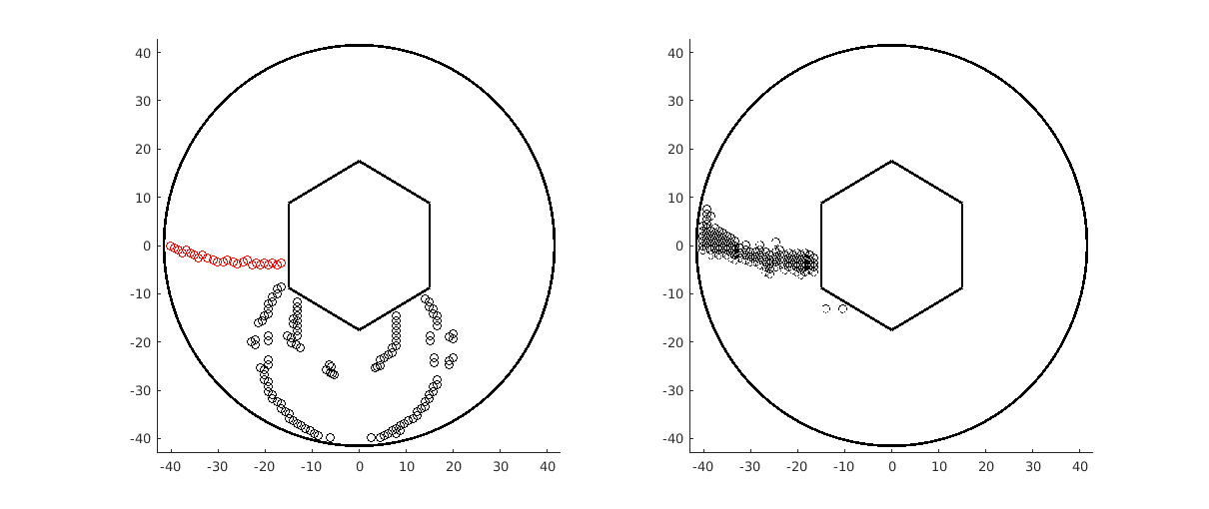
Results
Input:
Output:

Slide 8
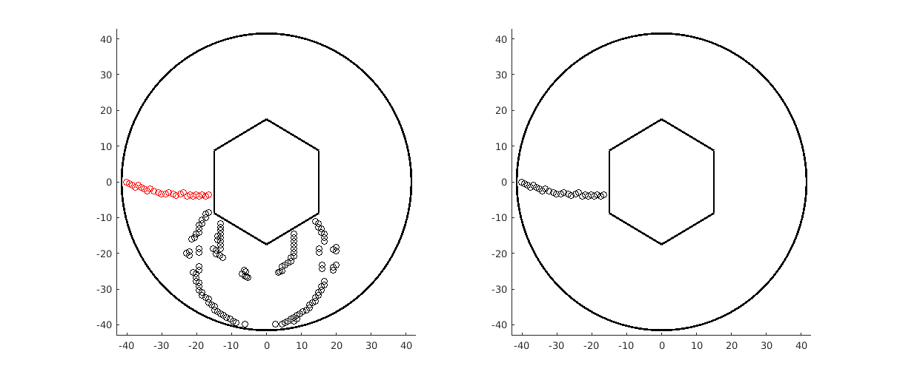
Results
Input:
Output:

Slide 9
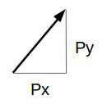
Extension
Is it possible to extract momentum as well?
Can use output from previous network

Slide 10
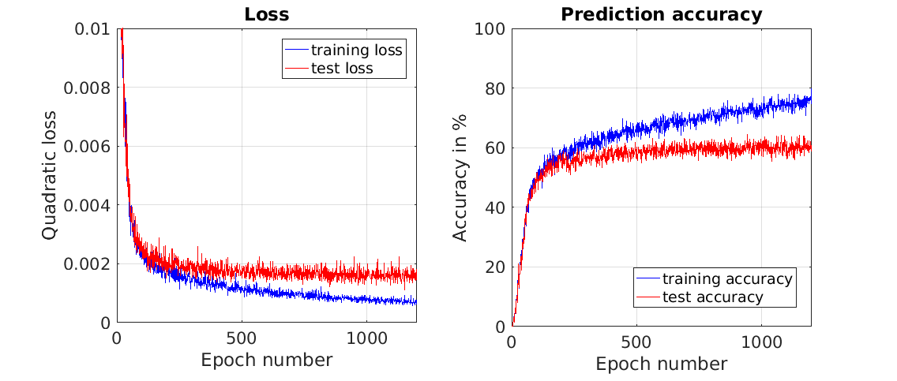
Results

Slide 11
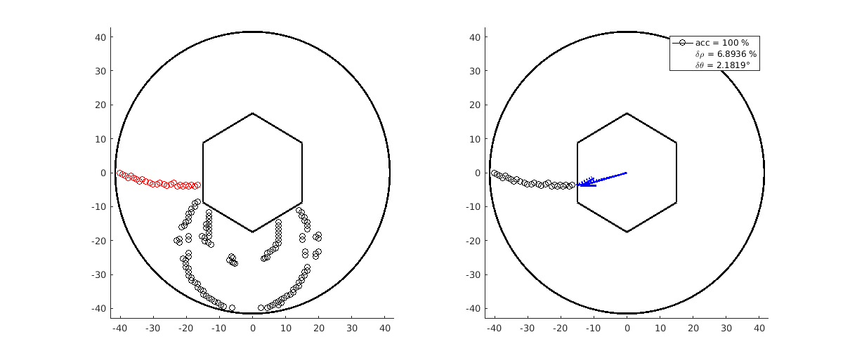
Results
Input:
Output:

Slide 12
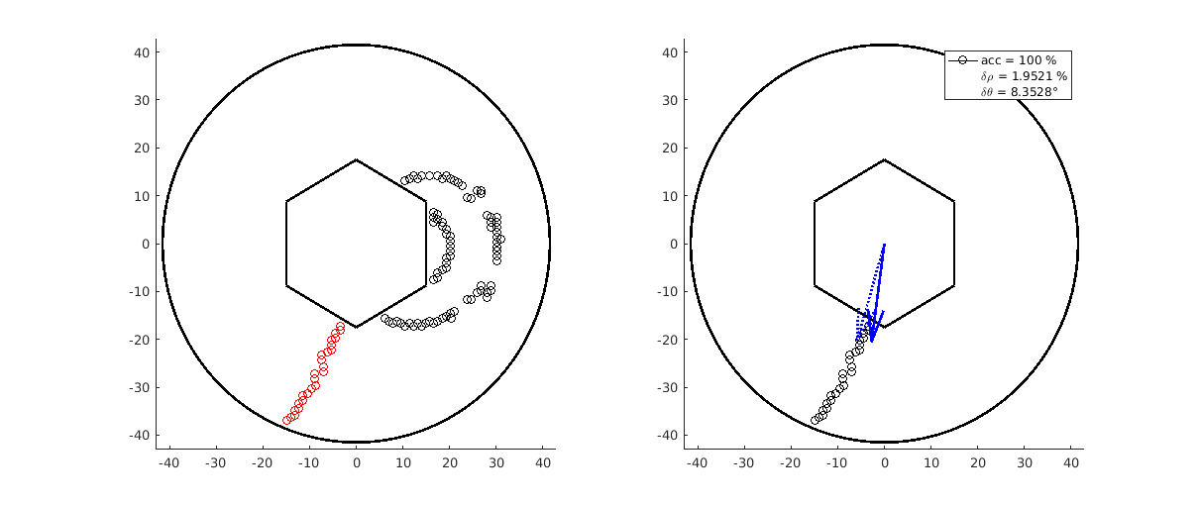
Results
Input:
Output:

Slide 13
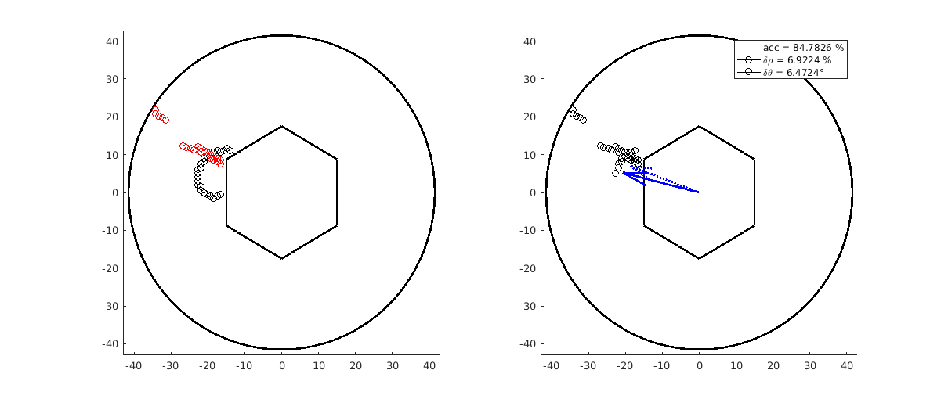
Results
Input:
Output:

Slide 14
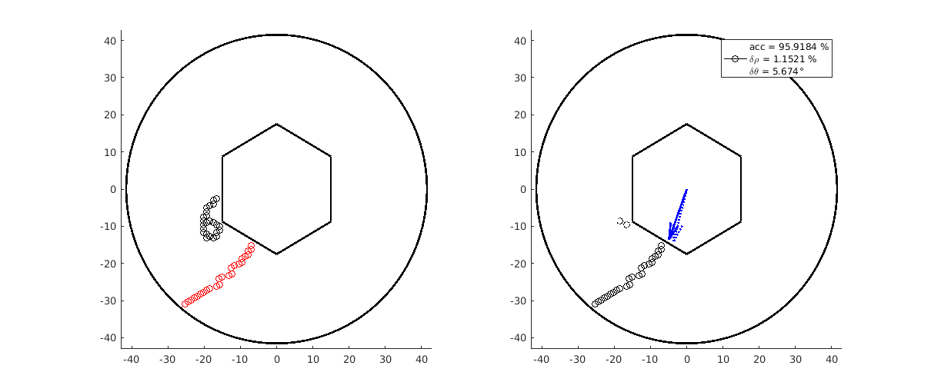
Results
Input:
Output:

Slide 15
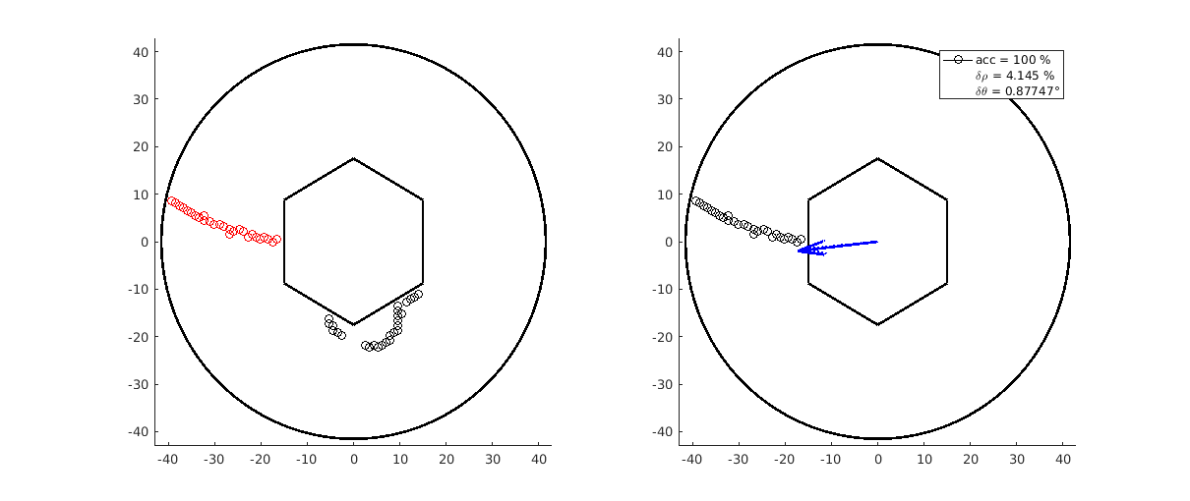
Results
Input:
Output:

Slide 16
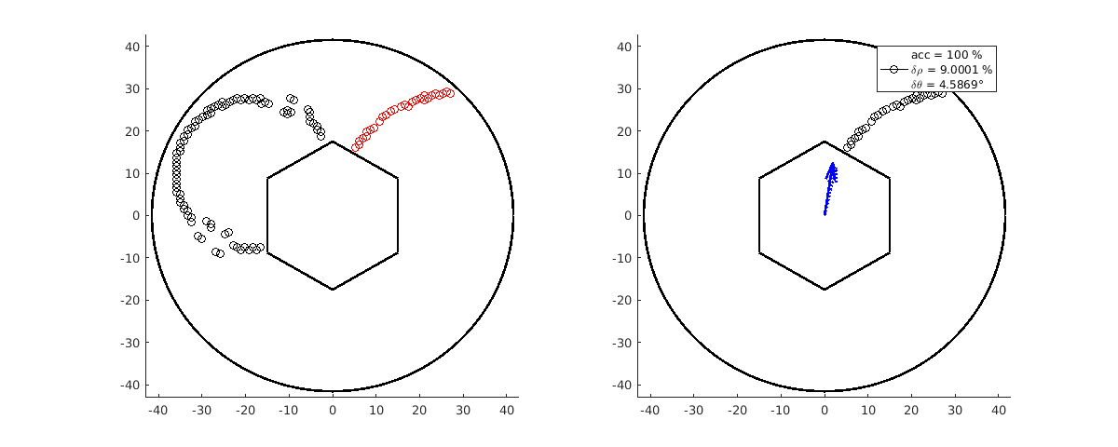
Results
Input:
Output:

Slide 17
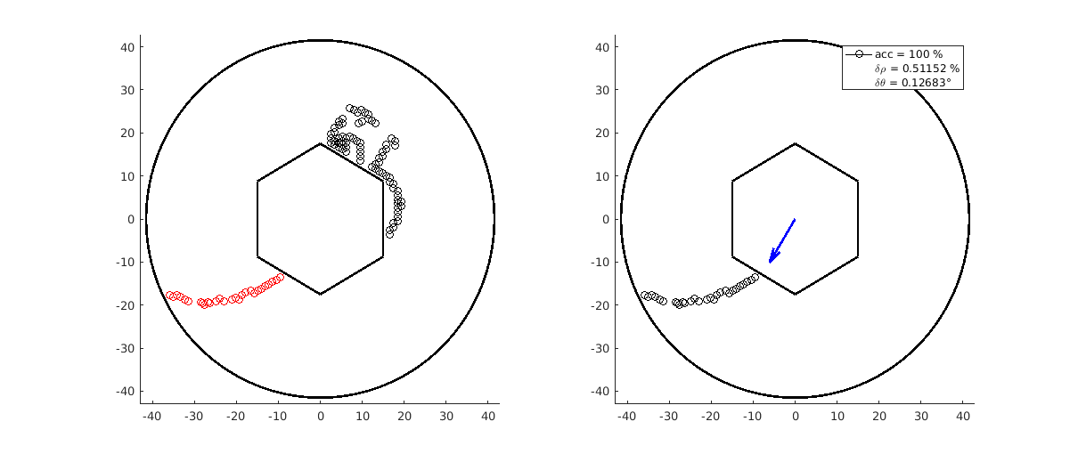
Results
Input:
Output:

Slide 18
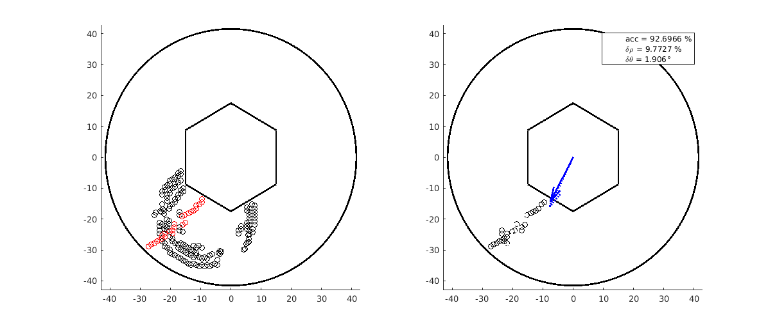
Results
Input:
Output:

Slide 19
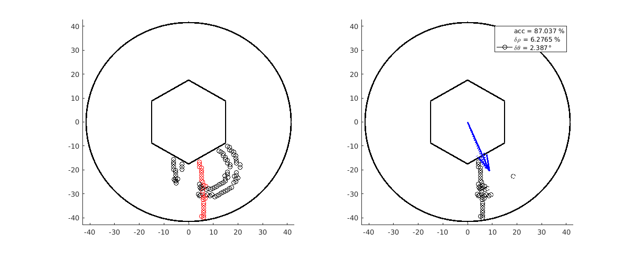
Results
Input:
Output:

