Slide 1
Chapter 3 Floorplanning
108062135 呂佳恩

Slide 2
Floorplanning
Input :
Hard blocks (rigid blocks) : Blocks with well-defined areas and shapes
Soft blocks (flexible blocks) : Blocks with approximate areas and no particular shapes
Netlist : Specification about the connections between the blocks
Goal :
Find locations for all blocks so that blocks do not overlap
Consider shapes, dimensions of soft blocks and pin locations of all the blocks
Minimize area
Reduce wirelength for critical nets
Maximize routability
Address thermal hotspots, power supply noise

Slide 3
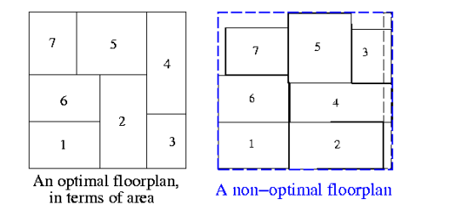
Floorplanning
Constraints:
Fixed outline
Preplaced blocks
Alignment problems

Slide 4
Floorplan Elements
Leaf block (cell/module) : a block at the lowest level of the hierarchy, it does not contain any other block.
Composite block (cell/module) : a block that is composed of either leaf blocks or lower-level composite blocks.
The whole IC is the highest-level composite block

Slide 5
Slicing Floorplan Slicing Tree
A composite block’s subblocks are obtained by a horizontal or vertical bisection/slice of the composite block
Slicing floorplans can be represented by a slicing tree.
A slicing tree could also be called a floor plan of order 2
In a slicing tree, all blocks except for the top level block have a parent, and all composite blocks have children

Slide 6
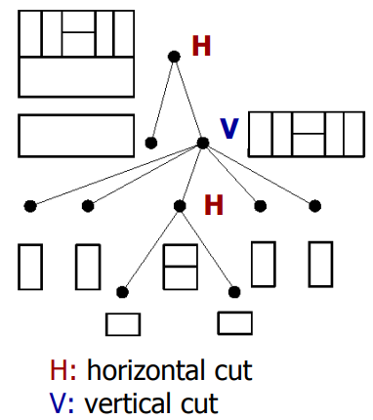
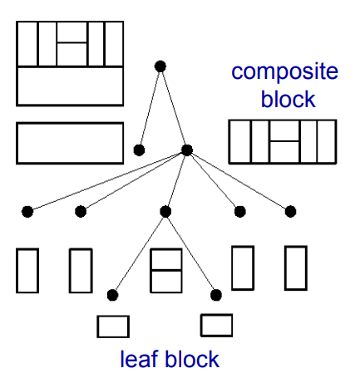

Slide 7
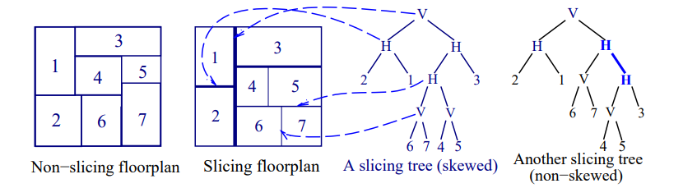
Floorplanning
Rectangular dissection : Subdivision of a given rectangle by a finite number of horizontal and vertical line segments into a finite number of non-overlapping rectangles.
Slicing structure : a rectangular dissection that can be obtained by repetitively subdividing rectangles horizontally or vertically
Skewed slicing tree: One slicing tree which no node and its right child are the same

Slide 8
Stockmeyer Algorithm
Input :
A slicing floorplan
Output :
An orientation of the blocks in the floorplan so that the overall floorplan area is minimized.
Usage :
Mostly used in post-process of the given slicing floorplan to further optimize the area objective.
For a non-slicing floorplan, it is proved that the optimal orientation problem is NP-complete

Slide 9
Stockmeyer algorithm
Rough Idea :
traverse the internal nodes of the slicing tree in bottom up so that we compute the candidate dimensions of each internal node.
Traverse the tree in top down fashion to select the dimensions for the internal nodes as well as the orientation of the leaf nodes, based on the decision made by the parent node.

Slide 10
Stockmeyer algorithm
Vertical Slice :
Suppose we have two children that are leaves ( bottom up ), we denote the dimensions of the nodes as left (wl, hl), right child (wr, hr)
Dimensions of the left and the right child are sorted so that the width is increasing and the height is decreasing
The resulting dimension after the merging is (wl + wr , max{hl, hr})
If hl > hr, we merge the second dimension of the left child and the first dimension of the right child
If hl < hr, we merge the first dimension of the left child and the second dimension of the right child
If hl = hr, we merge the second dimension of the left child and the second dimension of the right child
The merging is ended when we reach the end of the dimension list for either the left or the right child

Slide 11
Stockmeyer algorithm
Horizontal Slice :
Suppose we have two children that are leaves ( bottom up ), we denote the dimensions of the nodes as left (wl, hl), right child (wr, hr)
Dimensions of the left and the right child are sorted so that the width is decreasing and the height is increasing
The resulting dimension after the merging is (max{wl,wr}, hl + hr)
If hl > hr, we merge the second dimension of the left child and the first dimension of the right child
If hl < hr, we merge the first dimension of the left child and the second dimension of the right child
If hl = hr, we merge the second dimension of the left child and the second dimension of the right child
The merging is ended when we reach the end of the dimension list for either the left or the right child

Slide 12
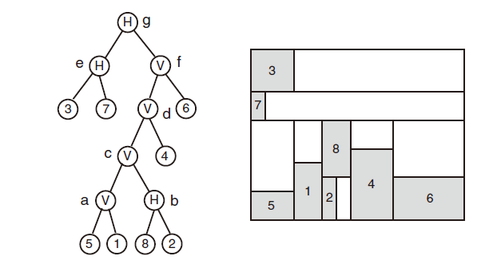
Stockmeyer Algorithm example

Slide 13
Width, height = {(2,4), (1,3), (3,3), (3,5), (3,2), (5,3), (1,2), (2,4)}.
Visit node a -> cut Vertical -> left child(5(3,2)), right child(1(2,4))
L = {(2, 3), (3, 2)}
R = {(2, 4), (4, 2)}
Join L1, R1 -> (2 + 2,max{3, 4}) = (4,4) ->maximum from R-> Join L1, R2
Join L1, R2 -> (2 + 4,max{3, 2}) = (6,3) ->maximum from L -> Join L2 R2
Join L2, R2 ->(3 + 4,max{2, 2}) = (7, 2) ->reach end
Result dimensions {(4, 4), (6, 3), (7, 2)}.
L = {(2, 3), (3, 2)} R = {(2, 4), (4, 2)}
L = {(2, 3), (3, 2)} R = {(2, 4), (4, 2)}
L = {(2, 3), (3, 2)} R = {(2, 4), (4, 2)}

Slide 14
Stockmeyer Algorithm example

Slide 15
Width, height = {(2,4), (1,3), (3,3), (3,5), (3,2), (5,3), (1,2), (2,4)}.
Visit node b -> cut Horizontal -> left child(8(2,4)), right child(2(1,3))
L = {(4, 2), (2, 4)}
R = {(3, 1), (1, 3)}
Join L1, R1 -> (max{4, 3},2 + 1) = (4, 3)->maximum from L-> Join L2, R1
Join L2, R1 -> (max{2, 3},4 + 1) = (3, 5)->maximum from R -> Join L2 R2
Join L2, R2 -> (max{2, 1},4 + 3) = (2, 7)->reach end
Result dimensions {(4, 3), (3, 5), (2, 7)}.
L = {(4, 2), (2, 4)} R = {(3, 1), (1, 3)}
L = {(4, 2), (2, 4)} R = {(3, 1), (1, 3)}
L = {(4, 2), (2, 4)} R = {(3, 1), (1, 3)}

Slide 16
Stockmeyer Algorithm example

Slide 17
Visit C
Cut vertical->left child a, right child b
L = {(4, 4), (6, 3), (7, 2)}
R = {(2, 7), (3, 5), (4, 3)}
Join L1, R1 -> (4 + 2,max{4, 7}) = (6, 7) ->maximum from R -> Join L1, R2
Join L1, R2 -> (4 + 3,max{4, 5}) = (7, 5) ->maximum from R -> Join L1, R3
Join L1, R3 -> (4 + 4,max{4, 3}) = (8, 4) ->maximum from L -> Join L2, R3
Join L2, R3 -> (6 + 4,max{3, 3}) = (10, 3) ->R=L -> reach End
Result dimensions {(6, 7), (7, 5), (8, 4), (10, 3)}.
L = {(4, 4), (6, 3), (7, 2)} R = {(2, 7), (3, 5), (4, 3)}
L = {(4, 4), (6, 3), (7, 2)} R = {(2, 7), (3, 5), (4, 3)}
L = {(4, 4), (6, 3), (7, 2)} R = {(2, 7), (3, 5), (4, 3)}
L = {(4, 4), (6, 3), (7, 2)} R = {(2, 7), (3, 5), (4, 3)}

Slide 18
Stockmeyer Algorithm example

Slide 19
Visit D, Width, height = {(2,4), (1,3), (3,3), (3,5), (3,2), (5,3), (1,2), (2,4)}.
Cut vertical->left child c, right child 4
L = {(6, 7), (7, 5), (8, 4), (10, 3)}
R = {(3, 5)(5, 3)}
Join L1, R1 -> (6 + 3,max{7, 5}) =(9, 7) ->maximum from L -> Join L2, R1
Join L2, R1 -> (7 + 3,max{5, 5}) = (10, 5)->R=L-> Join L3, R2
Join L3, R2 -> (8 + 5,max{4, 3}) = (13, 4)->maximum from L -> Join L4, R2
Join L4, R2 ->(10 + 5,max{3, 3}) =(15, 3). ->R=L -> reach End
Result dimensions {(9, 7), (10, 5), (13, 4), (15, 3)}.
L = {(6, 7), (7, 5), (8, 4), (10, 3)}
R = {(3, 5)(5, 3)}
L = {(6, 7), (7, 5), (8, 4), (10, 3)}
R = {(3, 5)(5, 3)}
L = {(6, 7), (7, 5), (8, 4), (10, 3)}
R = {(3, 5)(5, 3)}
L = {(6, 7), (7, 5), (8, 4), (10, 3)}
R = {(3, 5)(5, 3)}

Slide 20
Stockmeyer Algorithm example

Slide 21
Visit f
L = {(9, 7), (10, 5), (13, 4), (15, 3)}
R = {(3, 5)(5, 3)}
Result dimensions {(12, 7), (13, 5), (18, 4), (20, 3)}.
Visit e
L = {(3, 3)}
R = {(2, 1)(1, 2)}
Result dimensions {(3, 4)}.
Visit g
L = {(3, 4)}
R = {(20, 3), (18, 4), (13, 5), (12, 7)}
Result dimensions {(20, 7), (18, 8), (13, 9), (12, 11)}.

Slide 22
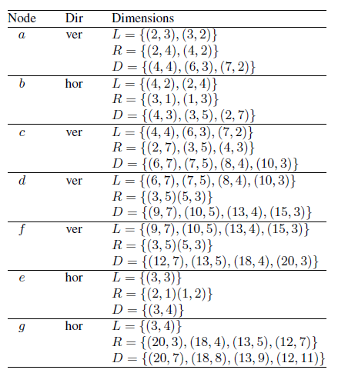
After visiting node G
Resulting Dimensions are {(20, 7), (18, 8), (13, 9), (12, 11)}.
Calculate the minimum area floor plan
13 x 9 = 117 is the minimum area

Slide 23
Top down to fine the optimal orientation
Node G : Choose (13, 9) coming from joining (3,4) and (13, 5)
Thus, node e is (3,4) node f is (13,5)

Slide 24
Top down to fine the optimal orientation
Node E : From Node G we know that Node E is (3,4)
This comes from joining (3,3) and (2,1)
We can see that the best orientation for
Block 3 is (3,3) and block 7 is (2,1)
Block 7 is rotated

Slide 25
Stockmeyer Algorithm example

Slide 26
Top down to fine the optimal orientation
Node f : From Node G we know that Node E is (13,5)
This comes from joining (10,5) and (3,5)
Node d is (10,5) and optimal orientation of
Block 6 is (3,5)
Block 6 is rotated

Slide 27
Stockmeyer Algorithm example

Slide 28
Top down to fine the optimal orientation
Node d : we know from Node f that Node d is (10,5)
This comes from joining (7,5) and (3,5)
Node c is (7,5) and optimal orientation for
block 4 is (3,5)

Slide 29
Top down to fine the optimal orientation
Node c : we know from Node d that Node c is (7,5)
This comes from joining (4,4) and (3,5)
Node a is (4,4) and Node b is (3,5)

Slide 30
Top down to fine the optimal orientation
Node a : we know from Node c that Node a is (4,4)
This comes from joining (2,3) and (2,4)
Optimal orientation of block 5 is (2,3)
Optimal orientation of block 1 is (2,4)
Block 5 is rotated

Slide 31
Stockmeyer Algorithm example

Slide 32
Top down to fine the optimal orientation
Node b : we know from Node c that Node a is (3,5)
This comes from joining (2,4) and (3,1)
Optimal orientation of block 8 is (2,4)
Optimal orientation of block 2 is (3,1)
Block 2 is rotated

Slide 33
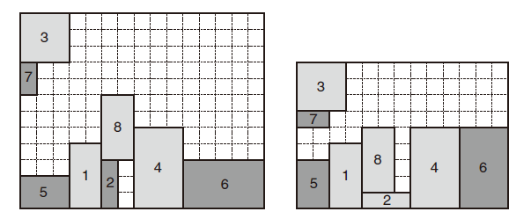
Before, after
4 blocks are rotated
Area reduced from 15x12 to 13x9

Slide 34
Conclusion
The Stockmeyer algorithm can improve the area significantly, or not at all, depending on the original placement and the critical path
Critical path is the longest path in the circuit and limits the clock speed.
If the Critical path is already minimized, then the area will stay the same.
Wire routing is a significant problem that we have to consider in a real world situation that this algorithm does not take into account

Slide 35
ILP Floorplanning Algorithm
ILP – Integer Linear Programming
How is ILP applied to floor planning?
The constraints specifying a feasible floor plan are described by a set of mathematical equations
Can use commercial ILP solvers

Slide 36
Problem Formulation
Modules of the problem make up the group S
Modules can be rigid or flexible
The original algorithm can handle flexible modules, however, it adds complexity to the problem
The textbook assumes the modules are all rigid for the following.
Rigid Block – Blocks with well-defined areas and shapes
Soft Block – Blocks with approximate areas and no particular shapes

Slide 37
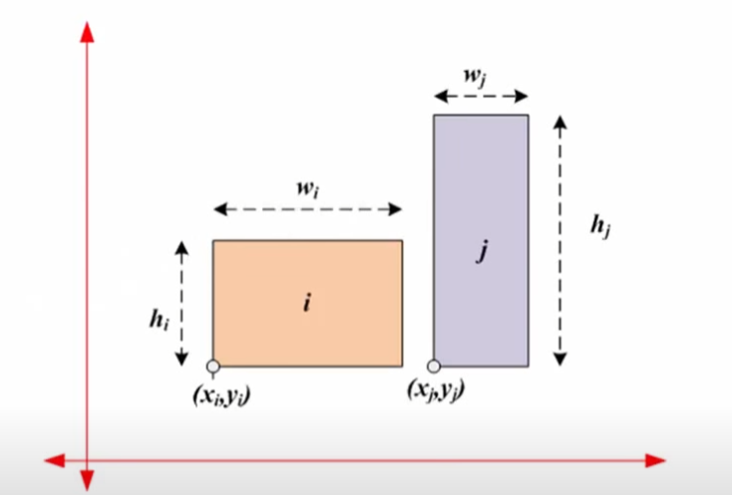
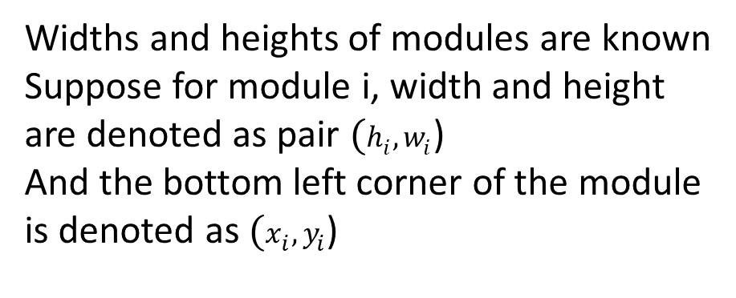
Problem Formulation
Widths and heights of modules are known
Suppose for module i, width and height are denoted as pair $(h_{i}, w_{i}$)
And the bottom left corner of the module is denoted as $(x_{i}, y_{i}$)

Slide 38
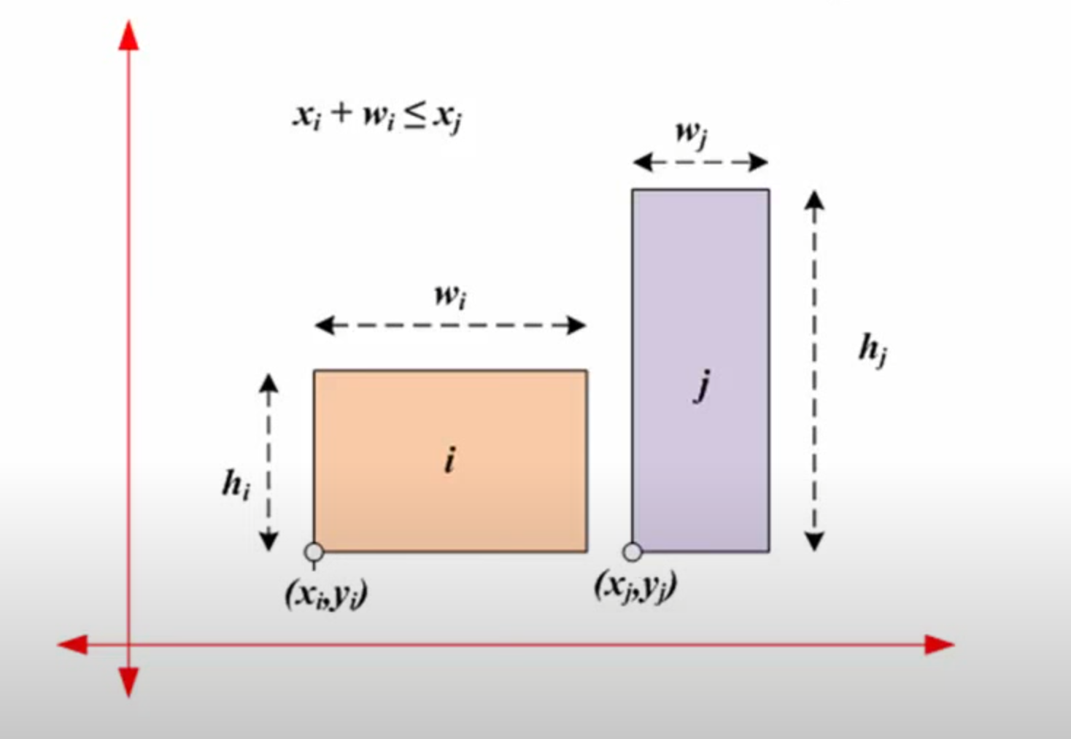
Module i is to the left of Module j

Slide 39
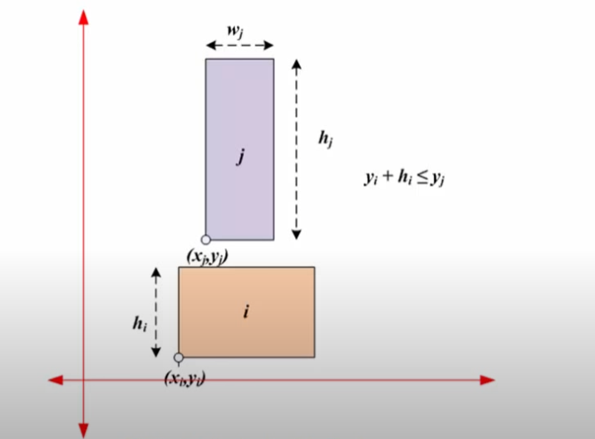
Module i is below Module j

Slide 40
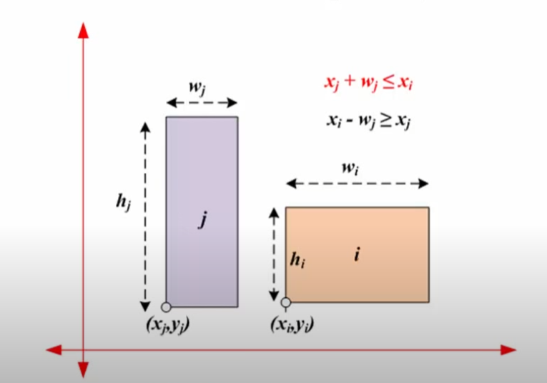
Module i is to the right of Module j

Slide 41
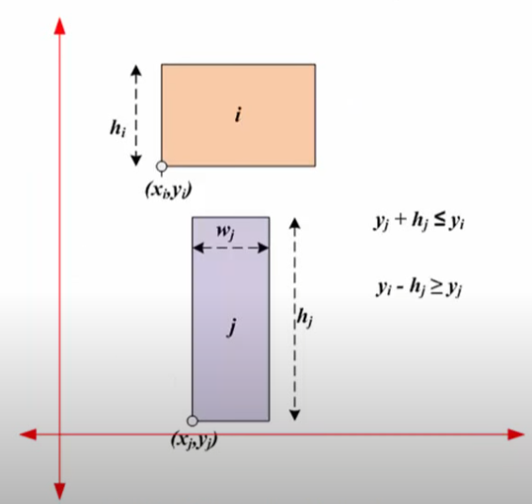
Module i is above Module j

Slide 42
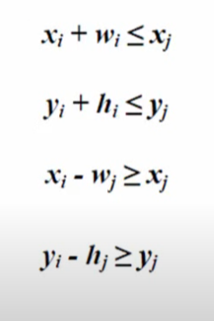
Relative positions of modules
Relative positions of 2 modules i and j are represented/governed by
the following 4 equations

Slide 43
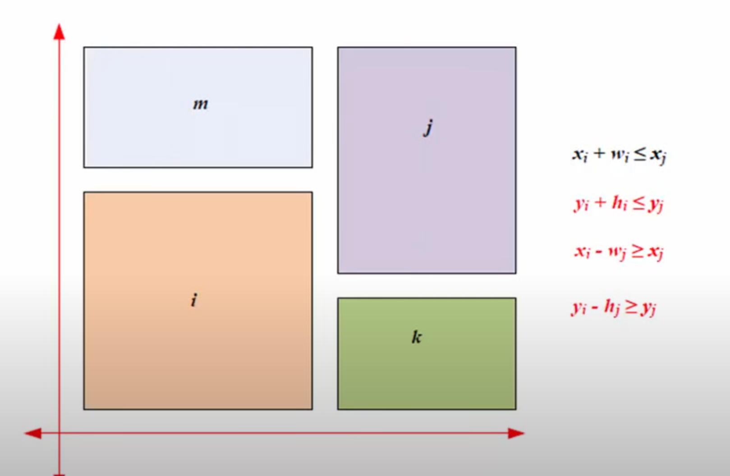
Equations to be satisfied (example 1)

Slide 44
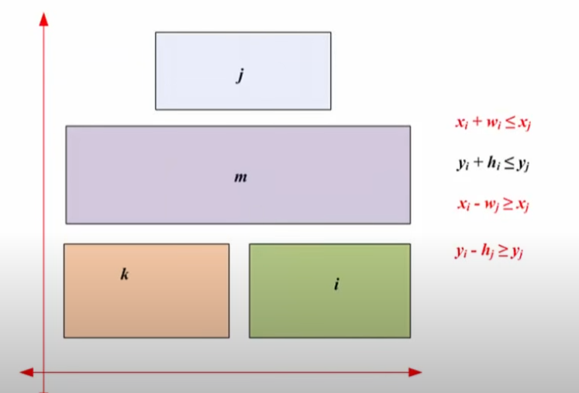
Equations to be satisfied (example 2)

Slide 45
Small conclusion
If we don’t want the Modules to overlap, one of the 4 following equations have to be satisfied

Slide 46
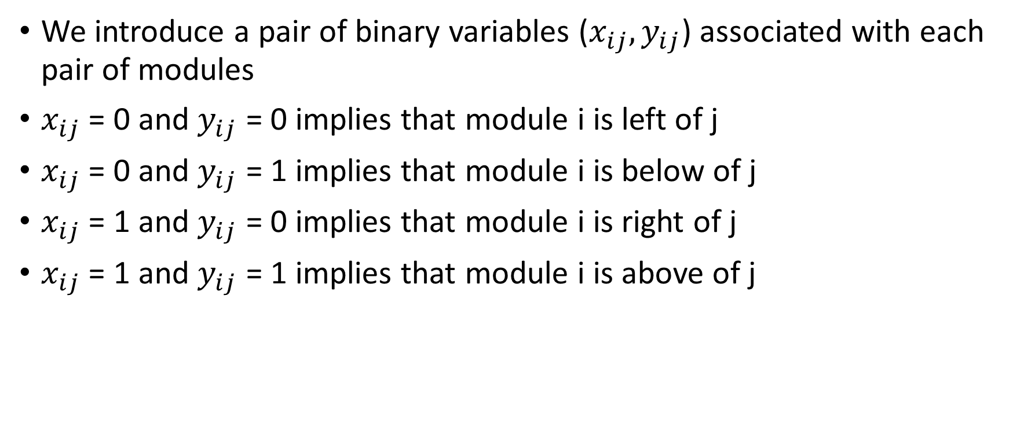
How to represent?
We introduce a pair of binary variables ($x_{ij}, y_{ij}$) associated with each pair of modules
$x_{ij}$ = 0 and $y_{ij}$ = 0 implies that module i is left of j
$x_{ij}$ = 0 and $y_{ij}$ = 1 implies that module i is below of j
$x_{ij}$ = 1 and $y_{ij}$ = 0 implies that module i is right of j
$x_{ij}$ = 1 and $y_{ij}$ = 1 implies that module i is above of j

Slide 47
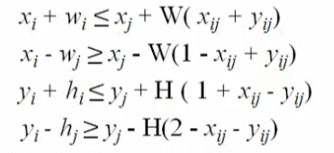
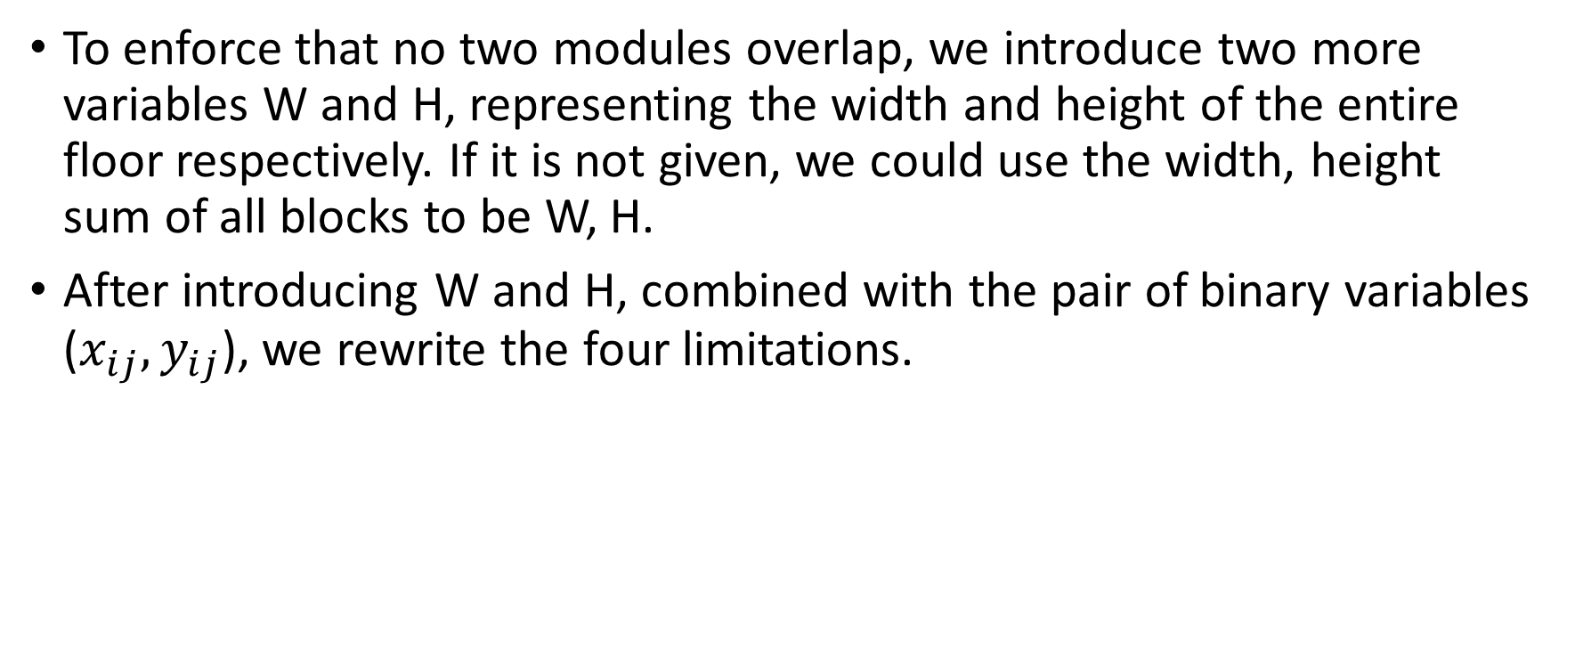
ILP floorplanning
To enforce that no two modules overlap, we introduce two more variables W and H, representing the width and height of the entire floor respectively. If it is not given, we could use the width, height sum of all blocks to be W, H.
After introducing W and H, combined with the pair of binary variables ($x_{ij}, y_{ij}$), we rewrite the four limitations.

Slide 48
Rewriting limitations
The limitations are rewritten as the following
We can find out that, according to the placement of two modules, one of the four equations will be used to reinforce the placement, while the other three conditions will be always true.

Slide 49
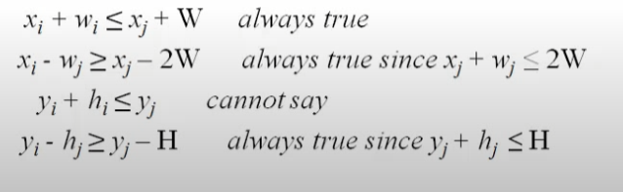

Example, suppose $x_{ij}$ = 0 and $y_{ij}$ = 1
The equations will be as the following

Slide 50
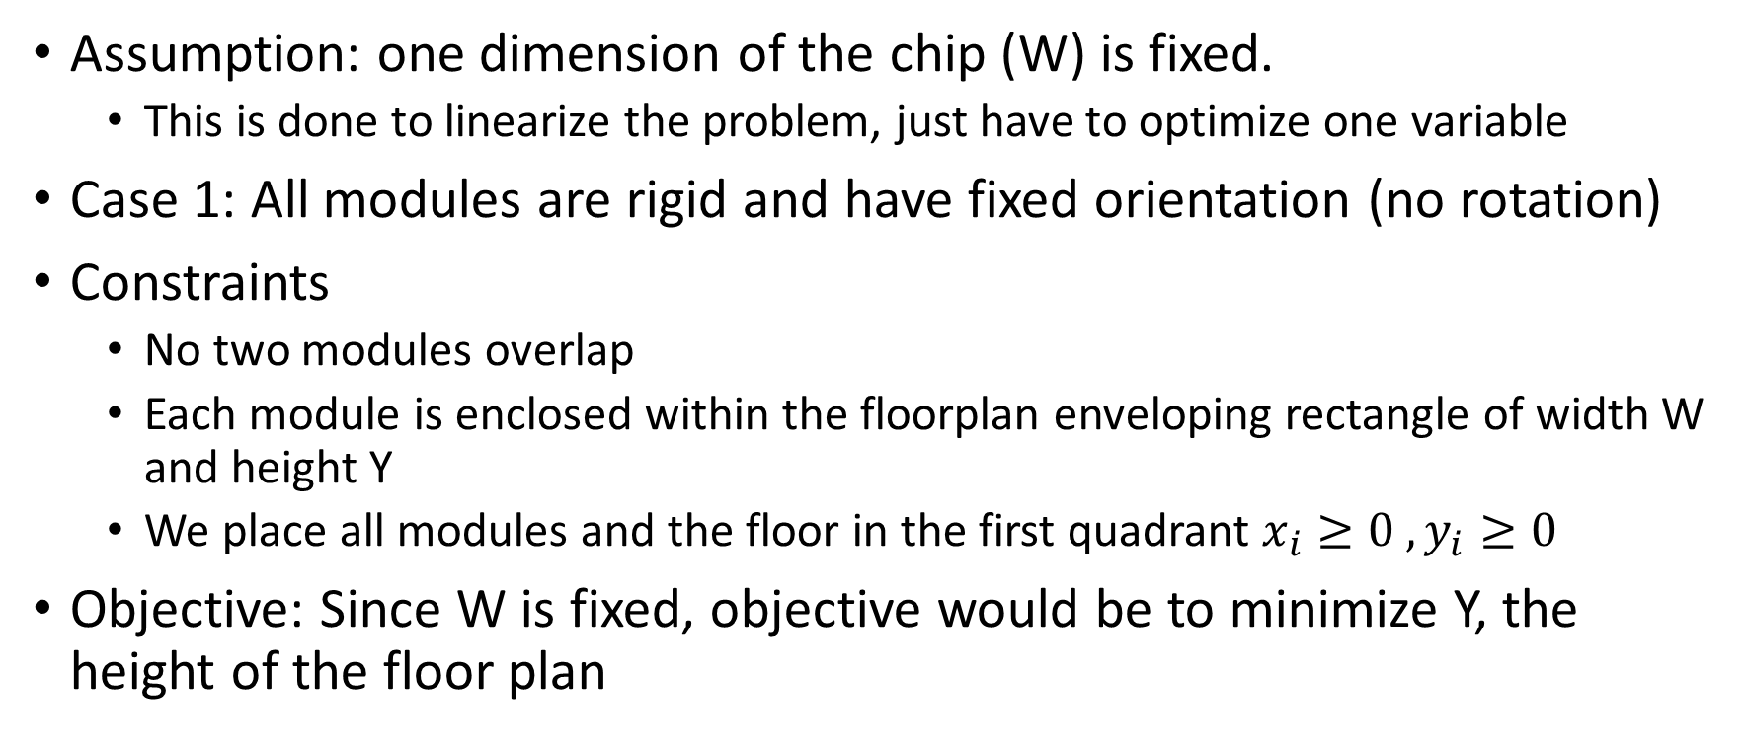
Linear programming Formulation
Assumption: one dimension of the chip (W) is fixed.
This is done to linearize the problem, just have to optimize one variable
Case 1: All modules are rigid and have fixed orientation (no rotation)
Constraints
No two modules overlap
Each module is enclosed within the floorplan enveloping rectangle of width W and height Y
We place all modules and the floor in the first quadrant $x_{i}≥0 , y_{i}≥0$
Objective: Since W is fixed, objective would be to minimize Y, the height of the floor plan

Slide 51
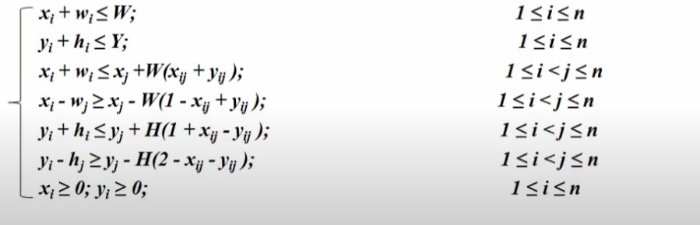
Linear Programming Formulation
We have the following inequations that we have to satisfy

Slide 52
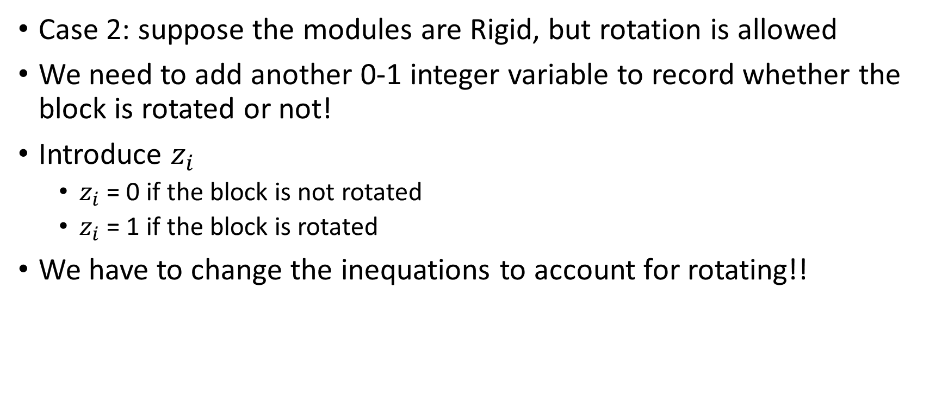
Linear programming Formulation
Case 2: suppose the modules are Rigid, but rotation is allowed
We need to add another 0-1 integer variable to record whether the block is rotated or not!
Introduce $z_{i}$
$z_{i}$ = 0 if the block is not rotated
$z_{i}$ = 1 if the block is rotated
We have to change the inequations to account for rotating!!

Slide 53
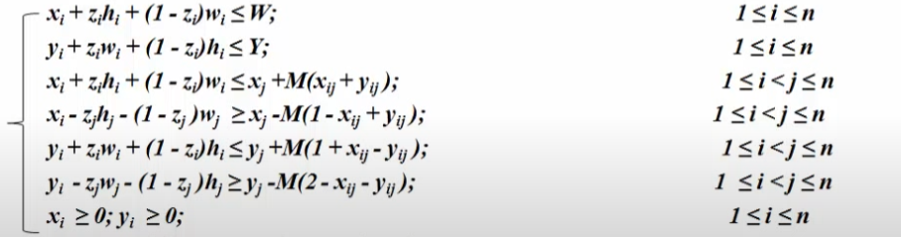
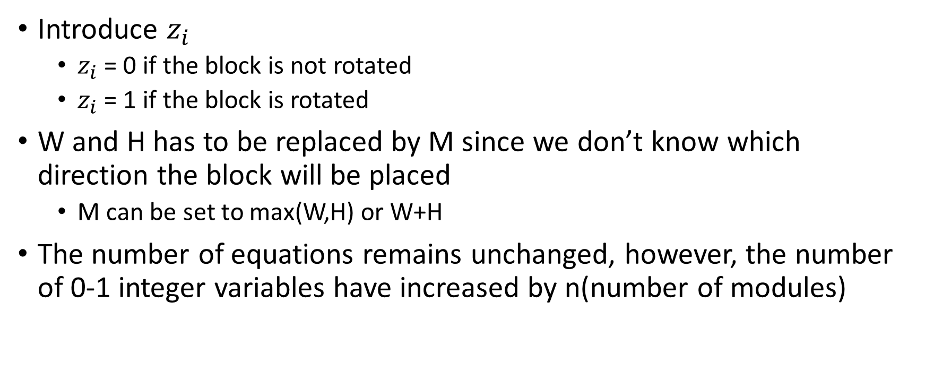
Linear Programming Formulation
Introduce $z_{i}$
$z_{i}$ = 0 if the block is not rotated
$z_{i}$ = 1 if the block is rotated
W and H has to be replaced by M since we don’t know which direction the block will be placed
M can be set to max(W,H) or W+H
The number of equations remains unchanged, however, the number of 0-1 integer variables have increased by n(number of modules)

Slide 54
Example
Problem: Formulate the ILP floorplanning for the following instances, The desired aspect ration is 1
The dimension of the fixed modules are given as (width, height)
There are four fixed modules, m1(4, 5), m2(3, 7), m3(6, 4), and m4(7, 7). Rotation is not allowed.
The aspect ration = 1 helps simplify the problem

Slide 55
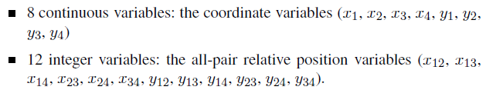

Step 1
We obtain the list of continuous and integer variables as follows
Calculate the upper bound as following

Slide 56
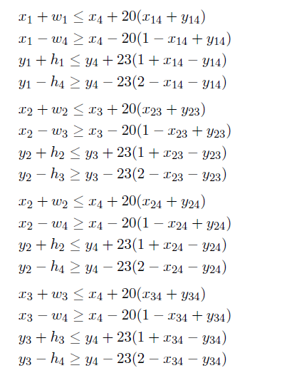
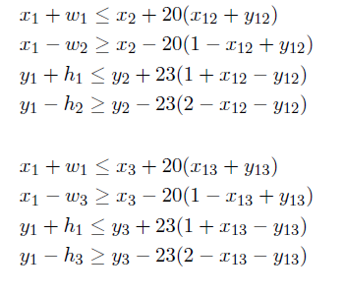
We then try to minimize y∗,
following the non-overlap constraints, we obtain

Slide 57
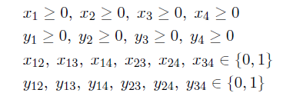
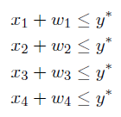
Following the variable type constraints, we obtain
Following the chip width constraints:

Slide 58
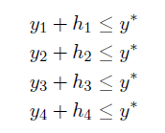
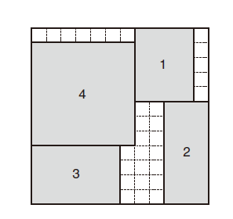
Following the height constraints:
After using a commercial solver, we obtain the following floorplan

Slide 59
Sequence pair Algorithm
Sequence pair is an easy representation of non-slicing floorplans of Modules
Similar to the Polish algorithm
The Polish algorithm is used for slicing floorplans
Use Simulated Annealing to find a good sequence-pair

Slide 60
Floor plan to Sequence pair (Gridding)
Two types of sequence pairs
Up-right
Down-left
Up-right Sequence pair
Start from the bottom left corner of a module until the upper right corner of the floor plan is reached. Draw vertical lines going up and horizontal lines going right in an alternate fashion so that the lines for all module do not cross
Down-left Sequence pair
Start from the upper left corner of a module until the bottom right corner of the floor plan is reached. Draw vertical lines going down and horizontal lines going left in an alternate fashion so that the lines for all module do not cross

Slide 61
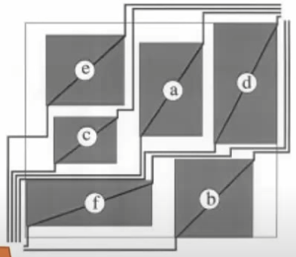
Up right sequence pair – Positive step line
The order among the lines from left
to right at the bottom left corner would be
the Positive step line sequence.
Positive step line sequence would be
ecadfb

Slide 62
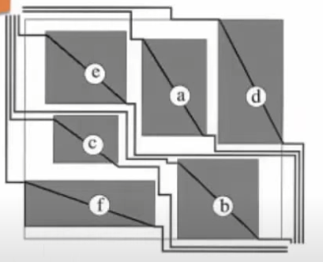
Down-left sequence pair - Negative step line
The order among the negative step lines from
bottom to top form the negative step line sequence
Negative step line sequence
fcbead

Slide 63
Benefits
Sequence pairs offer an advantages similar as the Polish expression, when used together with simulated Annealing
It provides efficient exploration of the solution space via local search
Polynomial time evaluation of a candidate solution
Author also shows that the solution space defined by sequence pair is called P-admissible, which in that situation always exists an optimal solution to the problem

Slide 64
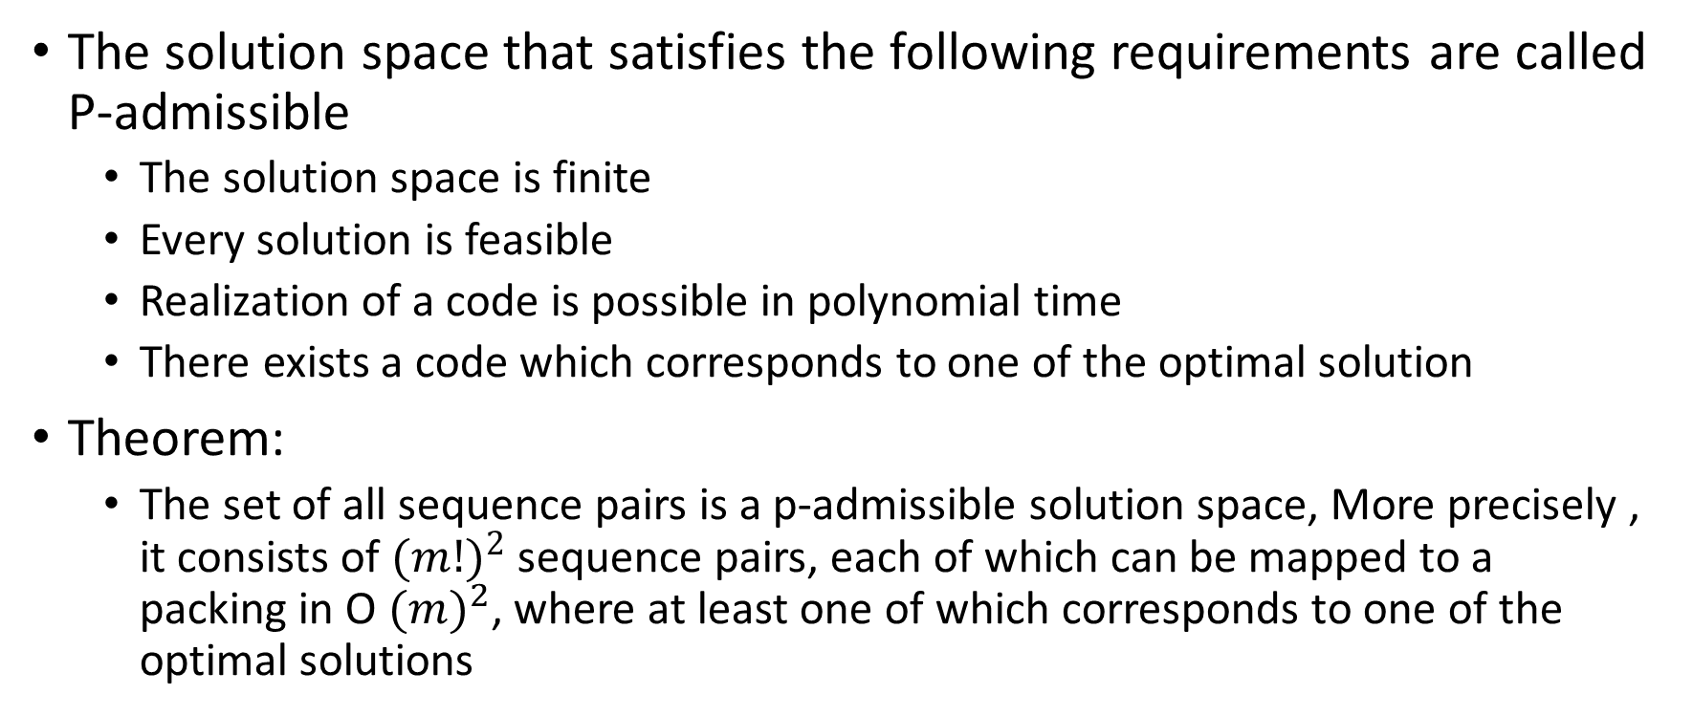
P-admissible
The solution space that satisfies the following requirements are called P-admissible
The solution space is finite
Every solution is feasible
Realization of a code is possible in polynomial time
There exists a code which corresponds to one of the optimal solution
Theorem:
The set of all sequence pairs is a p-admissible solution space, More precisely , it consists of ${(m!)}^{2}$ sequence pairs, each of which can be mapped to a packing in O ${(m)}^{2}$, where at least one of which corresponds to one of the optimal solutions

Slide 65
Geometric Info of sequence pair
Given a sequence pair (P, N), module a, b is a part of the set of blocks
a is right to b iff a is after b in both P and N
a is left to b iff a is before b in both P and N
a is above b iff a is before b in P and a is after b in N
a is below b iff a is after b in P and a is before b in N

Slide 66
Moves to optimize
M1 is swapping a random pair of modules in the first sequence
M2 is swapping a random pair of modules in both sequences
M3 is rotating a randomly selected module by 90 degrees

Slide 67
Example
Consider the following sequence pair SP1 = (17452638, 84725361).
The (width, height) of the modules 1 through 8 are {(2,4), (1,3), (3,3), (3,5), (3,2),(5,3), (1,2), (2,4)}.
Steps:
Draw the Horizontal and vertical constraint graphs
Find out the minimum area of the non-slicing floorplan\
The longest s-t path from horizontal and vertical
Draw out the corresponding non-slicing floorplan, find the location of the lower left corner of each module

Slide 68
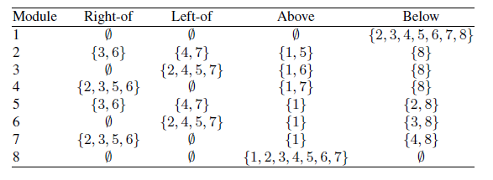
SP1 = (17452638, 84725361).
Using the geometric info provided by both sequences, we obtain the chart

Slide 69
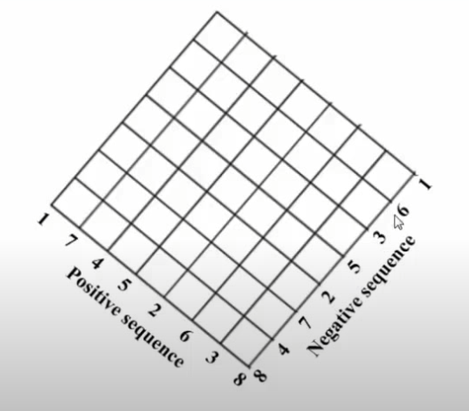
SP1 = (17452638, 84725361)
Then we try to map the sequence onto a grid marked as the following

Slide 70
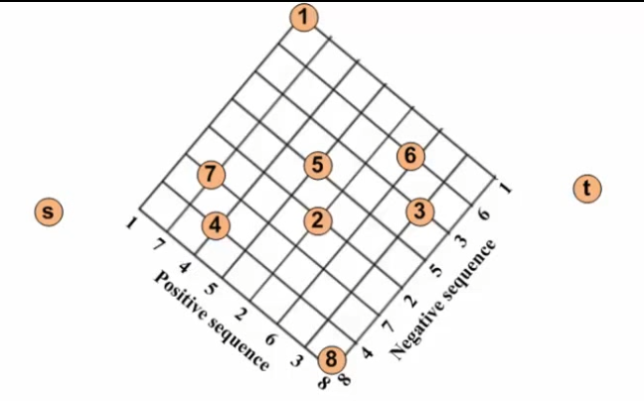
SP1 = (17452638, 84725361) (Horizontal)
The block would be placed on the intersection of the values, and add source to the left and target to the right

Slide 71
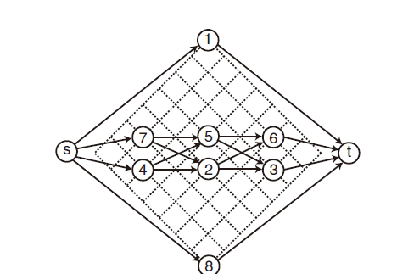
SP1 = (17452638, 84725361) (Horizontal)
We then connect the blocks

Slide 72
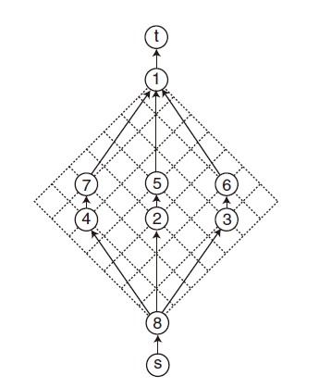
SP1 = (17452638, 84725361) (Vertical)
Add source to the bottom and the target on top

Slide 73
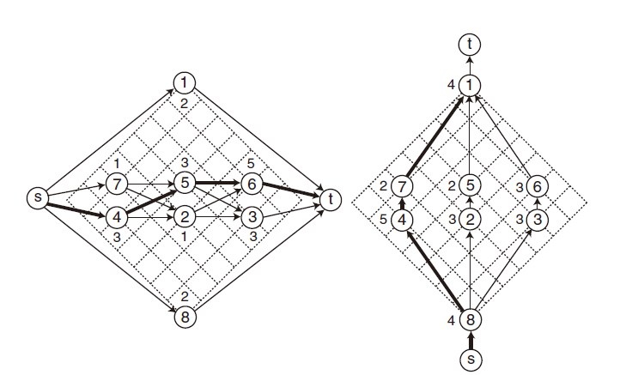
SP1 = (17452638, 84725361)
Add values of the width/height on the Horizontal/Vertical constraint graph, and find the longest path from s->t, it would be used to calculate the minimum area

Slide 74
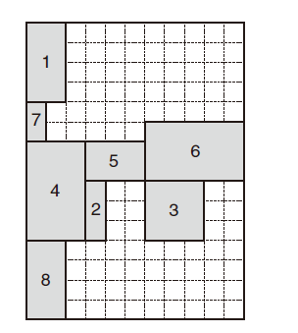
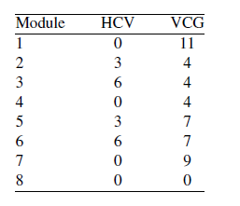
SP1 = (17452638, 84725361)
We then calculate the longest path lengths for the modules in the Horizontal constraint graph and vertical constraint graph
Area : 11x 15

Slide 75
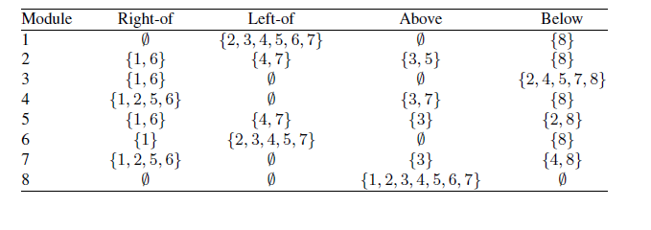
Perform Moves
Perform M1 move which swaps module 1 and 3 are swapped in the first(positive) sequence
SP1 = (17452638, 84725361) =>> SP2= (37452618, 84725361).

Slide 76
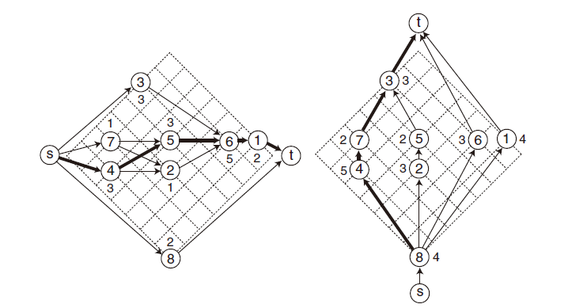
SP2= (37452618, 84725361).

Slide 77
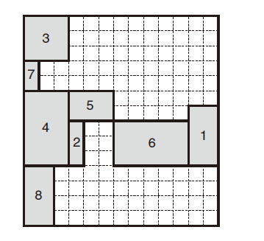
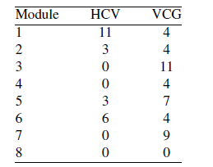
SP2= (37452618, 84725361)
Calculate the minimum area
Area = 13x14

Slide 78
SP1 ->> SP2
Area : 11x 15
Area = 13x14

Slide 79
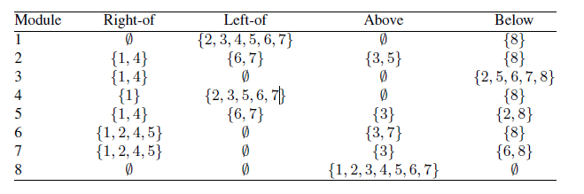
Perform Move
Swap Modules 4 and 6 in both sequences
SP2= (37452618, 84725361) -> SP3 =(37652418, 86725341)

Slide 80
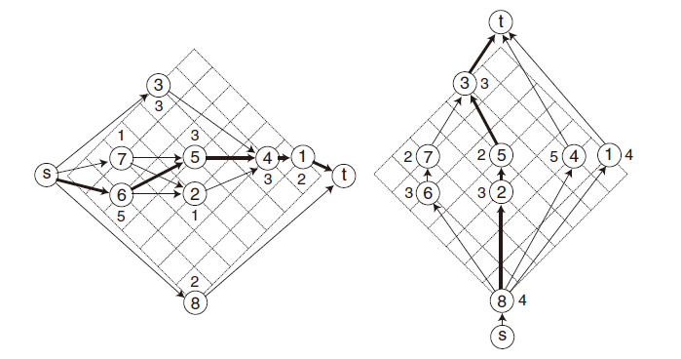
SP3 =(37652418, 86725341)

Slide 81
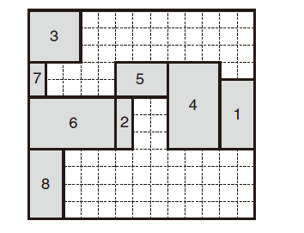

SP3 =(37652418, 86725341)
Area = 13x12

Slide 82
SP1 ->> SP2 ->> SP3
Area = 13x12
Area : 11x 15
Area = 13x14

