Slide 1
Assignment 1 Stock Price Forecast
Meng-Chien Lin
Po-Chih Kuo

Slide 2
Goal
To make stock price forecasting by using the stock price of a company to predict the other in the same industry
To implement the regression model to achieve the forecasting
Preprocess the data for model training/testing

Slide 3
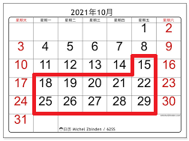
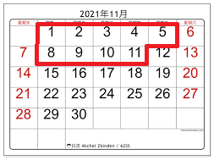
Basic (100%)
Use MTK’s stock prices to predict TSMC’s stock prices of 20 days followed by the due day (10/14) of the homework.
That is, to predict the prices from 10/15 to 11/11 (without holidays, totally 20 days)

Slide 4
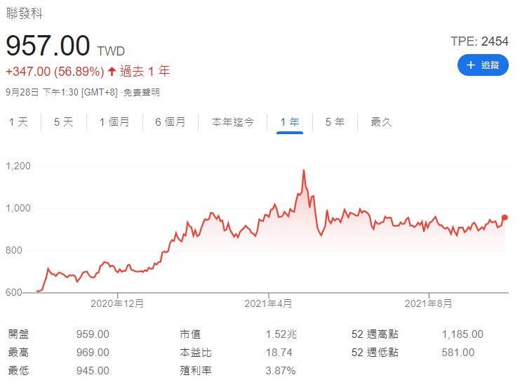
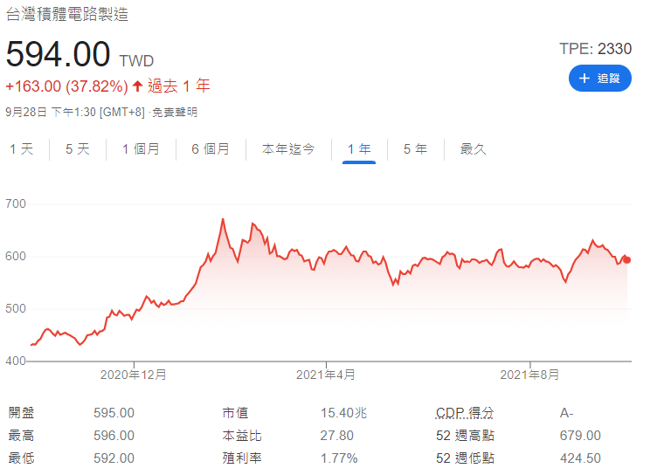
Data
Download link: https://www.twse.com.tw/zh/page/trading/exchange/STOCK_DAY_AVG.html
MediaTek Inc.
(MTK)
Taiwan Semiconductor Manufacturing Co., LTd (TSMC)

Slide 5
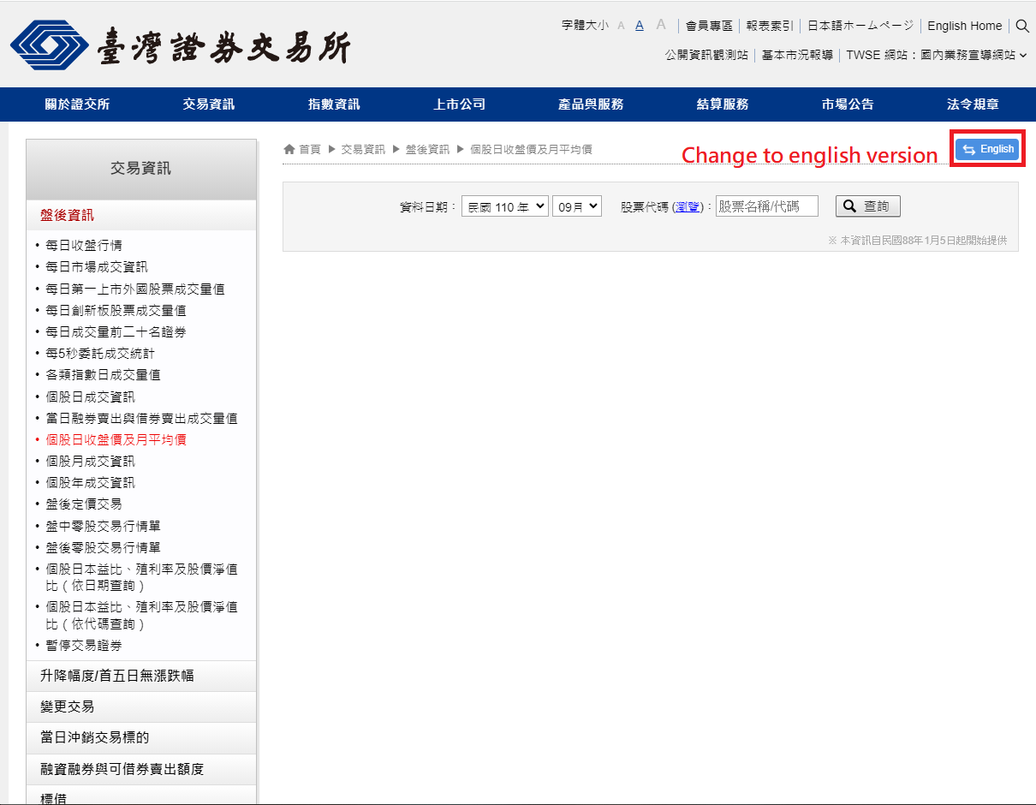
How To Download

Slide 6
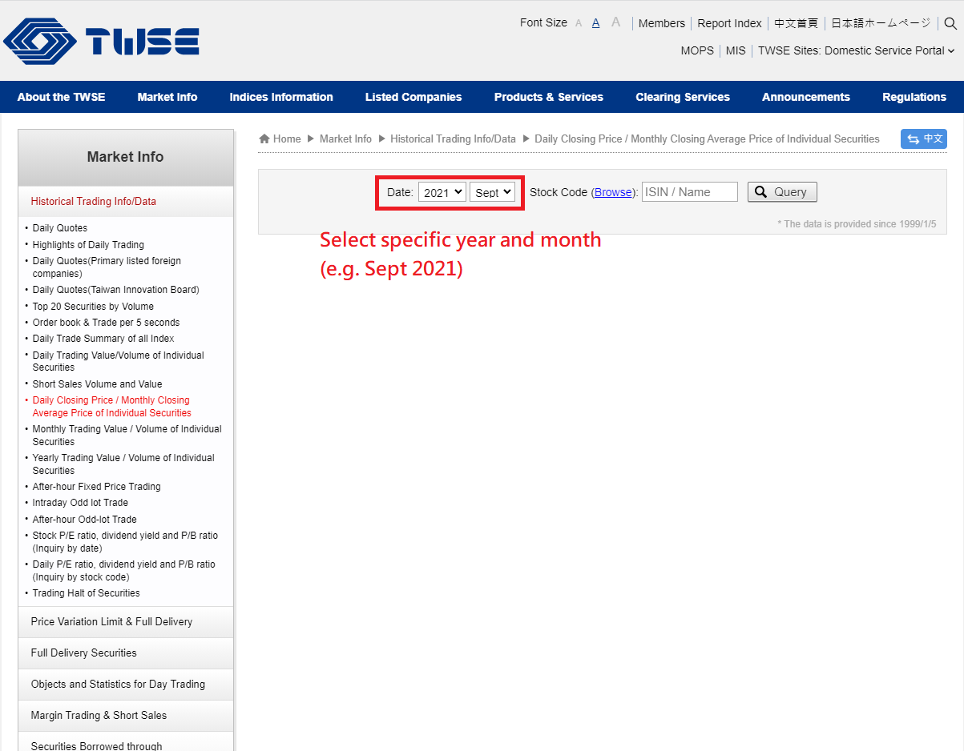
How To Download

Slide 7
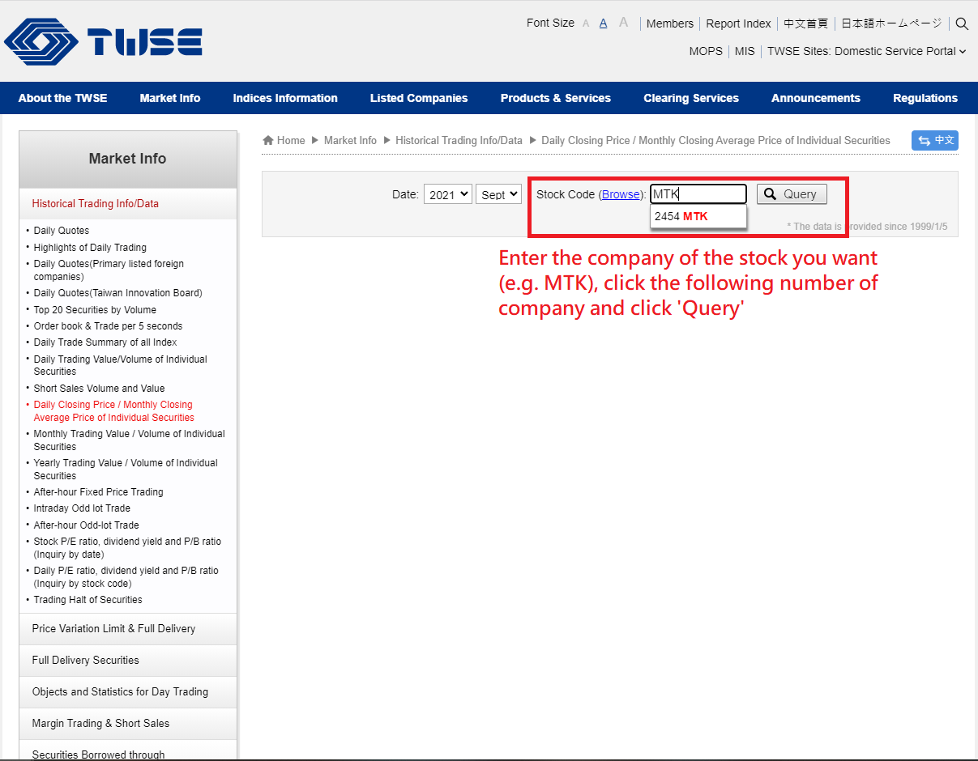
How To Download

Slide 8
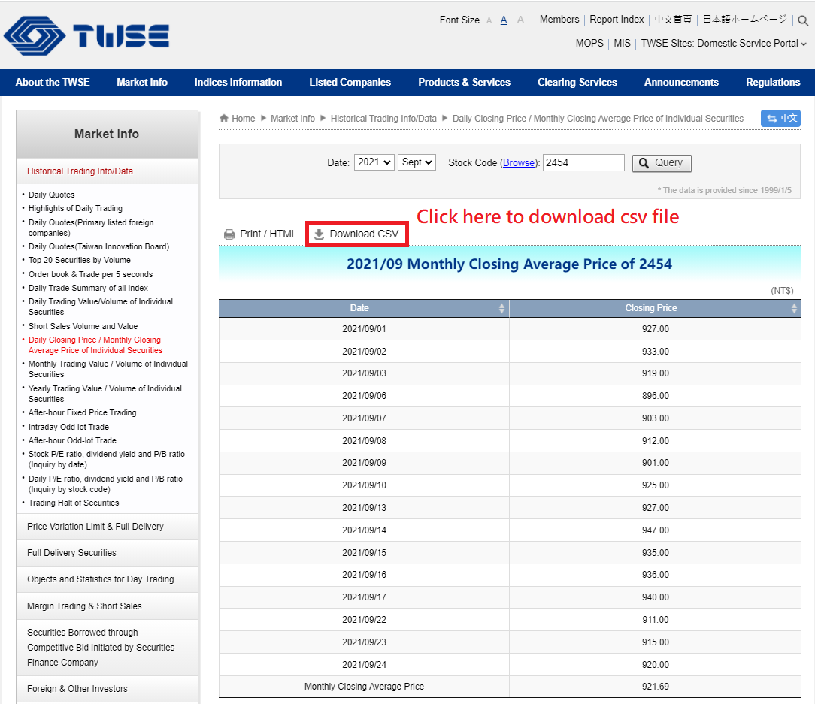
How To Download

Slide 9
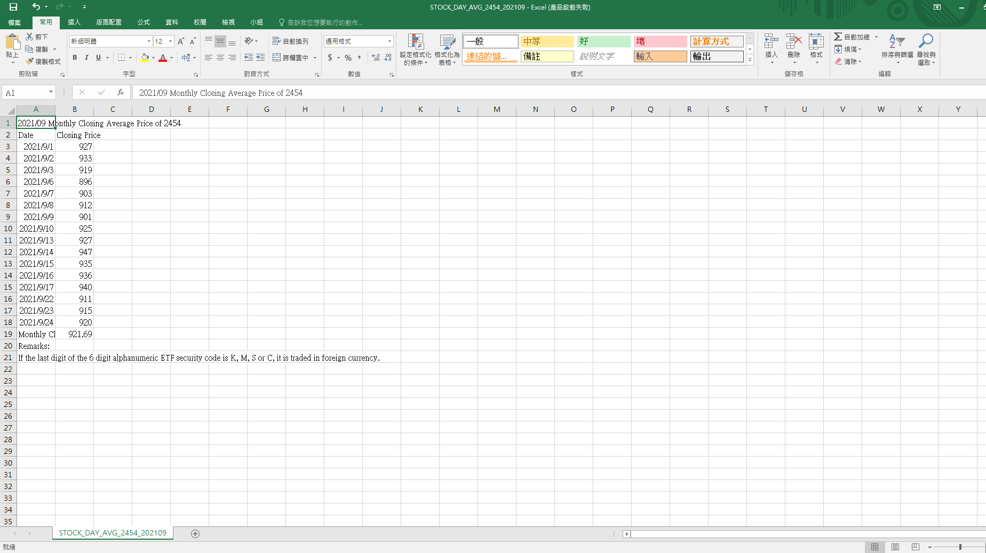
How To Download
Then you can get one month's stock data !
Combine several months of data to create the final input file

Slide 10
Report
Briefly describe how to implement regression
Summarize your work
No more than two pages

Slide 11
Basic Grading Policy
Model – 50%
Performance – 40%
Report – 10%

Slide 12
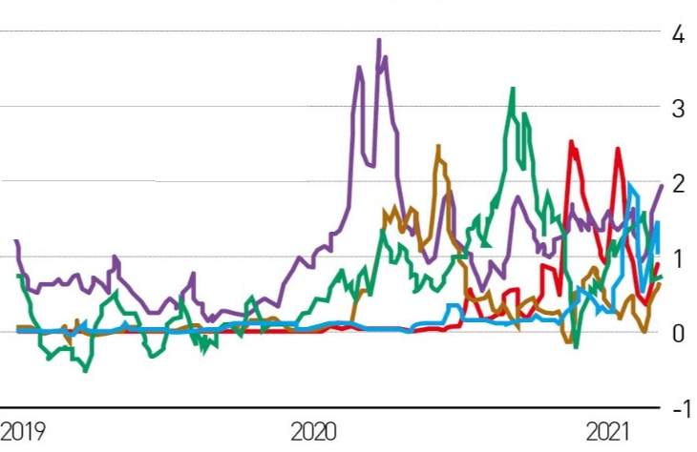
Bonus (extra 20%)
Use more than two companies to predict the stock price of TSMC in the next month (10/15~11/11 without holidays, totally 20 days)

Slide 13
Bonus Grading Policy
Model -- 5%
Performance – 10%
Report – 5% (You should write basic and bonus part of the report together in three pages)

Slide 14
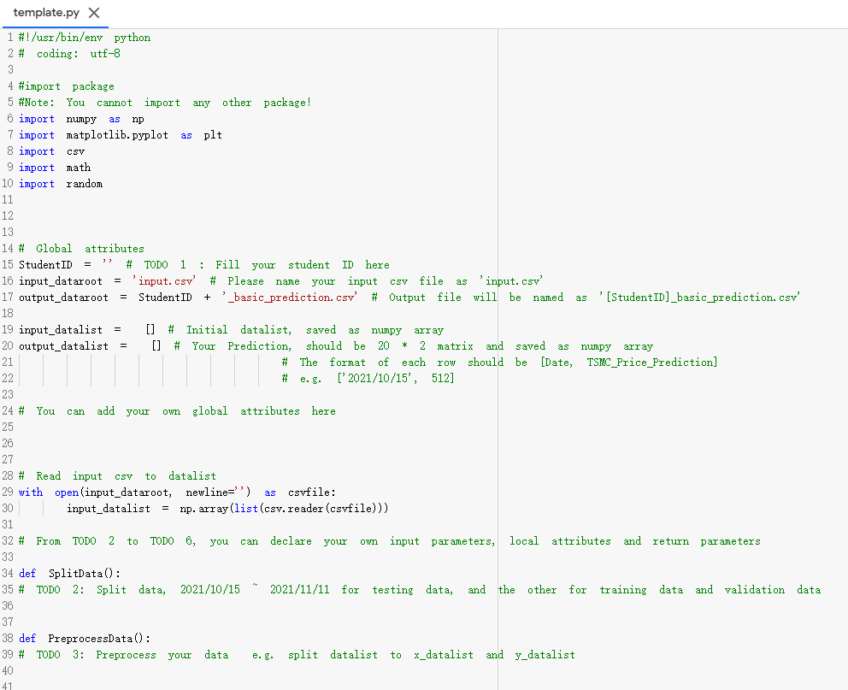
Template
Basic part must follow this format (There is no restriction for the format of bonus part)
You must use the given file “template.py” to build the model
Except for the imported packages in the template, you cannot use any other packages

Slide 15
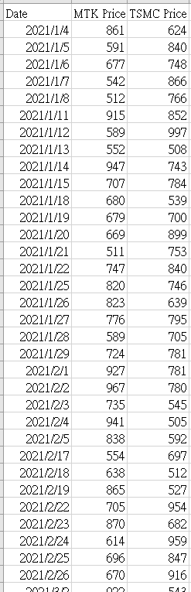
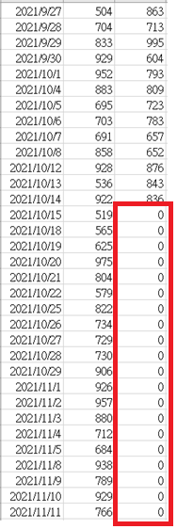
Input File Format
Basic part must follow this format (There is no restriction for the format of bonus part)
Named as “input.csv” and contains a n * 3 matrix, n means number of dates
Each row represents “Date, MTK Price, TSMC Price”
The part to be predicted (TSMC Price of 10/15 ~ 11/11 ) is filled with 0
You can refer to the given file “sample_input.csv”
We will use this format of csv file to test your model with n = 209 (1/4 ~ 11/11)
Please make sure your model can be correctly input into this format of csv file

Slide 16
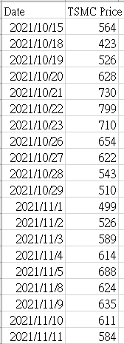
Output File Format
Both basic and bonus parts must follow this format
The prediction you turned in must also follow this format
Named as “[StudentID]_basic(bonus)_prediction.csv” and contains a 20 * 2 matrix
Each row represents “Date, TSMC Price(Prediction)”
You can refer to the given file “sample_output.csv”
Please make sure your model can correctly output this format of csv file

Slide 17
Assignment 1 Requirement
Do it individually! Not as a team! (team is for final project)
Announce date: 2021/9/30
Deadline: 2021/10/14 23:59 (Late submission is not allowed!)
Hand in your files in the following format
- [StudentID]_basic.py
- [StudentID]_basic_prediction.csv
- [StudentID]_bonus.py (optional)
- [StudentID]_bonus_prediction.csv (optional)
- [StudentID]_report.pdf
- Compress all files into [StudentID]_HW1.zip

Slide 18
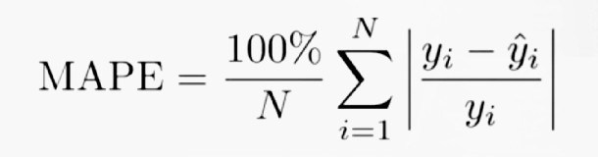
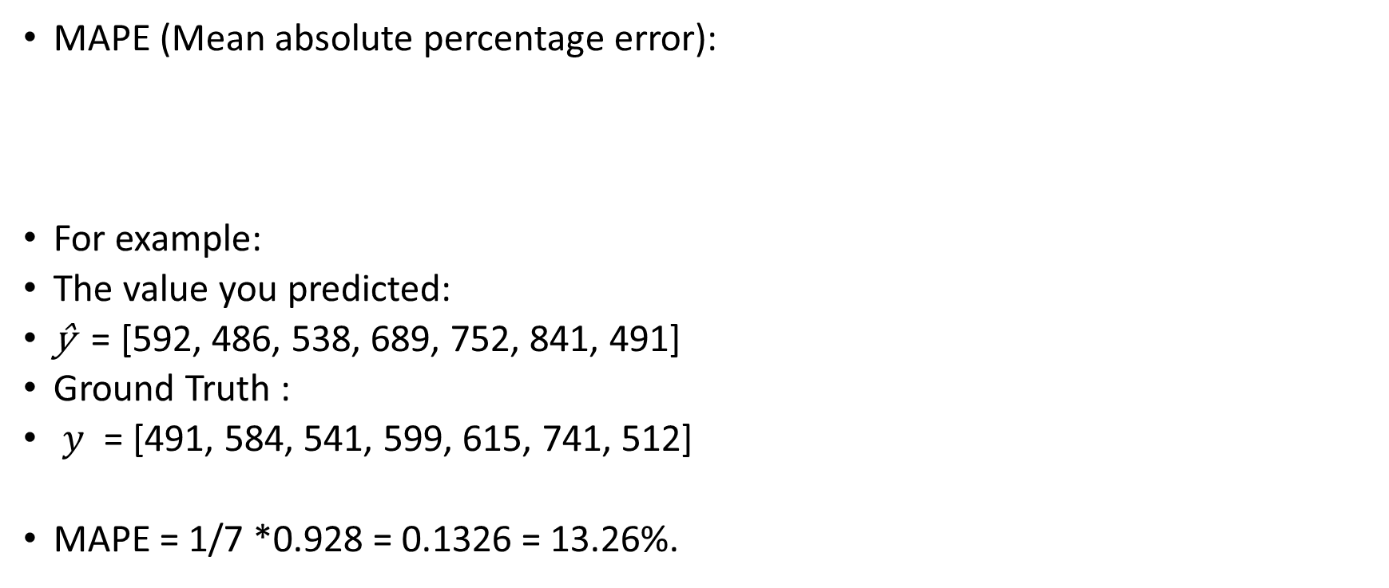
The Evaluation Metric
MAPE (Mean absolute percentage error):
For example:
The value you predicted:
$\text{ŷ}$ = [592, 486, 538, 689, 752, 841, 491]
Ground Truth :
$y$ = [491, 584, 541, 599, 615, 741, 512]
MAPE = 1/7 *0.928 = 0.1326 = 13.26%.

Slide 19
Penalty
0 points if any of the following conditions
Plagiarism
Late submission
Not using template or import any other packages in basic part
Incorrect input/output format
Incorrect submission format

Slide 20

Questions?
TA: Meng-Chien Lin (charlie2039667@gapp.nthu.edu.tw)

