Slide 1
Assignment 2 Decision Tree
Yi Shiuan Tseng
Po-Chih Kuo

Slide 2
Goal
Implement a binary decision tree with the restaurant waiting dataset
To build a machine learning model to predict the patients' death (‘hospDIED’) from real data
Preprocess the data or fine-tune the model for better performance

Slide 3
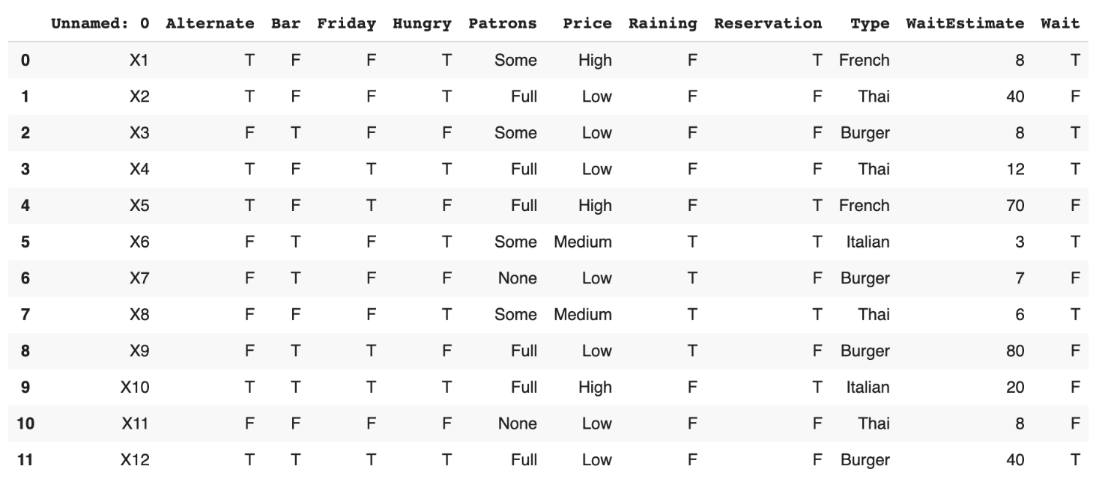
Implementation (70%)
Implement the binary decision tree in 3 steps with Restaurant dataset:
Step 1: calculate the entropy (20%)
Step 2: search for the best split (20%)
Step 3: build the decision tree (30%)
…

Slide 4
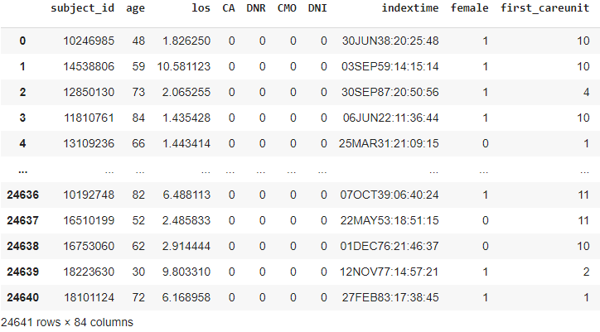

Prediction in Real Case (20%)
To classify death('hospDIED’) in the MIMIC dataset.
Note:
Decision tree is recommended but not mandatory.
x_train
y_train
…

Slide 5

The MIMIC Database
Medical Information Mart for Intensive Care
A large, freely-available database
Over 40,000 patients who stayed in critical care units
We extract 27379 cases with 84 attributes and 1 label(hospDIED)
2738 cases split to the test set
Data Description: https://docs.google.com/spreadsheets/d/1pxqxQFhIcv_hrgWEtwhXE6zBVQ5ISa-13PIhvXMtWCY/edit#gid=0
Johnson, A. E. W., Pollard, T. J., Shen, L., Lehman, L. H., Feng, M., Ghassemi, M., Moody, B., Szolovits, P., Celi, L. A., & Mark, R. G. (2016). MIMIC-III, a freely accessible critical care database. Scientific Data, 3, 160035.

Slide 6
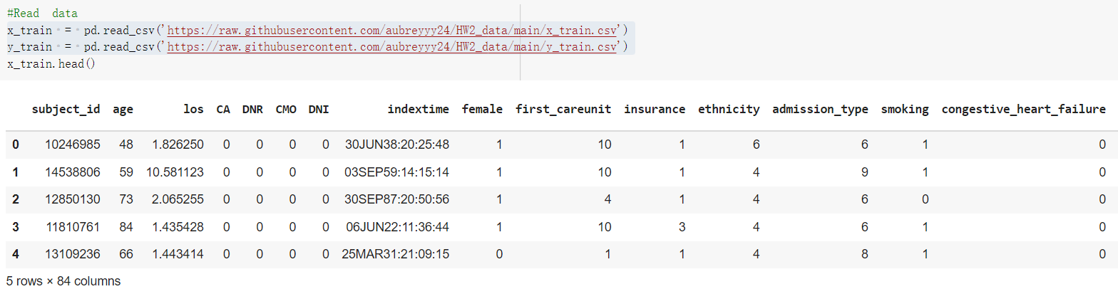
Data
The Restaurant Waiting data(data.csv) for implementation
The MIMIC dataset(x_train, y_train, x_test.csv) for real prediction
Both are included in the template already.

Slide 7
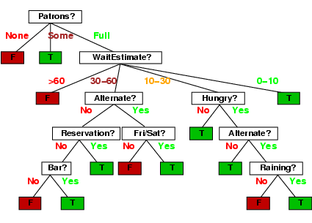
Bonus (extra 10%)
Visualize your decision tree of the classification part (with MIMIC data)
Your visualization image of the decision tree can contain five levels at most
Save your visualization image as [STUDENT_ID]_visualization.png!

Slide 8
Report (10%)
List the top 3 splitting features and their thresholds of your model (in the MIMIC dataset)
Briefly describe how you build the decision tree
Describe if you pay extra effort to improve your model
If you preprocess the MIMIC data in the second part(selecting features...), describe the work and reasons
Summarize your work
Do not exceed 2 pages!
Name your report file as “[STUDENT_ID]_report.pdf”

Slide 9
Grading Policy
Item | Score
Implementation | 70%
Classification (Performance) | 20%
Report | 10%
Decision Tree Visualization (bonus) | 10%

Slide 10
You will have the following items
Template: HW2_Decision_Tree.ipynb (input data inside)
Sample output: sample_implementation.csv
sample_prediction.csv

Slide 11
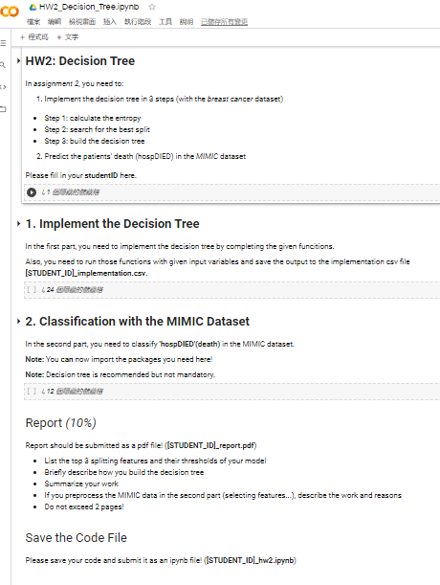
Template
Except for the imported packages in the template, you cannot use any other packages in the first(implementation) part
Remember to save the code file to [STUDENT_ID]_hw2.ipynb

Slide 12
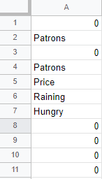
Output CSV File Format - Implementation
Named as “[StudentID]_implementation.csv”
There should be 3+2n rows in your csv file:
Entropy : 1
BestSplit column 2, BestSplit value 3
Tree features 4~4+(n-1), Tree thresholds 4+n~4+2n-1
n is the number of the features you used
Please make sure that your model can correctly output this format of csv file
example: if n=4
Entropy
column
BestSplit
threshold
features
Tree
thresholds

Slide 13
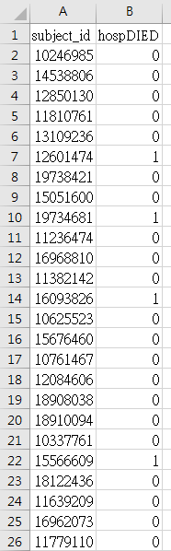
Output CSV File Format - Prediction
Named as “[StudentID]_prediction.csv”
y_test contains 2738 cases
Each row represents “subject_id, hospDIED (Prediction)”
Please make sure your model can correctly output this format of csv file

Slide 14
Assignment 2 Requirement
Do it individually! Not as a team! (team is for final project)
Announce date: 2021/10/21
Deadline: 2021/11/4 23:59 (Late submission is not allowed!)
Hand in your files in the following format
- [StudentID]_hw2.ipynb
- [StudentID]_implementation.csv
- [StudentID]_prediction.csv
- [StudentID]_visualization.png
- [StudentID]_report.pdf
- Compress all files into [StudentID]_HW2.zip

Slide 15
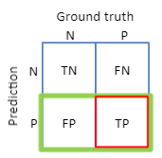
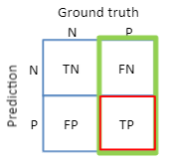
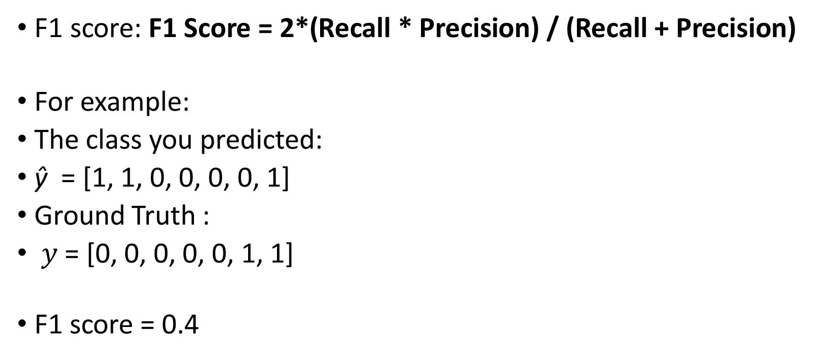
The Evaluation Metric
F1 score: F1 Score = 2*(Recall * Precision) / (Recall + Precision)
For example:
The class you predicted:
$\text{ŷ}$ = [1, 1, 0, 0, 0, 0, 1]
Ground Truth :
$y$ = [0, 0, 0, 0, 0, 1, 1]
F1 score = 0.4
Notes:
Precision = TP/TP+FP
Recall = TP/TP+FN

Slide 16
Penalty
0 points if any of the following conditions
Plagiarism
Late submission
Not using template or import any other packages in implementation part
Incorrect input/output format
Incorrect submission format

Slide 17
Questions?
TA: Yi Shiuan Tseng (aubreytys@gapp.nthu.edu.tw)

