Slide 1
Assignment 3
Backpropagation
Jia He Lim
Po-Chih Kuo

Slide 2
Goal
Build your own deep neural network step by step
Implement all the functions required to build a deep neural network
Understanding forward propagation, backward propagation and update
Implement Binary Cross-Entropy loss (basic part) and Categorical Cross-Entropy loss (bonus part)
Implement binary classifier (basic part) and multi-class classifier (bonus part)

Slide 3
Grading Policy
Item | Score
Basic Implementation | 70%
Basic Report | 30%
Bonus Implementation | 25%
Bonus Report | 5%

Slide 4
Overview
L_layer_model
initialize_parameters_deep
L_model_forward
compute_BCE_cost/
compute_CCE_cost
linear_activation_forward
linear_forward
sigmoid/relu/softmax
L_model_backward
linear_activation_backward
linear_backward
update_parameters
sigmoid_backward/relu_backward
softmax_CCE_backward

Slide 5
Basic Implementation (70%)
Create and initialize parameters of a linear layer with He initialization. (5%)
Create and initialize parameters for an L-layer neural network with He initialization. (5%)
Apply the linear transformation. (5%)
Implement activation function. (10%) (Sigmoid and ReLU)
Implement linear-activation layer. (5%) (Sigmoid and ReLU)
Compute the binary cross-entropy cost. (5%)
Implement linear backward. (5%)
Implement backward function. (10%) (Sigmoid and ReLU)
Implement the backpropagation for the linear-activation layer. (5%)
Implement gradient descent to update your parameters. (5%)
Implement a binary classifier and tune hyperparameter. (10%)

Slide 6
Basic Report (30%)
Describe what problems you encountered when implementing the basic functions.
Describe how you solve those problems.
Briefly describe how you build the binary classifier.
Describe if you pay extra effort to improve your model (e.g. hyperparameter finetuning).
Summarize your work.
Do not exceed 2 pages!
Name your report file as “[STUDENT_ID]_report.pdf”.

Slide 7
Bonus Implementation (25%)
Implement activation function and linear-activation layer. (5%) (Softmax)
Compute the categorical cross-entropy cost. (5%)
Implement backward function. (5%) (Softmax+CCE_loss)
Implement a multi-class classifier and tune hyperparameter. (10%)

Slide 8
Bonus Report (5%)
Describe what problems you encountered when implementing the bonus functions.
Describe how you solve those problems.
Briefly describe how you build the multi-class classifier.
Describe if you pay extra effort to improve your model (e.g. hyperparameter finetuning).
Summarize your work.
Do not exceed 1 page!
Write bonus part after basic part in the same report.

Slide 9
Data
Binary classification: Iris flower data set The data set consists of 50 samples from each of three species of Iris (Iris setosa, Iris virginica and Iris versicolor). Four features were measured from each sample: the length and the width of the sepals and petals, in centimeters. Only Iris setosa and Iris versicolor are used in our assignment, so there are 100 samples in total. The details of the training set and validation set are shown below:
shape of X: (4, 100)
shape of y: (1, 100)
shape of X_train: (4, 90) shape of y_train: (1, 90)
shape of X_val: (4, 10) shape of y_val: (1, 10)

Slide 10
Data
Multi-class classification: Classify gestures by reading muscle activity The armband has 8 sensors placed on skin surface, each measures electrical activity produced by muscles beneath. Each dataset column has 8 consecutive readings of all 8 sensors, so 64 rows of electromyography (EMG) data. A classifier given 64 numbers would predict a gesture class (0-3). Gesture classes were : rock - 0, scissors - 1, paper - 2, ok - 3. Rock, paper, scissors gestures are like in the game with the same name, and OK sign is index finger touching the thumb and the rest of the fingers spread.

Slide 11
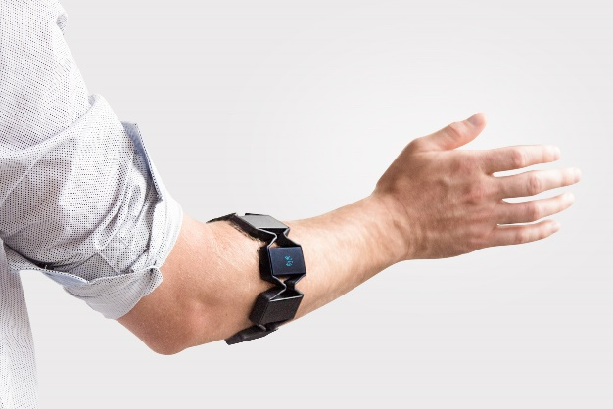
Data
Multi-class classification: Classify gestures by reading muscle activity
Each column has the following structure:
[8sensors] | [8sensors] | [8sensors] | [8sensors] | [8sensors] | [8sensors] | [8sensors] | [8sensors]
The details of the training set and testing set:
shape of X_train: (64, 9342)
shape of y_train: (4, 9342)
shape of X_test: (64, 2336)
We have already done the data preprocessing for you. The training data and testing data are scaled by using a standard scaler so that the data will have a mean of zero and a standard deviation of one for each feature.

Slide 12
You will have the following items
Template: HW3_Backpropagation.ipynb (input data inside) (You are encouraged to use Colab!)
Sample output: sample_output.npy

Slide 13
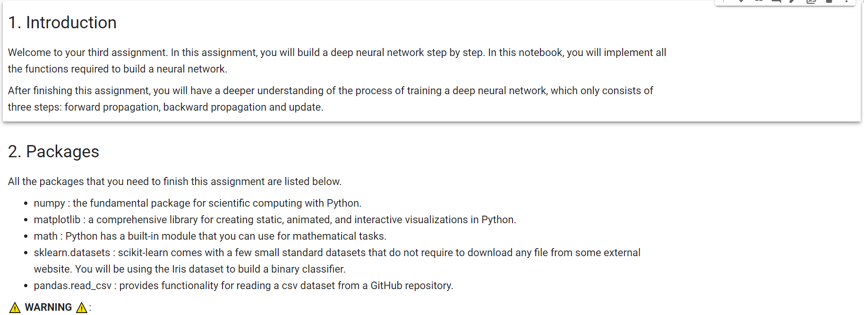
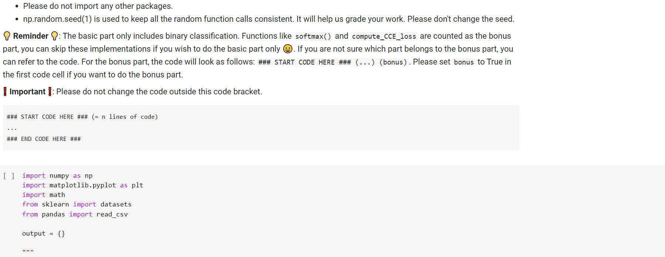
Template
Except for the imported packages in the template, you cannot use any other packages.
Remember to save the code file to [STUDENT_ID]_hw3.ipynb

Slide 14
Output NPY File Format
Named as “[StudentID]_output.npy”
This file is a dictionary that stores your output for each function and the prediction for both binary classification and multi-class classification.
The dictionary should have the following keys: 'initialize_parameters', 'initialize_parameters_deep', 'linear_forward', 'sigmoid', 'relu', 'softmax', 'linear_activation_forward_sigmoid', 'linear_activation_forward_relu', 'linear_activation_forward_softmax', 'compute_BCE_cost', 'compute_CCE_cost', 'linear_backward', 'sigmoid_backward', 'relu_backward', 'softmax_CCE_backward', 'linear_activation_backward_sigmoid', 'linear_activation_backward_relu', 'update_parameters', 'basic_pred_val', 'bonus_pred_test’
If you do not complete the bonus part, the value for the bonus part key will be None.

Slide 15
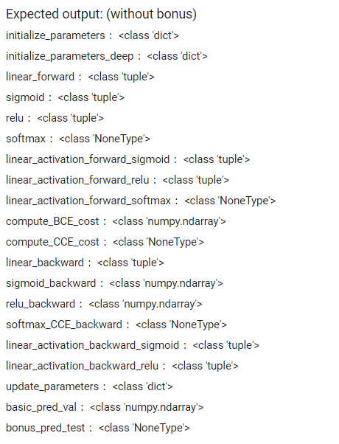
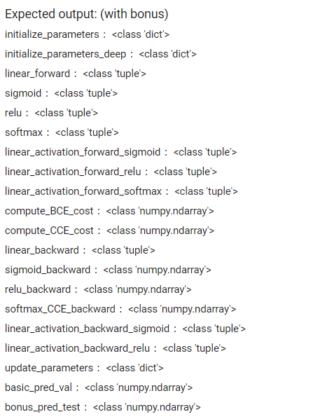
Output NPY File Format

Slide 16
Assignment 3 Requirement
Do it individually! Not as a team! (team is for final project)
Announce date: 2021/11/18
Deadline: - basic: 2021/11/30 10:00 - bonus: 2021/12/2 23:59 (Late submission is not allowed!)
Hand in your files in the following format - [StudentID]_hw3.ipynb (Please keep your code output when submitting your homework) - [StudentID]_output.npy - [StudentID]_report.pdf - Compress all files into [StudentID]_HW3.zip

Slide 17
The Evaluation Metric
For the basic function and bonus function implementations, you will get a full score if your output is exactly the same as the standard answer.
For the binary classifier and multi-class classifier, we will use accuracy to evaluate your classifier.
Binary classification: You will get a full mark if your validation accuracy is higher than 80%.
Multi-class classification: You will be compared with others who submit the bonus prediction.

Slide 18
Penalty
0 points if any of the following conditions:
Plagiarism (randomly choose some of you to explain your implementation, problems in the next exam will be based on the basic part of hw3)
Late submission
Not using template or import any other packages
Incorrect input/output format
Incorrect submission format

Slide 19
Questions?
TA: Jia He Lim (ivanljh123@gmail.com)

