Slide 1

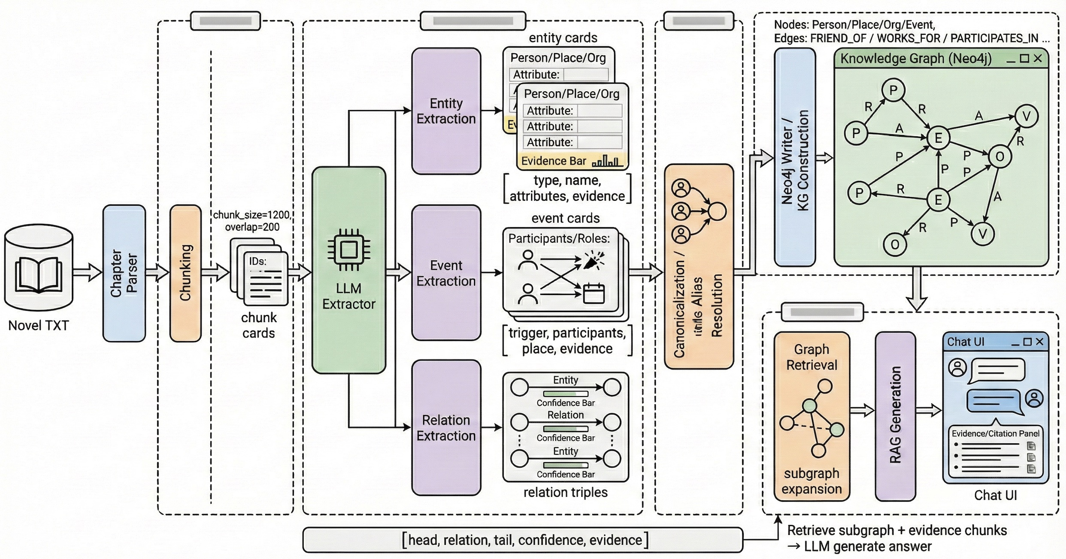
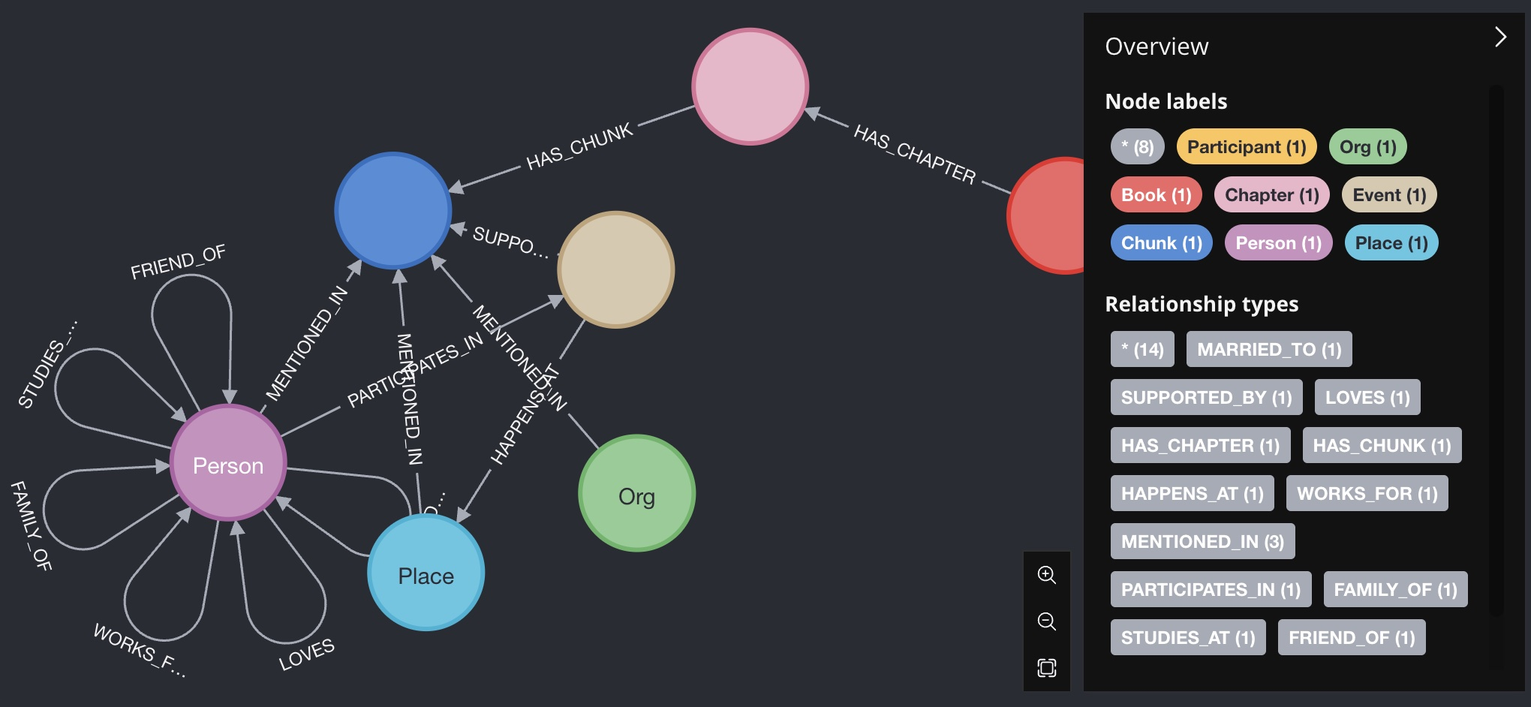
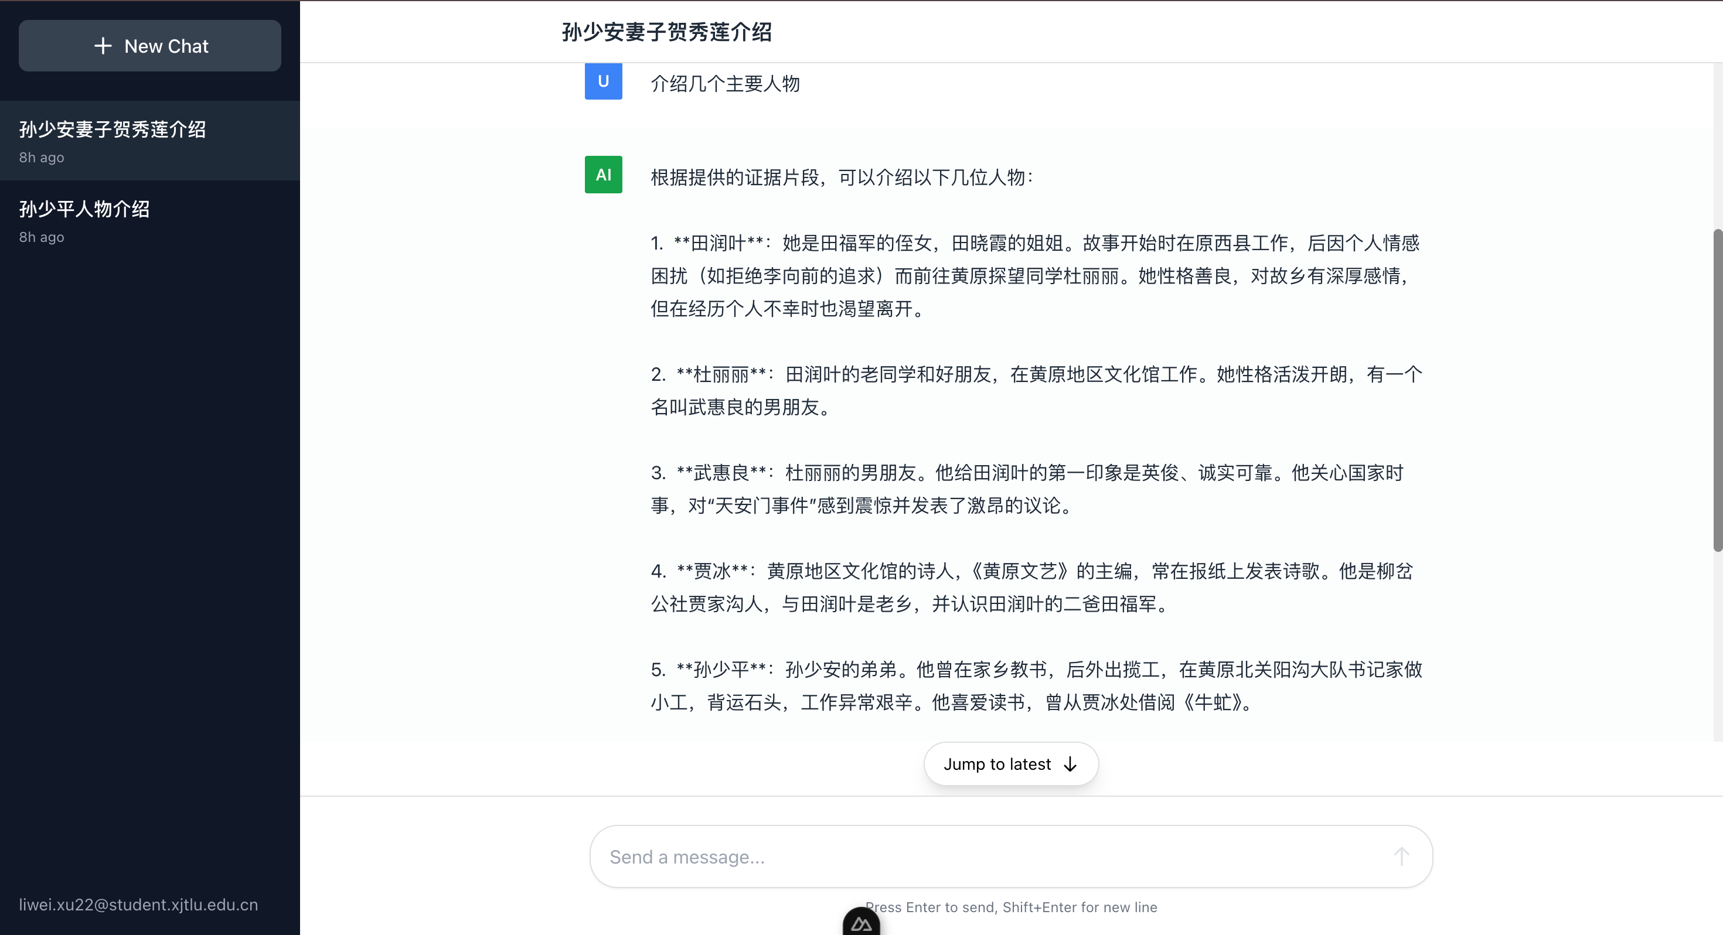
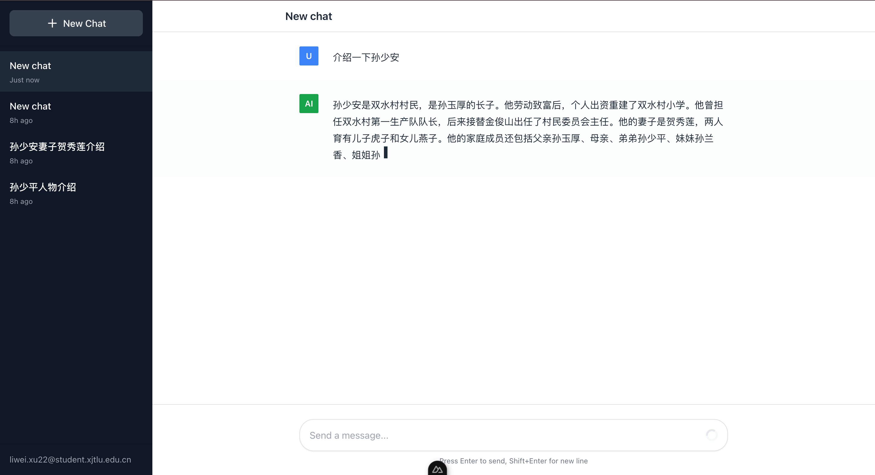
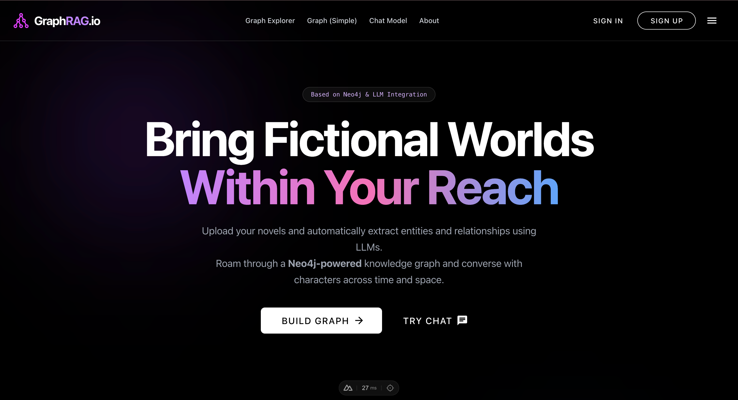
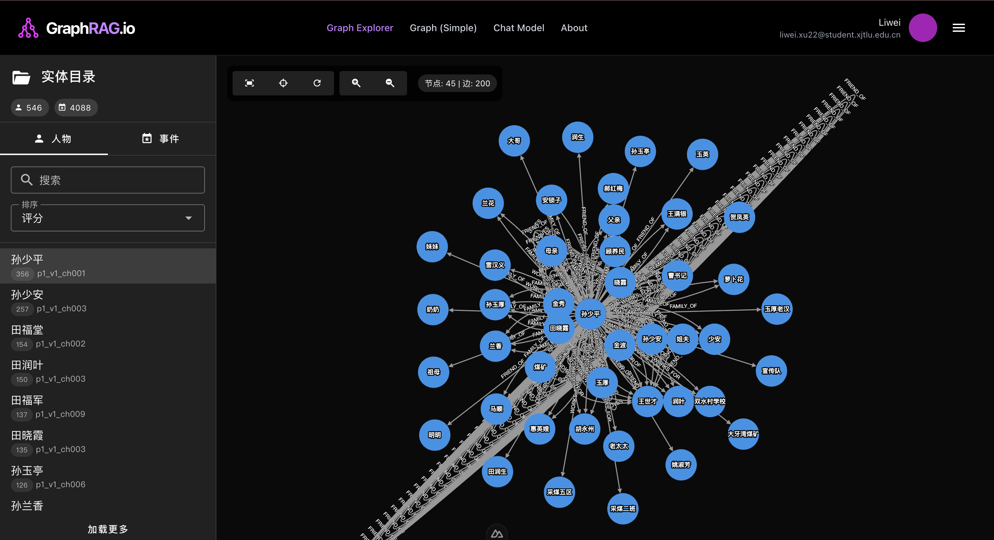
Novel-to-Knowledge Graph: LLM-Based Extraction & Neo4j GraphRAG Multi-Turn QA
Authors：Liwei.Xu
Supervisor：Chengtao.Ji
Abstract
In This project presents an end-to-end pipeline that transforms raw novel TXT files into a queryable knowledge graph and a GraphRAG-based conversational system with evidence grounding. The workflow first preprocesses the novel by chapter and splits the text into overlapping chunks, assigning stable identifiers (chapter_id/chunk_id) to enable traceability. For each chunk, a large language model extracts structured entities with attributes, identifies entity-grounded events, and further derives relations between entities as well as between entities and events. Every extracted item retains an evidence span from the original text, supporting interpretability and provenance. The resulting nodes and edges are ingested into Neo4j with a consistent schema for efficient querying and visualization. On top of the graph, a FastAPI backend provides user management, graph retrieval APIs, and a multi-turn GraphRAG chat endpoint. The Nuxt + Tailwind frontend offers an interactive graph browser and a streaming chat interface, receiving incremental tokens via Server-Sent Events (SSE) and presenting citation-style evidence snippets. Together, the system enables interactive exploration and evidence-backed question answering over long-form narrative text.
Motivation
Long-form novels contain dense information about characters, places, organizations, and events dispersed across chapters, and key relations are often expressed implicitly. This makes manual curation costly and weakens traceability. We build an end-to-end system that transforms raw TXT novels into a Neo4j knowledge graph and supports GraphRAG-based question answering. The pipeline segments text into overlapping chapter-level chunks with stable chapter_id and chunk_id provenance anchors, then uses an LLM to extract entities with attributes, entity-grounded events, and entity–entity/entity–event relations, retaining evidence spans for interpretability. The resulting graph is ingested into Neo4j for querying and visualization, and a multi-turn chatbot streams responses via SSE with citation-style evidence snippets.
Main contributions:
Successfully Build an End-to-End Novel-to-KG Pipeline. We design and implement a complete workflow that transforms raw TXT novels into structured outputs via chapter-aware chunking with stable provenance identifiers (chapter_id/chunk_id).
Perform Evidence-Grounded LLM Extraction for Entities, Events, and Relations. We use an LLM to extract entities with attributes, entity-grounded events, and entity–entity/entity–event relations, while retaining evidence spans to ensure interpretability and verifiable grounding.
Construct and Ingest a Queryable Neo4j Knowledge Graph. We define a Neo4j schema and ingest nodes, edges, properties, and evidence for efficient graph querying and visualization, enabling subgraph retrieval for downstream QA.
Enable Multi-turn GraphRAG Question Answering with Streaming UI. We build a GraphRAG-based chatbot that supports multi-turn conversations and streams token-level responses via SSE, presenting citation-style evidence snippets in a Nuxt + Tailwind frontend.
Methodology
Preprocess text:
Parse the TXT by chapters and split into overlapping chunks; assign stable chapter_id and chunk_id for provenance.
Extract entities:
Run an LLM per chunk to produce entities (type/name), plus attributes and evidence spans.
Extract events:
Identify narrative events in the chunk and bind them to participating entities (participants/roles) with evidence spans.
Extract relations:
Infer entity–entity and entity–event relations, recording evidence and the source chunk_id for each edge.
Canonicalize and merge:
Resolve duplicates and aliases via rules or similarity, producing canonical IDs to reduce redundancy.
Ingest into graph DB:
Store entities/events as nodes and relations as edges in Neo4j; create indexes and persist evidence properties.
GraphRAG retrieval:
Retrieve relevant subgraphs and evidence spans (via entity/event neighborhood expansion) to form structured context.
Generate and stream:
Feed retrieved context and dialogue history to the LLM; stream tokens via SSE and render incrementally with citation-style evidence.
Figure 1. End-to-End pipeline from novel text to KG and GraphRAG
Figure 2. Neo4j schema and example ego-graph
System Outputs & Diagnostics
Knowledge Graph Scale: Report #Chapters, #Chunks, #Nodes (Person/Place/Org/Event) and #Edges (relations), plus average degree to summarise graph density.
Provenance & Interpretability: each extracted entity/event/relation is stored with evidence spans and chunk_id for traceable, citation-style grounding.
Runtime & UX: measure time-to-first-token (TTFT) and end-to-end response latency under SSE streaming for interactive multi-turn QA.
System Summary (Development Deliverables):
Backend: FastAPI APIs for user module, graph retrieval, and GraphRAG chat (multi-turn).
Database: Neo4j schema with indexed nodes/edges and evidence properties, SQLite
Frontend: Nuxt + Tailwind UI for graph browsing and chat; SSE-based streaming rendering.
Figure 3. GraphUI and ChatUI

