Slide 1
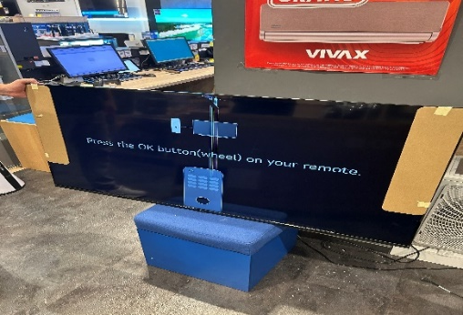
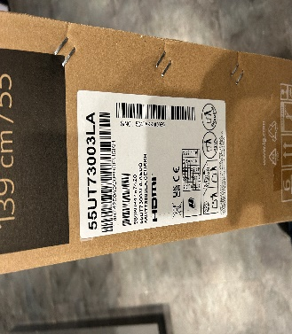
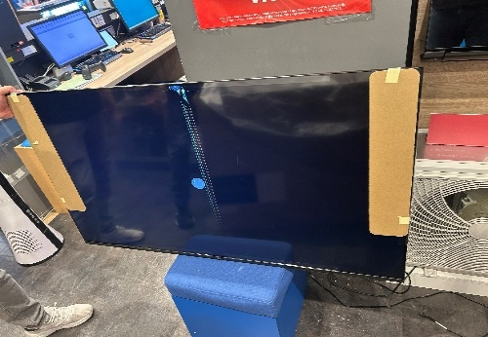
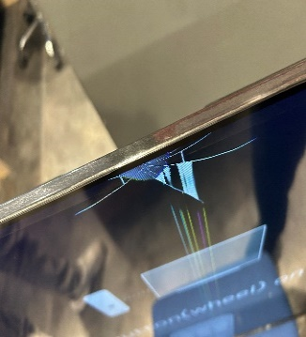
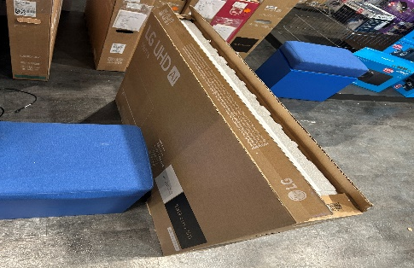
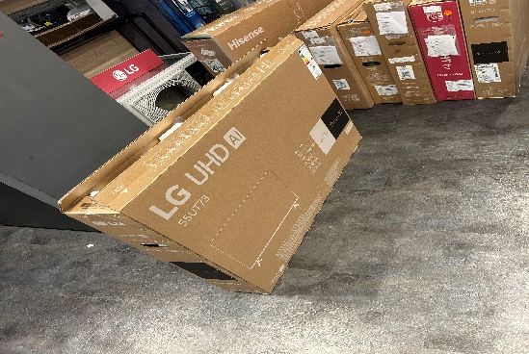
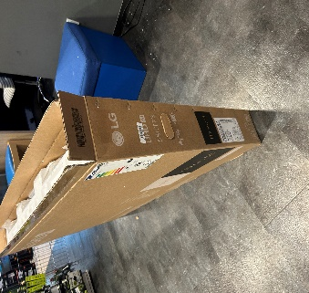
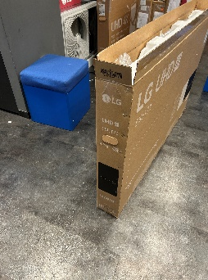
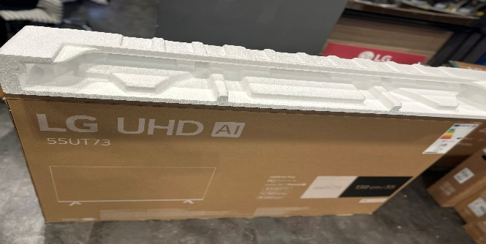
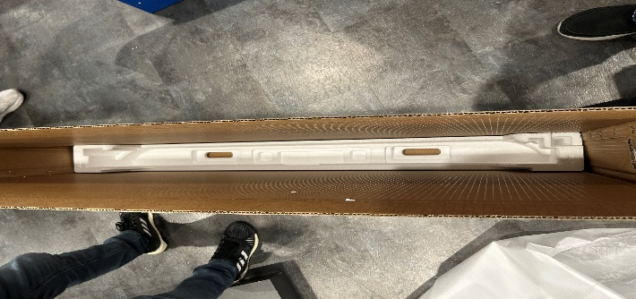
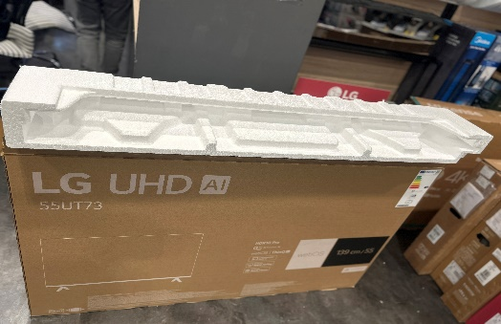
Panel Crack Inspection Report
Model | 55UT73003LA | Serial Number | 504TAKK0G069 | Detection Date | 09.09.2025. | Detection Place | STORE
Country | Croatia | Dealer | SANCTA DOMENICA |  | SANCTA DOMENICA | On/Off line
Item | Photo |  |  |  |  |  | Note
S E T
B O X
P A C K I N G
1 photo about the whole display (on and off too)
and another 1 about the
damage
Put photos about all sides but front and back side
are the most important
Put photos about
nikecells
1 / 1
Notes:
MR servis 15.12.2017

