Slide 1
Parallelizing Word2vec in Shared and Distributed Memory
Team: Kirti Bhandari, April Cai

Slide 2
What is word2vec?
Query a:b; c:?
King : queen ; man:?
King : queen ; man : woman
Word2vec is a group of related models used to produce vector representations of words in a continuous space.
These representations are termed as word embeddings.
Word vectors are very useful in various NLP applications.

Slide 3
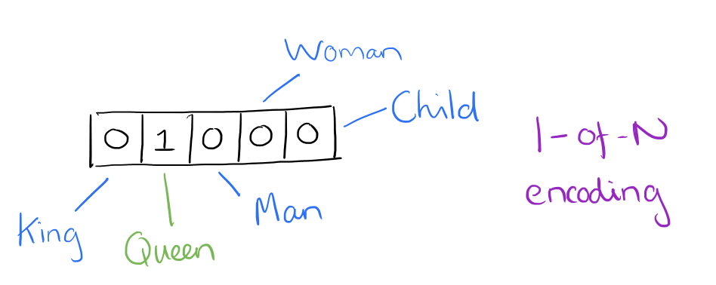
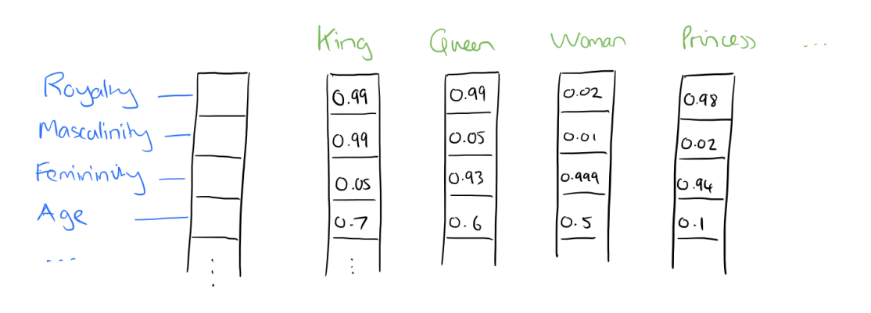
Why word2vec?
Analogy
Similarity measurement
No meaningful comparison
Distributed representation
Reference: https://blog.acolyer.org/2016/04/21/the-amazing-power-of-word-vectors/

Slide 4
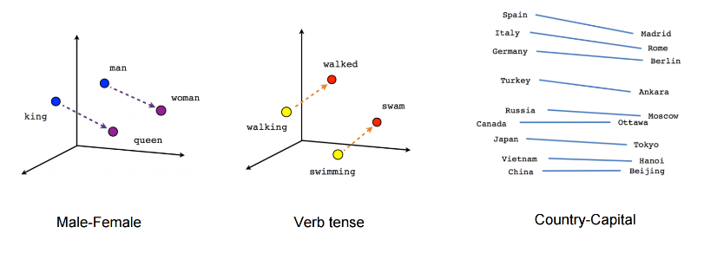
Reference:https://theneuralperspective.com/2016/11/16/embeddings-skipgram-and-cbow-implementations/

Slide 5
WORD2VEC ALGORITHM
Continuous Bag of Words Algorithm (CBOW)
Skip-gram Algorithm

Slide 6
Word2vec algorithm
Example:
The quick brown fox jump over the lazy dog.
Skip-gram model (with window of 1): (quick, the) (quick, brown) (brown, quick) (brown, fox), … (lazy, dog)
CBOW (with window of 1): (‘the brown’, ‘quick’) ('quick fox', 'brown') ('brown jump', 'fox), ...

Slide 7
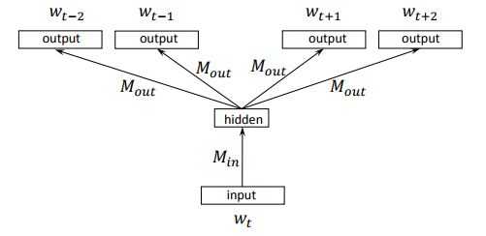
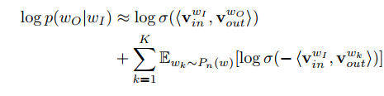
Word2vec algorithm

Slide 8
WORD2VEC ALGORITHM - SGD
Word2Vec: Takes word pairs (Winput, Wtarget) and computes the gradient of objective function w.r.t the word vectors.
Difficult to parallelize
Original word2vec: Hogwild implementation which ignores the conflicts between model updates by different threads
pWord2Vec: Hogbatch implementation = Hogwild + negative sample sharing

Slide 9
Limitations of original implementation
Threads updating same cache line can lead to ping-pong effect
Significant amount of spatial locality not exploited

Slide 10
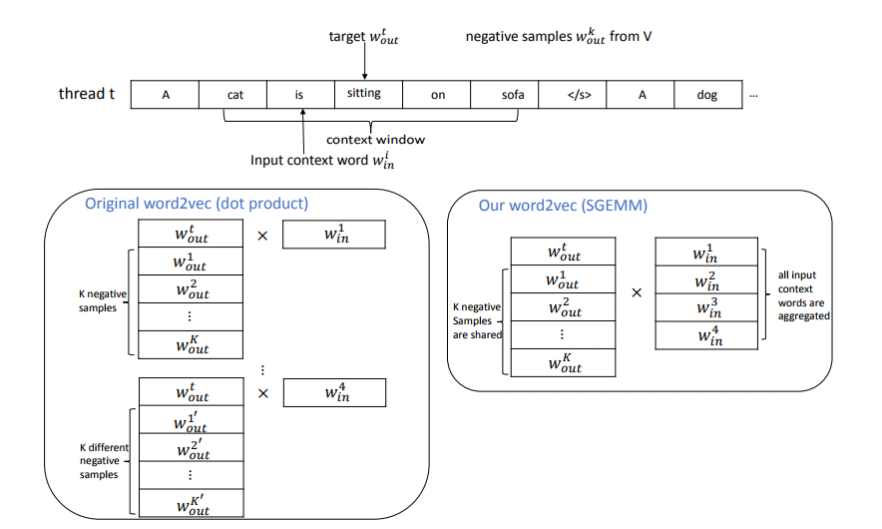
Data parallelism
Spatial locality
Reference: Ji, Shihao, et al. "Parallelizing word2vec in shared and distributed memory." arXiv preprint arXiv:1604.04661 (2016).
Notes:
Reference: Ji, Shihao, et al. "Parallelizing word2vec in shared and distributed memory." arXiv preprint arXiv:1604.04661 (2016).

Slide 11
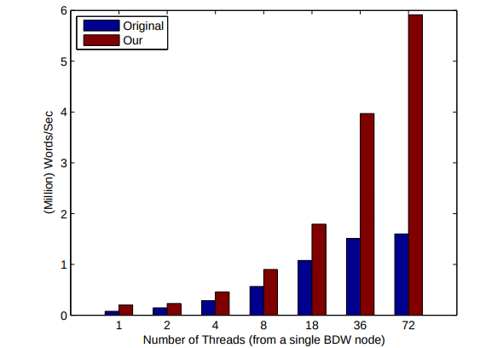
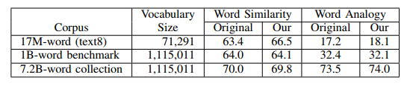
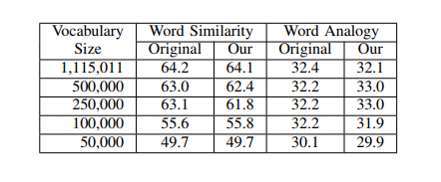
Results
Reference: Ji, Shihao, et al. "Parallelizing word2vec in shared and distributed memory." arXiv preprint arXiv:1604.04661 (2016).​

Slide 12
Another Approach
The paper suggested that distributed training with a parameter server might perform better.
Hence we decided to explore distributed training using word2vec model of Tensorflow.

Slide 13
Distributed Word2vec on Tensor Flow
Data Parallelism
Asynchronous training

Slide 14
DaTA PARALLELISM on Tensor Flow
The entire graph stays on a machine called the parameter server. Parameter servers can be replicated and kept in sync.
Training operations will be executed on multiple machines called workers. Each worker will be reading different data batches, computing gradients, and sending updates to the parameter servers.

Slide 15
ASYNCHRONOUS TRAINING on Tensor Flow
Each replica of the graph has an independent training loop that executes without coordination.
The workers will read from the parameter server(s) asynchronously, compute their training operation, and send asynchronous updates.

Slide 16
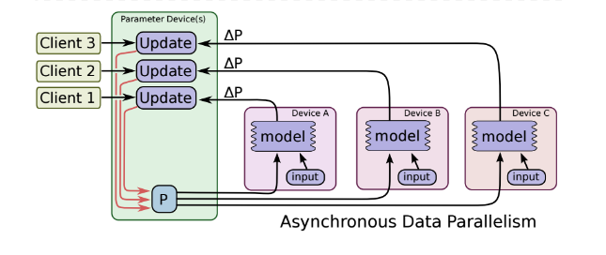
ASYNCHRONOUS TRAINING on Tensor Flow

Slide 17
Goals
Reproduce the results of pWord2Vec
Compare the results with GPU run
Create a distributed word2vec model in TF
Train the distributed word2vec model in TF 1billion dataset
Compare the performance of distributed word2vec against that of single node word2vec.
Measure the performance gain on 1 billion word benchmark.

Slide 18
Thank You!
Questions?

