Slide 1
DevOps

Slide 2
What is DevOps?
A set of practices to reduce the time between making a change to a system and realizing that change in production (whether on-premises or in the cloud) without sacrificing quality of system stability.
Historically slowed down by:
Transitioning to Dev / Test / Prod environments
Pet Servers
Organizational Culture / Mindset
Siloed teams
Notes:
So finally now that we understand how systems come together, how data science products are deployed, and the complexities with managing the process we can now define DevOps because we can see the need for it.

Slide 3
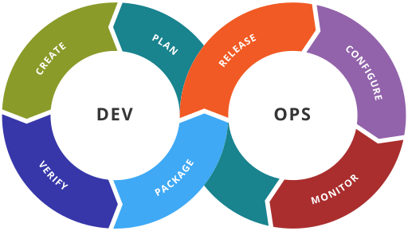
The DevOps Cycle
https://en.wikipedia.org/wiki/DevOps#/media/File:Devops-toolchain.svg

Slide 4
Core Values of DevOps - CAMS
Culture – breaking down barriers between teams, shortening feedback loops
Automation – productivity gains in deployment, systems thinking
Measurement – basing decisions on data instead of guessing
Sharing – tooling, discoveries and lessons among the team
Notes:
CAMS was first coined by Damon Edwards and John Willis at DevOpsDays Mountainview 2010 It is an acronym describing the core values of the DevOps Movement: Culture, Automation, Measurement, and Sharing.
[READ BULLETS]

Slide 5
DevOps Goals
Systems thinking - imagine your systems as a whole not as parts
Culture of ownership – everyone involved has ownership over the entire system and process
Shortening feedback loops - take less time to fix problems and achieve goals.
Culture of experimentation and learning - no fear of making changes as you should be able to test them easily.
Notes:
Systems thinking - imagine your systems as a whole not as parts
Culture of ownership – over the entire system and process. Everyone on the team has the same vested interest whether you’re a DBA, Developer, Data Scientist, Systems Administrator
Shortening feedback loops - take less time to fix problems and achieve goals. Try not to bog yourself down in bureaucracy and process.
Culture of experimentation and learning - focus on learning from your mistakes, and setup a technology environment which encourages and supports this.

Slide 6
Infrastructure as Code Methodology for DevOps
Treat your infrastructure as if it were code!
Store configurations, dependencies and scripts to bootstrap your systems in a source code management (SCM) system like Git.
This allows you set-up and tear down environments quickly and easily and deploy your systems in Dev, Test or Production.
Servers are commodity / utility resources, and not at all strategic. A perfect scenario for cloud computing!
Notes:
In the Infrastructure as Code methodology we our systems infrastructure as if it were code!
We Store configurations, dependencies and scripts to bootstrap your systems in a source code management (SCM) system like Git.
This allows you set-up and tear down environments and dependencies quickly and easily and deploy your systems in Dev, Test or Production.
In the grand scheme of things the servers (hardware and networks) are simply a commodity or utility and have no strategic value at all.

Slide 7
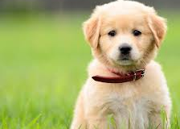
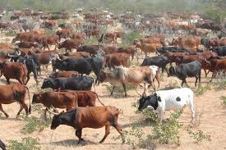
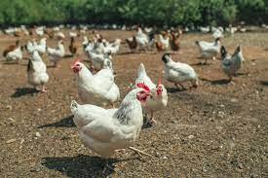
Treat Servers like Cattle or Chicken, Not Pets
Pet servers
Few of them
Are given names like mail.mycompany.com
Are built to solve the task at hand (email)
When they are “sick” we “nurse them back to health”
Cattle servers:
Lots of them
Are given numbers like s0045.mycompany.com
Are built to do the same thing: compute and storage
When they are “sick” we “take them out of commission” and replace with another.
Cloud Computing Mindset
Chicken containers
Lifetime shorter
Take up less space than servers
Notes:
A big mantra of DevOps is “Treat Servers like Cattle, Not Pets” It’s important to recognize we’re talking about HARDWARE here not the applications running on the hardware. We want the underlying infrastructure to be a commodity of storage network and compute . So the when we can design our application so that it is free to scale. The big internet companies like Google, Facebook, and Yahoo learned this early on.

Slide 8
Essential DevOps Toolbox for IaC
Source Code Management (git, subversion, mercurial)
Virtualization / Containerization (VMWare, Vagrant, Docker, CoreOS)
Configuration Management (Ansible, Chef, Puppet, Docker-Compose)
Orchestration (Kubernetes, Mesos, Rancher, Docker Swarm)
Continuous Integration / Continuous Delivery (Jenkins, TeamCity)
Monitoring / Logging (Monit, Nagios, ELK Stack)
Notes:
There are tools which help us execute the philosophy behind DevOps.
Source Code Management tools like Git allow us to work collaboratively, store multiple versions of our code and configurations, manage releases, and track changes to not only our applications but our infrastructure dependencies too.
Virtualization and Containerization tools are a key component which allows us to treat our servers like cattle, abstracting away an application’s dependencies so that they can be deployed easily to different hardware.
Configuration Management tools allow us to manage complete environment tools allow us to control and manage an application’s dependencies as a whole. In addition these tools allow us to push changes to existing systems.
Orchestration tools are best thought of as the combination of containerization + configuration management. These platforms abstract away the compute, network and storage of your hardware resources into a virtual pool of resources which can be allocated to your application as needed. Orchestration tools represent the next logical progression of containerization and configuration management and many of them incorporate such technologies into their platform.
Continuous Integration / Continuous Delivery tools pick up code commits from source code management tools and execute a task. They can test committed code to ensure no new bugs were introduced, or work with orchestration tools to automatically deploy an application to a test environment for use by beta testers. Likewise, they can even deploy changes into production!
Monitoring / Logging – one of the core values of devops is measurement, and these tools assist with that. They help us determine if services crash and why, and can perform auto-restarts. They can collect useage data (telemetry) so we can measure how our users interact with our applications – valuable information which can be used to create new features and enhancements.
ELK Elasticsearch Logstash Kibana

Slide 9
What is Containerization?

Slide 10
Containerization
Containerization is a form of virtualization at the application level
Containers run on the host operating system or in a host-based virtual machine
It was designed to overcome a key limitation of host virtualization

Slide 11
Host based Virtualization Is Heavy
Web Server
DNS Server
Database Server
Web App
DNS
Database
Linux (OS)
Linux (OS)
Linux (OS)
VMWare ESX (Hypervisor)
Dell PowerEdge (Hardware)

Slide 12
Why is it heavy?
With host virtualization the services share hardware resources only
There has to be an OS to use the hardware resources
The default virtual hard disk size for the operating system (OS) is typically 30 GB on a Linux VM in Azure. (https://docs.microsoft.com/en-us/azure/virtual-machines/linux/expand-disks)
NodeJS docker container size is < 1GB

Slide 13
Why is it heavy?
The operating system and configuration settings must be maintained on each virtual host
This creates a maintenance nightmare as it is easy to setup virtualized hosts but difficult and time consuming to maintain them.

Slide 14
Containers are lighter weight
Web Server
DNS Server
Database Server
Web App
DNS
Database
Docker (Container Runtime)
Linux (Operating System
VMWare ESX (Hypervisor)
Dell PowerEdge (Hardware)

Slide 15
Benefits of Containerization
Application components run in a container on the operating system
Operating system and dependencies and configuration of each service are no longer an issue.
Can easily re-create the environment multiple times for development and testing
Take up less disk space when compared to host virtualization, since one operating system is used.
Integration with other components.

Slide 16
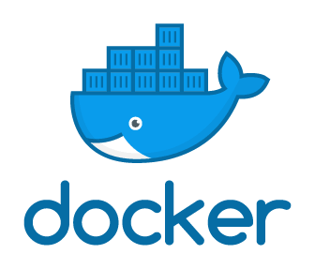
Docker
Docker is a popular container application. It manages:
Building of images
Running of containers and managing their run-time resources like memory, CPU, disk and network.
Sharing of containers with other people (via registry).

Slide 17
Container Concepts
Image – holds the software, it dependencies and information necessary to run the application
Container – Self-contained unit of software. It is a running image plus the configuration and state. At the time the container runs network and storage information is provided.
Volume – persistent storage mechanism for the container.
Network – containers have virtual network similar to host-based virtualization
Registry – an online source of images.
Image
Volume (Config)
Network (Config)
Container

Slide 18
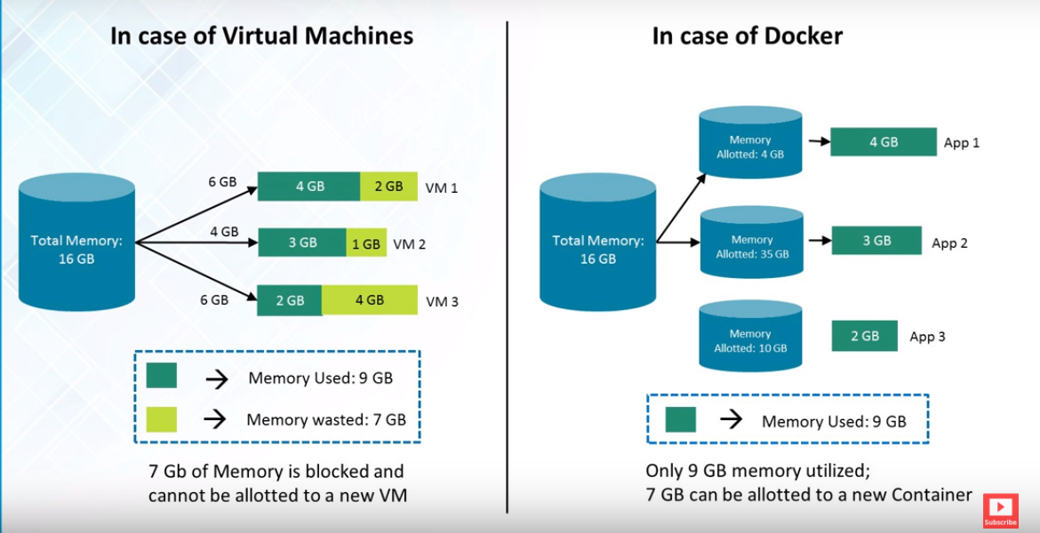

Slide 19
Docker Compose
Docker-compose is a tool for running multi-container docker applications.
All aspects of each running container are included in the compose file.
Image
Network
Volumes
The containers within the compose file are deployed as a single unit.

Slide 20
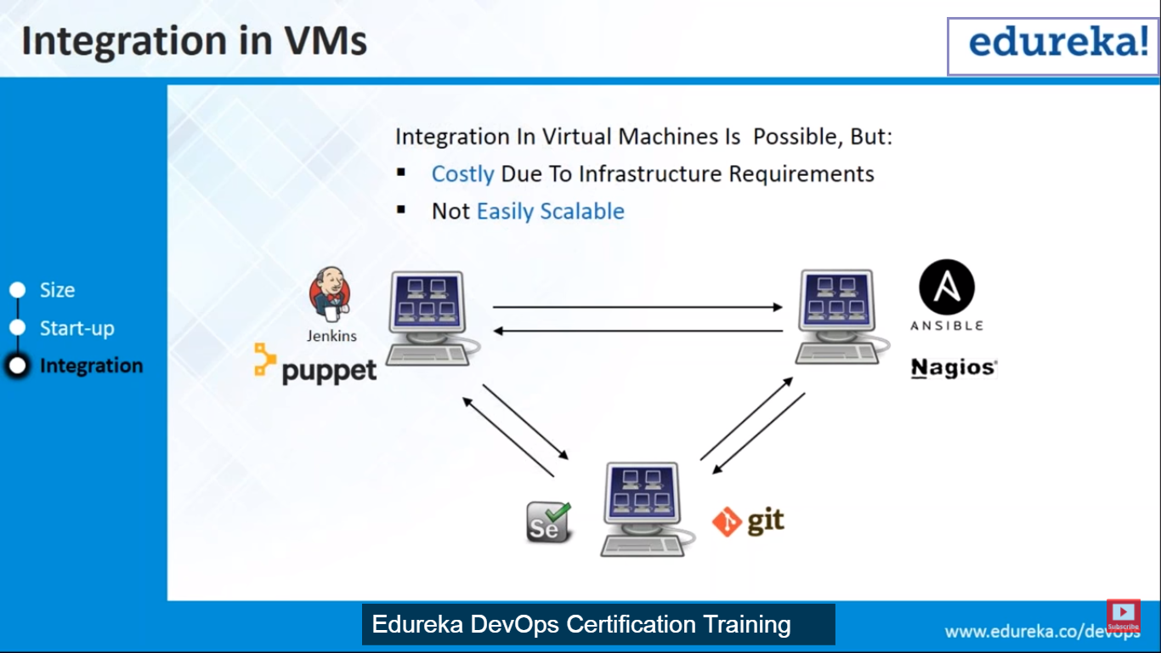
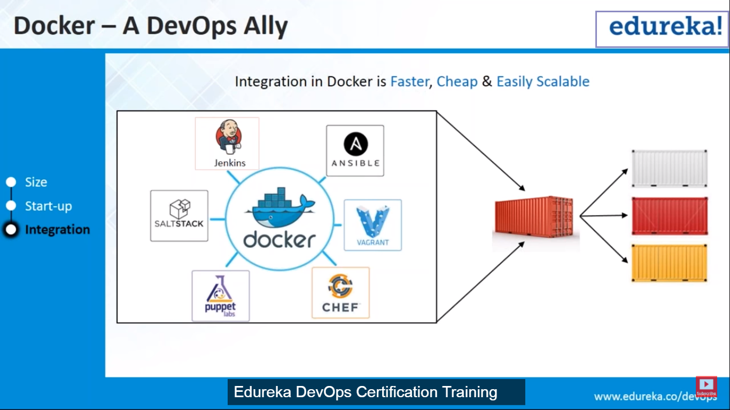
Integration

Slide 21
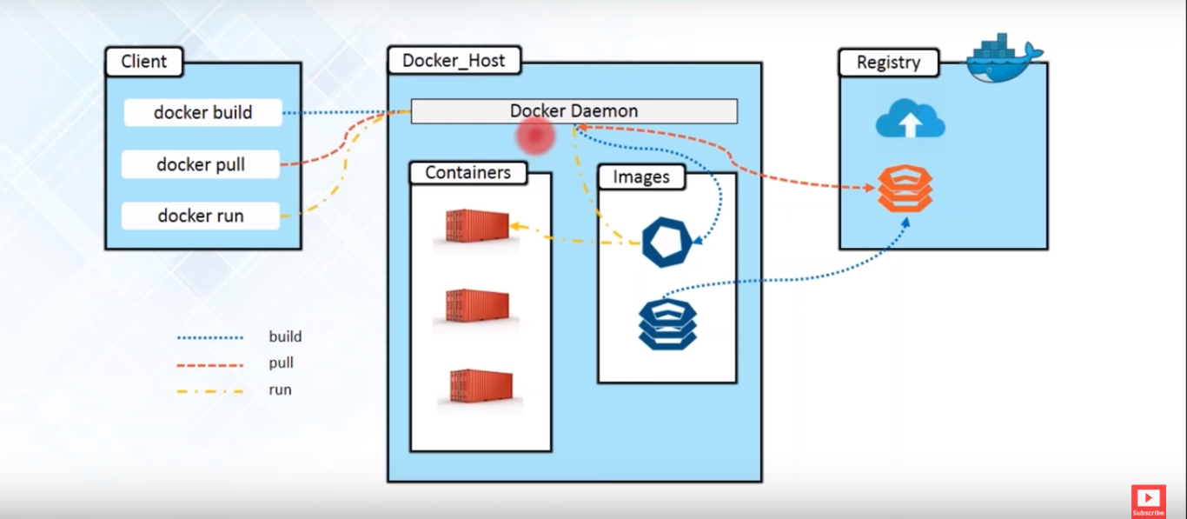
Docker Architecture

Slide 22
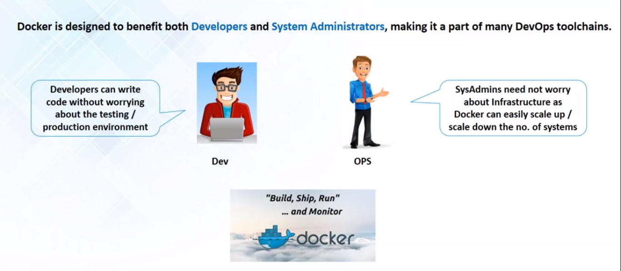
Who can use Docker

Slide 23
Docker Architecture

Slide 24
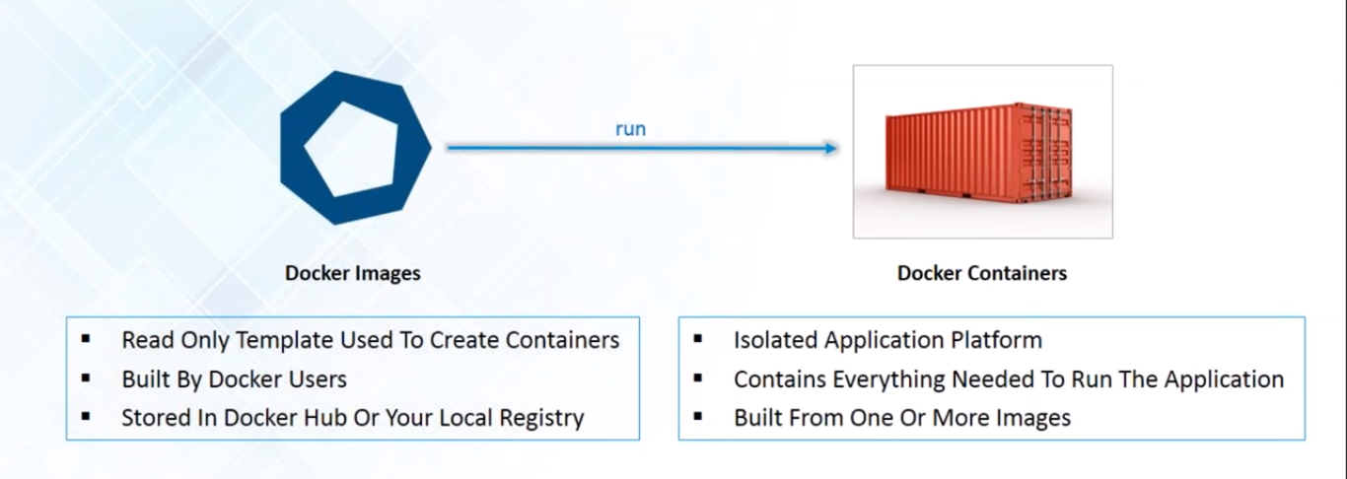
Docker Images & Containers

Slide 25
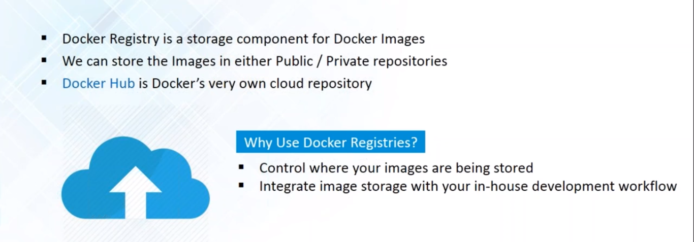
Docker Registry

Slide 26
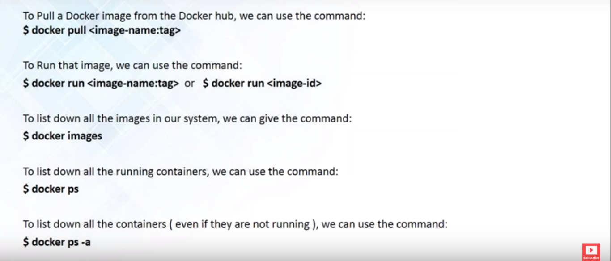
Docker Commands

Slide 27
Using Containers in the public cloud
https://azure.microsoft.com/en-us/services/container-registry/
https://aws.amazon.com/ecr/

