Slide 1

Stroke prediction – Progress Report
Abhijith Anil Vamadev

Slide 2
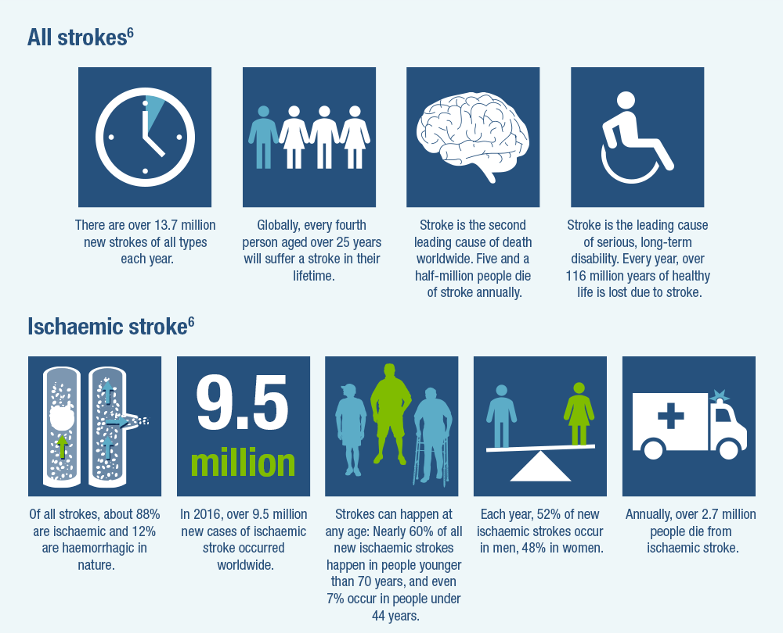
Why is it important?
Every 40 seconds, someone in the United States has a stroke
Patients who arrive at the ER within 3 hours of their symptoms are less likely to exhibit disability post stroke
High blood pressure, high cholesterol, smoking habits, obesity are all risk factors

Slide 3
Data Set
12 columns of data, 5110 rows of data
Target Variable – Stroke – Binary Classification variable
Variables:
ID – id of the patient
Gender – gender of the patient
Age – age of the patient
Hypertension – if the patient has hypertension
Heart Disease – heart disease patient or not
Ever Married – married or not
Work Type – work type
Residence Type – residence type
Avg_glucose – glucose level of patient
BMI – Body Mass Index of patient
Smoking Status – whether patient smokes or not.

Slide 4
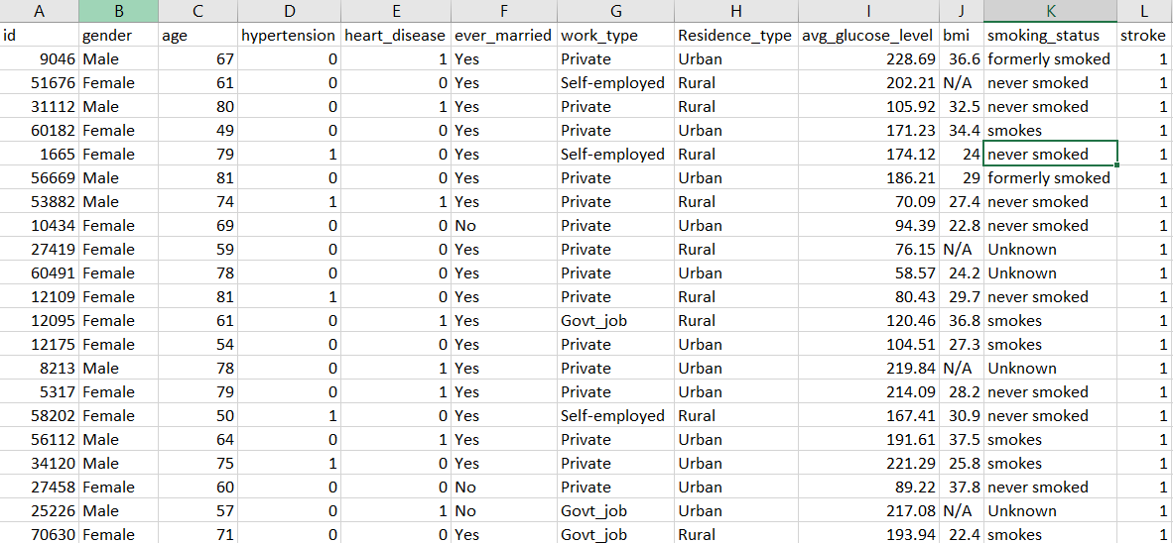
Data Preview

Slide 5
Data Preprocessing
Dropped ID column
BMI – 201 null values. Imputed using mean
Categorized variables into Categorical and Numerical.
3 Numerical variables, 8 categorical variables.
Outlier detection and removal for 2 numerical variables.
Conduct EDA(Exploratory Data Analysis) for all variables to understand the variables further

Slide 6
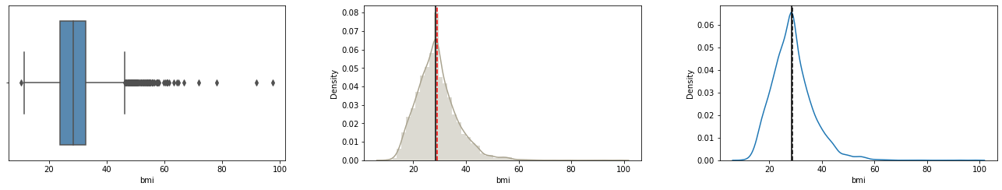
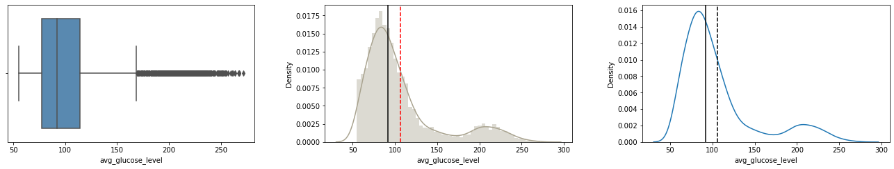
EDA – Numerical Variables

Slide 7
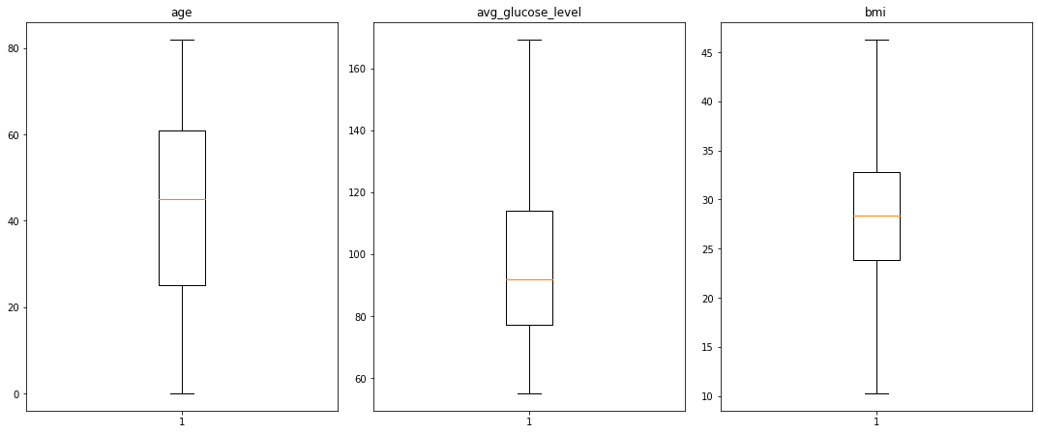
After Outlier Detection

Slide 8
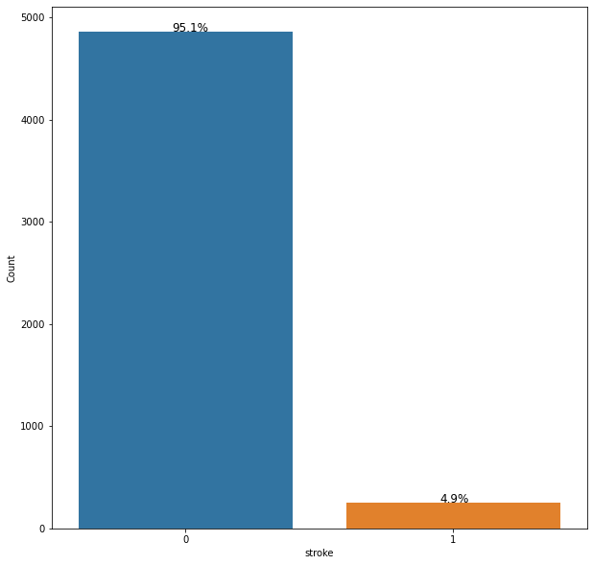
Dependent Variable - Stroke
95.1% of data are of patients that have not had a stroke
Model may be heavily biased

Slide 9
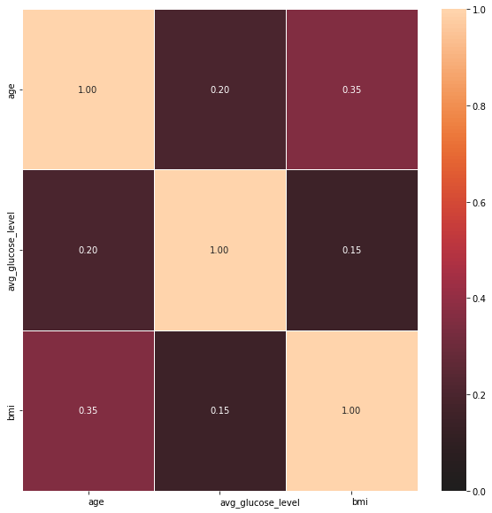
Correlation Heat map
The lighter the color, the larger the correlation magnitude.
No notable correlation among the numerical variables
There is some mild correlation of 0.35 between BMI of patients and age

Slide 10
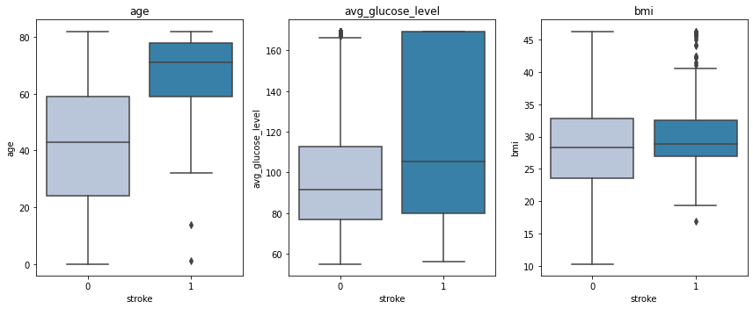
Stroke Vs Numerical Variables

Slide 11
Model evaluation
Recall and ROC_AUC Score will be used as the primary reference when comparing models, alongside accuracy.
One hot encoded the categorical variables.
Created dummy variables for categorical values
Total number of Variables – 16
Split the data by 70:30 for train and test
Models used for evaluation:
KNN
Decision Trees
Random Forests
Support Vector Machine(SVM)
Naive Bayes
Notes:
Accurate classification and reasonable intervention for high-risk population can effectively reduce the burden of stroke on families and the society. It is necessary to consider the recall of the classification model to ensure the pertinence of stroke intervention.
An ROC Curve is a plot which shows the performance of a classification model at various classification threshold levels.

Slide 12
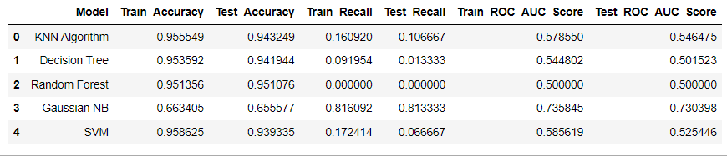
Final Model Scores

Slide 13
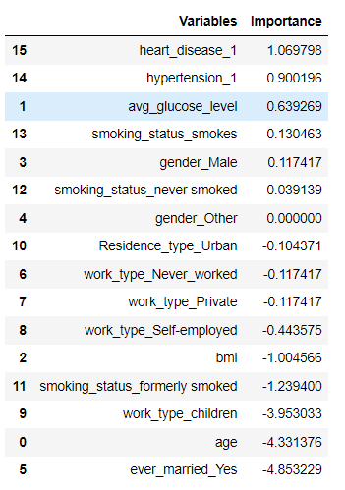
Naïve Bayes Model
Model – Easy to predict
Assumption – All variables are independent
Heat Map – Variables had very low correlation
Continuous variables were like that of a Gaussian Distribution
More Categorical Variables(8) present than numerical variables(3).
Permutation Importance
Negative values correspond to no impact on dependent variable
Notes:
The permutation_importance function calculates the feature importance of estimators for a given dataset.

Slide 14
Final Findings
Stroke has a huge financial impact all over that world. Based on severity of stroke patients may be disabled for life and may be unable to perform normal duties.
Naïve bayes was the best model for predicting this data
Previous history of heart disease and hypertension, along with higher levels of average glucose levels, were more likely to cause someone to have a stroke.
Data limitations –
Insufficient number of features – indicated by the low accuracy/ROC_auc_score
Unbalanced data set : Using principles like SMOTE, better models can be created

Slide 15
Sources:
https://www.cdc.gov/stroke/facts.htm#:~:text=In%202020%2C%201%20in%206,disease%20was%20due%20to%20stroke.&text=Every%2040%20seconds%2C%20someone%20in,minutes%2C%20someone%20dies%20of%20stroke.&text=Every%20year%2C%20more%20than%20795%2C000,United%20States%20have%20a%20stroke.
https://www.google.com/url?sa=i&url=https%3A%2F%2Fwww.strokeforum.com%2Foverview%2Fepidemiology&psig=AOvVaw1Kh6_-5Cp7DpnRKFB2apFp&ust=1651716500188000&source=images&cd=vfe&ved=2ahUKEwjWmrDL4cT3AhVunnIEHRbhAtMQr4kDegUIARDYAQ
https://towardsdatascience.com/naive-bayes-classifier-81d512f50a7c
https://blog.ineuron.ai/Feature-Importance-in-Naive-Bayes-Classifiers-5qob5d5sFW#:~:text=Na%C3%AFve%20Bayes%20methods%20work%20by,(compare%20with%20its%20documentation).

