Slide 1
Gadget Seva Hub
Operations portal, runner workflow, hybrid mobile app, billing, notifications, and audit
Generated from the updated Docs folder on 28 Mar 2026

Slide 2
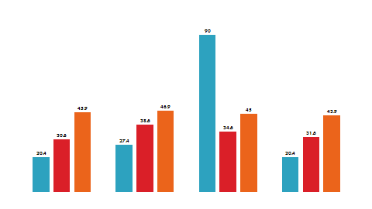
Platform At A Glance
- Role-based admin portal for service request intake and lifecycle management
- Indian device workflows covering mobile, TV, laptop, AC, and camera repair cases
- Modules include Pickup, Hub, Service Center, Estimates, Cashless, QC, Delivery, Billing, Reports, and Audit
- INR and rupee formatting are aligned across operational and finance screens

Slide 3

Live Architecture
- Frontend: Vite + React portal with protected routes, menu hierarchy, and shared toasts
- Backend: Spring Boot API for auth, workflow transitions, attachments, notifications, billing, and audit
- Storage: file-backed H2 locally and PostgreSQL-style integrated mode with the same domain model
- Files and notifications support signed access, LOG mode, and HTTP gateway delivery for SMS / WhatsApp

Slide 4
API Surface
- /api/auth/login for portal and runner authentication
- /api/service-requests for create, list, detail, pickup, estimate, status, delivery, attachments, invoice, payment, reconcile, and refund actions
- /api/public/pickups/{token} for runner accept, evidence upload, delete, and pickup completion
- /api/mobile/runner/notifications, /api/users, /api/users/pickup-runners, /api/devices/scan-qr, and /api/files/access

Slide 5

End-To-End Workflow
- REQUEST_CREATED -> PICKUP_ASSIGNED -> PICKUP_IN_PROGRESS -> PICKUP_COMPLETED
- RECEIVED_AT_HUB -> DIAGNOSIS_IN_PROGRESS -> ESTIMATE_PREPARED
- CASHLESS_PENDING_APPROVAL, ESTIMATE_APPROVED, and TOTAL_LOSS branches are supported
- REPAIR_IN_PROGRESS -> REPAIR_COMPLETED -> READY_FOR_DISPATCH -> DELIVERY_ASSIGNED -> OUT_FOR_DELIVERY -> DELIVERED -> INVOICED -> CLOSED
- status_history records each major transition

Slide 6
Pickup Runner Flow
- Admin onboards runner with mandatory mobile number and optional WhatsApp number
- Assign Pickup sends a smart link by SMS, WhatsApp, and rider APP only to the scheduled runner
- Runner opens the link in browser or hybrid mobile app and accepts the pickup
- Runner uploads 10 mandatory device photos plus optional extra photos before pickup completion
- Pickup done updates DB and API state and stores customer and admin notification records

Slide 7
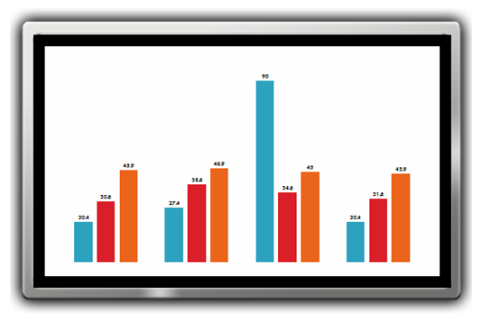
Menu, Data, And Mobile Parity
- Menu source of truth: frontend/src/utils/menuHierarchy.ts and frontend/src/main.tsx
- Specialized pages already exist for pickup dashboard, runner onboarding, assign pickup, delivery tracking, billing, and timeline
- Core tables include service_requests, pickups, attachments, notifications, invoices, payments, status_history, users, and roles
- Runner-specific fields include runner_portal_token, accepted_at, runner_link_sent_at, and whatsapp_number
- Public rider routes: /runner-access/:token, /runner-portal/:token, and /runner-app
- The Expo hybrid app uses the same live web pickup flow inside WebView for UI and behavior parity

Slide 8
QA And Handoff
- Updated Docs folder now includes API, architecture, DB schema, menu mapping, and test scenarios
- Test scenarios cover auth, claim registration, runner onboarding, pickup, hub, estimates, cashless, repair, delivery, billing, notifications, and data checks
- Web toasts and mobile alerts now provide submit feedback across major modules
- This deck is saved in Docs for demo walkthroughs, stakeholder review, and handoff

