Slide 1
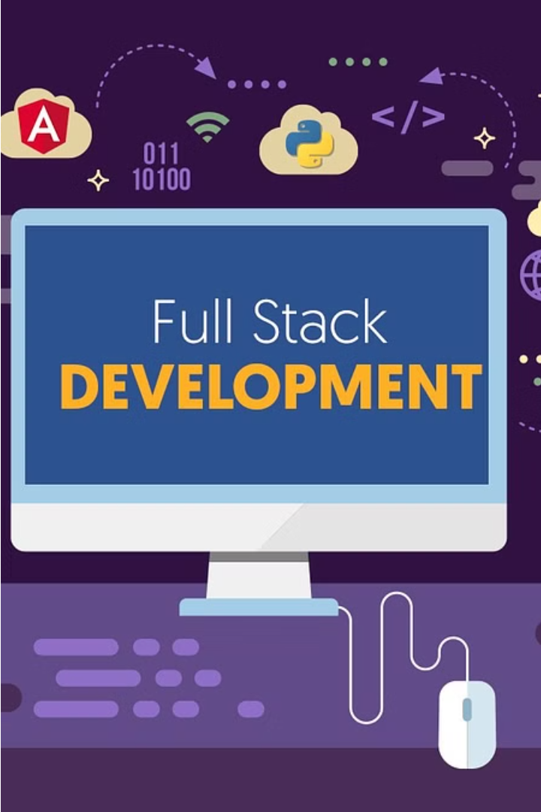

Introduction to Full Stack Development
Full stack development encompasses both front-end and back-end components, allowing developers to build complete, integrated web applications. This presentation will guide you through the key steps in creating a Doctor Search Website using full stack principles.
by AMARJEET KUMAR

Slide 2

Overview of the Doctor Search Website
User-Friendly Interface
Doctor Profiles
Patients can easily search for doctors by specialty, location, and availability.
Detailed profiles allow patients to learn about a doctor's experience, reviews, and services offered.
Appointment Booking
Patients can conveniently schedule appointments directly through the website.

Slide 3
Front-end Development: User Interface and Experience
Responsive Design
Intuitive Navigation
Dynamic Content
The website will be optimized for desktop, tablet, and mobile devices to provide a seamless user experience.
Clear menus, search functionality, and visual cues will guide patients through the website.
Interactive elements, such as doctor profile carousels and appointment calendars, will engage users.

Slide 4



Back-end Development: Server-side Logic and API Integration
API Endpoints
Server-side Logic
Third-party Integrations
Secure API endpoints will handle user authentication, doctor data retrieval, and appointment scheduling.
The back-end will process user requests, validate data, and manage the integration with the database.
The website will seamlessly integrate with external services, such as payment gateways and calendar APIs.

Slide 5
Database Design and Management
1
Relational Database
2
Data Normalization
A well-designed relational database will store patient, doctor, and appointment data.
The database schema will be normalized to minimize data redundancy and ensure data integrity.
3
Scalable Infrastructure
4
Backup and Security
The database infrastructure will be designed to handle increasing user and data volumes.
Robust backup procedures and security measures will protect sensitive patient information.

Slide 6
Integrating Front-end and Back-end Components
API Integration
The front-end will seamlessly communicate with the back-end API to retrieve and send data.
Performance Optimization
Techniques like caching and code splitting will be employed to optimize website performance.
1
2
3
State Management
Efficient state management techniques will ensure a smooth and responsive user experience.

Slide 7



Deployment and Hosting Considerations
Cloud Hosting
CI/CD Pipeline
Monitoring and Logging
The website will be hosted on a reliable cloud platform, ensuring scalability and high availability.
Automated build, test, and deployment processes will ensure seamless updates and bug fixes.
Comprehensive monitoring and logging solutions will provide insights into website performance and usage.

Slide 8

Conclusion and Next Steps
1
Continued Improvement
2
Scalability and Growth
The Doctor Search Website will undergo regular updates and enhancements based on user feedback.
The full stack architecture will enable the website to scale and support increasing user demands.
3
Expansion Opportunities
The successful implementation of this Doctor Search Website can lead to further expansion, such as mobile apps and additional features.

