Slide 1
Mid-term Presentation
51300 - Compiler Project
Zuoming Li
Xueyin Wang
https://github.com/aaaeeeo/51300-compiler

Slide 2
Intro
AST
Symbol Table
Type Check
Testing
Future Work
Assumption: Exactly file.y code grammar
Generating assambly code
Target architecture: c++, flex, bison
Group task:
Zuoming Li — Symbol Table
Xueyin Wang — Action in grammar file
Co-work — .lex, AST nodes in .h file

Slide 3
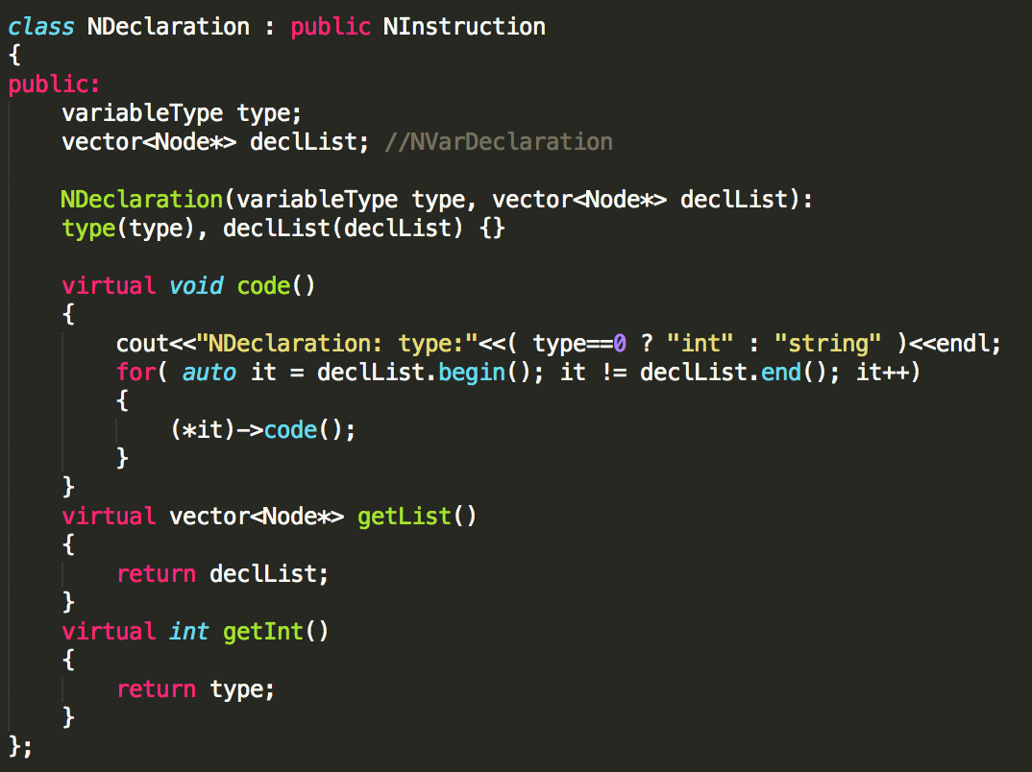
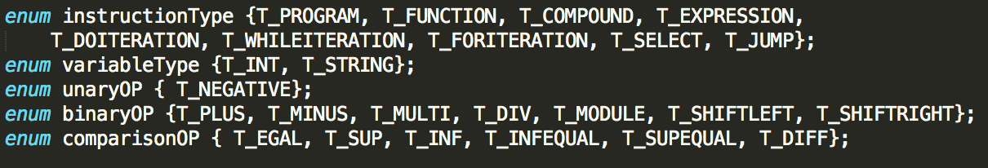
Intro
AST
Symbol Table
Type Check
Testing
Future Work

Slide 4
Intro
AST
Symbol Table
Type Check
Testing
Future Work
Yystype:
%union {
int u_i;
Node *u_node;
vector<Node*>* u_list;}
E.g. action:
expression_instruction :
expression ';' {
vector<Node*>* vec = new vector<Node*>;
vec->push_back($1);
$$ = new NInstruction(T_EXPRESSION, *vec); }
| assignment ';' {
vector<Node*>* vec = new vector<Node*>;
vec->push_back($1);
$$ = new NInstruction(T_EXPRESSION, *vec); };

Slide 5
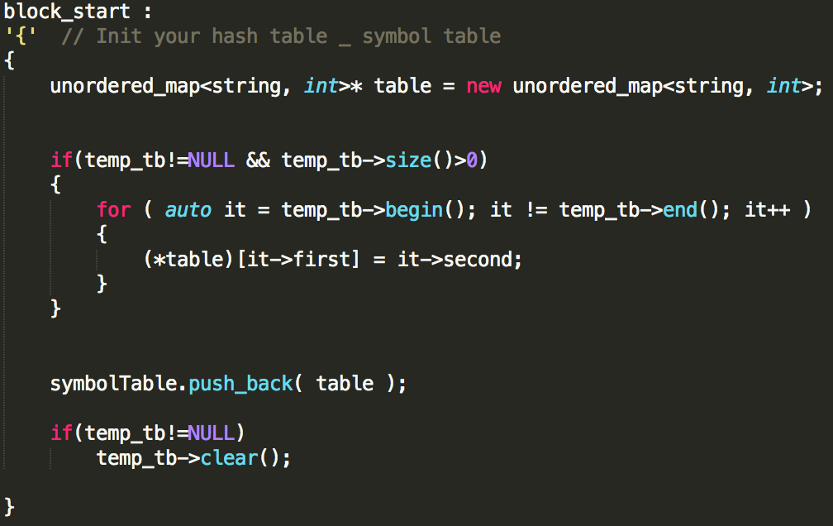
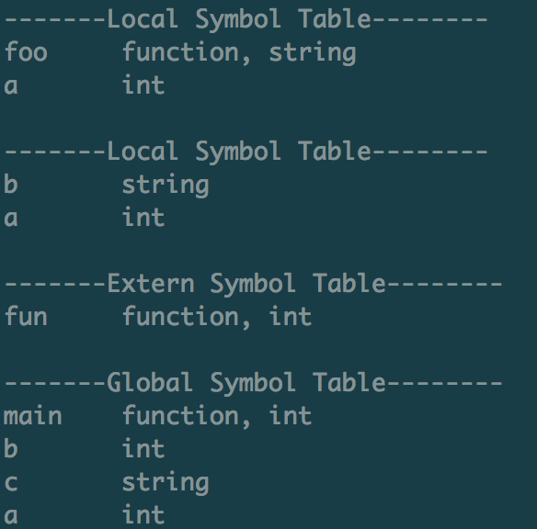
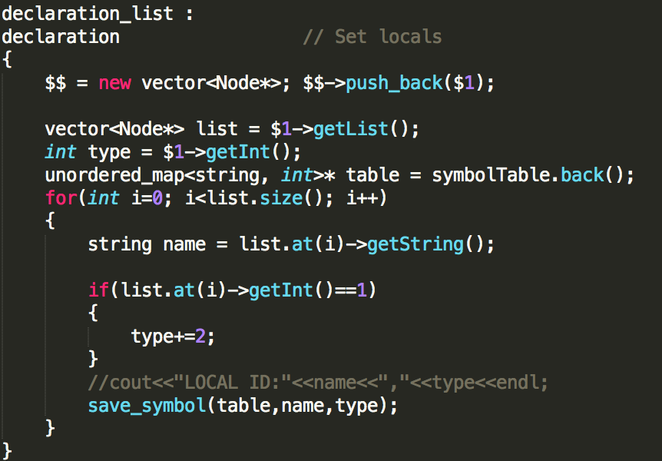
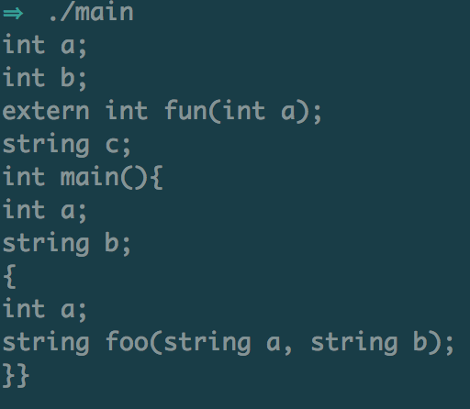
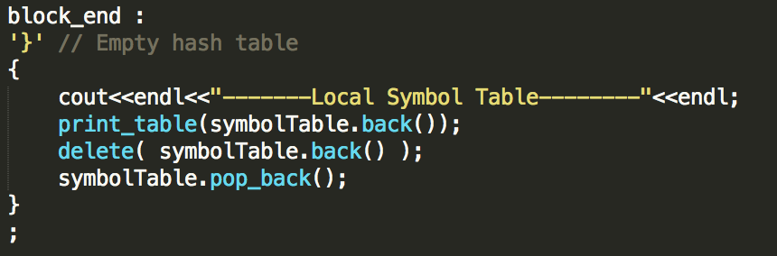
Intro
AST
Symbol Table
Type Check
Testing
Future Work
unordered_map<string, int> table;
vector< unordered_map<string, int>* > symbolTables;

Slide 6
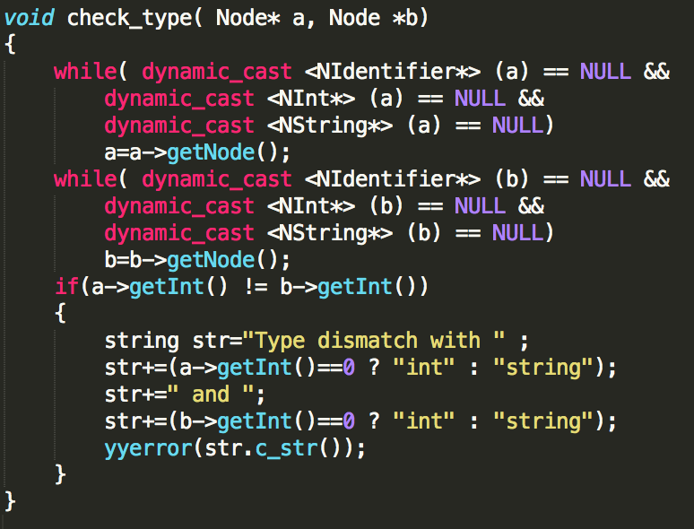
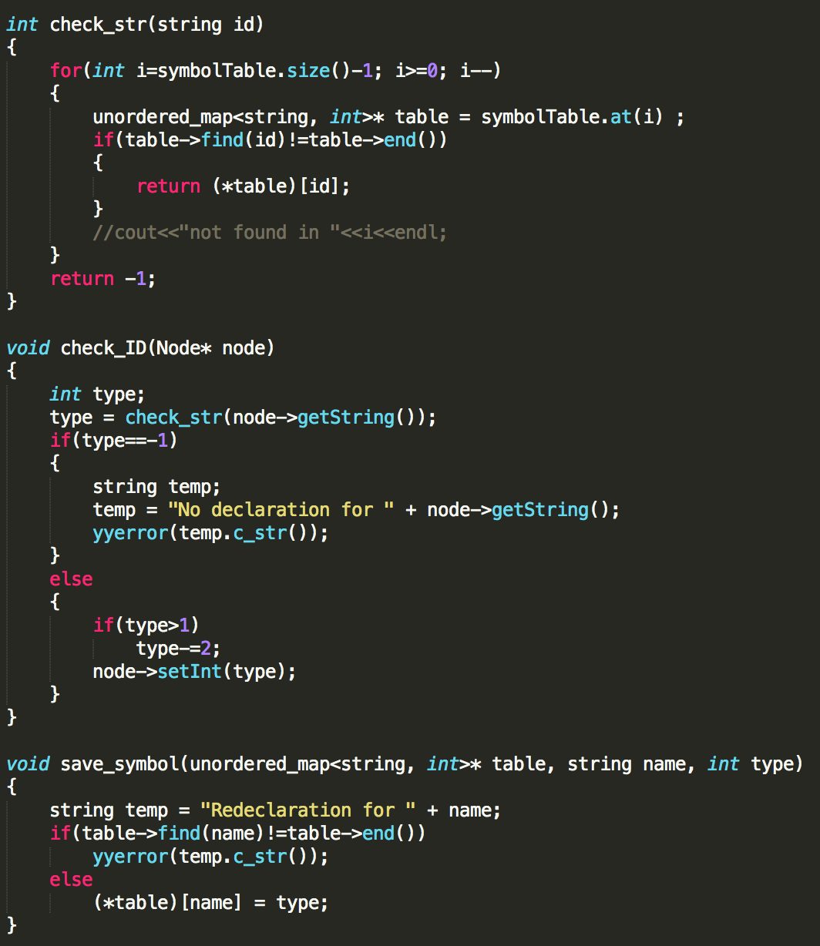
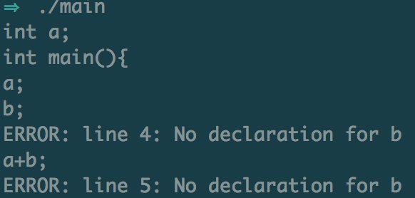
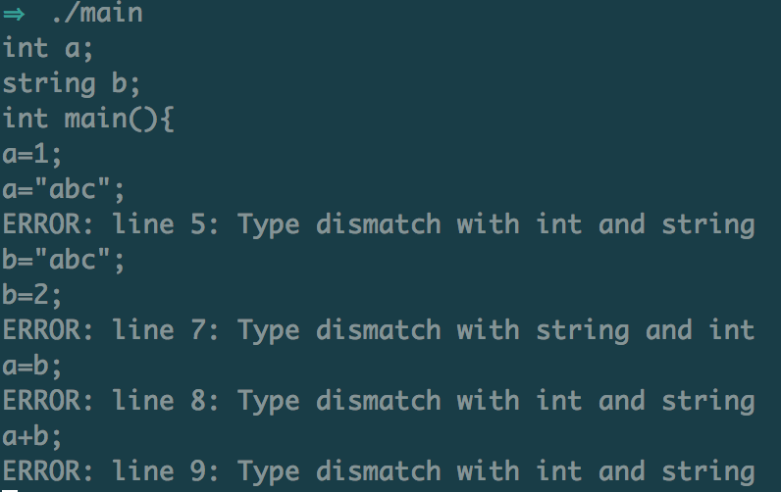
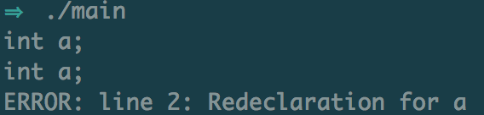
Intro
AST
Symbol Table
Type Check
Testing
Future Work

Slide 7
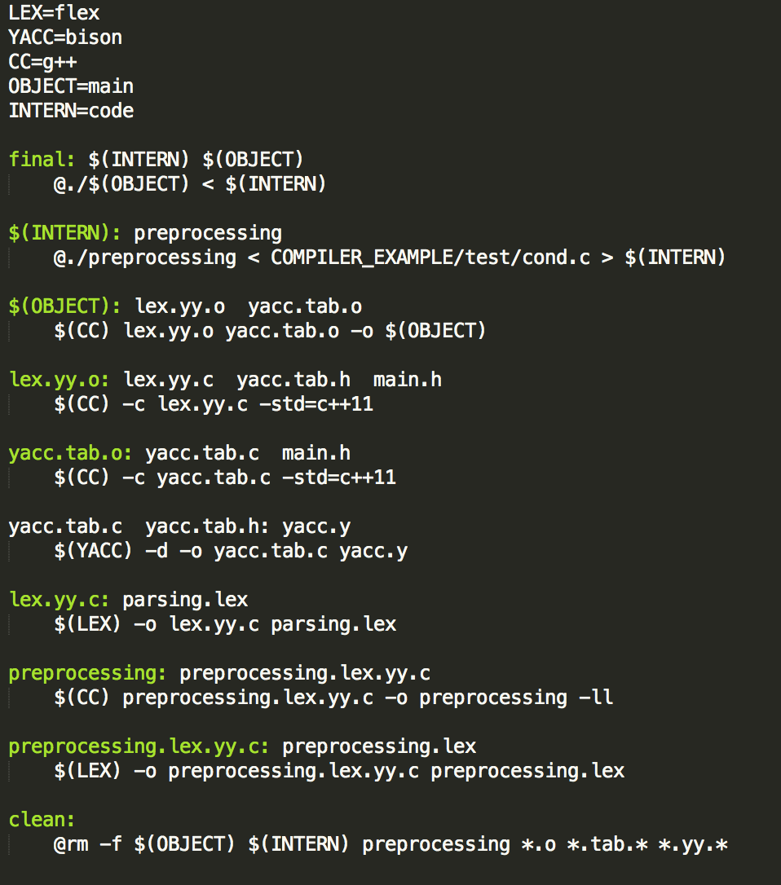
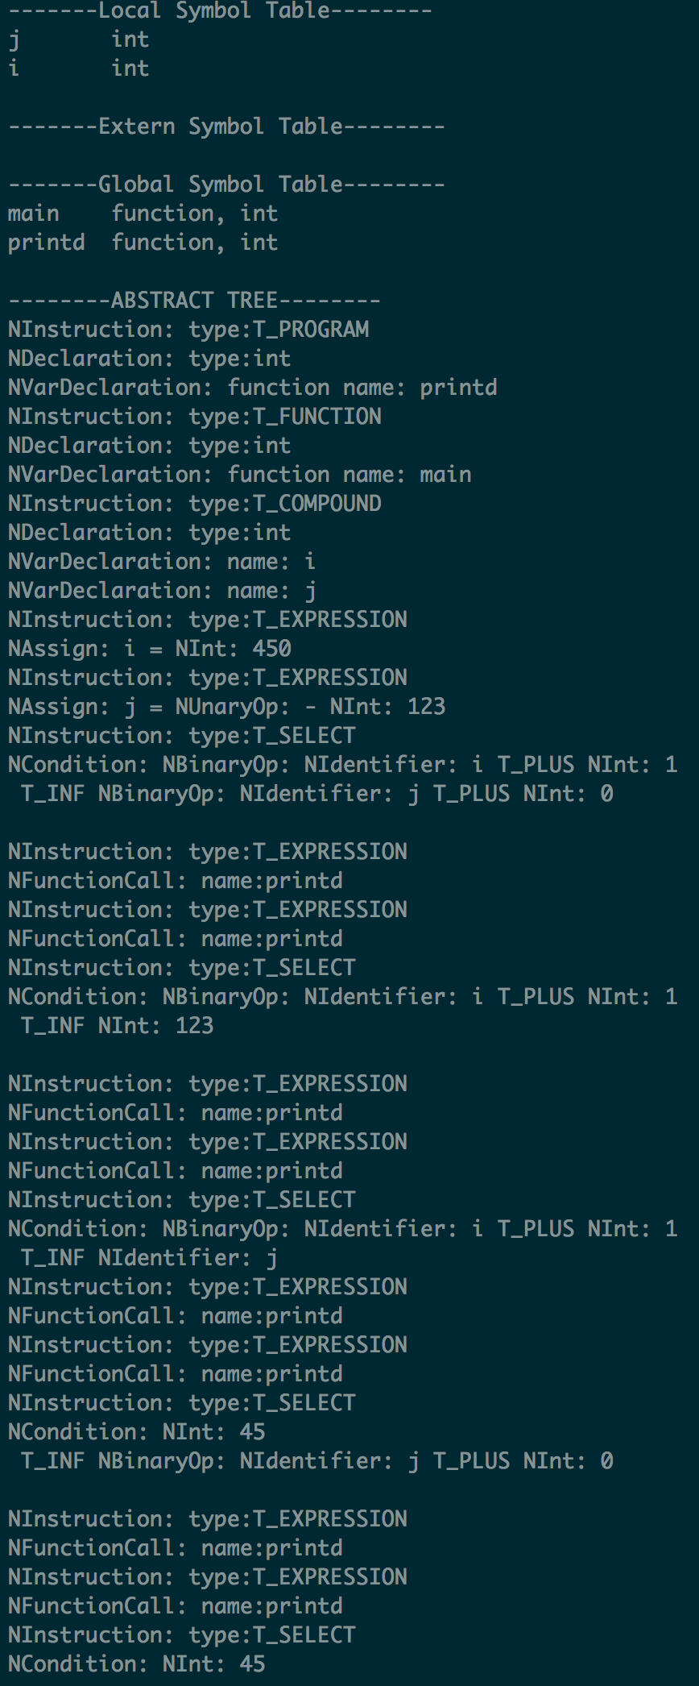
Intro
AST
Symbol Table
Type Check
Testing
Future Work

Slide 8
Intro
AST
Symbol Table
Type Check
Testing
Future Work
Compile multi-files and run all the test cases
Recover from some errors
Generate assembly code from abstract syntax tree

Slide 9
Mid-term Presentation
51300
Compiler Project
Thank
YOU
Zuoming Li
Xueyin Wang
https://github.com/aaaeeeo/51300-compiler

