Slide 1
ESG Score Predict on and Sustainable Corporate Analysis
Team: Code_Crafters
Alka Santhosh 2301730106
Aditi Gairi 2301730104
Nikhil 2301730077

Slide 2
PROJECT APPROACH
How do ESG scores vary across industries?
1. Data Collection & Loading: Load the ESG dataset containing company-level financial metrics, ESG scores, and environmental resource usage data. Check dimensions, datatypes, and basic info (.info(), .describe()).
2. Data Preprocessing
Handling Missing Values: Check for nulls (e.g., GrowthRate missing values).
3. Exploratory Data Analysis (EDA)
Univariate Analysis: Distribution of ESG scores, revenue, profit margin, market cap, emissions, etc.
Bivariate/Multivariate Analysis: Correlation heatmaps (financial vs ESG).ESG comparison across industries and regions. Trends over years (growth, emissions, ESG).
Visualization: Line plots for time trends. Bar charts for ESG across industries. Scatter plots for ESG vs financials.

Slide 3
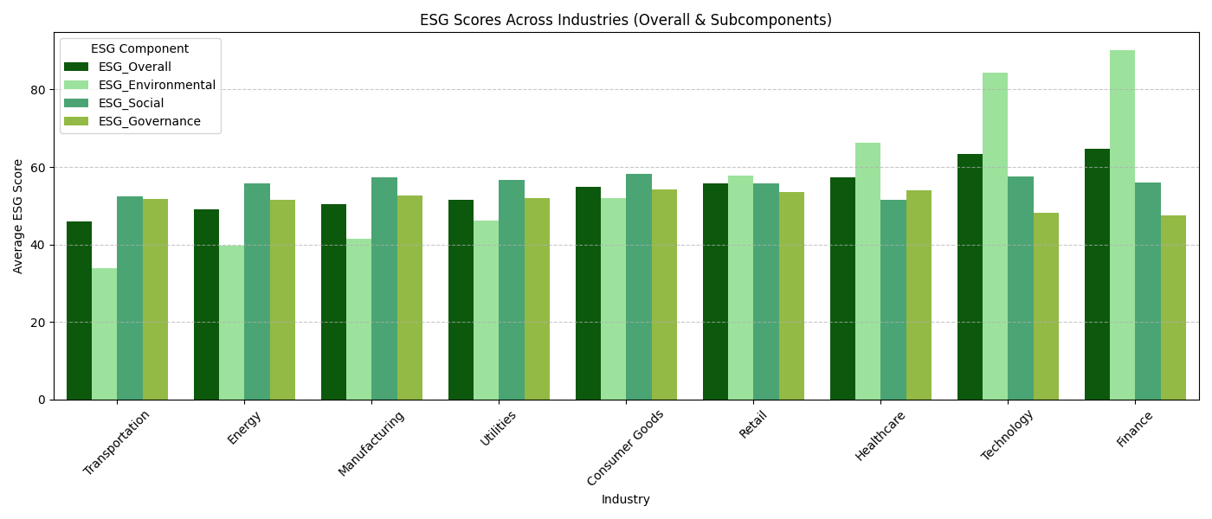
How do ESG scores vary across industries?

Slide 4
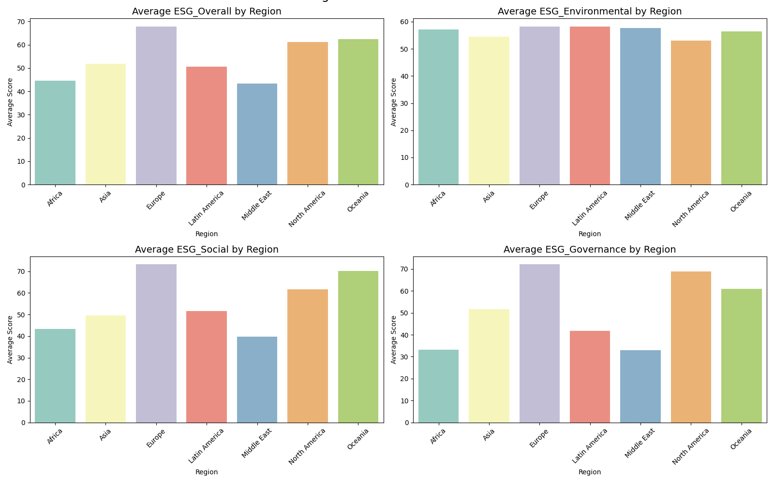
How do ESG scores vary across different regions?

Slide 5
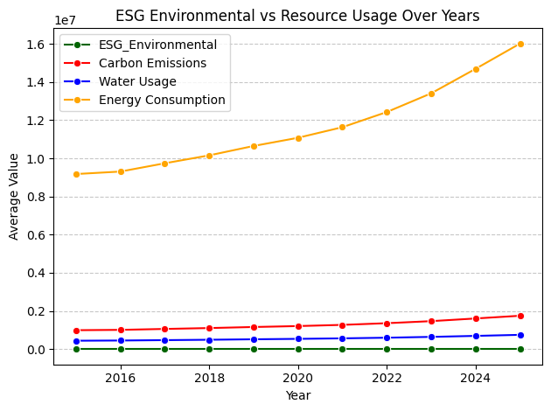
How do environmental ESG scores relate to resource usage trends over time?

Slide 6
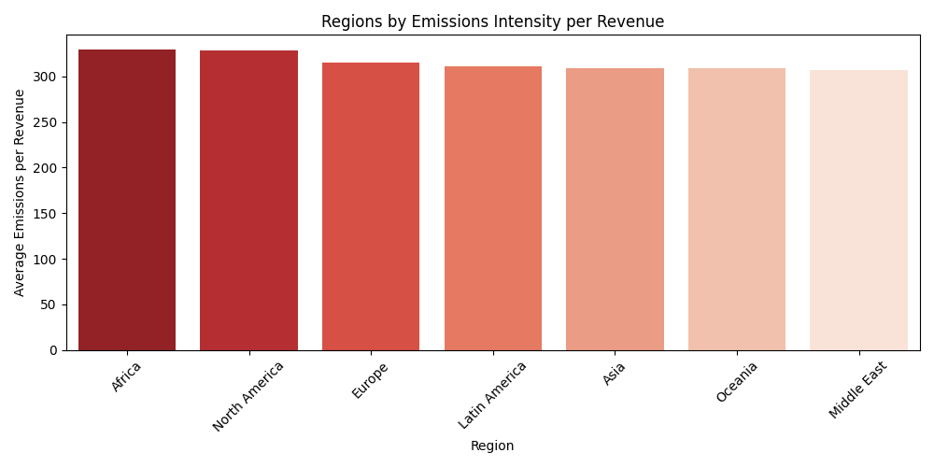
Which regions have highest emissions intensity per revenue? Which regions show fastest ESG improvement?

Slide 7
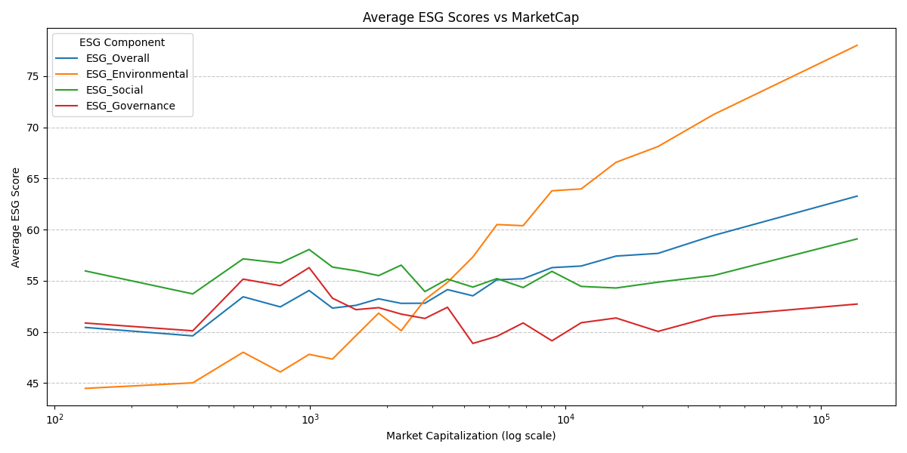
How does company size (Market Capitalization) relate to ESG performance i.e Do larger companies invest more in sustainability?

Slide 8
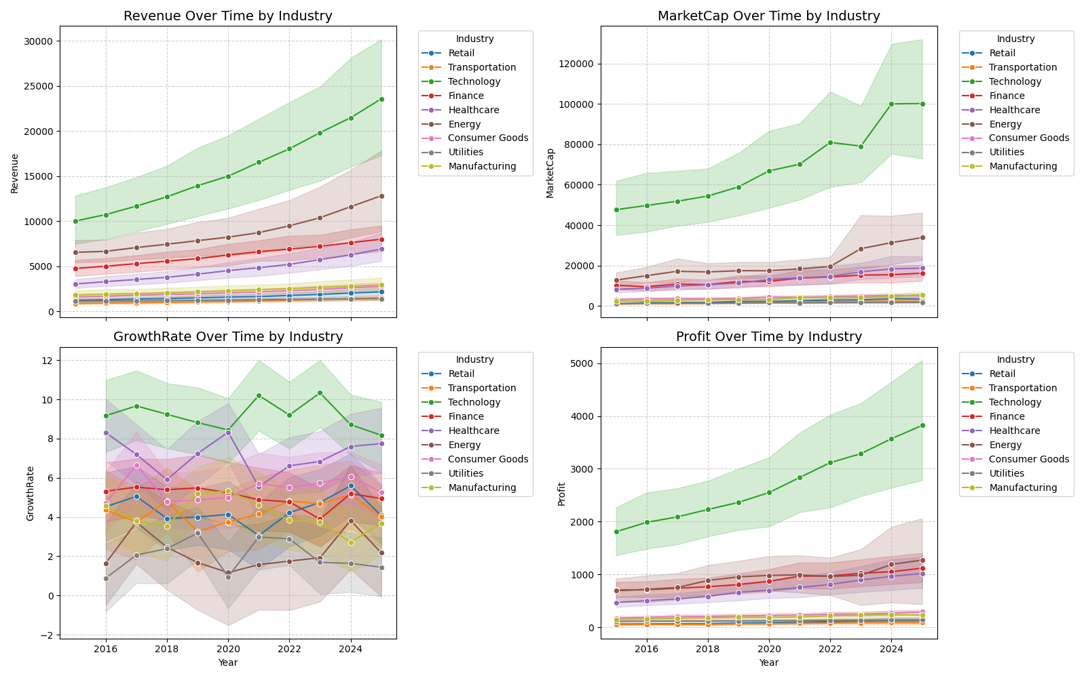
How do financial metrics vary across different industries over time.

Slide 9
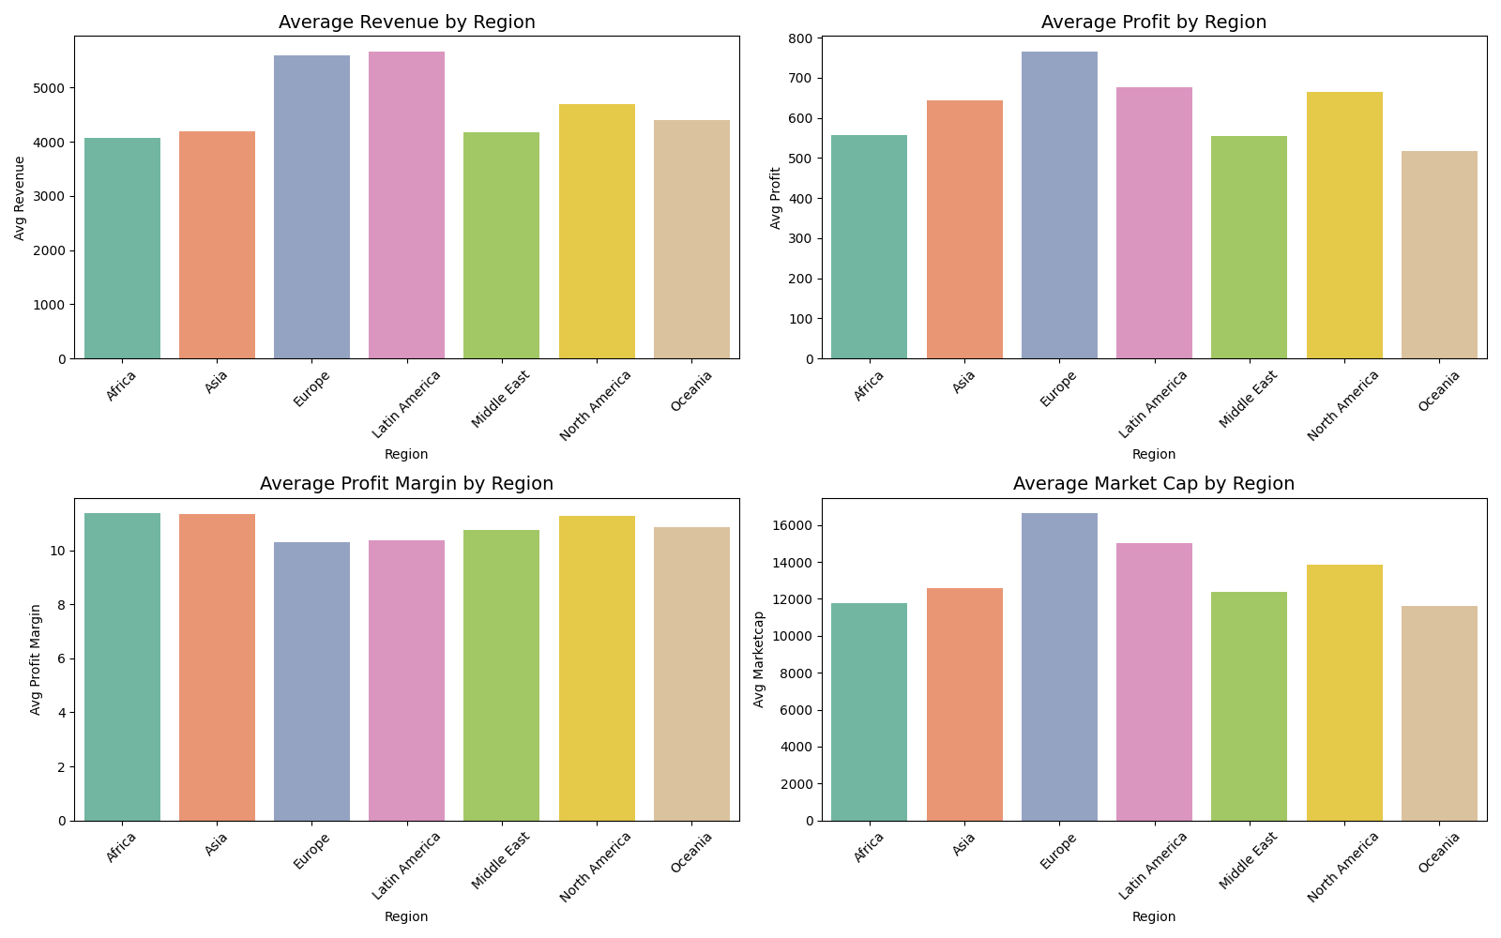
How do company financial metrics vary across different regions?

Slide 10
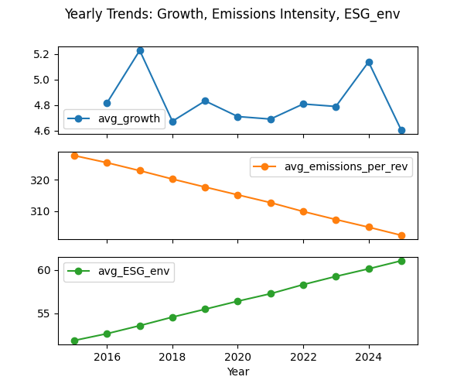
How have company growth, carbon emissions intensity, and environmental ESGscores evolved over time?

Slide 11
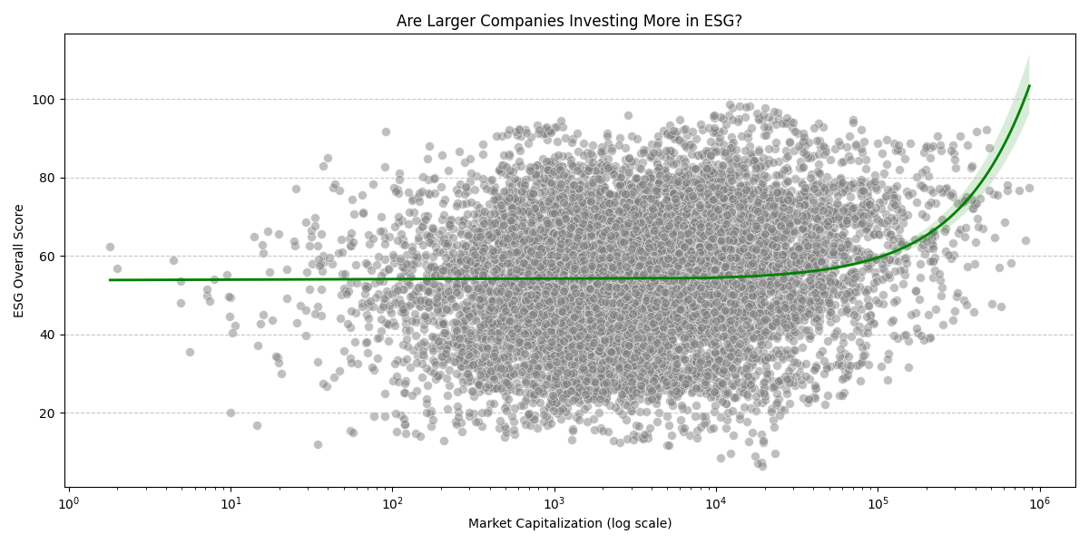
Do larger companies (by Market Capitalization) tend to have higher ESG Overall scores?

Slide 12
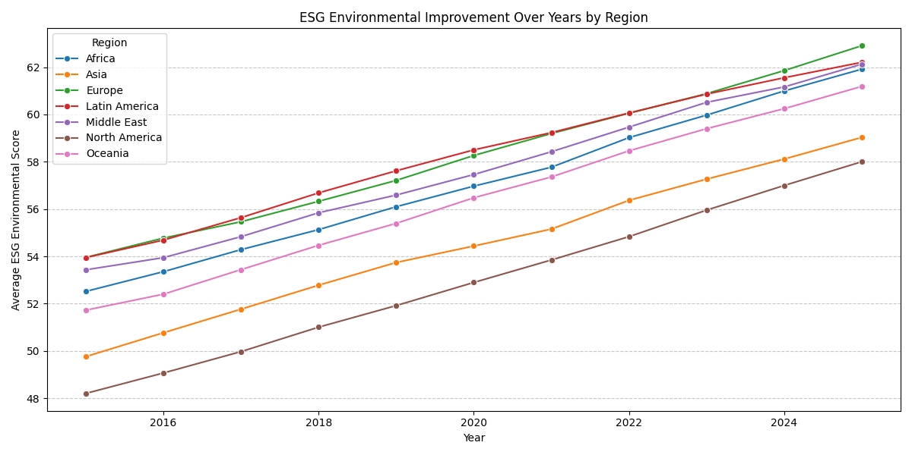
How have ESG Environmental scores improved over the years across different regions?”

Slide 13
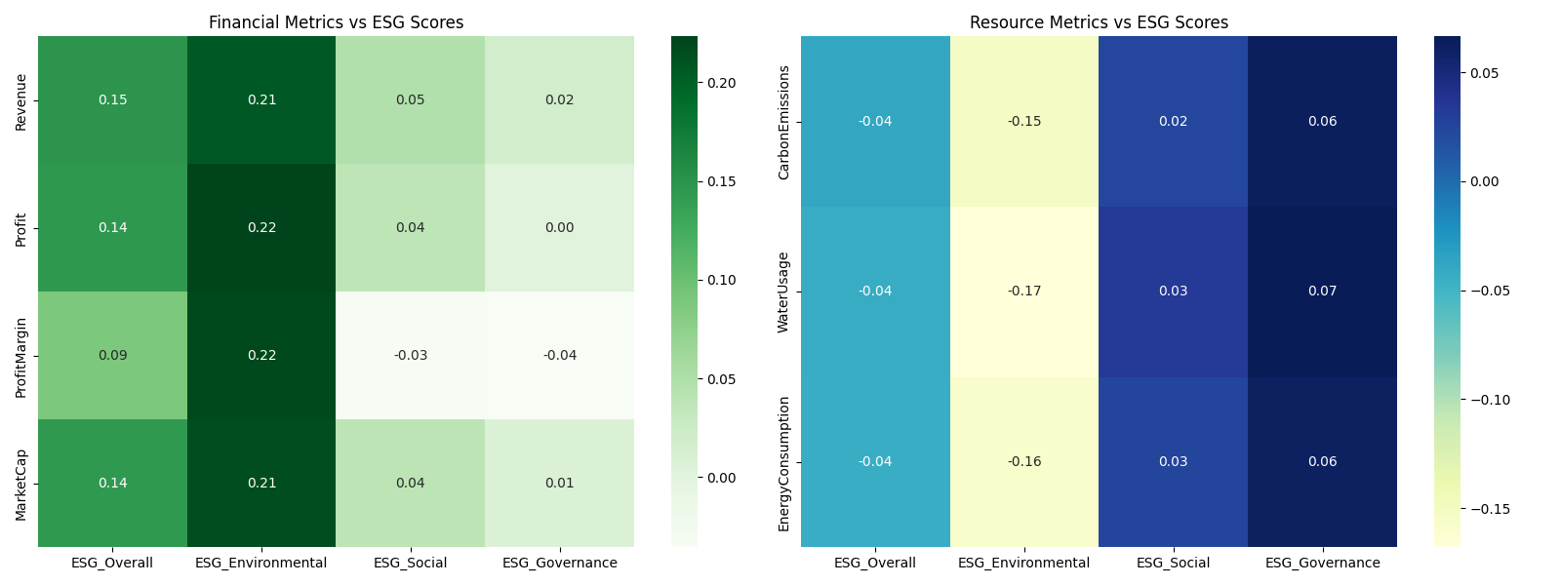
How do financial metrics and resource usage metrics relate to ESG scores

Slide 14
Policy Recommendations for Sustainable Corporate Practices
1. Sector-Specific ESG Regulations
Finance, Technology, and Healthcare lead in ESG, while Energy and Transportation lag environmentally.
Action: Enforce stricter carbon disclosure and provide incentives for renewable energy and green logistics in high-impact sectors.
2. Regional ESG Benchmarking & Support
Europe leads ESG performance; Africa and North America have high emissions per revenue, and Latin America lags in governance.
Action: Establish region-specific ESG benchmarks and offer governance training or emissions-efficiency programs tailored to regional needs.
3. Encourage ESG Adoption Among Smaller Companies
ESG performance is dominated by large corporations; smaller firms lag behind.
Action: Offer tax rebates, green financing, and simplified ESG frameworks to help SMEs adopt and scale sustainability initiatives.
4. Link Financial Performance with ESG Incentives
Financially stronger companies invest more in environmental sustainability, but governance remains weak.
Action: Introduce ESG-linked loans or investor incentives tied to environmental and governance performance metrics.
5. Strengthen ESG Reporting & Verification
Environmental ESG scores are rising, yet actual energy and emissions continue to increase, signaling greenwashing risks.
Action: Mandate third-party audits and require reporting of both ESG scores and tangible resource usage metrics (carbon, water, energy).

