Slide 1



Adversarial machine learning (tutorial)
Yevgeniy (Eugene) vorobeychik¹
Bo Li²
¹Assistant Professor, Computer Science & Biomedical Informatics
Director, Computational Economics Research Laboratory
Vanderbilt University
² Post Doctoral Research Associate, UC Berkeley

Slide 2
Part 1: Introduction to AML

Slide 3
What is AML?

Slide 4
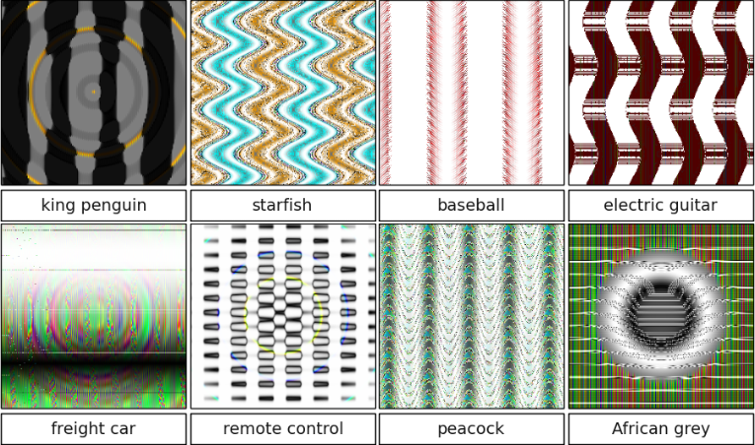
Adversarial examples

Slide 5


Adversarial examples
Classified as panda
Small adversarial noise
Classified as gibbon

Slide 6
Who cares about panda?

Slide 7

Suppose that the sign is

Slide 8
Add adversarial noise…
Small adversarial noise

Slide 9
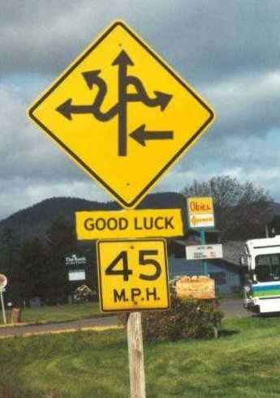
and the ML in your self-driving car thinks it’s

Slide 10
So, is that all there is to it?
NO

Slide 11
AI & Cybersecurity
Cylance: “Leveraging complex mathematical algorithms, predictive artificial intelligence (AI) capabilities, and the power of machine learning techniques, CylancePROTECT has emerged as the most strategic new offering in the Forrester Wave report.”

Slide 12
Adversarial ML
https://conf.startup.ml/geekdomsf/
Fraud detection
Malware detection
Intrusion detection
Spam detection
What do all of these have in common?
Detect bad “things” (actors, actions, objects)

Slide 13
Bad actors
Key issue in AML: bad actors (who do bad things) have objectives
the main one is not getting detected
they can change their behavior to avoid detection
This gives rise to evasion attacks
Attacks on ML, where malicious objects are deliberately transformed to evade detection (prediction by ML that these are malicious)

Slide 14
Data poisoning
An entirely different class of attacks are data poisoning attacks
In these, an adversary introduces malicious modifications to the data used for training
Can insert instances (for example, send specially crafted emails, either benign or malicious)
Can modify instances in the data (hack one of the servers used to store a part of the data)
Can selectively remove some instances

Slide 15
Evasion vs. poisoning
The crucial distinction between these classes of attacks is
Evasion is an attack on the learned model (e.g., an actual classifier)
Poisoning is an attack on the algorithm (e.g., least-squares regression learning)
they attack the model

Slide 16
Evasion vs. poisoning
The crucial distinction between these classes of attacks is
Evasion is an attack on the learned model (e.g., an actual classifier)
Poisoning is an attack on the algorithm (e.g., least-squares regression learning)
“adversarial examples” in DNN are close to evasion attacks, as they attack the model

Slide 17
Evasion vs. poisoning
The crucial distinction between these classes of attacks is
Evasion is an attack on the learned model (e.g., an actual classifier)
Poisoning is an attack on the algorithm (e.g., least-squares regression learning)
“adversarial examples” in DNN are close to evasion attacks, as they attack the model

Slide 18
Outline of the tutorial
Evasion attacks
Modeling adversarial evasion
Defending against evasion
Poisoning attacks
Understanding poisoning attacks
Defending against data poisoning
AML in Deep Neural Networks
Attacks on DNN
Defensive approaches for DNN

Slide 19
Part 2: adversarial evasion

Slide 20
outline
Evasion Attacks
Evasion-robust Classification
Validating evasion attack models

Slide 21
outline
Evasion Attacks
Modeling evasion
White-box vs. black-box attacks
Evasion-robust Classification
Validating evasion attack models

Slide 22
Classification learning
Class 1
classifier
Class 2
Data set: {(x₁,y₁),…,(x_{n},y_{n})}, (x,y) ~ D
x: feature vectors
y: binary label in {-1, +1} representing which class x belongs to
Learning: train classifier f(x) on data
Prediction: use f(x) to predict label for arbitrary x

Slide 23
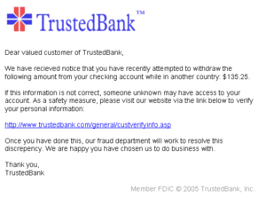
Classification in adversarial settings
Often, classifiers are tasked with telling apart ”good” from “bad”
Spam vs. non-spam (ham)
Benign vs. malicious software
Intrusion detection

Slide 24
Evasion attacks
Adversary who previously chose instance x (which is now classified as malicious) now chooses another instance x’ which is classified as benign

Slide 25
Evasion attacks
Adversary who previously chose instance x (which is now classified as malicious) now chooses another instance x’ which is classified as benign
Benign
Malicious

Slide 26
Evasion attacks
Adversary who previously chose instance x (which is now classified as malicious) now chooses another instance x’ which is classified as benign
Benign
classifier
Malicious

Slide 27
Example of Evasion
From: spammer@example.com
Cheap mortgage now!!!
1.
Feature Weights
2.
cheap = 1.0
mortgage = 1.5
3.
Total score = 2.5
> 1.0 (threshold)
Spam
Notes:
Evasion attack example!!
Bag of words

Slide 28
Example of Evasion
From: spammer@example.com
Cheap mortgage now!!! Joy Oregon
1.
Feature Weights
2.
cheap = 1.0
mortgage = 1.5
Joy= -1.0
Oregon = -1.0
3.
Total score = 0.5
< 1.0 (threshold)
OK

Slide 29
Modeling evasion attacks
Attacker has an “ideal” feature vector x_{ideal}
These are the original malicious feature vectors in training data
Modifying x into another feature vector x’ incurs a cost c(x_{ideal},x’)
The attacker’s goal is to appear “benign” to the classifier
Observation: feature space modeling
Attacker can make arbitrary changes to features
Cost is meant to capture any constraints faced by the attacker in practice
No actual attack instances are generated/validated (this just produces a new feature vector rather than, say, another malicious PDF)

Slide 30
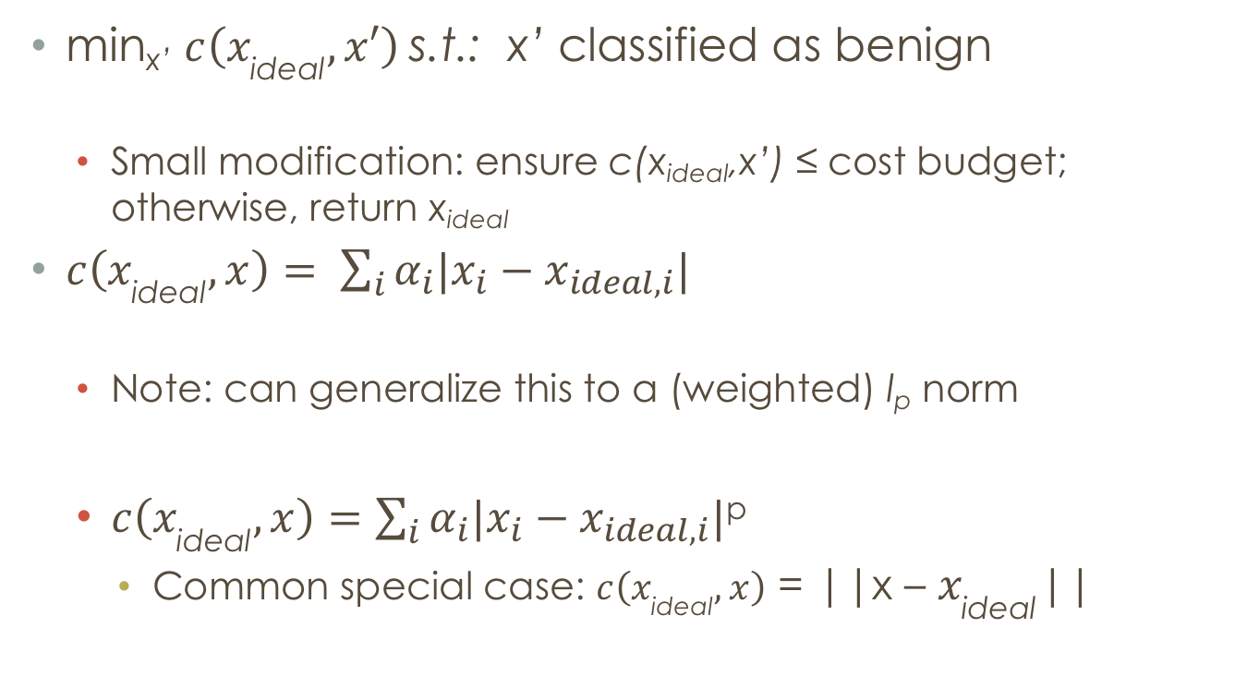
The lowd & meek model
min_{x’} $c\left(x_{\text{ideal}}, x′\right)$s.t.: x’ classified as benign
Small modification: ensure c(x_{ideal},x’) ≤ cost budget; otherwise, return x_{ideal}
$c\left(x_{\text{ideal}}, x\right)= \sum_{i}{α_{i}|x_{i}−x_{ideal,i}|}$
Note: can generalize this to a (weighted) l_{p} norm
$c\left(x_{\text{ideal}}, x\right)=$ $\sum_{i}{α_{i}|x_{i}−x_{ideal,i}|}$^{p}
Common special case: $c\left(x_{\text{ideal}}, x\right)$ = ||x – $x_{\text{ideal}}$||

Slide 31
Other models
Suppose that the classifier can be described as f(x) = sgn{g(x)}, for some g(x) : X -> R
Biggio et al. ECML ‘13:
min_{x} g(x) s.t.: c(x_{ideal},x’) ≤ cost budget
Li and Vorobeychik, ‘16
min_{x} g(x) + λ c(x_{ideal},x’)

Slide 32
Solving attacker optimization
Commonly, these are hard to solve optimally
Approaches depend on the nature of the feature space:
Continuous vs. binary (or discrete)

Slide 33
Continuous features
Lowd & Meek model: easy to solve for linear classifiers
Nelson et al. JMLR ‘12: can approximately solve for convex-inducing classifiers
More generally, gradient descent approaches (Biggio et al., ECML ‘13)

Slide 34
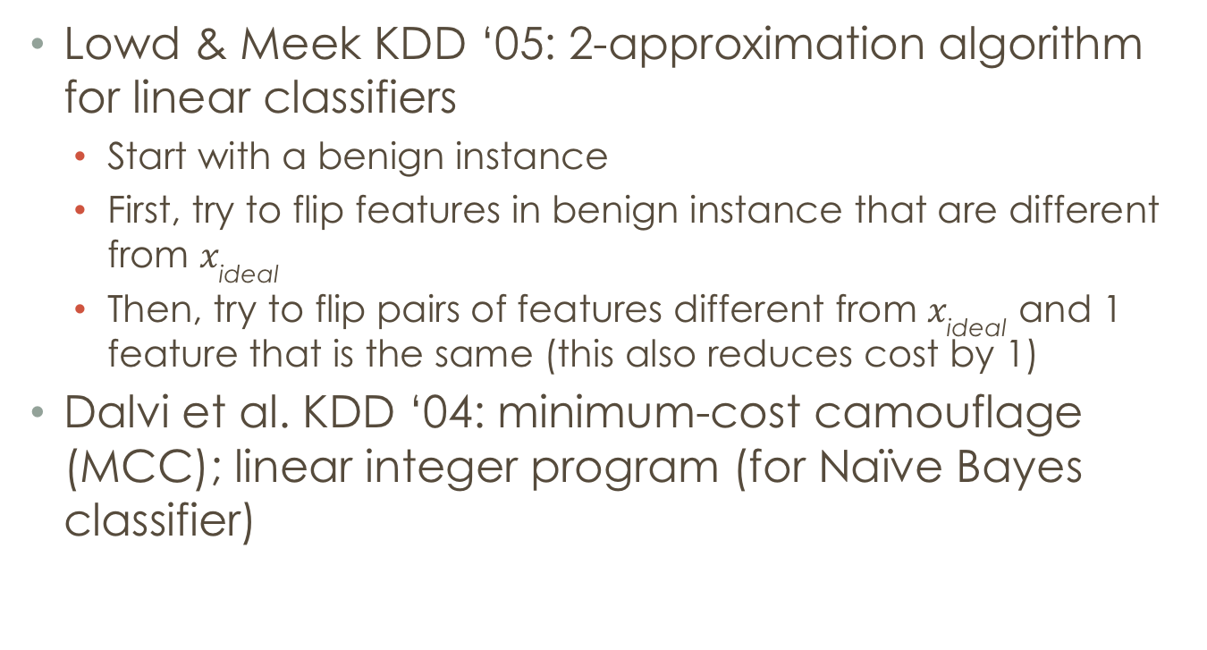
Binary features
Lowd & Meek KDD ‘05: 2-approximation algorithm for linear classifiers
Start with a benign instance
First, try to flip features in benign instance that are different from $x_{\text{ideal}}$
Then, try to flip pairs of features different from $x_{\text{ideal}}$ and 1 feature that is the same (this also reduces cost by 1)
Dalvi et al. KDD ‘04: minimum-cost camouflage (MCC); linear integer program (for Naïve Bayes classifier)

Slide 35
Is distance the right cost function?

Slide 36
Distance Based Cost Function Underestimates Adversary
X
C = 5
Synonym
Spam
Ham
C = 1
Hello!
Are you ready to become more active and attractive than ever before?
Our final product for losing weight is on clearance now.
Follow the link and you will find he cheapest way to gain your body back.
http://www.ebay.com/application_form
Hello!
Are you happy to become more active and attractive than ever before?
Our final merchandises for losing weigbt is on claerance now.
Follow the link and you will find he deapest way to gain your body back.
http://www.ebay.com/application_form
Letter substitution
Notes:
Title!
Explain the meaning of cost!!!

Slide 37
An Alternative Cost Function
Model the adversarial cost function
Traditional: Distance based cost function
Equivalence based cost function
Feature Class
Notes:
Visual, high level idea
Citation
Use this proposed cost function to model the adversarial capabilities
Add results
Align with the xA and x’

Slide 38
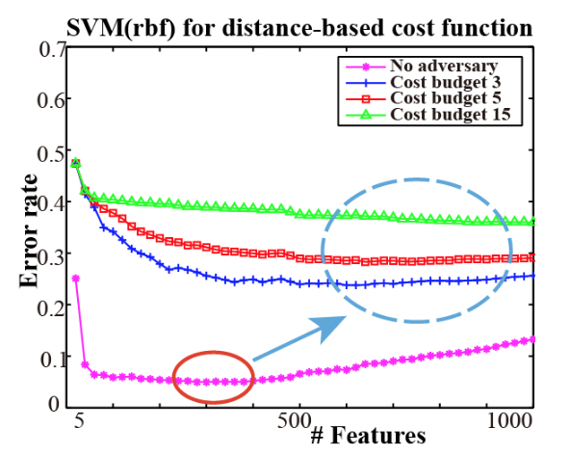
Perils of Dimension Reduction
No Adversary: Dimension Reduction = Good
With Adversary: Dimension Reduction = Vulnerable
Notes:
As a standard solution to the curse of dimensionality, feature reduction can open a wide door for the adversary to evade the classifier
1 standard error
Reasons:
typically, you don’t push right, even it is flat, actually stop earlier instead of right side.
Linear it is flat, if non-linear, it goes up
Feature reduction (check)
citation

Slide 39
White-box vs. black-box attacks
In attack models, assumed that the attacker knows the classifier
Black-box attacks: attacker has a query access to the classifier; can get examples
Lowd & Meek; Nelson et al.: minimizing the evasion cost through a sequence of queries to the classifier
NP-Hard in general (even for linear classifiers)
Poly-time approximations for linear and convex-inducing classifiers
Is the black-box attack fundamentally hard?

Slide 40
Black-box attacks
Can the adversary approximate the classifier h used by the defender to (near)-arbitrary precision?
Using only queries x to find out h(x)?
NP-Hard in general

Slide 41
reverse engineering is easy “in practice”
Previous results on black-box learnability are worst-case over an entire family of classifiers (linear, convex-inducing)
Observation: these classifiers do not spontaneously appear; they are learned from data!
This fact implies a lot of structure: since someone learned them to begin with, they should be learnable
Theorem: suppose a hypothesis class H is efficiently learnable, and h in H is learned (given data). Then h can be efficiently reverse engineered.
Reverse engineered: learned with arbitrarily small error
Follows directly from the fact that H is efficiently learnable and h is in H.
Consequence: theoretical reason why “black-box” attacks, e.g., with DNNs, work

Slide 42
References (evasion modeling)
Dalvi et al. Adversarial classification. KDD ‘04.
Lowd and Meek. Adversarial learning. KDD ’05.
Nelson et al. Query strategies for evading convex-inducing classifiers. JMLR ‘12.
Biggio et al. Evasion attacks against machine learning at test time. ECML/PKDD ‘13.
Li and Vorobeychik. Feature cross-substitution in adversarial classification. NIPS ‘14.
Vorobeychik and Li. Optimal randomized classification in adversarial settings. AAMAS ‘14.
Li, Vorobeychik, Chen. A general retraining framework for scalable adversarial classification. arxiv, 2016.
Not exhaustive
Vorobeychik and Kantarcioglu, Adversarial Machine Learning book will have a more extensive bibliography

Slide 43
outline
Evasion Attacks
Evasion-robust Classification
Optimal evasion-robust classification
Scaling up with systematic retraining
Validating evasion attack models

Slide 44
Stackelberg Game
Learner: commits strategy
Adversary: best response based on
Example: Spam Evasion Attack
Classifier
Benign
Learner commits to a strategy
Adversary solves to generate from ideal
Malicious
Adversary Model
: adversarial instance
Notes:
Stackelberg game here
Citation enlarge
Strategy: learning algorithm; oracle, label as malicious
the defender first chooses which assets to protect (in a possibly randomized fashion), and the attacker subsequently responds, taking into account the defender’s strategy or, more generally, his posterior belief about it [Paruchuri et al., 2008].
Lighten out the points
Optimize over sd

Slide 45
Designing evasion-robust classifiers
If ”back-box” attacks are approximately “white-box” attacks, we focus on white-box evasion attacks

Slide 46
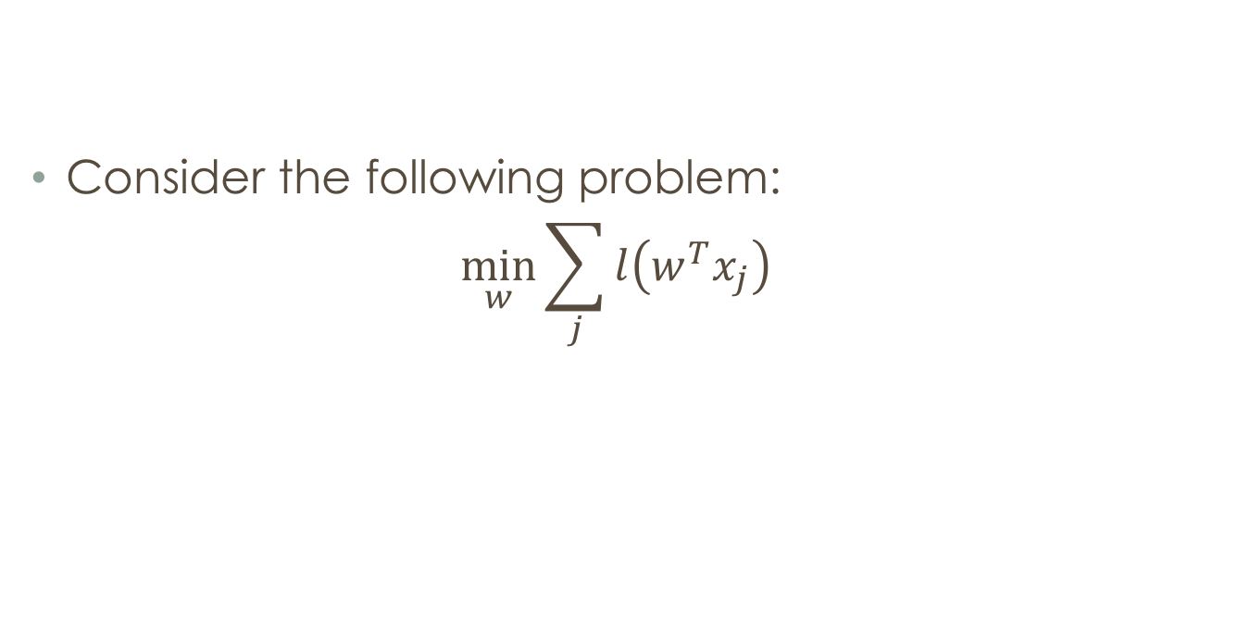
Robust learning through regularization
Consider the following problem:
$$\min_{w}{\sum_{j}{l\left(w^{T}x_{j}\right)}}$$
Empirical risk minimization

Slide 47
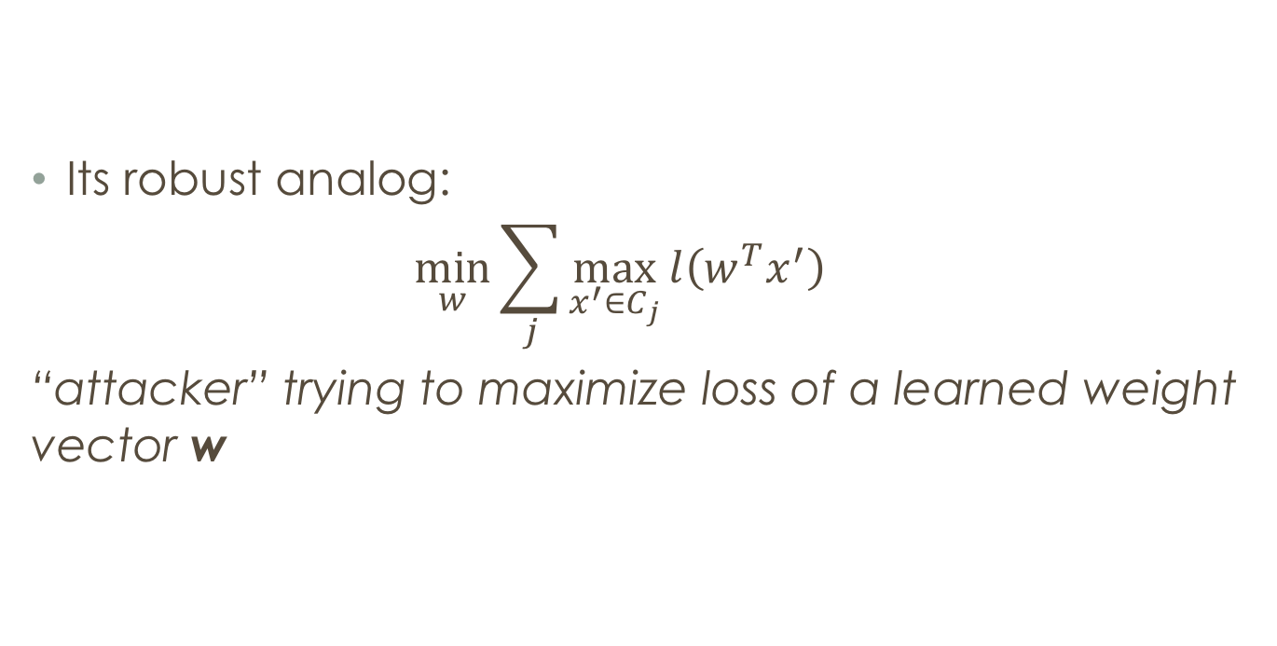
Robust learning through regularization
Its robust analog:
$$\min_{w}{\sum_{j}{\max_{x^{′}∈C_{j}}{l\left(w^{T}x^{′}\right)}}}$$
“attacker” trying to maximize loss of a learned weight vector w

Slide 48
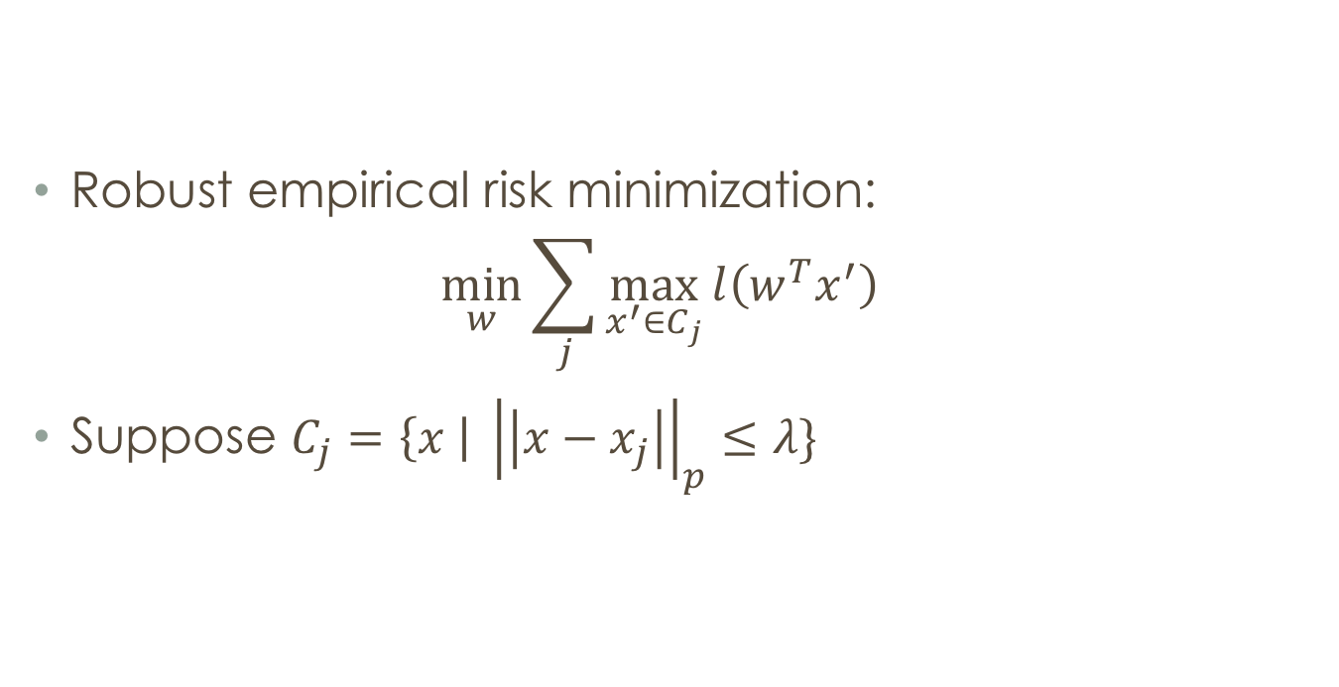
Robust learning through regularization
Robust empirical risk minimization:
$$\min_{w}{\sum_{j}{\max_{x^{′}∈C_{j}}{l\left(w^{T}x^{′}\right)}}}$$
Suppose $C_{j}=\left\{x \right| {\left|\left|x−x_{j}\right|\right|}_{p}≤λ\}$

Slide 49
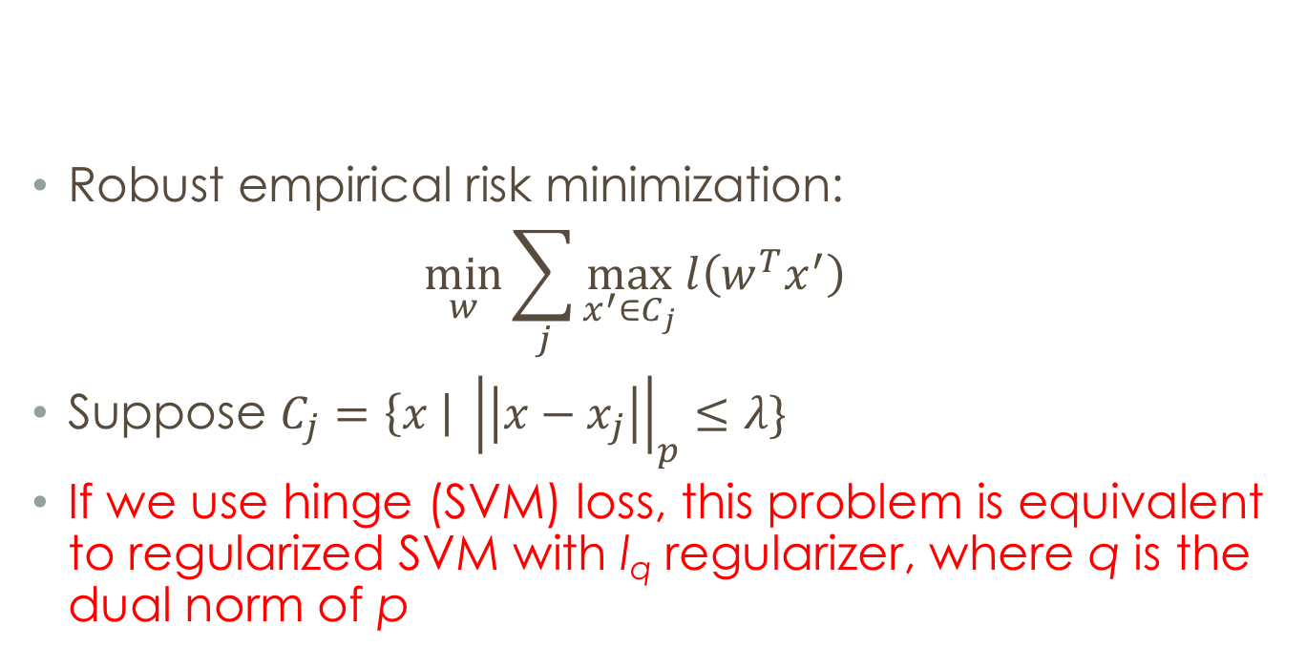
Robust learning through regularization
Robust empirical risk minimization:
$$\min_{w}{\sum_{j}{\max_{x^{′}∈C_{j}}{l\left(w^{T}x^{′}\right)}}}$$
Suppose $C_{j}=\left\{x \right| {\left|\left|x−x_{j}\right|\right|}_{p}≤λ\}$
If we use hinge (SVM) loss, this problem is equivalent to regularized SVM with l_{q} regularizer, where q is the dual norm of p

Slide 50
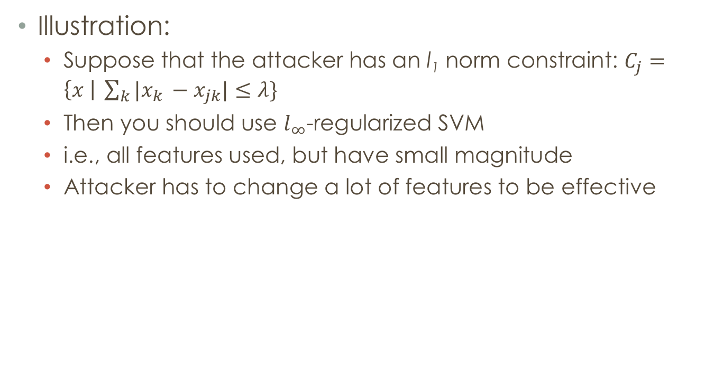
Robust learning through regularization
Illustration:
Suppose that the attacker has an l₁ norm constraint: $C_{j}=\left\{x \right| \sum_{k}{|x_{k }−x_{jk}|}≤λ\}$
Then you should use $l_{∞}$-regularized SVM
i.e., all features used, but have small magnitude
Attacker has to change a lot of features to be effective

Slide 51
But this is not quite our problem
First, attacker is maximizing loss
In fact, attackers are interested in not being detected, which is not the same; may wish to consider alternative models of attacks
Attackers may only correspond to malicious instances

Slide 52
Adversarial risk minimization
Minimize l₁ regularized (hinge) risk, accounting for evasion
Optimization problem:
l( * ) : hinge loss
A(x_{j};w) : adversarial decision model for an attacker who previously used a feature vector x_{j}

Slide 53
Adversarial risk minimization
Can formulate the problem as a mixed integer linear program
In this formulation, we capture A(x_{j};w) for an optimizing attacker using constraints
Assume that the attacker acts according to our evasion model earlier
Scalability challenge: too many constraints
Each constraint corresponds to a malicious instance in the data and all possible alternative instances for the corresponding attacker
Approach: clustering attacks + constraint generation

Slide 54
Limitations
Scalability: formulation and solution approach still can only scale to dozens of features and relatively small data sets
Classifier limitation: Limited to linear classifiers
Attack model limitation: Attack model is limited to threats which are optimizers (minimizing evasion cost); what about other models (e.g., behavioral, data-driven, etc)?
Simple solution: iterative retraining

Slide 55
Retraining
Start with original data
Use any learning algorithm to learn a model f
For malicious instances, apply any evasion method to generate new instances x’ to add to the dataset
Repeat
Stop when:
No new instances to add
Iteration limit
Classifier changes small between successive iterations

Slide 56
Retraining
Start with original data
Use any learning algorithm to learn a model f
For malicious instances, apply any evasion method to generate new instances x’ to add to the dataset
Repeat
Stop when:
No new instances to add
Iteration limit
Classifier changes small between successive iterations
RAD: Retraining with ADversarial examples

Slide 57
Effectiveness of Retraining
Theorem: if algorithm terminates when no new instances to add, the result is an upper bound on the optimal adversarial risk

Slide 58
Randomized intrusion detection
Can improve robustness by randomizing classification decisions

Slide 59
Learning in a box
Key idea: separate learning [about prediction based on current distribution of attacks] and operational decisions [using predictions made by learning, an adversary model, and operational constraints, to decide what to do]
Use learning as a black box to get p(x) = probability that x is generated by a malicious actor (e.g., use Naïve Bayes or logistic regression)
p(x) is a probability distribution over adversarial preferences (i.e., probability that x is the ideal instance for the corresponding adversary)
Optimize operational decisions based on p(x) and a model of adversarial response (adversary’s utility a function of how far they are from ideal instance, and probability the email is filtered)
Operational decisions can be randomized; use instance-based randomization, q(x) (probability of “acting” on x)

Slide 60
Optimization Problem
max_{q} U_{D}(q,p,X)
subject to:
0 ≤ q(x) ≤ 1
v_{A} (x;q) ≥ U_{A}(x,x’; q) for all attacks x’
Represent attacker’s response as a set of constraints
operational
budget constraint
Σ_{x} q(x) ≤ c|X|
Linear program, but: X (set of all feature vectors) is extremely large
(binary features: 2^{n})

Slide 61
Scalability
Idea: represent q(x) using basis functions
and optimize over α_{j}
Optimization program is linear in α
But: what should the basis be?

Slide 62
scalability
Commonly, the input space X is Boolean
Spam/phish detection: presence of specific words/phrases in the text
Fact: any function f on Boolean ({-1,+1}) vector space can be represented using a parity basis
Idea: solve for q(x) using training data; choose a small parity basis to approximate q(x); use this basis in the full optimization problem

Slide 63

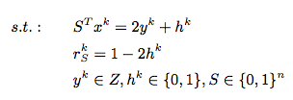
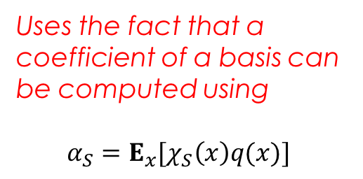
Solution approach
Approximating the basis:
Can formulate an integer program to compute the parity function with the largest coefficient
Greedily add basis functions until the largest remaining coefficient is below a threshold
Dealing with constraints:
Constraint generation (iteratively computing attacker’s best response)
Uses the fact that a coefficient of a basis can be computed using
$$α_{S}=E_{x}[χ_{S}\left(x\right)q(x)]$$

Slide 64
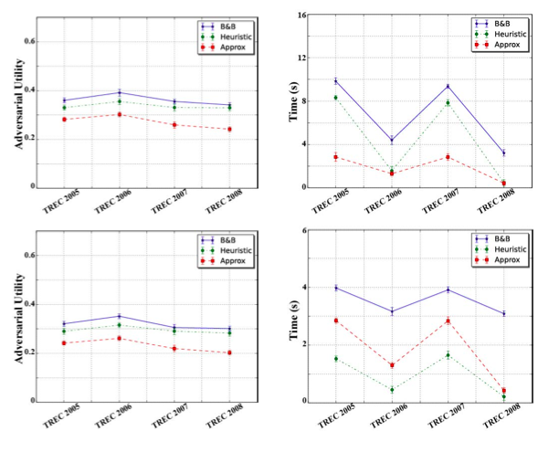

Attacker’s best response
Decision Problem version of the attacker’s best response:
Thm: EVASION is NP-Complete.
Approaches:
Polynomial approximation algorithm. Suppose that c bounds the number of inputs in any basis. Algorithm approximates best response to a factor 1+ε in time poly(n,1/ε,2^{c})
Complete branch-and-bound search
Greedy heuristic: near-optimal in practice (close to branch-and-bound); faster than alternatives)
EVASION

Slide 65
References (evasion-robust learning)
Xu et al. Robustness and regularization of Support Vector Machines. JMLR ’09.
Teo et al. Convex learning with invariances. NIPS ‘07.
Li and Vorobeychik. Feature cross-substitution in adversarial classification. NIPS ‘14.
Li and Vorobeychik. Scalable optimization of randomized operational decisions in adversarial classification. AISTATS ‘15.
Kantchelian et al. Evasion and hardening of tree ensemble classifiers. ICML ’16.
Li, Vorobeychik, Chen. A general retraining framework for scalable adversarial classification. arxiv, 2016.
Tong et al. Hardening classifiers against evasion: the good, the bad, and the ugly. arxiv, 2017.
Not exhaustive
Vorobeychik and Kantarcioglu, Adversarial Machine Learning book will have a more extensive bibliography

Slide 66
outline
Evasion Attacks
Evasion-robust Classification
Validating evasion attack models

Slide 67
Science and modeling
In science, modeling is typically a process
validate
model
experiments
confirm/falsify; revise

Slide 68
Modeling in security
Falsifying models:
All threat models are wrong; usually easy to falsify
But are they useful?
So how do you falsify a threat model in a security-meaningful way?
A threat model is useful if it helps design a better defense (i.e. defense aiming to protect against this threat model)
“Better”: against other (e.g., more concrete) attacks
Falsifying a threat model: showing that it is (relatively) ineffective in devising a defense

Slide 69
Feature space vs. problem space evasion attacks
Evasion attacks
Evasion robust classifier
Feature space
modify features directly
Feature space
Problem space
(i.e., using feature-space
attack models)
modify actual instances
How well do feature space evasion models represent actual attacks in problem space?

Slide 70
Distinction between feature space and problem space
Problem space evasion attacks: modify actual malware source, and then check that it is still malicious using a sandbox
Classifier then extracts features from the modified instance
Cannot have arbitrary feature modifications, but constraints on “feasible” attack space non-obvious and highly complex!

Slide 71
Pdf malware classifier Evasion attacks in problem space
Automated evasion in problem space (EvadeML-NDSS’16) using genetic programming + Cuckoo sandbox
Population Initialization
Fitness Evaluation
End?
Y
Stop
N
Mutation
Selection

Slide 72
Defense through retraining
Start with original data
Use any learning algorithm to learn a model f
For malicious instances, apply any evasion method to generate new instances x’ to add to the dataset
Repeat
Stop when:
No new instances to add
Iteration limit
Classifier changes small between successive iterations

Slide 73
Experimental methodology
Problem space retraining. Generating problem space adversarial instances (e.g. real-world malicious PDFs; e.g., using EvadeML), extract feature vectors, and add to the training data.
Feature space retraining. Generating evasions by using mathematical evasion models in feature space (no actual malware is generated), and add the resulting feature vectors to the training data.

Slide 74
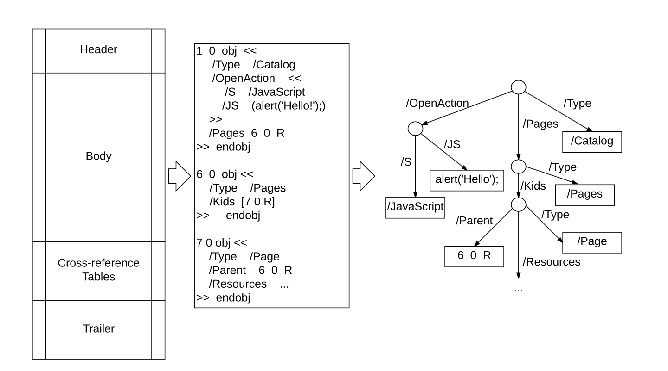
Case study using structure-based PDF malware classifiers
Structure-based features using object paths within a PDF file
Features: existence of specific structural paths (binary)

Slide 75
PDF malware detector
Hidost: PDF malware classifier with ~1000 structural features

Slide 76
Hidost
gap
original
Problem space retraining
Feature space retraining

Slide 77
Limitations of feature space models
Synthetically generated adversarial instances may in actuality NOT preserve malicious functionality. This introduce noise and bias into the retraining process.
Realistic adversarial instances may not be produced as the evasion model may not abide by realistic attack constraints.
How can we fix the model?

Slide 78
Classifying with conserved features
Conserved features: features which are essentially invariant in problem space attacks.
We identify a set of conserved features of Hidost by systematically manipulating each PDF object, checking impact on extracted features, and evaluating the corresponding maliciousness.
This way we identified 7 conserved features, out of 1,000

Slide 79
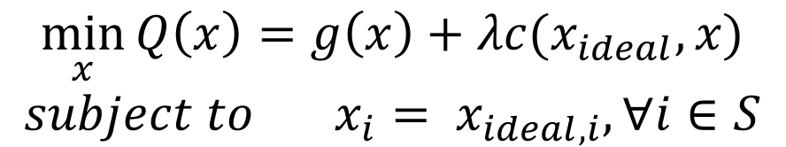
Retraining with conserved features
Additional constraint: conserved features are preserved in evasive instances.
$$\min_{x}{Q\left(x\right)=g\left(x\right)+λc(x_{ideal}, x)}$$
$$subject to x_{i}= x_{ideal,i}, ∀i∈S$$
S: set of conserved features

Slide 80
Hidost, CF retraining
gap
original
Problem space retraining
Feature space retraining
Feature space retraining with CF

Slide 81
What about other attacks?
An alternative mimicry attack using Generative Adversarial Networks (MalGAN)

Slide 82
hidost
“Overfit” to EvadeML
Generalized robustness!

Slide 83
References (validation of evasion models)
Tong et al. Hardening classifiers against evasion: the good, the bad, and the ugly. arxiv, 2017.
Exhaustive

