Slide 1


Reasoning on Knowledge Graphs: Symbolic or Neural?
Meng Qu^{1,2}, Zhaocheng Zhu^{1,2}, Jian Tang^{1,3,4}
Mila-Quebec AI Institute¹
University of Montreal²
CIFAR AI Chair³, HEC Montreal⁴
Feb 23, 2022

Slide 2
Roadmap
Part I: Neural Methods
Part II: Symbolic Logic Methods
Part III: Neural-Symbolic Methods
Part IV: Logic Rule Induction Methods
Part V: Summary and Future Directions

Slide 3
Neural Methods
Knowledge Graph Embeddings
Learn a low-dimensional embedding for each entity & relation
Preserve the observed triplets
?

Slide 4
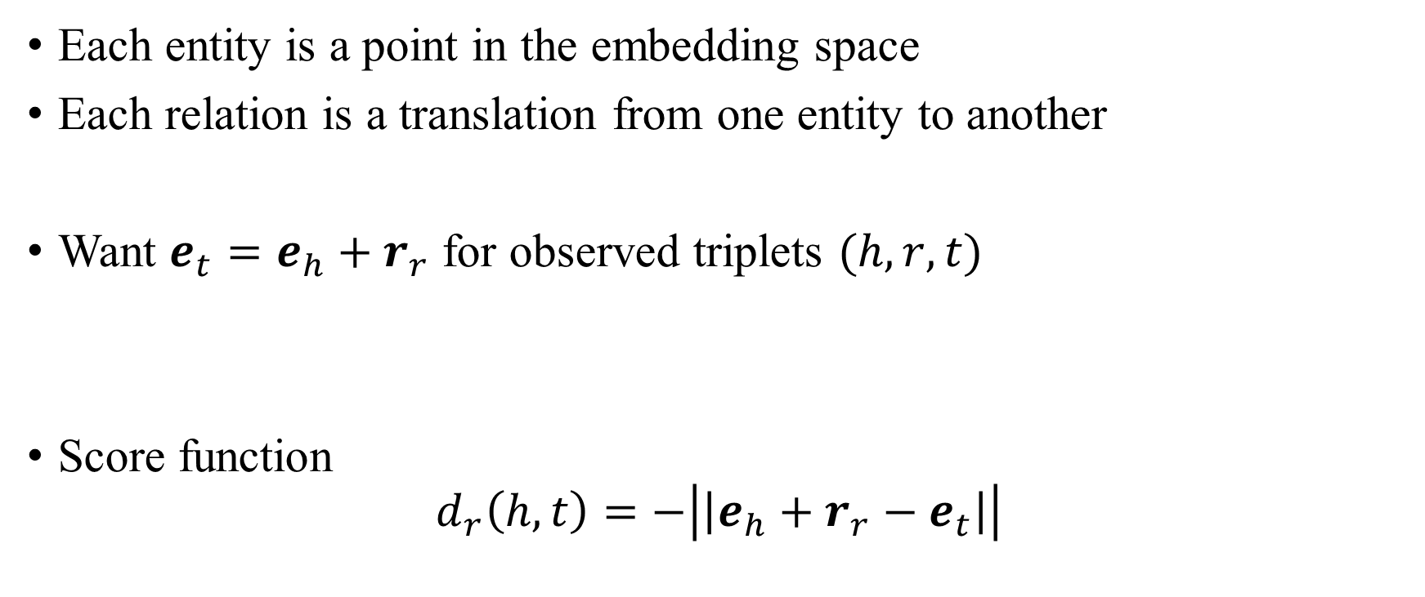
TransE
Each entity is a point in the embedding space
Each relation is a translation from one entity to another
Want $e_{t}=e_{h}+r_{r}$ for observed triplets $(h,r,t)$
Score function
$$d_{r}\left(h,t\right)=−\left|\left|e_{h}+r_{r}−e_{t}\right|\right|$$
Antoine Bordes, et al. Translating embeddings for modeling multi-relational data. NIPS 2013.

Slide 5
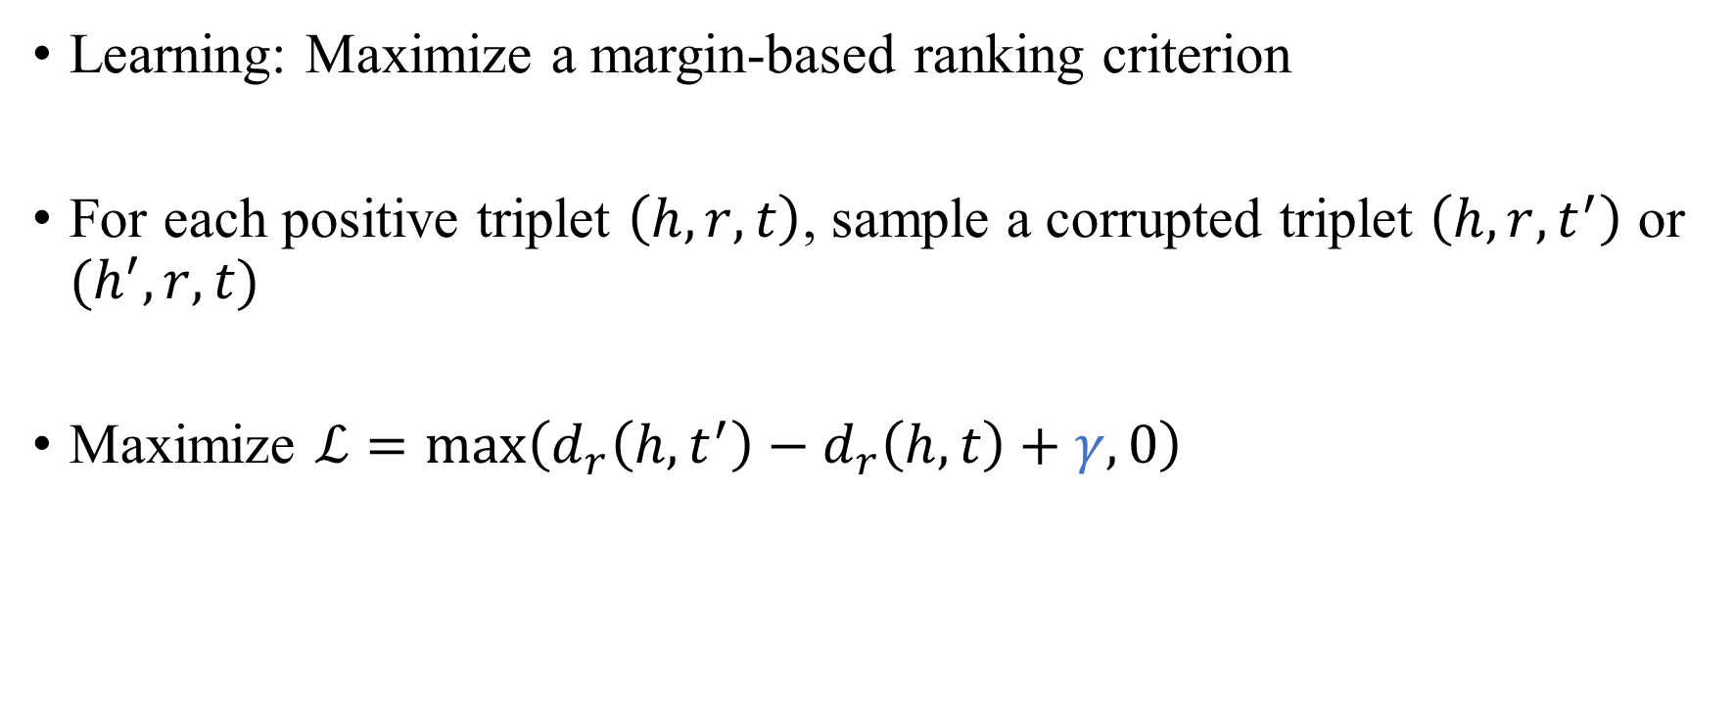
TransE
Learning: Maximize a margin-based ranking criterion
For each positive triplet $\left(h, r, t\right)$, sample a corrupted triplet $\left(h,r,t^{′}\right)$ or $(h^{′},r,t)$
Maximize $ℒ=\max\left(d_{r}\left(h,t^{′}\right)−d_{r}\left(h,t\right)+γ, 0\right)$
margin
Antoine Bordes, et al. Translating embeddings for modeling multi-relational data. NIPS 2013.

Slide 6
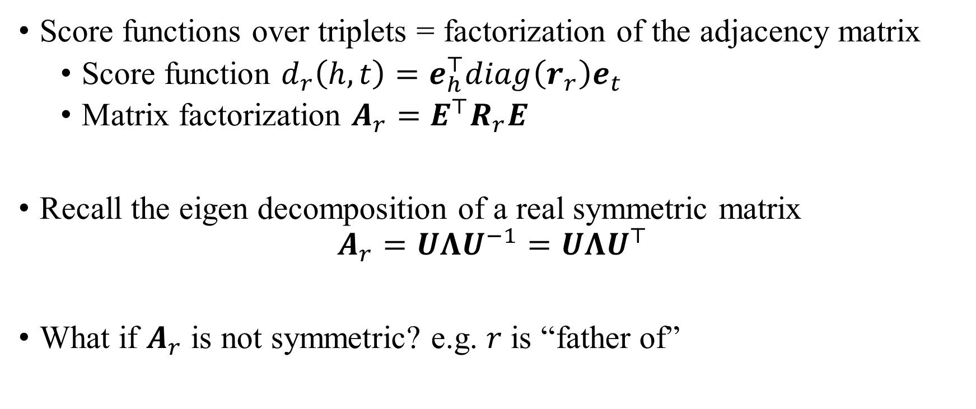
ComplEx
Score functions over triplets = factorization of the adjacency matrix
Score function $d_{r}\left(h,t\right)=e_{h}^{⊤}diag\left(r_{r}\right)e_{t}$
Matrix factorization $A_{r}=E^{⊤}R_{r}E$
Recall the eigen decomposition of a real symmetric matrix
$$A_{r}=UΛU^{−1}=UΛU^{⊤}$$
What if $A_{r}$ is not symmetric? e.g. $r$ is “father of”
Same as above
Théo Trouillon, et al. Complex embeddings for simple link prediction. ICML 2016.

Slide 7

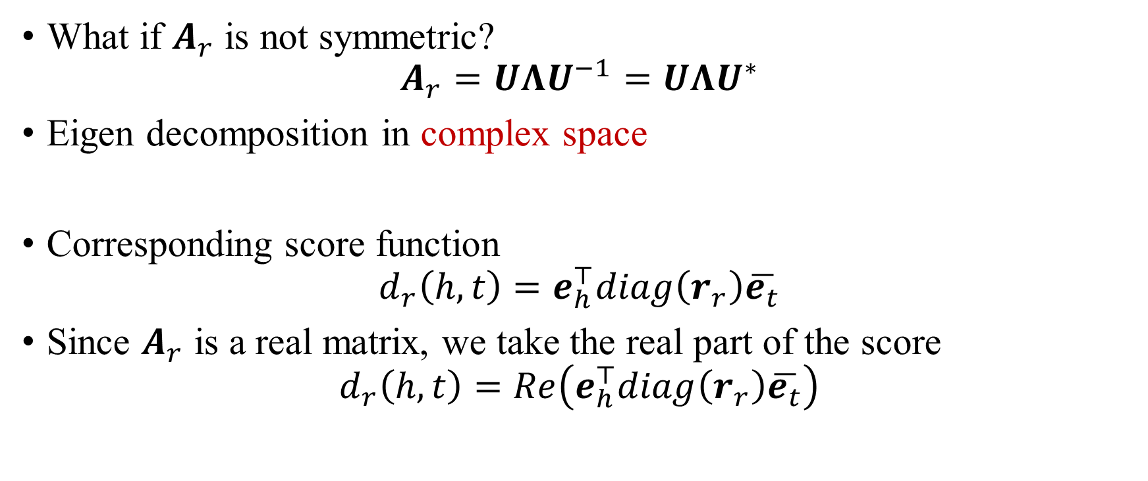
ComplEx
What if $A_{r}$ is not symmetric?
$$A_{r}=UΛU^{−1}=UΛU^{∗}$$
Eigen decomposition in complex space
Corresponding score function
$$d_{r}\left(h,t\right)=e_{h}^{⊤}diag\left(r_{r}\right)\overline{e_{t}}$$
Since $A_{r}$ is a real matrix, we take the real part of the score
$$d_{r}\left(h,t\right)=Re\left(e_{h}^{⊤}diag\left(r_{r}\right)\overline{e_{t}}\right)$$
$$UU^{∗}=I$$
Théo Trouillon, et al. Complex embeddings for simple link prediction. ICML 2016.

Slide 8
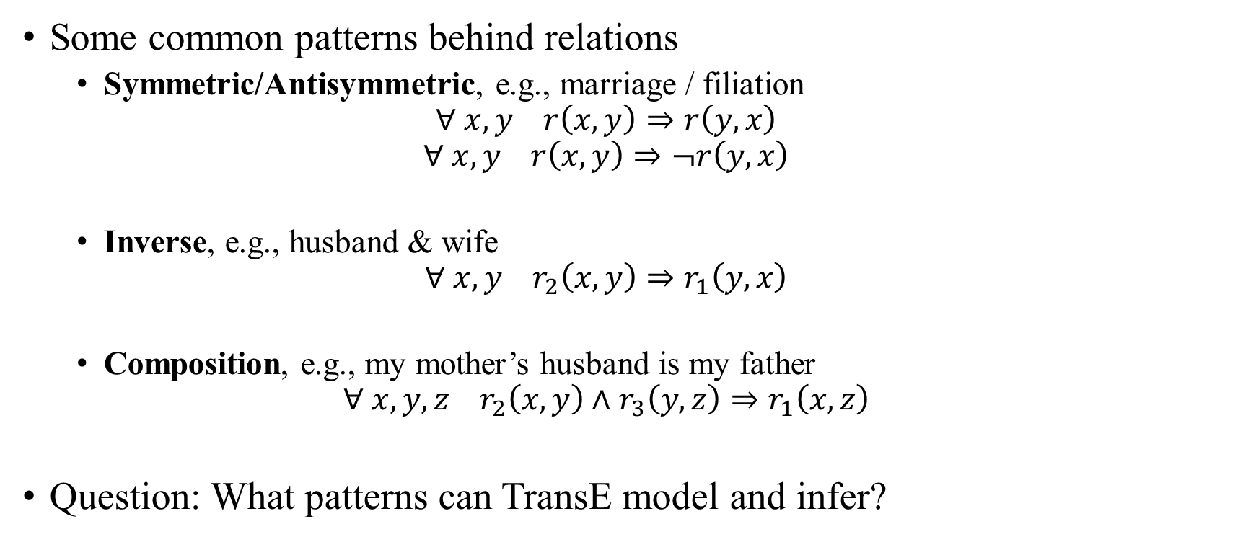
RotatE
Some common patterns behind relations
Symmetric/Antisymmetric, e.g., marriage / filiation
$$∀ x, y r\left(x,y\right)⇒r\left(y,x\right)$$
$$∀ x, y r\left(x,y\right)⇒¬r\left(y,x\right)$$
Inverse, e.g., husband & wife
$$∀ x, y r_{2}\left(x,y\right)⇒r_{1}\left(y,x\right)$$
Composition, e.g., my mother’s husband is my father
$$∀ x, y,z r_{2}\left(x,y\right)∧r_{3}\left(y,z\right)⇒r_{1}\left(x,z\right)$$
Question: What patterns can TransE model and infer?
Zhiqing Sun, et al. RotatE: Knowledge graph embedding by relational rotation in complex space. ICLR 2019.

Slide 9
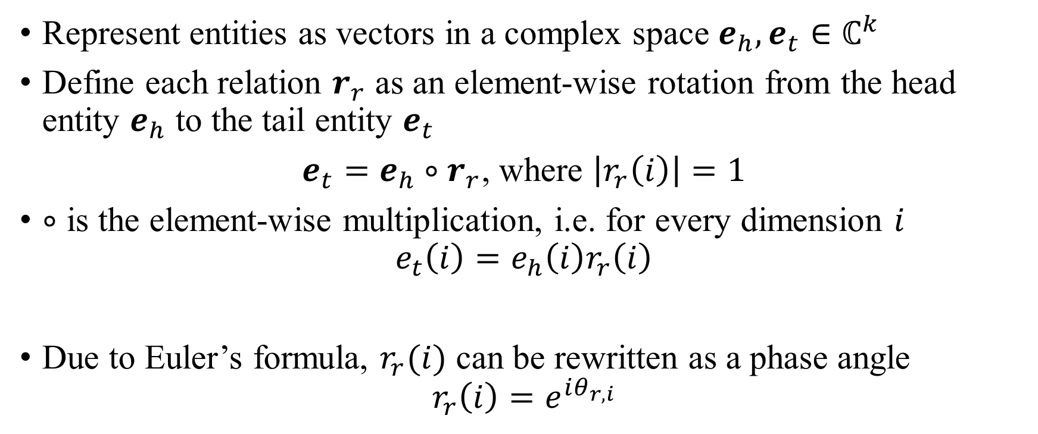
RotatE
Represent entities as vectors in a complex space $e_{h},e_{t}∈ℂ^{k}$
Define each relation $r_{r}$ as an element-wise rotation from the head entity $e_{h}$ to the tail entity $e_{t}$
$e_{t}=e_{h}∘r_{r}$, where $\left|r_{r}\left(i\right)\right|=1$
$∘$ is the element-wise multiplication, i.e. for every dimension $i$
$$e_{t}\left(i\right)=e_{h}\left(i\right)r_{r}\left(i\right)$$
Due to Euler’s formula, $r_{r}(i)$ can be rewritten as a phase angle
$$r_{r}\left(i\right)=e^{iθ_{r,i}}$$
Zhiqing Sun, et al. RotatE: Knowledge graph embedding by relational rotation in complex space. ICLR 2019.

Slide 10
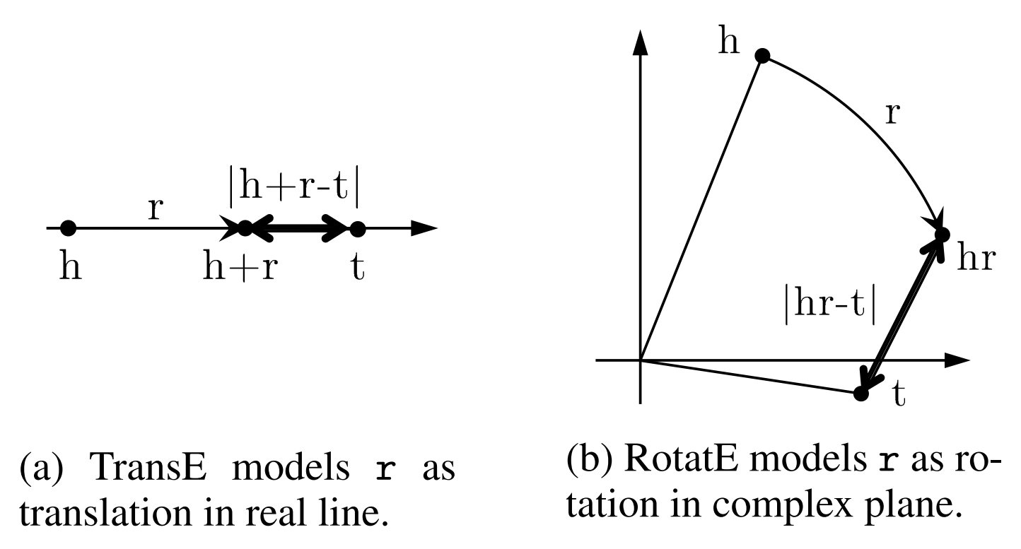

RotatE
Score function
$$d_{r}\left(h,t\right)=−\left|\left|e_{h}∘r_{r}−e_{t}\right|\right|$$
Zhiqing Sun, et al. RotatE: Knowledge graph embedding by relational rotation in complex space. ICLR 2019.

Slide 11
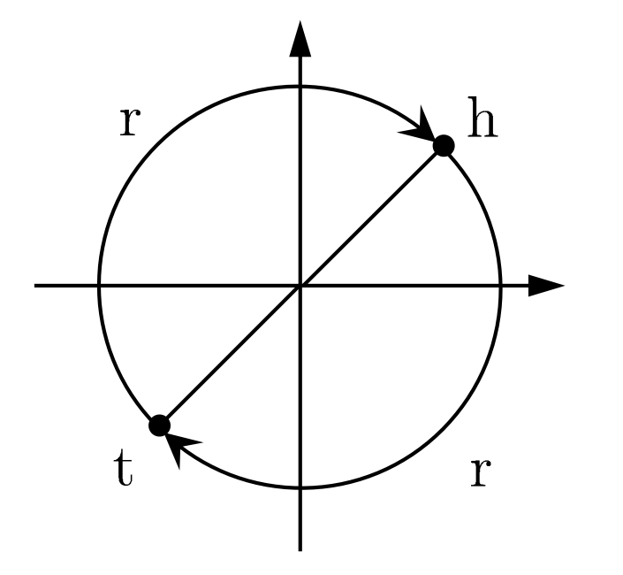

Model the Relation Patterns with RotatE
A relation r is symmetric if and only if $r_{r}\left(i\right)=±1$, i.e.
$θ_{r,i}=0$ or $π$
e.g., For $r_{r}\left(i\right)=−1$ ($θ_{r,i}=π$), RotatE looks like
Zhiqing Sun, et al. RotatE: Knowledge graph embedding by relational rotation in complex space. ICLR 2019.

Slide 12
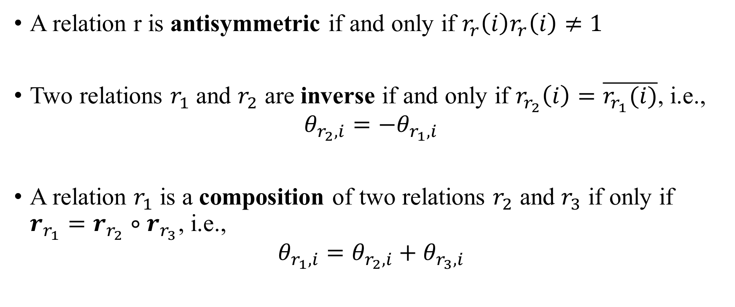
Model the Relation Patterns with RotatE
A relation r is antisymmetric if and only if $r_{r}\left(i\right)r_{r}\left(i\right)≠1$
Two relations $r_{1}$ and $r_{2}$ are inverse if and only if $r_{r_{2}}\left(i\right)=\overline{r_{r_{1}}(i)}$, i.e.,
$$θ_{r_{2},i}=−θ_{r_{1},i}$$
A relation $r_{1}$ is a composition of two relations $r_{2}$ and $r_{3}$ if only if $r_{r_{1}}=r_{r_{2}}∘r_{r_{3}}$, i.e.,
$$θ_{r_{1},i}=θ_{r_{2},i}+θ_{r_{3},i}$$
Zhiqing Sun, et al. RotatE: Knowledge graph embedding by relational rotation in complex space. ICLR 2019.

Slide 13
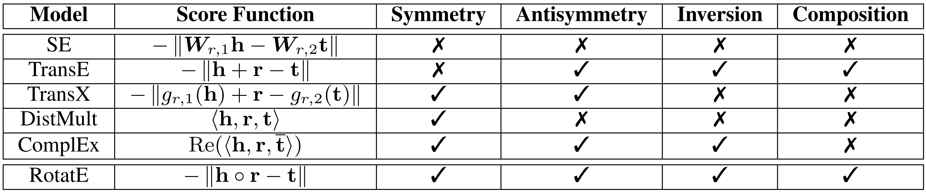
Relation Patterns in Previous Methods
RotatE is the first to model all four relation patterns.
Zhiqing Sun, et al. RotatE: Knowledge graph embedding by relational rotation in complex space. ICLR 2019.

Slide 14
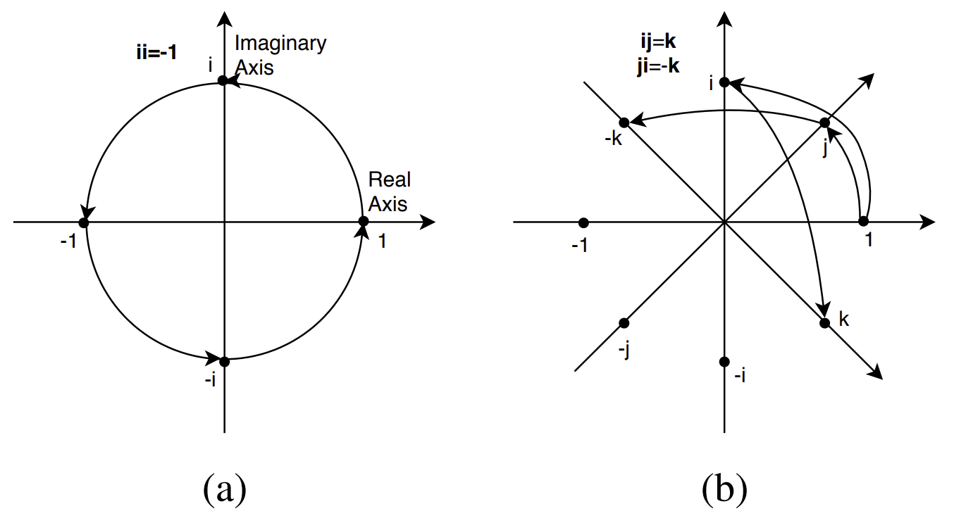

QuatE
Extend RotatE to quaternion space
Model relation with Hamilton product
$$\left(a+bi+cj+dk\right)⊗\left(p+qi+uj+vk\right)$$
$$=\left(ap−bq−cu−dv\right)+\left(aq+bp+cv−du\right)i \\ +\left(au−bv+cp+dq\right)j+\left(av+bu−cq+dp\right)k$$
Shuai Zhang, et al. Quaternion knowledge graph embeddings. NeurIPS 2019.

Slide 15
QuatE
Hamilton product is non-commutative, e.g.,
mother’s father = grandfather
father’s mother = grandmother
In RotatE, mother’s father is always modeled the same as father’s mother
Shuai Zhang, et al. Quaternion knowledge graph embeddings. NeurIPS 2019.

Slide 16
Neural Methods
Graph Neural Networks
Learn to encode local graph structures for reasoning
?

Slide 17
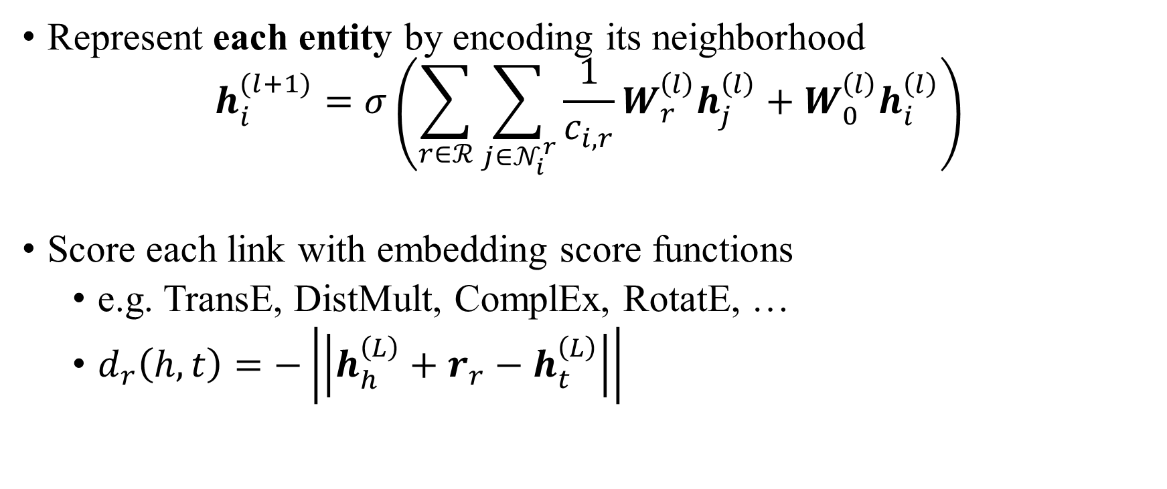
RGCN
Represent each entity by encoding its neighborhood
$$h_{i}^{(l+1)}=σ\left(\sum_{r∈ℛ}{\sum_{j∈𝒩_{i}^{r}}{\frac{1}{c_{i,r}}W_{r}^{\left(l\right)}h_{j}^{\left(l\right)}}}+W_{0}^{\left(l\right)}h_{i}^{\left(l\right)}\right)$$
Score each link with embedding score functions
e.g. TransE, DistMult, ComplEx, RotatE, …
$d_{r}\left(h,t\right)=−\left|\left|h_{h}^{\left(L\right)}+r_{r}−h_{t}^{\left(L\right)}\right|\right|$
Michael Schlichtkrull, et al. Modeling relational data with graph convolutional networks. European semantic web conference 2018.

Slide 18
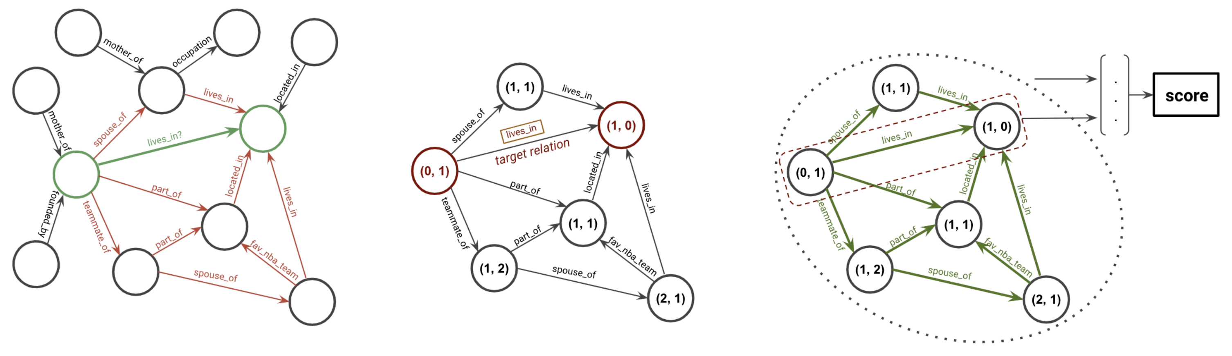
GraIL
Represent each link by encoding its surrouding subgraph
Extract a subgraph for each link
Apply node labeling to the subgraph based on distance to head / tail entities
Apply RGCN and average pooling to predict the score
Komal Teru, Etienne Denis, and Will Hamilton. Inductive relation prediction by subgraph reasoning. ICML 2020.

Slide 19
Benchmark Datasets
FB15k: a subset of Freebase. Contains general purpose facts like history, science, sports and awards.
WN18: a subset of WordNet. Contains words and lexical ontologies.
Since the inverse (either symmetric or antisymmetric) of many test triplets are present in the training set, two improved datasets are
FB15k-237: a subset of FB15k where inverse relations are removed.
WN18RR: a subset of WN18 where inverse relations are removed.

Slide 20
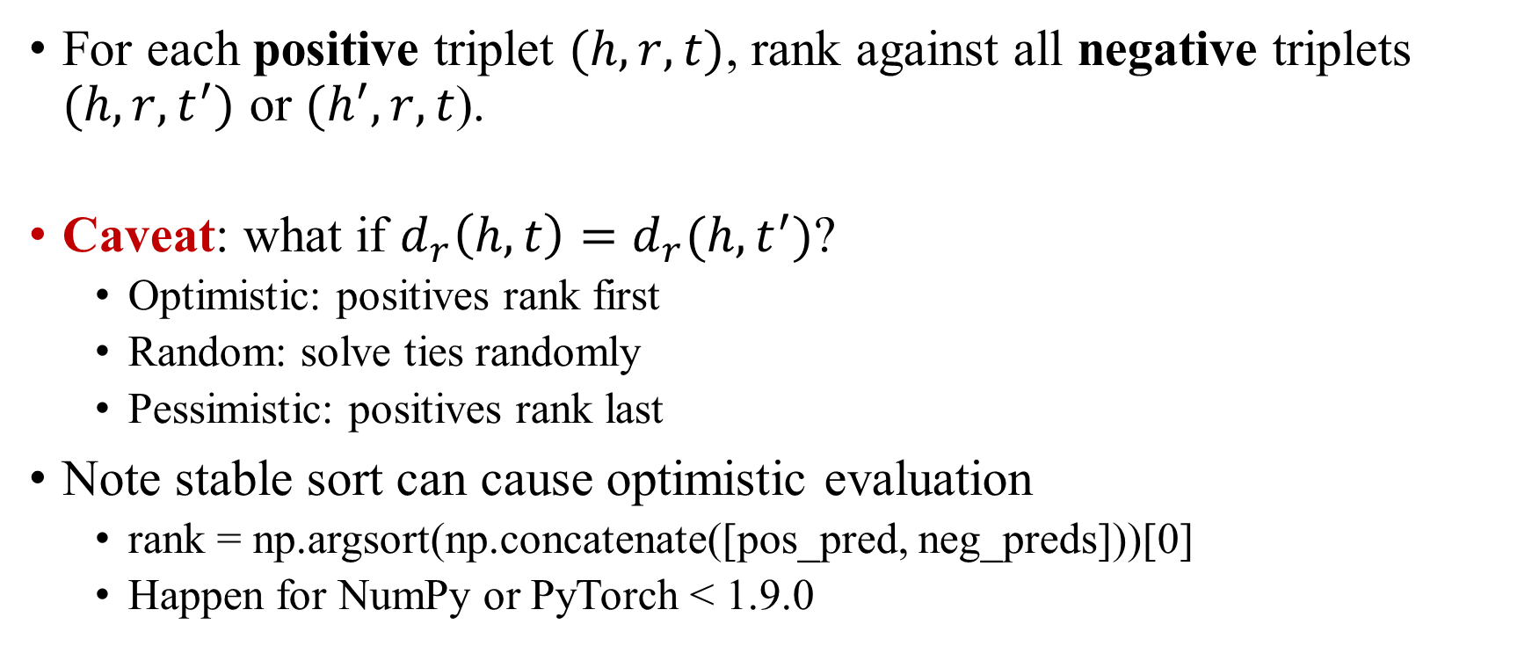
Evaluation
For each positive triplet $(h,r,t)$, rank against all negative triplets $(h,r,t^{′})$ or $(h^{′},r,t$).
Caveat: what if $d_{r}\left(h,t\right)=d_{r}(h,t^{′})$?
Optimistic: positives rank first
Random: solve ties randomly
Pessimistic: positives rank last
Note stable sort can cause optimistic evaluation
rank = np.argsort(np.concatenate([pos_pred, neg_preds]))[0]
Happen for NumPy or PyTorch < 1.9.0
Zhiqing Sun, et al. A re-evaluation of knowledge graph completion methods. ACL 2020.

Slide 21
Benchmark Results
Metric
MR: mean rank
MRR: mean reciprocal rank
H@K: HITS at K

Slide 22
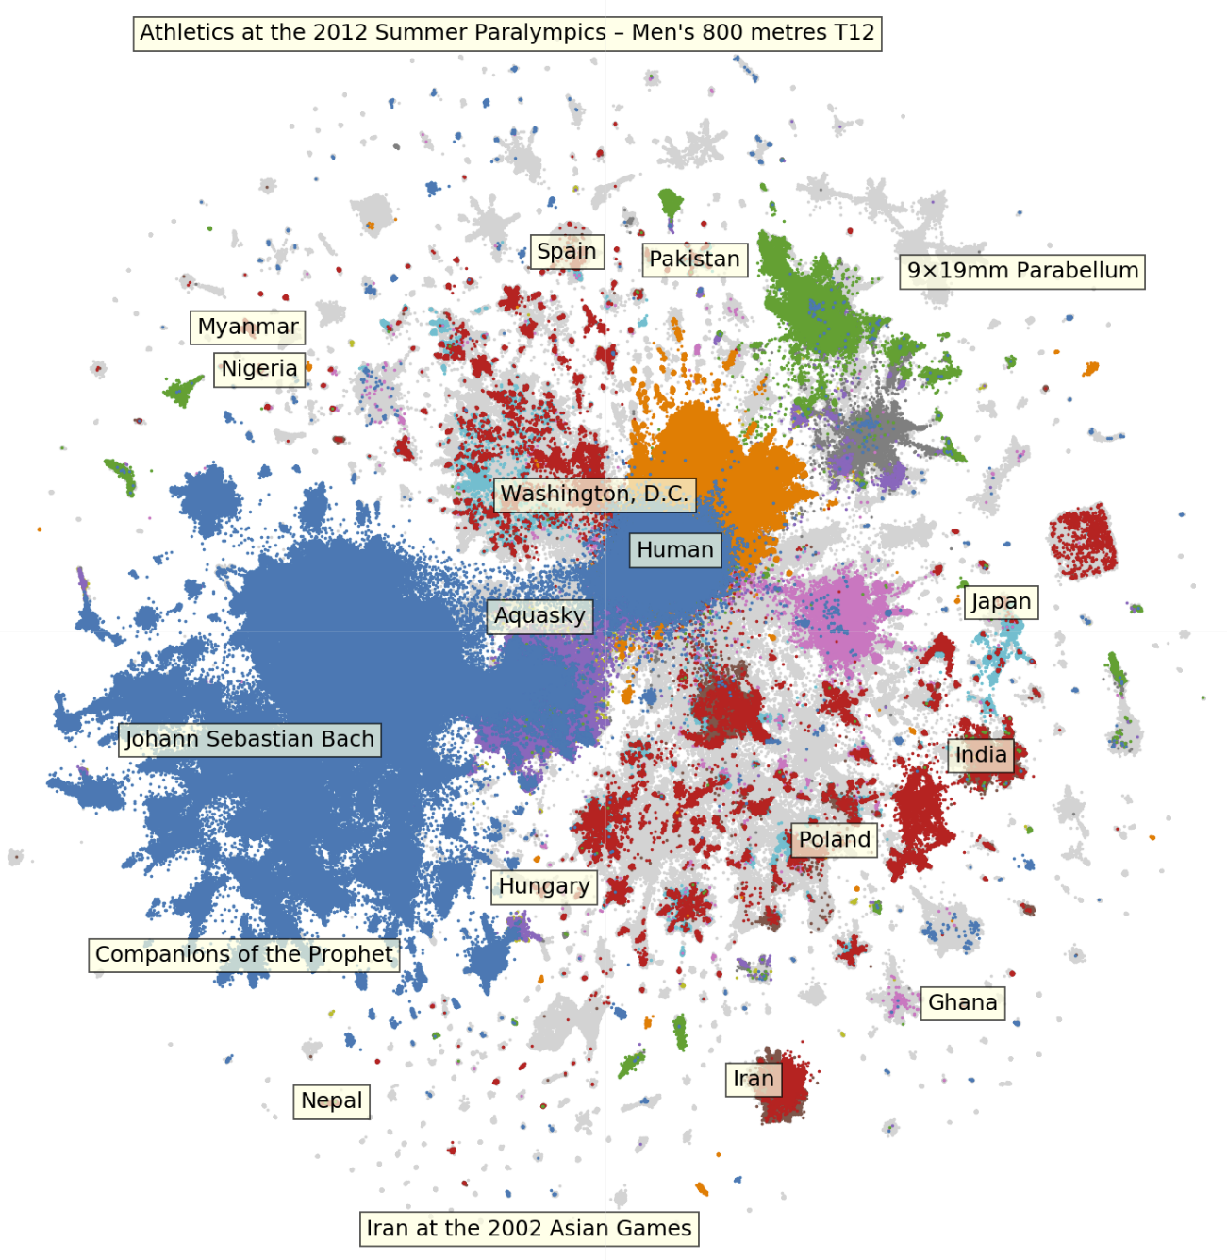
Large-Scale Datasets
Wikidata5M
5 million entities, 822 relations and 20 million triplets
Each entity has text descriptions from Wikipedia
Pretrained embeddings available at https://graphvite.io/docs/latest/pretrained_model
WikiKG90Mv2
91 million entities, 1387 relations and 601 million triplets
Each entity and relation has embeddings computed by language models
Xiaozhi Wang, et al. KEPLER: A unified model for knowledge embedding and pre-trained language representation. TACL 2021.
Weihua Hu, et al. OGB-LSC: A large-scale challenge for machine learning on graphs. arXiv 2021.

Slide 23
Open Source Packages
KnowledgeGraphEmbedding from Jian Tang’s group https://github.com/DeepGraphLearning/KnowledgeGraphEmbedding
GraphVite from Jian Tang’s group: https://graphvite.io/
PyTorch-BigGraph from FAIR: https://github.com/facebookresearch/PyTorch-BigGraph
DGL-KE from Amazon: https://github.com/awslabs/dgl-ke
OpenKE from Zhiyuan Liu’s group https://github.com/thunlp/OpenKE
PyKEEN from Jens Lehmann’s group: https://github.com/pykeen/pykeen

