Slide 1


Reasoning on Knowledge Graphs: Symbolic or Neural?
Meng Qu^{1,2}, Zhaocheng Zhu^{1,2}, Jian Tang^{1,3,4}
Mila-Quebec AI Institute¹
University of Montreal²
CIFAR AI Chair³, HEC Montreal⁴
Feb 23, 2022

Slide 2
Roadmap
Part I: Neural Methods
Part II: Symbolic Logic Methods
Part III: Neural-Symbolic Methods
Part IV: Logic Rule Induction Methods
Part V: Summary and Future Directions

Slide 3
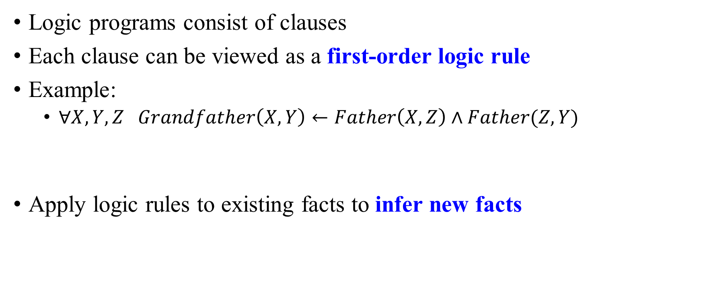
Logic Programming
Logic programs consist of clauses
Each clause can be viewed as a first-order logic rule
Example:
$∀X,Y,Z Grandfather\left(X,Y\right)←Father\left(X,Z\right)∧Father(Z,Y)$
Apply logic rules to existing facts to infer new facts
Rule Head
Rule Body

Slide 4
Inference Algorithms
Two fundamental algorithms:
Forward chaining algorithm:
Repeatly apply given logic rules to the current set of facts, until the fact set converges.
Strength: able to find a large number of facts every time
Weakness: inefficient and high memory cost
Backward chaining algorithm:
For each query, use the given logic rules and depth-first search to construct a search tree to infer the answer.
Strength: efficient
Weakness: focus on each individual query

Slide 5




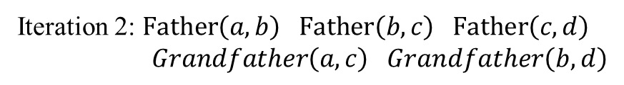

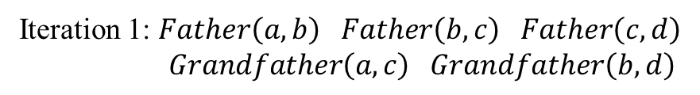


Inference Algorithms
Examples:
Given facts: $Father\left(a,b\right) Father\left(b,c\right) Father\left(c,d\right)$
Given logic rule: $∀X,Y,Z Grandfather\left(X,Y\right)←Father\left(X,Z\right)∧Father(Z,Y)$
Forward Chaining
Backward Chaining
Iteration 0: $Father\left(a,b\right) Father\left(b,c\right) Father\left(c,d\right)$
Query: $Grandfather\left(?,c\right)$
Apply the given rule
Iteration 1: $Father\left(a,b\right) Father\left(b,c\right) Father\left(c,d\right)$
$Grandfather\left(a,c\right) Grandfather\left(b,d\right)$
$$Father\left(?,Z\right)∧Father\left(Z,c\right)$$
Replace $Z$ with $b$
Iteration 2: $Father\left(a,b\right) Father\left(b,c\right) Father\left(c,d\right)$
$Grandfather\left(a,c\right) Grandfather\left(b,d\right)$
$$Father\left(?,b\right)$$
Replace $?$ with $a$
Convergence
$$?=a$$

Slide 6
Logic Programming in Probabilistic Ways
Combine first-order logic with probabilistic models
Model logic rules in a probabilistic way, yielding soft rules.
Handle the uncertainty of logic rules
Representative methods:
Bayesian logic programming (Jaynes et al. 2003)
ProbLog (Raedt et al. 2007)
Markov logic programming (Richardson and Domingos, 2006):
Markov Logic Networks (Richardson and Domingos, 2006)
Stochastic logic programming (Cussens, 2001) :
TensorLog (Cohen, 2016)

Slide 7
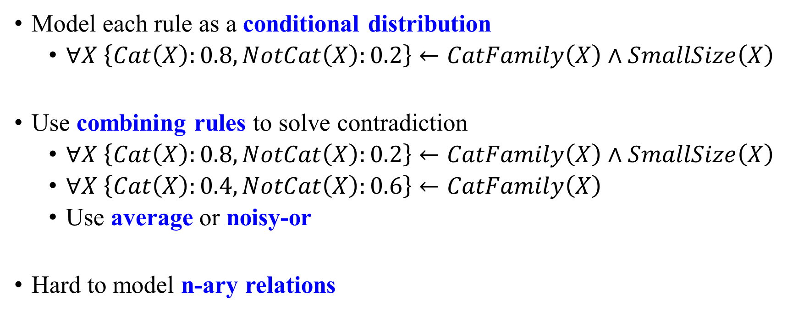
Bayesian Logic Programming
Model each rule as a conditional distribution
$∀X \left\{Cat\left(X\right):0.8, NotCat\left(X\right):0.2\right\}←CatFamily\left(X\right)∧SmallSize\left(X\right)$
Use combining rules to solve contradiction
$∀X \left\{Cat\left(X\right):0.8, NotCat\left(X\right):0.2\right\}←CatFamily\left(X\right)∧SmallSize\left(X\right)$
$∀X \left\{Cat\left(X\right):0.4, NotCat\left(X\right):0.6\right\}←CatFamily\left(X\right)$
Use average or noisy-or
Hard to model n-ary relations
Jaynes, Edwin T. Probability theory: The logic of science. Cambridge university press, 2003.

Slide 8
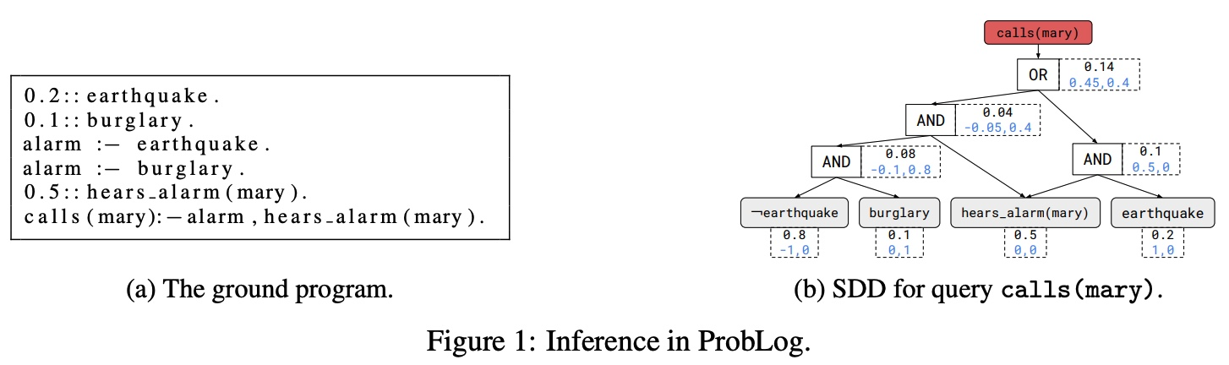
ProbLog / DeepProbLog
Consider a query and some rules
Construct a computational graph with AND and OR operations
Compute the probability that the query is satisfied
Luc De Raedt, et al. Statistical relational artificial intelligence: Logic, probability, and computation. Synthesis lectures on artificial intelligence and machine learning 2016
Robin Manhaeve, et al. Deepproblog: Neural probabilistic logic programming. NIPS 2018.

Slide 9
Markov Logic Programming
Associate a scalar weight to each logic rule
Apply the given logic rules to the given facts, and use the forward chaining algorithm to find a collection of relevant facts.
Build a Markov network and perform inference to predict the value of each fact (true/false)
Matthew Richardson, and Pedro Domingos. Markov logic networks. ML 2006.

Slide 10




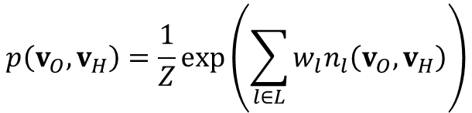

Markov Logic Programming
Example:
Rules:
R1: $∀X,Y Nationality\left(X,Y\right)←LiveIn\left(X,Y\right)$
R2: $∀X,Y Nationality\left(X,Y\right)←PoliticianOf\left(X,Y\right)$
R3: $∀X,Y$ $Nationality\left(X,Z\right)←BornIn\left(X,Y\right)∧CityOf\left(Y,Z\right)$
All obtained facts and the graph structure:
weight 0.2
weight 2.6
weight 1.5
$$p\left(v_{O},v_{H}\right)=\frac{1}{Z}\exp\left(\sum_{l∈L}{w_{l}n_{l}\left(v_{O},v_{H}\right)}\right)$$
$v_{O}$: Observed facts
$v_{H}$: Hidden facts inferred by forward chaining
$w_{l}$: Weight of rule $l$
$n_{l}$: Number of times $l$ is satisfied
Matthew Richardson, and Pedro Domingos. Markov logic networks. ML 2006.

Slide 11
Stochastic Logic Programming
Associate a scalar weight to each logic rule
For each query, use the given logic rules and backward chaining algoritm to build a search tree.
Infer the answer according to rule weights and tree structure
James Cussens. Parameter estimation in stochastic logic programs. ML 2001.

Slide 12
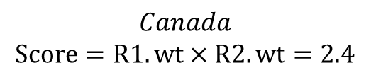






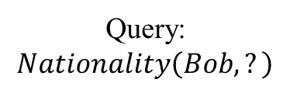
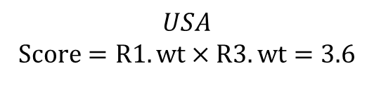
Stochastic Logic Programming
Example:
Rules:
R1: $∀X,Y Nationality\left(X,Y\right)←BornIn\left(X,Y\right)$
R2: $∀X,Y$ $BornIn\left(X,Y\right)←LiveIn\left(X,Y\right)$
R3: $∀X,Y$ $BornIn\left(X,Y\right)←GrewUpIn\left(X,Y\right)$
weight 3.0
weight 0.8
weight 1.2
Multiplying the weights of rules in a reasoning path as score
Normalizing entity scores to get a distribution for the answer
Apply R2
$$LiveIn\left(Bob,?\right)$$
$$Canada$$
$$Score=R1.wt×R2.wt=2.4$$
$$P=0.33$$
Query:
$$Nationality\left(Bob,?\right)$$
Apply R1
$$BornIn\left(Bob,?\right)$$
Apply R3
$$GrewUpIn\left(Bob,?\right)$$
$$USA$$
$$Score=R1.wt×R3.wt=3.6$$
$$P=0.67$$
James Cussens. Parameter estimation in stochastic logic programs. ML 2001.

Slide 13
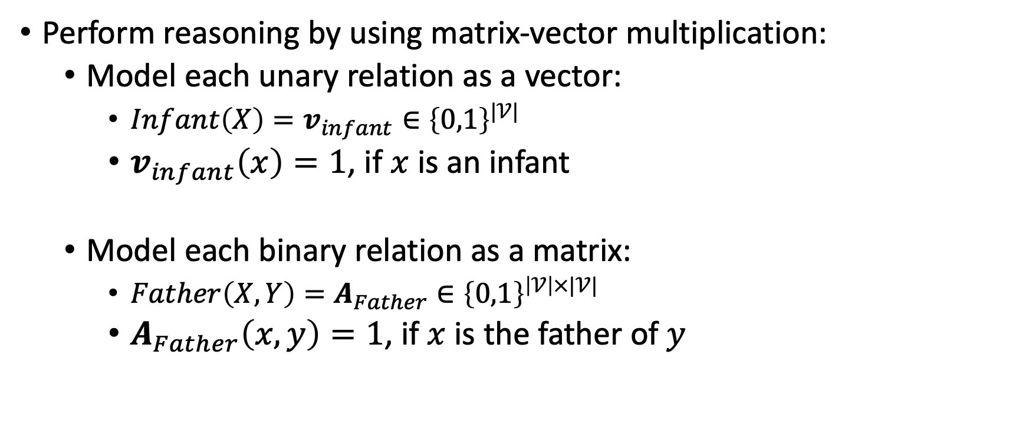
TensorLog
Perform reasoning by using matrix-vector multiplication:
Model each unary relation as a vector:
$Infant\left(X\right)=v_{infant}∈{\left\{0,1\right\}}^{|𝒱|}$
$v_{infant}\left(x\right)=1$, if $x$ is an infant
Model each binary relation as a matrix:
$Father\left(X,Y\right)=A_{Father}∈{\left\{0,1\right\}}^{\left|𝒱\right|×|𝒱|}$
$A_{Father}\left(x,y\right)=1$, if $x$ is the father of $y$
William W. Cohen. TensorLog: A differentiable deductive database. NIPS 2016.

Slide 14
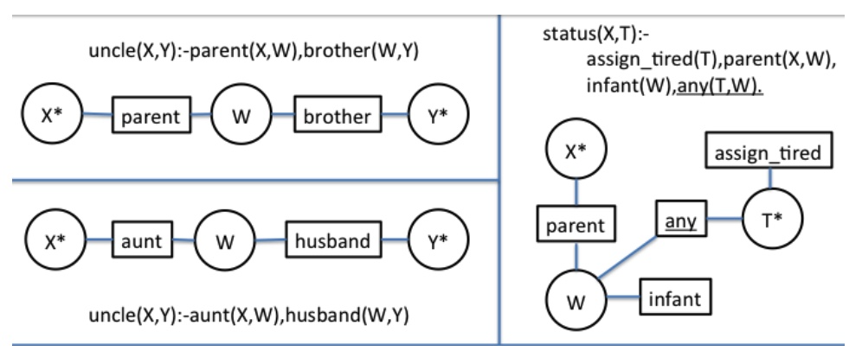
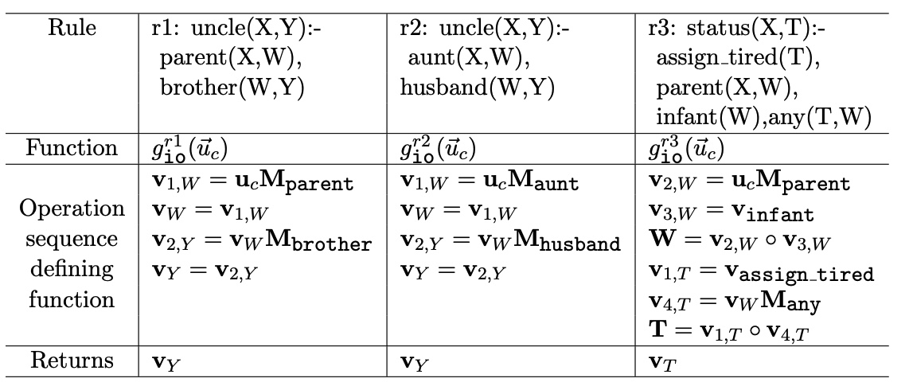
TensorLog
Examples:

