Slide 1


Reasoning on Knowledge Graphs: Symbolic or Neural?
Meng Qu^{1,2}, Zhaocheng Zhu^{1,2}, Jian Tang^{1,3,4}
Mila-Quebec AI Institute¹
University of Montreal²
CIFAR AI Chair³, HEC Montreal⁴
Feb 23, 2022

Slide 2
Roadmap
Part I: Neural Methods
Part II: Symbolic Logic Methods
Part III: Neural-Symbolic Methods
Part IV: Logic Rule Induction Methods
Part V: Summary and Future Directions

Slide 3
Markov Logic Programming Based
Idea:
Use a collection of logic rules and forward chaining to build a Markov logic network
Use neural methods to improve inference and learning of MLN
Strength:
Symbolic: ability of using domain knowledge, interpretability
Neural: efficiency, capacity

Slide 4


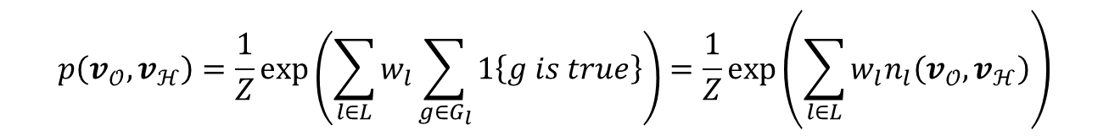


Markov Logic Networks
Combines first-order logic and probabilistic graphical models
0.2
$$Live\left(X,Y\right)→Nationality(X,Y)$$
2.6
$$Politician_of\left(X,Y\right)→Nationality(X,Y)$$
1.5
$$Born\left(X,Y\right)∧City_of\left(Y,Z\right)→Nationality(X,Z)$$
$$p\left(v_{𝒪},v_{ℋ}\right)=\frac{1}{Z}\exp\left(\sum_{l∈L}{w_{l}\sum_{g∈G_{l}}{1\left\{g is true\right\}}}\right)=\frac{1}{Z}\exp\left(\sum_{l∈L}{w_{l}n_{l}\left(v_{𝒪},v_{ℋ}\right)}\right)$$
$v_{𝒪}$: observed facts
$w_{l}$: weight of logic rule $l$
$v_{ℋ}$: unobserved/hidden facts
$n_{l}(v_{𝒪},v_{ℋ})$: number of true grounds of the logic rule $l$

Slide 5
Pros and Cons
Pros
Effectively leverage domain knowledge with logic rules
Handle the uncertainty
Limitation
Inference is difficult due to complicated graph structures
Recall is low since many facts are not covered by any logic rules

Slide 6
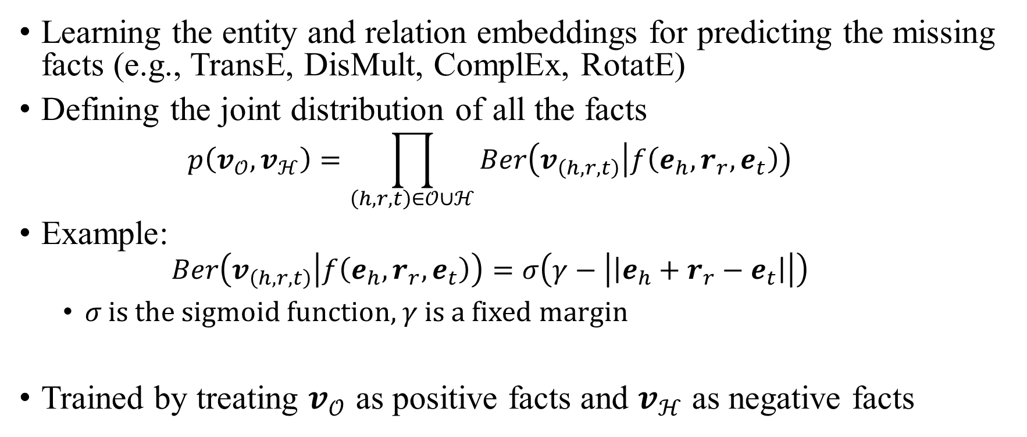
Knowledge Graph Embeddings
Learning the entity and relation embeddings for predicting the missing facts (e.g., TransE, DisMult, ComplEx, RotatE)
Defining the joint distribution of all the facts
$$p\left(v_{𝒪},v_{ℋ}\right)=\prod_{\left(h,r,t\right)∈𝒪∪ℋ}{Ber\left(v_{\left(h,r,t\right)} | f\left(e_{h}, r_{r},e_{t}\right)\right)}$$
Example:
$$Ber\left(v_{\left(h,r,t\right)} | f\left(e_{h}, r_{r},e_{t}\right)\right)=σ\left(γ−\left|\left|e_{h}+r_{r}−e_{t}\right|\right|\right)$$
𝜎 is the sigmoid function, 𝛾 is a fixed margin
Trained by treating $v_{𝒪}$ as positive facts and $v_{ℋ}$ as negative facts

Slide 7
Pros and Cons
Pros
Can be effectively and efficiently trained by SGD
High recall of missing link prediction with entity and relation embeddings
Cons
Hard to leverage domain knowledge (logic rules)

Slide 8
Probabilistic Logic Neural Networks for Reasoning
Towards combining Markov Logic Networks and knowledge graph embedding
Leverage logic rules and handle their uncertainty
Effective and efficient inference
Define the joint distribution of facts with Markov Logic Network
Optimization with variational EM
Parametrize the variational distribution with knowledge graph embedding methods
Meng Qu and Jian Tang. Probabilistic logic neural networks for reasoning. NeurIPS 2019.

Slide 9

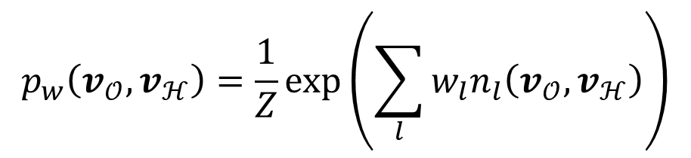
pLogicNet
Define the joint distribution of facts with an MLN
Learning by maximizing the variational lower-bound of the log-likelihood of observed facts
$$\log{p_{w}(v_{𝒪})}≥ℒ\left(q_{θ},p_{w}\right)=𝔼_{q_{θ}\left(v_{ℋ}\right)}\left[\log{p_{w}\left(v_{𝒪}, v_{ℋ}\right)}−\log{q_{θ}\left(v_{ℋ}\right)}\right]$$
$$p_{w}\left(v_{𝒪},v_{ℋ}\right)=\frac{1}{Z}\exp\left(\sum_{l}{w_{l}n_{l}\left(v_{𝒪},v_{ℋ}\right)}\right)$$
Meng Qu and Jian Tang. Probabilistic logic neural networks for reasoning. NeurIPS 2019.

Slide 10
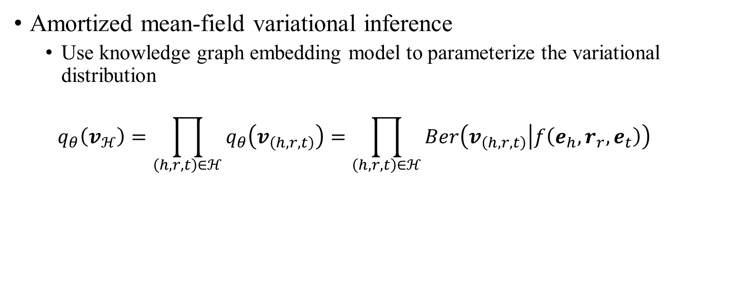
Inference
Amortized mean-field variational inference
Use knowledge graph embedding model to parameterize the variational distribution
$$q_{θ}\left(v_{ℋ}\right)=\prod_{\left(h,r,t\right)∈ℋ}{q_{θ}\left(v_{\left(h,r,t\right)}\right)}=\prod_{\left(h,r,t\right)∈ℋ}{Ber\left(v_{\left(h,r,t\right)} | f\left(e_{h}, r_{r},e_{t}\right)\right)}$$

Slide 11
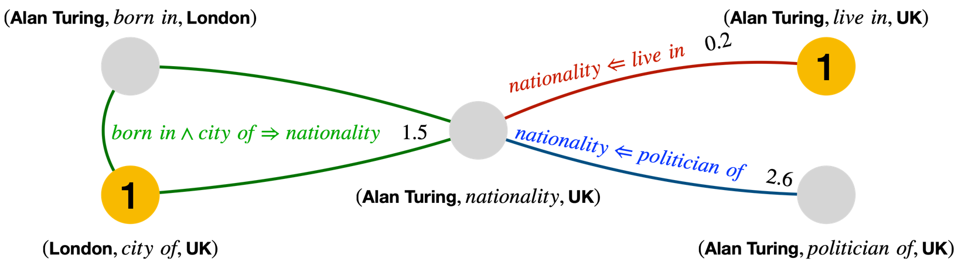
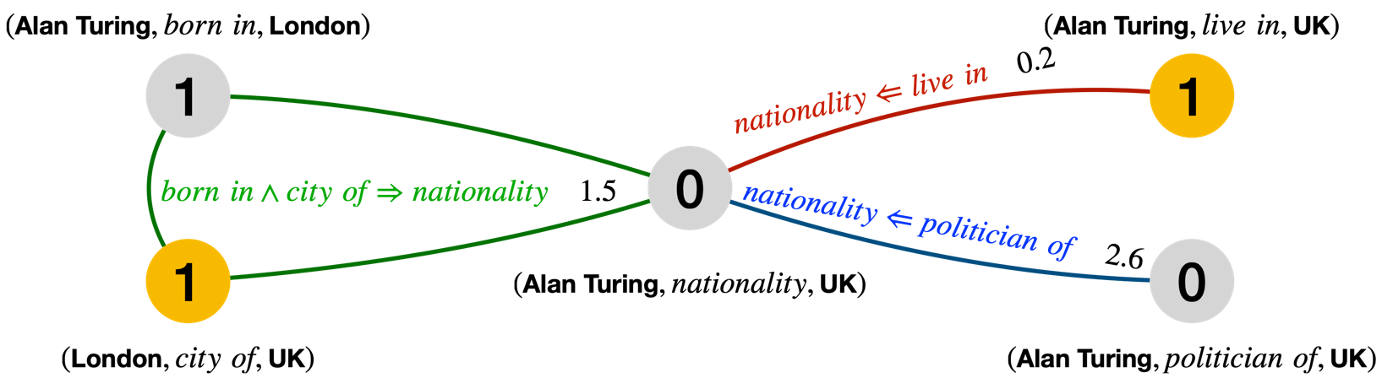
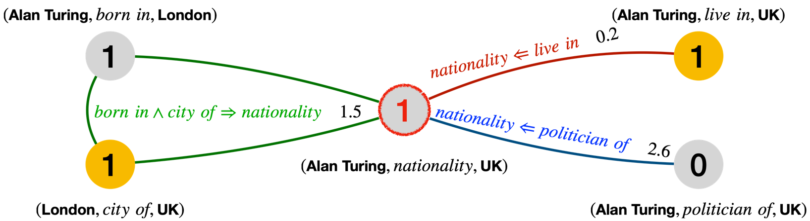
Inference

Slide 12
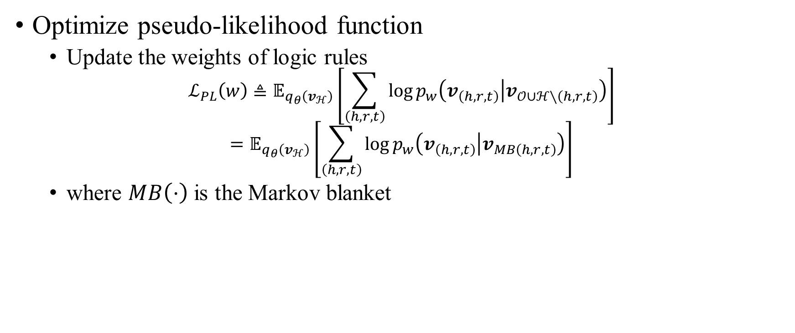
Learning
Optimize pseudo-likelihood function
Update the weights of logic rules
$$ℒ_{PL}\left(w\right)≜𝔼_{q_{θ}\left(v_{ℋ}\right)}\left[\sum_{\left(h,r,t\right)}{\log{p_{w}\left(v_{\left(h,r,t\right)} | v_{𝒪∪ℋ∖\left(h,r,t\right)}\right)}}\right]$$
$$=𝔼_{q_{θ}\left(v_{ℋ}\right)}\left[\sum_{\left(h,r,t\right)}{\log{p_{w}\left(v_{\left(h,r,t\right)} | v_{MB\left(h,r,t\right)}\right)}}\right]$$
where $MB\left(⋅\right)$ is the Markov blanket

Slide 13

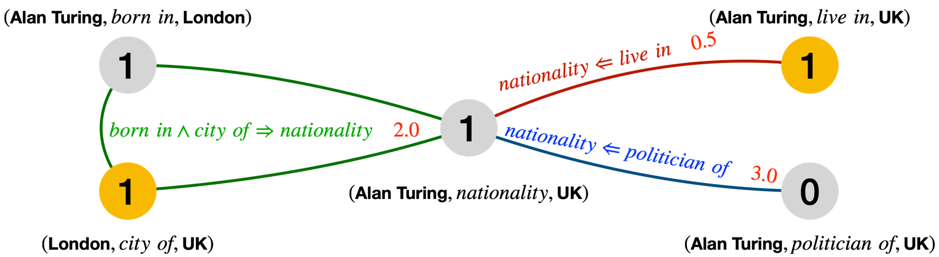
Learning

Slide 14
Performance of Link Prediction
Datasets: benchmark knowledge graphs
FB15K, WN18, FB15K-237, WN18-RR
Logic rules:
Composition rules (e.g., Father of Father is GrandFather)
Inverse rules (e.g., Husband and Wife)
Symmetric rules (e.g., Similar)
Subrelation rules (e.g., Man => Person)

Slide 15
Stochastic Logic Programming Based
Idea:
Use a collection of logic rules and backward chaining to build a reasoning graph
Use neural methods to aggregate relational paths for reasoning
Strength:
Better handle each query with better efficiency

Slide 16
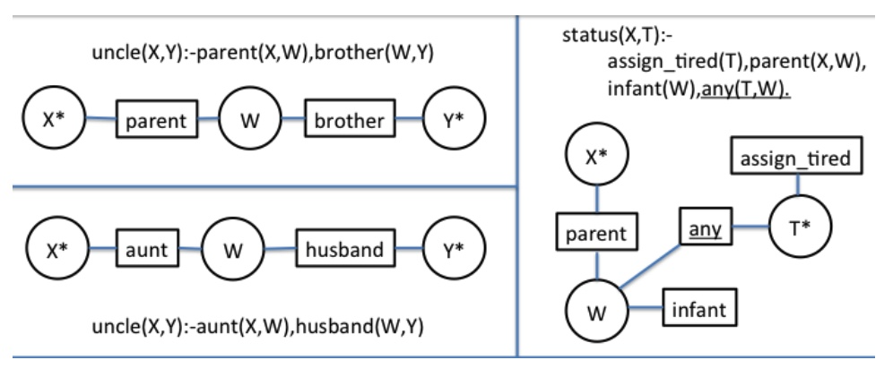
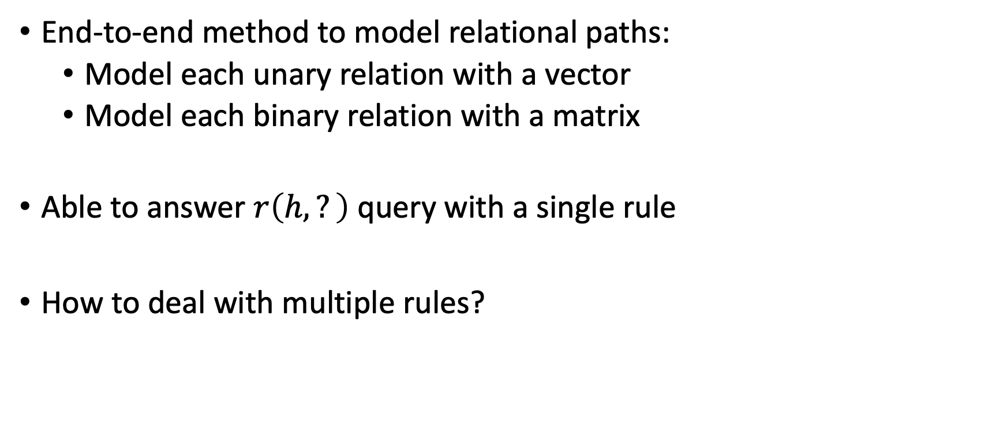
TensorLog
End-to-end method to model relational paths:
Model each unary relation with a vector
Model each binary relation with a matrix
Able to answer $r\left(h,?\right)$ query with a single rule
How to deal with multiple rules?

Slide 17
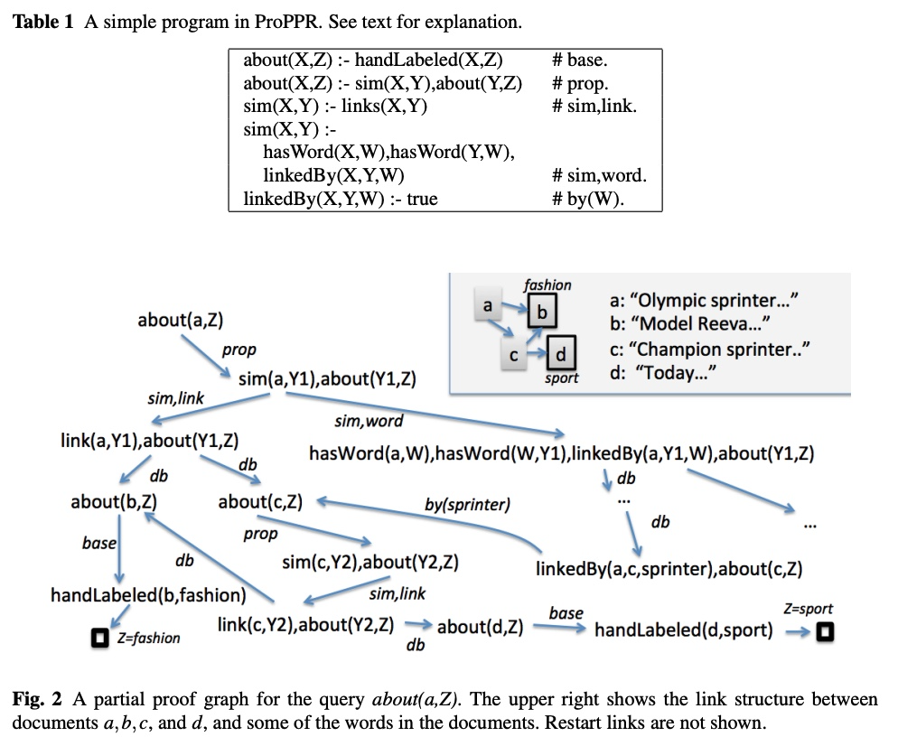
ProPPR
Consider multiple rules
Build the inference graph with backward chaining
The transition probability from a node to its children is decided by rule weights
William Yang Wang, Kathryn Mazaitis, and William W. Cohen. Programming with personalized pagerank: a locally groundable first-order probabilistic logic. CIKM 2013.

Slide 18
ProPPR
Apply personalized page rank to the inference graph
Predict the answer as the entity with the highest stationary probability
William Yang Wang, Kathryn Mazaitis, and William W. Cohen. Programming with personalized pagerank: a locally groundable first-order probabilistic logic. CIKM 2013.

Slide 19
Source Codes
pLogicNet: https://github.com/DeepGraphLearning/pLogicNet
ProPPR: https://github.com/TeamCohen/ProPPR

