Slide 1
The Simigle Image Search Engine
Wei Dong
2010-09-23

Slide 2
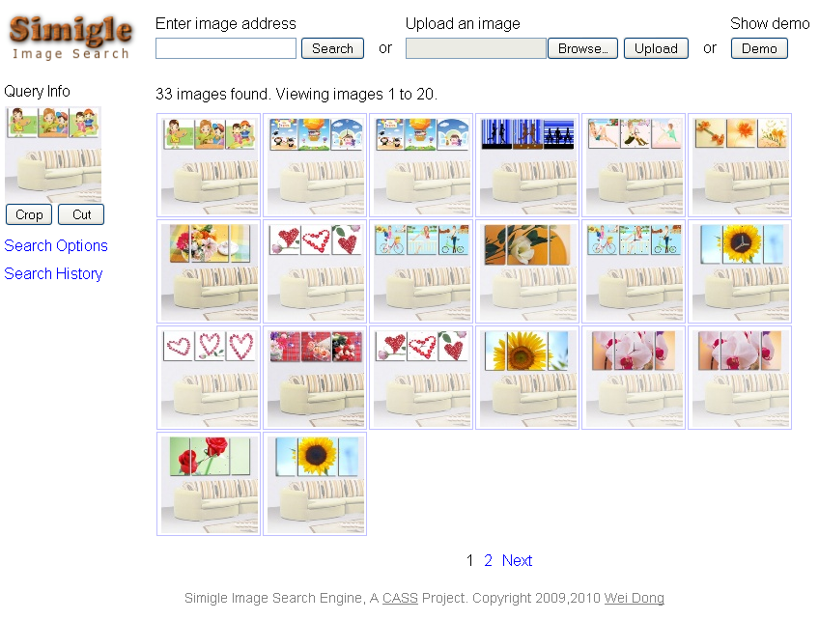
http://www.simigle.com/

Slide 3
Challenges
Large dataset
  ~100 million images w/ single server
High confidence
  False positive rate < 10⁻⁶
High recall
  Recall ~ 80%
Online search
High throughput
  Still a long way to go

Slide 4


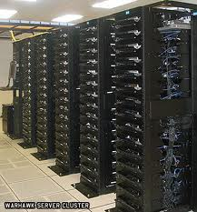




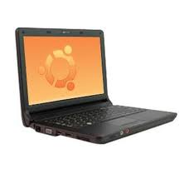

System Overview
Json
Jpeg
html
Easy to replicate
Read Only
Database
Images
Loosely coupled
Search servers
A cluster for crawling and indexing images
Clients w/
Various Browsers
Software techniques:
Javascript, jquery
C++, boost, poco
C++, java, hadoop

Slide 5
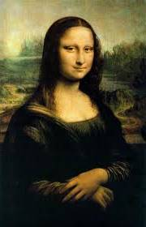
Search Server Architecture
query
Search Process
Session
Cache
(by UUID)
Retrieval
Cache
(by SHA1)
miss
Feature Extraction
Feature Search
Query Expansion
Thumbnail
Database
Feature
Index
Feature
Index
Feature
Index
Feature
Index

Slide 6
Main Techniques
Entropy-filtered local image features
  High confidence
Graph-based query expansion
  High recall
Compact sketch representation
  Smaller database, faster search
Flexible bit-vector indexing
  Online search
Content-aware disk layout
  High throughput thumbnail retrieval

Slide 7
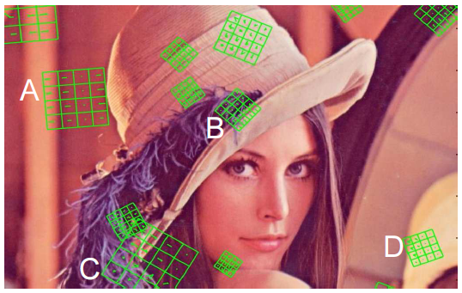
Entropy-Filtered Local Feature
Feature detection w/ Difference-of- Gaussian
Entropy-based filtering for high confidence
DoG detects more regions than needed.
Some plain regions can cause false positives (like A, D).
We only keep regions with high entropy (rich content, like B, C)
10x reduction of error rate
Less features have to be indexed
[ Unpublished ]

Slide 8
Graph-Base Query Expansion
We can find more results if we use the initial results to search again
Keep searching until we find no more
Problem: hit a lot of false positives
We use graph-partitioning method^{[1]} to smartly cut-off expansion.
Recall from 43% to ~80% w/ same false positive rate^{[2].}
[1] Andersen, et al. Local graph partitioning using PageRank vectors. FOCS’ 06.
[2] Unpublished.

Slide 9
Compact Sketch Representation
Raw features are large, 5~10KB/image
  About 80 features / image
  128 bytes / feature (SIFT)
  or 64 bytes / feature (SURF) with lower quality
  Encodes all information about a region
We only need to tell if two features are extremely similar
128-bit sketch with random space partitioning techniques
Dong, et al. Asymmetric Distance Estimation with Sketches for Similarity Search in High-Dimensional Spaces. SIGIR ’08.

Slide 10
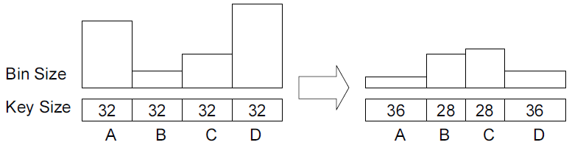
Flexible Bit-Vector Indexing
Search for sketches w/ <=3 bits different.
Divide 128-bit into 4 blocks, so at least one block is identical.
State-of-art^{[1]} is equal partitioning.
We find optimal partitioning with dynamic programming^{[2]}
  Faster
  More flexible
[1] Manku, et al. Detecting near-duplicates for web crawling. WWW'07.
[2] Unpublished

Slide 11
Content-Aware Disk Layout
Query results range from a few to 1000s
20~100 thumbnails / page
If thumbnails are randomly stored on disk, throughput will be limited by disk seeks
We store similar images together on disk and load a bunch with one disk seek
Results on a single query can be covered with a few disk seeks.
[ Unpublished ]

Slide 12
Conclusion
We present a system for similar web image retrieval
  High capacity (~100 million images / server)
  High confidence (10⁻⁶ error rate)
  High recall (~80% recall)
  Online search (searches return in seconds)
Future work: further improve responsiveness and throughput.

