Slide 1
COEN 244 project presentation
Monday, April 19, 2021
Concordia University
Montreal, QC.
Nguyen Hoang Anh
anhhoang.nguyen@concordia.ca
https://github.com/aaanh
https://hoanganh.tech

Slide 2
Data Visualization using Graph Implementation on Panama Papers Partial Dataset

Slide 3
Data Visualization using Graph Implementation on Panama Papers Partial Dataset

Slide 4

Background information
illustration by ICIJ
Panama Papers is a dataset on tax evasion
Dataset created by Int’l Consortium of Investigative Journalists (ICIJ)
Corporations create asset-holding companies based in the Republic of Panama
Panama provides a tax haven (lower taxes than original country)
In the middle is the Panamanian law firm: Mossack Fonseca

Slide 5
Objective
Use OOP to abstract entries in dataset
Create searchable graph of companies in the dataset
Visualize common attributes between those companies
Possibly infer connections in a complicated tax haven situation
Why it matters:
Overview: https://ec.europa.eu/jrc/sites/jrcsh/files/fairness_pb2019_taxevasion.pdf
Tax evasion creates void in the public financial sector
Tax evasion undermines funding for public infrastructures

Slide 6
About the dataset
Source: https://offshoreleaks.icij.org/pages/database
https://offshoreleaks-data.icij.org/offshoreleaks/csv/csv_panama_papers.2018-02-14.zip#_ga=2.181200676.208090824.1618778303-1172881103.1618778303
Original dataset: panama_papers.nodes.entity.csv
.csv comma-separated values format
17 attributes: many of which not useful for inference
213635 length: too large for single-threaded operation + I’ve yet to have the knowledge
Syntax not suitable for R/W by C++ stdlibs: marred with separators (,) and double quotes (“”)
Cleaned partial dataset:
Preprocessed by using python kernel in jupyter notebook with pandas package for convenience
Dropped attributes to 6: node_id,name,jurisdiction_code,jurisdiction,country_code,country_name
Culled to 2000 length
Filtered unwanted symbols from entries

Slide 7
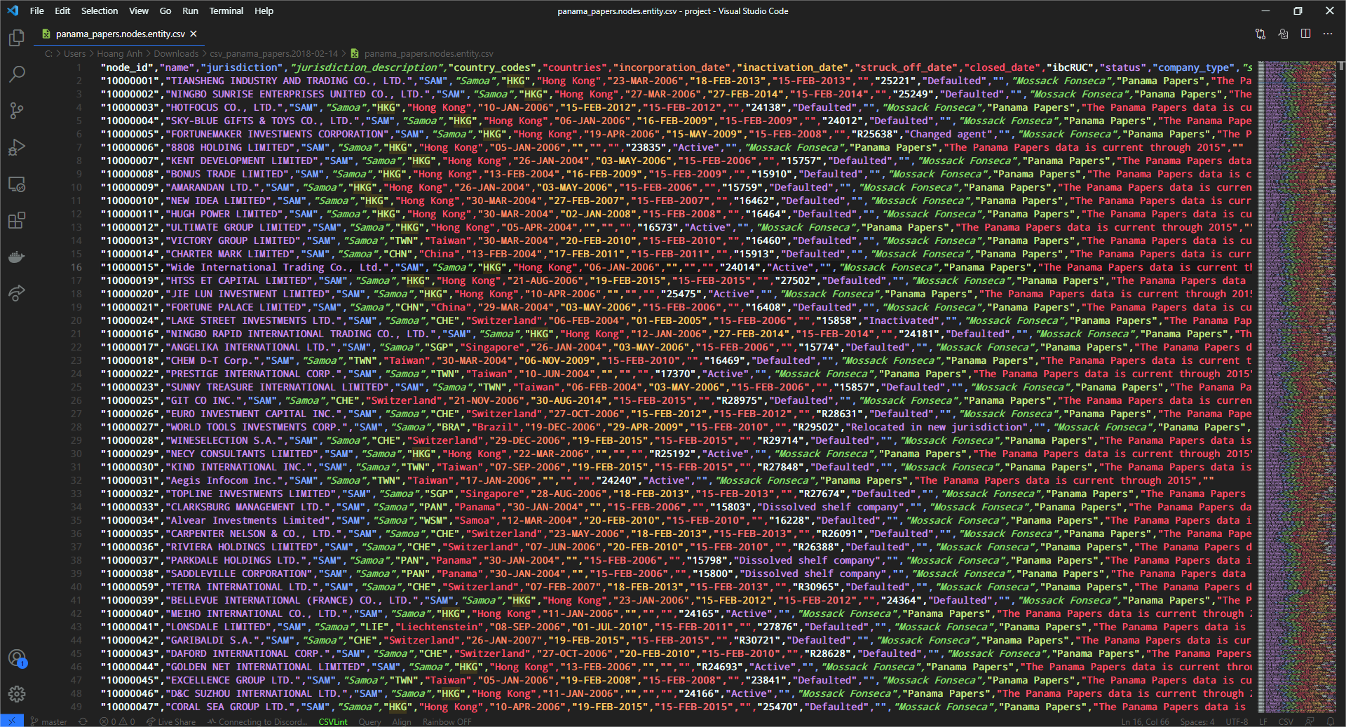
Before

Slide 8
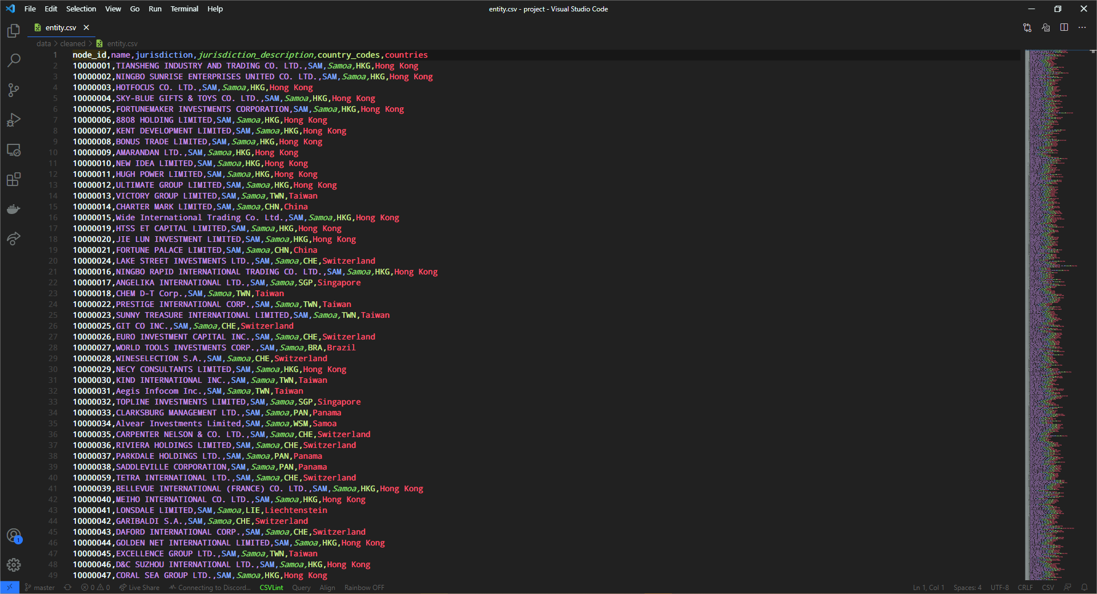
After

Slide 9
Methodology
Object-oriented programming in C++
Abstraction of data entries into graph theory:
Container: contains multiple graphs (datasets)
Graph: dataset
Node: entry
Edge: connection between 2 entries
Types of connection:
by country (or country code),
by jurisdiction (or jurisdiction description)
Utilities: perform dataset I/O operations

Slide 10
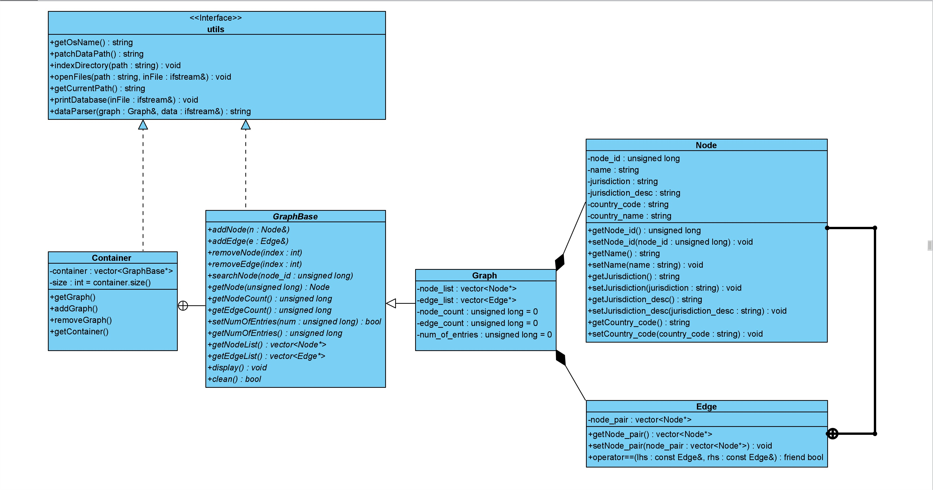
From dataset to graph the UML model

Slide 11
From dataset to graph utilities in “utils.h”
fed into
queries
utils
path to data
indexes
directory
initializes
Graph object
opens
parsed into
database
Node instances
added to
parsed into
Edge instances

Slide 12
From dataset to graph an example of the data-to-graph pipeline
Node _n1
node_id = 10000001
name = TIANSHENG INDUSTRY
jurisdiction = SAM
juris_desc = Samoa
country_codes = HKG
countries = Hong Kong
Graph _graph
node_list = {_n1, _n2, …}
edge_list = {_edge, …}
node_count = 2 + ...
edge_count = 1 + ...
num_of_entries = 5000
Edge _edge
Node _n2
vector<Node*> = {_n1, _n2}
node_id = 10000002
name = NINGBO SUNRISE
jurisdiction = SAM
juris_desc = Samoa
country_codes = HKG
countries = Hong Kong

Slide 13

Visualization/Representation using adjacency list
goto Program;

