Slide 1
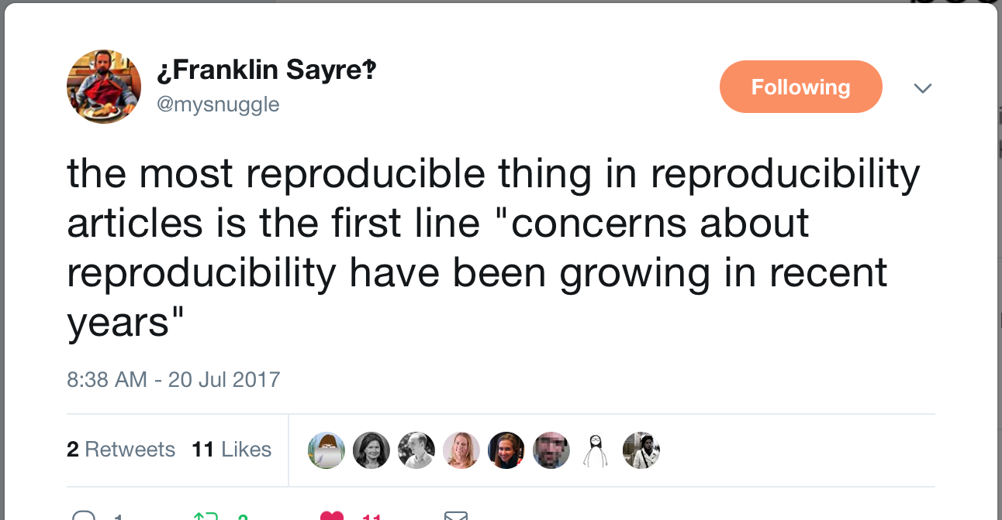
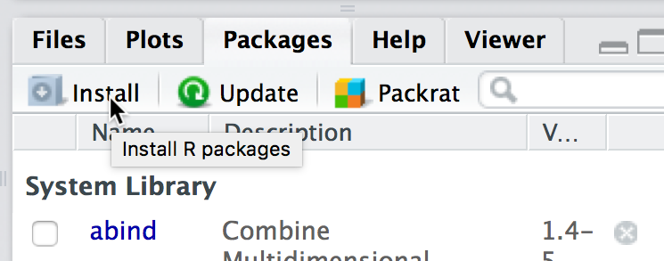
Developing a Workflow to Maximize Reproducibility and Research Impact: Managing Data, Computer Code, and Projects for Success
Althea A. ArchMiller, Concordia College, MN
John R. Fieberg, University of Minnesota, MN
Please open RStudio and install these packages:
1. knitr 2. ezknitr 3. devtools

Slide 2
Why worry about reproducibility?
Working towards future reproducibility makes my code easier for my collaborators (and me) to read, run, and debug today, and that’s why I think reproducibility is a win-win for all researchers.
-Althea

Slide 3
Why worry about reproducibility?
Reproducibility provides security, saves time, and forces me to be more thoughtful about my workflow.
- Ethan Young

Slide 4
Why worry about reproducibility?
Make your life easier (now and in the future)
Collaborations
Broader research impact
Increased citations
Transparency
Grant and journal requirements

Slide 5
Is your research reproducible?

Slide 6
What formats are your research documents stored in?
Considered “reproducible”
Considered “Not reproducible”
.csv
.txt
.pdf
.html
.R/.Rdata
.doc/.docx
.xls/.xlsx
.sas
Any other proprietary file format

Slide 7
Is your code linear?
Clear environment often and at the beginning of each script
Each program should focus on one main task or analysis
Don’t rely on manual commenting and uncommenting

Slide 8
What is wrong with this code?
# I want to know what vars are significant # I will try each variable in turn lm.out <- lm(weight ~ height, data = trial.data) # clear previous lm.out for each # new lm() definition above remove(lm.out) # Is the relationship significant? # (If not, clear and try a new variable) summary(lm.out)

Slide 9
Is your code linear?
Clear environment often and at the beginning of each script
Each program should focus on one main task or analysis
Don’t rely on manual commenting and uncommenting
Don’t save your history or .Rdata

Slide 10
Don’t save your history or .Rdata

Slide 11
Don’t save your history or .Rdata

Slide 12
Don’t save your history or .Rdata

Slide 13
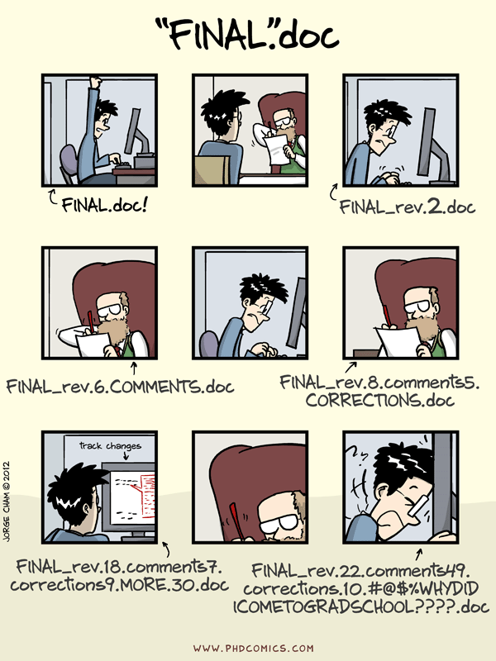
Why use GitHub?

