Slide 1
Parallel Computer Architecture
Lecture 2:
Flynn’s Taxonomy
Intuition for Parallelism
Armin Mehrabian
Spring 2025

Slide 2
Taxonomies and Definitions
Outline
• Definitions and Conceptual Classifications
Parallel Processing, MPP’s, and Related Terms
Flynn’s Classification of Computer Architectures
• Operational Models for Parallel Computer
• Parallelism Intuition

Slide 3
Definitions and Conceptual Classification
What is Parallel Processing?
A data processing approach that emphasizes exploring and exploiting inherent parallelism in a problem.
Related Terms:
Massively Parallel Processors (MPPs): Systems designed with many processors working concurrently.
Scalable Processors: Architectures that maintain efficiency as more processors are added.
Heterogeneous Processing:
1990s: Workstations with processors from different vendors.
Now: Use of accelerators like GPUs, FPGAs, TPUs, and other specialized hardware (e.g., Intel Xeon Phi, until its discontinuation).
Grid Computing: Distributed systems across multiple administrative domains for large-scale computing.
Cloud Computing: Virtualized resources on demand over the internet.

Slide 4
Definitions and Conceptual Classification
Why Massively Parallel Processors (MPPs)?
Increased Processing Speed & Memory: Enables the study of problems with higher resolutions or larger datasets.
Cost Efficiency:
Offers a low-cost alternative to traditional vector machines.
Achieves high performance without relying on expensive processors or memory technologies.

Slide 5
Vector Machines
Vector Machines: specialized computing systems designed to handle vector operations efficiently. They were widely used in high-performance computing (HPC) during the 1970s and 1980s, especially for scientific and engineering applications.
Key Characteristics of Vector Machines:
Vector Processing:
Instead of processing one data element at a time (like scalar processors), vector machines operate on entire vectors (arrays of data) simultaneously.
This is ideal for operations like matrix multiplications, simulations, and other computations that involve repetitive data patterns.
Hardware Design:
These machines use specialized vector registers and pipelines optimized for handling long sequences of data.
Examples include Cray-1 and the NEC SX series.
High Performance for Specific Applications:
Vector machines exceled in tasks with predictable data patterns, like weather modeling, fluid dynamics, and structural analysis.
Cost and Complexity:
Vector machines were extremely expensive to build and maintain.
Their hardware was less adaptable to general-purpose computing

Slide 6
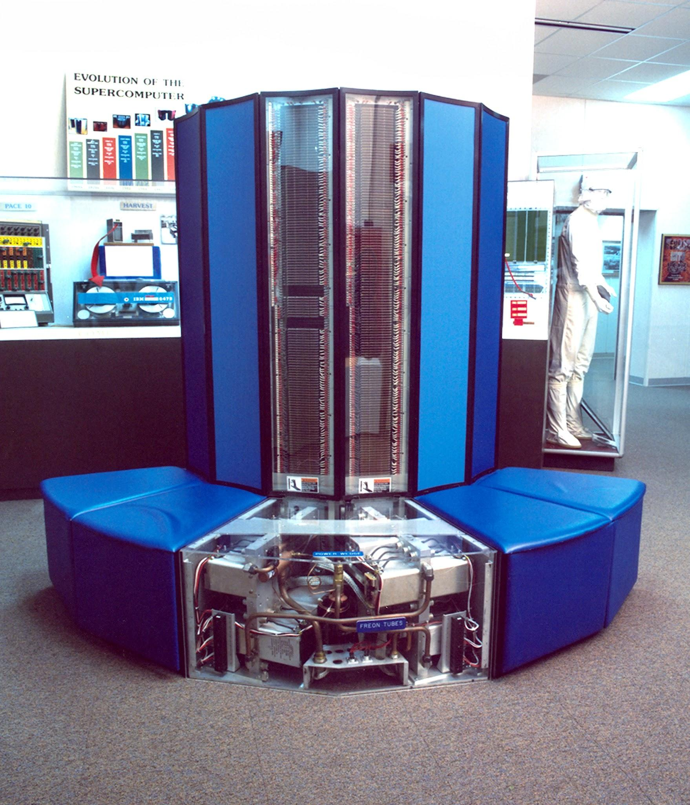
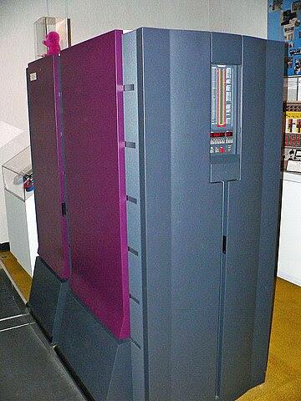
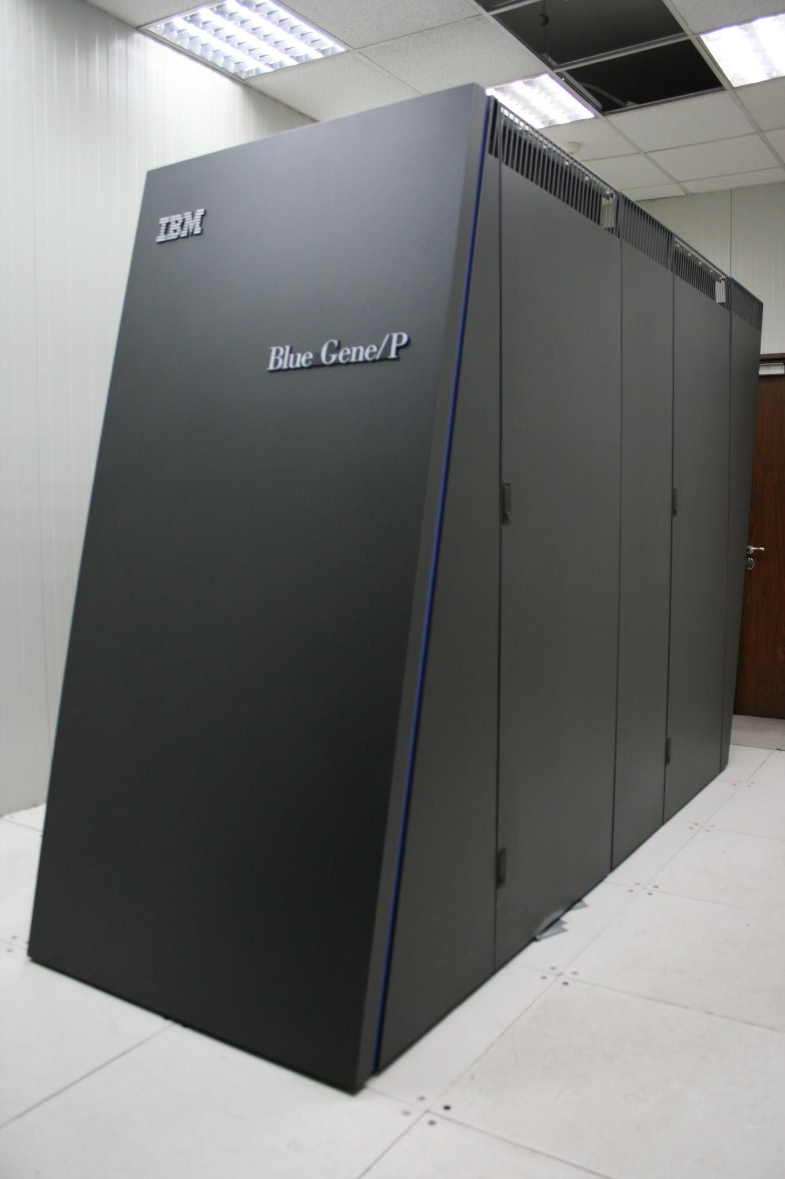
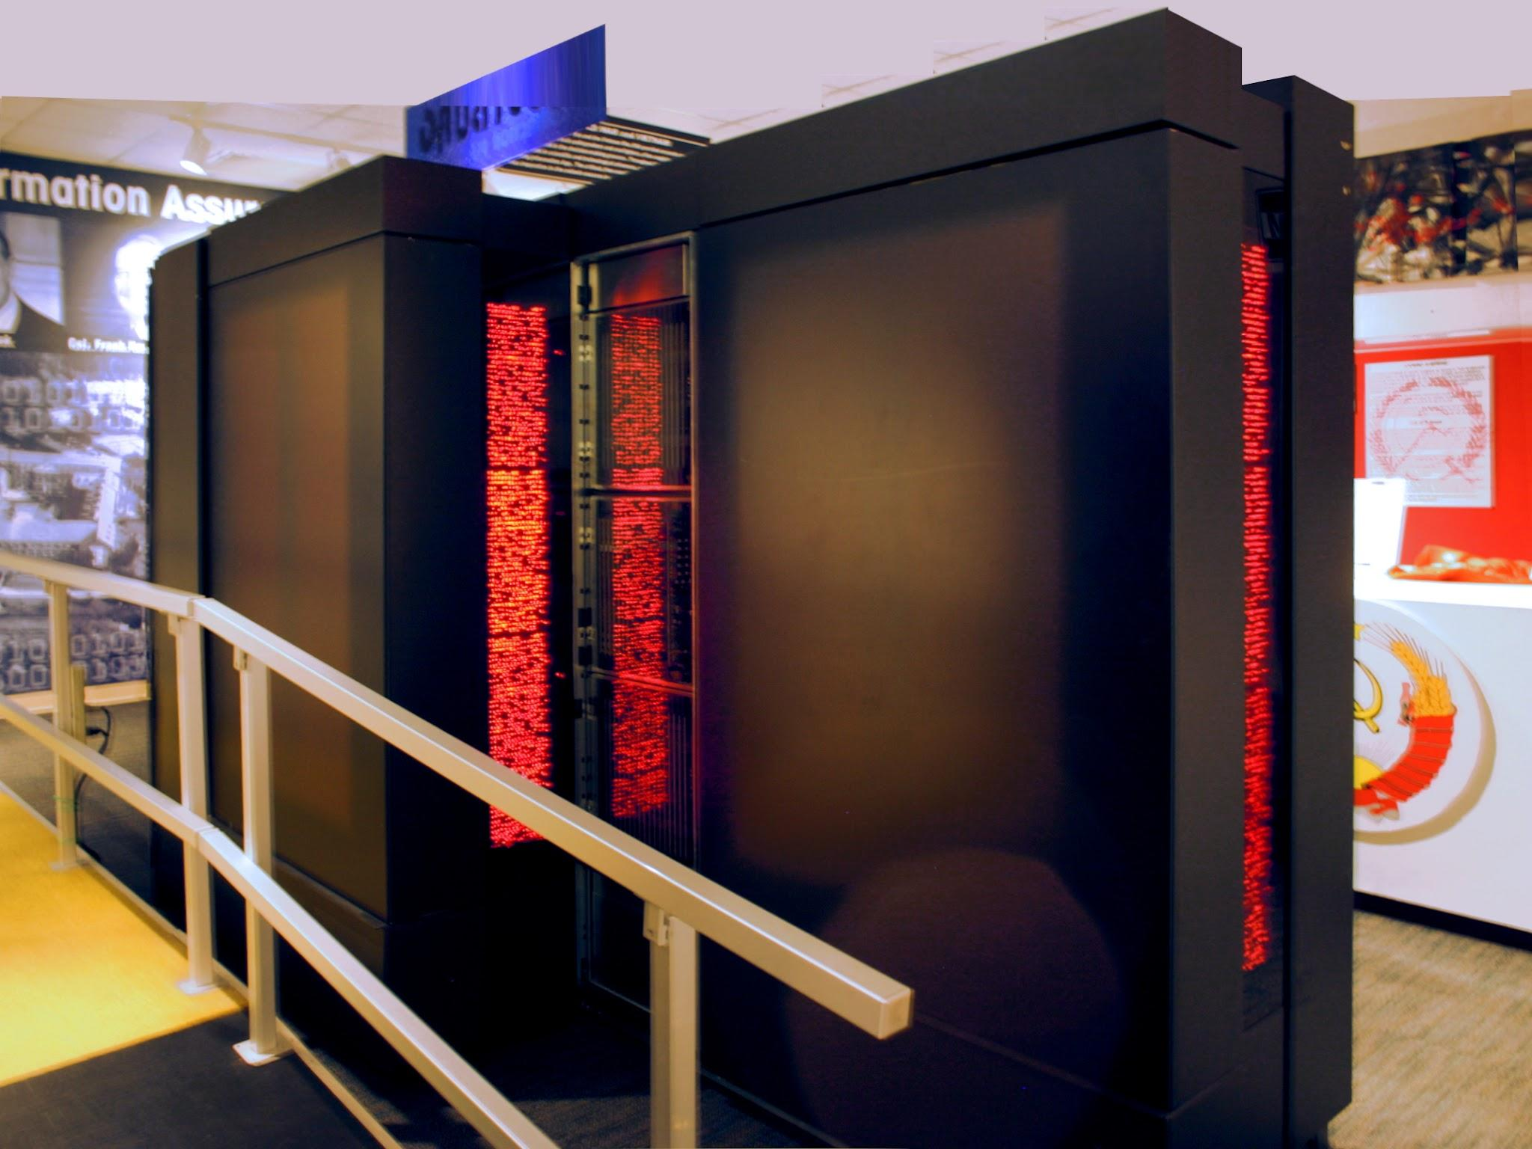
Vector vs. MPP
Architectures in Supercomputers:
Vector Processor-Based Systems:
Specialized for high-speed computation on vector data.
Examples: Cray X-MP, Y-MP, C90, T94.
Key Features: Few, highly optimized processors; limited scalability.
Microprocessor-Based Systems (MPP):
Built using many off-the-shelf microprocessors.
Examples: IBM Blue Gene, Thinking Machines CM-5.
Key Features: Highly scalable and cost-efficient.
Historical Transition:
1980s–90s: Shift from vector processors to microprocessor-based architectures due to scalability and cost benefits.

Slide 7
Von Neumann Architectures & Flynn’s Taxonomy

Slide 8
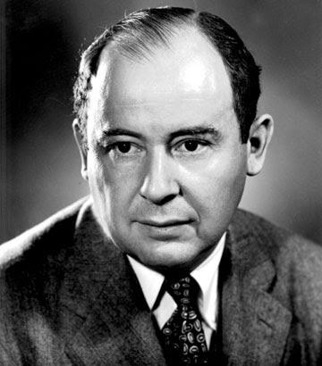
Von Neumann Architecture
Key Concept:
Separation of Memory and Compute:
Memory stores both instructions and data.
The processor fetches instructions and data from memory to execute tasks.
Core Features:
Single Memory: Shared storage for both program instructions and data.
Sequential Execution: Operations are performed step-by-step in a cycle:
Fetch → Decode → Execute.
Control by a Central Processor: Manages all computation and memory operations.
Why It Matters:
Forms the foundation of most modern computers.
Simple and flexible design, but limited by the Von Neumann Bottleneck (slow memory access compared to processor speed).

Slide 9
Von Neumann Architecture
Processor
Memory
Registers
Program
Data
Address
ALU
µ-Instruction Register
Data /
Instructions
CU
Instruction Register
Notes:
Processor (CPU):
The processor performs the actual computation and control functions. It contains:
Registers:
Small, fast storage locations for temporary data.
Used to hold operands, intermediate results, and addresses during computation.
Arithmetic Logic Unit (ALU):
Performs mathematical (addition, subtraction, etc.) and logical operations (AND, OR, NOT, etc.).
Control Unit (CU):
Manages and coordinates the execution of instructions by directing data flow between the memory, ALU, and input/output devices.
Instruction Register (IR):
Holds the current instruction being executed.
Micro-Instruction Register (µ-Instruction Register):
Typically used in microprogrammed control units to store low-level control instructions that implement the machine instructions.
Memory:
The shared memory holds both program instructions and data:
Program Memory:
Stores instructions for the CPU to execute.
Data Memory:
Stores data that the instructions operate on.
This reflects the stored program concept, where programs and data reside in the same memory space.
Communication between Processor and Memory:
Address Line:
The processor uses this line to specify the memory location it wants to access (for either an instruction or data).
Data/Instructions Line:
Transmits the actual data or instructions between the memory and processor.

Slide 10
µ-Instructions
Micro-instructions are low-level control instructions used in microprogrammed control units within a CPU. These instructions break down complex machine-level instructions into smaller steps that directly control the hardware.
Example of Micro-Instructions
Consider a simple example of executing an ADD instruction at the machine level (e.g., adding the contents of two registers). The micro-instructions to implement this could look something like this:
Fetch Phase:
MAR ← PC (Move the value of the Program Counter into the Memory Address Register to locate the next instruction).
MDR ← MEM[MAR] (Load the instruction from memory into the Memory Data Register).
IR ← MDR (Move the instruction into the Instruction Register).
PC ← PC + 1 (Increment the Program Counter to the next instruction).
Decode Phase:
Control Unit interprets the opcode in IR.
Determine the operation (e.g., ADD) and operands (e.g., contents of registers R1 and R2).
Execute Phase:
TEMP ← R1 (Move the contents of Register R1 into a temporary register).
ALU_OUT ← TEMP + R2 (Perform the addition in the Arithmetic Logic Unit).
R3 ← ALU_OUT (Store the result into the destination register, R3).
Write Back Phase (if needed):
Update flags in the Status Register (e.g., carry, overflow, zero) based on the result.

Slide 11
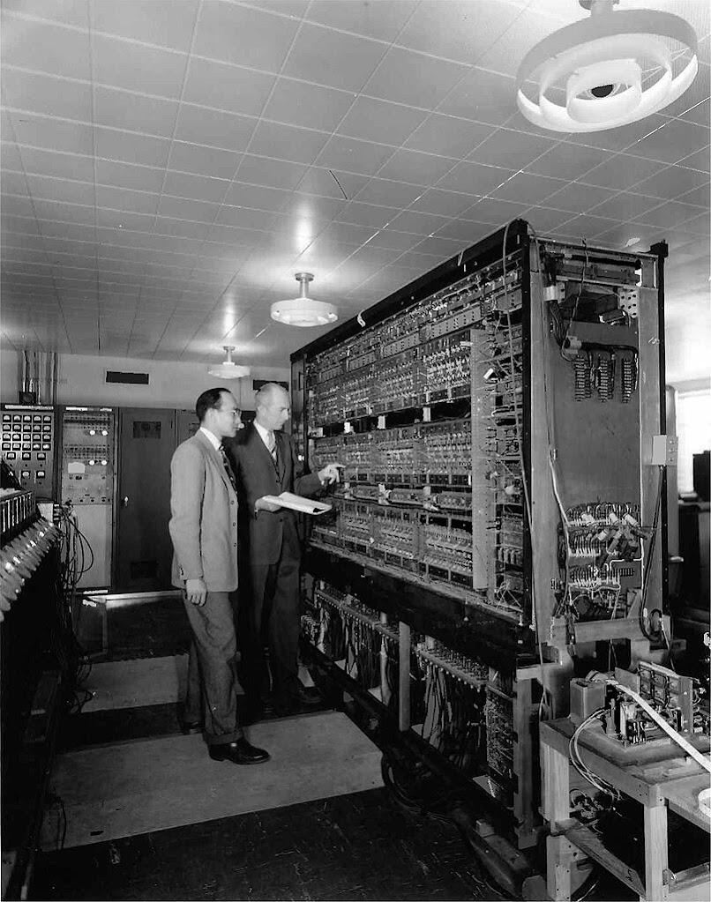
The IAS Machine and Von Neumann Architecture
Developed by:
John von Neumann at the Institute for Advanced Study (IAS), Princeton.
Historical Significance:
First electronic computer to implement the stored program concept.
Key Features:
Stored Program Concept:
Programs and data are stored together in the same memory.
Von Neumann Architecture:
Common memory shared for both instructions and data.
Instruction Cycle:
Fetch → Decode → Execute → Write Back (basic operational steps of the CPU).

Slide 12
Flynn’s Classification (1966)
A simple and memorable way to classify computer architectures.
Multiplicity of instruction streams (SI/MI) and data streams (SD/MD).

Slide 13
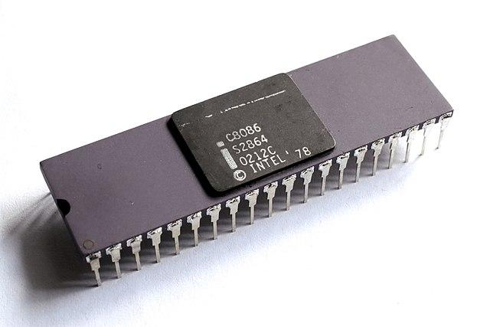
1. Single Instruction, Single Data (SISD)
Definition:
A single control unit fetches and executes one instruction at a time, operating on a single data item.
Traditional sequential computing.
Examples:
Classical Example:
Early computers like the Intel 8086 or ENIAC.
Modern Example:
Single-core CPUs when running a single thread (e.g., a single-core processor executing simple tasks).
Use Case:
Tasks with no inherent parallelism, such as simple control programs.

Slide 14
1. Single Instruction, Single Data (SISD)
Processor
I/O
µIS
DS
PE (ALU)
CU
M
IS
CU= Control Unit
PE= Processing Element (same as ALU)
M= Memory
IS= Instruction Stream
DS= Data Stream,
µIS= MicroInstructions Stream

Slide 15
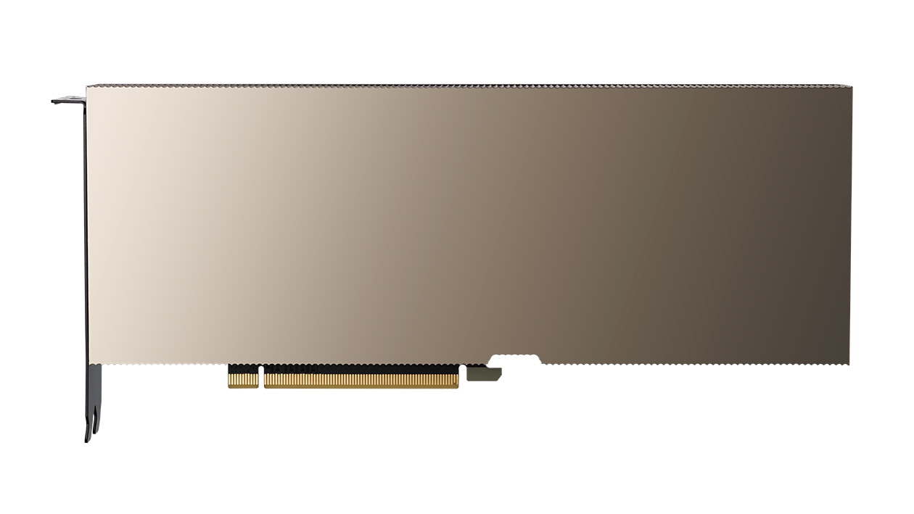
2. Single Instruction, Multiple Data (SIMD)
Definition:
A single instruction operates on multiple data elements simultaneously. Ideal for data-level parallelism.
Used in vector processors and GPUs.
Examples:
Classical Example:
Cray-1 or early vector processors.
Modern Example:
GPUs:
NVIDIA GPUs (e.g., CUDA cores processing image pixels simultaneously).
AMD Radeon GPUs.
SIMD Extensions in CPUs:
Intel's AVX (Advanced Vector Extensions) or ARM's NEON.
Use Case:
Applications like matrix multiplication, image processing, machine learning, or any task with large-scale repetitive operations.

Slide 16
2. Single Instruction, Multiple Data (SIMD)
Processor
DS
PE1
LM1
IS
•
CU
µIS
DS
CUMem
PEN
LMN
CU= Control Unit
PE= Processing Element
M= Memory
IS= Instruction Stream
DS= Data Stream
LM=Local Memory

Slide 17
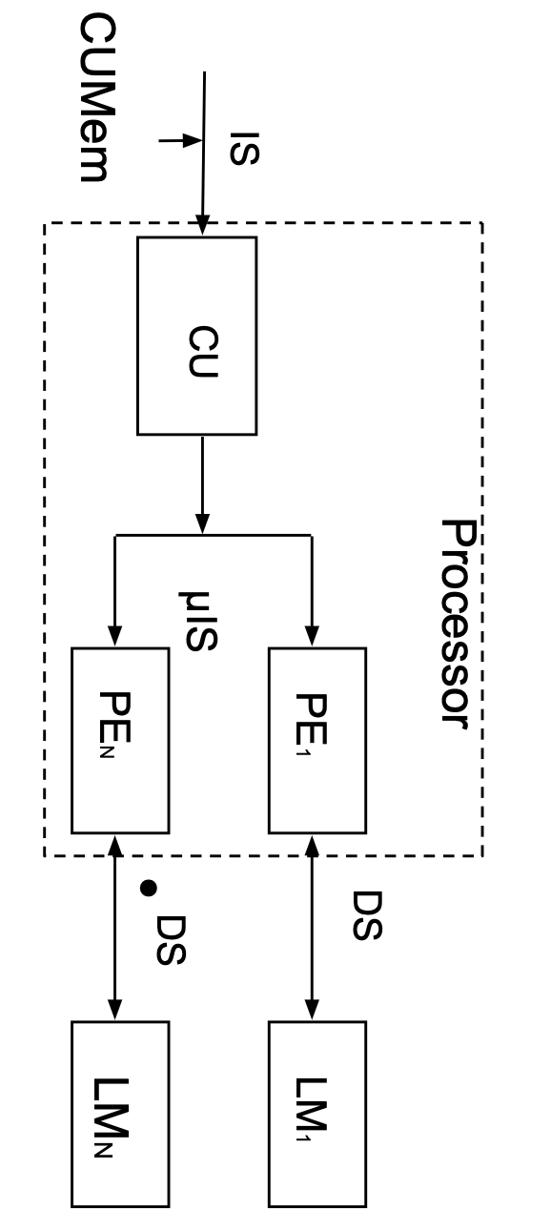
2. Single Instruction, Multiple Data (SIMD)
PEs – Array Processing Elements:
SIMD systems consist of multiple processing elements (PEs) that work in parallel.
Each PE is responsible for processing a portion of the data array simultaneously.
Example: In a GPU, "cores" are the processing elements that operate on multiple pixels or data chunks in parallel.
Hardware Synchronization by the Same Processor:
All PEs are synchronized by a single control unit or processor.
The same instruction is broadcast to all PEs, and they execute it simultaneously on different data elements.
This synchronization ensures uniformity and efficiency in SIMD operations.
Exploits Spatial or Data Parallelism:
SIMD excels at data parallelism, where the same operation is applied to different pieces of data simultaneously.
Spatial parallelism means the data being processed is stored in a way that makes it easily accessible to the PEs (e.g., stored contiguously in memory).
Typical data structures: Arrays, matrices, and other contiguous data structures that facilitate parallel access.

Slide 18
3. Multiple Instructions, Single Data (MISD)
Definition:
Multiple instructions operate on the same data stream.
Rare in practice, mostly theoretical or used in specialized systems.
Examples:
Theoretical Example:
Fault-tolerant systems where multiple processors execute the same operations redundantly to detect errors
Space Shuttle Flight Control Computers: Ensure reliability by comparing outputs of redundant operations
Modern Example:
Some systolic arrays or specialized pipelines for error detection and control (e.g., certain control systems in spacecraft or avionics).
Use Case:
Fault tolerance, niche control systems.
Multiple processors execute different instructions on the same data.
Outputs are compared to detect and mask errors (e.g., redundancy for reliability).

Slide 19
3. Multiple Instructions, Single Data (MISD)
Processor
Processor
Processor
CU
CU
CU
µIS
µIS
µIS
Memory
PE
PE
PE
DS
DS
DS
DS
CU= Control Unit,
PE= Processing Element,
M= Memory

Slide 20

4. Multiple Instructions, Multiple Data (MIMD)
Definition:
Multiple processors execute independent instructions on independent data streams.
The most common category for modern parallel computing.
Examples:
Classical Example:
Early distributed systems like IBM SP-2 or Beowulf clusters.
Modern Example:
Multi-core Processors:
Intel Core i9 or AMD Ryzen (each core runs independent threads).
Distributed Systems:
Cloud computing (e.g., AWS clusters, Google TPU pods).
Supercomputers:
Modern supercomputers like the Fugaku or Summit (MIMD nodes communicate via networks).
Use Case:
High-performance computing (HPC), distributed databases, or real-time applications.
https://www.hpe.com/emea_europe/en/compute/hpc/lawrence-livermore-national-laboratory.html

Slide 21
4. Multiple Instructions, Multiple Data (MIMD)
Processor
IS
µIS
DS
CU1
PE1
•
•
•
Local or Distributed
Memory
•
•
•
Processor
IS
µIS
DS
CUN
PEN
CU= Control Unit
PE= Processing Element
M= Memory
IS= Instruction Stream
DS= Data Stream

Slide 22
Flynn Classification
Category | Definition | Classical Example | Modern Example | Use Case
SISD | Single instruction, single data | Intel 8086, ENIAC | Single-core CPUs | Basic sequential tasks
SIMD | Single instruction, multiple data | Cray-1 | GPUs, AVX, TPUs | Vector operations, machine learning
MISD | Multiple instructions, single data | Fault-tolerant systems | Control systems, niche systolic arrays | Error detection, redundancy
MIMD | Multiple instructions, multiple data | IBM SP-2 | Multi-core CPUs, cloud clusters | HPC, cloud computing, distributed systems

Slide 23
Systolic Arrays
Definition of Systolic Arrays:
Arrays of processors arranged in a regular, grid-like network. Data flows rhythmically through the array, and each processor performs a small portion of the computation.
Typically used for repetitive, highly parallel computations.
Classification:
SIMD:
Systolic arrays operate like SIMD systems when the same operation is performed on multiple data elements in a predictable pattern (e.g., matrix multiplication in machine learning).
MISD:
In some configurations, systolic arrays could act as MISD systems when different processors perform distinct instructions on the same data stream, though this is less common.
Modern Examples of Systolic Arrays:
TPUs (Tensor Processing Units):
Google’s TPUs use systolic arrays to perform matrix multiplications for machine learning tasks efficiently.
FPGAs:
Field-programmable gate arrays often implement systolic arrays for specialized applications like signal processing or AI inference.

Slide 24
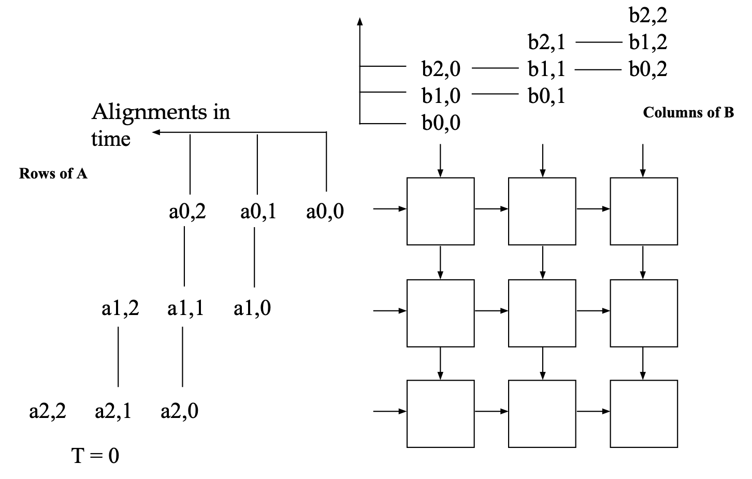
Systolic Array Example: 3x3 Systolic Array Matrix Multiplication
Processors arranged in a 2-D grid
Each processor accumulates one element of the product

Slide 25
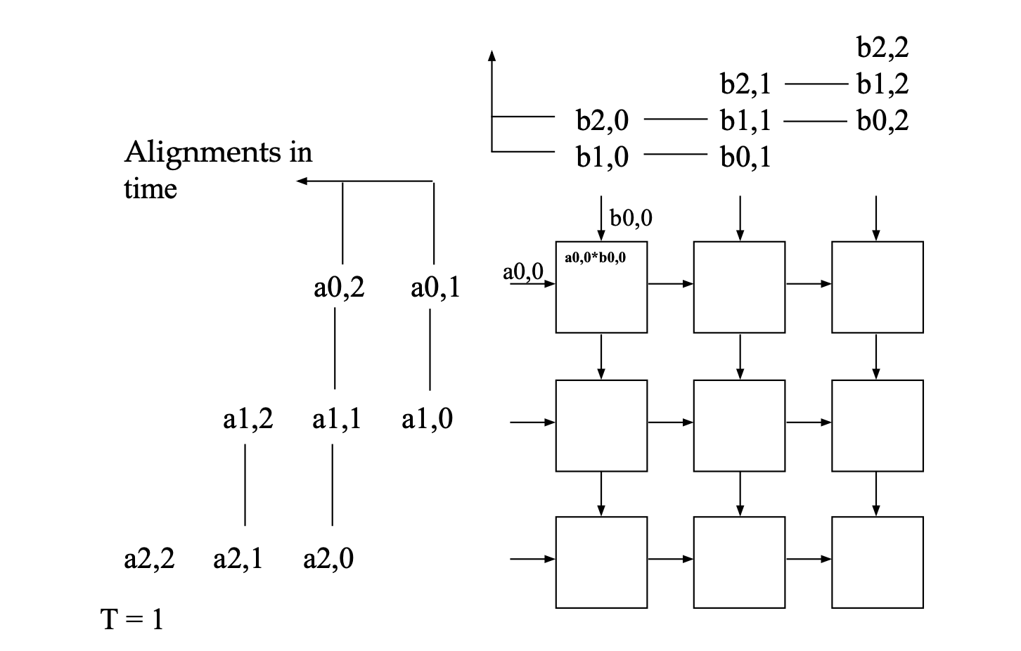
Systolic Array Example: 3x3 Systolic Array Matrix Multiplication
Processors arranged in a 2-D grid
Each processor accumulates one element of the product

Slide 26
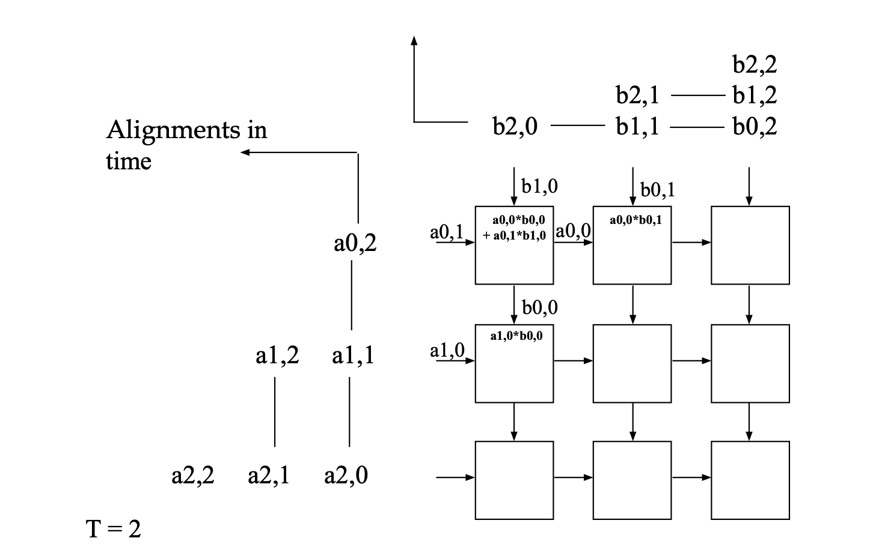
Systolic Array Example: 3x3 Systolic Array Matrix Multiplication
Processors arranged in a 2-D grid
Each processor accumulates one element of the product

Slide 27
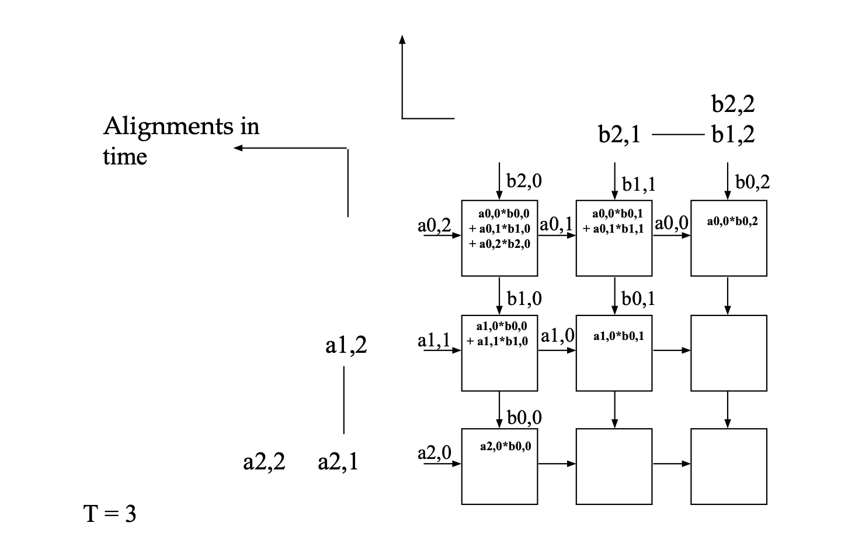
Systolic Array Example: 3x3 Systolic Array Matrix Multiplication
Processors arranged in a 2-D grid
Each processor accumulates one element of the product

Slide 28
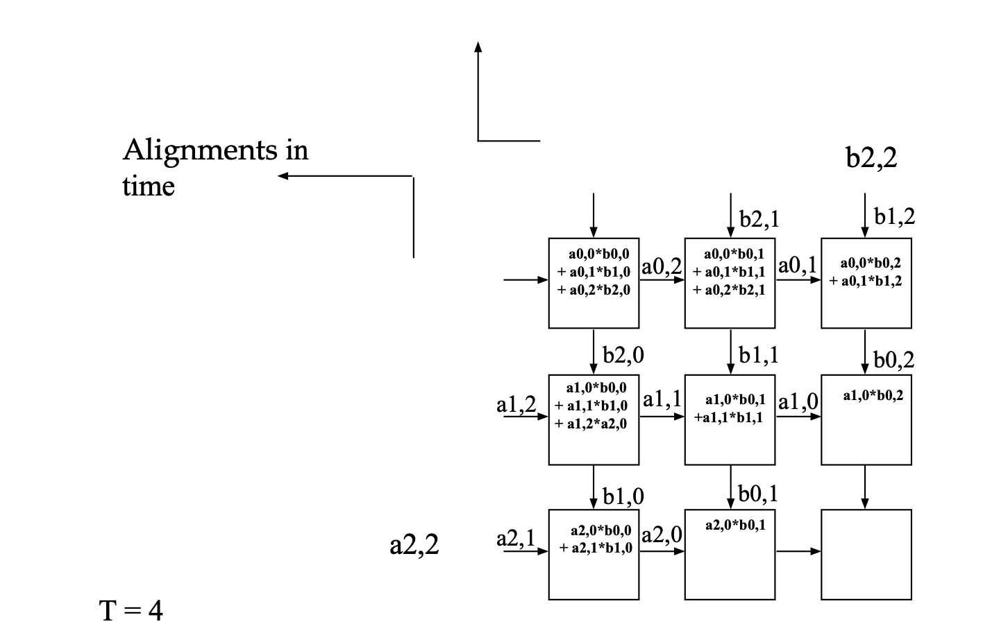
Systolic Array Example: 3x3 Systolic Array Matrix Multiplication
Processors arranged in a 2-D grid
Each processor accumulates one element of the product

Slide 29
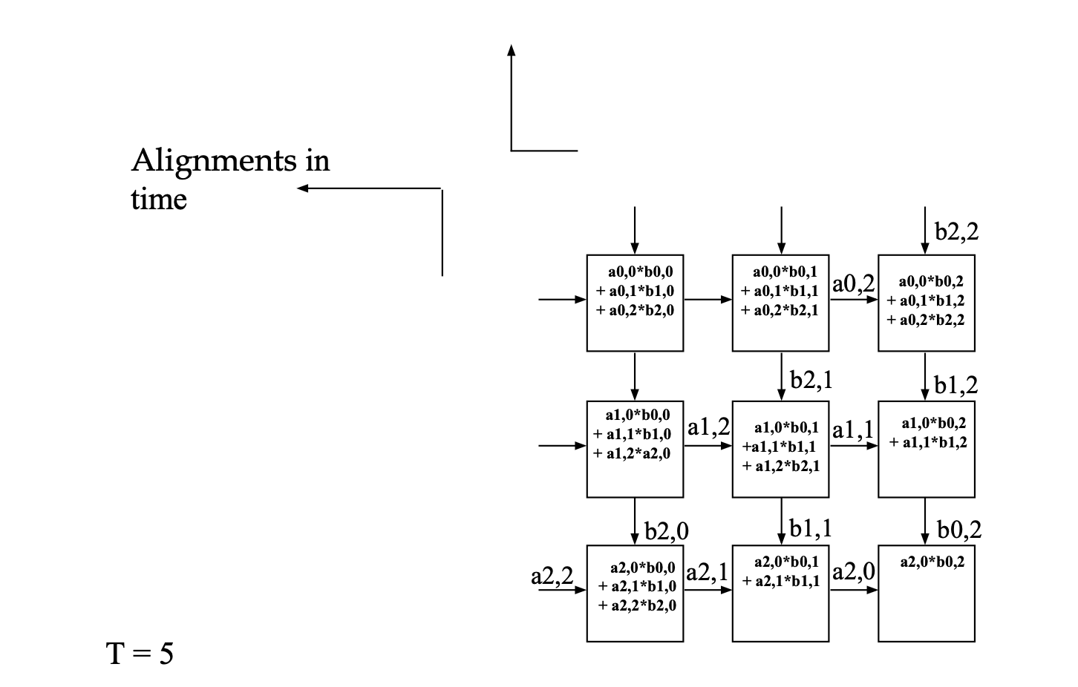
Systolic Array Example: 3x3 Systolic Array Matrix Multiplication
Processors arranged in a 2-D grid
Each processor accumulates one element of the product

Slide 30
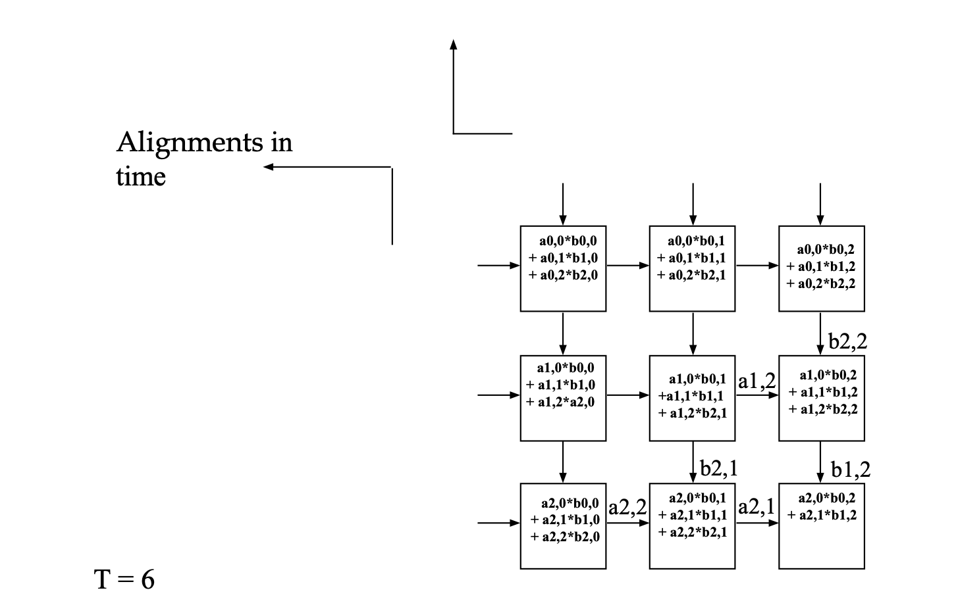
Systolic Array Example: 3x3 Systolic Array Matrix Multiplication
Processors arranged in a 2-D grid
Each processor accumulates one element of the product

Slide 31
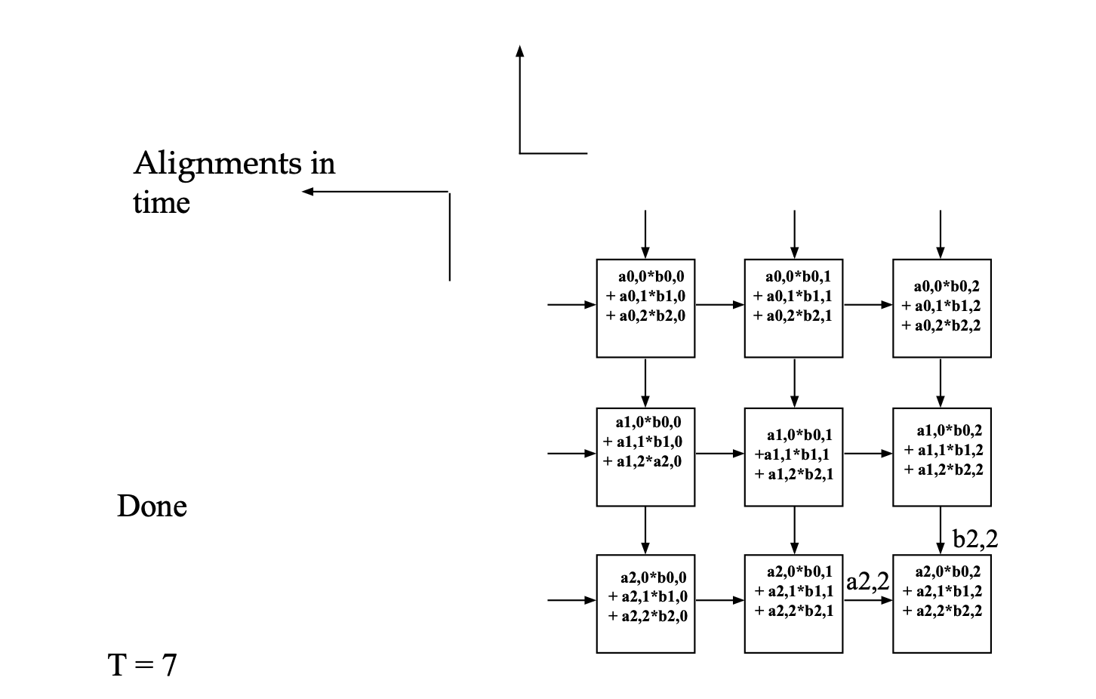
Systolic Array Example: 3x3 Systolic Array Matrix Multiplication
Processors arranged in a 2-D grid
Each processor accumulates one element of the product

Slide 32
Parallelism Styles in Programs

Slide 33
Data Parallelism
Definition: Many data elements processed in the same manner simultaneously.
Programming Examples:
GPU programming with CUDA/OpenCL: Applying a kernel to every element in a matrix.
High-level frameworks:
TensorFlow for neural networks.
NumPy's vectorize or parallel loops for mathematical operations on arrays.
Real-world example:
Image Processing: Applying a filter (e.g., Gaussian blur) to every pixel of an image in parallel.
Hardware Connection:
Efficiently implemented on SIMD architectures like GPUs, vector processors, or CPUs with SIMD extensions (e.g., Intel AVX).

Slide 34
Functional Parallelism
Definition:Independent functions or program modules execute concurrently.
Programming Examples:
Multi-threaded programs:
Web Servers: Threads handling multiple client requests independently (e.g., using Python's threading module or C++ std::thread).
Data Pipelines: ETL (Extract, Transform, Load) processes with independent stages running in parallel.
Distributed systems:
MapReduce Frameworks (Hadoop): Splitting data processing tasks across nodes.
Real-World Example:
Web Servers: Separate threads handle tasks like request parsing, database queries, and response generation simultaneously for different parts of the application.
Hardware Connection:
Best suited for MIMD architectures, such as multi-core CPUs, clusters, and distributed systems.

Slide 35
Pipeline Parallelism
Definition: Tasks are arranged to overlap their execution, reducing idle time.
Programming Examples:
Asynchronous Programming:
Using Python’s asyncio to overlap I/O-bound operations (e.g., fetching multiple webpages) or non-blocking I/O in C
Instruction Pipelines in CPUs:
Fetch → Decode → Execute stages overlap for better throughput.
Real-World Example:
Network Packet Processing:
While one packet is being sent, the next packet is prepared, reducing transmission delay.
Matrix Multiplication with Pipelining:
A systolic array processes partial products of a matrix while new rows and columns are streamed.
Hardware Connection:
Implemented in pipelined architectures, common in all modern CPUs and specialized hardware

Slide 36
Pipelining
Tasks are divided into sequential stages, with each stage performing part of the work.
Goal: Increase throughput by overlapping the execution of tasks.
Example – Floating Point Addition Pipeline:
Stages:
Align: Align operands to the same exponent.
Add: Perform the addition operation.
Normalize: Adjust the result to standard floating-point format.
Scenario:
4 tasks, each requiring all 3 stages.
Pipeline takes 6 clocks to complete all tasks, compared to 12 clocks in a non-pipelined system.
Performance: Up to 3x faster when the number of tasks is large.
3-Stage Pipeline
In
S0
S1 S2
Out
S2
T02
T12
T22
T32
S1
T01
T11
T21
T31
T41
S0
T00
T10
T20
T30
T40
T50
Clocks

Slide 37
Pipelining
Real-World Application – Instruction Pipelines:
Example: Pipelined CPU processing where stages include:
Instruction Fetch (IF): Retrieve instruction from memory.
Decode (ID): Interpret the instruction.
Operand Fetch (OF): Retrieve required data.
Execute (EX): Perform the operation.
Write Back (WB): Store results back into memory or registers.
Improves throughput by overlapping these stages across multiple instructions.
Key Advantage:
Exploits overlapped/temporal parallelism to maximize system efficiency.
Notes:
Explain Throughput: Emphasize that pipelining improves throughput, not latency (time for a single task).
Relate to Real Hardware: Mention modern CPUs and GPUs use deep instruction pipelines to achieve high performance.

Slide 38
Data Hazards
Data Hazards in Pipelines
Definition: Occurs when an instruction depends on the result of a previous instruction that has not yet completed.
Types of Data Hazards:
RAW (Read After Write):
Example: assembly CopyEdit ADD R1, R2, R3 // Produces result in R1
SUB R4, R1, R5 // Needs R1 but ADD is not finished yet
Dependency stalls the pipeline.
Resolution Techniques:
Forwarding/Bypassing: Use intermediate results directly from pipeline stages.
Stalling: Delay dependent instructions until the hazard resolves.
Notes:
WAR (Write After Read):
Example: assembly CopyEdit LOAD R2, 0(R3) // Reads R2
ADD R2, R4, R5 // Writes to R2
Conflict if the read isn't finished before the write.
WAW (Write After Write):
Example: assembly CopyEdit ADD R1, R2, R3 // Writes to R1
SUB R1, R4, R5 // Writes to R1 again
Conflict when two instructions write to the same register in the wrong order.

Slide 39
Structural Hazards
Definition: Occurs when multiple instructions require the same hardware resource at the same time.
Examples:
Single Memory Port:
One instruction is fetching data from memory while another needs to write results back to memory.
Shared ALU:
Multiple floating-point instructions require the ALU simultaneously.
Impact:
Prevents the pipeline from executing instructions in parallel.
Introduces stalls until the resource becomes available.
Resolution Techniques:
Increase Resources: Add duplicate units (e.g., dual-port memory or multiple ALUs).
Stalls: Serialize access when resources are limited.

Slide 40
Control Hazards
Occurs when the pipeline is unsure of which instruction to fetch next due to branches or jumps.
Example:
BEQ R1, R2, LABEL // Conditional branch
ADD R3, R4, R5 // Next instruction depends on the branch outcome
The pipeline must wait to determine whether the branch is taken or not.
Resolution Techniques:
Branch Prediction:
Predict the branch outcome to keep the pipeline moving.
Modern CPUs achieve ~90-95% prediction accuracy.
Speculative Execution:
Execute instructions along the predicted path but discard them if the prediction is wrong.
Pipeline Flush:
Clear incorrect instructions when a branch misprediction occurs, introducing a stall.
Impact:
Reduces pipeline efficiency, especially in branch-heavy programs.
Notes:
Explanation of BEQ R1, R2, LABEL:
BEQ (Branch if Equal):
The mnemonic BEQ stands for "Branch if Equal."
This instruction checks whether the values in registers R1 and R2 are equal.
Condition:
If R1 == R2, the program control jumps (branches) to the address specified by LABEL.
If R1 != R2, the next sequential instruction is executed.
LABEL:
LABEL is a symbolic name representing a specific address in memory. It typically marks the beginning of a different block of instructions elsewhere in the program.
Behavior in Pipelines:
While the processor determines whether to branch or not (evaluates R1 == R2), the pipeline might stallbecause it doesn't yet know which instruction to fetch next.
This creates a control hazard if the decision to branch isn't resolved quickly.

Slide 41
Operational Models for Parallel Computers

Slide 42
Operational Models for Parallel Computers
Basic Categories of Commercial High-Performance Computers (Historical Perspective):
SIMD: Now integrated into modern processors (e.g., GPUs, Intel AVX, ARM NEON).
MIMD: Basis for multi-core CPUs and distributed systems.
Vector Processors: Historical standalone systems; vectorization concepts live on in SIMD extensions.
Clusters: Modern clusters are heterogeneous, combining CPUs, GPUs, and accelerators.
Modern Systems:
Employ a mix of these models at different levels of architecture.
Example: Supercomputers like Fugaku and Summit integrate SIMD, MIMD, and cluster architectures.

Slide 43
SIMD and Vector Processors

Slide 44
Operational Models for Parallel Computers: Vector Processors
Key Features:
Efficient Vector Processing:
Replace entire loops manipulating arrays with a single vector instruction.
Memory Optimization:
Fetch entire arrays from memory in a pipelined manner, leveraging parallel high-speed interleaved memory.
Vector Registers:
Store and operate on entire arrays in CPU vector registers, minimizing memory access delays.
Support for Scalar Operations:
Includes both scalar and vector functional units and instructions, supporting scalar and vector data.
Classes of Operations:
Scalar and Vector Operand Combinations:
S x V -> V: Scalar times vector produces a vector (e.g., scaling a vector).
V -> S: Vector reduces to scalar (e.g., sum of vector elements).
V x V -> V: Vector times vector produces a vector (e.g., element-wise multiplication).
V -> V: Vector to vector operations (e.g., transformations like negation).
Notes:
Legacy and Modern Usage:
Historical vector machines like Cray-1 introduced these concepts.
Today, SIMD extensions (Intel AVX, ARM NEON) and GPUs embody vector processing principles.

Slide 45
Decline of Standalone Vector Processors
Historical Dominance (1970s-1980s):
Vector processors like the Cray-1 and NEC SX series were highly successful in scientific and engineering applications, leveraging their ability to process arrays efficiently.
Why They Declined:
Cost of Custom Hardware:
Standalone vector processors required specialized, expensive hardware, which became less competitive as general-purpose processors improved.
Scalability Issues:
Vector processors excel at data-parallel workloads but struggled to adapt to task-parallel workloads and massively distributed systems (e.g., modern supercomputers).
Rise of Commodity Hardware:
The emergence of commodity microprocessors (MIMD systems with SIMD extensions) offered cost-effective alternatives that combined vector-like capabilities with flexibility.
Shift to Clusters:
Distributed systems and clusters using off-the-shelf processors became the dominant architecture for high-performance computing (HPC), reducing the demand for custom vector hardware.

Slide 46
Operational Models for Parallel Computers: SIMD
Key Features:
SIMD (Single Instruction, Multiple Data):
Architecture designed for data parallelism, applying the same operation to multiple data items simultaneously.
Historical Context:
1980s: Standalone SIMD machines like Connection Machine, Thinking Machines CM-2.
Today: Integrated into modern CPUs, GPUs, and accelerators.
Modern SIMD Extensions:
CPU SIMD Extensions:
Intel AVX (Advanced Vector Extensions), IBM VMX/Altivec, ARM NEON.
GPU SIMD-like Model:
NVIDIA SIMT (Single Instruction, Multiple Threads).
Technical Features:
Instruction Broadcast: Microinstructions are broadcast to all processing elements.
Hardware Synchronization: Ensures simultaneous operation on all elements.
Challenge – Independent Branching:
Divergence occurs if different elements need to execute different instructions (e.g., in GPUs).

Slide 47
Operational Models for Parallel Computers: SIMD
IS
CU
CU
μIS
DS
DS
DS
PEM
PE
PEM
PE
• • •
PEM
PE
To F.E. and I/O

Slide 48
Operational Models for Parallel Computers: SIMD
IS
CU
CM
μIS
DS
DS
DS
PEM
PE
PEM
PE
• • •
PEM
PE
To F.E. and I/O
CU (Control Unit):
The centralized controller that issues microinstructions (µIS) to all the processing elements (PEs).
Responsible for:
Decoding the instruction sequence (IS input).
Broadcasting instructions to all PEs.
Ensures that all PEs execute the same operation synchronously.

Slide 49
Operational Models for Parallel Computers: SIMD
IS
CU
CM
μIS
DS
DS
DS
PEM
PE
PEM
PE
• • •
PEM
PE
To F.E. and I/O
CM (Control Memory):
Stores the program or instructions (IS) that the control unit fetches and executes.
Acts as the program memory for the SIMD system.

Slide 50
Operational Models for Parallel Computers: SIMD
IS
CU
CM
μIS
DS
DS
DS
PEM
PE
PEM
PE
• • •
PEM
PE
To F.E. and I/O
PE (Processing Element):
These are the data processors in the SIMD system.
Each PE has:
ALU (Arithmetic Logic Unit): Performs arithmetic and logical operations.
Local memory (PEM): Holds the data assigned to that particular PE.
PEs work independently on different pieces of data but execute the same instruction at the same time (as directed by the CU).

Slide 51
Operational Models for Parallel Computers: SIMD
IS
CU
CM
μIS
DS
DS
DS
PEM
PE
PEM
PE
• • •
PEM
PE
To F.E. and I/O
PEM (Processing Element Memory):
Local memory attached to each PE that stores the subset of data being processed.
Enables distributed data storage for the parallel computation.

Slide 52
Operational Models for Parallel Computers: SIMD
IS
CU
CM
μIS
DS
DS
DS
PEM
PE
PEM
PE
• • •
PEM
PE
To F.E. and I/O
DS (Data Stream):
Represents communication channels between PEs, often enabling nearest-neighbor communication.
For example, in operations like matrix averaging, data flows horizontally or vertically between PEs to exchange neighboring values.

Slide 53
Operational Models for Parallel Computers: SIMD
IS
CU
CM
μIS
DS
DS
DS
PEM
PE
PEM
PE
• • •
PEM
PE
To F.E. and I/O
To F.E. and I/O:
Represents the interface for front-end control and input/output operations, which handle data input and results output for the SIMD system.

Slide 54
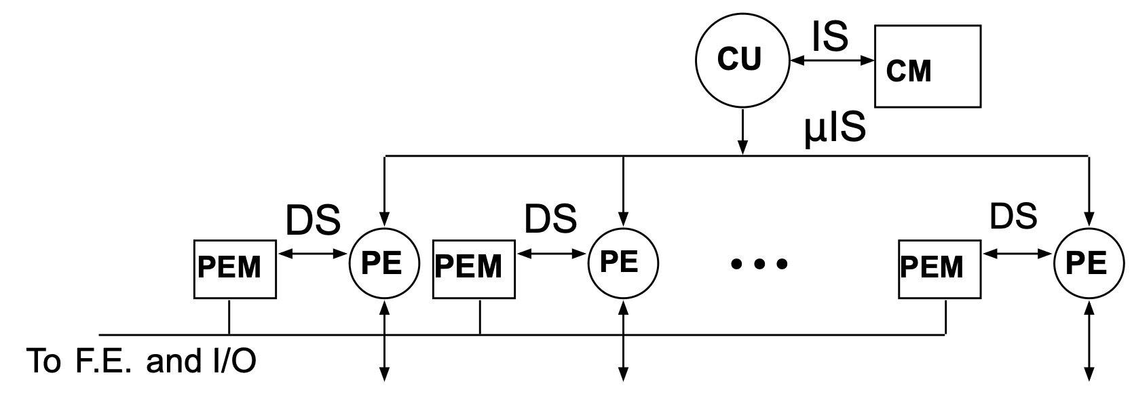
How it operates
Instruction Fetch and Broadcast:
The control unit (CU) fetches instructions from its memory (CUM) and broadcasts them as microinstructions (µIS) to all PEs.
Parallel Data Processing:
Each processing element (PE) performs the same operation on its local data (stored in PEM).
Example: If the operation is ADD, each PE adds its local value to a neighbor's value.
Data Communication Between PEs:
Data can flow between PEs through the data stream (DS) connections, enabling operations like matrix shifts, averaging, or stencil computations.
Synchronization:
All PEs operate in lockstep, meaning they execute the same instruction simultaneously, ensuring efficient parallelism.

Slide 55
How it operates
Example Usage: Matrix Averaging
To compute the average of a matrix element with its four neighbors:
Each PE is assigned one element of the matrix, stored in its PEM (local memory).
The control unit broadcasts an instruction to shift data across neighbors using the DS (data stream) connections (e.g., shift left, right, up, down).
Each PE accumulates the values of its neighbors and computes the average locally.
This process is repeated for all matrix elements in parallel.

Slide 56
MIMD

Slide 57
Operational Models for Parallel Computers: MIMD
Key Features:
Control/Functional Parallelism:
Emphasizes parallel execution of independent instructions across multiple processors.
Asynchronous Operation:
Processors execute independently and do not require global synchronization.
Synchronization:
Typically handled in software (e.g., via operating system or application-level tools).
Can emulate SIMD behavior using SPMD (Single Program, Multiple Data) for application-level synchronization.
Examples:
Clusters and Supercomputers:
IBM BlueGene, SGI Altix, Cray XC50, Sunway TaihuLight, Fugaku.
Modern Distributed Systems:
Cloud computing platforms, large-scale HPC clusters, and GPU-accelerated distributed systems.

Slide 58
Operational Models for Parallel Computers: MIMD
Local or Distributed
Shared Memory
Processor
IS,DS
CU
PE
μIS
Processor
LM
IS,DS
Interconnection
Network
shared
Memory
CU
PE
μIS
•
•
•
LM

Slide 59
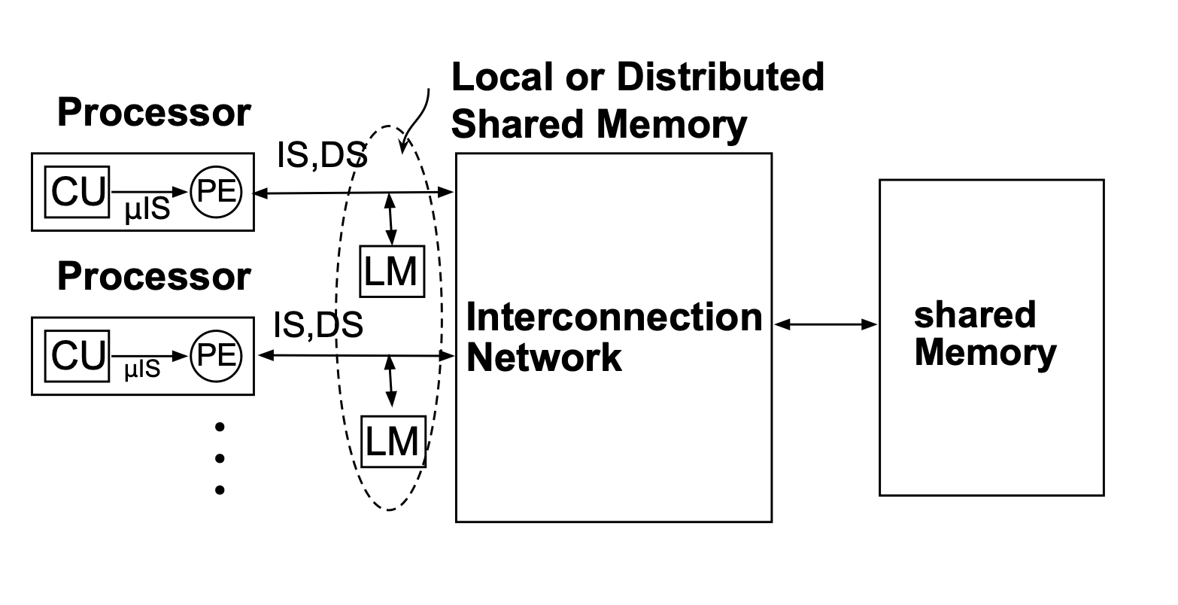
Operational Models for Parallel Computers: MIMD
Processor Units:
Each processor contains:
CU (Control Unit):
Responsible for instruction sequencing and managing data flow within the processor.
PE (Processing Element):
Executes instructions and performs computations based on microinstructions (µIS) issued by the CU.
Role: Each processor operates independently on its assigned tasks but may share data through the shared memory.

Slide 60
Operational Models for Parallel Computers: MIMD
Local Memory (LM):
Each processor is connected to its local memory, which is private to the processor.
Purpose:
Store frequently accessed data for faster processing.
Reduce contention for shared memory by holding temporary or local data.

Slide 61
Operational Models for Parallel Computers: MIMD
Shared Memory:
A global memory accessible by all processors through the interconnection network.
Purpose:
Facilitates communication and data sharing between processors.
Example: Used for tasks like collaborative computation, where intermediate results are shared among processors.

Slide 62
Operational Models for Parallel Computers: MIMD
Interconnection Network:
Acts as the bridge between processors (with their local memories) and the shared memory.
Types of Networks:
Bus-based: Simple, but prone to bottlenecks.
Switch-based (Crossbar or Mesh): Scalable and allows simultaneous data transfers.
Role: Handles communication between processors and shared memory, enabling data sharing or synchronization.

Slide 63
How it works
Data Access:
Processors work on data stored in their local memory (LM) for fast, independent operation.
If a processor needs shared data, it accesses shared memory through the interconnection network.
Communication:
Shared memory is used for communication and synchronization between processors.
For example, one processor writes results to shared memory, and another processor reads those results to continue computation.
Synchronization:
The processors may need to synchronize to avoid conflicts or inconsistencies when accessing shared memory.
Example: Locks, barriers, or semaphores are used to coordinate access.

Slide 64
Advantages and Challenges
Advantages
Ease of Programming:
Shared memory provides a global address space, making it easier for programmers to manage data sharing.
Fast Local Access:
Processors can use local memory for frequently accessed data, reducing contention for shared memory.
Scalability:
With an appropriate interconnection network (e.g., crossbar or mesh), the architecture can scale to a large number of processors.
Challenges
Memory Contention:
Processors may compete for access to shared memory, causing delays.
Synchronization Overhead:
Ensuring consistency and preventing data races can add complexity and reduce performance.
Interconnection Network Bottlenecks:
The efficiency of the network affects overall system performance.

Slide 65
Taxonomy of MIMD
Comparison of Architectures
MIMD
Shared Address Spaces
Multiple Address Space
Multiprocessors (MPs)
Multicomputers (NORMA)
(Scaleable) (MPPs, cluster) IBM BLUE Gene, Fugaku
Central Memory MPs
(Non-Scaleable)
Distributed MPs
(Scaleable)
UMA/SMP
(e.g. SGI Power Ch.)
NUMA/DSM
(e.g. SGI Altix, AMD EPYC and Intel Xeon)
COMA
(e.g. KSR)
NUMA: Non-Uniform Memory Access
NORMA: No Remote Memory Access
UMA: Uniform Memory Access
COMA: Cache-Only Memory Access
SMP: Symmetric Multiprocessing
DSM: Distributed Shared Memory
Note: a NUMA could be either cache-coherent or not
Notes:
1. NUMA (Non-Uniform Memory Access)
Definition:
In a NUMA system, each processor has faster access to its local memory and slower access to remote memory (memory attached to other processors).
Key Features:
Processors can access all memory in the system (shared memory model), but the access time depends on whether the memory is local or remote.
Designed to improve scalability by reducing contention on a single memory bus.
Example Systems:
Modern multi-core processors like AMD EPYC and Intel Xeon with multiple memory controllers.
HPC systems like HPE Cray EX and some supercomputers.
2. NORMA (No Remote Memory Access)
Definition:
In a NORMA system, each processor has its own private memory, and processors cannot access each other's memory directly.
Communication between processors is done through message passing.
Key Features:
No shared address space. Each processor operates independently on its local data.
Suited for distributed memory systems, like clusters.
Example Systems:
Classic clusters or multicomputers.
Example: IBM Blue Gene, modern MPI-based distributed systems.
3. UMA (Uniform Memory Access)
Definition:
In a UMA system, all processors share the same memory, and the access time to any memory location is the same for all processors.
Uses a single centralized memory connected to all processors.
Key Features:
Simple to program because all processors share a single global memory.
Limited scalability because memory access becomes a bottleneck as the number of processors increases.
Example Systems:
SMP (Symmetric Multiprocessing):
Early multi-core CPUs (e.g., SGI Power Challenge).
Single-socket systems with multiple cores (e.g., Intel Core or AMD Ryzen CPUs).
4. COMA (Cache-Only Memory Access)
Definition:
In a COMA system, there is no central or local memory. Instead, all memory is treated as a cache, and data moves dynamically to where it is needed.
Key Features:
Highly dynamic memory allocation, making it suitable for data-intensive tasks.
Rarely used today due to complexity and cost.
Example Systems:
Kendall Square Research (KSR) machines.

Slide 66
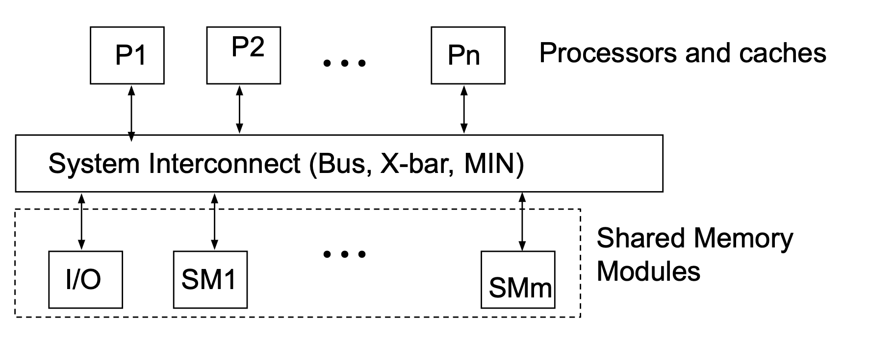
Uniform Memory Access (UMA) MP Model
Memory access time is uniform for all processors, regardless of which memory module is being accessed.
Symmetric Multiprocessing (SMP):
All processors have equal access to:
Memory.
Peripherals (e.g., I/O devices).
Operating System Kernel.
Processors can execute independent tasks or work on the same task collaboratively.

Slide 67
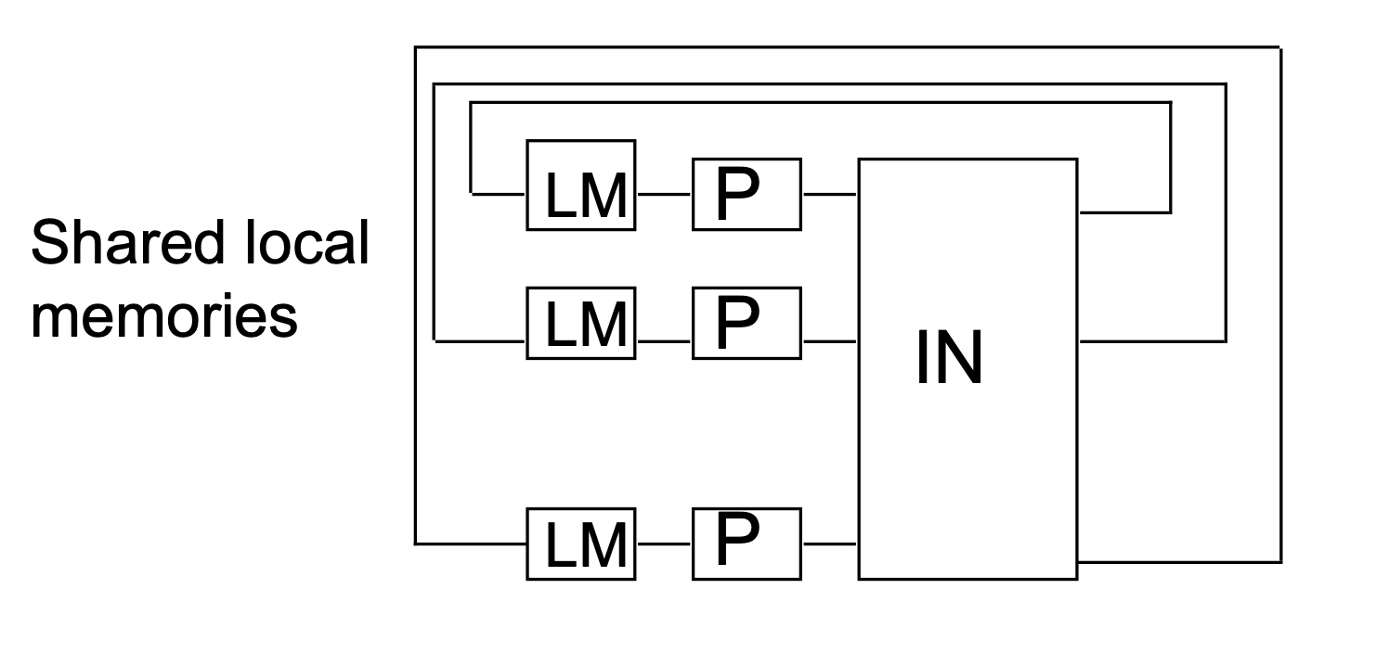
Non-Uniform Memory Access (NUMA)
Key Features:
Global Address Space:
Local memory (LM) and global shared memory (GSM) are mapped into a single global address spaceaccessible by all processors.
Access Time Hierarchy:
Fastest: Local memory (LM) or memory within the same cluster.
Second: Global shared memory (GSM).
Slowest: Memory in an external cluster.
Access Time Variance:
Memory access time depends on the location of the memory relative to the processor.
Designed to minimize latency by prioritizing access to nearby memory.

Slide 68
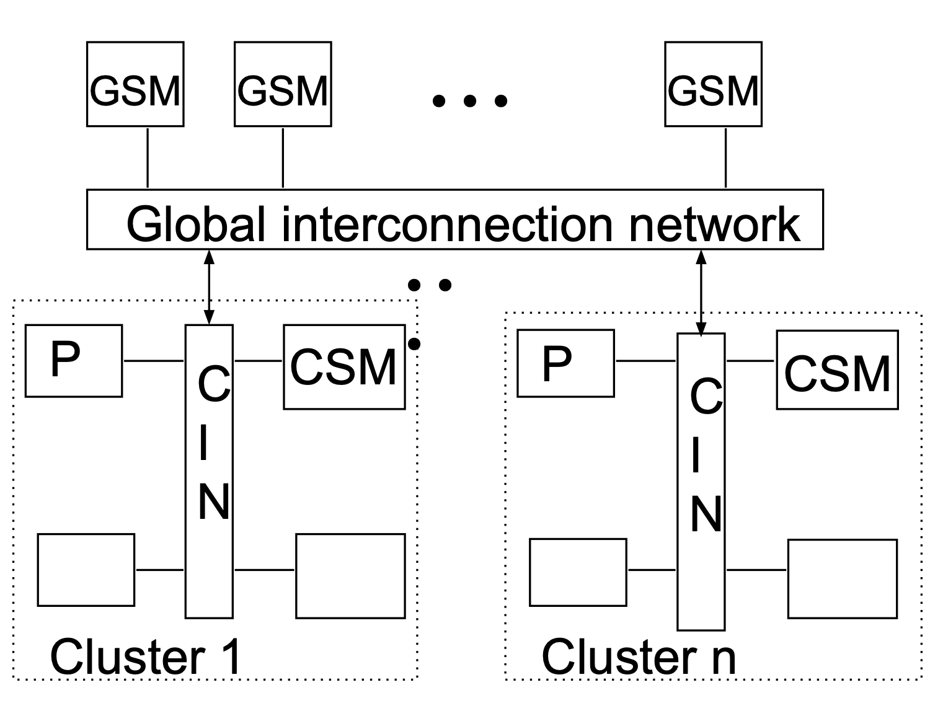
Hierarchical NUMA
A memory architecture that organizes memory in a multi-level hierarchical structure, typically used in large-scale systems.
Each cluster (or node) has its own local memory, but clusters are further grouped into higher levels of hierarchy.
Memory Access Levels:
Level 1: Local memory (fastest access, lowest latency).
Level 2: Memory within the same cluster (CSM – Cluster Shared Memory).
Level 3: Global shared memory (GSM) in other clusters, accessed through the interconnection network (slower).
Cluster Organization:
Processors are grouped into clusters.
Clusters may be connected through a Cluster Interconnection Network (CIN) such as NUMAlink, InfiniBand, or Ethernet.
Global Address Space:
Memory from all levels is mapped into a single global address space, but the time to access memory depends on its distance from the processor.

Slide 69
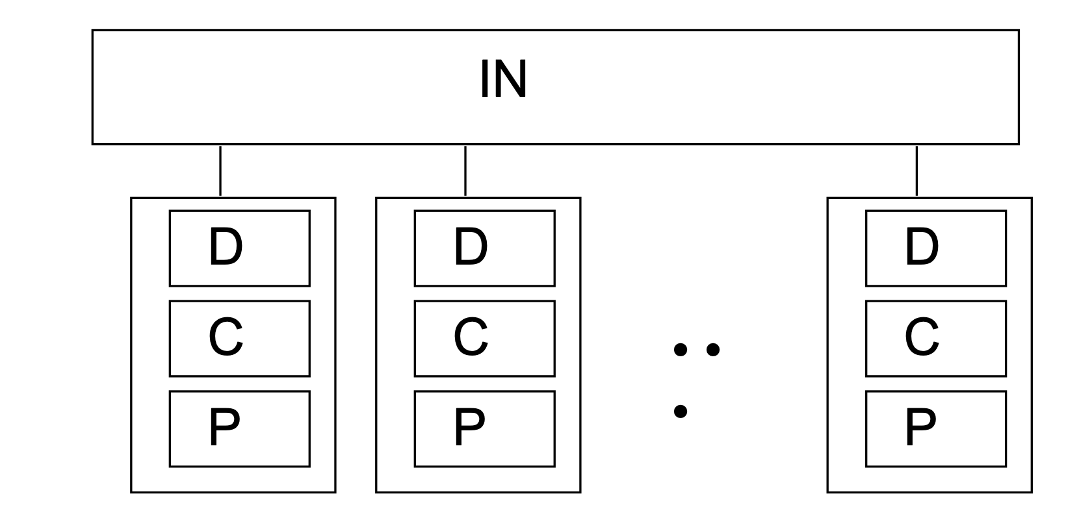
Cache-Only Memory Access (COMA) Multiprocessors
A special case of NUMA, where all local memories are structured as caches (COMA caches).
Unlike NUMA, COMA does not have fixed "home nodes" for memory addresses. Instead, data dynamically migrates to the processor(s) that access it most frequently.
COMA Caches:
All local memories are treated as large caches (e.g., KSR's "ALLCACHE" architecture).
COMA caches are much larger than typical L2 caches, making the system expensive.
Dynamic Data Migration and Replication:
Data is migrated and replicated dynamically based on access patterns, enabling efficient use of memory resources.
Memory coherence is maintained using hardware mechanisms.
Elimination of Home Nodes:
Unlike NUMA, there are no fixed "home nodes" for memory addresses.
Data moves to where it is needed, reducing redundant copies.
Challenges:
Data Location: Without home nodes, locating specific data requires complex hardware mechanisms.
Memory Pressure: When local memory fills up, evictions are required. Evicted data has no home, complicating management.

Slide 70
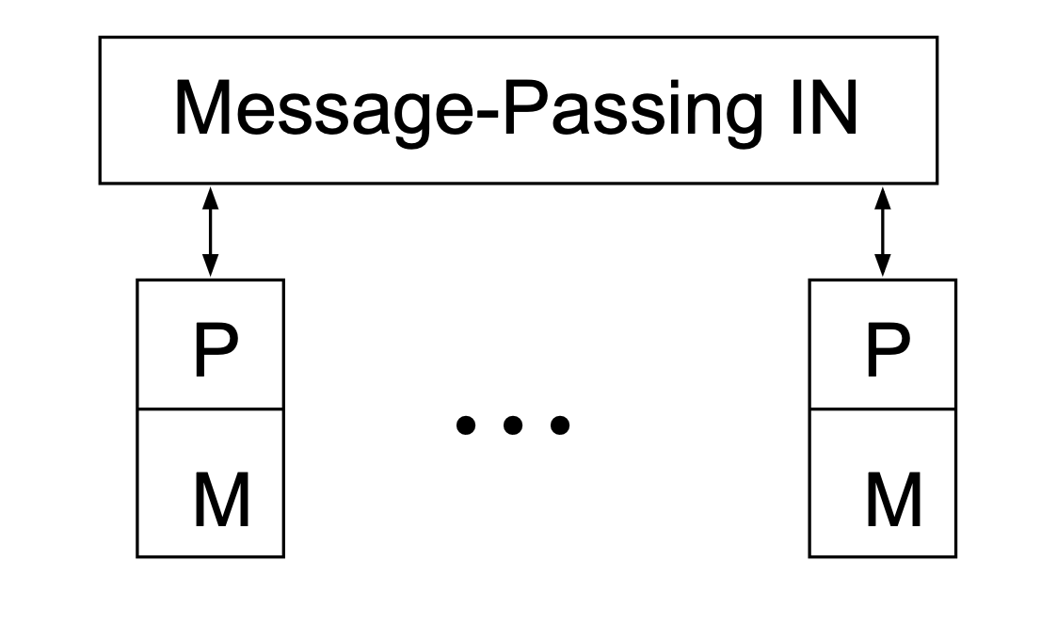
Multicomputers – MPPs or Clusters
Distributed Memory:
Each processor has its own private memory.
No shared memory; processors communicate explicitly.
No Remote Memory Access (NORMA):
Processors cannot directly access the memory of other nodes.
Communication relies entirely on message-passing.
Communication:
Message-Passing Interface (MPI):
Standardized communication protocol for exchanging data between nodes.
Network Interconnects:
High-speed interconnects like InfiniBand or Cray Aries link the processors.
Challenges:
Programming Complexity:
Requires explicit message-passing, increasing the burden on programmers.
Latency:
Remote communication via interconnects is slower than accessing shared memory.

Slide 71
Intuitions for Parallelism

Slide 72
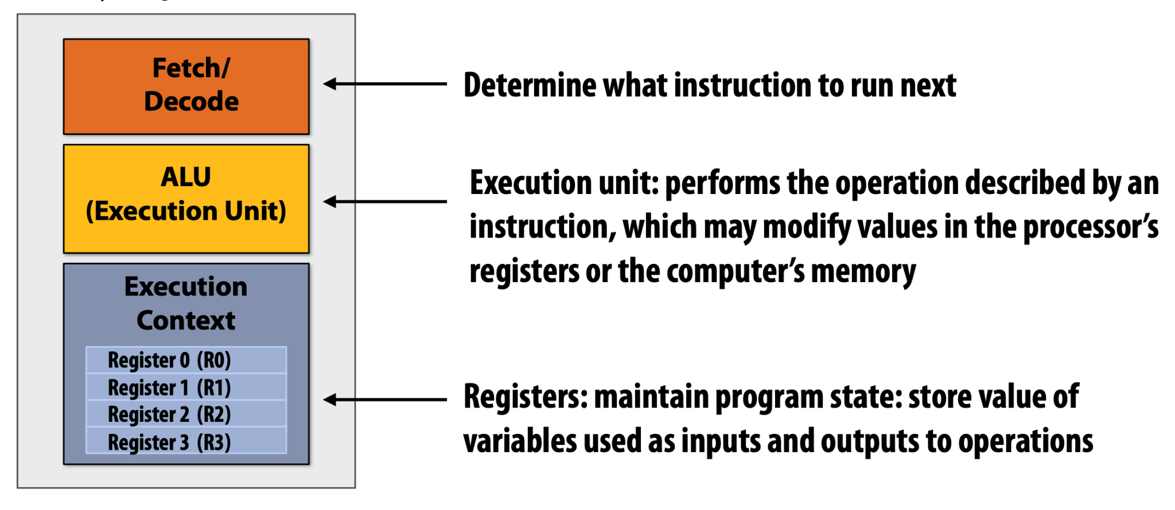
Parallelism Intuitions

Slide 73
A Programs Perspective of Memory
A computer’s memory is structured as an array of bytes.
• Each byte is assigned a unique address, which represents its position in the memory array.
(We’ll continue assuming the memory is byte-addressable.)
• Examples:
• The byte at address 0x2 contains the value 1.
• The byte at address 0x1F (31) contains the value 255.
Memory
Address | Value
0x0 | 10
0x1 | 0
0x2 | 1
…
0x1F | 255
Notes:
Address Binary Representation Decimal Value
0xF 0000 1111 15
0x1F 0001 1111 31

Slide 74
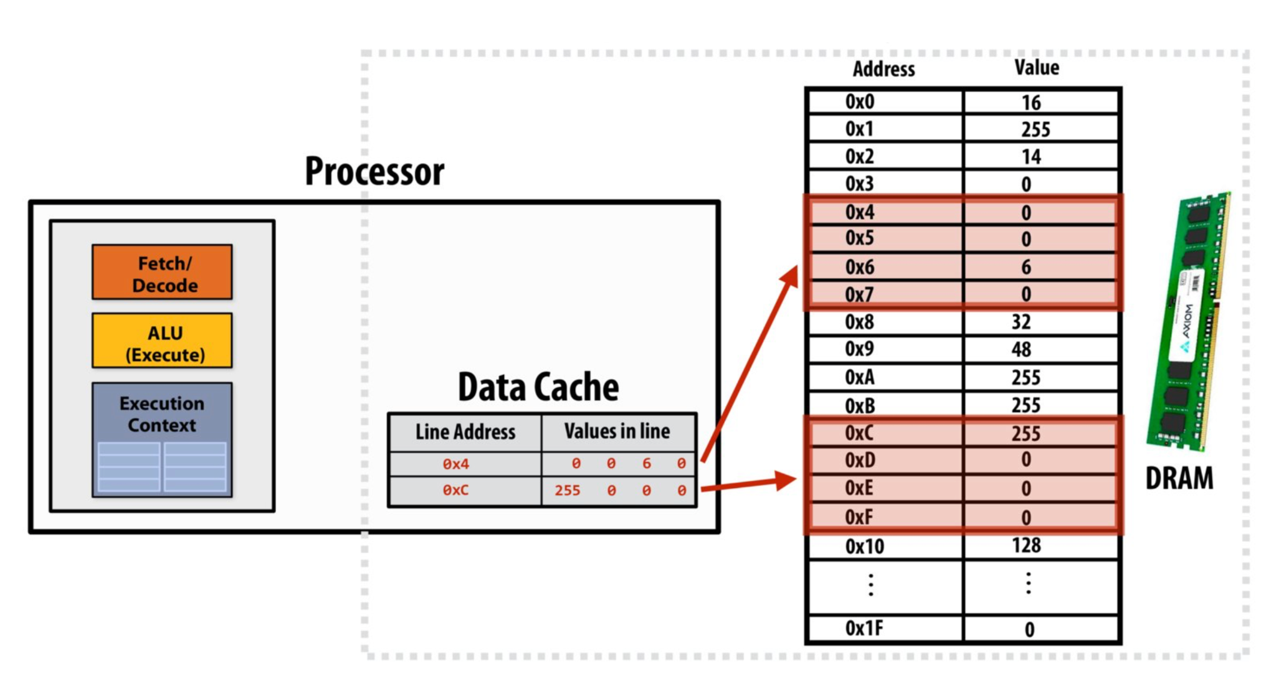
Cache
What Are Caches? A cache is a small, high-speed hardware storage layer that holds frequently accessed data to reduce memory access latency.
Key Properties of Caches
Transparent to Software
Does not alter program behavior.
Only impacts performance.
On-Chip Storage
Stores a subset of data from main memory.
Faster access than DRAM (e.g., 1-5 cycles vs. 100+ cycles).
Cache Line Granularity
Data stored in fixed-size blocks (cache lines).
Example: 4-byte line size.
Two ways caches help
Spatial and Temporal locality

Slide 75
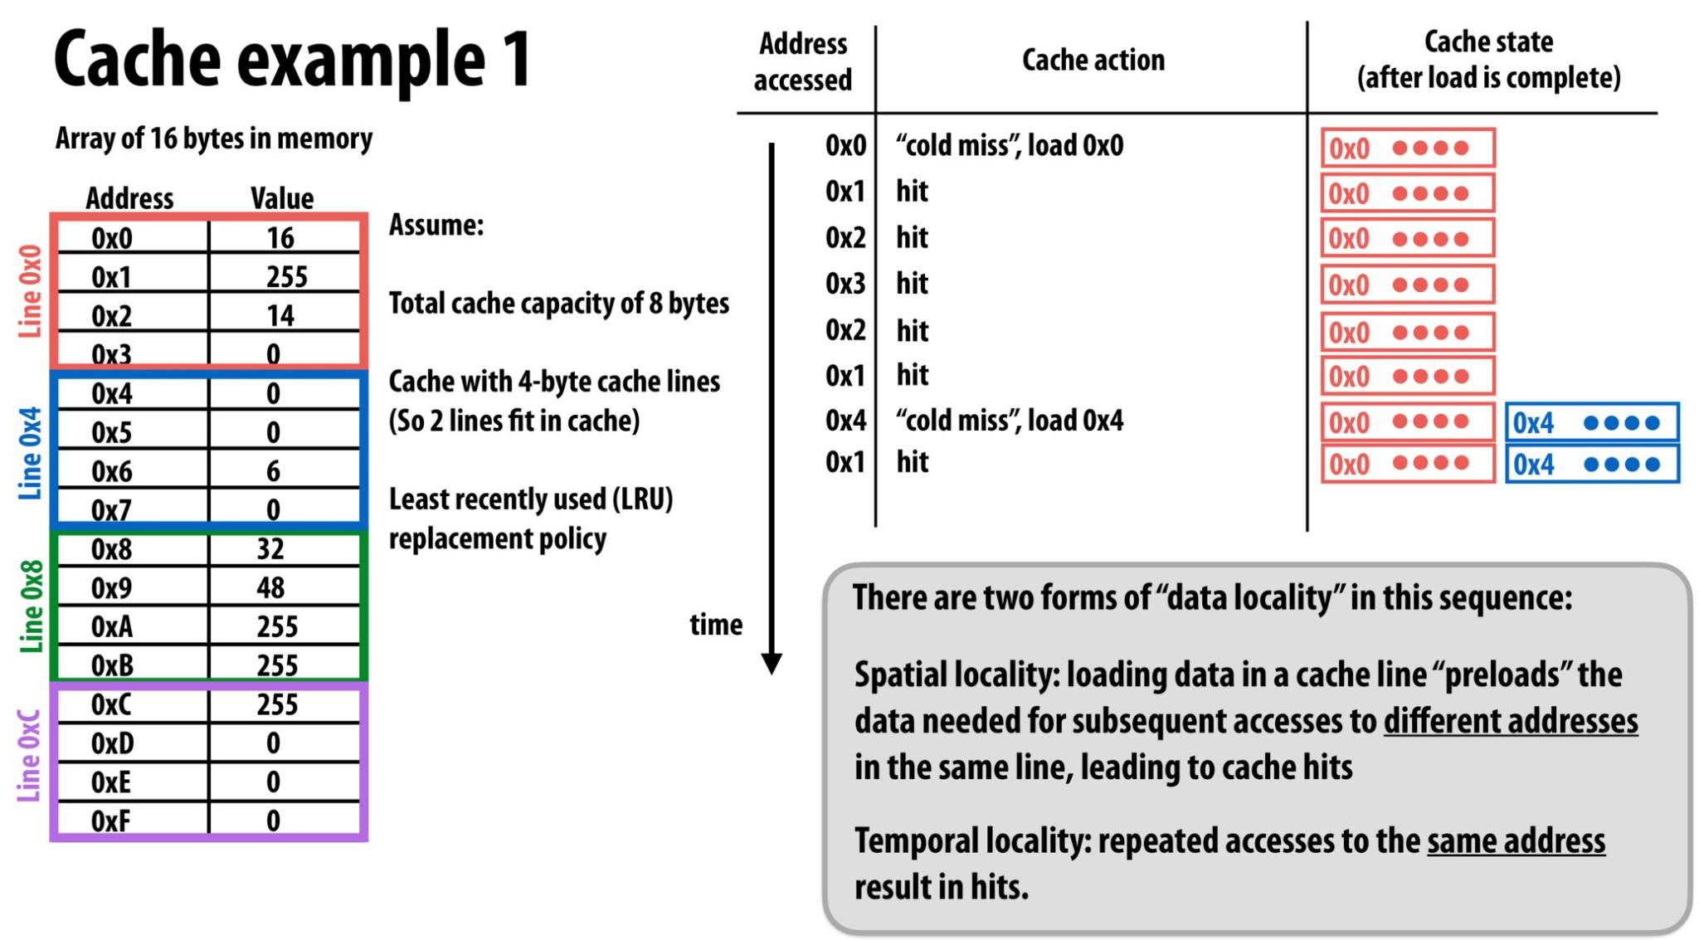
Caches and Data Locality

Slide 76
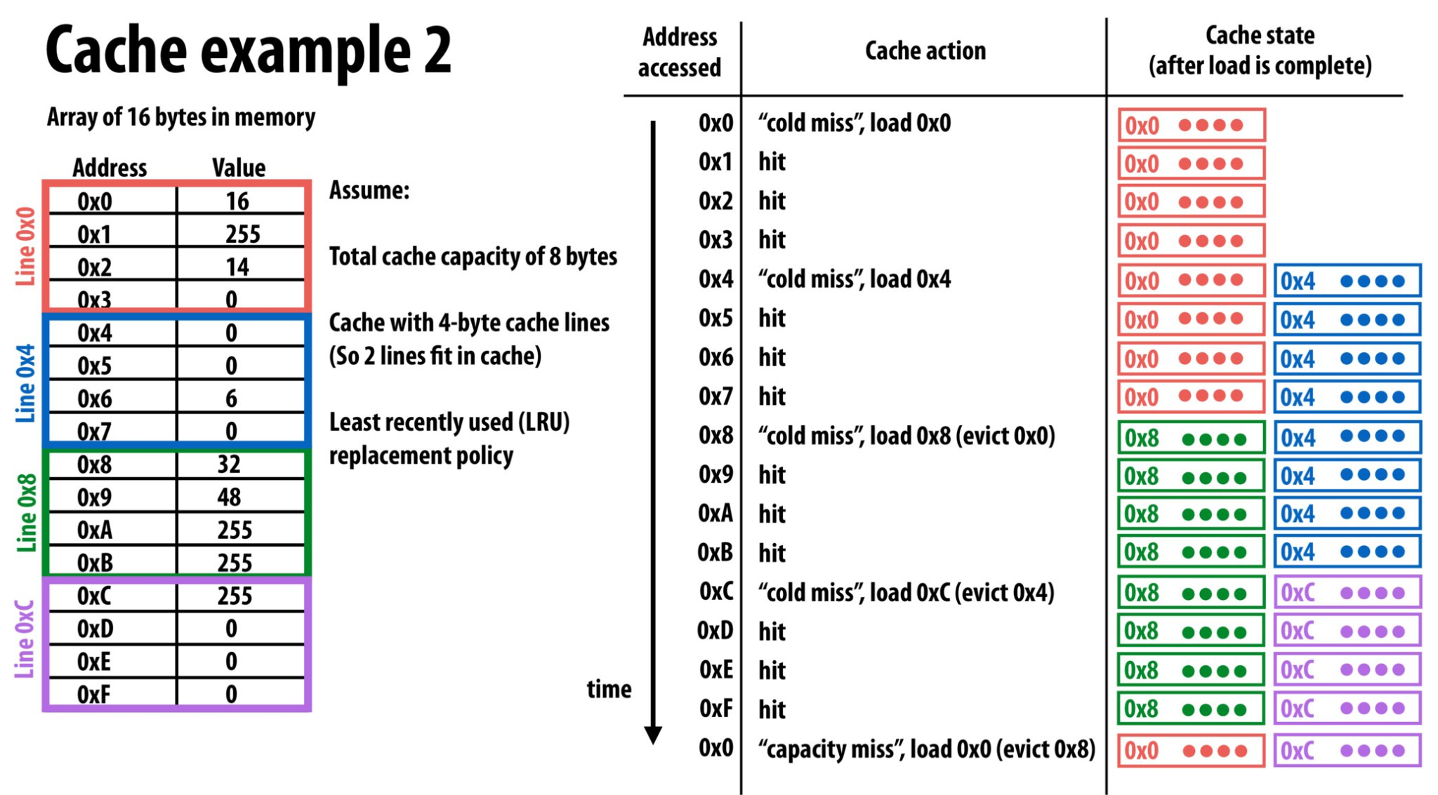
Caches and Data Locality

Slide 77
How Does a Processor Decide What Data to Keep in Cache?
Cache Mapping Policies (Simplified Overview)
Direct-Mapped Cache
Each memory block maps to exactly one location in the cache.
Set-Associative Cache
Each memory block maps to a set of cache locations (e.g., 4-way associative).
Fully Associative Cache
Data can be placed anywhere in the cache (rarely used).

Slide 78
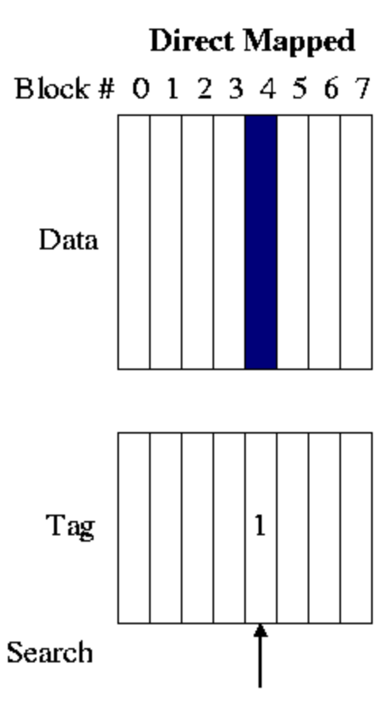
Direct-Mapped Cache
Rule: Each memory address maps to exactly one cache line. Example:
Cache Size: 4 lines (0-3).
Memory Addresses: 0x00, 0x04, 0x08, 0x0C.
Mapping Formula: Cache Line = (Address / Block Size) % Total Lines.
Pros ✅
Simple hardware: Easy to implement (no complex search logic).
Fast access time: Fixed mapping means no decision-making overhead.
Low power consumption: Minimal circuitry required.
Cons ❌
High conflict misses: Multiple addresses compete for the same cache line.
Infexible replacement: No choice in eviction—forced replacement on collision.
Poor utilization: Frequently accessed blocks may evict each other.

Slide 79
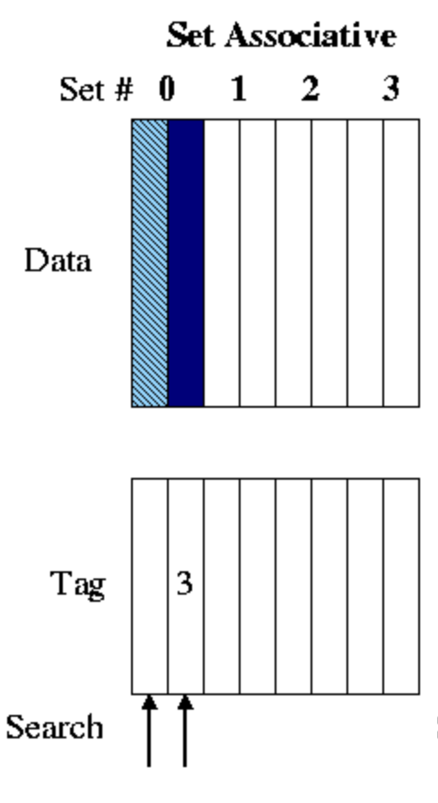
2. Set-Associative Cache
Rule: Each memory address maps to a set (e.g., 2 lines per set). Example:
Cache: 4 sets × 2 lines = 8 total lines.
Memory Addresses: 0x00, 0x08, 0x10.
Mapping Formula: Set = (Address / Block Size) % Total Sets.
Pros ✅
Reduced conflict misses: Multiple slots per set reduce collisions.
Balanced performance: Better hit rate than direct-mapped, simpler than fully associative.
Flexible replacement: Policies like LRU can be applied within a set.
Cons ❌
Increased complexity: Additional logic to manage sets and replacement policies.
Slower than direct-mapped: Slightly longer access time due to set search.
Higher power usage: More circuitry for tag comparison.

Slide 80
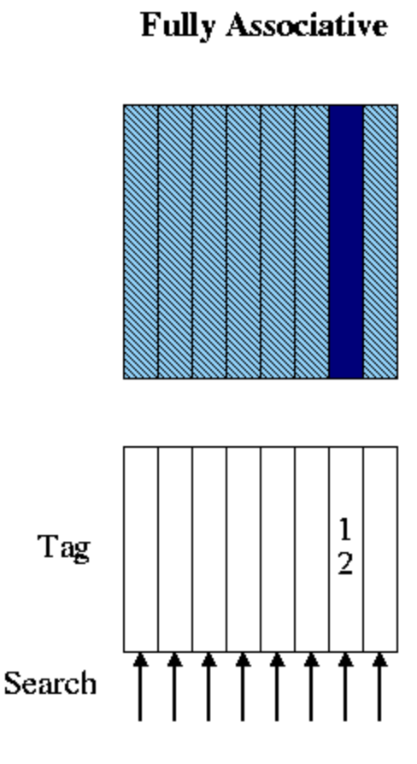
3. Fully-Associative Cache
Rule: Any memory address can map to any cache line. Example:
Cache Size: 4 lines.
Memory Addresses: 0x00, 0x04, 0x08, 0x0C, 0x10.
Pros ✅
Minimal conflict misses: Any block can occupy any cache line.
Optimal replacement: Global LRU policy maximizes cache utilization.
Flexibility: Ideal for small, high-priority caches (e.g., TLB).
Cons ❌
High complexity: Requires searching all entries for a match (slow).
Impractical for large sizes: Hardware cost grows exponentially with cache size.
Power-intensive: Parallel tag comparison consumes significant energy.

Slide 81
Example Program
ld r0, addr[r1]
───────────────────────────────
mul r1, r0, r0
───────────────────────────────
mul r1, r1, r0
───────────────────────────────
...
───────────────────────────────
st addr[r2], r0
v
int main() {
int result = 1;
for (int i = 0; i < 10; i++) {
result = result * 2;
}
printf("%d\n", result);
return 0;
}
Compile

Slide 82
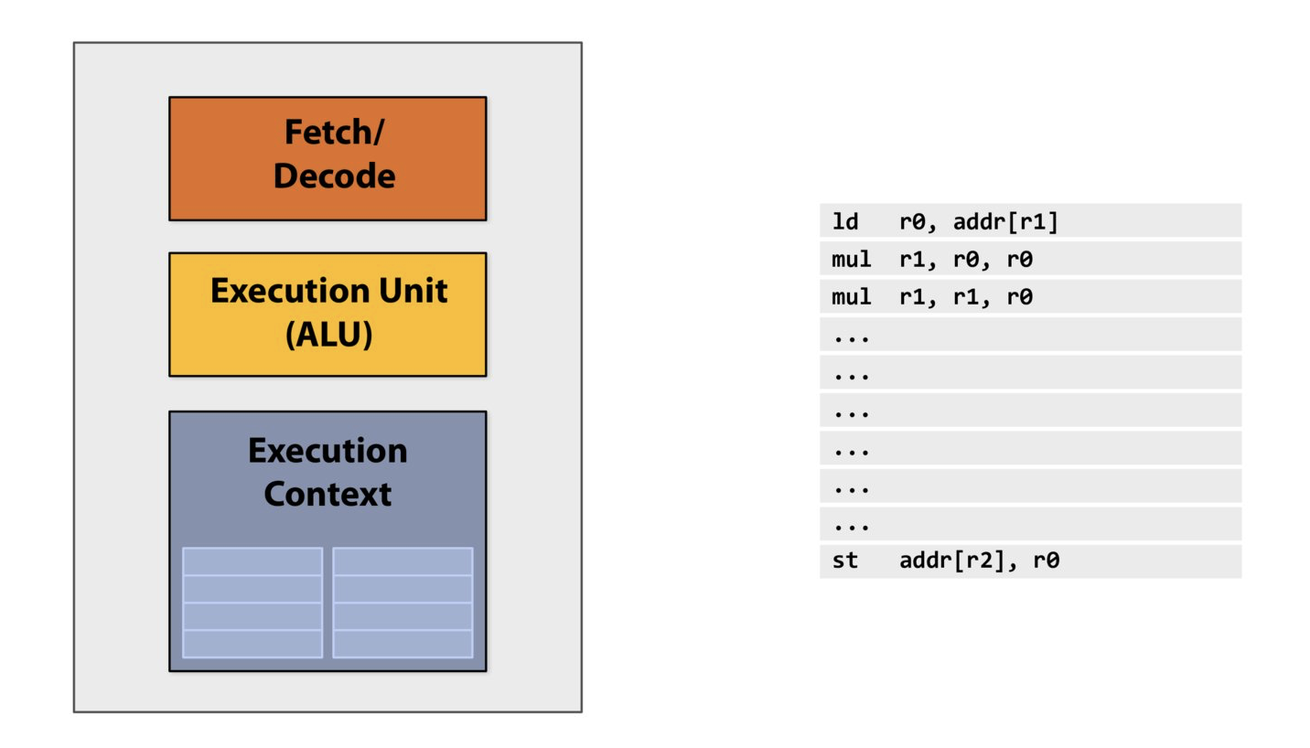

Slide 83
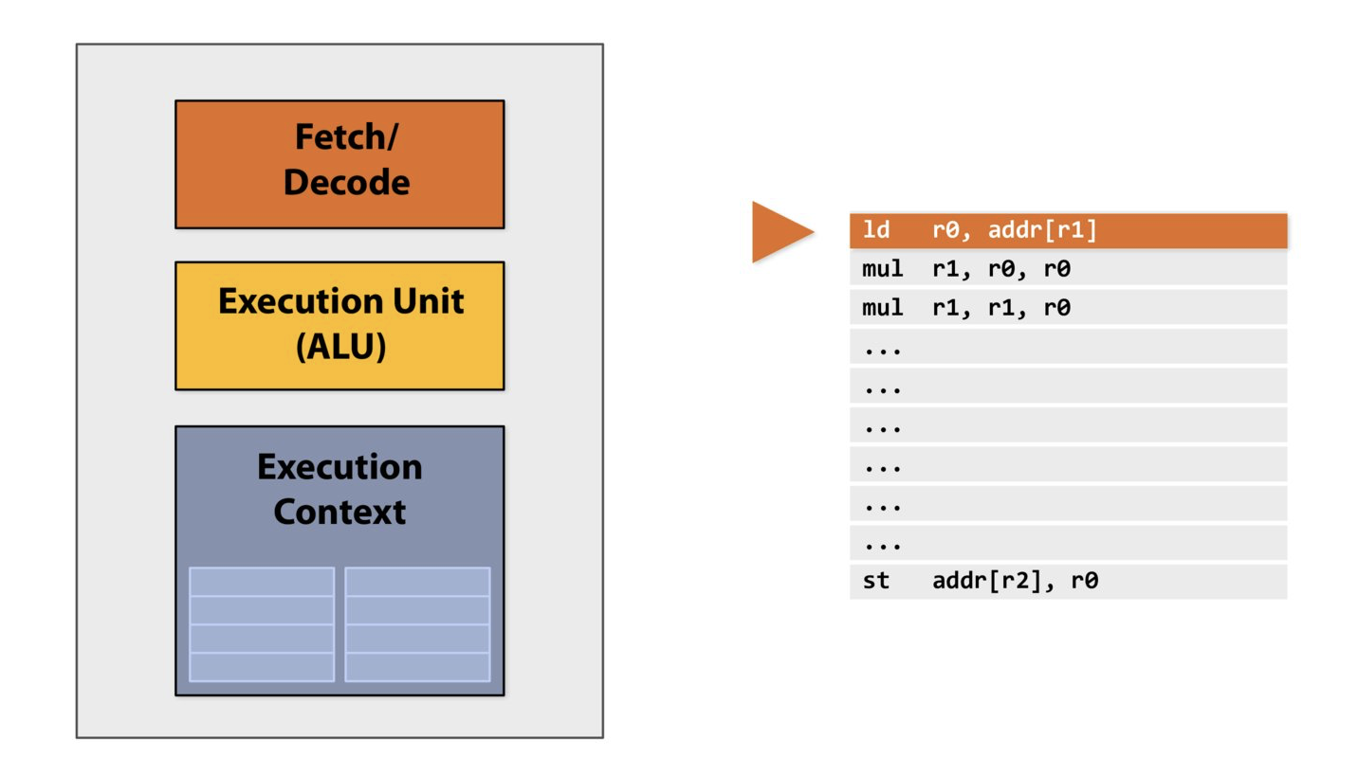

Slide 84
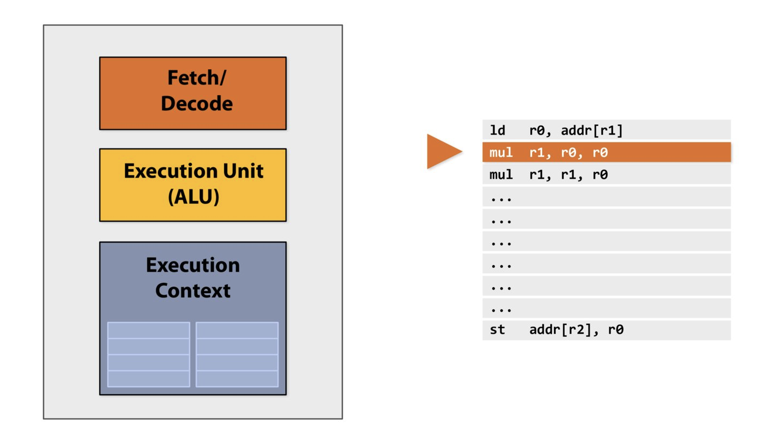

Slide 85
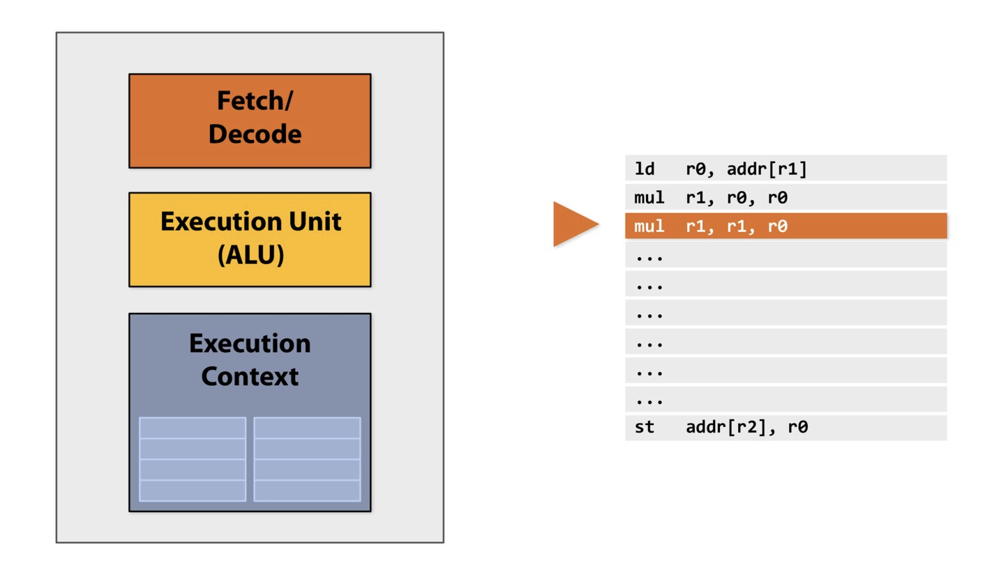

Slide 86
First Attempt at Parallelism (ILP)
Instruction-Level Parallelism (ILP)
Executing multiple instructions simultaneously within a single program thread.
Key Techniques
Superscalar Execution
Multiple instructions decoded/executed per clock cycle.
Example: Intel/AMD processors.
Pipelining
Overlap stages of instruction processing (Fetch, Decode, Execute, Writeback).
Out-of-Order Execution
Dynamically reorder instructions to avoid stalls.
1. a = x + y ──┐
2. b = z * 2 │ Independent → Can run in parallel
3. c = a + b ──┘ (Depends on 1 and 2)
4. d = m - n ──► Independent of 1-3

Slide 87
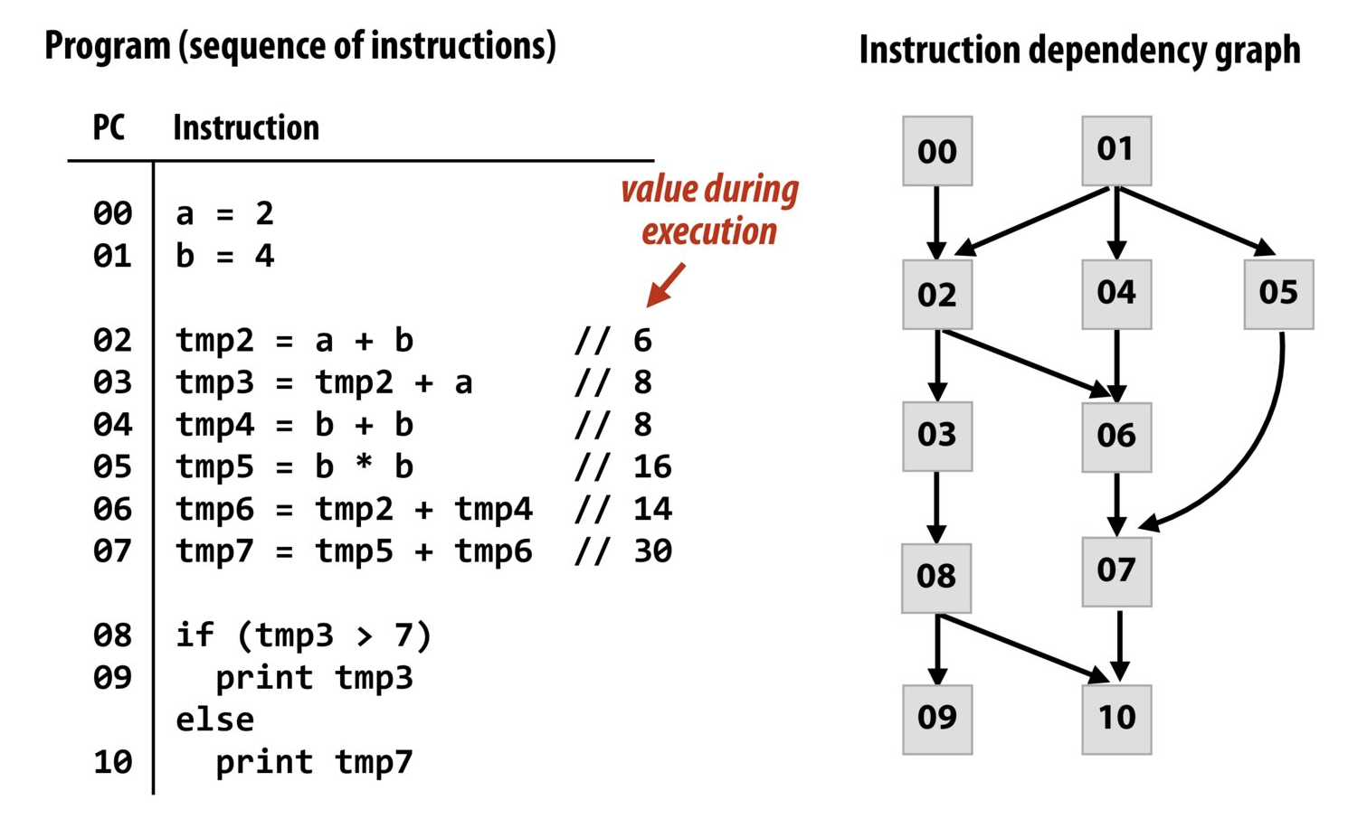
Example Program with ILP

Slide 88
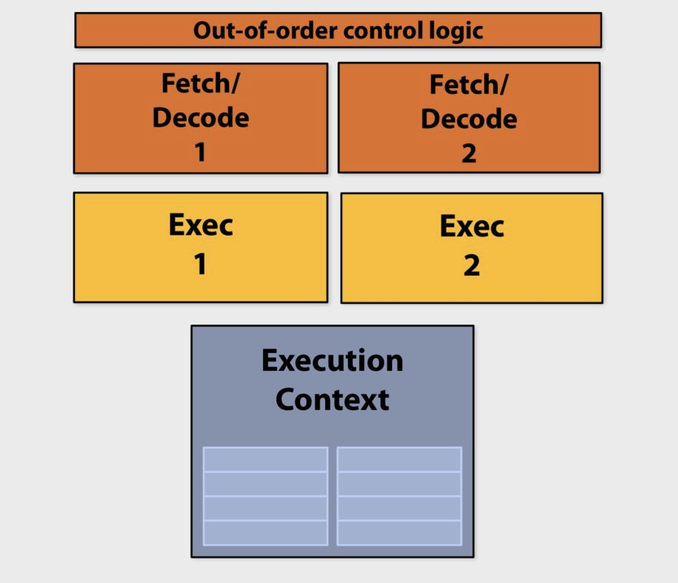
ILP: One processor, Multiple Execution Unit

Slide 89
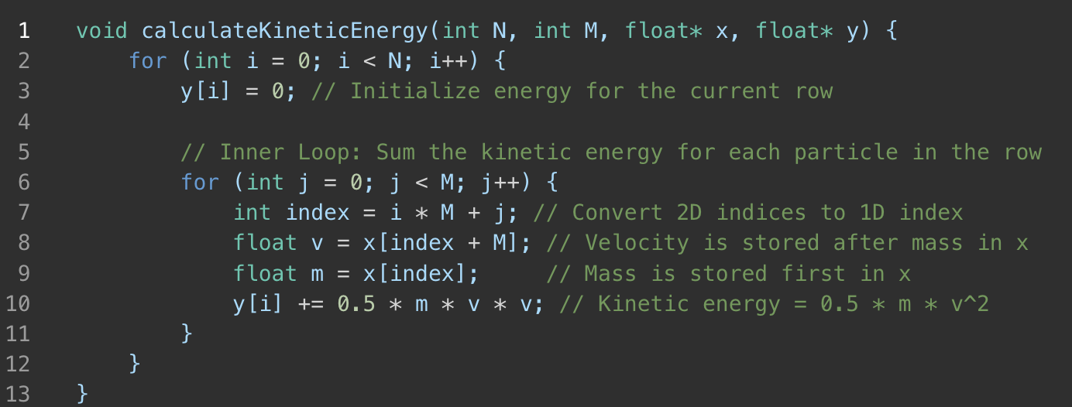
Example Program
Inputs (x):
A single 1D array containing both masses and velocities for the 2D grid:
The first half of x contains mass values (x[index]).
The second half contains velocity values (x[index + M]).
Organized in a row-major format for a grid with dimensions N x M.
Outputs (y):
A 1D array where each element represents the total kinetic energy for a row in the grid.
y[i] corresponds to the total energy for the ith row.

Slide 90
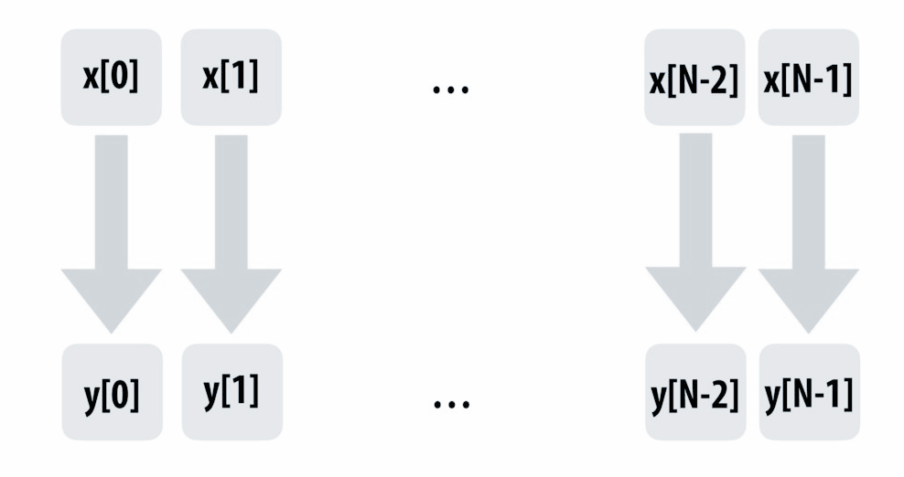
Example Program

Slide 91
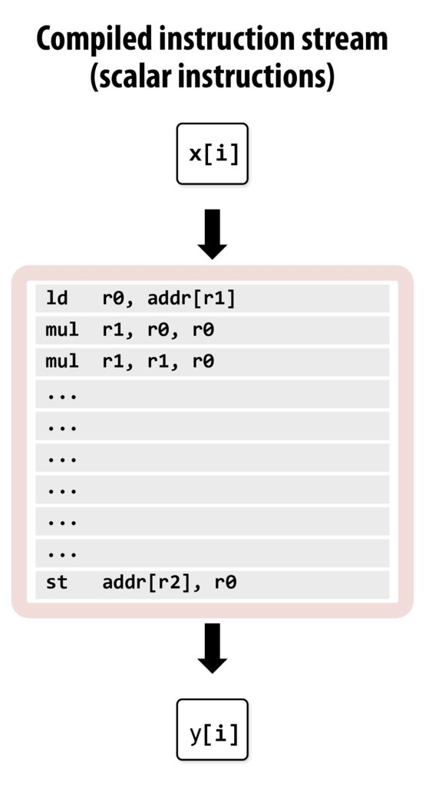
Example Program
Compile the program → Sequence of Instructions
Compile

Slide 92
Example Program

Slide 93
Example Program: ILP
Dependency!

Slide 94
ILP vs higher level parallelism
Is there any parallelism left here?

Slide 95
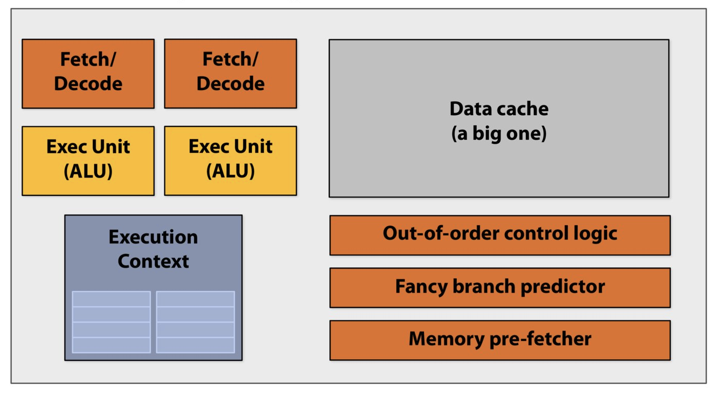
ILP Diminishing Return
The majority of chip transistors are utilized to enhance the speed of executing a single instruction stream.
Diminishing Returns: More transistors for ILP features yield smaller performance gains as ILP approaches its limits.
Higher Costs: Complex ILP logic increases design complexity, power usage, and manufacturing costs.
Underutilized Potential: Many workloads lack sufficient parallelism to fully benefit from advanced ILP optimizations.
Better Alternatives: Transistors could be better spent on more cores or specialized accelerators.
Memory Bottlenecks: Larger caches and smarter predictors can’t fully mitigate memory access delays.
ILP Saturation: Techniques like out-of-order execution face hard limits on their effectiveness.

Slide 96
Parallelism
Any other idea for parallelism?

