Slide 1
Parallel Computer Architecture
Lecture 4:
Interconnect Networks 1
Basics
Topology
Armin Mehrabian
Spring 2025

Slide 2
Scalable Interconnect Network
Key Issues:
Topology: Network structure and its impact on performance
Mathematical Formulation & Properties:
Self-routing capability: Packets determine their own path dynamically
Partitioning strategies: Dividing network resources for efficiency and fault tolerance
Algorithm mapping & embedding: Placing computational tasks onto the network to optimize communication
Traffic Flow Management: Handling congestion and efficient data movement
Link Technologies: Electrical vs. Optical links and their trade-offs
Evaluation Metrics:
Performance: Latency, bandwidth, scalability, fault tolerance
Cost: Trade-offs in complexity, power, and implementation

Slide 3
Scalable Interconnect Network
Communication Overhead: Must be minimized for efficiency
Communication-to-Computation Ratio:
Should remain low to maximize computational efficiency
Determines network bandwidth requirements
Affected by workload patterns (localized vs. dispersed, bursty vs. uniform)
Key Trade-offs in Programming Models:
Granularity of Transfer: Impacts efficiency; smaller transfers increase overhead
Amortization: Cost distribution over multiple operations
Bandwidth vs. Latency: Balancing data transfer rate and response time
Communication & Computation Overlap: Hiding latency through concurrent execution

Slide 4
Basic Definitions in Interconnect Networks
Network Interface Controller (NIC) / Host Interface
Connects a computer node to the network
Manages bidirectional traffic between host and network
Key functions:
Arbitration: Decides access to shared network resources
Buffering: Temporarily stores incoming/outgoing data
Routing: Determines packet paths

Slide 5
Basic Definitions in Interconnect Networks
Links / Channels / Cables
Physical connections between two hardware units
Typically a bundle of wires or optical fibers carrying signals
Transmitter converts digital data into an analog signal
Receiver converts analog signals back into digital data
Collectively form a channel for digital information flow

Slide 6
Basic Definitions in Interconnect Networks
Switches
Connect a fixed number of input and output channels/links
Each input port has a receiver & input buffer
Each output port has a transmitter
Forward data through the network by steering packets/messages

Slide 7
Basic Definitions in Interconnect Networks
Key Networking Concepts:
Network Composition: Links & switches enable routing from source to destination
Physical Layer Protocol: Converts digital symbols into signals for transmission
Link-Level Protocol: Segments streams into packets/messages for switch interpretation
Node-Level Protocol: Embeds remote communication commands within packets

Slide 8
Formalism of Interconnect Networks
Graph Representation
Network as a Graph: V={switches, nodes}V={switches, nodes}, connected by communication channels C⊆V×V
Channel Properties:
Width ww: Number of bits transmitted in parallel
Signaling Rate f=1/t​: Data transfer frequency
Bandwidth b=w⋅f: Effective data transfer rate
Basic Network Concepts
Flit/Phit (Physical Unit): Smallest data unit transferred per cycle across a link
Switch Degree / Node Degree: Number of input or output channels at a switch or node
Route: Sequence of switches and links followed by a message from source to destination
Street Analogy for Routing
Streets & Intersections:
Street (Channel): Has a speed limit (signaling rate) and lanes (width)
Intersection (Switch): Directs traffic between multiple streets
Traffic Flow & Routing:
Multiple concurrent trips (messages) share or cross paths
Various route options exist, with different congestion levels
Notes:
f=t1​ means that the signaling rate is the reciprocal of tt.
Here, tt represents the time interval between signal transitions on the communication channel.
This could be:
The time for one bit to be transmitted in serial communication.
The clock period if the system transmits data on every clock cycle.
In double data rate (DDR) signaling, data is transferred on both the rising and falling edges of the clock, making tt effectively half of the clock cycle.

Slide 9
What Characterizes a Network?
1. Topology (What?)
Defines the physical interconnection structure of the network graph
Direct Networks: Every switch is connected to a host node (e.g., meshes, tori)
Indirect Networks: Hosts connect to only a subset of switches, forming a multi-stage network (e.g., Omega, fat trees, Clos networks)
Key Property: Network Diameter – maximum shortest path between any two nodes

Slide 10
What Characterizes a Network?
2. Switching Strategy (How?)
Determines how data in a message moves through the network
Circuit Switching:
Establishes and reserves a dedicated path before transmission
Efficient for large, continuous data transfers but requires setup time
Analogy: Parade route reservation
Packet Switching:
Breaks messages into packets that are individually routed
Utilizes network resources more efficiently
Analogy: Traveling in individual cars

Slide 11
What Characterizes a Network?
Flow Control Mechanism (When?)
Controls when messages or portions of them traverse the network
Manages traffic contention:
Stalling packets
Buffering packets
Rerouting (if supported)
Dropping packets (usually unacceptable)
Flow Control Unit (Flit): Minimum transferable unit over a link (can be as small as a phit or as large as a packet)

Slide 12
Routing Algorithm (Which Paths to Take?)
1. Role of a Routing Algorithm
Determines which paths messages can take through the network
Restricts the set of possible routes to avoid contention and improve efficiency
Impacts performance, congestion, and fault tolerance
2. Key Properties of Routing Algorithms
Deterministic vs. Adaptive:
Deterministic: Always chooses the same path for a given source-destination pair (e.g., XY routing in meshes)
Adaptive: Dynamically selects paths based on network conditions (e.g., minimal adaptive routing)
Minimal vs. Non-minimal:
Minimal: Always takes the shortest possible path
Non-minimal: May take longer paths to balance load and avoid congestion
Deadlock and Gridlock Avoidance:
Deadlocks occur when packets cyclically block each other
Strategies include virtual channels and deadlock-free routing rules

Slide 13
Routing Algorithm (Which Paths to Take?)
3. Routing and Data Movement Strategies
Store-and-Forward:
Entire packet is received before being forwarded
Higher latency but simpler control
Wormhole Routing:
Packet is split into small flits that move in a pipeline-like fashion
Reduces buffer requirements and improves latency

Slide 14
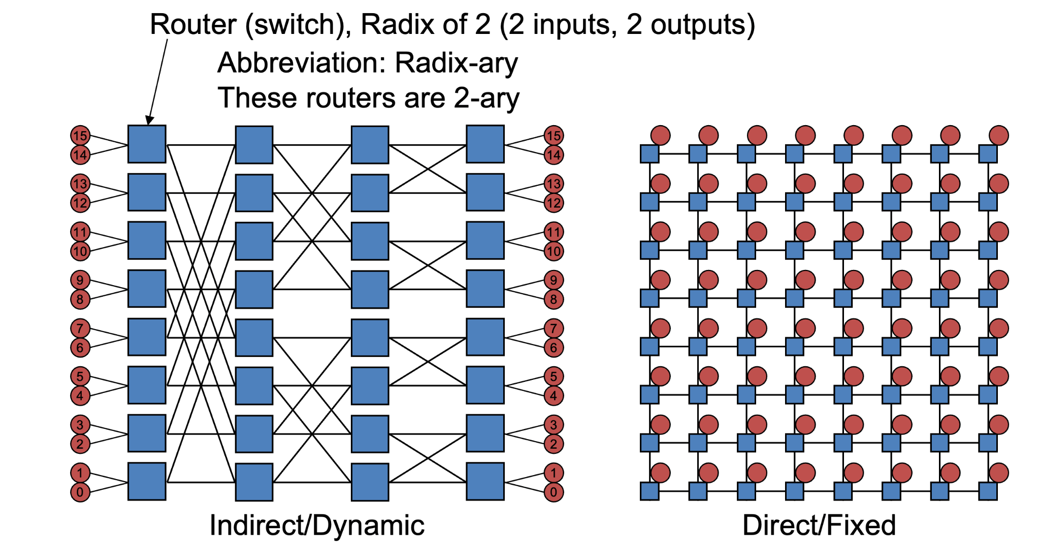
What Characterizes a Network?
1. Direct (Fixed) Networks
Endpoints (nodes) are part of the network itself
Every node acts as both an endpoint and a router/switch
Example: Mesh, Torus, Hypercube
Characteristics:
Fixed topology with predictable routes
Scales well with local communication patterns
Lower latency for nearby nodes but may require more hops for distant nodes
2. Indirect (Dynamic) Networks
Endpoints connect only to a subset of dedicated switches
Hosts do not participate in routing; switches handle all traffic
Example: Fat-tree, Clos network, Butterfly
Characteristics:
More flexible routing paths, allowing for adaptive routing strategies
Can handle higher bisection bandwidth efficiently
Often used in large-scale HPC and datacenter networks

Slide 15
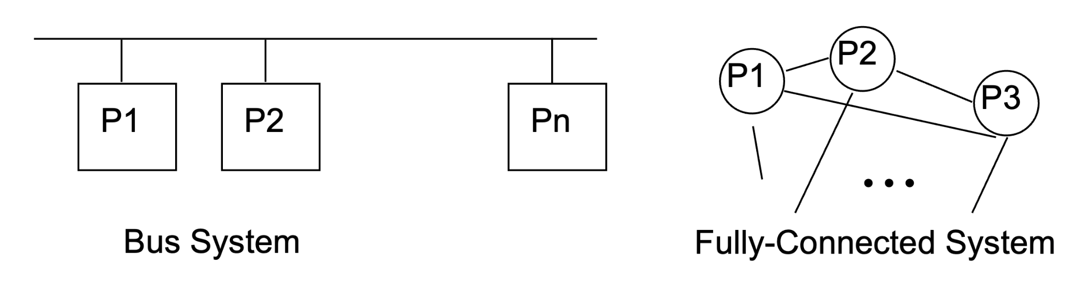
Why Interconnect Network?
Scalability: Avoids bottlenecks of a shared bus system
Cost-Efficiency: Reduces the prohibitive cost of full connectivity
Performance: Provides better balance between delay and cost

Slide 16
Why Interconnect Network?
Scalability: Avoids bottlenecks of a shared bus system
Cost-Efficiency: Reduces the prohibitive cost of full connectivity
Performance: Provides better balance between delay and cost
System Type | Delay | Cost | Characteristics
Bus System | O(n) | O(1) | Simple, low cost, but performance degrades with more nodes (contention & scalability issues)
Fully Connected | O(1) | O(n) | Fast, direct communication, but impractical for large-scale systems due to excessive wiring cost
Interconnection Network | Optimized | Balanced | Offers scalable communication with a trade-off between cost and performance

Slide 17
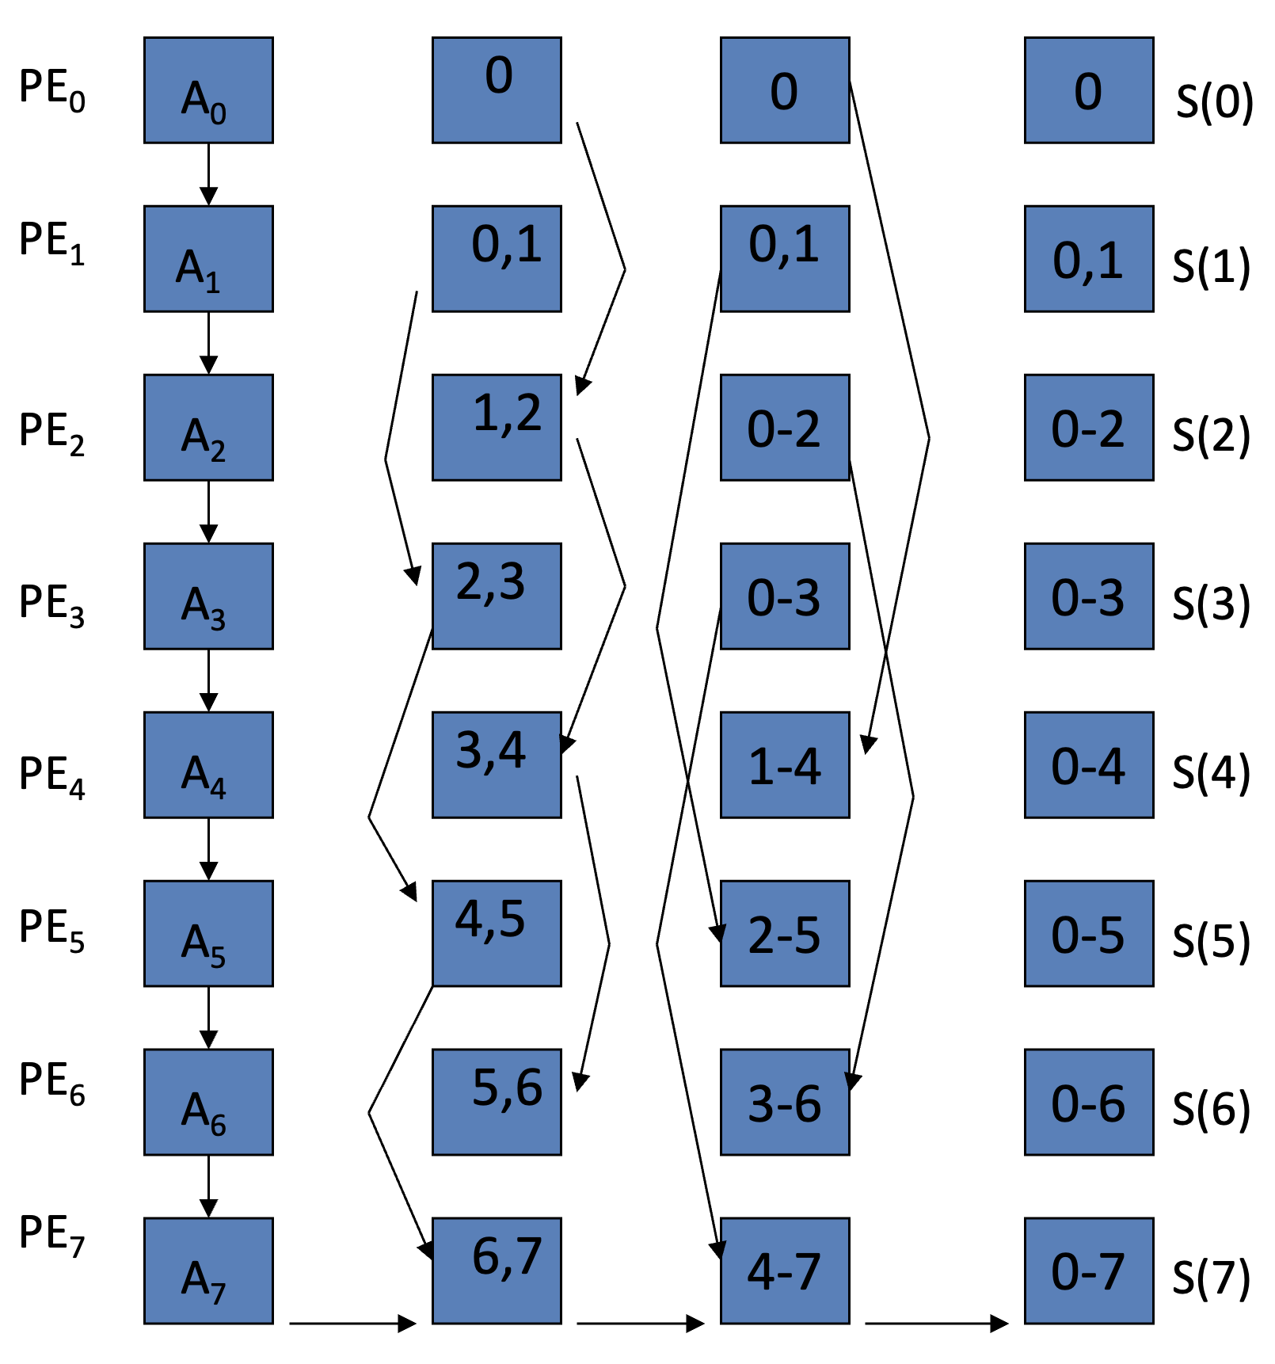
Using an Appropriate Interconnection Network (IN), It Can Work Fast!
Example: Prefix Sum or Parallel Scan
The example shows prefix sum or parallel scan, a common operation in parallel computing.
What is Prefix Sum?
Goal: Compute cumulative sums across an array of values.
For an array A=[a0,a1,a2,...,an−1], compute:S[i]=a0+a1+...+ai for i=0,1,2,...,n−1
Example: If A=[1,2,3,4], the prefix sum is:S=[1,3,6,10]
Why Parallel Processing?
Computing prefix sums sequentially takes O(n) time.
By parallelizing, the computation can be done in O(log⁡2(n)) steps using n processors.
Notes:
Diagram Explanation
Left Section:
Processing Elements (PE) at each stage (A0,A1,…A0​,A1​,…) pass partial sums to the next stage.
Arrows show data flow between processing elements.
Right Section:
Graph Representation: Nodes (circles) show direct connections between processing elements (PE0PE0​ to PE7PE7​).
Illustrates how the interconnection network supports communication patterns.

Slide 18
Using an Appropriate Interconnection Network (IN), It Can Work Fast!
Example: Prefix Sum or Parallel Scan
Operation: Compute cumulative sums efficiently in parallel
Setup:
N nodes, n=log⁡2(N)n=log2​(N) steps
Compute:
y0=x0y
y1=x0+x1
y2=x0+x1+x2…
Connection Requirements:
PE0 must communicate with PE1,PE2,PE1​,PE2​, and PE4
PE1​ communicates with PE0,PE2,PE3,PE0​,PE2​,PE3​, and PE5
…
Interconnection Advantage:
The network supports the required communication efficiently, matching the needs of the operation.
Parallel communication enables significant speedups.
Notes:
Diagram Explanation
Left Section:
Processing Elements (PE) at each stage (A0,A1,…A0​,A1​,…) pass partial sums to the next stage.
Arrows show data flow between processing elements.
Right Section:
Graph Representation: Nodes (circles) show direct connections between processing elements (PE0PE0​ to PE7PE7​).
Illustrates how the interconnection network supports communication patterns.

Slide 19
Interconnect Networks: Performance and Cost Metrics
1. Key Metrics
Distance Between Nodes:
Number of hops to reach one node from another
Network Diameter:
Maximum distance (hops) between any two nodes
Determines the maximum delay in the network
Average Distance:
Average number of hops between all node pairs
Impacts the average communication delay

Slide 20
Interconnect Networks: Performance and Cost Metrics
2. Performance Metrics
Latency:
Time from the request to when the first bit of data is received
Depends on distance, routing, and flow control
Bandwidth:
Data transmission rate when all processors are sending and receiving
Bisection Bandwidth:
Maximum data transfer rate (or number of wires) between two halves of the network

Slide 21
Interconnect Networks: Performance and Cost Metrics
3. Cost Metrics
Node Degree:
Number of ports per node (affects cost)
Fixed degree is desirable for scalability
Connectivity:
Minimum number of parallel paths between any two nodes
Higher connectivity improves fault tolerance
Symmetry & Scalability:
Symmetric networks simplify routing and balance performance
Scalable designs allow efficient expansion

Slide 22
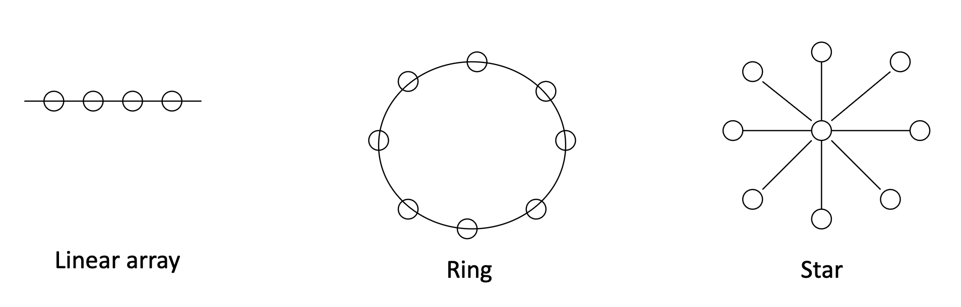
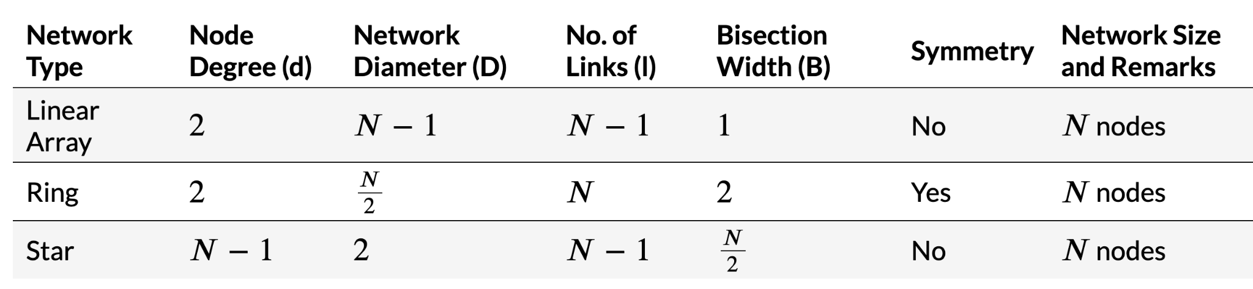
Fixed Interconnect Networks

Slide 23
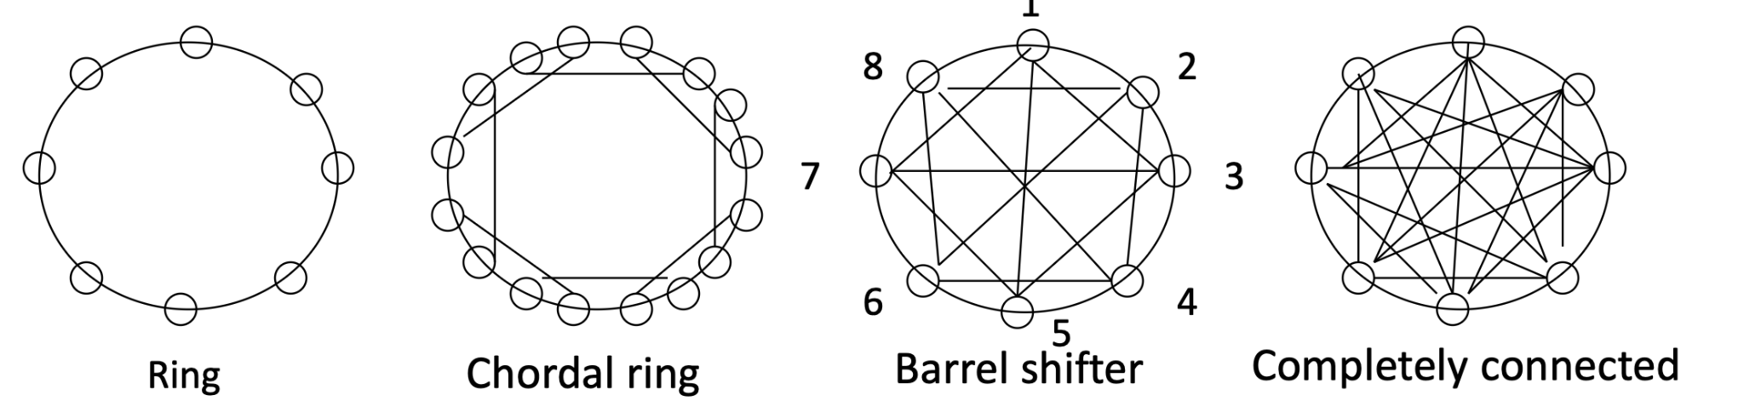
Increasing node degree and connectivity
Ring:Nodes connected in a circular fashion. Each node is directly connected to its two neighbors.
Chordal Ring:An enhanced ring network where additional shortcuts (chords) are added between non-adjacent nodes to reduce the diameter and improve communication latency.
Barrel Shifter: A ring topology with specific direct connections enabling bit-wise circular shifting. Each node connects to multiple others, supporting parallel communication patterns efficiently.
Completely Connected Network: Every node is directly connected to every other node. Maximum connectivity ensures minimal communication latency but increases complexity and cost.
Notes:
Key Notes for the Instructor:
Ring vs. Chordal Ring:
Highlight how the addition of chords in a chordal ring reduces the network diameter and improves fault tolerance compared to a standard ring.
Barrel Shifter:
Common in hardware designs like crossbars and specific processor architectures. Emphasize its use for shifting, routing, or rotating operations.
Completely Connected Network:
Ideal for small-scale systems requiring extremely low latency but impractical for large systems due to the exponential growth in the number of links (N(N−1)/2N(N−1)/2).
Discussion Points:
Trade-offs between complexity, scalability, and performance in these topologies.
Real-world examples of usage:
Chordal rings in multiprocessor interconnects.
Barrel shifters in specialized hardware (e.g., graphics processing).
Completely connected networks in small, high-performance clusters or peer-to-peer communication.

Slide 24
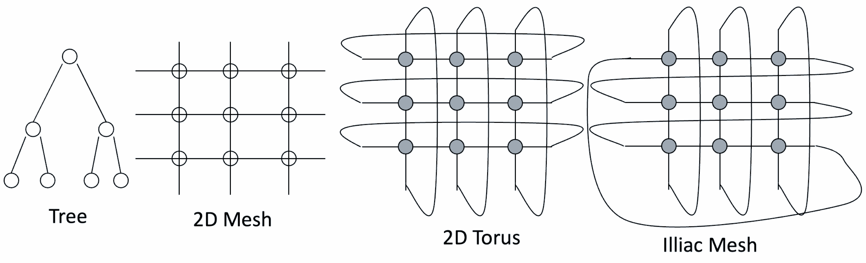
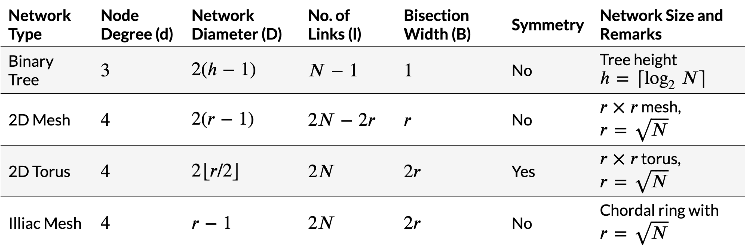
Fixed Interconnect Networks
Notes:
1. Binary Tree
Node Degree (dd): Each internal node connects to 3 nodes: one parent and two children. Leaf nodes only connect to 1 parent. However, the average degree is 3 for most nodes in a balanced binary tree.
Network Diameter (DD): Diameter is the longest distance between any two nodes. In a binary tree: D=2(h−1)D=2(h−1), where h=⌈log⁡2N⌉h=⌈log2​N⌉ is the height of the tree for NN nodes. This accounts for traversing from one leaf node to another via the root.
Number of Links (ll): Each node except the root has one parent. Therefore, there are N−1N−1 links in a binary tree with NN nodes.
Bisection Width (BB): The bisection cuts the tree at the middle level. At most, one link connects the root's subtrees, so B=1B=1.
2. 2D Mesh
Node Degree (dd): Each node connects to 4 neighbors (left, right, top, and bottom) in a 2D grid, except for edge and corner nodes, which have fewer neighbors. For simplicity, we assume the average degree is d=4d=4.
Network Diameter (DD): In an r×rr×r grid (r=Nr=N​), the longest path is from one corner to the opposite corner. The number of hops is: D=2(r−1)D=2(r−1).
Number of Links (ll): Each of the NN nodes connects to at most 4 neighbors, but every link is shared by two nodes. Therefore: l=2N−2rl=2N−2r.
Bisection Width (BB): Cutting the network into two halves requires cutting rr links (along a row or column), so B=rB=r.
3. 2D Torus
Node Degree (dd): Similar to a 2D mesh, but with wrap-around connections for edge nodes, so every node always has 4 neighbors (d=4d=4).
Network Diameter (DD): The longest distance in a torus is half the perimeter of the grid, which is: D=2⌊r/2⌋D=2⌊r/2⌋. The floor operation accounts for even/odd dimensions of the grid.
Number of Links (ll): Unlike the mesh, all edge nodes are connected via wrap-around links. Thus, the total number of links is simply: l=2Nl=2N.
Bisection Width (BB): Cutting the network into two halves requires cutting both horizontal and vertical wrap-around connections. This doubles the bisection width compared to a 2D mesh: B=2rB=2r.
4. Illiac Mesh
Node Degree (dd): Similar to the 2D mesh, each node connects to 4 neighbors, but the Illiac mesh includes diagonal/chordal connections. However, the degree is kept at d=4d=4.
Network Diameter (DD): With additional diagonal links, the diameter is smaller than a regular 2D mesh. It is given by: D=r−1D=r−1.
Number of Links (ll): The additional diagonal links double the number of total links in the mesh: l=2Nl=2N.
Bisection Width (BB): Like the 2D Torus, cutting through both horizontal and vertical links gives: B=2rB=2r.

Slide 25
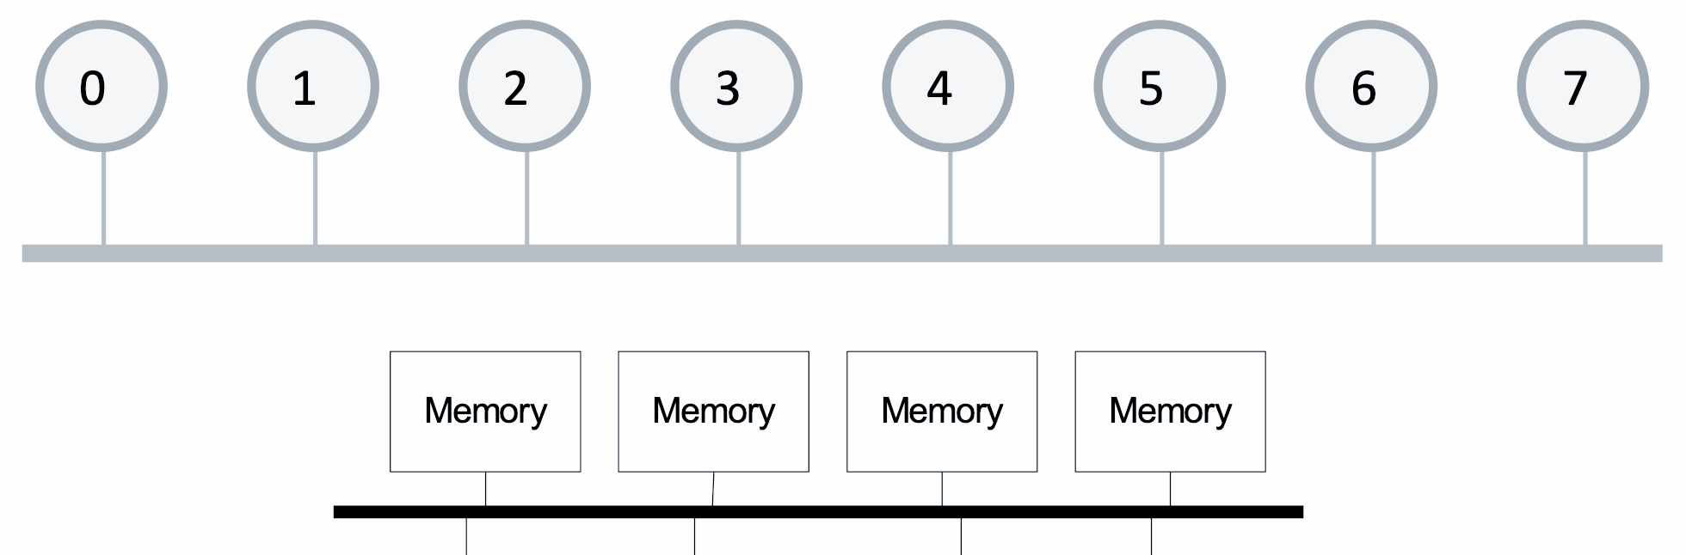
Bus Interconnect Network
Definition: All nodes are connected to a single shared communication link.
Processor
Processor
Processor
Processor

Slide 26
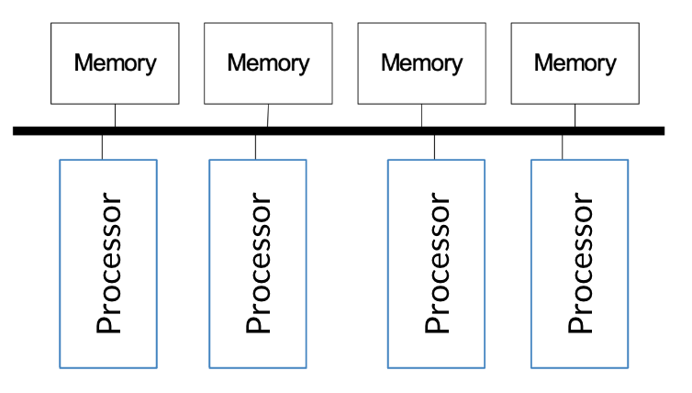
Bus Interconnect Network
Advantages:
Simple: Straightforward design and easy to implement.
Cost-Effective: Ideal for systems with a small number of nodes.
Coherence Management: Simplifies cache coherence through snooping and serialization mechanisms.
Disadvantages:
Limited Scalability:
Bandwidth is shared among all nodes.
Electrical loading reduces operating frequency as more nodes are added.
High Contention:
Shared link leads to frequent contention for access.
Saturates quickly as the number of nodes or traffic increases.
Notes:
Highlight that buses are most effective for small systems (e.g., single-board computers or small clusters).
Discuss examples like PCIe and early multiprocessor systems using shared buses.
Emphasize the transition to scalable networks (e.g., crossbars or meshes) for larger systems.

Slide 27
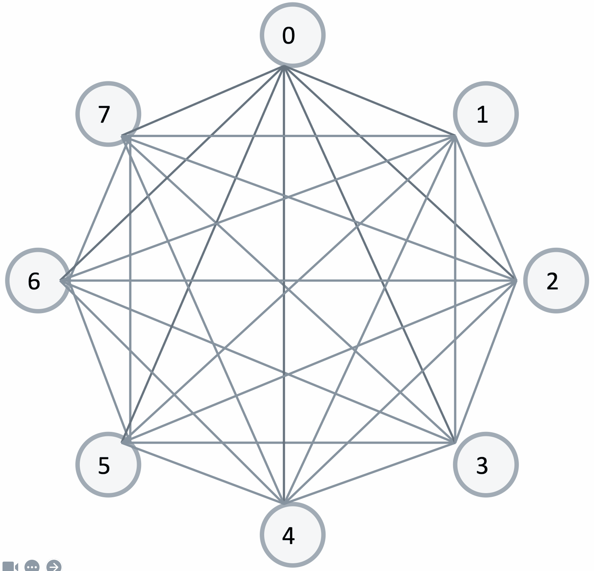
Point to Point Networks
Definition: Every node is connected directly to every other node using dedicated links.

Slide 28
Point to Point Networks
Advantages:
Lowest Contention: No sharing of links, eliminating contention for resources.
Lowest Latency: Direct connections ensure minimal communication delay.
Ideal Performance: Perfect for systems where cost is not a constraint.
Disadvantages:
High Cost:
O(N) ports per node.
O(N²) links required for N nodes.
Not Scalable:
Exponential growth in hardware cost makes it impractical for large systems.
Layout Challenges:
Difficult to physically lay out all the connections on a chip.
Notes:
Highlight examples where point-to-point networks are used, such as small-scale systems with a limited number of nodes (e.g., FPGA designs or specialized hardware).
Discuss how this network is an extreme case and serves as a theoretical benchmark for performance comparisons.
Contrast with more scalable topologies like mesh or torus networks.

Slide 29
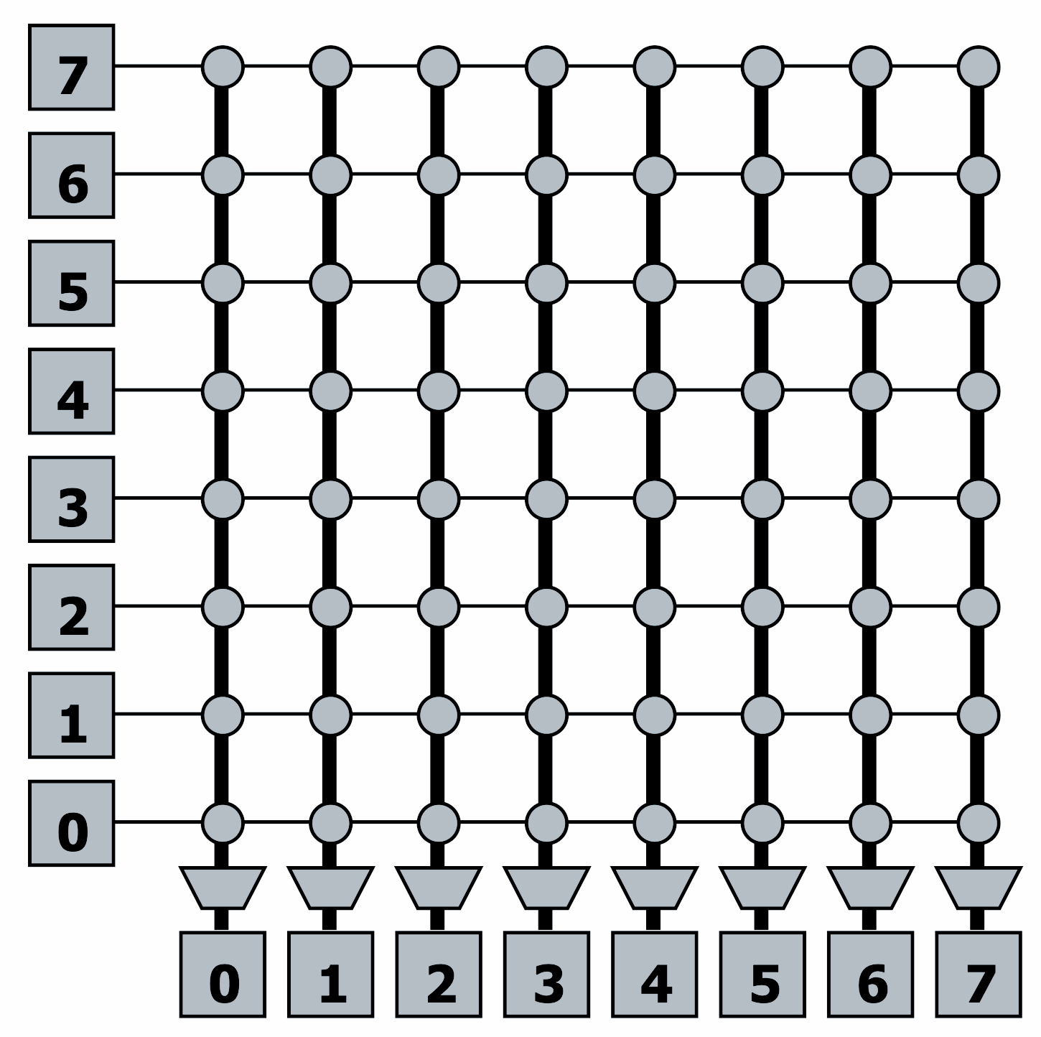
Crossbar Interconnect Networks
Definition: Every node is connected to every other node via a shared link for each destination.
Key Feature: Enables concurrent transfers to non-conflicting destinations.

Slide 30
Crossbar Interconnect Networks
Advantages:
Low Latency: Direct connections ensure minimal communication delays.
High Throughput: Supports multiple simultaneous data transfers without interference.
Cost-Effective (Small Systems): Works well for systems with a small number of nodes.
Disadvantages:
High Cost:
O(N²) connections, leading to exponential growth in cost as the number of nodes increases.
Poor Scalability: Unsuitable for large systems due to link and hardware complexity.
Arbitration Complexity: Managing access to shared links becomes challenging as N grows.
Applications:
Used in core-to-cache-bank networks
Notes:
Emphasize that crossbars are used in tightly coupled systems where performance is critical, and cost is secondary (e.g., CPU-cache interconnects).
Discuss how crossbars compare to point-to-point networks in terms of cost vs. scalability.
Consider highlighting arbitration mechanisms like round-robin or priority-based schemes to resolve conflicts.

Slide 31
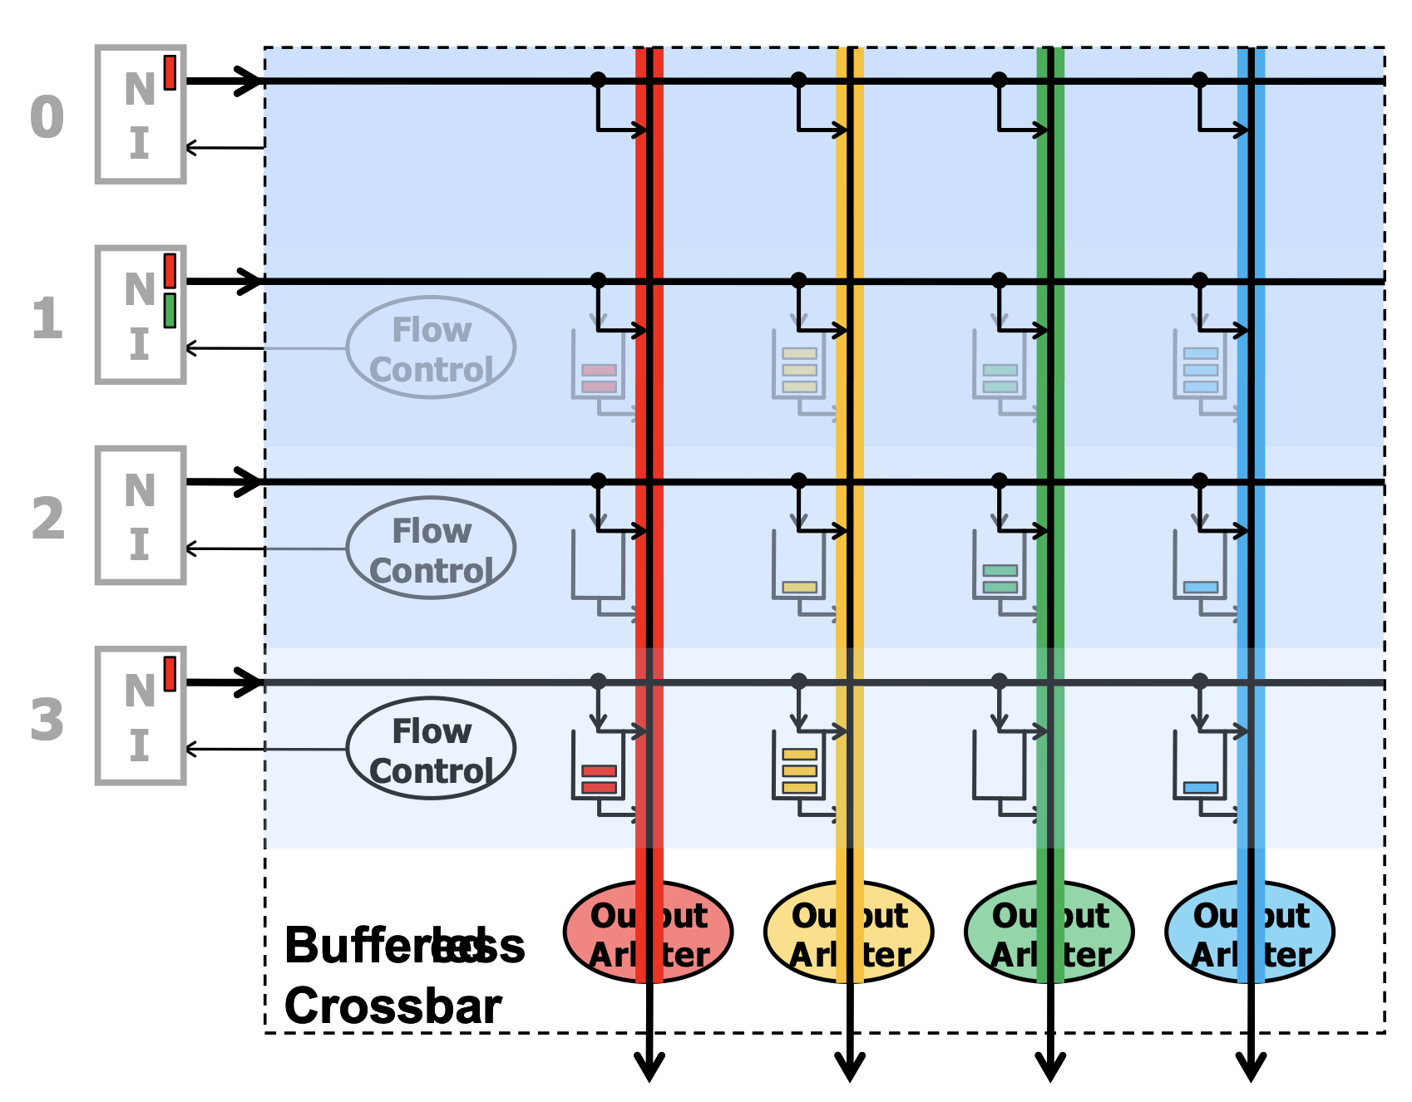
Buffered vs. Bufferless Xbars
Bufferless Crossbar:
A crossbar switch without internal buffering.
Packets are directly forwarded to outputs based on arbitration decisions.
Buffered Crossbar:
A crossbar switch with internal buffers at each crosspoint.
Packets are temporarily stored when contention occurs.
Notes:
Highlight use cases for both types:
Buffered Crossbars are better for high-traffic systems with variable packet sizes.
Bufferless Crossbars are ideal for energy-efficient designs or predictable traffic patterns.
Mention examples:
Buffered Crossbars: Used in some high-performance routers and switches.
Bufferless Crossbars: Common in low-power interconnects or small-scale systems.

Slide 32
Buffered Xbars
Advantages of Buffered Crossbars:
Simpler Arbitration/Scheduling:
Buffers reduce contention, simplifying the need for complex arbitration mechanisms.
Support for Variable-Size Packets:
Packets of different sizes can be stored in buffers, enabling flexible communication.
Disadvantages of Buffered Crossbars:
Higher Hardware Cost:
Requires N² buffers, where N is the number of input/output ports.
Increased Latency:
Buffering packets can introduce additional delays.

Slide 33
Bufferless Xbars
Advantages of Bufferless Crossbars:
Lower Complexity:
No need for N² buffers or associated control logic.
Energy-Efficient:
Eliminates power consumption associated with managing buffers.
Disadvantages of Bufferless Crossbars:
Complex Arbitration:
Requires sophisticated arbitration mechanisms to resolve output contention.
Packet Drops:
Packets are dropped when contention occurs due to lack of buffering.

Slide 34
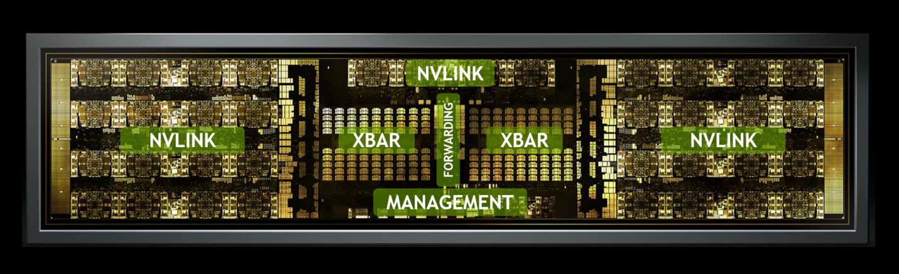
NVIDIA NVSwitch, which is a high-performance interconnect
Designed for large-scale GPU communication
It is a critical component in NVIDIA’s data center and high-performance computing (HPC) solutions, such as the NVIDIA DGX systems.

Slide 35
NVIDIA NVSwitch, which is a high-performance interconnect
NVLink Interconnects:
NVLink is NVIDIA’s proprietary high-speed, point-to-point interconnect for GPUs.
The NVSwitch integrates multiple NVLink connections to enable direct communication between GPUs in a system.
Each NVSwitch supports NVLink 3.0, with up to 900 GB/s of aggregate bandwidth.

Slide 36
NVIDIA NVSwitch, which is a high-performance interconnect
Crossbar (XBAR):
The crossbar is the core switching fabric within the NVSwitch.
It connects GPUs to one another by routing data packets from one NVLink interface to another with minimal latency.
The XBAR facilitates non-blocking concurrent data transfers across all GPUs in the system.

Slide 37
NVIDIA NVSwitch, which is a high-performance interconnect
Management Module:
Responsible for coordinating the NVSwitch’s operations, such as routing, arbitration, and load balancing.
Ensures efficient utilization of the interconnect bandwidth.
Forwarding Logic:
Optimized packet forwarding between NVLinks based on source and destination GPU.
Enables multi-hop communication between GPUs not directly connected by NVLinks.

Slide 38
How NVSwitch Works
In systems with multiple GPUs (e.g., NVIDIA DGX A100 or H100), NVSwitch acts as a central interconnect, allowing any GPU to communicate with any other GPU directly, regardless of physical placement.
The crossbar within the NVSwitch enables full-bandwidth, all-to-all GPU communication, avoiding bottlenecks typical in other interconnect topologies.

Slide 39
Can We Get Lower Cost than A Crossbar and yet still have low contention compared to a Bus?

Slide 40
References
Introduction to Parallel Computing" by Ananth Grama, Anshul Gupta, George Karypis, and Vipin Kumar
Computer Architecture: A Quantitative Approach" by John L. Hennessy and David A. Patterson
Eth Zurich - Computer Architecture Lectures

