Slide 1
Customer segmentation
Data Science Internship – Exposys Data Labs
- Aarushi Gupta

Slide 2
Introduction

Slide 3
What is Customer Segmentation?
Customer segmentation is the process of dividing customers into groups based on common characteristics so companies can market to each group effectively and appropriately.
In business-to-business marketing, a company might segment customers according to a wide range of factors, including:
• Industry
• Number of employees
• Products previously purchased from the company
• Location
In business-to-consumer marketing, companies often segment customers according to demographics that include:
• Age
• Gender
• Marital status
• Location (urban, suburban, rural)
• Life stage (single, married, divorced, empty-nester, retired, etc.)

Slide 4
Why Segment Customers?
Segmentation allows marketers to better tailor their marketing efforts to various audience subsets. Those efforts can relate to both communications and product development. Specifically, segmentation helps a company:
• Create and communicate targeted marketing messages that will resonate with specific groups of customers, but not with others (who will receive messages tailored to their needs and interests, instead).
• Select the best communication channel for the segment, which might be email, social media posts, radio advertising, or another approach, depending on the segment.
• Identify ways to improve products or new product or service opportunities.
• Establish better customer relationships.
• Test pricing options.
• Focus on the most profitable customers.
• Improve customer service.
• Upsell and cross-sell other products and services.

Slide 5
How to Segment Customers
Customer segmentation requires a company to gather specific information – data – about customers and analyze it to identify patterns that can be used to create segments.
Some of that can be gathered from purchasing information – job title, geography, products purchased, for example. Some of it might be gleaned from how the customer entered your system. An online marketer working from an opt-in email list might segment marketing messages according to the opt-in offer that attracted the customer, for example. Other information, however, including consumer demographics such as age and marital status, will need to be acquired in other ways.
Typical information-gathering methods include:
• Face-to-face or telephone interviews
• Surveys
• General research using published information about market categories
• Focus groups

Slide 6
Using Customer Segments
Common characteristics in customer segments can guide how a company markets to individual segments and what products or services it promotes to them. A small business selling hand-made guitars, for example, might decide to promote lower-priced products to younger guitarists and higher-priced premium guitars to older musicians based on segment knowledge that tells them that younger musicians have less disposable income than their older counterparts. Similarly, a meals-by-mail service might emphasize convenience to millennial customers and “tastes-like-mother-used-to-make” benefits to baby boomers.
Customer segmentation can be practiced by all businesses regardless of size or industry and whether they sell online or in person. It begins with gathering and analyzing data and ends with acting on the information gathered in a way that is appropriate and effective.

Slide 7
methodology

Slide 8
Clustering
Clustering is one of the most common exploratory data analysis technique used to get an intuition about the structure of the data. It can be defined as the task of identifying subgroups in the data such that data points in the same subgroup (cluster) are very similar while data points in different clusters are very different. In other words, we try to find homogeneous subgroups within the data such that data points in each cluster are as similar as possible according to a similarity measure such as Euclidean-based distance or correlation-based distance. The decision of which similarity measure to use is application-specific.
Clustering analysis can be done on the basis of features where we try to find subgroups of samples based on features or on the basis of samples where we try to find subgroups of features based on samples. We’ll cover here clustering based on features. Clustering is used in market segmentation; where we try to find customers that are similar to each other whether in terms of behaviors or attributes, image segmentation/compression; where we try to group similar regions together, document clustering based on topics, etc.
Unlike supervised learning, clustering is considered an unsupervised learning method since we don’t have the ground truth to compare the output of the clustering algorithm to the true labels to evaluate its performance. We only want to try to investigate the structure of the data by grouping the data points into distinct subgroups.
In this post, we will cover only Kmeans which is considered as one of the most used clustering algorithms due to its simplicity.

Slide 9
Kmeans Algorithm
Kmeans algorithm is an iterative algorithm that tries to partition the dataset into Kpre-defined distinct non-overlapping subgroups (clusters) where each data point belongs to only one group. It tries to make the intra-cluster data points as similar as possible while also keeping the clusters as different (far) as possible. It assigns data points to a cluster such that the sum of the squared distance between the data points and the cluster’s centroid (arithmetic mean of all the data points that belong to that cluster) is at the minimum. The less variation we have within clusters, the more homogeneous (similar) the data points are within the same cluster.
The way kmeans algorithm works is as follows:
1. Specify number of clusters K.
2. Initialize centroids by first shuffling the dataset and then randomly selecting K data points for the centroids without replacement.
3. Keep iterating until there is no change to the centroids. i.e. assignment of data points to clusters isn’t changing.
• Compute the sum of the squared distance between data points and all centroids.
• Assign each data point to the closest cluster (centroid).
• Compute the centroids for the clusters by taking the average of the all data points that belong to each cluster.

Slide 10
applications
kmeans algorithm is very popular and used in a variety of applications such as market segmentation, document clustering, image segmentation and image compression, etc. The goal usually when we undergo a cluster analysis is either:
Get a meaningful intuition of the structure of the data we’re dealing with.
Cluster-then-predict where different models will be built for different subgroups if we believe there is a wide variation in the behaviours of different subgroups. An example of that is clustering patients into different subgroups and build a model for each subgroup to predict the probability of the risk of having heart attack.

Slide 11
Data visualization

Slide 12
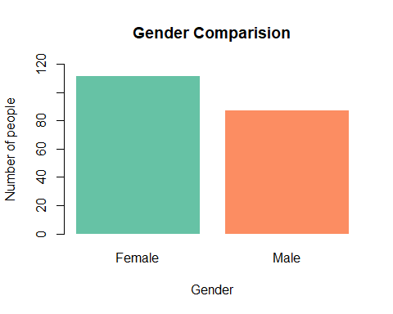
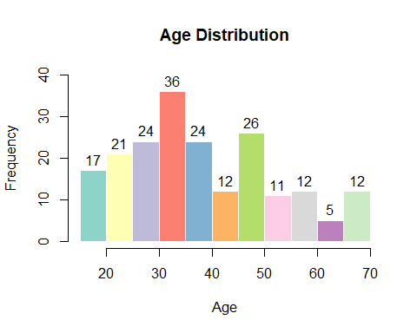

Slide 13
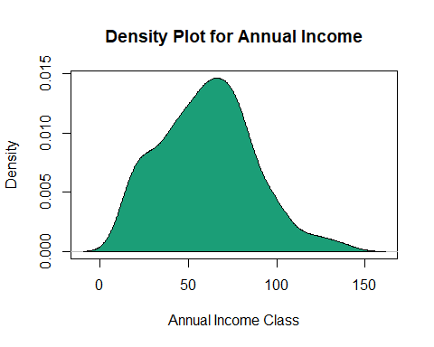
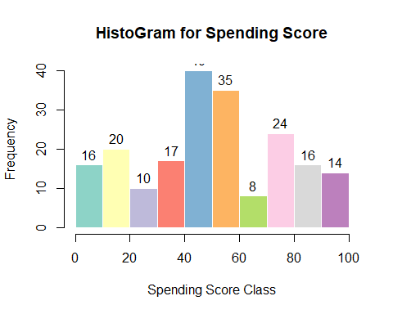
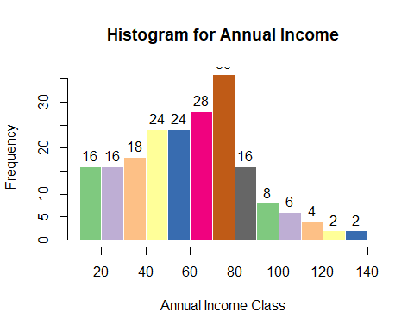

Slide 14
Determining optimal number of clusters

Slide 15
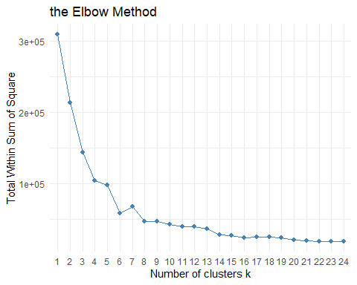
The “Elbow” Method
Probably the most well-known method, the elbow method, in which the sum of squares at each number of clusters is calculated and graphed, and the user looks for a change of slope from steep to shallow (an elbow) to determine the optimal number of clusters. This method is inexact, but still potentially helpful.
The Elbow Curve method is helpful because it shows how increasing the number of the clusters contribute separating the clusters in a meaningful way, not in a marginal way. The bend indicates that additional clusters beyond the fifth have little value.
The Elbow method is fairly clear, if not a naïve solution based on intra-cluster variance.

Slide 16
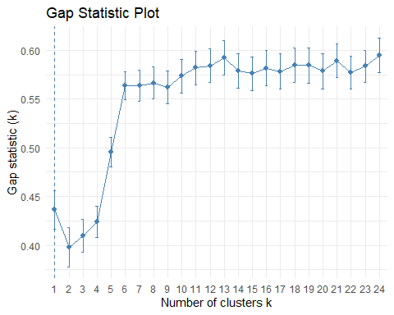
The Gap Statistic
The gap statistic compares the total within intra-cluster variation for different values of k with their expected values under null reference distribution of the data. The estimate of the optimal clusters will be value that maximize the gap statistic (i.e., that yields the largest gap statistic). This means that the clustering structure is far away from the random uniform distribution of points.
The gap stats plot shows the statistics by number of clusters (k) with standard errors drawn with vertical segments and the optimal value of k marked with a vertical dashed blue line.

Slide 17
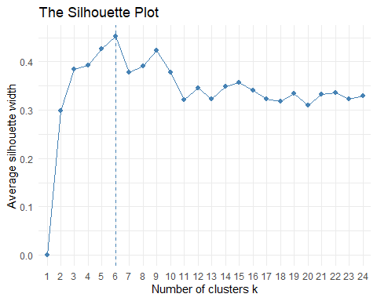
The Silhouette Method
Another visualization that can help determine the optimal number of clusters is called the a silhouette method. Average silhouette method computes the average silhouette of observations for different values of k. The optimal number of clusters k is the one that maximize the average silhouette over a range of possible values for k.

Slide 18
Visualizing the Identified Clusters

Slide 19
