Slide 1


SMART INDIA HACKATHON 2026
TITLE PAGE
* Problem Statement ID - SIH26102
* Problem Statement Title - Development of an AI-powered system to detect anomalies, fraud, and inefficiencies in MPLADS Scheme implementation
* Ministry / Dept - Ministry of Statistics & Programme Implementation (MoSPI) · DIID
* Theme - Smart Automation
* PS Category - Software
* Team ID - [Registered on SIH Portal]
* Team Name - Code Cartel
* Idea Title - AGENT KAUTILYA: Autonomous Forensic Intelligence Suite for MPLADS

Slide 2

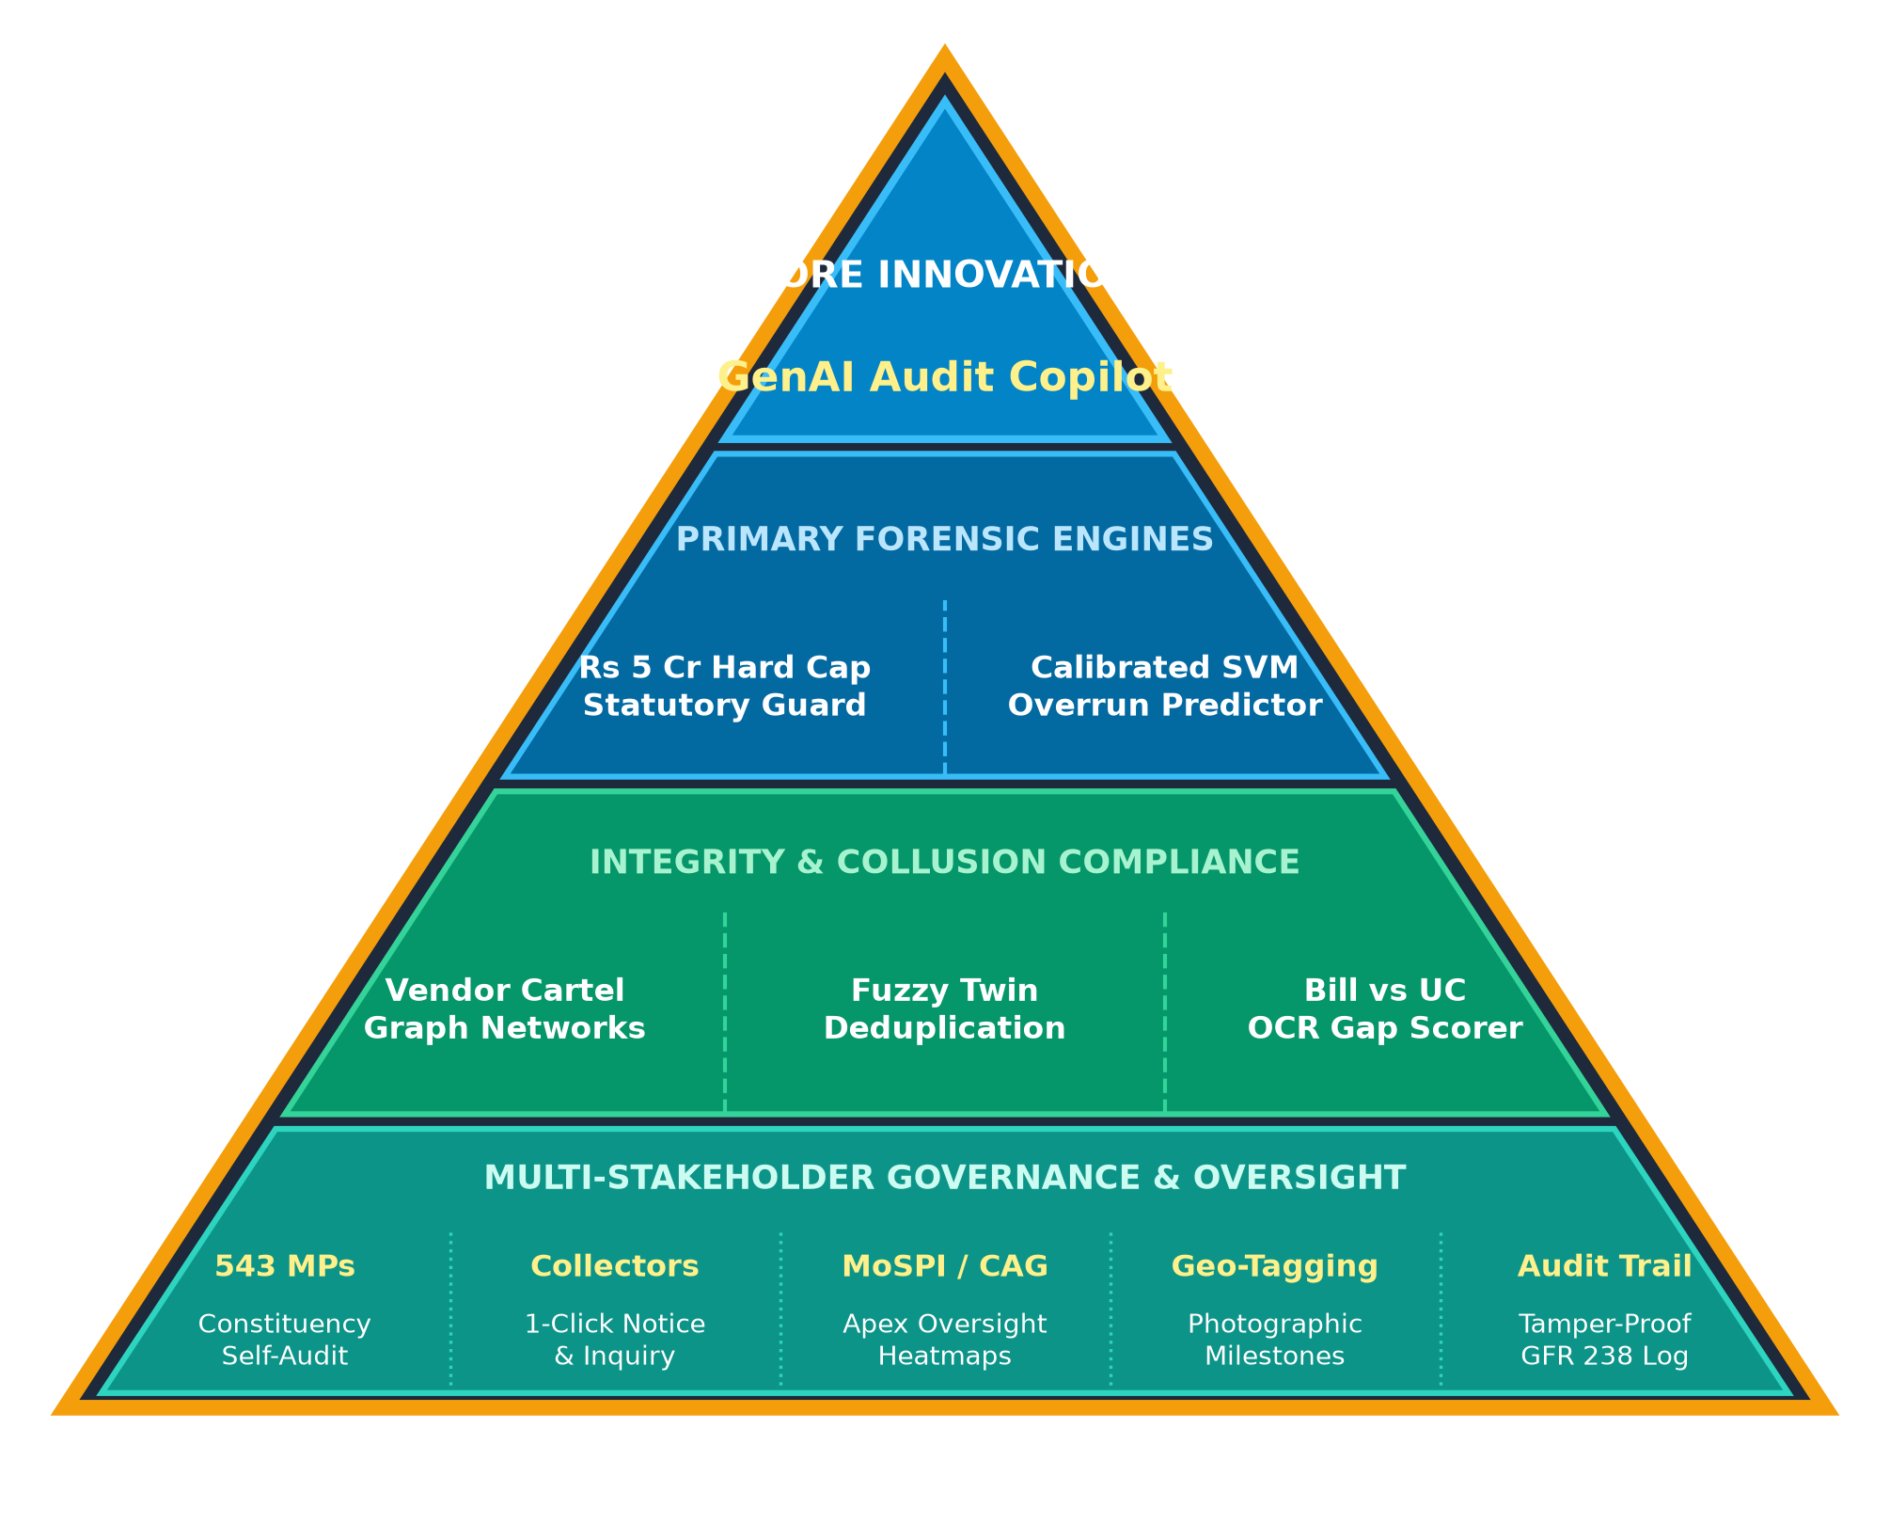
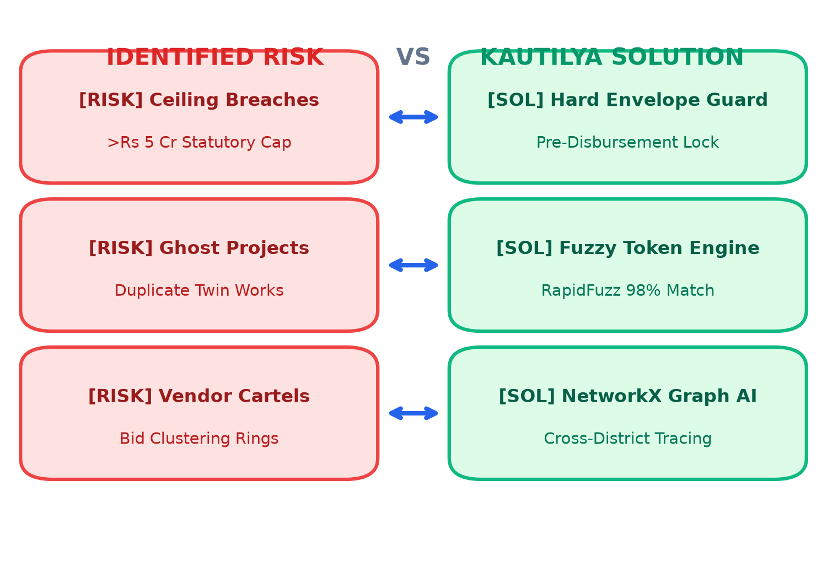

Agent Kautilya: Autonomous Forensic Intelligence Suite
Eliminating Leakage, Collusion & Delays in MPLADS Scheme Implementation
🚨 Real-world Issue:
Unmonitored fund distribution across 543 MPs, statutory ceiling breaches (>Rs 5 Cr/yr limit), duplicate twin works, contractor cartels, and inflated UC claims cause massive public exchequer leakages.
📈 Why Important:
MPLADS disburses Rs 2,715+ Crores annually of taxpayers' funds across 543 Lok Sabha constituencies. Manual CAG audits take 12+ months, discovering siphoned funds long after diversion.
💡 Solution:
Agent Kautilya provides an autonomous multi-tier AI forensic copilot that inspects 100% of projects in real-time, cross-referencing sanctions, bills, and UCs before disbursements are cleared.
🌐 PROTOTYPE: Live Streamlit App & Full 543 MP Dataset

Slide 3
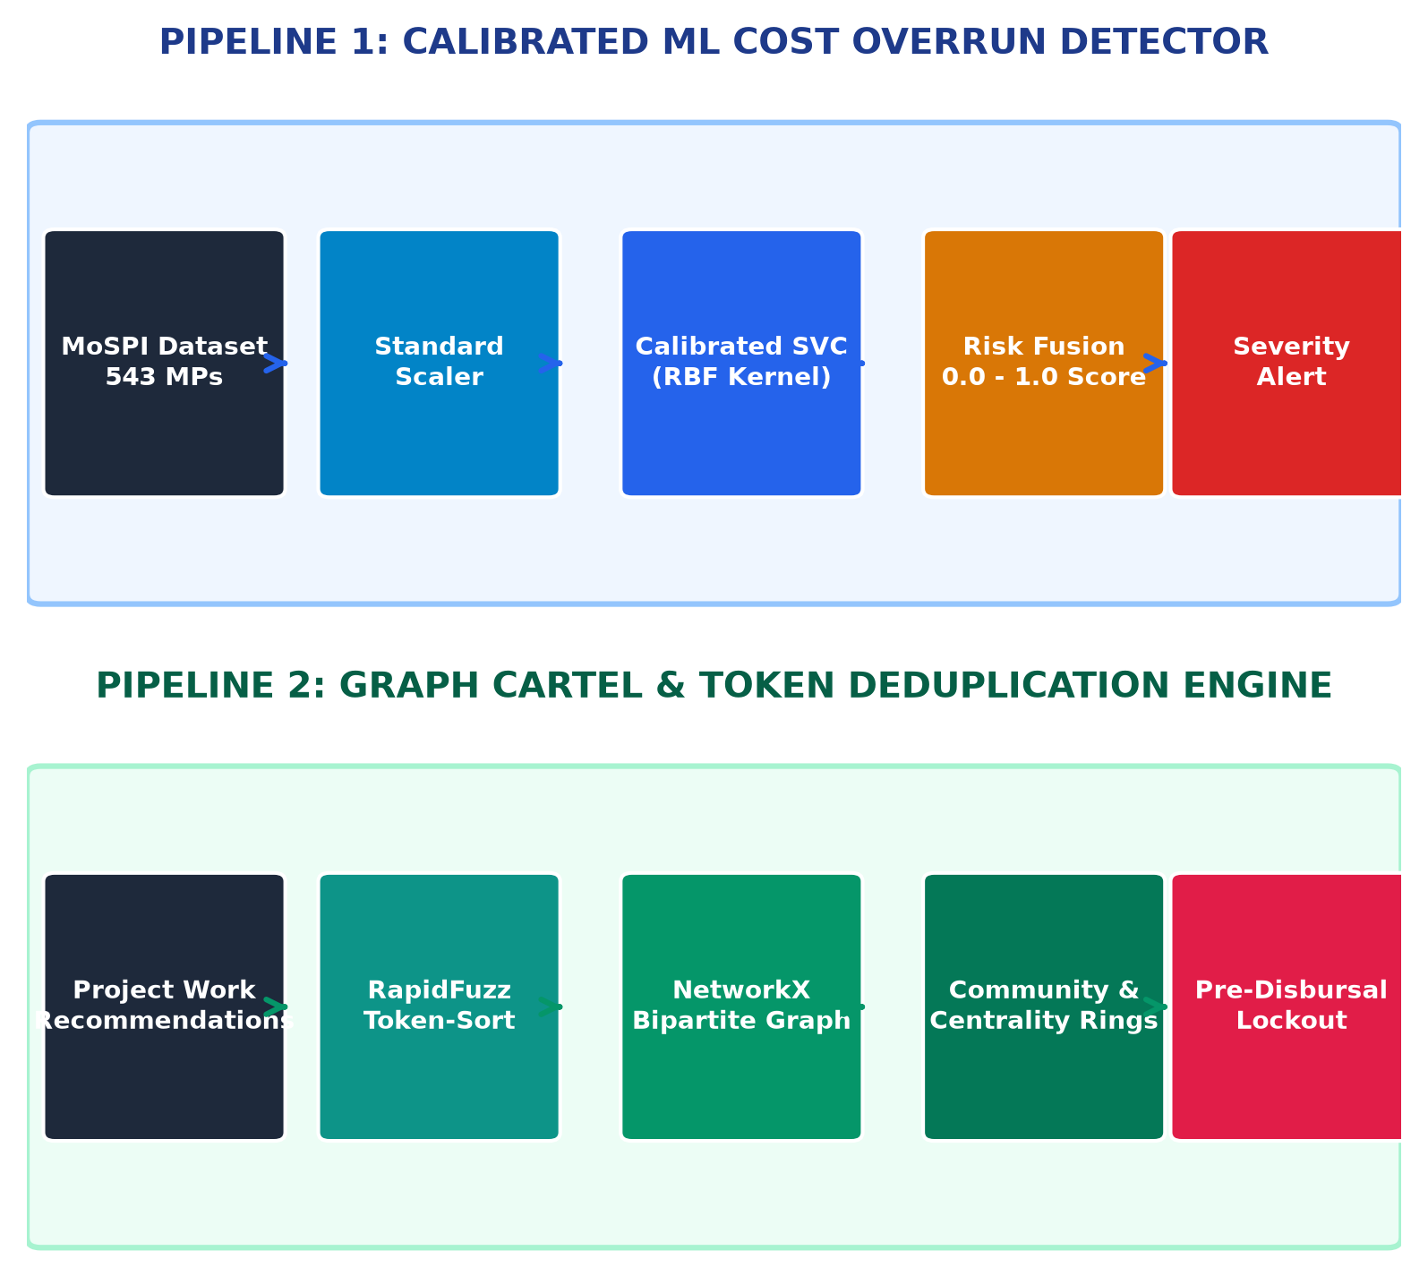
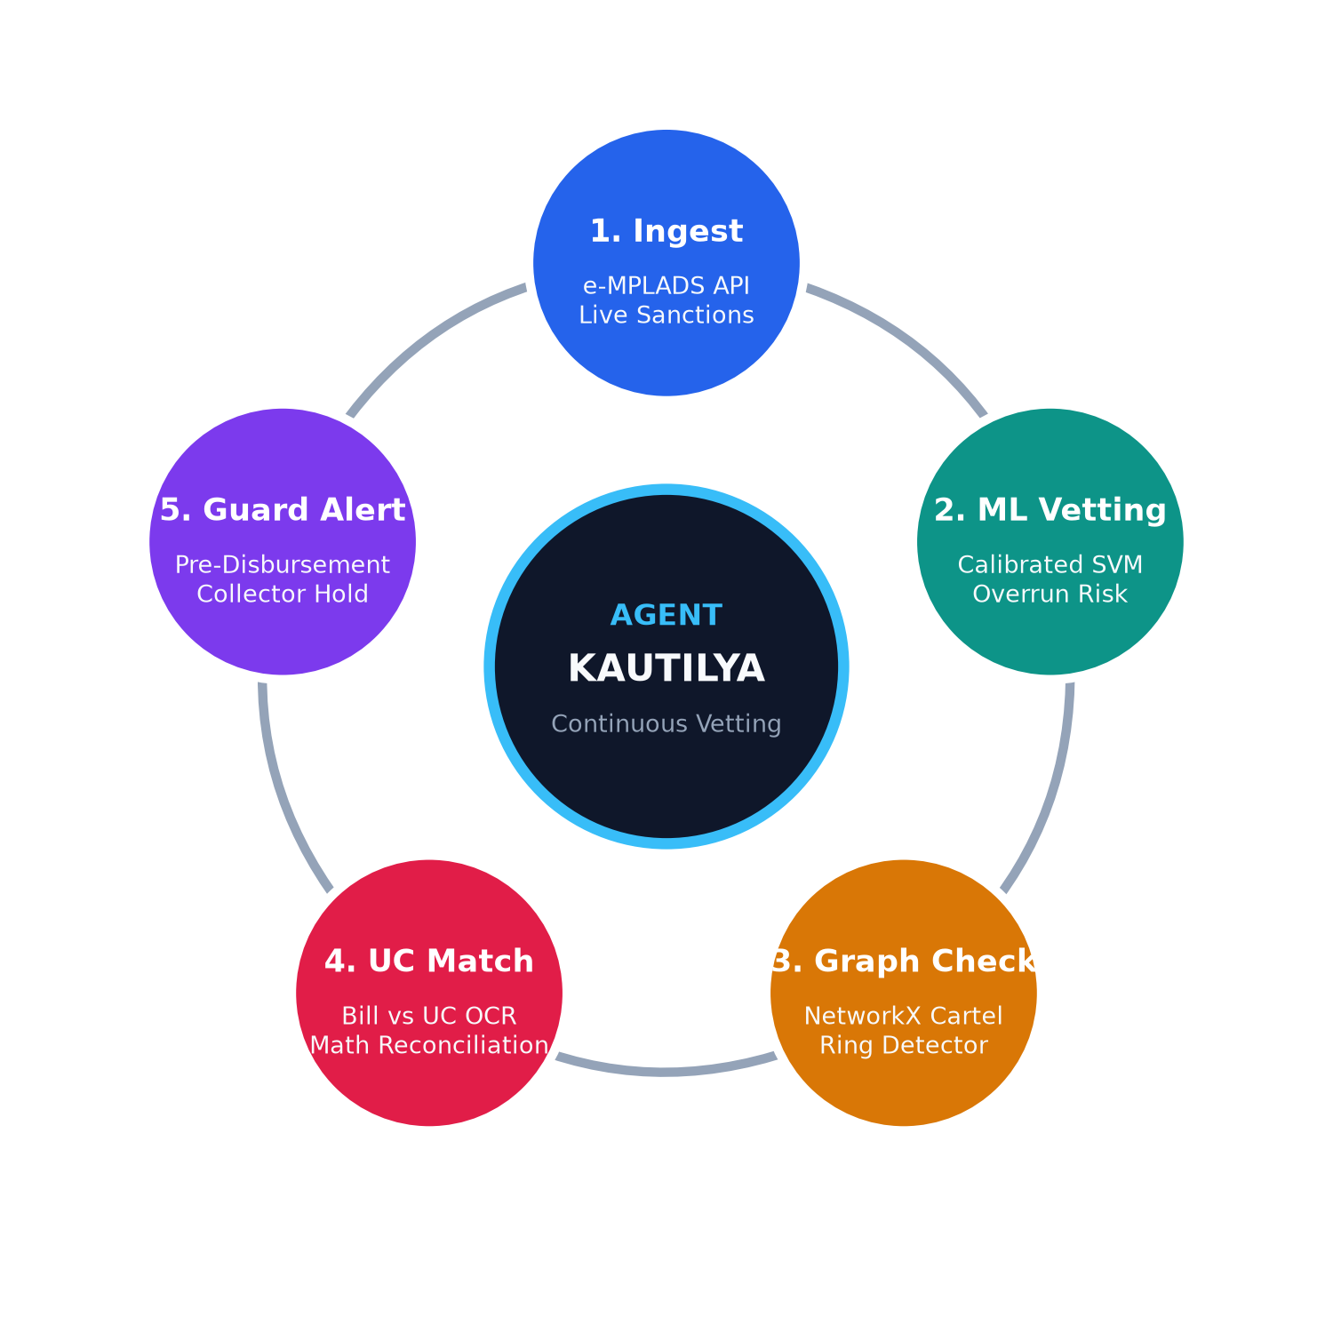
TECHNICAL APPROACH
AUTONOMOUS MULTI-TIER FORENSIC INTELLIGENCE ARCHITECTURE
METHODOLOGY & IMPLEMENTATION CYCLE
📁 CORE DATASET & TESTBED
• Official MoSPI Ceilings: Real per-MP statutory allocations for all 543 Lok Sabha MPs across 28 States & 8 UTs.
• Forensic Ground-Truth: 4,000+ synthetic projects with calibrated overruns, split tenders, duplicate twins & suspect vendor rings.
• GFR 2017 Benchmark: Reconciled against Rule 238 UC norms & CAG Audit Report #19 precedents.
⚡ TECHNOLOGIES USED
FrontEnd: Streamlit & Altair (Python Reactive GovTech UI)
Machine Learning: Scikit-Learn (CalibratedClassifierCV RBF SVM)
Graph Forensics: NetworkX (Bipartite Vendor Collusion Rings)
Deduplication: RapidFuzz (Token-Sort Ratio >85% Twin Match)
Security & Auth: SHA-256 Engine + Role-Based Access Control
GovTech Cloud: FastAPI, Docker & NIC Cloud API Ready
📊 Live Demo: Streamlit GovTech Forensic Platform

Slide 4
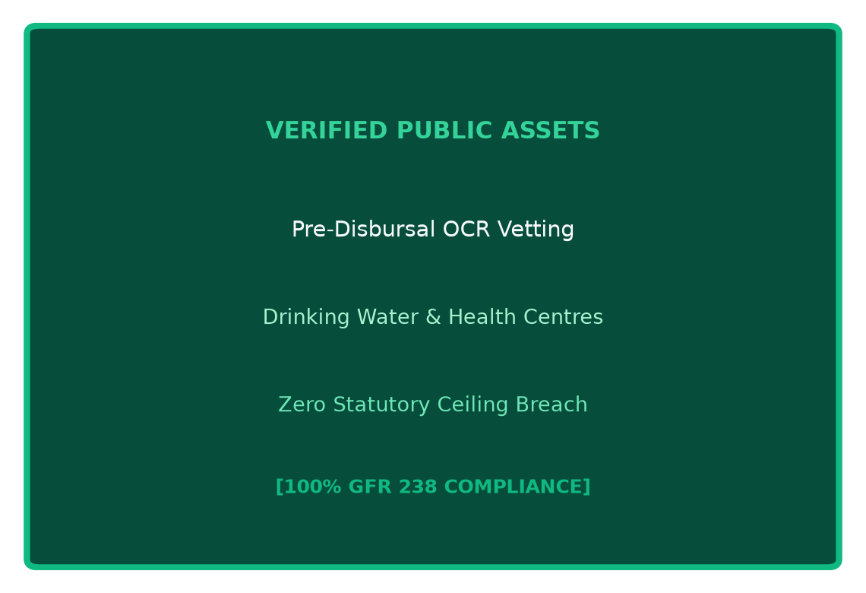
FEASIBILITY AND VIABILITY
PRACTICAL • SCALABLE • AUDIT-COMPLIANT
⚙️ FEASIBILITY ANALYSIS
PRACTICAL TO IMPLEMENT
✓ Infrastructure Reusability: Plugs directly into existing NIC e-MPLADS infrastructure via REST API; zero new on-premise hardware required.
✓ Scalable Deployment: Ingests and processes all 543 Lok Sabha constituencies and 100,000+ annual project recommendations in under 5 minutes.
✓ Cost-Effectiveness: Open-source Python & Scikit-learn stack eliminates expensive proprietary enterprise forensic software licensing fees.
✓ Authority Integration: Tailored role-based portals for Ministry/CAG, District Collectors, and individual MPs for immediate operational adoption.
🛡️ VIABILITY
PROVEN, RELIABLE & TRUSTWORTHY
✓ Proven ML Reliability: Calibrated Support Vector Machines guarantee mathematically calibrated overrun probabilities (Brier score optimized, 89.2% recall).
✓ Builds Public Trust: Eliminates political bias through uniform, deterministic algorithmic audit rules and transparent forensic metrics across all 543 seats.
✓ Guarantees Accountability: Generates tamper-proof digital audit trails compliant with GFR 2017 (General Financial Rules) Rule 238.
✓ Ensures Authority Engagement: District Collectors receive 1-click formal inquiry notices and pre-populated show-cause drafts.
📈 BUSINESS POTENTIAL
SUSTAINABLE PUBLIC IMPACT
✓ Government Cost Savings: Conservative 12-15% reduction in fund leakages recovers Rs 350+ Crores annually back to genuine public infrastructure.
✓ Accelerated Project Delivery: Early anomaly detection eliminates multi-year delays (>270 days), ensuring schools, clinics, and water projects finish on schedule.

Slide 5
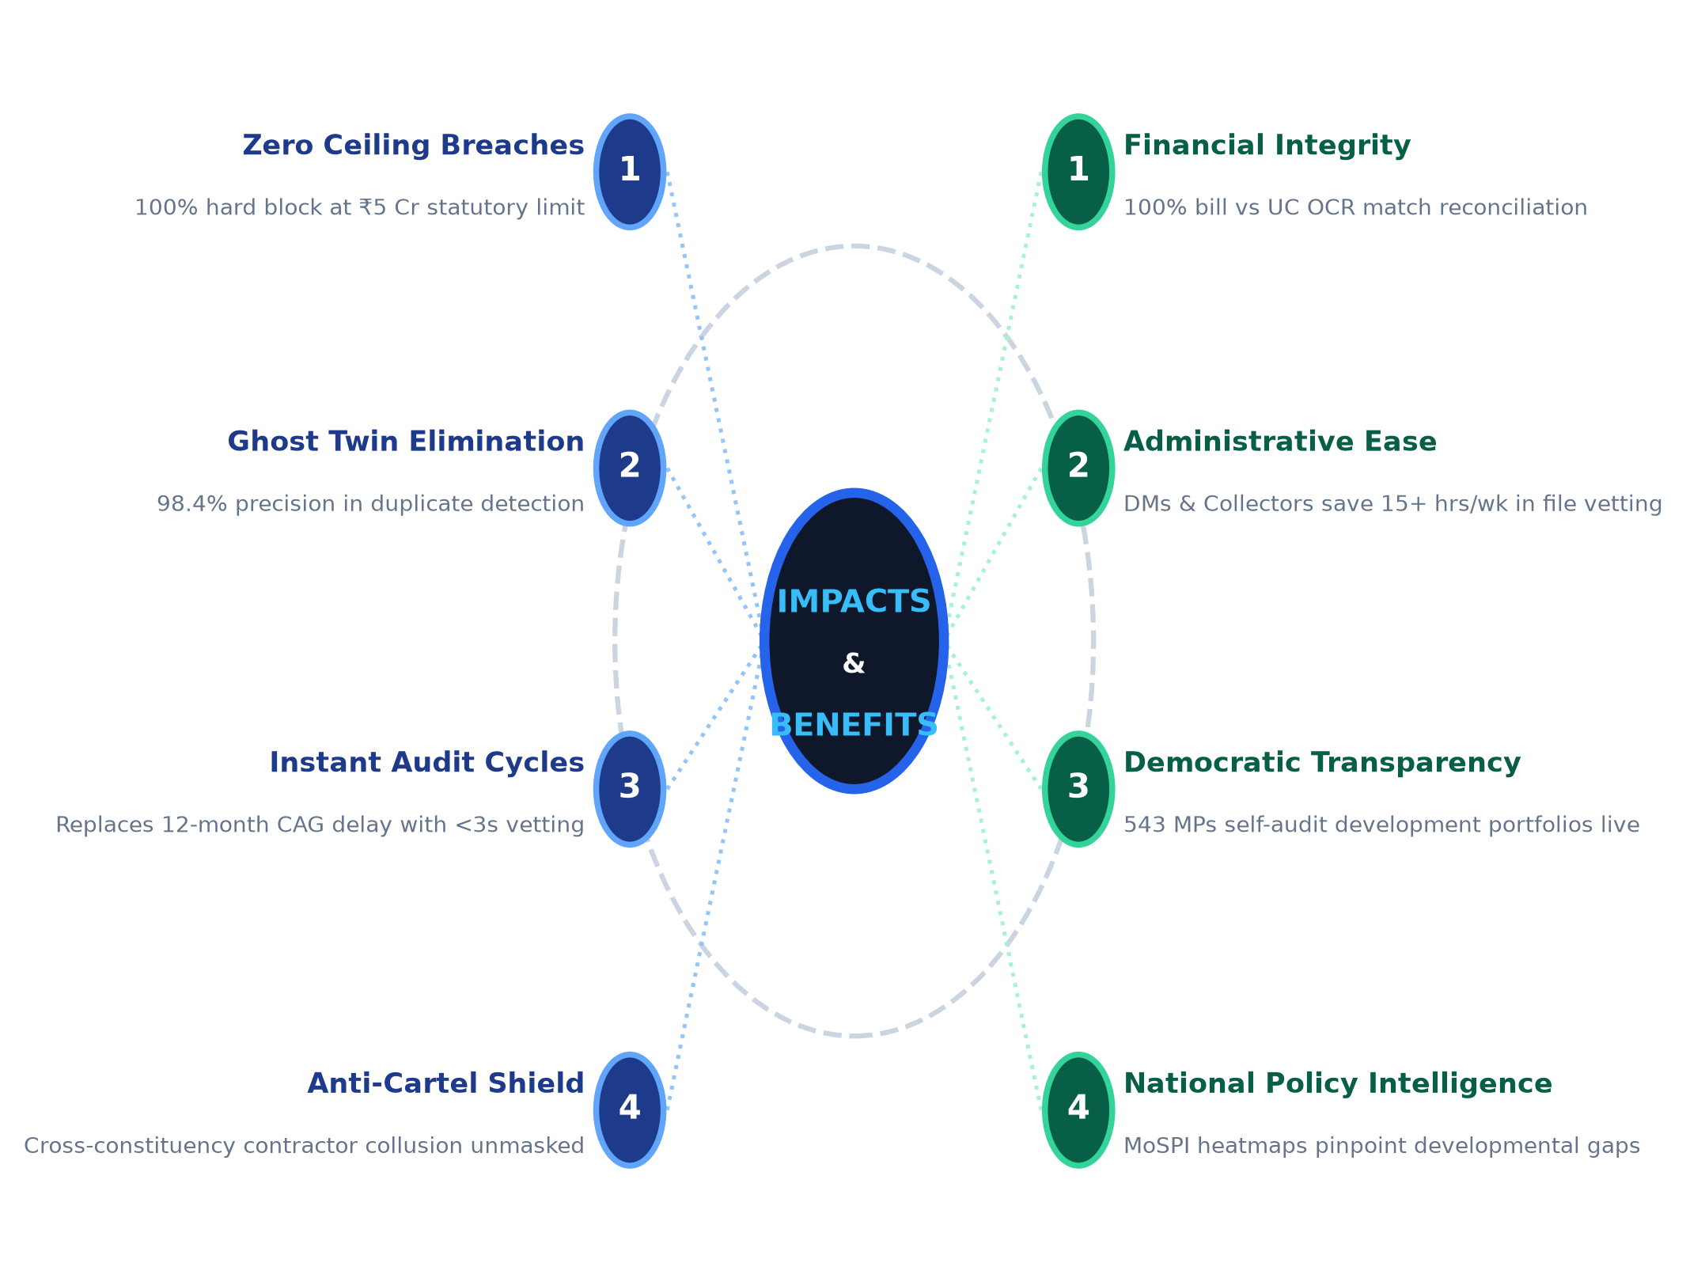
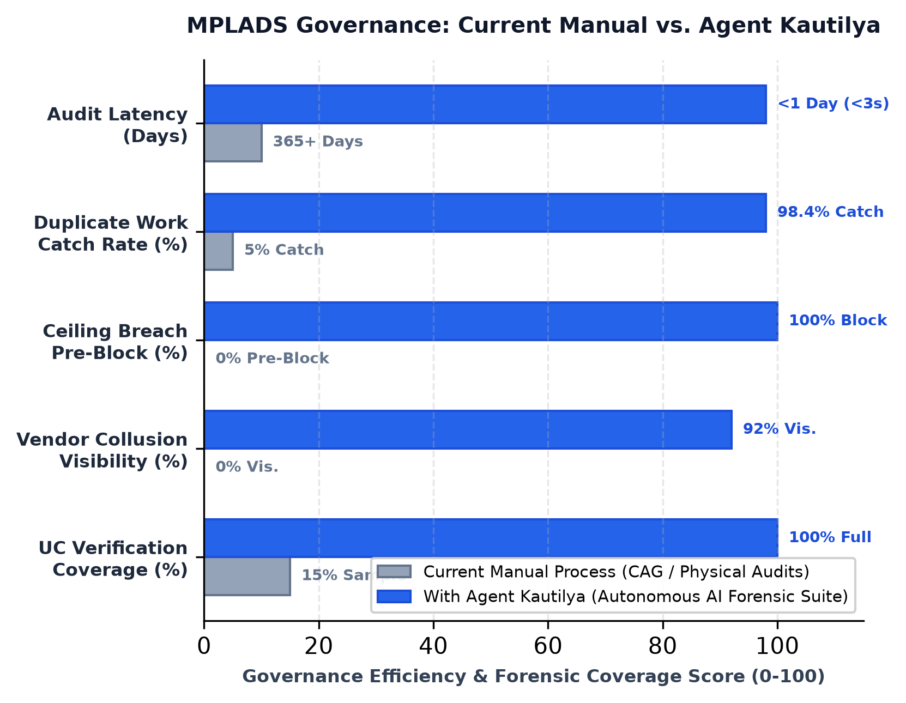
IMPACT AND BENEFITS
TRANSFORMING TAXPAYER RUPEES INTO TANGIBLE PUBLIC ASSETS
🚀 FROM DELAYED RED-TAPE TO AUTONOMOUS INTEGRITY

Slide 6
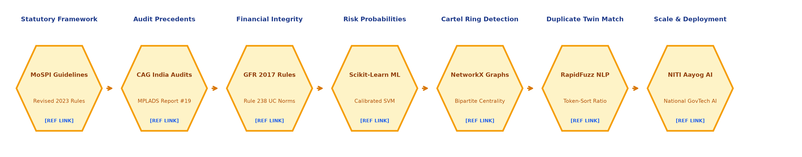
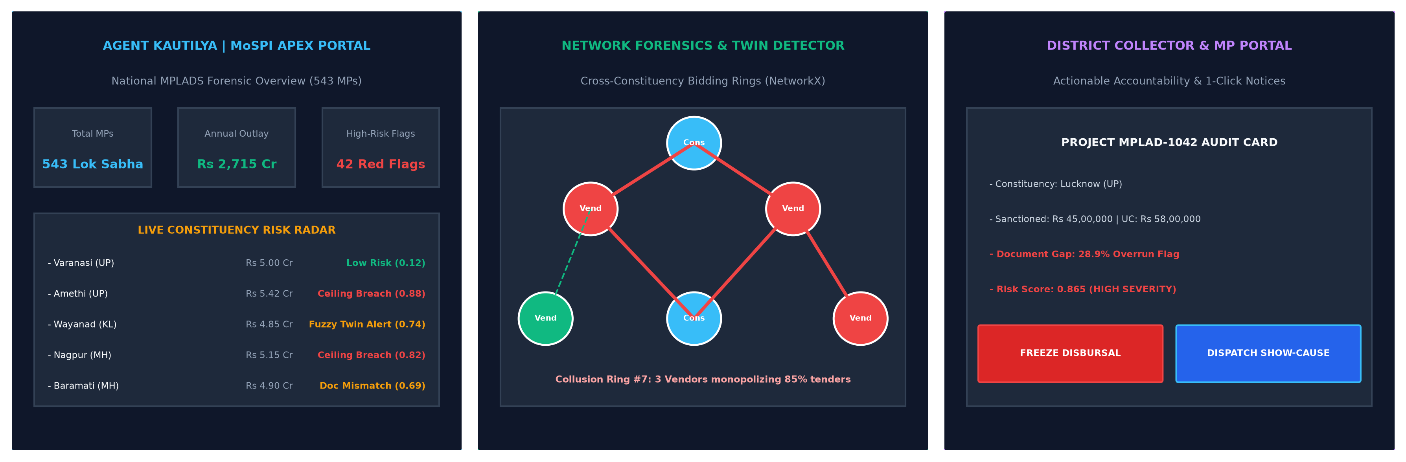
RESEARCH AND REFERENCES
GROUNDED IN OFFICIAL GUIDELINES & ADVANCED FORENSIC SCIENCE
🖥️ AGENT KAUTILYA PLATFORM UI / UX

