Slide 1
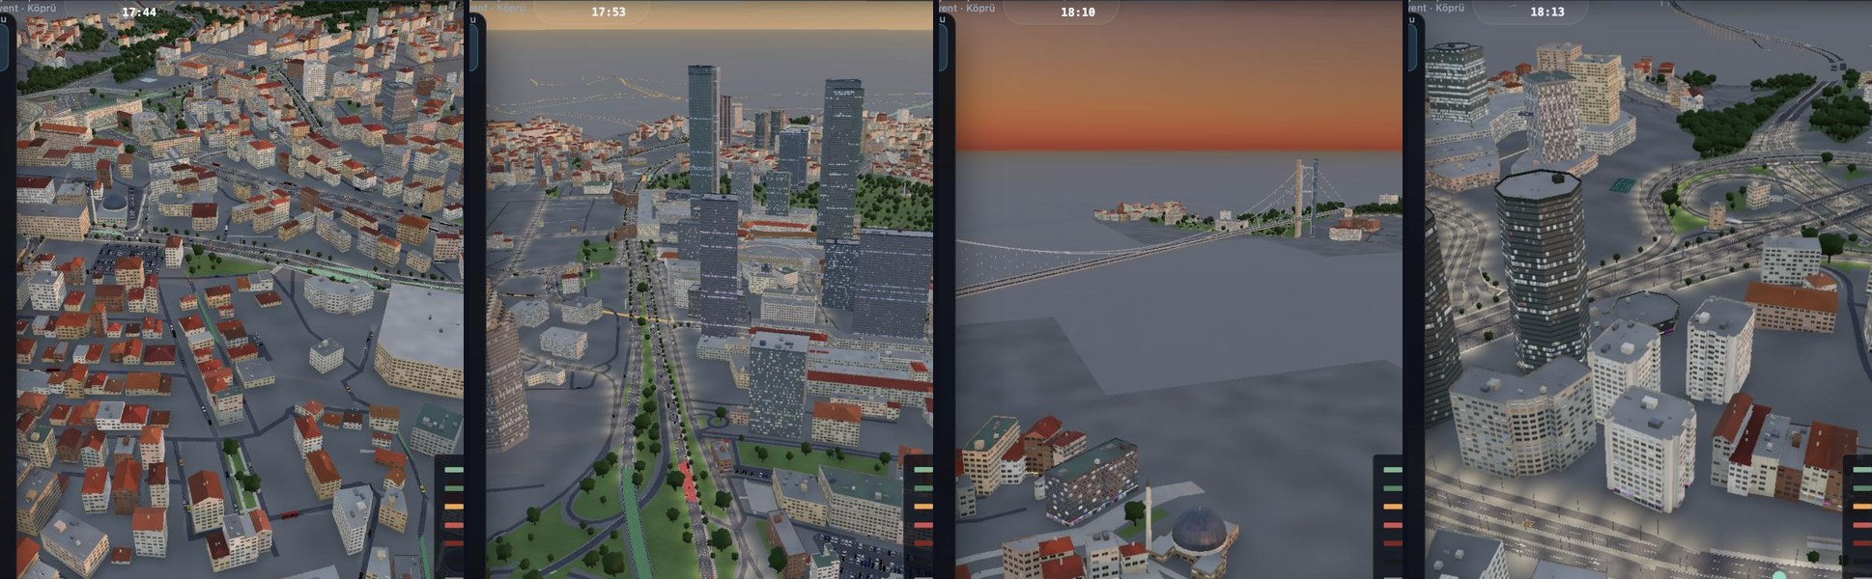
PROCEDURAL ISTANBUL
Reading a city's traffic from road speeds
An open digital twin of Istanbul's Maslak – 15 July Bridge corridor
Abdurrahim Arif Aşıroğlu
October 2026 · aaasiroglu.github.io/procedural-istanbul
Notes:
Hello everyone. Today I will show you a project about traffic in Istanbul. The short version: we only measure how fast cars move on the roads, and from that we try to work out how many people travel from where to where. I will keep it simple, and at the end you can open the project on your phone.

Slide 2



The big question
How many cars travel from where to where, every hour?
Planning
Where do we need more capacity, a new lane, a new bus line?
Accidents
If a motorway closes, where will the cars go?
Traffic engineers call this table an origin–destination (O-D) matrix. Every simulator, every new road plan and every response to an accident starts from it.
Simulation
A traffic simulator needs to know who travels where.
Notes:
The question is simple: how many cars go from each area to each other area, every hour. This table is called an O-D matrix: O for origin, D for destination. Planners need it, accident response needs it, and every traffic simulator needs it. The problem: no sensor measures it directly.

Slide 3
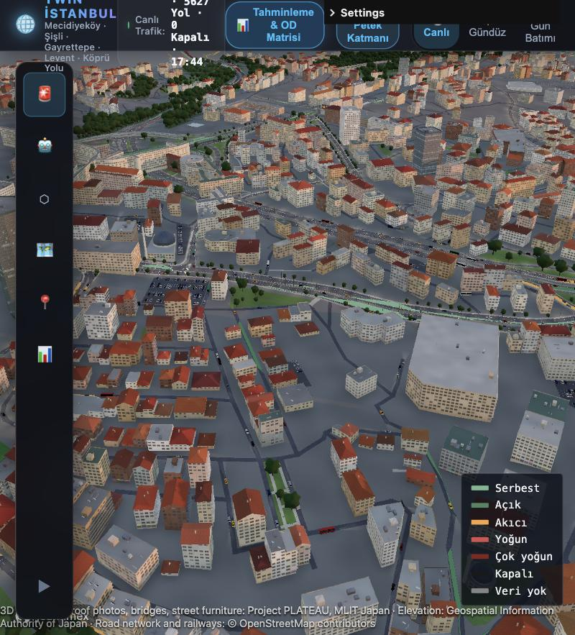
What we can measure in Istanbul
~1,000
road pieces with a live speed, updated every few minutes
23
car counters: only a few places count actual cars
31
metro and Metrobüs stops: Istanbulkart taps per hour
All of it is free, open data from the Istanbul Metropolitan Municipality (İBB) and OpenStreetMap.
Roads coloured by live İBB speeds
Notes:
Here is what we have. Speeds: about one thousand road pieces, live. Counts of actual cars: only 23 places. And the Istanbulkart taps at 31 metro and Metrobüs stops. So we know speeds almost everywhere, but car numbers almost nowhere. Everything here is open data.

Slide 4
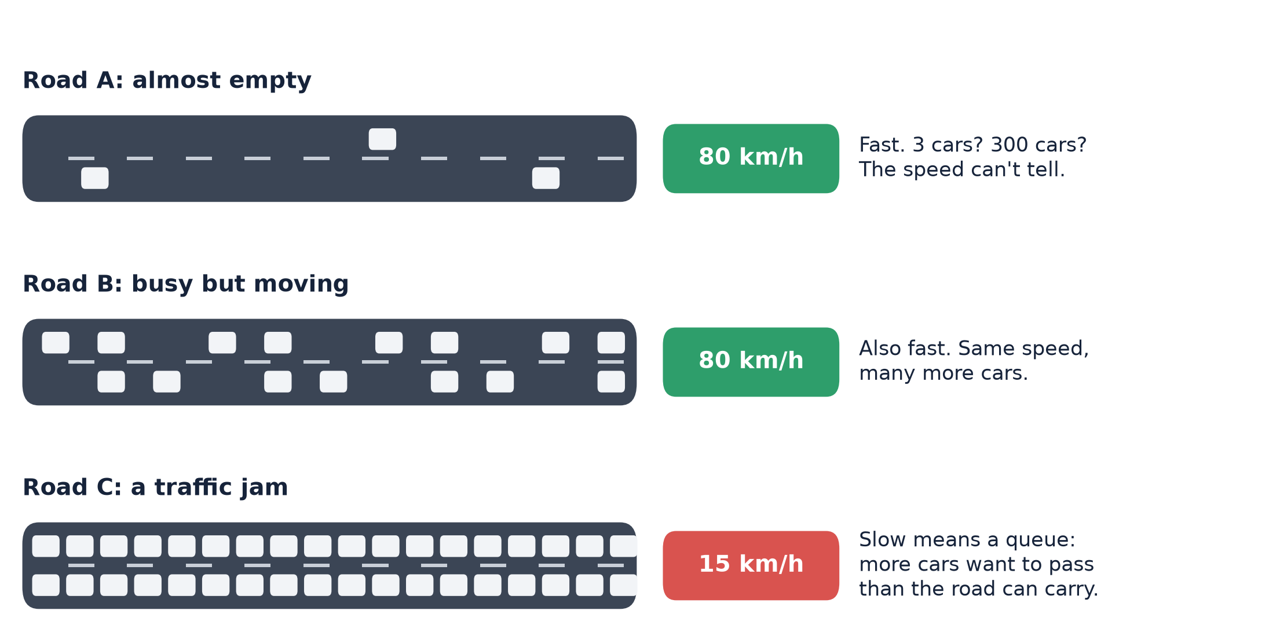
Why is this hard? A speed is not a count
Our rule
Fast road:
“at most this many cars”
Jammed road:
“at least this many cars”
We never invent an exact number.
This careful use of speed (a “censored observation”) is the main idea of the project.
Notes:
This is the key idea. Look at roads A and B: both at 80 km per hour. One has three cars, the other has many. The speed cannot tell them apart. Road C is slow, so there is a queue: more cars want to pass than the road can carry. So a fast road gives us 'at most', a jammed road gives us 'at least'. Most methods turn speed into an exact count. We do not, because that would be making up numbers.

Slide 5



Our approach in three steps
1 Measure
→
2 Work backwards
→
3 Check and simulate
Speeds on 1,000 roads, 23 car counters and metro card taps
Find the trips that best explain what we measured, and say how sure we are
Test on data the model never saw, then play “what if” in a traffic simulator
Like a detective: we do not see the trips, only their footprints on the roads.
Notes:
The project has three steps. First, measure: speeds, counts, card taps. Second, work backwards: which trips would create this traffic? And for every number we also say how sure we are. Third, check honestly and then simulate. It is a bit like a detective: we do not see the trips, only their footprints.

Slide 6
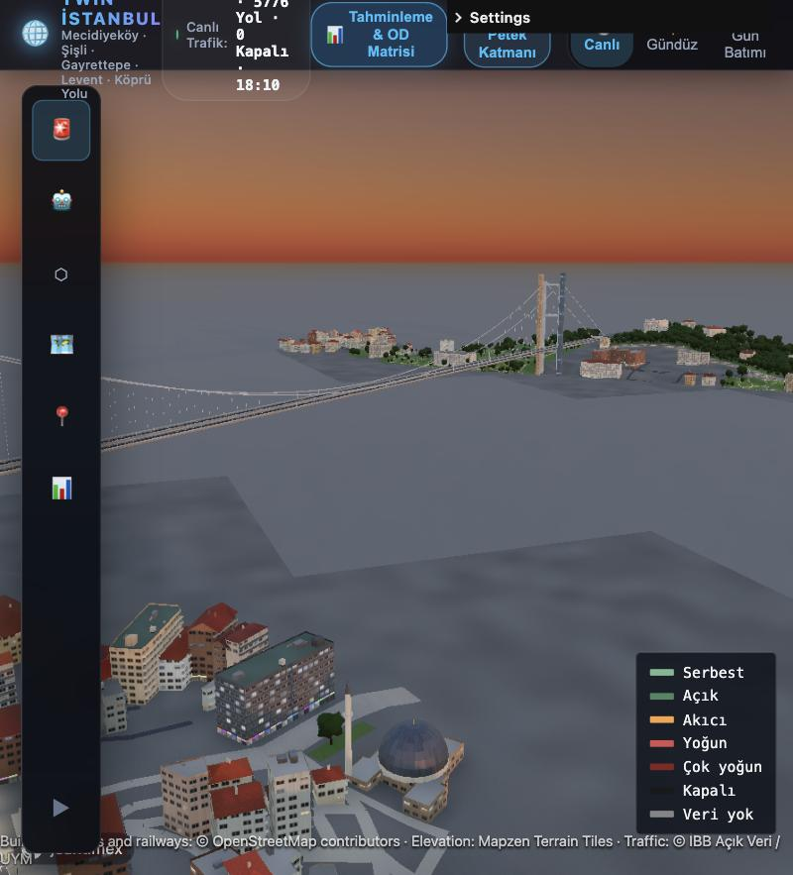
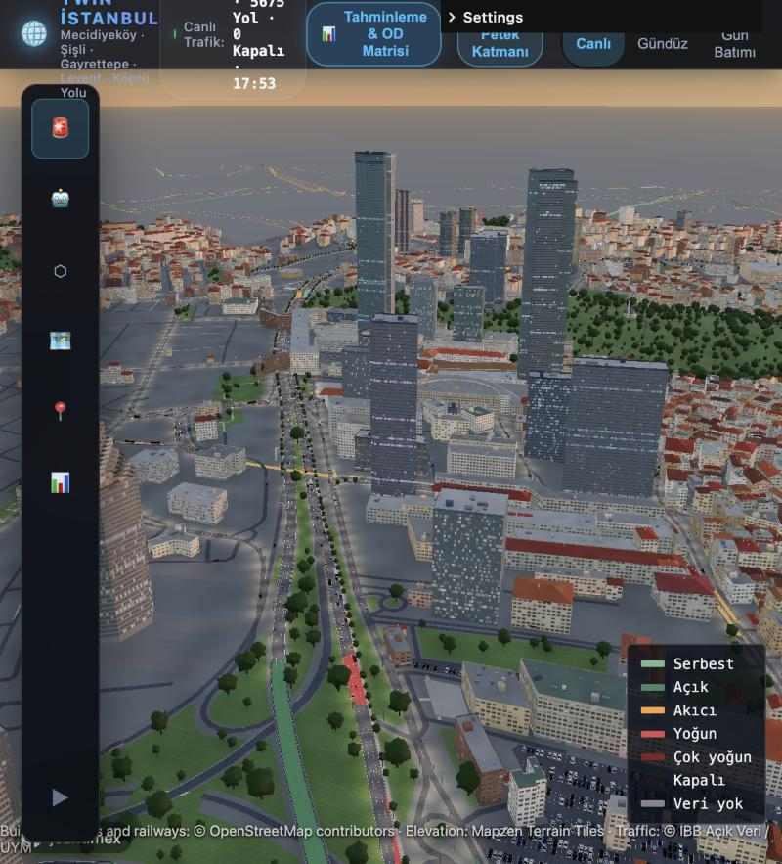
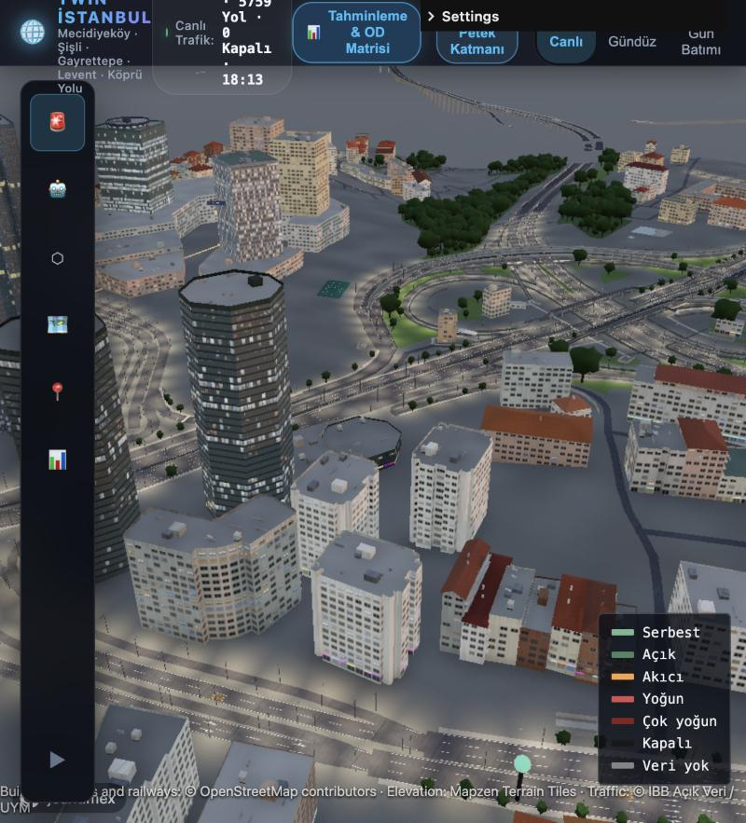
Step 1 · A 3D copy of the city from open data
15 July Bridge and Ortaköy
Levent towers
Zincirlikuyu junction
38,000 buildings · 1,170 km of roads · runs in a web browser · roads coloured by live İBB speeds
Notes:
Step one is the city itself. We built a 3D copy of the corridor from OpenStreetMap: about 38 thousand buildings and 1,170 kilometres of roads. It runs in a normal web browser, and the roads are coloured with the live speeds from İBB. Behind it there is a real traffic simulator called SUMO.

Slide 7
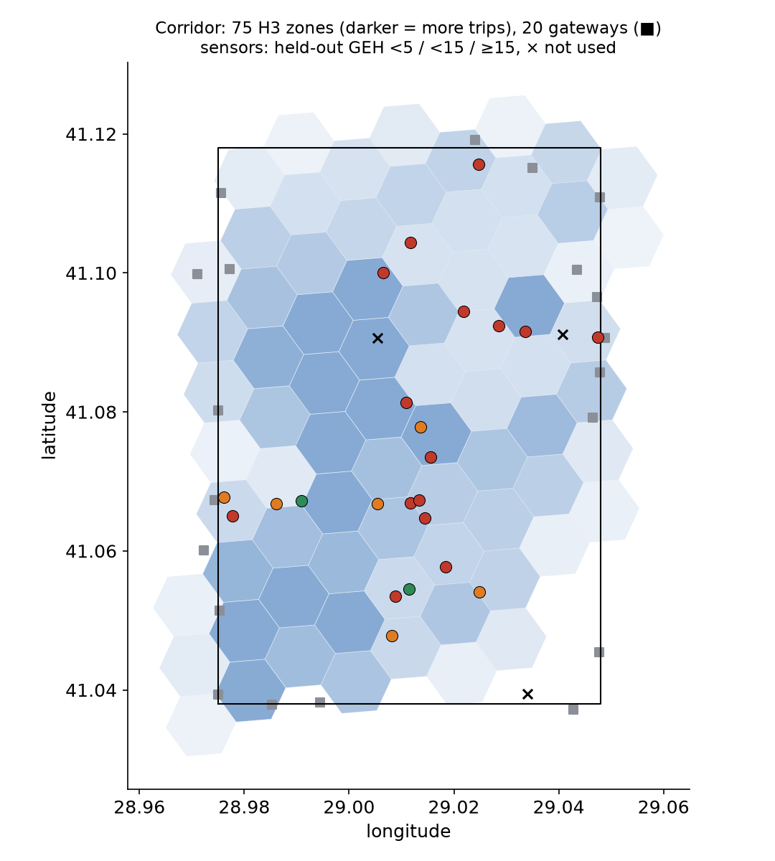




Step 2 · Work backwards from speeds to trips
95 areas
75 hexagons inside the corridor and 20 “gates” where big roads cross its edge, like the bridge
9,025 possible trips
every area to every other area; far more unknowns than measurements
A first guess
from buildings and shops: “this area sends out so many cars”
Then the data corrects it
and for every number we report how much came from data and how much from the guess
Notes:
Step two. We split the corridor into 95 areas: 75 hexagons inside and 20 gates where big roads like the bridge cross the edge. That gives 9,025 possible area-to-area trips: many more unknowns than we have measurements. So we start with a first guess from buildings and shops, and let the data correct it. For every number we also say how much came from data and how much from the guess.

Slide 8
Key finding: our first guess was 3 times too high
3×
too many cars in the first guess, built only from buildings
When we fed the first guess into the simulator, the whole network locked up. The counts showed why: the city was simply too full of imaginary cars. Now the total comes from measurements, and we can say so with 81 % of it backed by data.
Notes:
This is the most important result. Our first guess, built only from buildings, said about 118 thousand cars per hour. The real counts brought it down to about 62 thousand: the first guess was roughly three times too high in its overall level. That explains why our first simulation locked up completely. Now the total comes from measurements, and 81 percent of it is backed by data.

Slide 9

Checking honestly: hide the answer, then predict it
Like an exam you have not seen
We hide one car counter, build the model without it, predict that counter, and compare with the real number. Then we repeat for every counter.
The score is called GEH: below 5 is a good match. The usual target is below 5 on 85 % of counters.
Honest result: the total is right, but where the cars go is not yet right. Only about 1 counter in 10 is predicted well. We report this openly.
Notes:
How do we know if the model is good? We do not grade it on the numbers it already saw. We hide one counter, build the model without it, and ask it to predict that counter. Like an exam you have not seen. The score is called GEH; below 5 is good. Our error went down from about 36 to 23. But honestly, the target is not reached yet: the total is right, but where exactly the cars go is still weak. We say that openly.

Slide 10


What if the motorway closes? Ask the simulator first
At the moment of an accident we take a “snapshot” of all traffic, then play several futures from the same snapshot, much faster than real time.
Road stays open
the reference
Drivers not told
they find out at the closure
Drivers warned at once
signs and navigation apps
Answer: warn drivers at once. +735 cars get through compared with not telling them. All runs took about 9 minutes.
Notes:
Now a practical use. Imagine a five-lane part of the TEM motorway closes. We take a snapshot of all traffic and play three futures from it: the road stays open, drivers are not told, or drivers are warned at once. Warning drivers at once gets 735 more cars to their destination in 20 minutes. And the computer answered in about 9 minutes, so the decision is ready before the problem grows. One honest note: part of the gain comes from drivers re-planning their route more often.

Slide 11


Where we are: what works and what does not yet
Works
Not yet
3D city with live İBB speeds, in the browser
Total traffic level set by real counts
Honest checks on hidden counters
“What if” simulator for accidents
Recommendations panel built on real data
Where the cars go: only 1 counter in 10 predicted well
Some counters may count one direction only: İBB must confirm
Only one hour of one day so far
Fast AI version: first try failed our own check
Next: more days and hours, confirm the counters with İBB, and train the fast AI version on simulator runs.
Notes:
To sum up honestly. What works: the 3D city with live speeds, the total traffic level from real counts, honest checks, the what-if simulator, and a recommendations panel on real data. What does not work yet: predicting where exactly the cars go; some counters may count only one direction, which İBB needs to confirm; we have only one hour of one day; and a fast AI version did not pass our own quality check yet.

Slide 12


Try it yourself
The live 3D twin
Project site, report and slides
aaasiroglu.github.io/procedural-istanbul/app
aaasiroglu.github.io/procedural-istanbul
Notes:
You can try it now. The left code opens the live 3D twin; it works best on a laptop. The right code opens the project site, with a simple explanation of every term, the full technical report and these slides. Everything is open source.

Slide 13
Thank you
Questions?
One idea to remember: a speed tells you “at most” or “at least”, never an exact number of cars.
Notes:
Thank you. If you remember one thing: a speed tells you 'at most' or 'at least', never an exact number of cars. Using it honestly is the whole idea. Questions are welcome.

