Slide 1
TUTORIAL 2

Slide 2
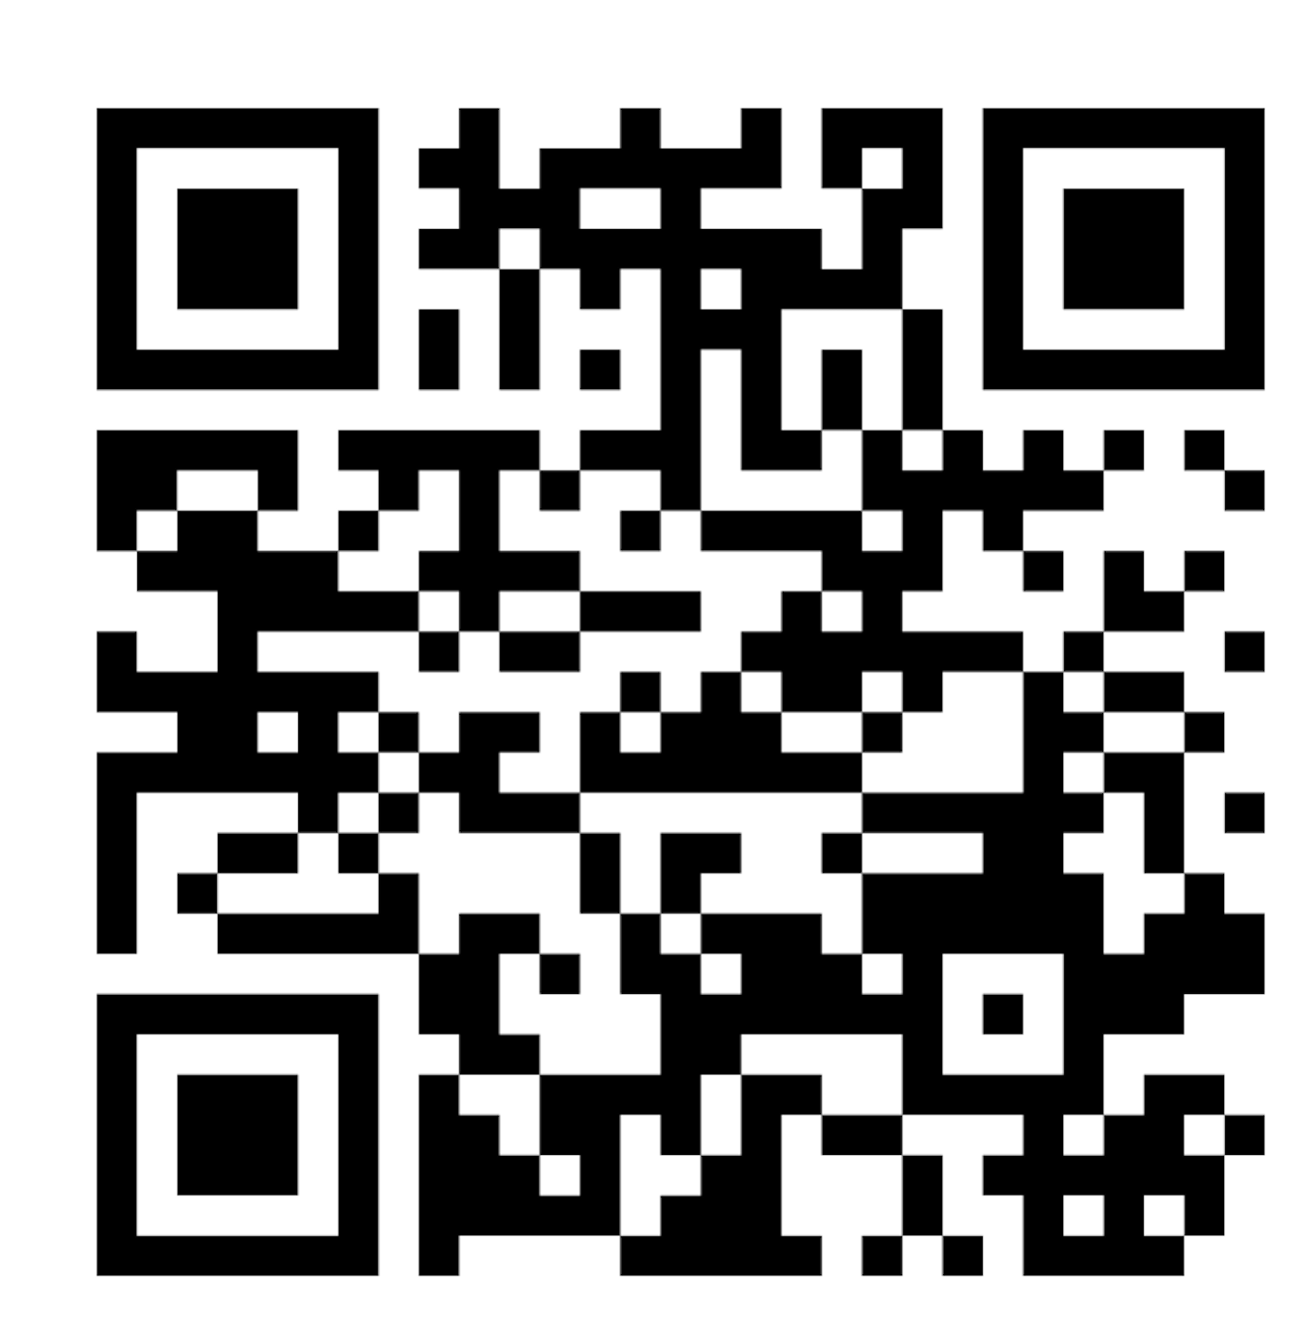
https://www.menti.com/alrk1keuyr4k

