Slide 1
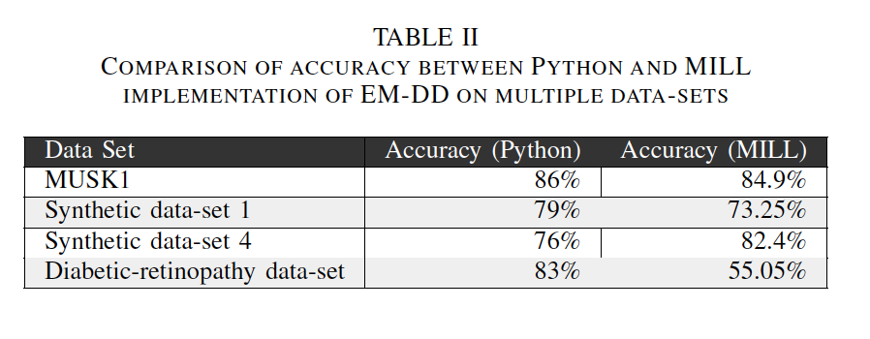
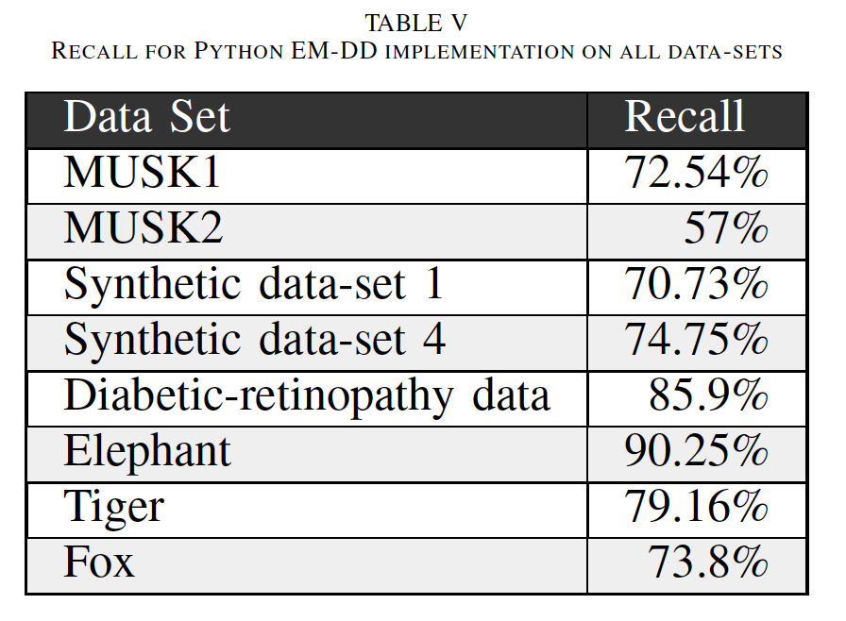
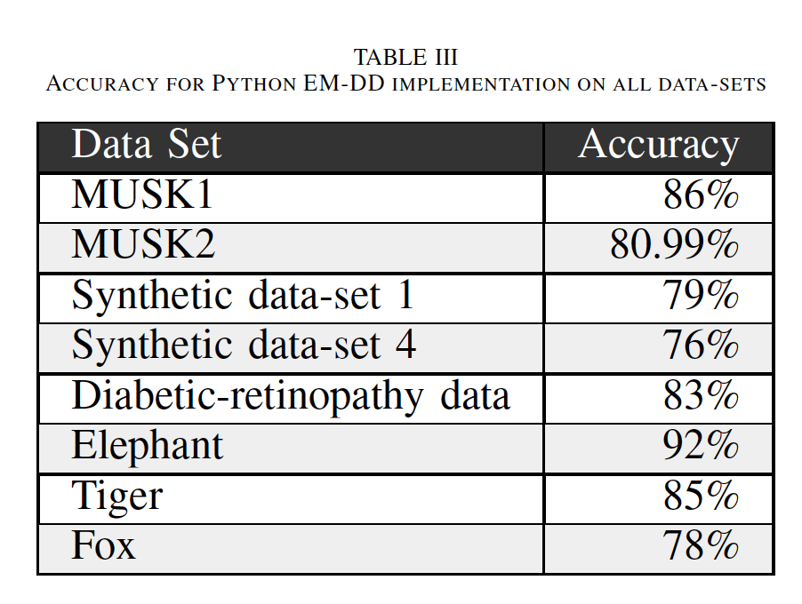
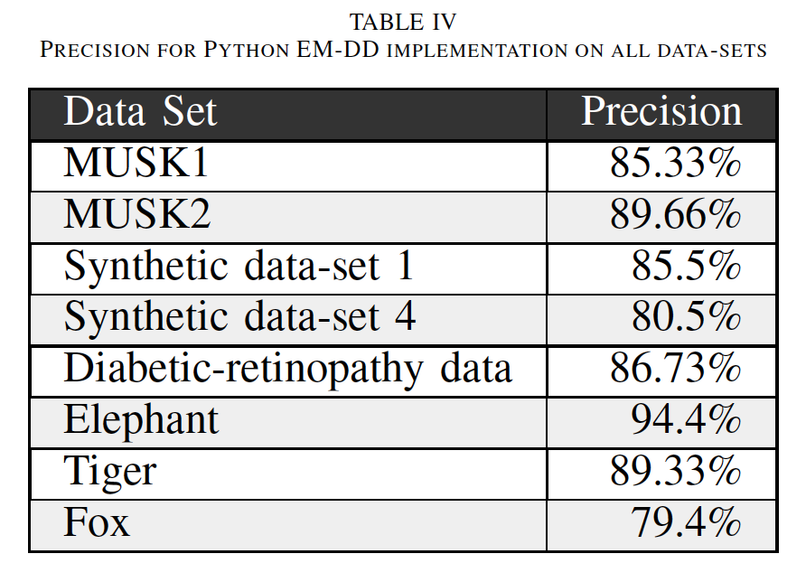
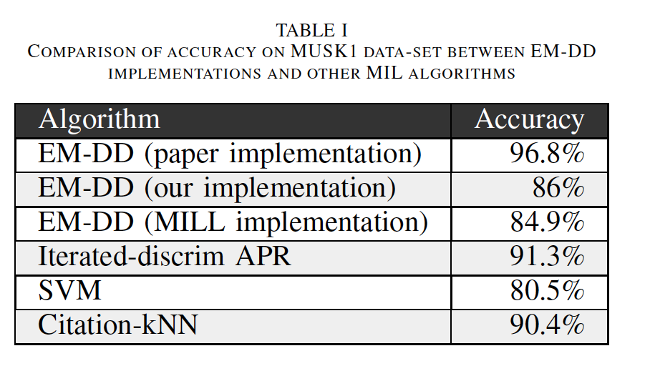
Multiple Instance Learning using EMDD
Vivin Paliath, Tejas Khairnar
Arizona State University
Introduction
EMDD algorithm
Results - con’t
Results - con’t
In this paper, we investigate and implement the Expectation Maximization Diverse Density (EM-DD) algorithm, and compare its performance to other, similar algorithms. EMDD is an approach that has seen significant success in Multiple-Instances Learning problems and is a generalization of the supervised-learning classification-problem. Our goal is to demonstrate an understanding of this algorithm by providing a valid implementation and measuring its performance against various data sets. We will also compare the performance of the EM-DD
algorithm against the MatLab MIL-toolkit implementation.
Step 1: The algorithm starts with an initial guess of the target point t, using instances from positive bags
Step 2: It then repeatedly performs the E -step and the M -step to search
for the maximum-likelihood hypothesis
Step 3: In the E -step, the
algorithm needs to select the appropriate instances from the bag.
Step 4: It identifies the most-likely instance from each bag that is responsible for the label of the bag, based on the current target t .
Step 5: In the M -step, the algorithm uses a gradient-ascent search to find the new target t’ that maximizes the diverse-density at
h.
Step 6: After the maximization set, t is set to t0 and the algorithm returns to the first step and runs until convergence.
Conclusions
Successfully implemented EMDD algorithm in Python
Ran our implementation over the following datasets
  Musk 1
  Musk 2
  Synthetic Dataset 1
  Synthetic Dataset 2
  Diabetic-retinopathy Dataset
  Elephant dataset
  Tiger Dataset
  Fox Dataset
Investigated other methods like Iterated-discrim APR, SVM, Citation-kNN which solve the MIL problem
Compared results of our implementation with CMU MIL toolbox
Our Approach
We successfully implemented the EM-DD algorithm using the Python programming-language and verified its correctness
In Python, we used the SciPy Library to perform Mathematical operations
To minimize the criterion function we used scipy.optimize.minize
EMDD algorithm in MILL toolkit uses the average of the estimated target and scale vector corresponding to the best diverse density
We were able to increase our performance by using average of the results.
Our implementation will only update the value of the previous density if the current density is better
We also calculate precision and recall in addition to the accuracy.
We also perform 10-fold cross validation to calculate our average accuracy.
Results
References
Q. Zhang et.al“Em-dd: An improved multiple-instance learning technique,” in Advances in neural information processing systems, 2001, pp. 1073–1080.
T. G. Dietterich, et.al. “Solving the multiple instance problem with axis-parallel rectangles,”

