Slide 1
Project 2 Report
Data Agent System and LLM Startup Business Plan
Zhang Yan 12313327
Q1
Data Agent
Q2
Startup Plan
System
Architecture

Slide 2
02
Overview
Project Scope
A complete path from model training to product design.
Q1 Technical Prototype
DataMind-12K selection
Qwen3.5-0.8B LoRA tuning
Gradio Web Demo
Q2 Business Plan
InsightPilot AI startup idea
SME data analysis SaaS
Pricing, GTM and risks
Industrial Architecture
LLM engine and sandbox
Async queue for heavy jobs
Storage and monitoring layer

Slide 3
03
Q1
Data Agent Pipeline
The technical workflow implemented in the project.
1
Data Selection
2
ChatML Data
3
LoRA Training
4
Adapter Export
5
Web Demo
Input
DataMind-12K multi-turn analysis trajectories
Training Objective
Improve instruction following for data analysis tasks
Output
A local assistant with file upload and code execution

Slide 4
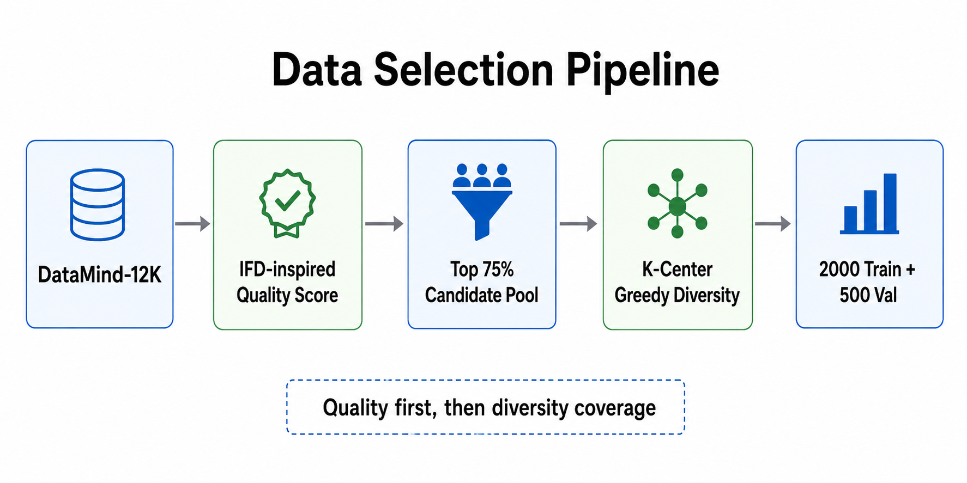
04
Method
Data Selection Pipeline
Quality filtering followed by diversity-aware sample selection.
The selected subset is designed to preserve both sample quality and task diversity.

Slide 5
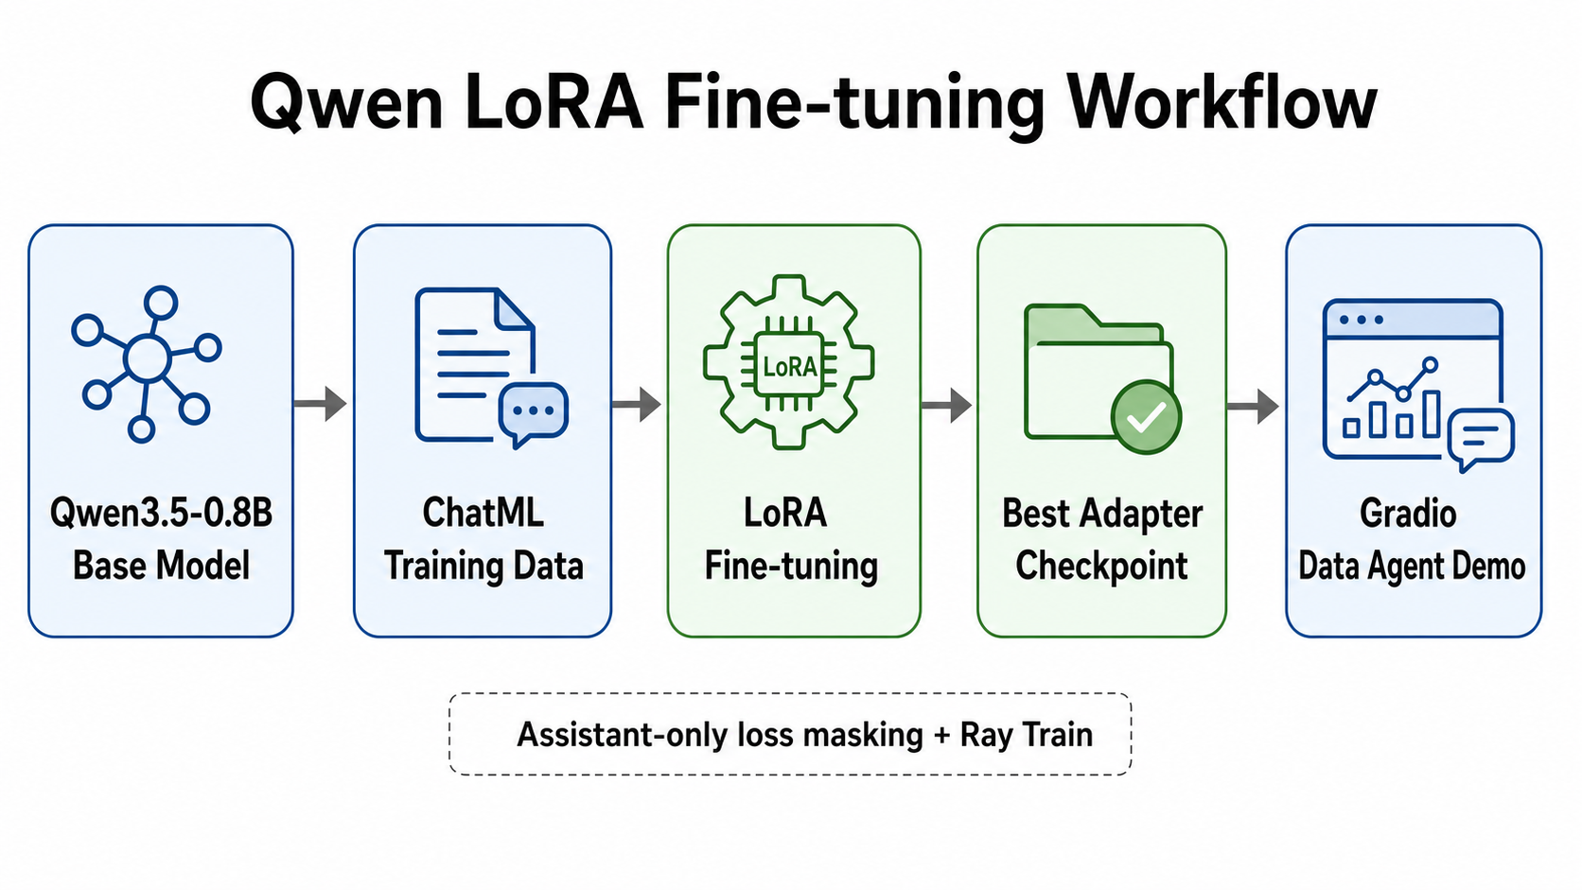
05
Training
Qwen LoRA Fine-tuning Workflow
The model is adapted with LoRA and deployed through the Gradio demo.
The workflow links ChatML data, Ray Train, LoRA adapter checkpoint and the final demo.

Slide 6
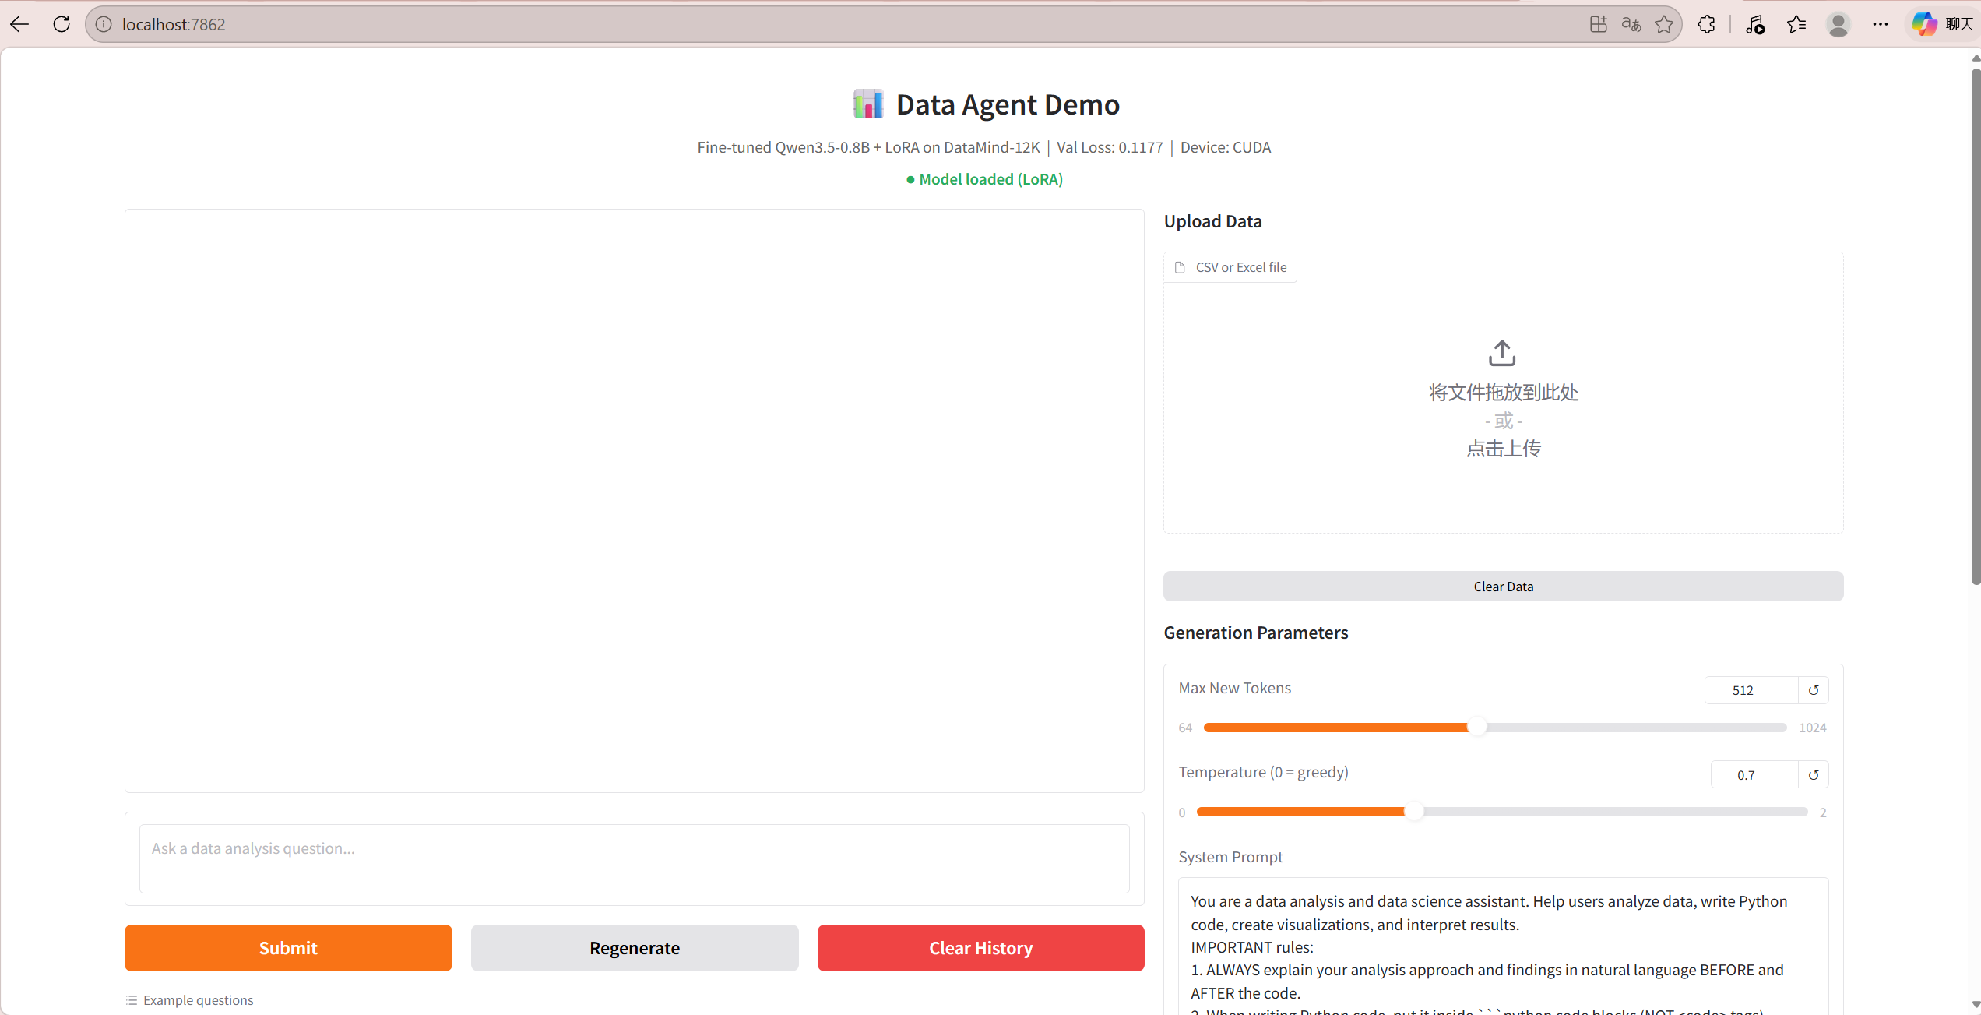
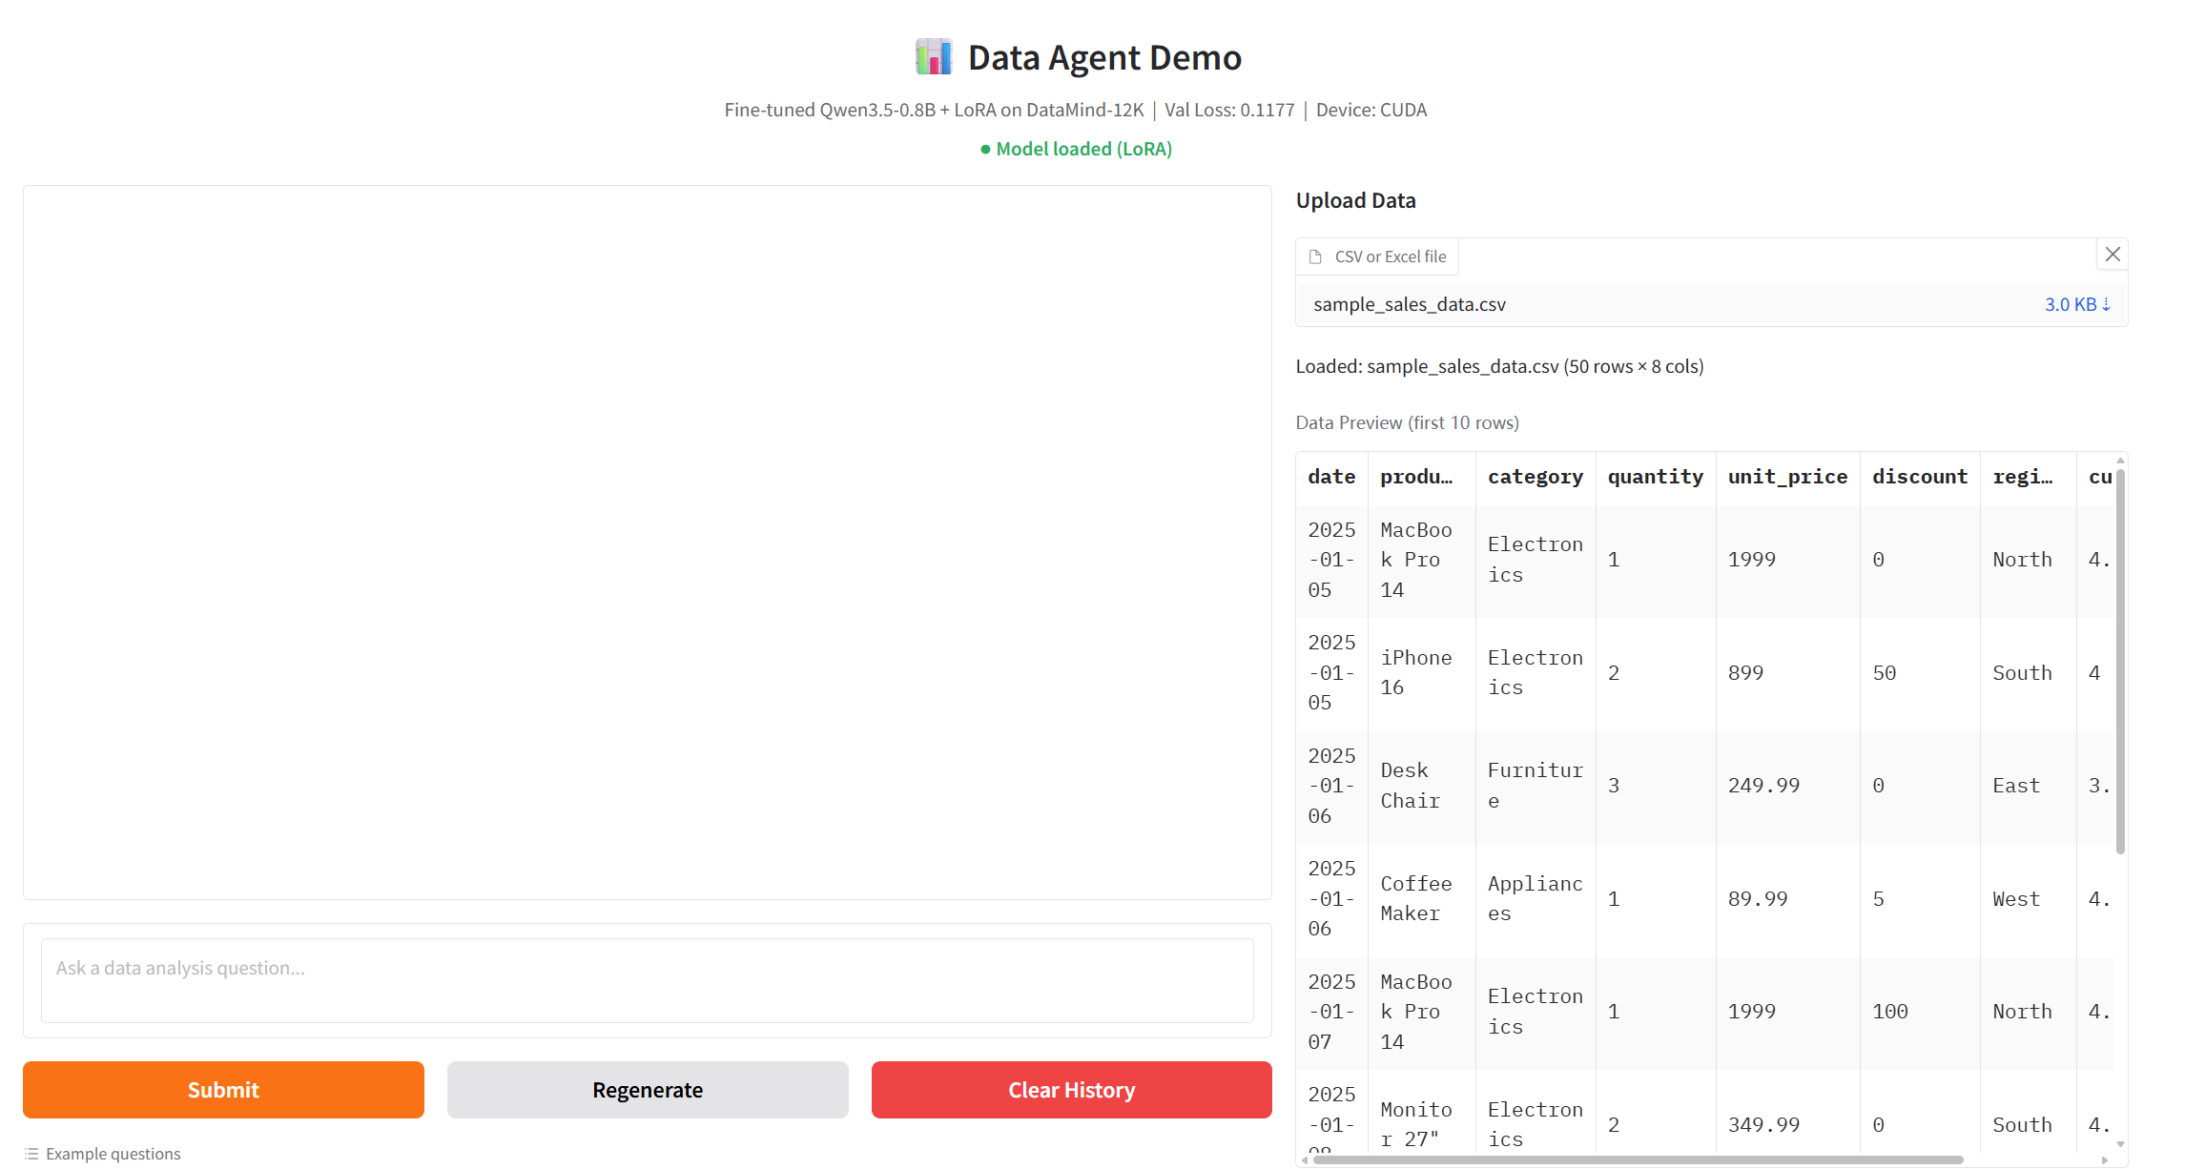
06
Demo
Web Demo: Model and Data Upload
The demo runs locally with CUDA and LoRA loaded.
Model loaded, Val Loss displayed, CUDA device active.
CSV upload shows file metadata and first 10-row preview.

Slide 7
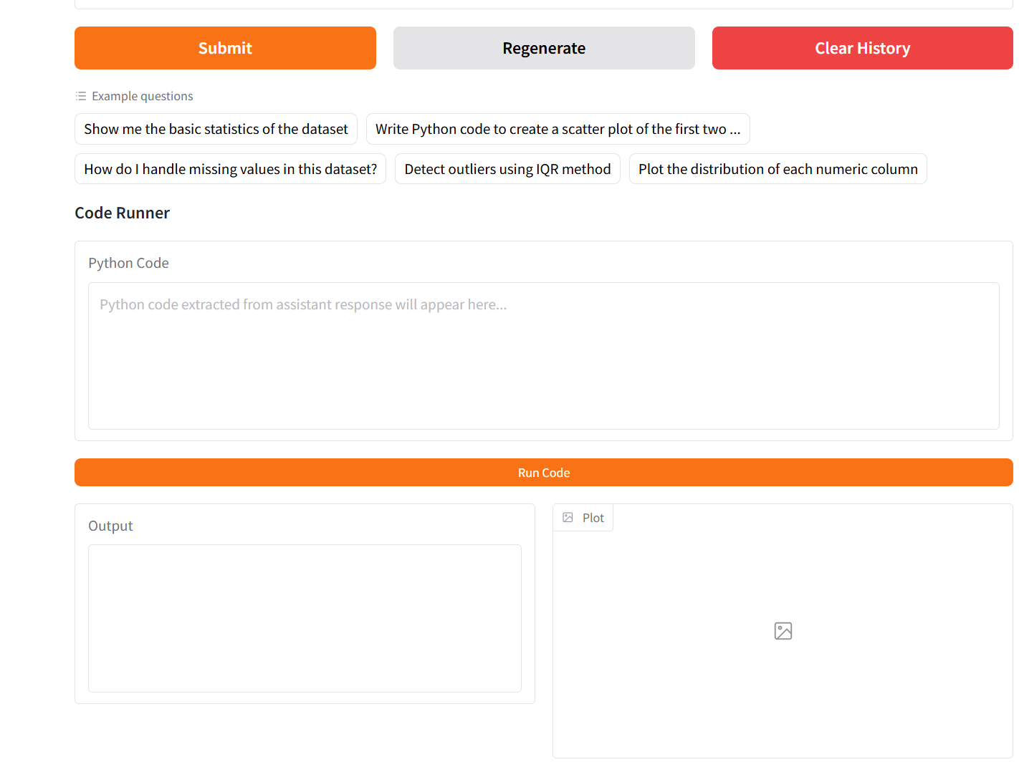
07
Demo
Natural-language Analysis
The user asks a business question and receives an analysis answer.
This demonstrates context-aware data analysis using the uploaded dataset summary.

Slide 8
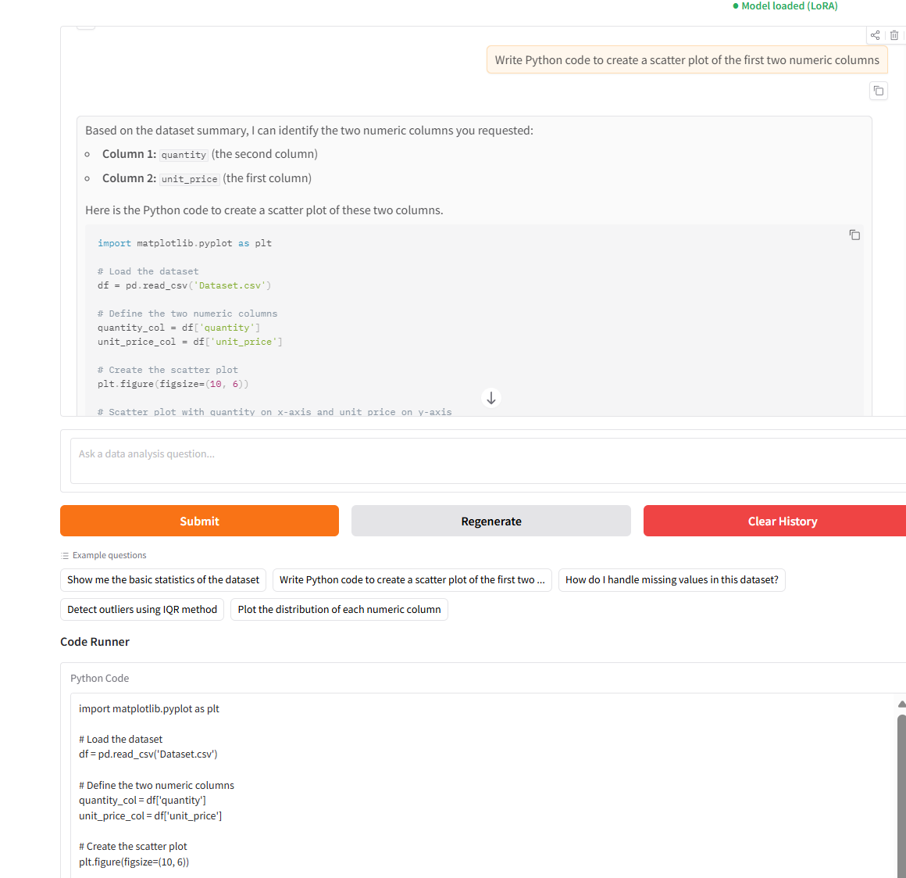
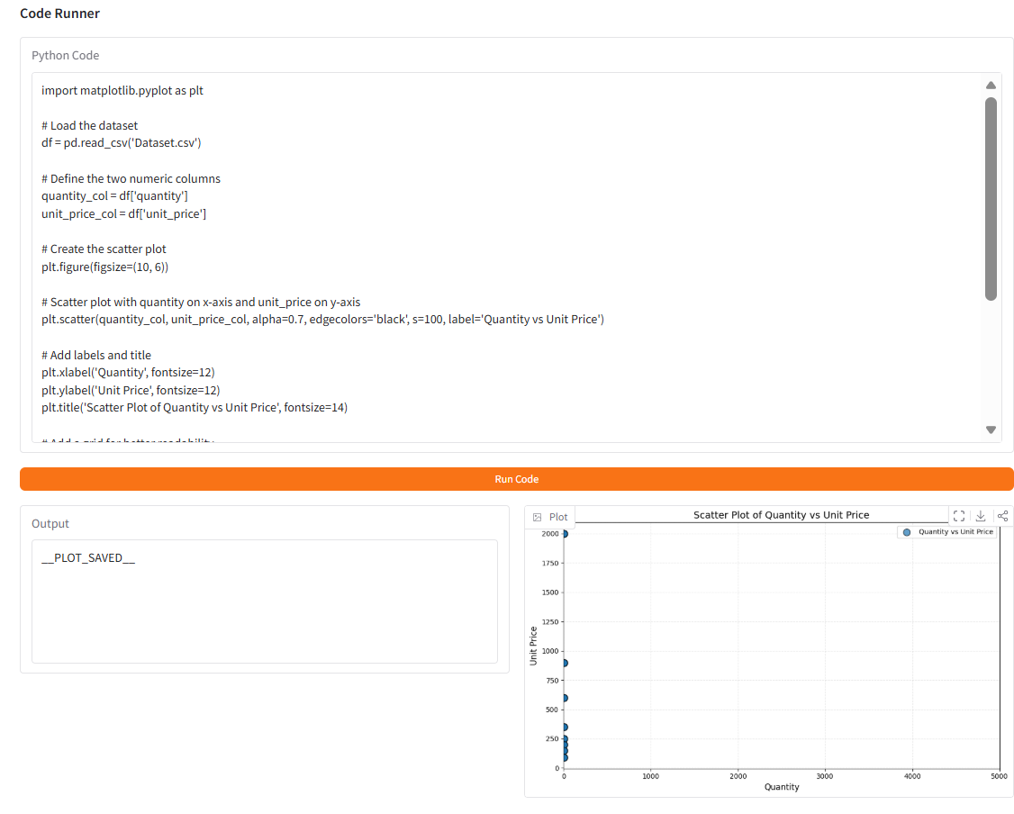
08
Demo
Code Runner and Plot Output
Generated code is extracted, executed and visualized.
Code block extraction from assistant response.
Execution result with stdout and matplotlib chart.

Slide 9
09
Engineering
Deployment and Debugging
The project was adapted from Linux to Windows local deployment.
Environment Fixes
local Qwen model path
PyTorch / CUDA compatibility
transformers version update
Code Runner Fixes
Markdown and XML code tags
dedent indentation cleanup
pre-loaded df variable
UI Fixes
streaming output
image file return for gr.Image
system prompt refinement
Engineering lesson: a Data Agent is not only model training; it also requires robust paths, dependencies, UI behavior and execution safety.

Slide 10
10
Q2
InsightPilot AI Startup Plan
A commercial extension of the Q1 Data Agent prototype.
Problem
SMEs have sales, marketing and operation data, but no dedicated data team.
Solution
An AI data analyst that turns uploaded data into code, charts and reports.
Beachhead Market
Small e-commerce and digital marketing teams with frequent reporting needs.

Slide 11
11
Business
Business Model and Differentiation
A focused SaaS product between generic AI chat and enterprise BI.
Free
limited upload
limited messages
Starter
$19 / month
CSV analysis
Team
$49 / user
workspaces
Business
$299+
connectors
Services
custom setup
templates
Differentiation: SME workflow, transparent code, reusable reports and low setup cost.

Slide 12
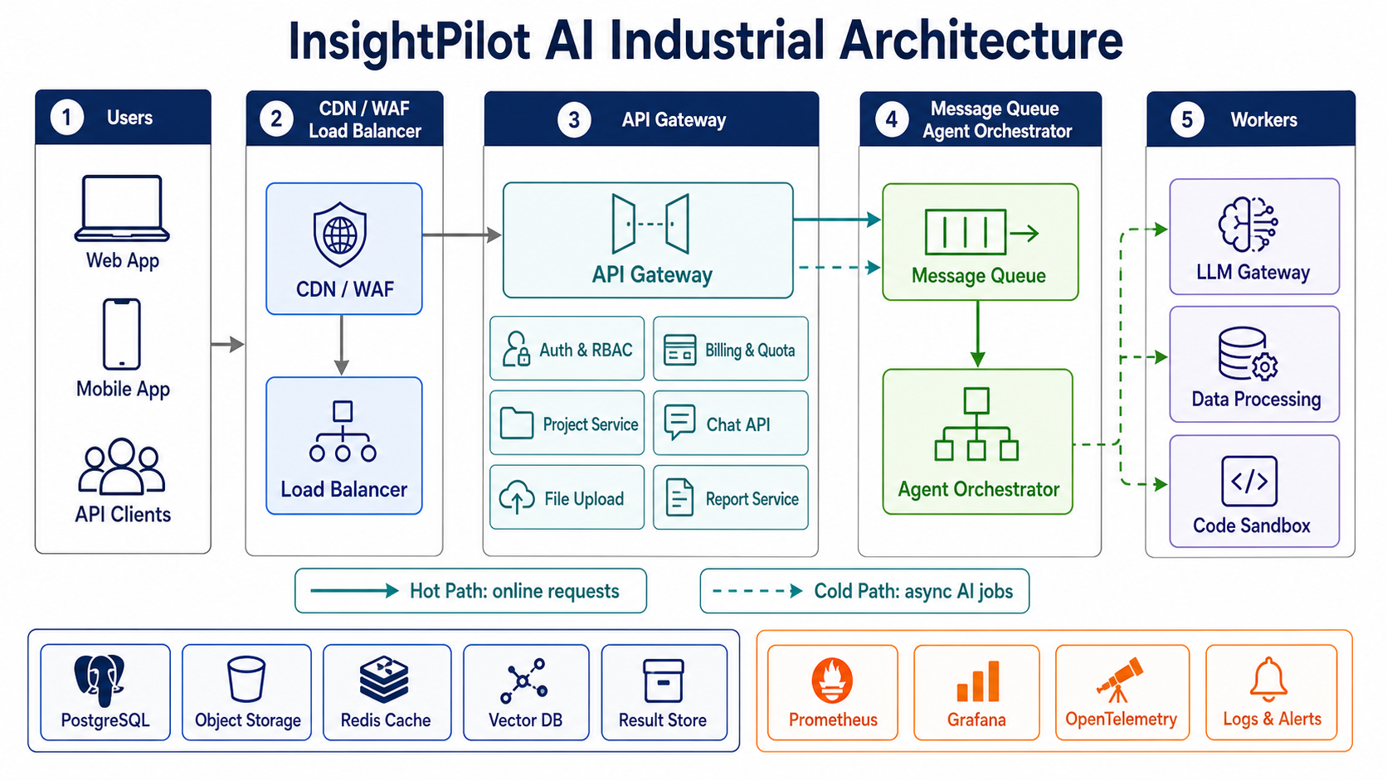
12
Architecture
Industrial System Architecture
Hot path for online requests; cold path for expensive AI jobs.

Slide 13
13
Reflection
Limitations and Future Work
A realistic assessment of the prototype and the next development steps.
Model Capacity
The base model is small; complex multi-step data analysis can still be limited.
Prototype Safety
The current demo is local; production deployment needs stronger sandbox isolation.
SaaS Requirements
A real product needs connectors, permissions, audit logs and cost control.
Future Work
Add scheduled reports, feedback loop, systematic model evaluation and connector ecosystem.
Takeaway: the prototype proves feasibility, while production readiness depends on reliability, safety and evaluation.

Slide 14
Thank you！

