Slide 1
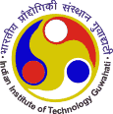
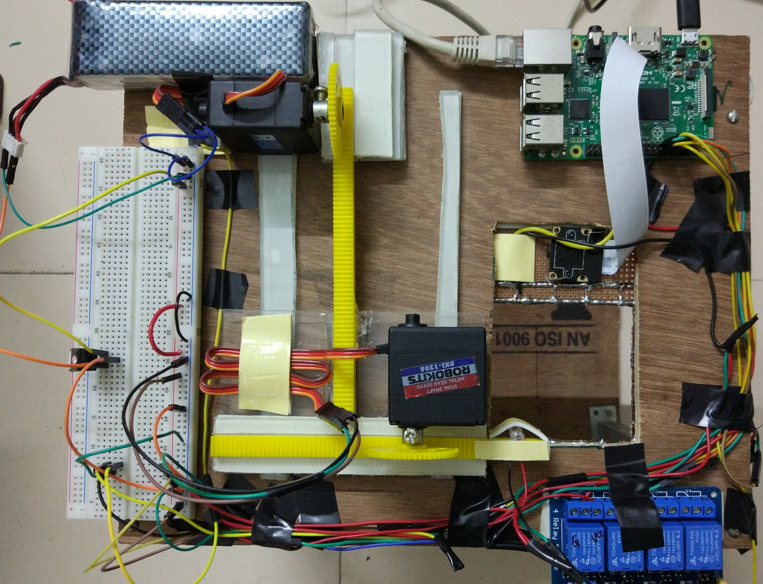
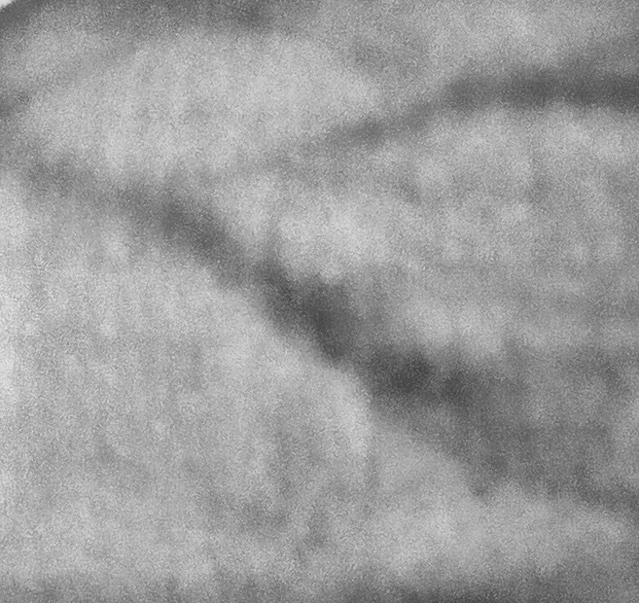
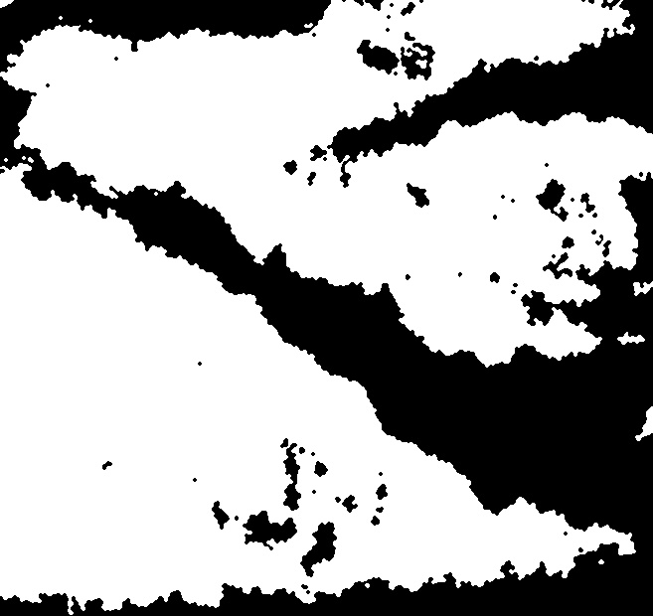
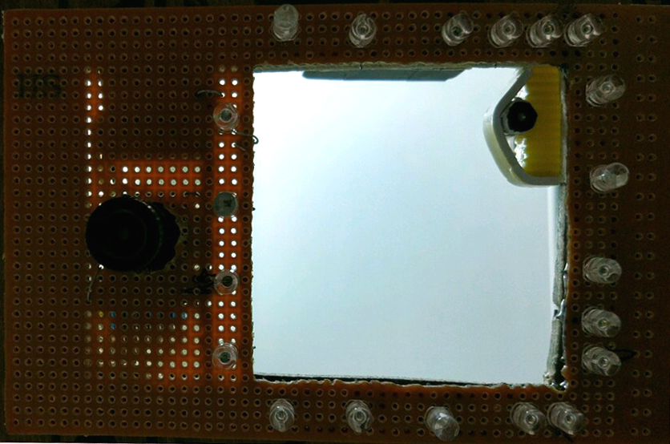
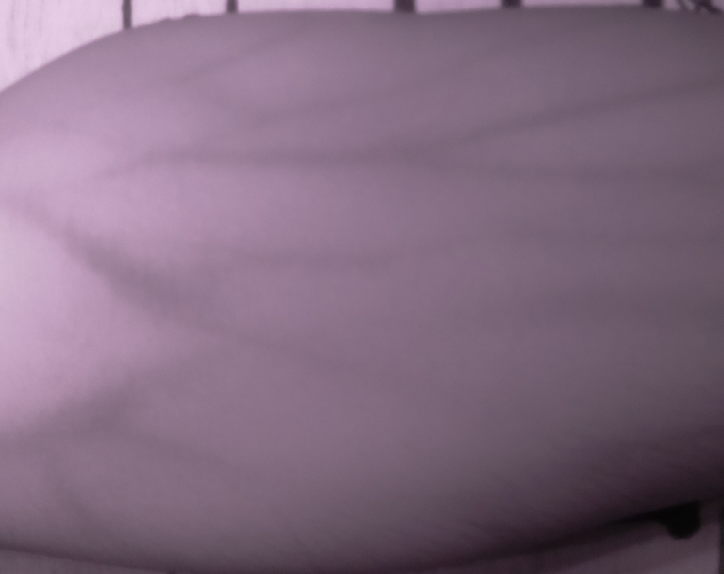
Portable Infrared-based Vein Finder
Supervisor – Dr. Amit Sethi
Ritwik Vatsyayan (140102049), Samir Pandit (140102054) and Anmol Nijhawan (140102081)
Department of Electronics and Electrical Engineering, Indian Institute of Technology Guwahati, Guwahati-781039, India
Abstract: The use of Infrared devices is a relatively new concept in the field of medical technology. Injection is a basic medical procedure which requires finding of the patient’s vein. In the case of many patients, finding the vein turn out to be a major difficulty. The main aim of this project is to develop a device which can detect the sub-cutaneous veins to provide doctors an easy access for efficient drug delivery and improved patient comfort.
1. INTRODUCTION
One to one mapping of image pixels to X-Y co-ordinates of hand is achieved, by co-ordinate transformation to account for the small errors in the alignments of the camera and the laser diode. An appropriate pixel depicting the centre of the major vein is chosen by width comparison and respective co-ordinate is stored in a file.
A python script reads the co-ordinates from this file and sends appropriate control signals through GPIO pins to the servo motors.
The motors move appropriately in X-Y directions and a laser pointer mounted on it, points to the exact vein location on hand.
Near infrared light can penetrate into the biological tissue up to 3mm depth. The deoxygenated blood absorbs more of infrared radiation than the oxygenated blood and the surrounding tissue, so it enhances the contrast of blood veins in the image acquired.
An IR camera with an IR flash is ideal for acquiring the vein pattern of the desired body part. The IR camera can filter out light of wavelengths less than that of the infrared light used.
Existing literature in the field of IR based vein sensing focusses on projecting captured image. This, however still leaves room for human error. We have attempted to develop a novel method combining infrared sensing and image processing to identify with greater accuracy the major vein in the part under consideration.
2. METHODOLOGY
IR Image Capture with IR Flash
Image Processing for Contrast Enhancement
Binary Segmentation of Vein and Tissue
Fig.3: Experimental Setup
Pointing a laser at the Vein through a couple of Servo Motors
Finding the major Vein by width comparison
4. RESULTS
The enhanced image after Adaptive Histogram Equalization and Median Filtering, and the corresponding segmented image are shown below:
3. EXPERIMENTAL
IR-LEDs are used to design a flash, with the help of which IR images of the desired body part are captured using an IR-camera. The veins have distinctive contrast as compared to surrounding tissue.
Fig. 4: Enhanced image
of region of interest
Fig. 5: Segmented image to
separate veins from tissue
IR LEDs
Some small dark patches also appear along with the veins due to non-uniform illumination of the IR flash.
The laser was pointed towards the thickest available vein in the system, closest to the center of the region of interest.
IR Camera
Laser Pointer
Fig.1 : Image Acquisition System
Fig.2 : Image Captured by IR Camera
The acquired image is sent to the Raspberry pi for contrast enhancement of veins through image processing. The techniques used are Adaptive Histogram Equalization and Median Filtering.
The enhanced image is binary-segmented into veins and tissue using adaptive Otsu thresholding.
5. CONCLUSION
An infrared based vein detector was developed based on the differential adsorption of IR light of the veins and surrounding tissue. A laser pointer mounted on a motor is used to point out the location of the identified vein. The accuracy is observed to be good in different lighting conditions, but is affected by factors such as presence of fat tissue in the body.

