Slide 1

ST425 Group Project
Alqa Husni
Jiheng Xu
Ruyin Gong
Zhenqi Wang

Slide 2
Background and Assumption
1
An insurance company with fixed commercial customers.

Slide 3
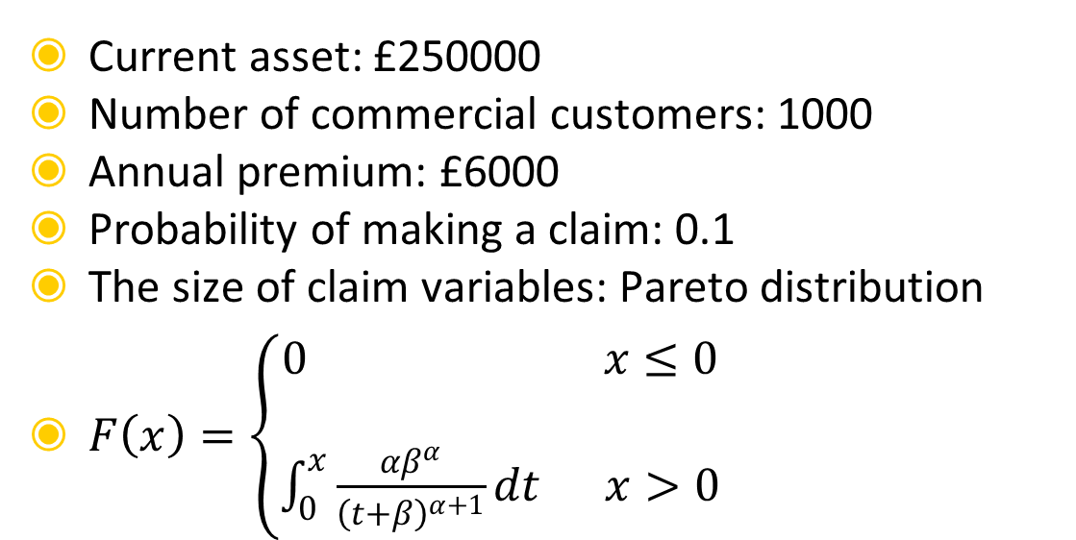
BASIC ASSUMPTIONS
Current asset: £250000
Number of commercial customers: 1000
Annual premium: £6000
Probability of making a claim: 0.1
The size of claim variables: Pareto distribution
$F\left(x\right)=\left\{\begin{aligned}0 x≤0 \\ \\ \int_{0}^{x}{\frac{{αβ}^{α}}{{\left(t+β\right)}^{α+1}}dt x>0}\end{aligned}\right.$

Slide 4
OTHER ASSUMPTIONS
One customer can only make one claim each year.
The probability of making a claim is fixed and equal for each customer.
Claims are made independently of each other and no customer is influenced by the other.

Slide 5
OTHER ASSUMPTIONS
The value of the premium is fixed irrespective of the size of the claim.
All customers are loyal and will not drop out at any circumstance(eg:- When premium increases)
No deductibles are paid by any customers.
The company will retain all premiums charged with itself and not invest on anything else.

Slide 6
Simulation the Size of Claims
2
Let X be the size of a typical claim.

Slide 7
a) Calculate the cumulative distribution function F(x) of X, the expectation E(X), the median of X, and the variance of X. State any conditions on α and/or β that need to be satisfied.

Slide 8
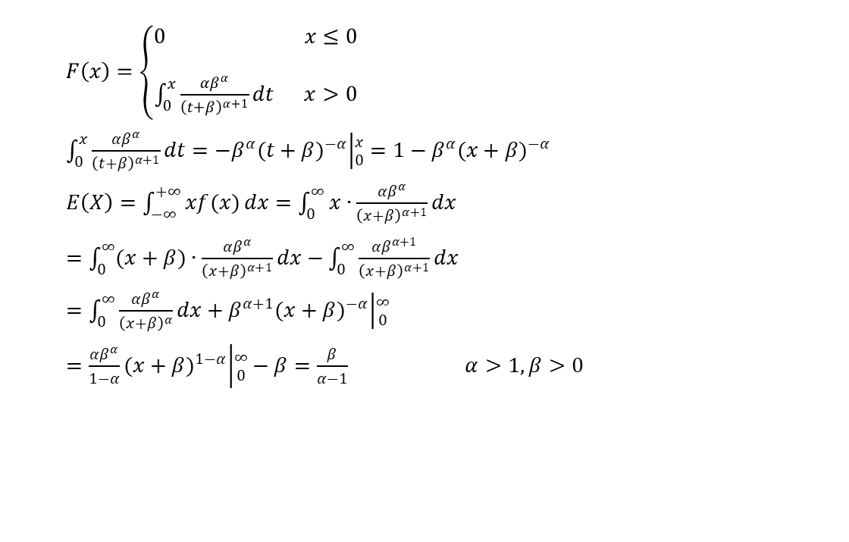
EXPECTATION OF X
$F\left(x\right)=\left\{\begin{aligned}0 x≤0 \\ \\ \int_{0}^{x}{\frac{{αβ}^{α}}{{\left(t+β\right)}^{α+1}}dt x>0}\end{aligned}\right.$
$\int_{0}^{x}{\frac{{αβ}^{α}}{{\left(t+β\right)}^{α+1}}dt=−β^{α}{(t+β)}^{−α}\left|{x \atop 0}=1−β^{α}{(x+β)}^{−α}\right.}$
$E\left(X\right)=\int_{−∞}^{+∞}{xf(x)dx=\int_{0}^{∞}{x∙\frac{{αβ}^{α}}{{\left(x+β\right)}^{α+1}}dx}}$
$=\int_{0}^{∞}{(x+β)∙\frac{{αβ}^{α}}{{\left(x+β\right)}^{α+1}}dx}−\int_{0}^{∞}{\frac{{αβ}^{α+1}}{{\left(x+β\right)}^{α+1}}dx}$
$=\int_{0}^{∞}{\frac{{αβ}^{α}}{{\left(x+β\right)}^{α}}dx}+β^{α+1}{(x+β)}^{−α}\left|{∞ \atop 0}\right.$
$=\frac{{αβ}^{α}}{1−α}{(x+β)}^{1−α}\left|{∞ \atop 0}−β=\frac{β}{α−1}\right. α>1,β>0$

Slide 9
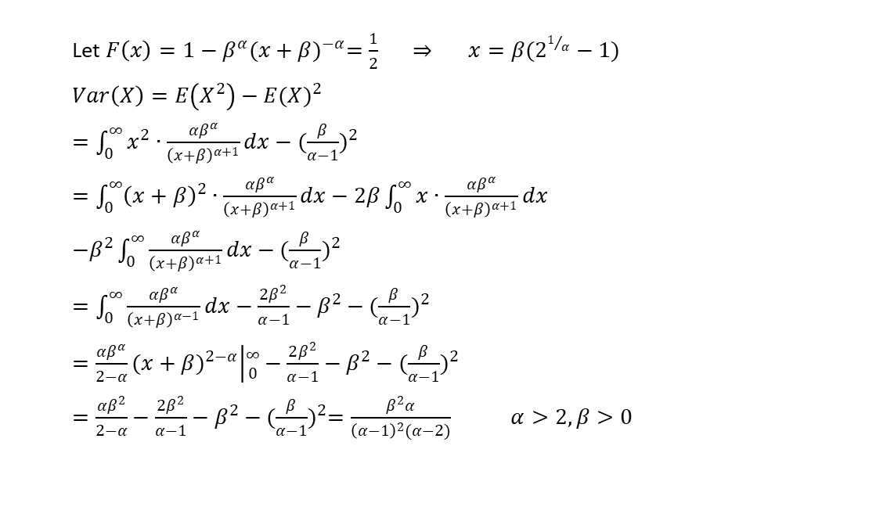
MEDIAN AND VARIANCE OF X
Let $F\left(x\right)=1−β^{α}{(x+β)}^{−α}=\frac{1}{2} \underset{⇒}{} x=β(2^{1/α}−1)$
$Var\left(X\right)=E\left(X^{2}\right)−{E(X)}^{2}$
$=\int_{0}^{∞}{x^{2}∙\frac{{αβ}^{α}}{{\left(x+β\right)}^{α+1}}dx}−{(\frac{β}{α−1})}^{2}$
$=\int_{0}^{∞}{{\left(x+β\right)}^{2}∙\frac{{αβ}^{α}}{{\left(x+β\right)}^{α+1}}dx}−2β\int_{0}^{∞}{x∙\frac{{αβ}^{α}}{{\left(x+β\right)}^{α+1}}dx}$
$−β^{2}\int_{0}^{∞}{\frac{{αβ}^{α}}{{\left(x+β\right)}^{α+1}}dx}−{(\frac{β}{α−1})}^{2}$
$=\int_{0}^{∞}{\frac{{αβ}^{α}}{{\left(x+β\right)}^{α−1}}dx}−\frac{2β^{2}}{α−1}−β^{2}−{(\frac{β}{α−1})}^{2}$
$=\frac{{αβ}^{α}}{2−α}{(x+β)}^{2−α}\left|{∞ \atop 0}\right.−\frac{2β^{2}}{α−1}−β^{2}−{(\frac{β}{α−1})}^{2}$
$=\frac{{αβ}^{2}}{2−α}−\frac{2β^{2}}{α−1}−β^{2}−{(\frac{β}{α−1})}^{2}=\frac{β^{2}α}{{\left(α−1\right)}^{2}(α−2)} α>2,β>0$

Slide 10
b) Describe how the inversion method may be used to simulate from X.

Slide 11
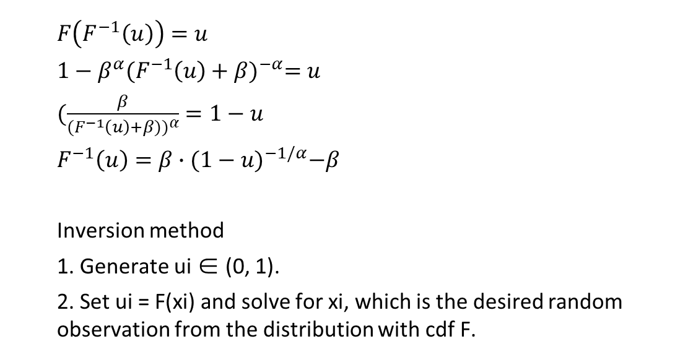
INVERSION METHOD
$F\left(F^{−1}\left(u\right)\right)=u$
$1−β^{α}{(F^{−1}\left(u\right)+β)}^{−α}=u$
$(\frac{β}{{(F^{−1}\left(u\right)+β))}^{α}}=1−u$
$F^{−1}\left(u\right)=β∙{(1−u)}^{−1/α}−β$
Inversion method
1. Generate ui ∈ (0, 1).
2. Set ui = F(xi) and solve for xi, which is the desired random observation from the distribution with cdf F.

Slide 12
c) Simulation of 10000 values drawn from X. Comparison with the true density function superimposed.

Slide 13
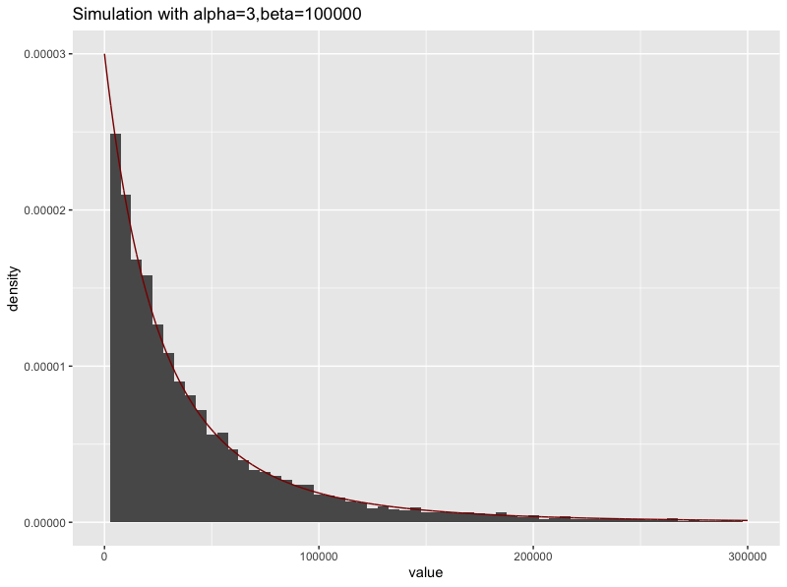
SIMULATION FOR SIZE OF CLAIMS

Slide 14
d) Reasons for use of a Pareto distribution to describe insurance claims.

Slide 15
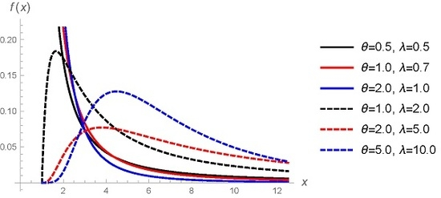
PARETO DISTRIBUTION
The Pareto distribution is positively skewed and has a heavy tail on the right. Insurance applications, Pareto for this reason can be used for modelling extreme loss, especially for more risky types of insurance.
Resource: MDPI

Slide 16
Model of Year End Assets
3
To find a simplified model of insurance company

Slide 17
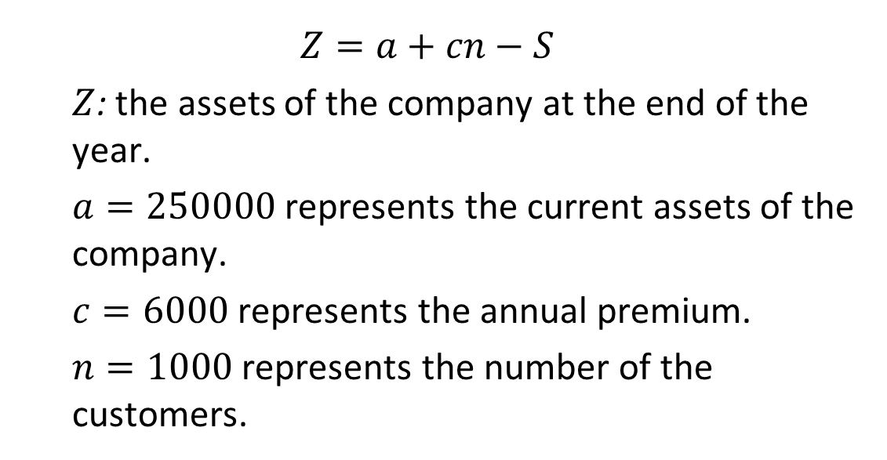
BUILDING UP THE MODEL
$Z=a+cn−S$
$Z$: the assets of the company at the end of the year.
$a=250000$ represents the current assets of the company.
$c=6000$ represents the annual premium.
$n=1000$ represents the number of the customers.

Slide 18
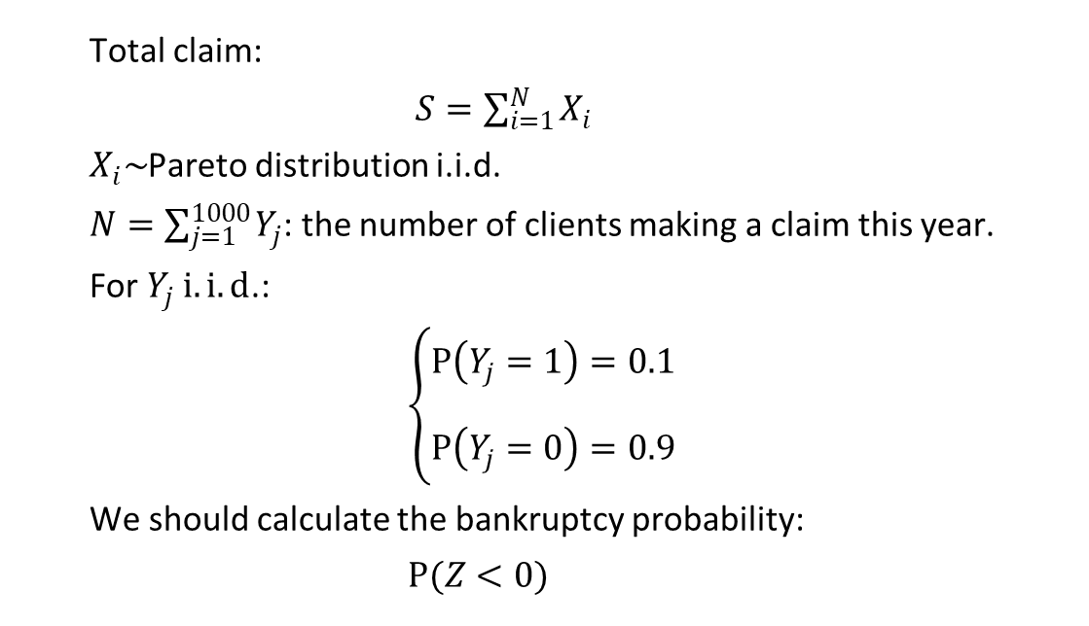
BUILDING UP THE MODEL
Total claim:
$S=\sum_{i=1}^{N}{X_{i}}$
$X_{i}\sim$Pareto distribution i.i.d.
$N=\sum_{j=1}^{1000}{Y_{j}}$: the number of clients making a claim this year.
For $Y_{j} i.i.d$.:
$\left\{\begin{aligned}P\left(Y_{j}=1\right)=0.1 \\ \\ P\left(Y_{j}=0\right)=0.9\end{aligned}\right.$
We should calculate the bankruptcy probability:
$P(Z<0)$

Slide 19
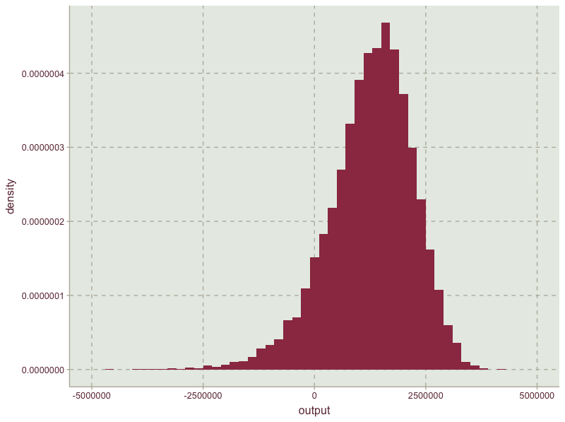
YEAR END TOTAL ASSET
The expected asset: 1249603.2379
The probability of bankruptcy: 0.0977

Slide 20
Changing Inputs of the Model
4
Changing the annual premiums and probability of making a claim.

Slide 21
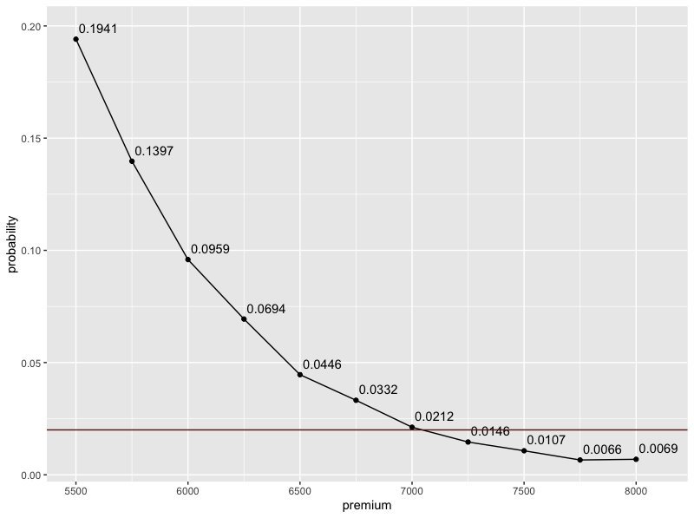
CHANGE OF PREMIUM
PREMIUM | BALANCE | PROBABILITY
5500 | 741136.6002 | 0.1941
5750 | 1003137.7332 | 0.1397
6000 | 1255157.6144 | 0.0959
6250 | 1498083.9745 | 0.0694
6500 | 1759673.6819 | 0.0446
6750 | 2002743.6275 | 0.0332
7000 | 2251394.9805 | 0.0212
7250 | 2490678.6568 | 0.0146
7500 | 2740845.1092 | 0.0107
7750 | 2994727.1776 | 0.0066
8000 | 3255043.8666 | 0.0069
Minimal premium level: 7250

Slide 22
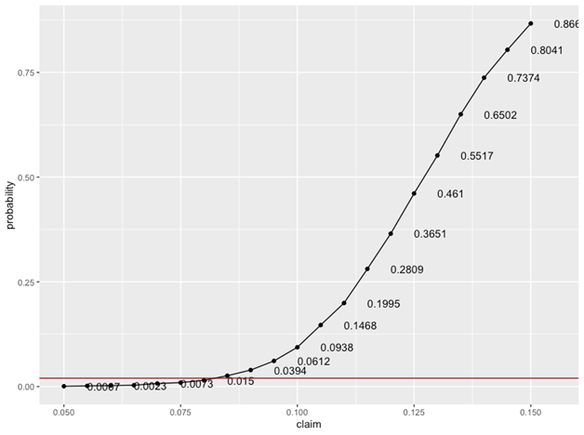
CHANGE OF PROBABILITY
CLAIM | BALANCE | PROBABILITY
0.05 | 3759849.6438 | 0.0007
0.055 | 3497623.5856 | 0.0016
0.06 | 3260109.4721 | 0.0023
0.065 | 3009525.6470 | 0.0032
0.07 | 2746500.6304 | 0.0073
0.075 | 2490617.9996 | 0.0094
0.08 | 2243506.9708 | 0.015
0.085 | 1998117.9679 | 0.0259
0.09 | 1740876.9193 | 0.0394
0.095 | 1499039.7931 | 0.0612
0.1 | 1251768.8584 | 0.0938
0.105 | 993418.8423 | 0.1468
0.11 | 754042.4828 | 0.1995
0.115 | 502591.5330 | 0.2809
0.12 | 252371.5275 | 0.3651
0.125 | -1004.4900 | 0.461
0.13 | -242388.0170 | 0.5517
0.135 | -497185.3079 | 0.6502
0.14 | -746170.9921 | 0.7374
0.145 | -991378.6177 | 0.8041
0.15 | -1247132.7022 | 0.8669
Minimal premium level: 7250

Slide 23
Discussions on the Model
5
Advices, reservations and extending models.

Slide 24
Advices on factors that the company may be able to control and reservations of the model

Slide 25
FACTORS THAT THE COMPANY CAN CONTROL
Premium
Try to maintain the premium at ￡7250 as this is the minimal premium level to ensure that the probability of loss is no more than 2%.
Probability
The maximum estimated probability of a customer making a claim is 0.08 for the risk of bankruptcy to be less than 2%. Forecast the probability of a customer making a claim before accepting customers and accept those who are at most 8% likely to make a claim.

Slide 26
FACTORS THAT THE COMPANY CAN CONTROL
Updated Evaluations
Do not wait till the net balance has reached zero to calculate the risk of bankruptcy. Always keep updated with the evaluations.
Number of Claims
Find the relationship between number of claims made per year and risk of bankruptcy and limit to the maximum number of claims with minimal risk.
Other Advices
Conduct frequent seminars, providing advice to minimize avoidable risks and network with the customers.
Work together and maintain dialogues with customers throughout the year and not limit to the time of bankruptcy.

Slide 27
FACTORS THAT THE COMPANY CAN CONTROL
> prob<-as_tibble(prob) %>%mutate(premium=0)
> for (i in 1:length(prob$value)){
+ j=1
+ while (j <=length(premium)) {
+ prob0<-mean(AssetSim(1000,premium[j],prob$value[i])<0)
+ if(prob0<0.02){
+ prob$premium[i]<-premium[j]
+ break}
+ j=j+1
+ }
+ }
Finding Optimal Portfolios

Slide 28
This outcome is from a given probability, to calculate the minimal premium needed to avoid bankruptcy.
For probability (of making a claim) more than 0.11, the premium will be beyond the upper limit (which is 8000) of given premium intervals, we consider those as abnormal situations that will not be accepted. (it means that even when the premium approaches 8000, you can’t reduce the probability of bankruptcy to 0.02)
PROBABILITY | PREMIUM
0.05 | 5500
0.055 | 5500
0.06 | 5500
0.065 | 5500
0.07 | 5500
0.075 | 5750
0.08 | 5750
0.085 | 6250
0.09 | 6500
0.095 | 7250
0.1 | 7250
0.105 | 7750
0.11 | 7750

Slide 29
RESERVATIONS OF THE MODEL
The probability of a customer making a claim is practically not fixed. It varies with each customer and is dependent on age, annual income, etc.
Throughout our analysis, the values for α and β were fixed. The risk of bankruptcy may vary with different values of α and β. But our calculation is restricted to α=3 and β=1000.
Claims made by customers are generally not independent of each other.
In reality, one customer can make more than one claim per year.
There is a time constraint in the above analysis, which restricts the company to come to conclusions due to insufficient information.

Slide 30
EXTENDING MODEL
We can extend the model from following aspects:
Consider 10 years’ time period
The number of customers is not fixed every year and the premium is not necessarily paid at the start of a year. The total number of pays of annual premium has a Poisson distribution.
The probability of customers making a claim is not identical for everyone. Assume the number of times making a claim also has a Poisson distribution.

Slide 31
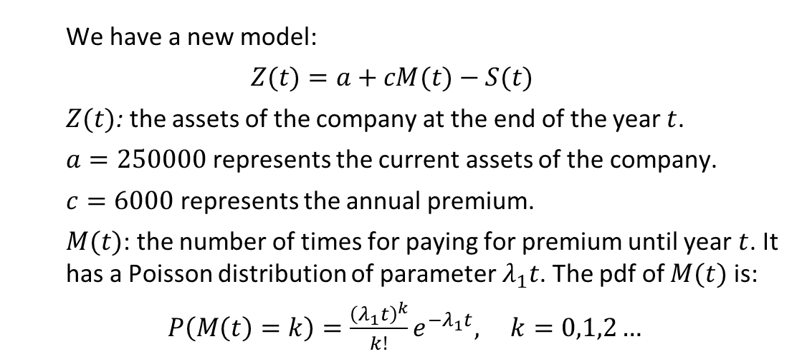
EXTENDING MODEL
We have a new model:
$Z(t)=a+cM(t)−S(t)$
$Z(t)$: the assets of the company at the end of the year $t$.
$a=250000$ represents the current assets of the company.
$c=6000$ represents the annual premium.
$M(t)$: the number of times for paying for premium until year $t$. It has a Poisson distribution of parameter $λ_{1}t$. The pdf of $M(t)$ is:
$P\left(M\left(t\right)=k\right)=\frac{{\left(λ_{1}t\right)}^{k}}{k!}e^{−λ_{1}t}, k=0,1,2…$

Slide 32
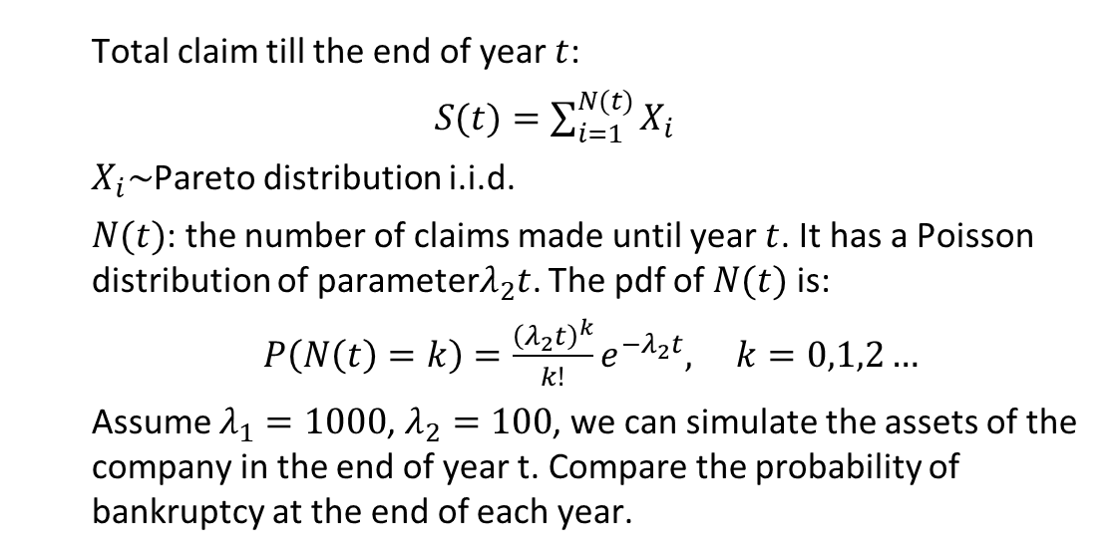
EXTENDING MODEL
Total claim till the end of year $t$:
$S(t)=\sum_{i=1}^{N(t)}{X_{i}}$
$X_{i}\sim$Pareto distribution i.i.d.
$N(t)$: the number of claims made until year $t$. It has a Poisson distribution of parameter$λ_{2}t$. The pdf of $N(t)$ is:
$P\left(N\left(t\right)=k\right)=\frac{{\left(λ_{2}t\right)}^{k}}{k!}e^{−λ_{2}t}, k=0,1,2…$
Assume $λ_{1}=1000$, $λ_{2}=100$, we can simulate the assets of the company in the end of year t. Compare the probability of bankruptcy at the end of each year.

Slide 33
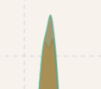
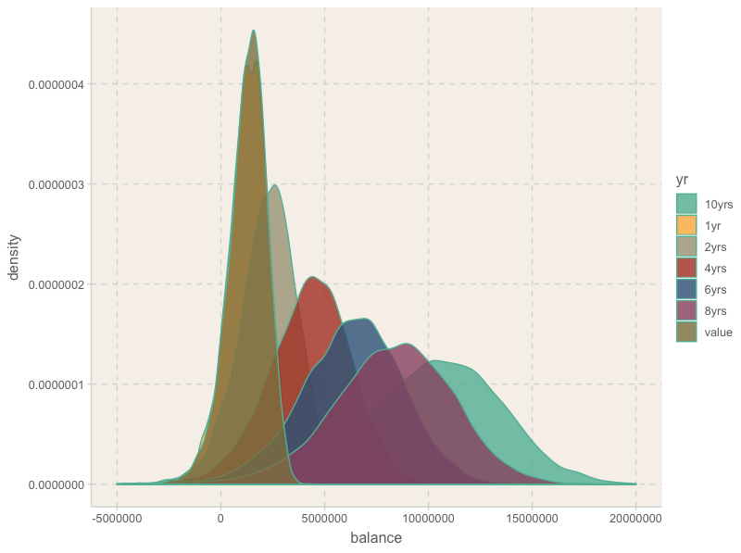
ASSET OF TEN YEARS’ PERIOD
The probability of bankruptcy in ten years: 0.1456
The mean balance at the end of each year:
1255702 2254113 3253047 4244971
5253847 6267491 7286082 8271802
9267766 10265101
Minimal premium level: 7500
To reduce bankruptcy down to 0.02, at any year of the 10 years, the minimum premium should be 7500.

Slide 34

Thanks!
Any questions ?

