Slide 1
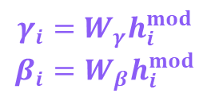






Dual-Stream Embedding
Transformer Encoder
Output Heads
FiLM Fusion
×N layers
Magnitude
Mag. Features
MLP_{mag}
$$\left(1+γ_{i}\right)⨀h_{i}^{mag}+β_{i}$$
Regression
$$f_{i}^{mag}∈R^{4}$$
$$h_{i}^{mag}∈R^{d}$$
Pre-LN
Input
Sign
$$γ_{i}=W_{γ}h_{i}^{mod}$$
$$β_{i}=W_{β}h_{i}^{mod}$$
Multi-Head Attn
$$x_{1},…,x_{L}$$
FFN
Classification
W_{mod}
Mod. Features
Modulo ×100
+Position Encoding
Classification
$$f_{i}^{mod}∈R^{200}$$
$$h_{i}^{mod}∈R^{d}$$

