Slide 1


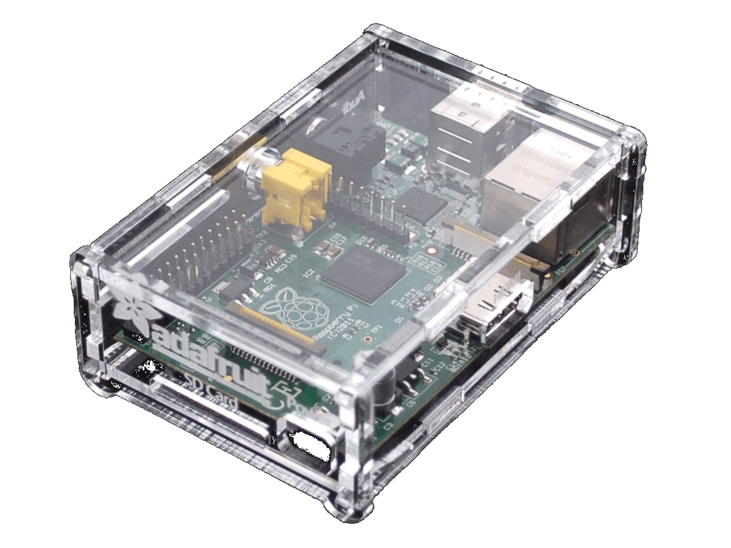





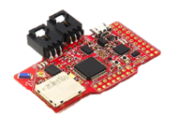
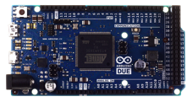

High-end devices
Low-end devices

Slide 2
Single board computers
→ Raspberry Pi, connected cars, smartphones…
Resources similar to average internet devices
→ memory, CPU, network, etc
Cannot run on battery on a long period of time
Can use TCP/IP based protocols
Can support usual OS such as Linux
Memory ~ 2GB
Memory ~ 500MB
Memory ~ 1GB

Slide 3
Smaller & cheaper
→ Smart objects
Low power Microcontroller & Radios
→ Can run on battery on a long period of time
Cannot use TCP/IP based protocols
Cannot support usual OS such as Linux
Memory ~ 16KB
Memory ~ 8KB
Memory ~ 100KB

Slide 4






RIOT
RIOT
802.15.4
6lowPAN
CoAP/MQTT
Web App
Microservices
RIOT
Gateway
Internet/Cloud
Private network

Slide 5
HTTP
server
Web
application
RIOT
Serve HTML pages
WS server
(clients)
WS server
(gateways)
WS client
to broker
IoT
protocol
logic
RIOT
Broker service
Gateway service
Broadcast info to clients
Redirect requests to gateways
Alive nodes management
Cache
Extra metadata
RIOT
Web/mobile
clients
Public microservices
Private network
Nodes

Slide 6
HTTP
server
Tornado
application
Tornado + hbmqtt
WS client
to broker
MQTT
logic
Tornado
MQTT Gateway
WS server
(clients)
WS server
(gateways)
Tornado + aiocoap
Broker service
WS client
to broker
CoAP
logic
CoAP Gateway

Slide 7
Gateway
Node
Notifies itself
Request available resources
Reply list of resources
loop
Request resource
foreach
resource
Reply resource value
Send resource value
loop

Slide 8
Tornado + aiocoap
WS client
to broker
CoAP
Server &
Client
CoAP
Server &
Client
CoAP Gateway
Node
Tornado + hbmqtt
WS client
to broker
MQTT
Client
PUB/SUB
Mosquitto RSMB
MQTT Broker
MQTT-SN
Client
PUB/SUB
MQTT Gateway
Node

